Slide 1
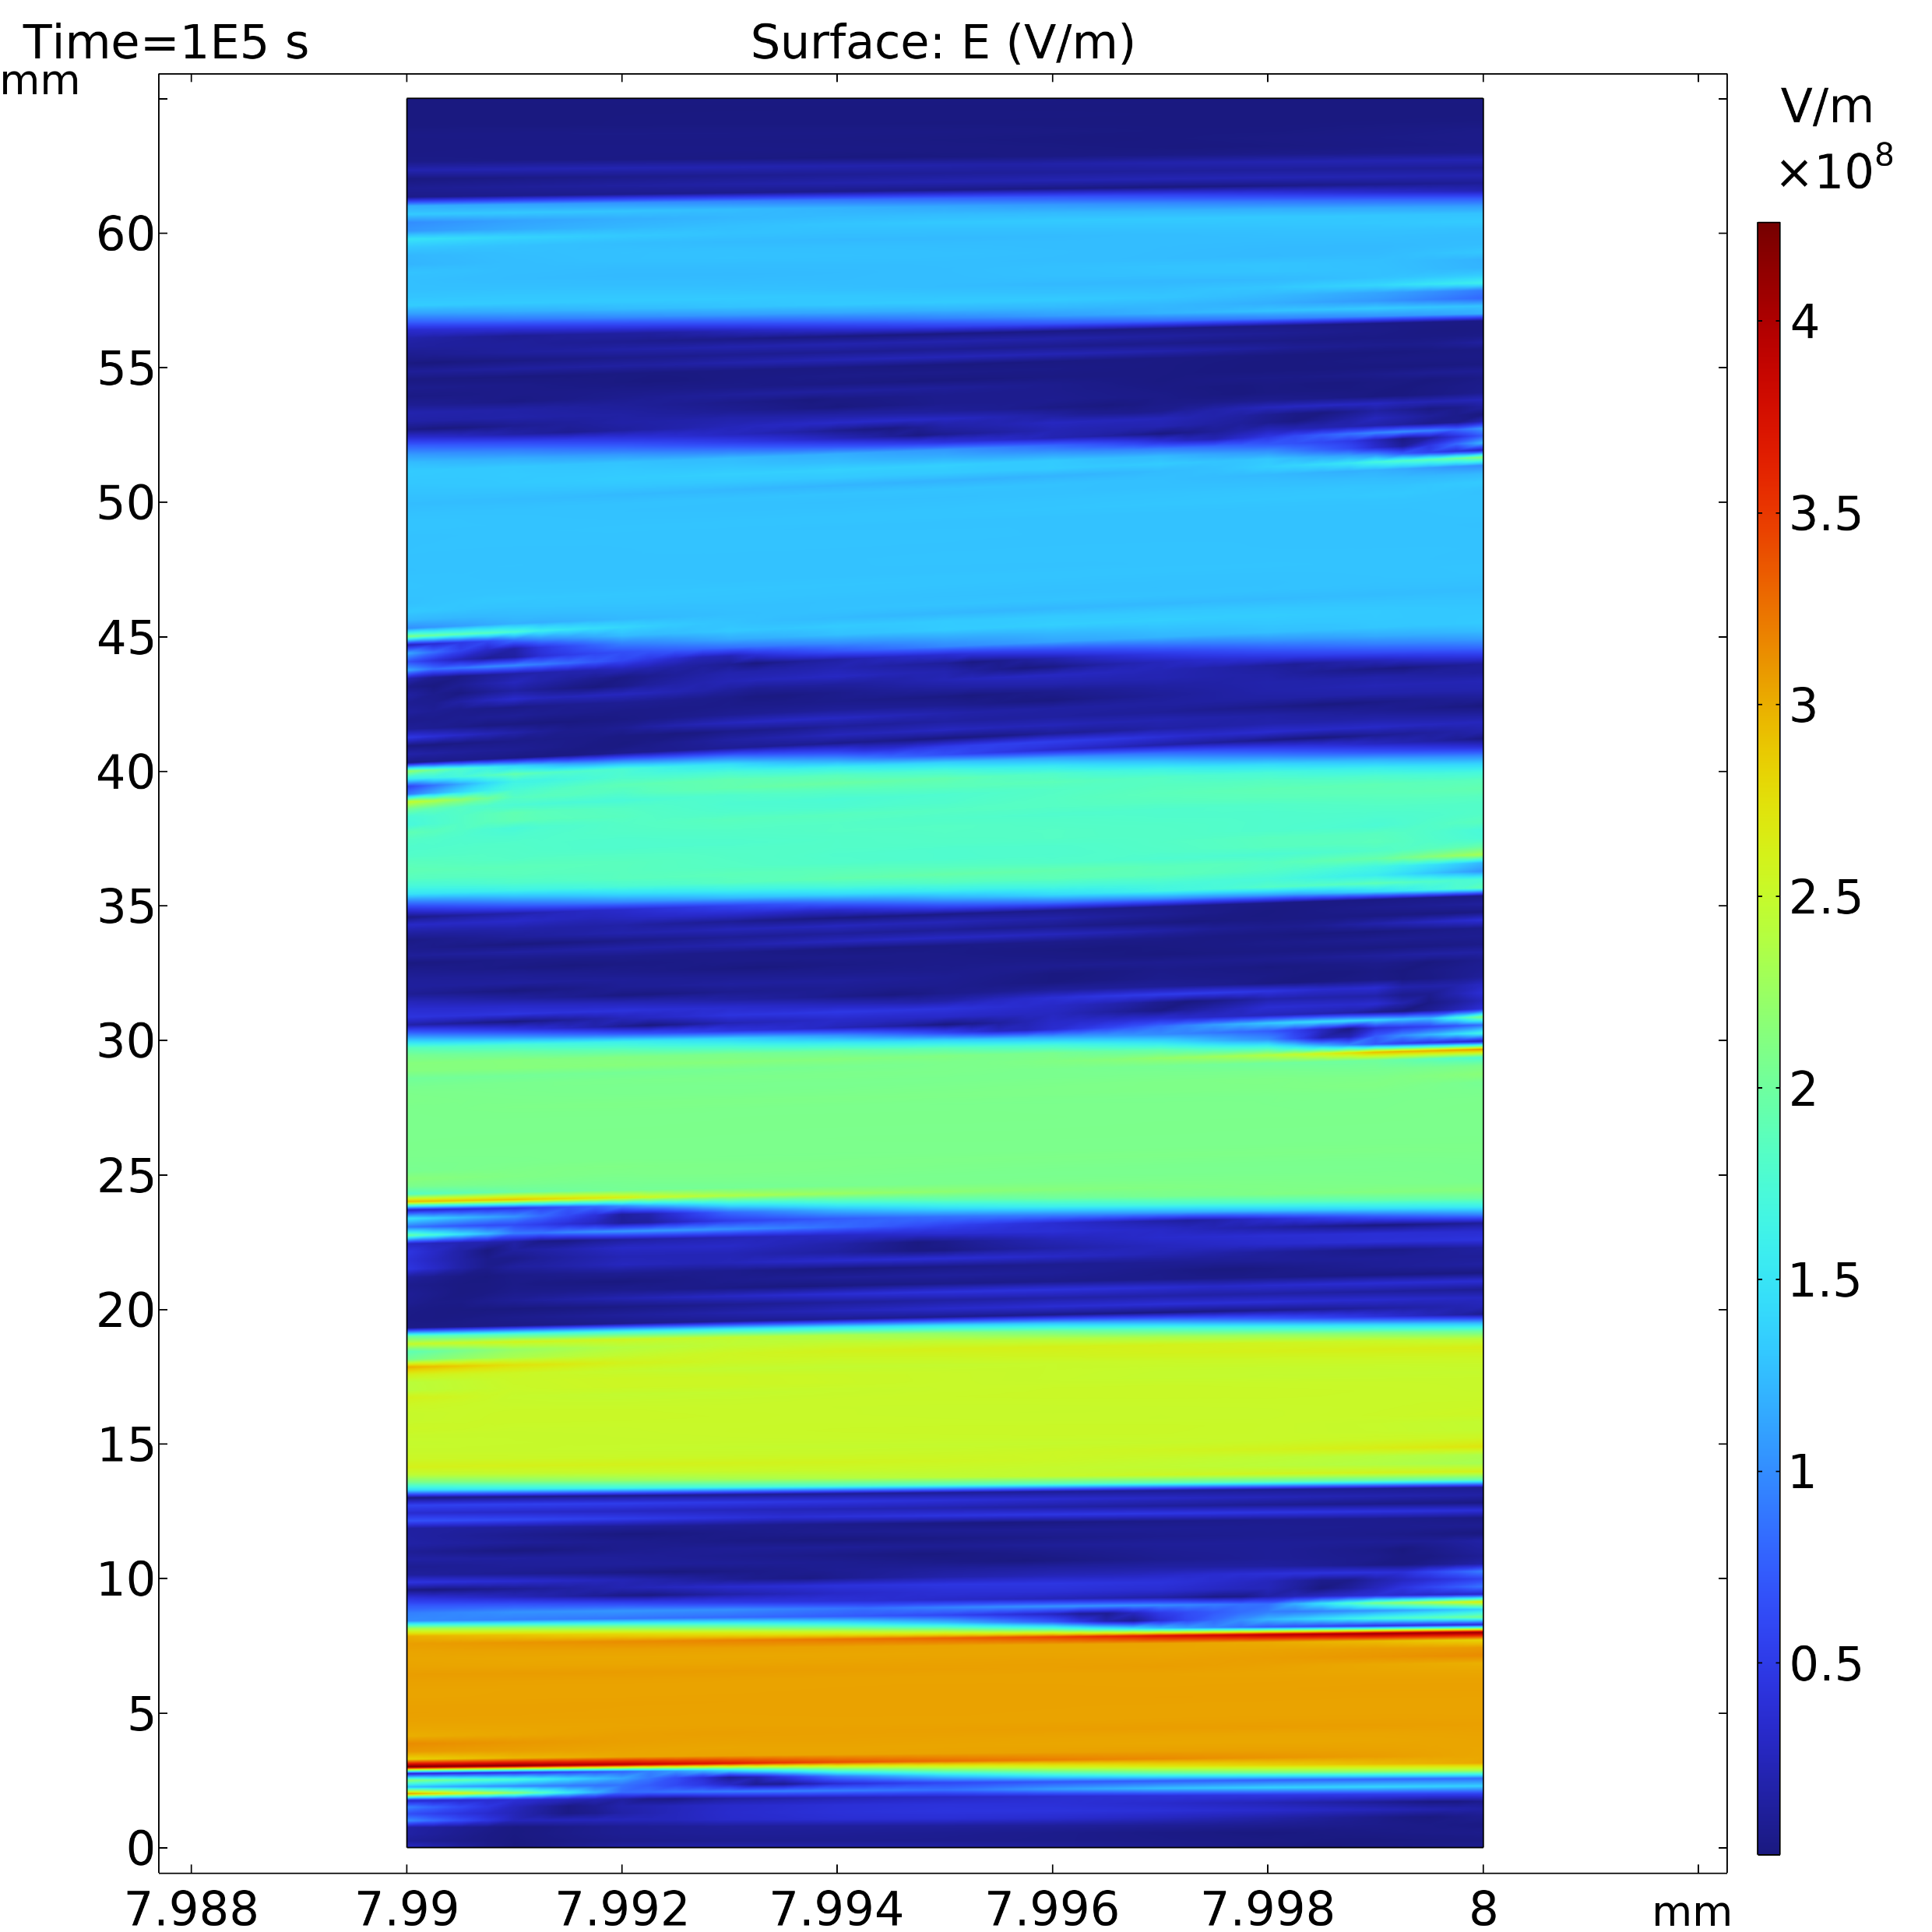
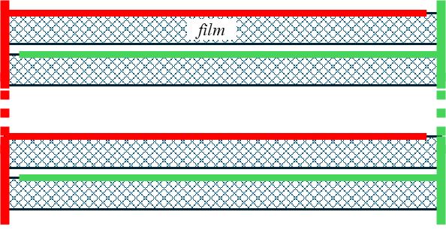
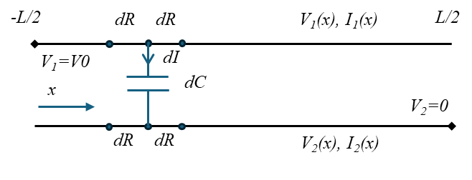
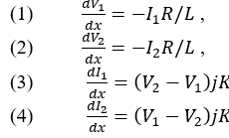
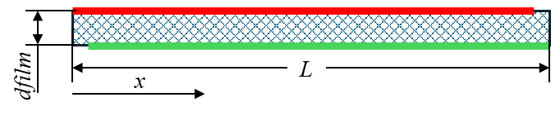


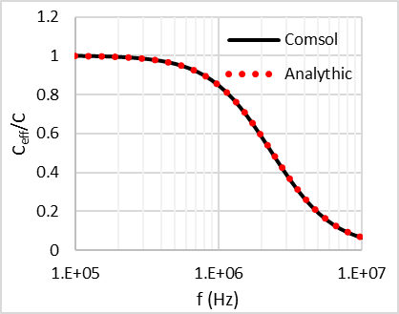
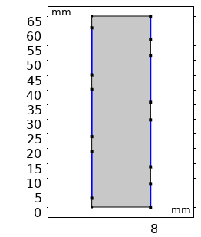
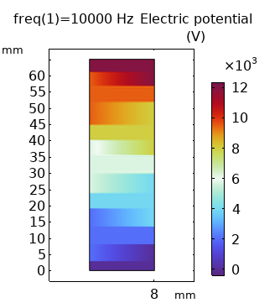
Voltage Distribution in Metallized Film Cylindrical Capacitors
100kV
Electric field distribution in HV metallized film capacitors is governed by both dielectric’s permittivity and resistivity; it is heavily influenced by the metallization surface resistivity.
A. Pokryvailo Spellman High Voltage Electronics Corp., 475 Wireless Blvd., Hauppauge, NY 11788, USA
Abstract
We narrow the consideration to HV cylindrical parts with leads located on the opposite sides. They are tens of millimeters long, so at moderate frequencies of up to 10MHz they may be analyzed as lumped elements (not as transmission lines), although in some cases they may be regarded as Large HV Structures per definition of [1]. Voltage and current distribution (VCD) in metalized film capacitors was analyzed in an electrostatic approximation using Electric Current interface, accounting for both conduction and displacement currents. First, an analytical solution for VCD in capacitors with two resistive plates was obtained. (It largely replicates [2]; derived independently, and probably, more rigorously.) Analytical solution was compared to numerical solutions, both in field and circuit formulations, the latter using equivalent circuits; analytical and FEA solutions matched perfectly. Field distribution in multisectioned capacitors with linear and nonlinear dielectric was also analyzed.
Methodology
Analytical treatment (closed form expressions obtained)
FEA (in axisymmetric approximation) using Electric Current (EC) interface; solutions in frequency and time-domains
Coupled thermal-EC simulation accounting for nonlinear conductivity σ(E,T) of dielectric
FIGURE 1. To derivation of DE for a two-plate capacitor with lossless dielectric fed from voltage source connected to opposite sides.
Selected Results
The effective capacitance drops at higher frequencies with high metallization resistivity. The same is true for multisectioned parts. Voltage sharing between the capacitor sections with a “real” (nonlinear) dielectric is distorted at dc voltage. The degree of nonuniformity stays uncertain in view of large uncertainty of solid (and liquid) dielectrics’ conductivity dependence on the field E and temperature T. This topic should linger in the conscience of an HV insulation designer.
FIGURE 2. Left: effective capacitance decreases with higher frequency. Center: axisymmetric model of segmented capacitor. Metallization plates are Blue, modeled as Thin Layers. The top right point is at V0=12 kV, bottom right point is ground. dfilm=10 μm, not to scale. Right: voltage distribution.
Pokryvailo, A., ““Large” HV Structures: Transient Analysis of Voltage Distribution from First Principles”, Proc. 2018 IEEE Power Modulator and High Voltage Conference, Jackson Lake Lodge WY, 03 June 2018 - 07 June 2018, pp 306-311
Emel’yanov O.A., Ivanov I.O. "Frequency Dispersion of the Impedance of Capacitor Structures with Asymmetrically Connected Electrodes" in Technical Physics, vol. 63, no. 1, pp. 111-115

