Slide 1
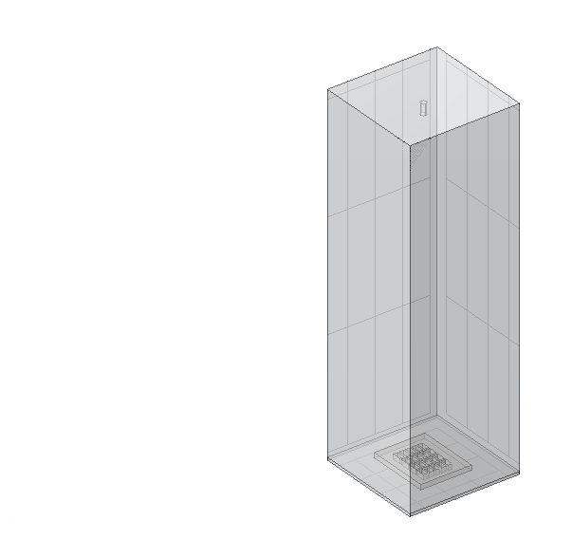
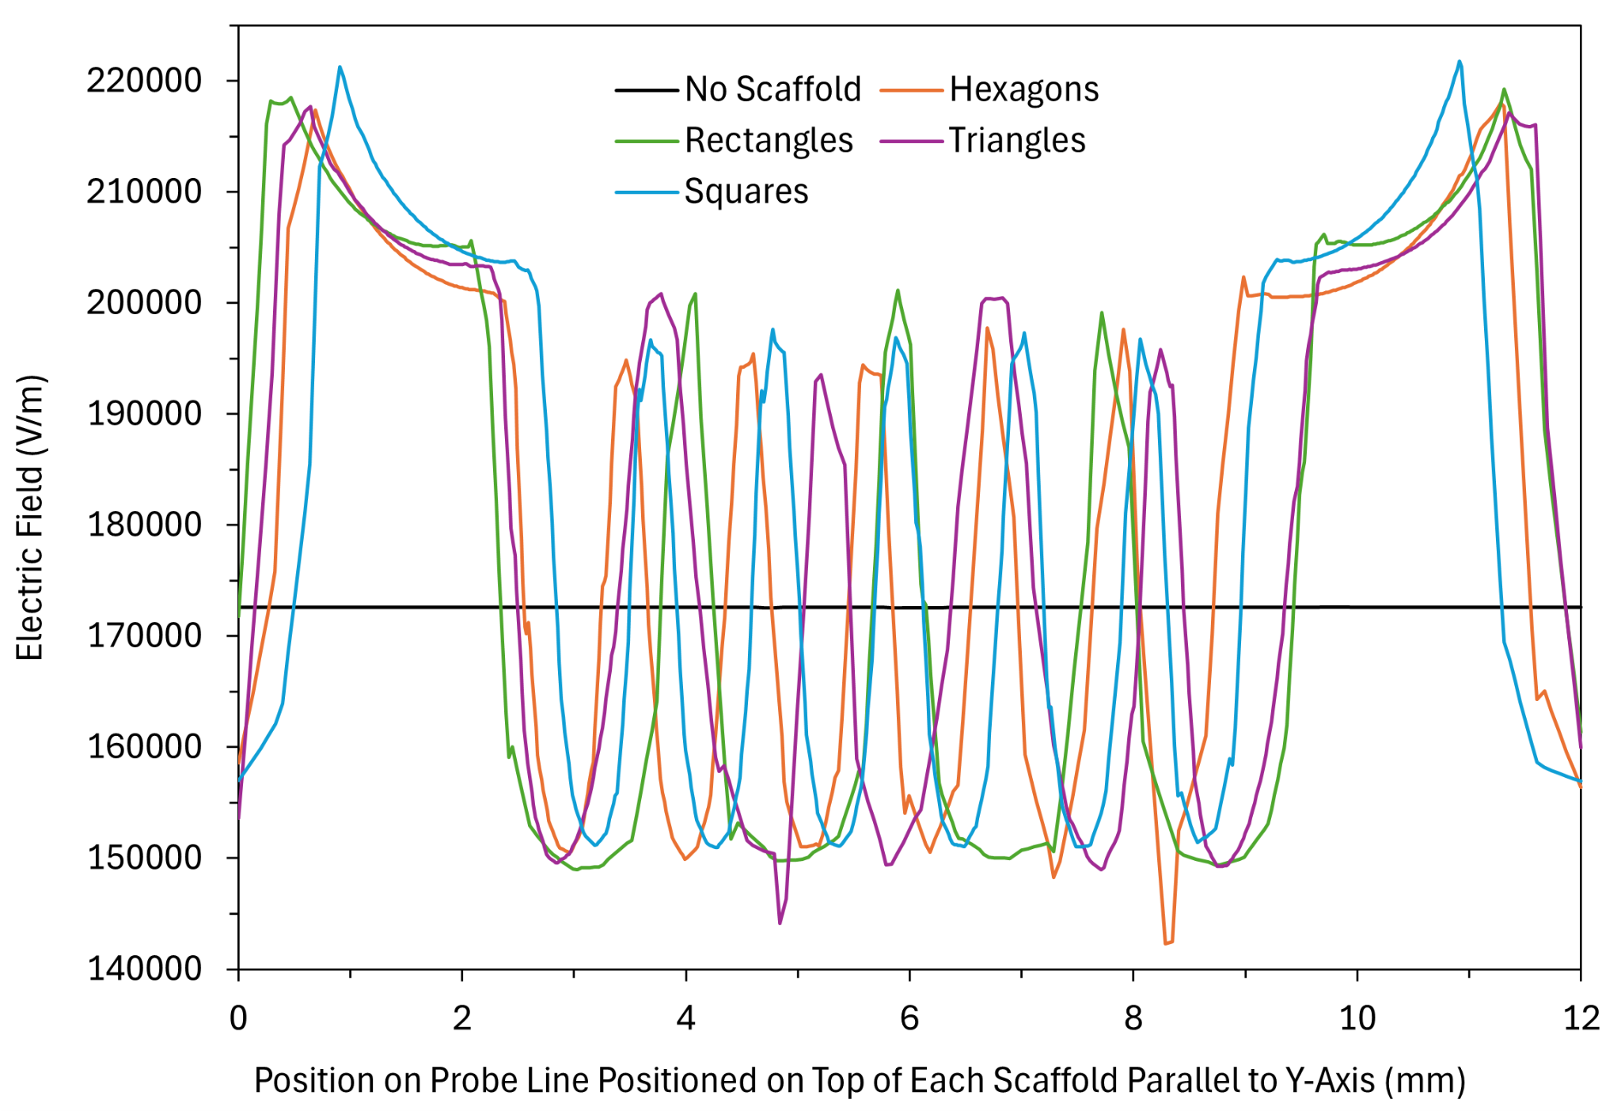
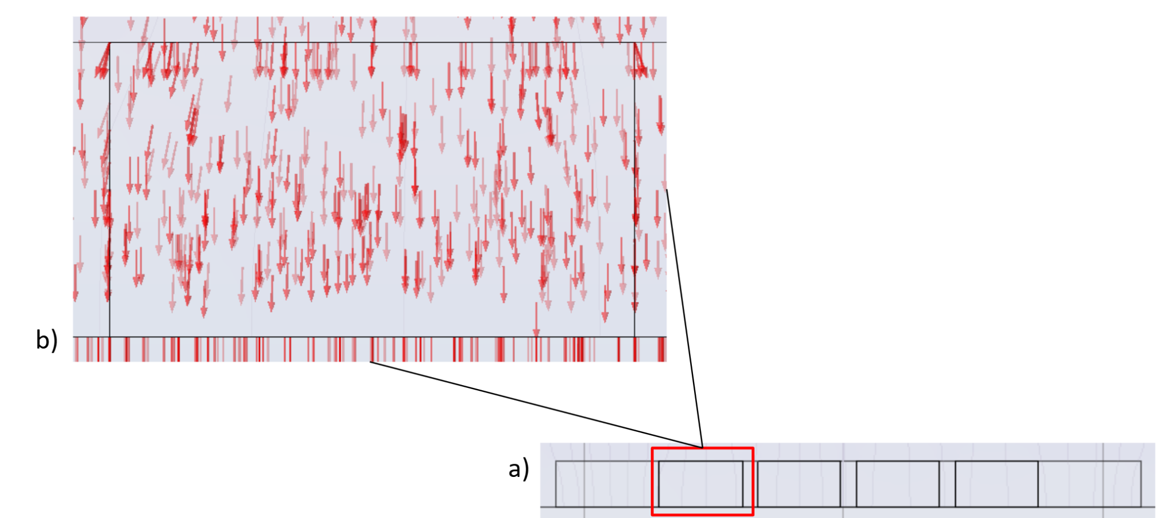

Using COMSOL to Compare the High Voltage Electric Field in Electrospinning for 3D-Printed Geometries
Steel Nozzle
Air Box
Modeling how 3D-printed scaffold geometries influence electric field orientation to improve fiber alignment in electrospinning for tissue engineering applications.
Rebecca Chory¹, Phillip Sgobba², Naser Haghbin¹, Isaac Macwan²
¹ Department of Mechanical Engineering, Fairfield University, Fairfield, CT, USA
² Department of Electrical and Biomedical Engineering, Fairfield University, Fairfield, CT, USA
Scaffold
Aluminum Foil
Introduction & Goals
Electrospun nanofibers are widely used in tissue engineering as extracellular matrices (ECMs), because they support cell adhesion and guide cell development. The alignment of these fibers is governed by the resultant vector field generated between the spinneret and collector electrodes, which dictates fiber trajectory through electrostatic forces during electrospinning.
This study evaluates how different 3D-printed scaffold geometries and materials modify the electric field distribution and nanofiber alignment during electrospinning. By applying finite element simulations in COMSOL Multiphysics®, we model how both geometry and dielectric constants change the field’s magnitude, gradient, and directionality, ultimately guiding data-driven design choices in scaffold fabrication for regenerative medicine.
Methodology
A stationary electrostatics simulation was performed in COMSOL Multiphysics® to model an electrospinning setup. Scaffold geometries were imported from SolidWorks and positioned over a grounded aluminum collector. A steel nozzle, held at 17 kV and 60 mm above the collector, served as the high-voltage electrode.
Two Formlabs resins—V4 Grey and Biomed White V1—were assigned material properties based on datasheets. Electric field intensity (V/m) and direction were quantified by extracting numerical data along probe lines positioned along the top surface of the individual scaffolds. The electric field was analyzed using streamline plots across different scaffold geometries, including square, rectangular, triangular, and hexagonal designs. This data is represented in Fig. 1, which compares the electric field magnitude of each individual scaffold.
Fig. 1. Electric field magnitude measured along a probe line parallel to the Y axis for each scaffold geometry and for no scaffold present.
Results
In simulations with V4 Grey and Biomed White V1 scaffolds, electric field strength peaked at approximately 2.2 × 10⁵ V/m along scaffold struts and dropped to about 1.5 × 10⁵ V/m at hole centers (Fig. 1). Field vectors were redirected toward the holes (Fig. 2a,b), with square scaffolds producing ~45° angles from the vertical. This electric field line alignment would potentially help quantify the electrospun nanofiber orientation observed under SEM.
Rectangular scaffolds redirected field lines perpendicular to their long axis, leading to anisotropic fiber deposition. In contrast, the absence of a scaffold produced a more uniform electric field of ~1.7 × 10⁴ V/m with vertically directed vectors. Biomed White V1 showed no measurable difference in electric field strength or direction compared to V4 Grey, as both materials had similar dielectric and conductive properties.
Fig. 2. (a) Y–Z plane side view of the scaffold, visualized using streamlines and red arrow vectors. (b) Enlarged view of a selected rectangular region from (a), highlighting local field concentration and direction.
Gupta et al., Chem. Eng. Sci., 2021. [DOI:10.1016/j.ces.2021.116463]
Ye et al., Ceram. Int., 2025. [DOI:10.1016/j.ceramint.2025.01.070]
Wang et al., Adv. Mater., 2015. [DOI:10.1002/adma.201403943]
Chia & Wu, J. Biol. Eng., 2015. [DOI:10.1186/s13036-015-0001-4]
Abar et al., J. Biomed. Mater. Res. A, 2021. [DOI:10.1002/jbm.a.37006]

