Slide 1
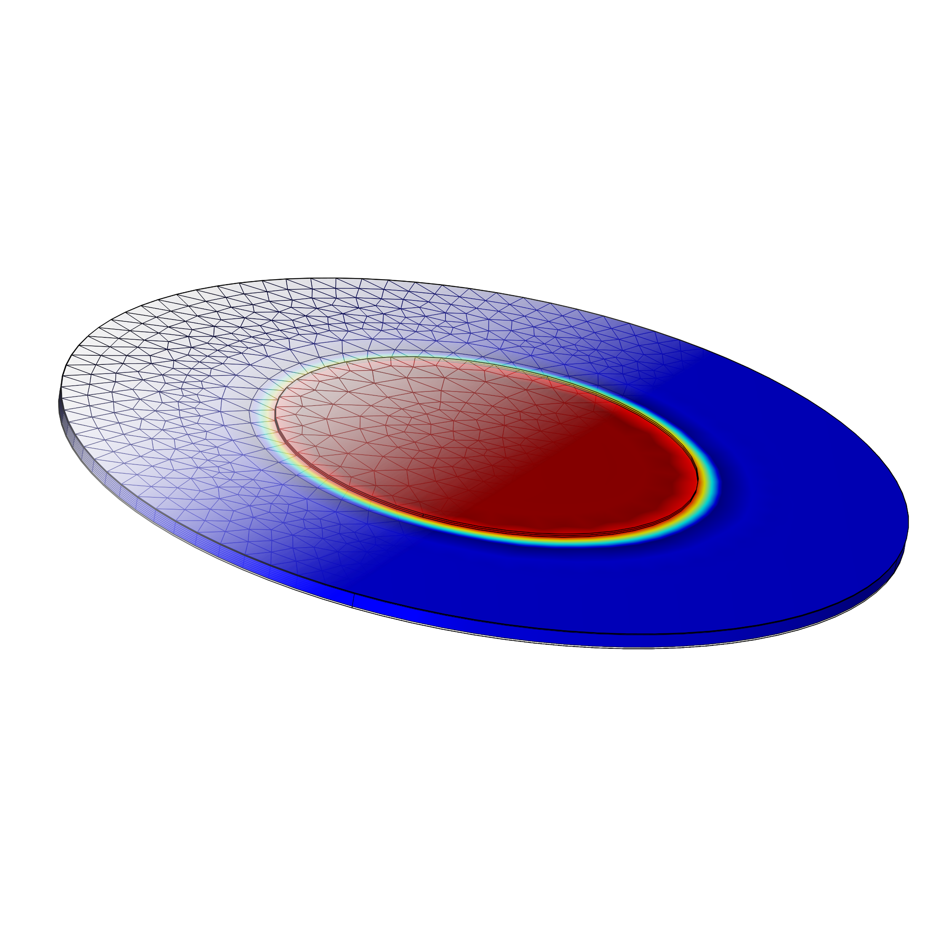
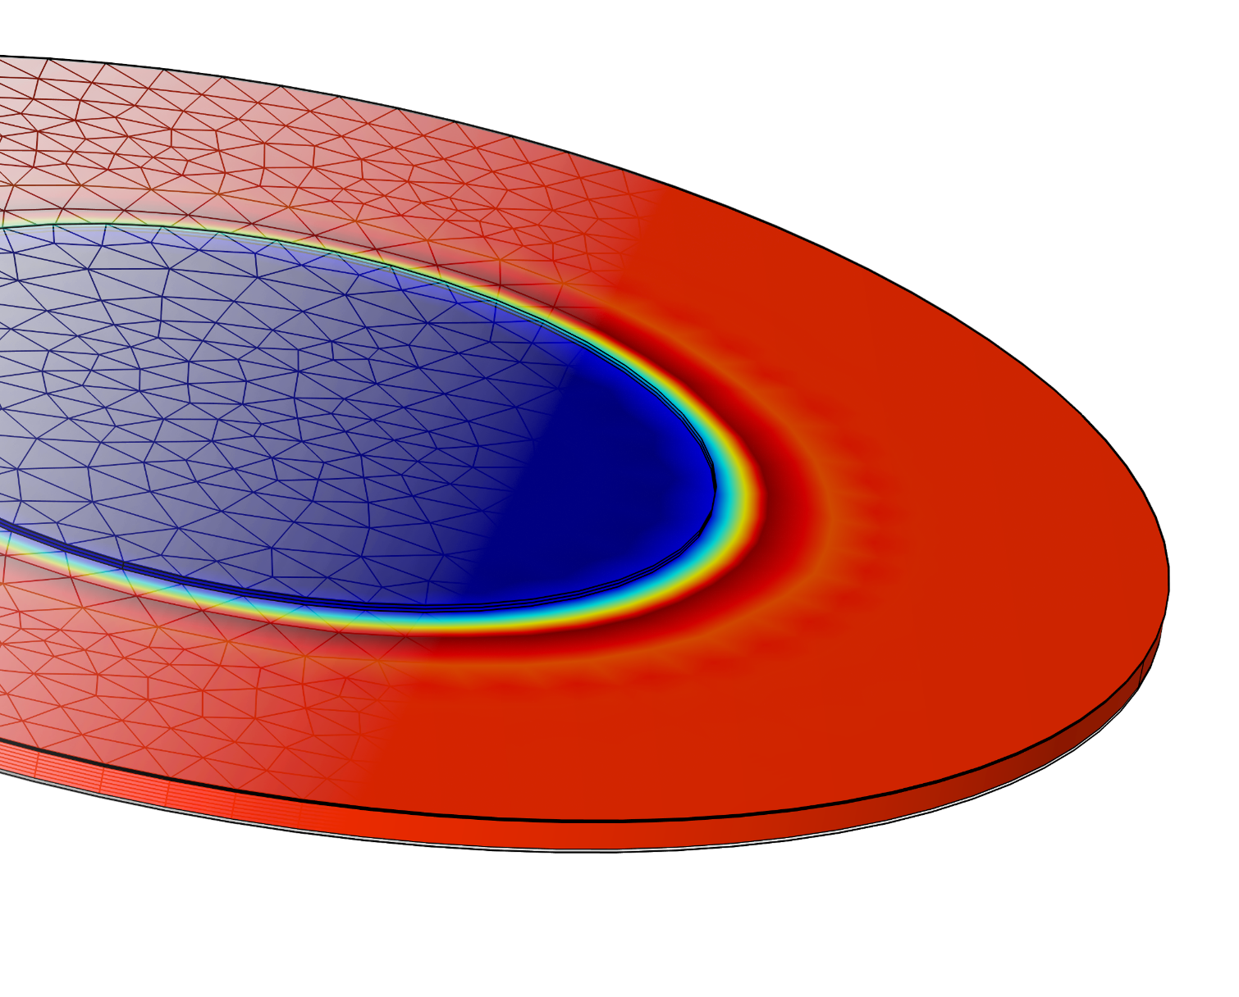
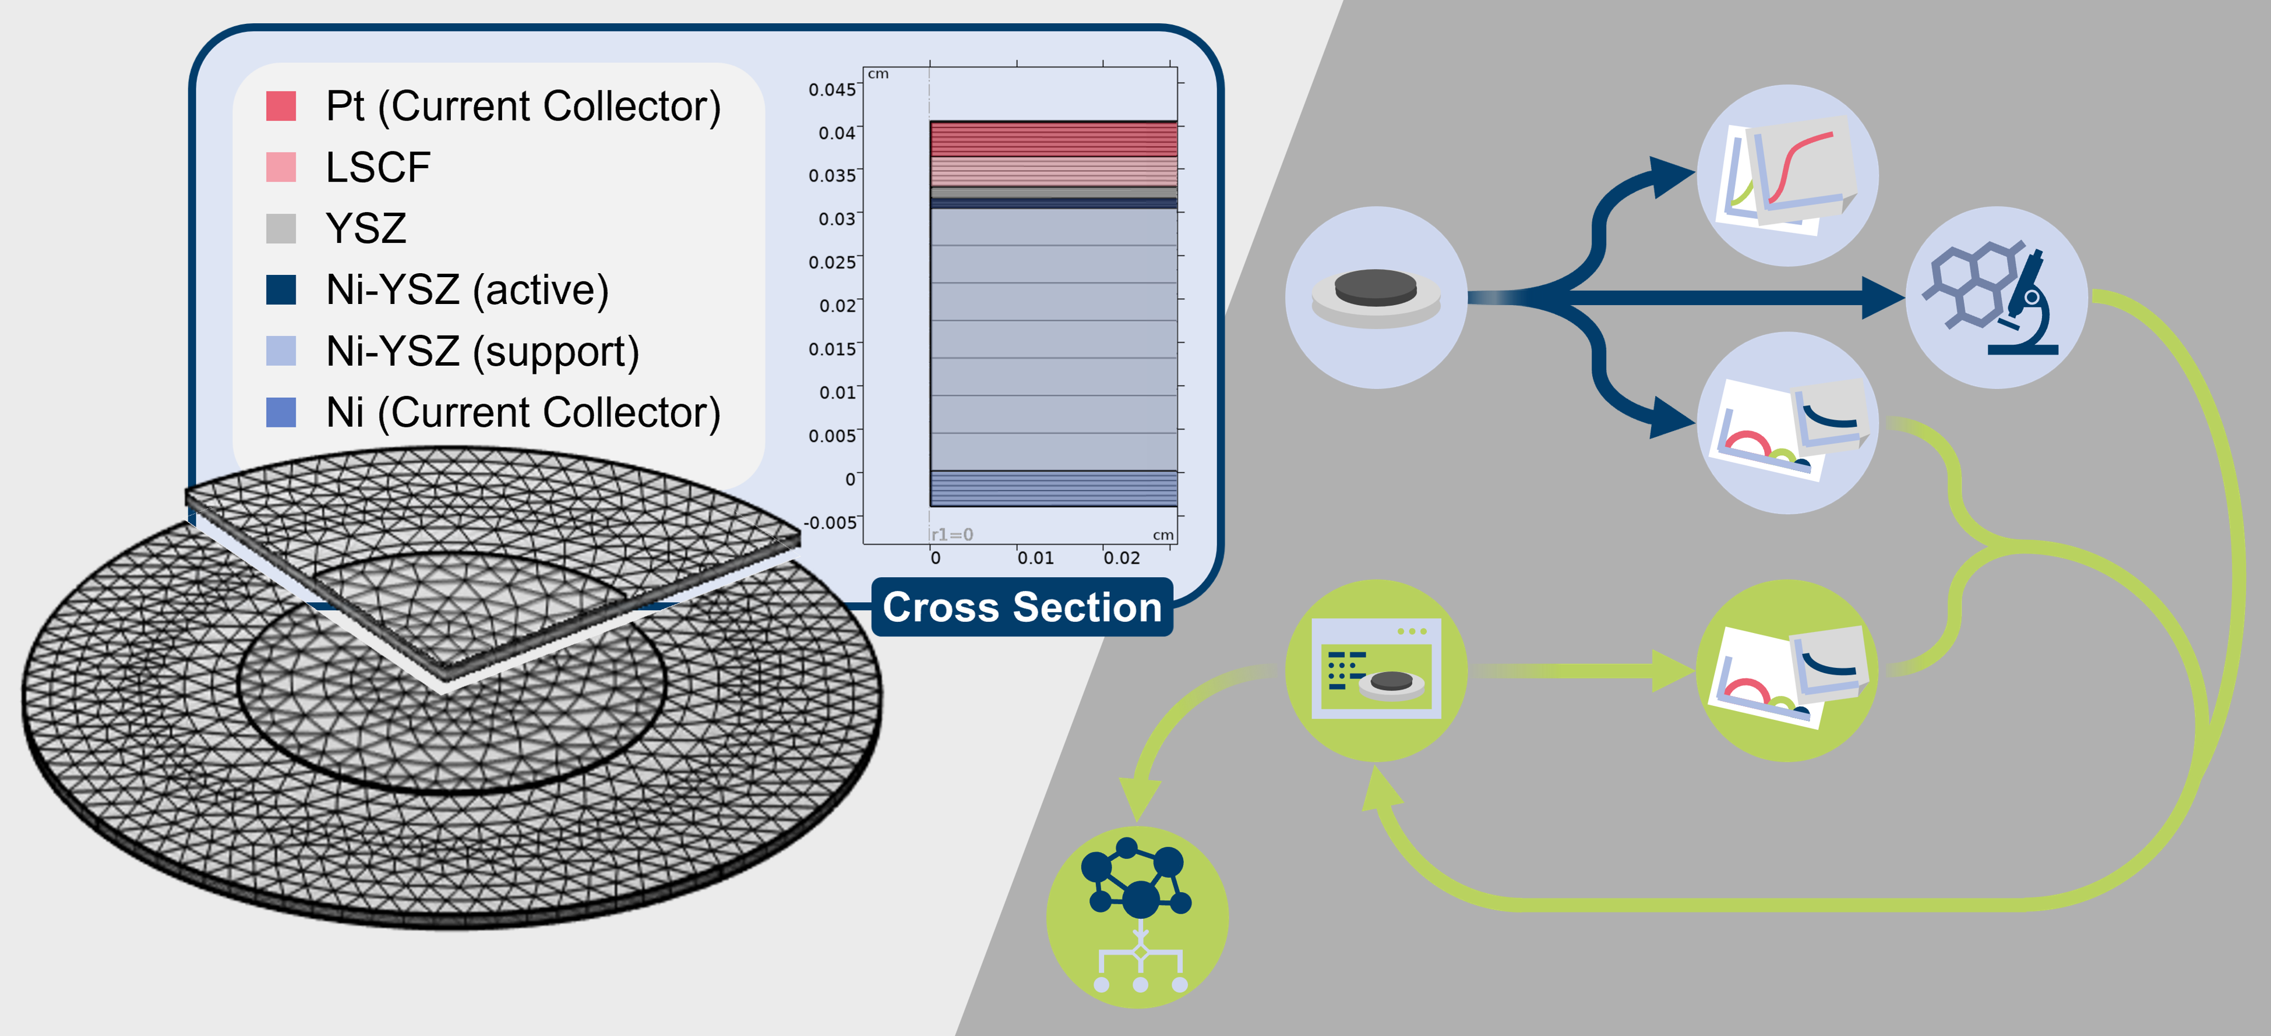
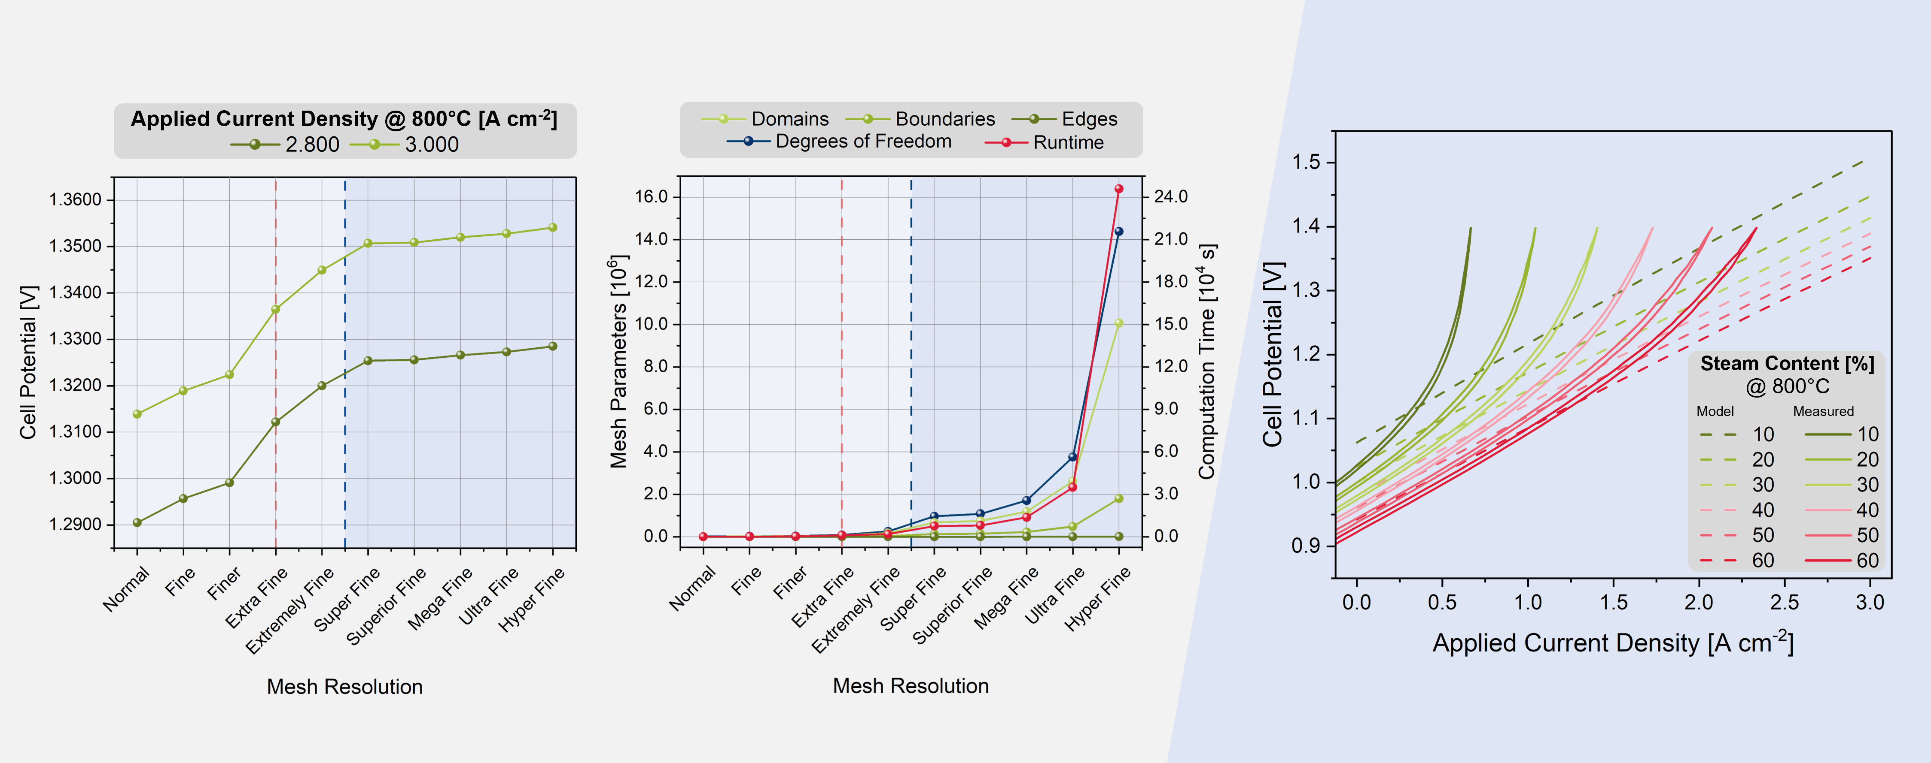


Towards a Data-Driven Framework for Predictive Electrochemistry in Solid Oxide Cells
To enable automated data generation for machine-learning training a COMSOL-based Multiphysics model is developed and iteratively refined by integrating experimental microstructure and electro-chemistry data. This ultimately aims to reduce the need for experi-mental campaigns, easing to create large, high-quality datasets.
N. Eyckeler^{1,2}, T. Frömling¹ & R.-A. Eichel^{1,2}
1. Institute of Energy Technologies (IET-1), Forschungszentrum Jülich, Jülich, Germany
2. Institute of Physical Chemistry, RWTH Aachen University, Aachen, Germany
Introduction & Goals
The development of SOEC materials traditionally relies on time- and cost-intensive experimental workflows. To accelerate progress, a multiphysics-based finite element model is being developed as validated, high-fidelity simulation tool to generate physics-based synthetic data for machine learning algorithms.
By integrating real-world microstructural data from FIB-SEM analyses and validating against experimental electrochemical data, the model aims to improve predictive accuracy, uncover and under-stand degradation mechanisms and ultimately support the design of more durable SOEC materials.
The long-term goal is to establish a framework that allows to identify performance limiting processes and optimize material properties. Therefore, this approach has the potential to signifi-cantly accelerate SOEC materials research and development.
Methodology
The modeling framework is implemented in COMSOL Multiphysics®, coupling electrochemistry, mass transport, and microstructure parameters. The latter are obtained from FIB-SEM imaging ensuring realistic electrode geometries. Coupled with COMSOL’s Water Electrolyzer interface current-voltage (i-V) curves are simulated as a primary performance metric.
Initial Benchmarking was performed and results of parameter sweeps are ongoingly validated via experimental electrochemistry performance data to identify and mitigate discrepancies between simulation data and experimental results. After achieving accurate predictions, the validated model will be used to generate large-scale synthetic datasets for training machine learning models enabling faster and cheaper material screening.
FIGURE 1: Implemented model geometry and mesh (left) and scheme of the model development approach (right).
Results
The initial model version successfully reproduces qualitative trends in current-voltage behavior across a wide parameter space and mesh independence studies ensured numerical stability and minimized computational cost while maintaining accuracy.
However, several critical challenges remain as an accurate representa-tion of gas transport requires coupling stacked solid phases with a single fluid domain within the Free and Porous Media Flow module. This issue becomes particularly evident at higher current densities. Model data furthermore, exhibits a shift in cell potential compared to experiment data, whose origin is still under investigation. Additionally impedance spectroscopy is implemented to dissect frequency-dependent processes. While first results qualitatively match to experiments, quantitative agreement has not yet been achieved.
The initial model version successfully reproduces qualitative trends in current-voltage behavior across a wide parameter space and mesh independence studies ensured numerical stability and minimized computational cost while maintaining accuracy.
Parameter variations revealed the model's ability to capture expected performance trends, highlighting its general potential for predicting real-world behavior. Comparison with experimental data exposed deviations, mainly due to simplified diffusion treatments. Refinements using COMSOL’s Free and Porous Media Flow module are already in progress. Furthermore, Implementation of impedance spectroscopy simulations is underway to dissect frequency-dependent processes and further validate the model's predictive power.
FIGURE 2: Results of the Benchmarking Procedure in terms of mesh precision based on the calculated cell potential (left) and further performance metrics (middle) as well as an exemplary i-V-curve generated with the current model version (right).
Acknowledgement
M. Nohl et al., Validation of and Simulations using a High-Temperature Electrolysis Model, ECS Trans., 111 (6), 1057-1066 (2023)
M. Nohl, Modellierung der Hochtemperaturelektrolyse von H₂O und CO₂, PhD Thesis, RWTH Aachen University, Aachen (2024)
N. Eyckeler et al., Multiphysics modeling of degradational behavior in high-temperature electrolysis cells based on experimental studies, Master Thesis, RWTH Aachen University, Aachen (2024)
Funding by the German Federal Ministry of Research, Technology and Space (BMFTR) within the project Phoenix is greatly acknowledged.

