Slide 1
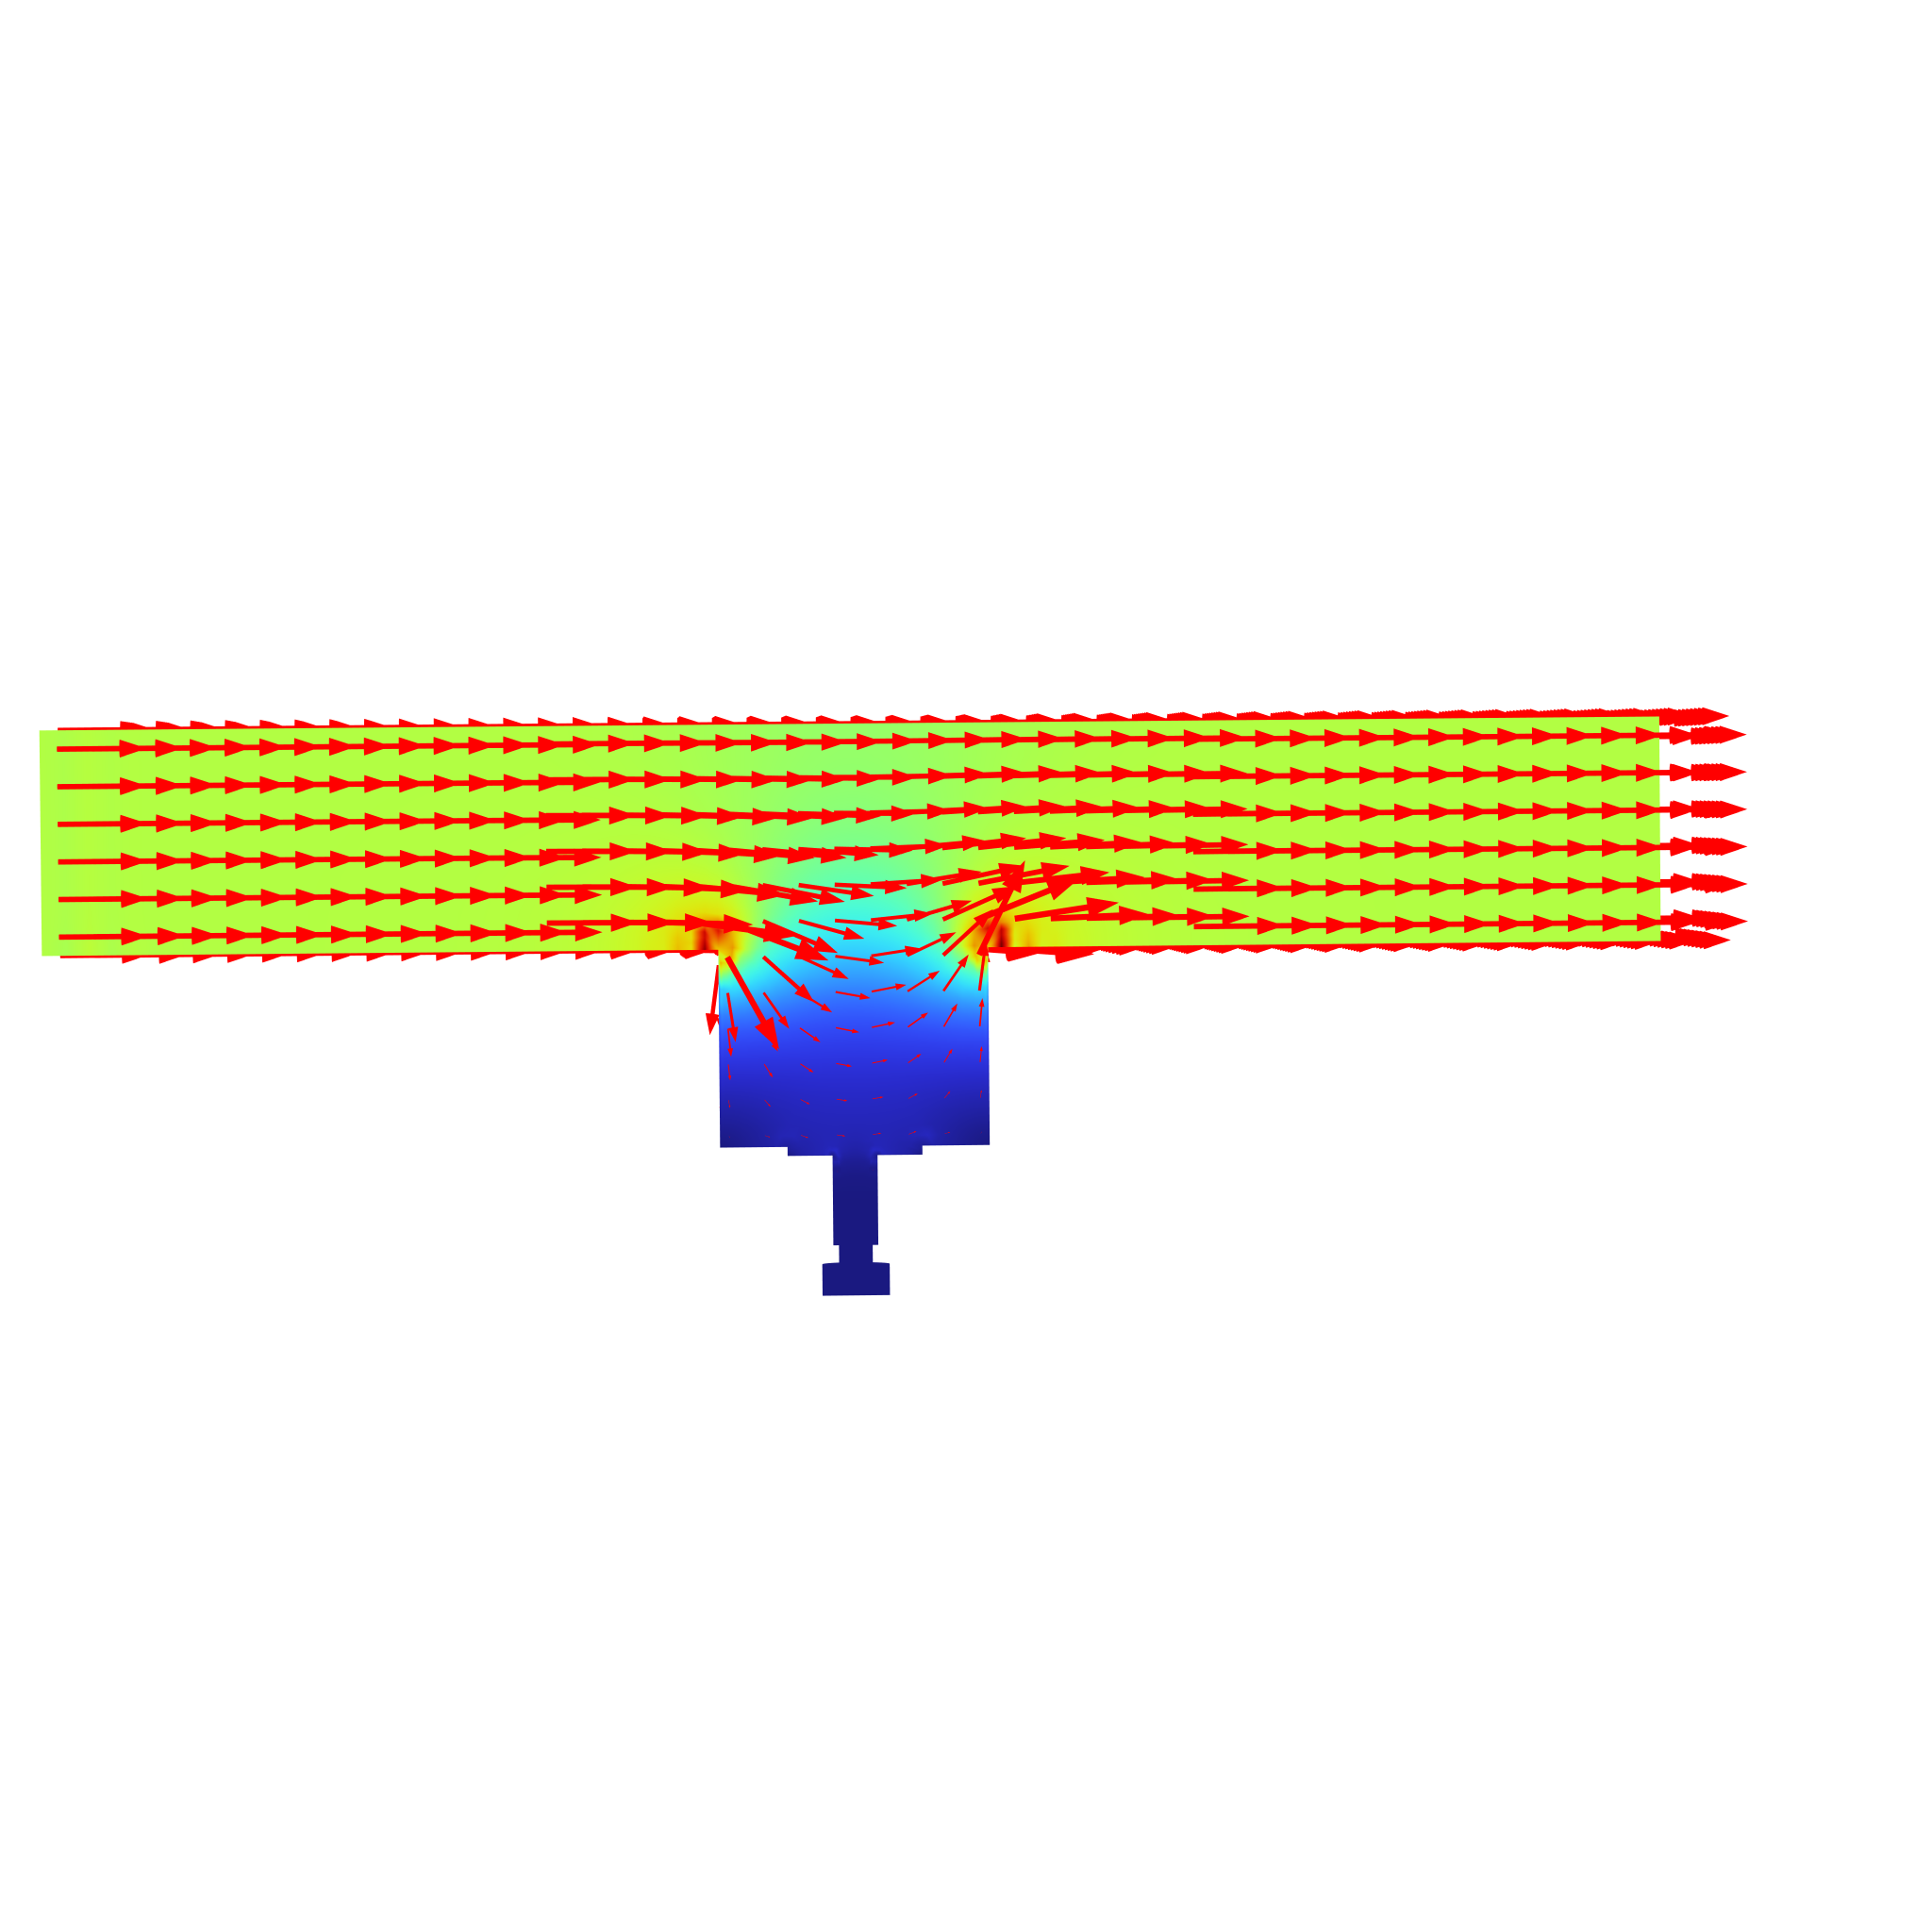
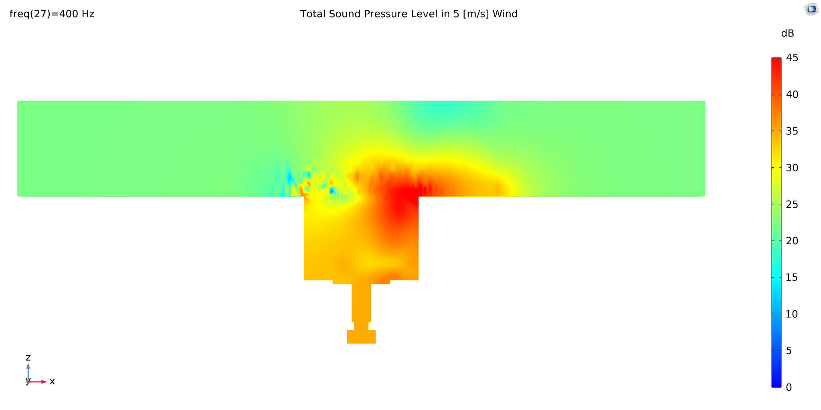
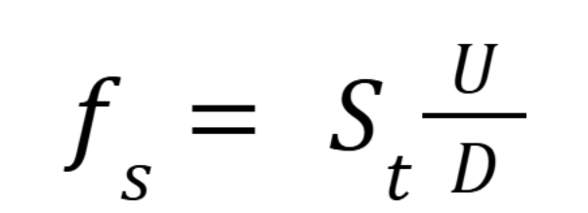
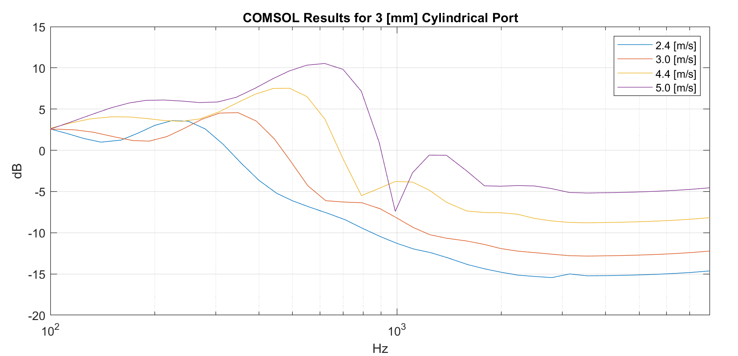

Analysis of Wind-Generated Noise in Microphone Ports
Microphones pick up disturbances in air, including from wind. Simulations of different velocities show how wind noise changes under varying wind conditions.
O. Canavan, E. Johnson, K. Dong
Audio Engineering, Sonos Inc., Boston, MA
Abstract
MEMS microphones have been widely adopted in a variety of consumer electronic systems. Microphones are typically used to convey voices, but the presence of wind noise can be overpowering and distort speech. We present a simulation workflow that predicts how cross-flow velocity shapes the wind noise spectrum. This model uses the AeroAcoustics Flow Source Coupling to combine the Large Eddy Simulation and Pressure Acoustics. Results show that changes in wind velocity alter the corner frequency of wind noise and change broadband levels. This offers early guidance for design choices and wind mitigation.
Methodology
In 3D, we designed a 3 [mm] cylindrical microphone port with a wind tunnel to simulate a smooth column of air flowing across the microphone cavity. The wind speed s selected were 2.4 [m/s], 3.0 [m/s], 4.0 [m/s], and 5.0 [m/s].
The shedding frequency is predicted based on the Strouhal scaling. (Ref. 1).
FIGURE 1: Surface sound pressure level of a 3.0 [mm] microphone cavity during 5.0 [m/s] of wind.
Results
Our model reproduces the expected dependence of wind-noise spectra on flow velocity. As velocity increases, the dominant shedding peak shifts upward, consistent with the Strouhal shedding frequency prediction. Broadband wind noise levels rise with speed. Although the shedding frequency does not perfectly match the prediction, the simulation still captures the velocity-driven shift in corner/knee frequency, making it a practical tool for early design screening (e.g., port/cavity geometry and wind treatments).
FIGURE 2: Sound pressure level at the microphone diaphragm for varying wind velocities.
C. Dalton, “FUNDAMENTALS OF VORTEX-INDUCED VIBRATION.” Available: https://www.bsee.gov/sites/bsee.gov/files/tap-technical-assessment-program/485ab.pdf

