Slide 1
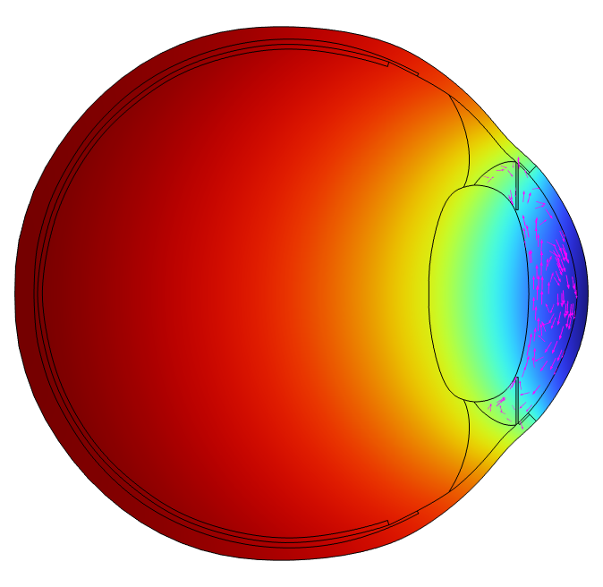
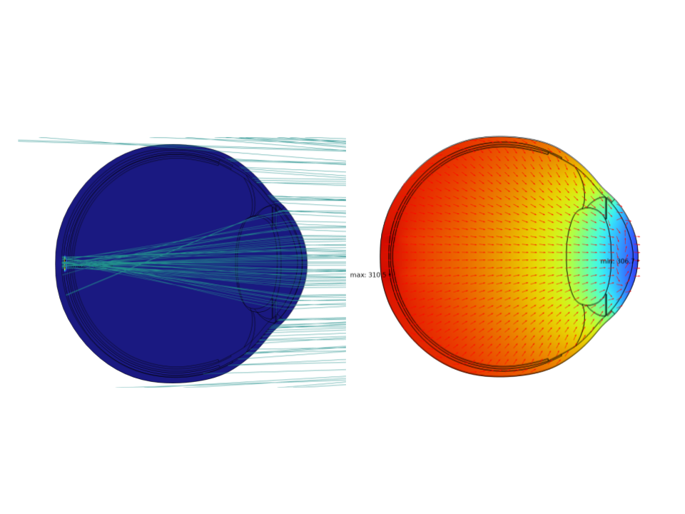
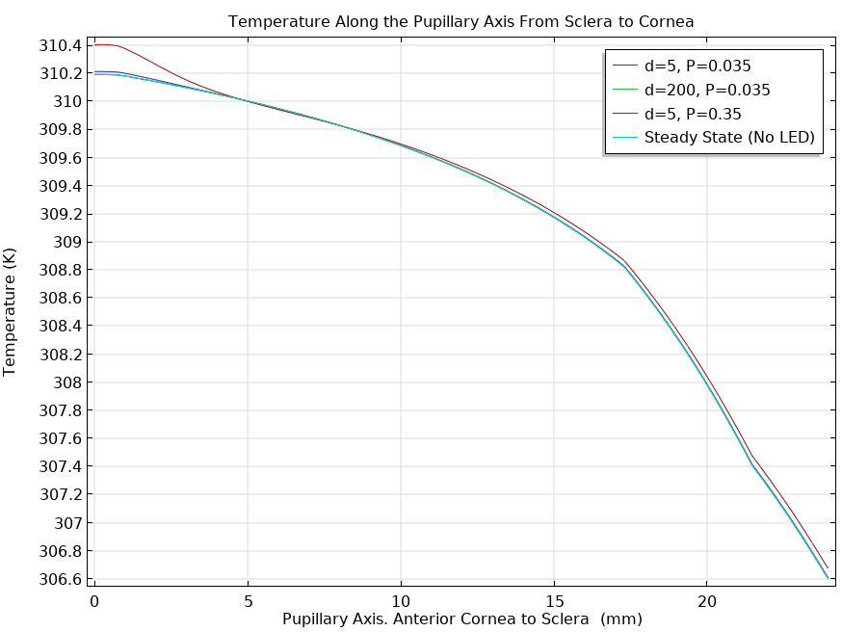

Numerical Thermal Analysis of Human Eye under LED Ray Illumination
This study aims to investigate the thermal response of the eye to IR LED exposure through a multiphysics simulation approach, predicting temperature in ocular tissues due to IR absorption. The increasing adoption of infrared (IR) light-emitting diodes (LEDs) in various applications, including augmented reality (AR) headsets, medical treatment, automotives, mobile phones, and military technology, has led to a growing interest in understanding the interactions between IR radiation and the human eye. Specifically, IR LEDs are being utilized for eye tracking and gaze detection.
Sergio Hernandez, P.E.
Meta, Menlo Park, CA
Abstract
This study investigates the temperature distribution in the human eye subjected to IR-LED ray heating using a 2D numerical model. The model comprises various ocular tissues, including the cornea, aqueous humour (AH), ciliary body, trabecular meshwork (TM), lens, vitreous humour (VH), retina, choroid, and sclera. The eye dimensions, boundary conditions, and heat loads are consistent with previous studies. The Boussinesq flow approximation is applied to the AH domain, while Darcy’s law is employed for the TM domain. The heat-transfer and Geometrical Optics (GOP) interfaces are utilized to calculate ray heating at varying distances. The steady-state model results show good agreement with existing numerical models in terms of corneal temperature and fluid velocity in the AH domain. The results also show temperature rise from IR-LED rays. The findings of this study contribute to the understanding of thermal effects in the human eye under IR-LED ray heating, providing valuable insights for different applications and development.
Methodology
A 2D schematic of the human eye was developed based on literature dimensions, incorporating key structures [1]. The Bio-heat equation was used to model heat transfer. Fluid flow in the AH domain was modeled using the Boussinesq approximation, while flow between AH and TM domains was governed by Darcy's law. Thermal properties were based on literature values, with metabolic heating and blood perfusion incorporated into the thermal analysis [1]. Optical properties were approximated using wavelength-dependent complex refractive indices and extinction coefficients, with absorption coefficients calculated from transmittance data [2-4]. Simulations were performed with LED sources (850 nm) at varying distances from the cornea (5 mm and 200 mm), calculating eye temperature using an optical attenuation model with tissue-specific coefficients.
Figure 1. Ray tracing, intensity map, Temperature field and Heat FLux
Results
The steady-state test results were validated against existing published documents, demonstrating excellent agreement. Specifically, the temperature at the cornea (306.6 K) and sclera (310.2 K) showed percent differences of 0.09% and 0.004%, respectively, compared to published values. Additionally, the maximum velocity in the aqueous humor (AH) domain exhibited a 3% difference, further confirming the accuracy of the results. These findings suggest that the model is reliable and can be used for further analysis. Ray tracing simulations revealed that at a distance of 200 mm, the rays focus on the retina and choroid domains, indicating optimal image formation. In contrast, at a shorter distance of 5 mm, the rays are out of focus and dispersed. Furthermore, simulations showed that temperature rise is more pronounced at shorter distances and higher optical power, highlighting the importance of careful consideration of these factors in system design.
Figure 2 Pupillary Axis - Sclera (0 mm) to Cornea
[1] Md Ashiqur Rahman, et.al, “Characterizing the Aging Process of the Human Eye: Tear Evaporation, Fluid Dynamics, Blood Flow, and Metabolism-Based Comparative Study”, BioMed Research International Volume 2022.
[2] Edward A. Boettner and ]. Reimer Wolter, “Transmission of Ocular Media”, Invistigative ophthalmology, 1971, Vol.1, Number 6, pp 776-783.
[3] Cvetkovic M, Poljak D, et.al., Modeling of Human eye Exposed to Laser Radiation (Human Eye Imaging and Modeling) (CRC Press, 2012) ch 14, pp 279–309
[4] GZanellati, et.al., “A review of optical and thermal eye tissue parameters for improved computational models in retinal laser therapy”, Prog. Biomed. Eng. 7 (2025).

