Slide 1
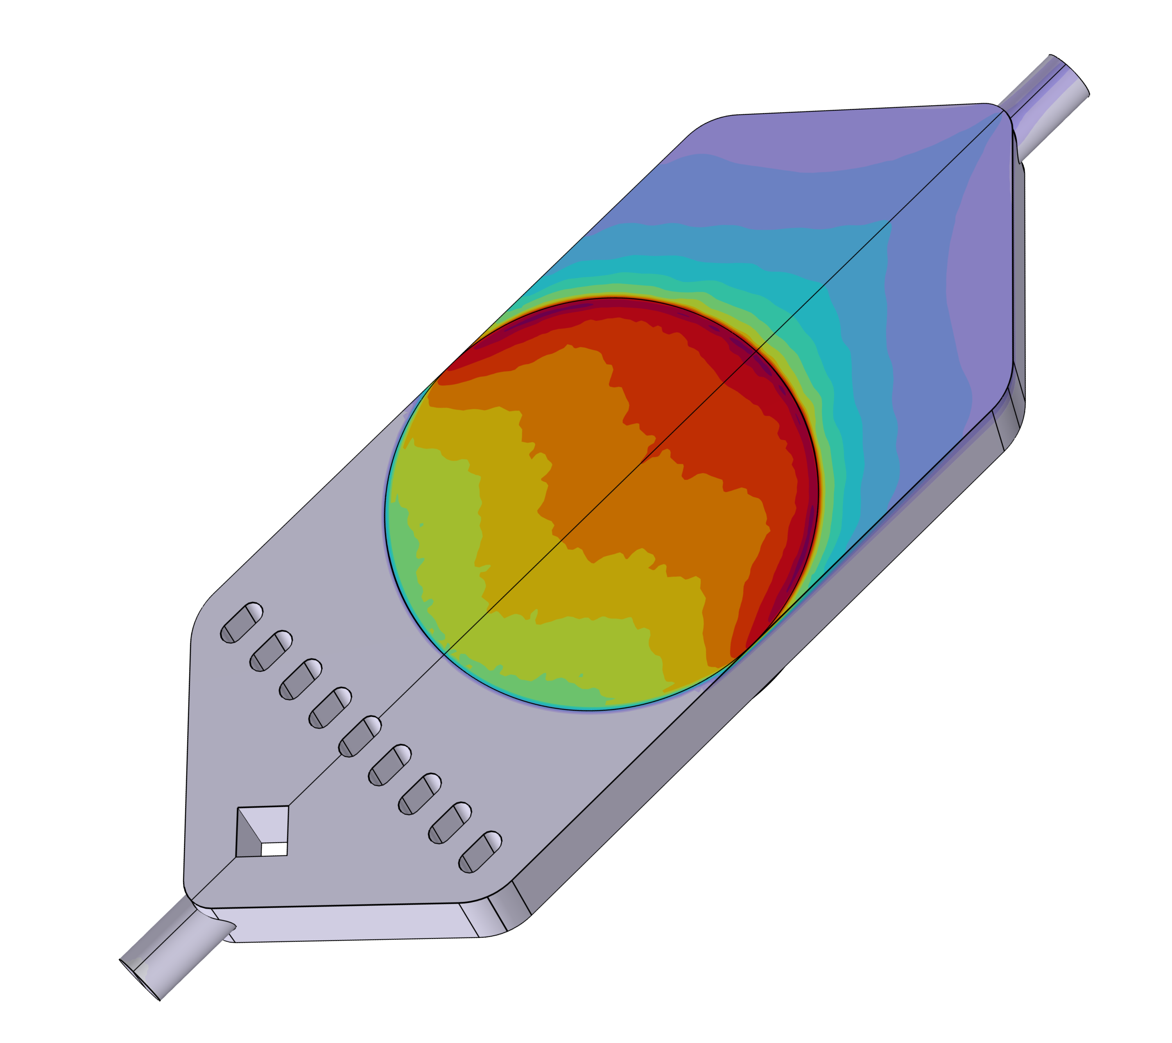

Performance analysis of a Rechargeable Zn-Air Flow Battery
The mathematical modeling of rechargeable Zn-air flow batteries (RZAFBs) plays a key role in prototype design and scale-up. Developing a comprehensive Multiphysics model requires coupling various physico-chemical and thermal processes to accurately capture the system’s behavior.
Jacopo Strada^{1,*}, Luca Magagnin¹ and Benedetto Bozzini² ¹Department of Chemistry, Materials and Chemical Engineering, Politecnico di Milano, Milan, Italy ²Department of Energy Engineering, Politecnico di Milano, Milan, Italy
Introduction & Goals
RZAFBs are emerging as a promising energy storage solution due to their high energy density, cost-effectiveness, and sustainability. [1] With the potential for long cycle life and environmentally friendly operation, they present an alternative for large-scale stationary energy storage applications, particularly in supporting renewable energy integration and grid stability. [2,3]
This study investigates the performance and efficiency of RZAFBs, emphasizing critical factors, including: (1) fluid dynamics and the effect of various battery geometries, (2) liquid-gas phase exchange to describe the correct physics inside the gas diffusion layer (GDE), (3) performance variation due to different ambient conditions, (4) system thermal dependance, (5) polarization (i-V) curve, and (6) limiting current density (l.c.d.) depending on BCs and geometries.
Methodology
The 3D model predicts the electrical performance of RZAFBs during charge and discharge. It features a zinc electrode, an alkaline electrolyte, and a porous GDE with both liquid and gas phases. In the stationary Multiphysics model, physics are coupled in:
1) Electric field drives liquid species transport. Vice versa, concentrations affect reaction rates via Butler-Volmer equation in the electric field. 2) Fluid dynamics governs mass transport in both phases, thanks to Navier-Stokes equation and Darcy’s law. 3) Gas-liquid interactions follow Henry’s law. 4) Temperature evolution is coupled with all physics through electrochemical heat sources.
FIGURE 1. Fluid dynamics in different cell geometries: the implementation of different deflector configurations promotes a more homogeneous concentration field of liquid species, resulting in more uniform zinc electrodeposition and corrosion.
Results
In Fig. 2, (A) the l.c.d. increases with electrolyte flow rate during charging, whereas during discharging it varies only with ambient pressure, which is the driving force of the limiting species, the dissolved oxygen. (B) Geometry variations influence only the charging phase, as evidenced by the increase in l.c.d. – and hence in the operational range of the battery – resulting from improved fluid dynamics: a more homogeneous electrolyte flow promotes more uniform zinc electrodeposition (C). This in turn reduces the occurrence of zincate-depleted regions.
The temperature variation is very limited, as is the dependence of the other physical processes on temperature, thereby confirming the assumption of system isothermality.
FIGURE 2. (A) i-V characteristics of the OG cell: charging at varying electrolyte flow rates and discharging at different ambient air pressures. (B) i-V characteristics of all geometries at identical electrolyte flow rate. (C) Distribution of zincate limiting concentration during charging, correlated with the l.c.d.
1. W. Lao-atiman et al., “Model-based analysis of an integrated zinc-air flow battery/zinc electrolyzer system”, Front. Energy Res., 7, 15, 2019. 2. W. Yu et al., “Elucidating the mechanism of discharge performance improvement in zinc-air flow batteries: a combination of experimental and modeling investigations”, J. Energy Storage, 40, 102779, 2021. 3. J. Strada et al., “Multiphysics modelling for rechargeable zinc-air flow batteries – Part I: A physico-chemical and mathematical reassessment of the model”, J. Electroanal. Chem., 988, 119136, 2025.

