Slide 1
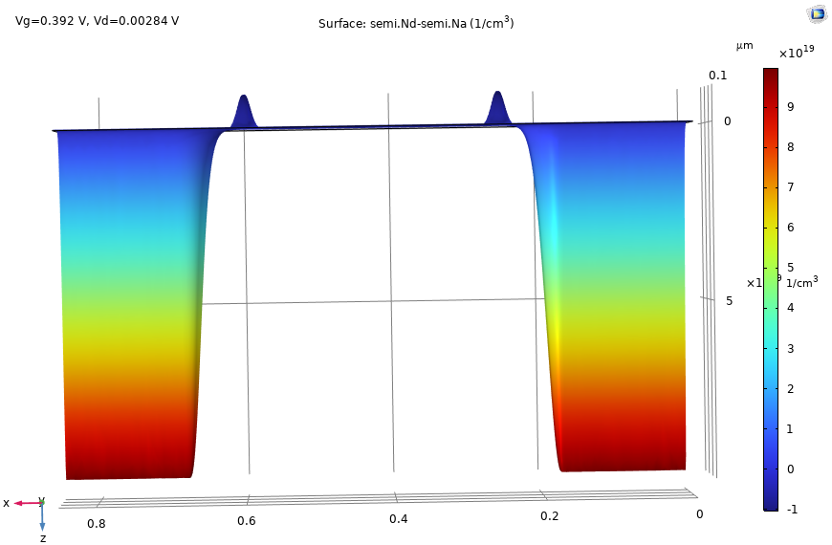
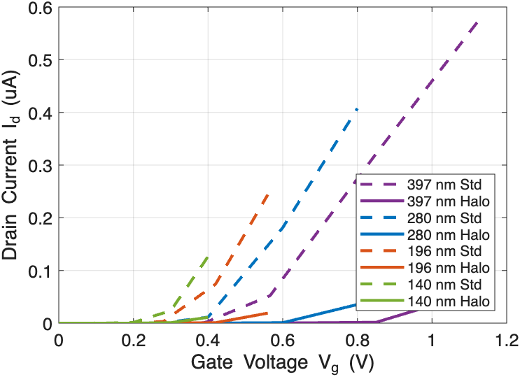
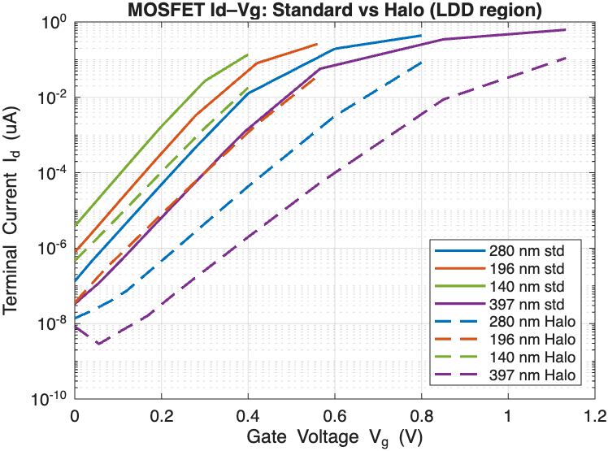
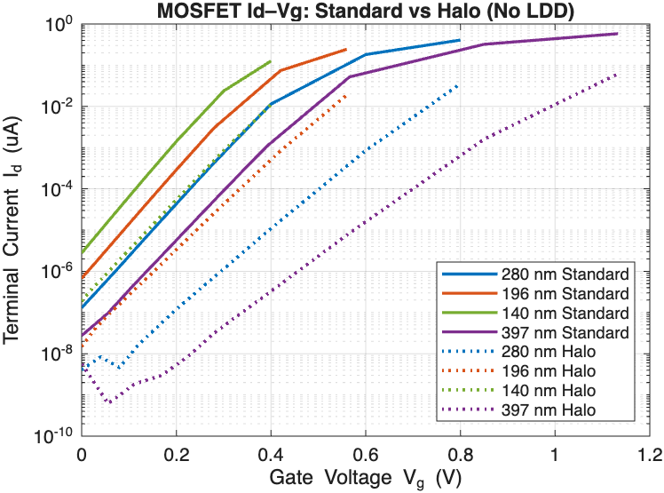

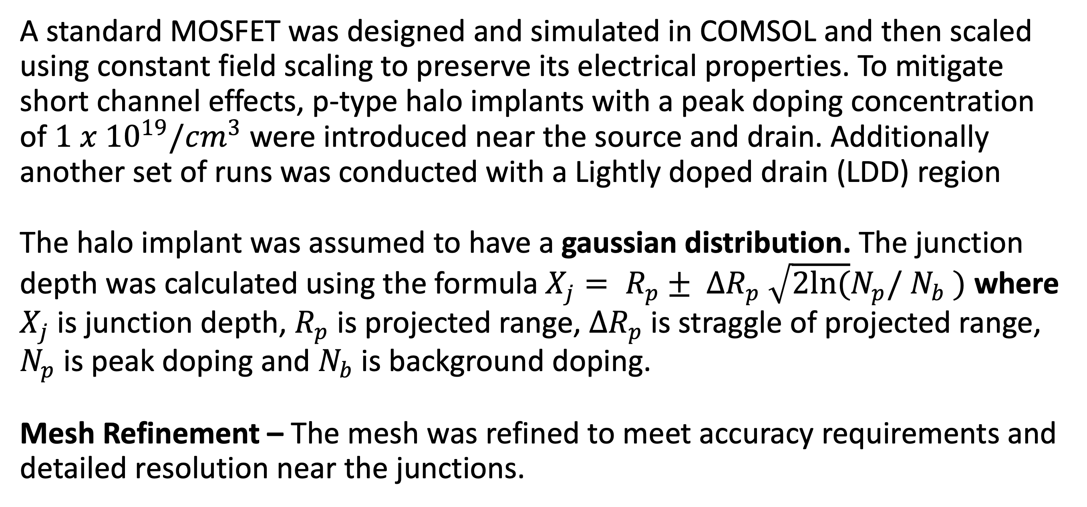
MOSFET Channel Engineering And Scaling Study With Halo Implants Using COMSOL Multiphysics
This study uses COMSOL Multiphysics simulations to show that p-type halo architecture in n-channel MOSFETs can be used to reduce subthreshold current and increase the threshold voltage.
K. Sethia¹ and D.A Fixel¹
¹Dept. of Engineering, Trinity College, Hartford, CT – 06106, USA
Abstract
As MOSFETs continue to scale to submicron sizes, managing subthreshold current and threshold voltage becomes extremely important. This study focuses on 2-D MOSFETs built using COMSOL Multiphysics with silicon substrate and p-type halo implants introduced near the source and drain. Different mobility models - Arora, Lombardi surface, and Caughey-Thomas were utilized to capture lattice scattering, surface scattering, and high-field effects. Electrical characteristics (Id-Vg and Id-Vd) plots were analyzed for MOSFETs of gate lengths 397 nm, 280 nm, 196 nm, and 140 nm, following constant-field scaling trends. The results indicated a significant reduction in terminal current below the threshold voltage for halo-doped devices, effectively reducing leakage current. Additionally, an increase in threshold voltage was observed for the halo-doped MOSFETs.
Methodology
A standard MOSFET was designed and simulated in COMSOL and then scaled using constant field scaling to preserve its electrical properties. To mitigate short channel effects, p-type halo implants with a peak doping concentration of $1 x {10}^{19}/{cm}^{3}$ were introduced near the source and drain. Additionally another set of runs was conducted with a Lightly doped drain (LDD) region
The halo implant was assumed to have a gaussian distribution. The junction depth was calculated using the formula $X_{j}= R_{p}± ∆R_{p} \sqrt{2ln(}N_{p}/$ $N_{b} )$ where $X_{j}$is junction depth, $R_{p}$ is projected range, $∆R_{p}$ is straggle of projected range, $N_{p}$ is peak doping and $N_{b}$is background doping.
Mesh Refinement – The mesh was refined to meet accuracy requirements and detailed resolution near the junctions.
Figure 1. Id-Vg for Halo vs Standard MOSFETs of different Gate Lengths to analyze Threshold Voltage
Results
Increase in Threshold Voltage – MOSFETs with Halo Implants showed a significant increase in threshold voltage compared to the standard MOSFETs. Fig 1. shows a threshold voltage comparison between standard MOSFETs and halo implants.
Reduction in Subthreshold current – A significant reduction in subthreshold current was observed which indicates lower leakage currents which would contribute immensely to the energy efficiency. Fig 2a. and Fig 2b. show the subthreshold current (using Id-Vg plots) comparison between MOSFETs with and without halo implants, both in the presence and absence of an LDD region.
(a)
(b)
Figure 2a. Id-Vg plots for Halo vs Std MOSFET with LDD region
Figure 2b. Id-Vg plots for Halo vs Std MOSFET without LDD region
[1]D. Neamen, Semiconductor Physics and Devices. in Fourth Edition. Mcgraw Hill.
[2]]S. K. Saha, ‘Effect of Statistical Dopant Fluctuations on Threshold Voltage of Emerging Devices’, IEEE J. Electron Devices Soc., vol. 9, pp. 985–994, 2021, doi: 10.1109/JEDS.2021.3120661.
[3] D. L. Critchlow, "Mosfet Scaling-the Driver of VLSI Technology," in Proceedings of the IEEE, vol. 87, no. 4, pp. 659-667, April 1999, doi: 10.1109/JPROC.1999.752521.
[4] R.C. Jaeger, Introduction to microelectronic fabrication, Volume V, (1988). Reading, Massachusetts. Addison-Wesley, 1988.

