Slide 1
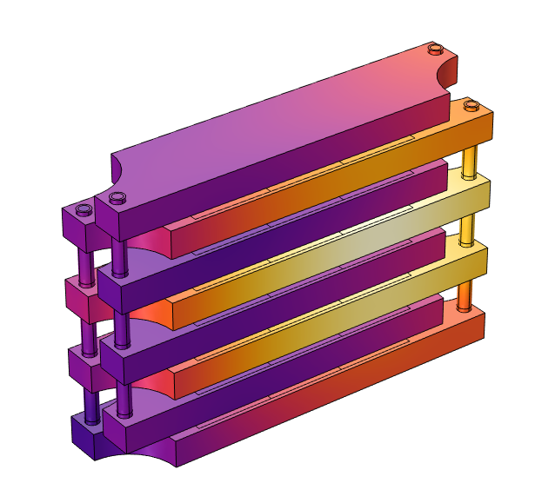
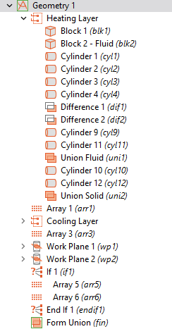
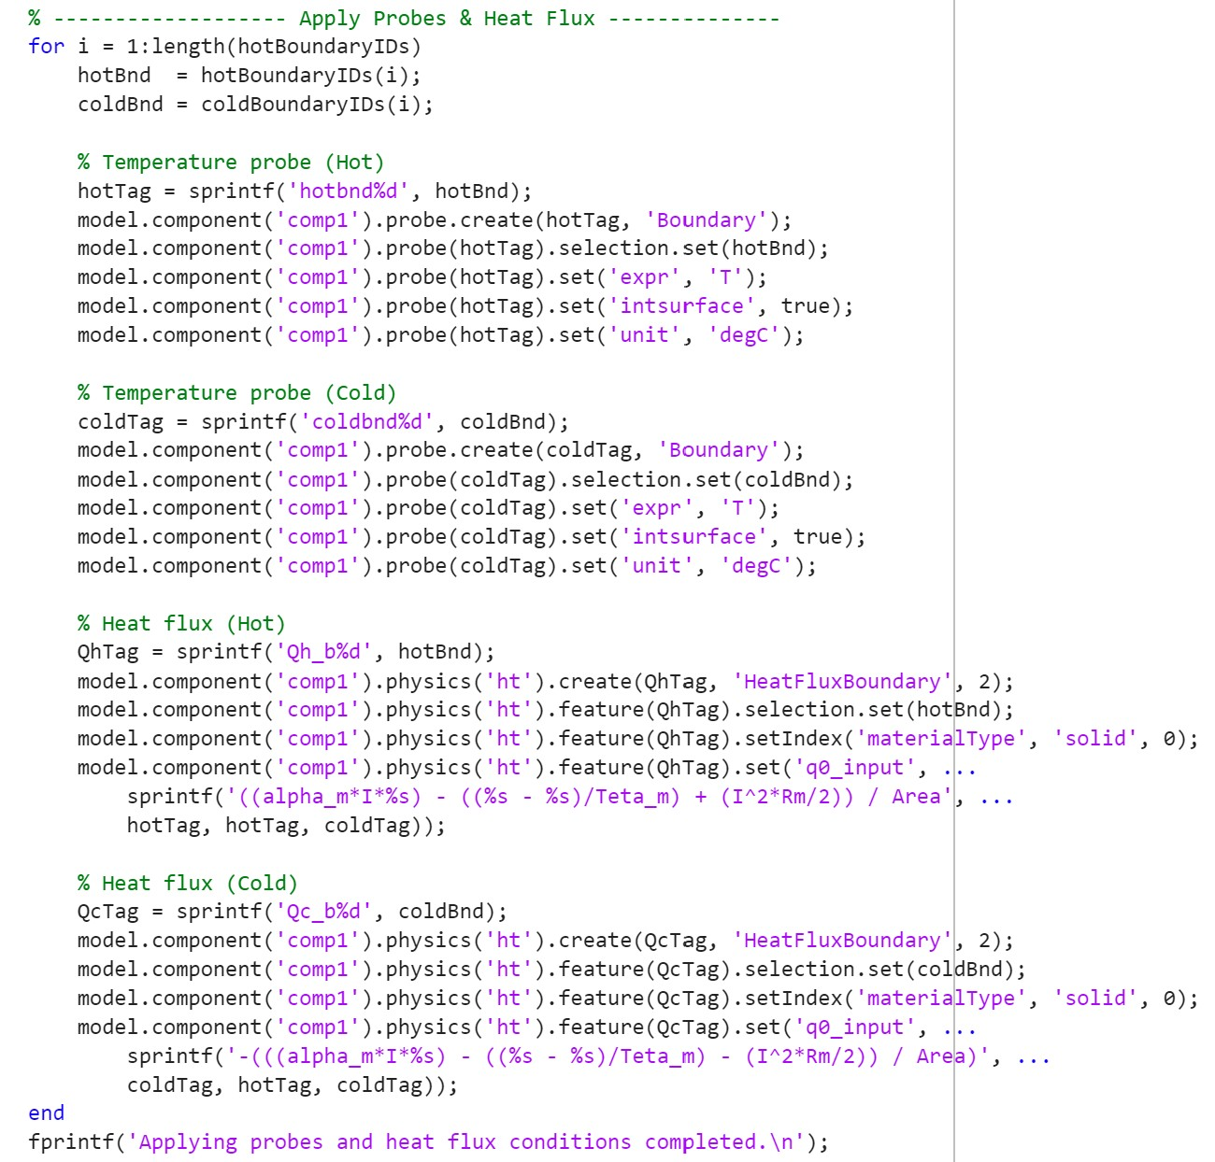
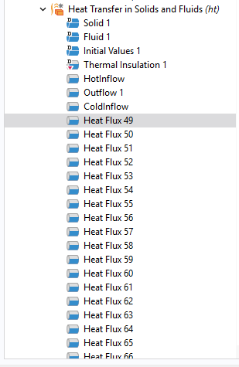
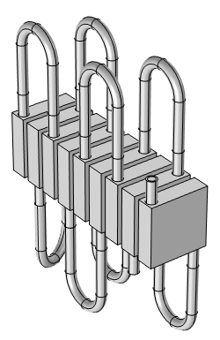
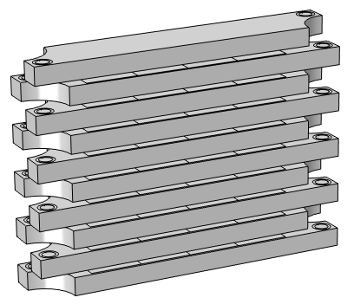
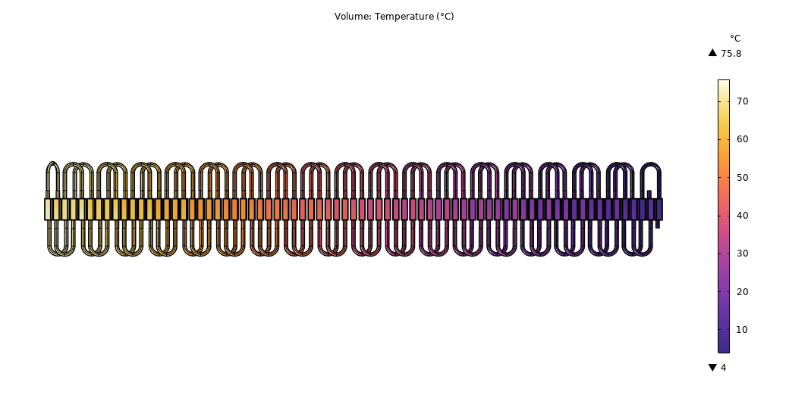
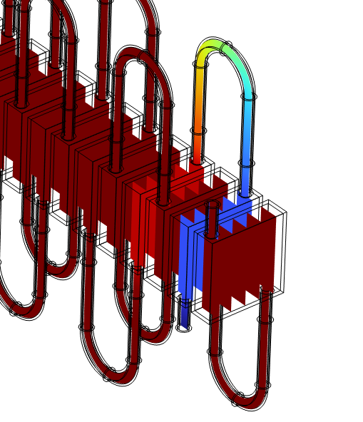
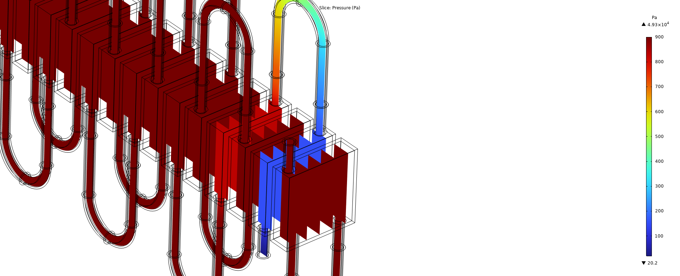
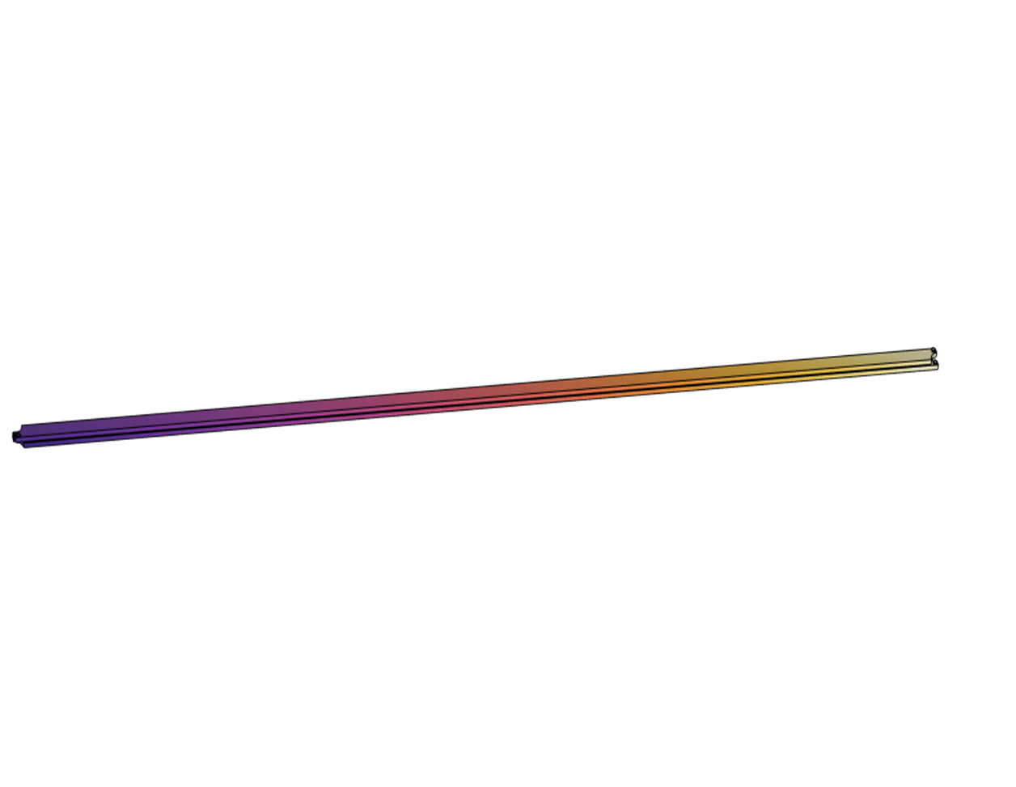
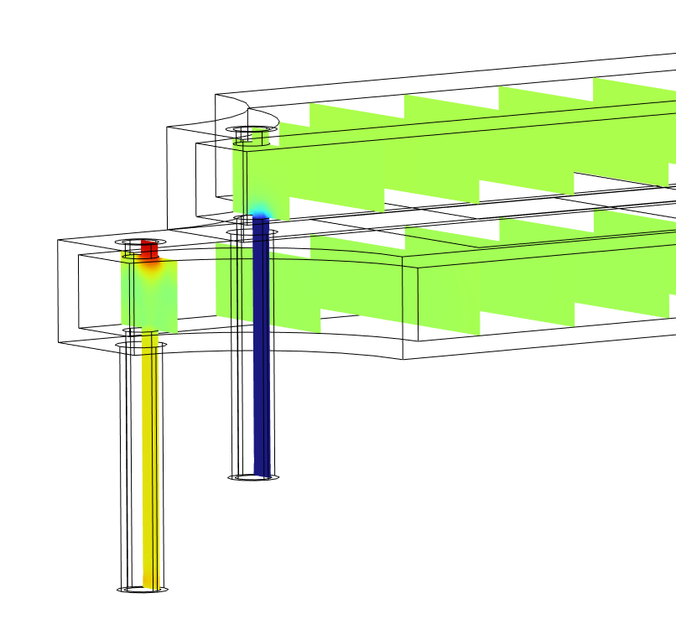
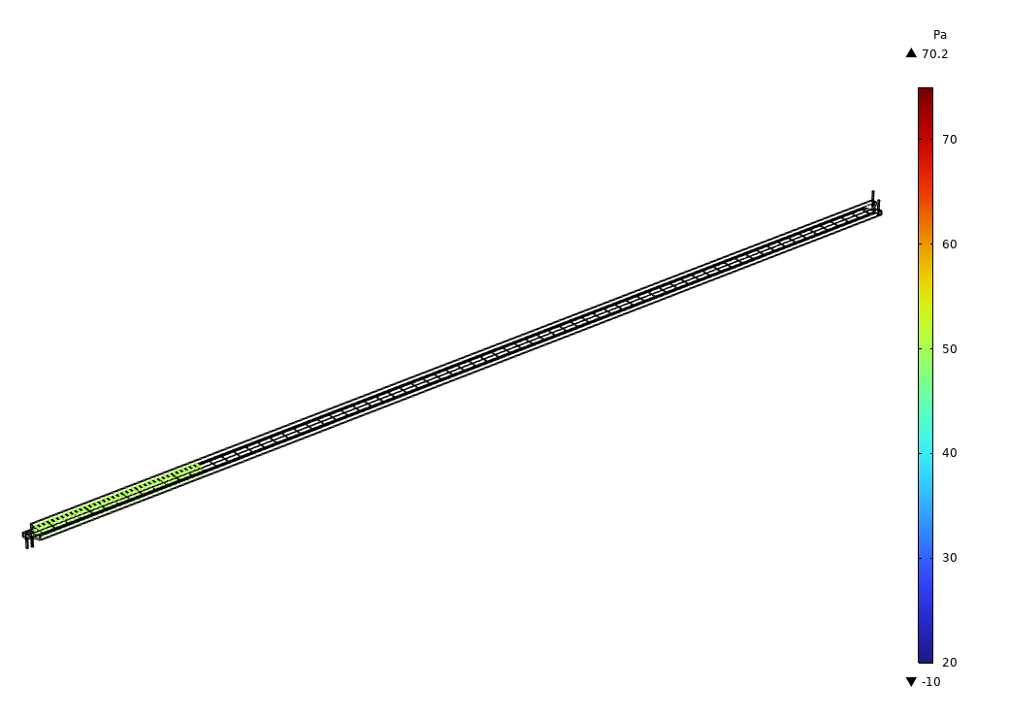


Modeling to design a novel thermoelectric-based heat exchanger for liquid foods pasteurization
Development of a Multiphysics Model for Simulating Heat Transfer and Fluid Flow in Two Thermoelectric-based Heat Exchanger Designs to Optimize Energy Efficiency as an Alternative to the Conventional Liquid Foods Pasteurization System.
Sahar Saadat¹, Mark T. Morgan¹, Hao Gan¹, Gong Gu¹, Jiajia Chen¹
1. University of Tennessee, Knoxville, TN, United States
Introduction and goals
The High-Temperature-Short-Time (HTST) heat exchanger is widely used for pasteurizing liquid foods such as milk and juice. It relies on steam for heating and cold water for cooling via passive heat transfer, resulting in high energy consumption. The Thermoelectric-based heat exchanger is an electrified, energy-efficient alternative to the HTST system. The TE system eliminates the need for steam, reduces system complexity and pumping, and enables active thermal energy recovery using TE devices.
To develop this technology, COMSOL Multiphysics was used to simulate the TE heat exchange process and evaluate different designs to optimize system performance and energy efficiency. The TE heat exchanger combines multiple complex processes: heat generation and pumping within TE devices, heat transfer in the solids of exchanger plates and the liquids of raw and pasteurized foods, and fluid flow of the liquid food between the exchanger plates. Maximizing energy efficiency requires optimizing both the TE devices' performance and the fluid pumping efficiency (Ref. 1, 2, 3)
(a)
(b)
(c)
Methodology
Two TE heat exchanger models were developed: parallel and series connections to evaluate thermal and pumping energy efficiency. In the parallel connection, multiple TE devices are stacked between layers with alternating heating and cooling fluid flow channels. The liquid is heated and cooled after passing of TE devices with many turns. In the series connection, multiple TE devices are connected in series as a TE plate, and the fluid is heated and cooled after a single pass of the TE plates.
In simulation, an analytical model that estimated the temperature-dependent heat flux of TE devices was developed and integrated with COMSOL as boundary conditions through LiveLink for MATLAB. The COMSOL models also integrated modules of CFD and Heat Transfer to simulate the heat exchange process to evaluate the thermal and pumping energy performances.
(d)
(e)
Figure1. (a) Geometry section in COMSOL model, (b) MATLAB scripts for applying boundary probes and heat flux,(c) Applied Heat flux on Boundary condition (d) example of parallel configuration, (e) example of series configuration.
Results
The simulation results showed that both parallel and series configurations can achieve similar and high thermal energy efficiency with a coefficient of performance (COP) of 15.9 and 15.0, respectively. This is higher than the reported lab-scale HTST system with a COP of 6.7 (Ref. 4) at an equivalent flow rate. The pressure drop in the series configuration is much lower than that in the parallel configuration, indicating better pumping energy efficiency.
The integration of COMSOL with LiveLink for MATLAB enables easy design of the TE heat exchangers at scaling-up conditions. The program can increase the designed heat exchanger size in geometry and assign temperature-dependent boundary conditions for TE devices automatically with embedded parameters. COMSOL Multiphysics serves as an essential tool in designing and evaluating these novel TE heat exchangers for liquid food pasteurization.
(a) Temperature distribution of parallel connection
(c) Pressure distribution of two TE system designs
(b) Temperature distribution of series connection
Figure2. Temperature distribution across the parallel configuration (a) and series configuration (b), and pressure distribution in parallel and series configurations (c).
Dongliang Zhao, G.T., A review of thermoelectric cooling: Materials, modeling and applications. Applied Thermal Engineering, 66, p. 15 – 24, 2014.
Patel, et.al, Experimental evaluation and thermodynamic system modeling of thermoelectric heat pump clothes dryer. Appl Energy,217, p. 221-232,2018.
Patel, et.al, Validated model of a thermoelectric heat pump clothes dryer using secondary pumped loops. Appl Therm Eng, 184, 2021
Helena F. Aguiar, etal. Continuous HTST pasteurization of liquid foods with plate heat exchangers: Mathematical modeling and experimental validation using a time-temperature integrator, Journal of Food Engineering,123, p. 78-86, 2014.

