Slide 1
Modeling to design a novel thermoelectric-based heat exchanger for liquid foods pasteurization
Sahar Saadat¹, Mark T. Morgan¹, Hao Gan², Gong Gu³, Jiajia Chen¹
1. Department of Food Science, University of Tennessee, Knoxville, TN, USA
2. Department of Biosystem Eng & Soil Sci, University of Tennessee, Knoxville, TN, USA
3. Department of Electrical Engineering, University of Tennessee, Knoxville, TN, USA
COMSOL Conference, Boston, October 2025

Slide 2
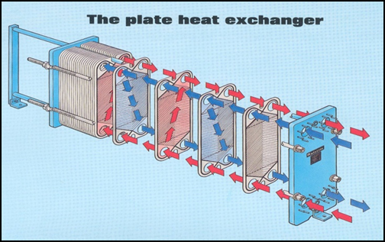
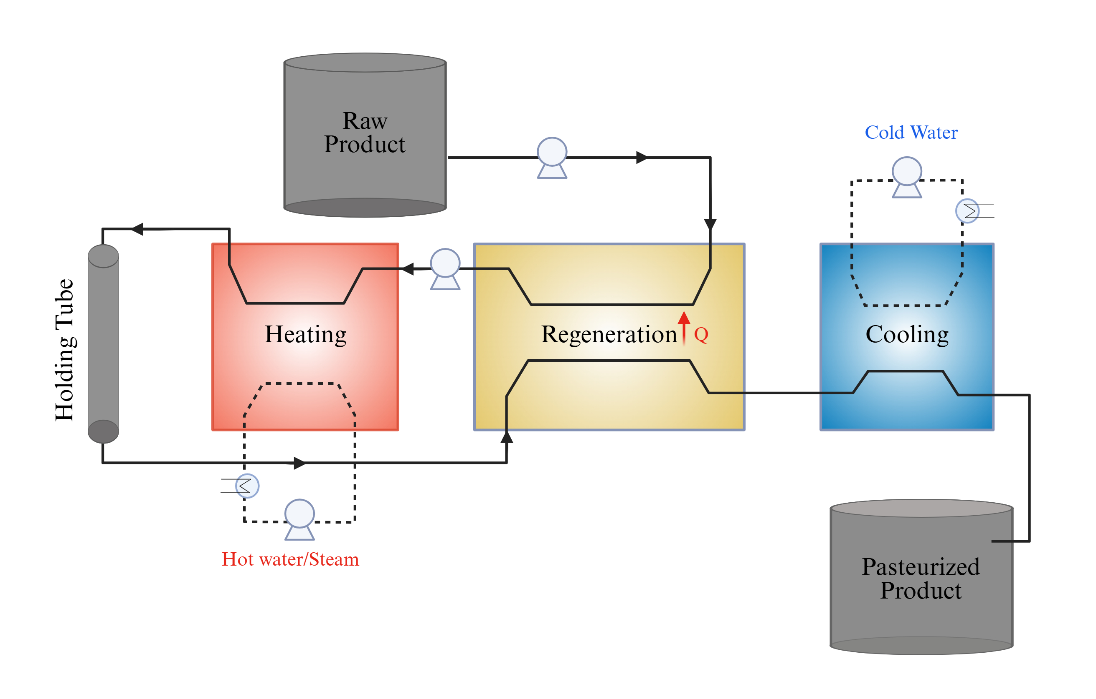
Introduction
Liquid Foods Pasteurization
HTST: High Temperature Short Time (72 ℃ – 15 s)
Use of multiple fluid streams
Passive heat transfer
Significant energy input
Ref: SPRSUN New Energy Technology Development
Notes:
Many liquids intended for humans or animal consumption must be pasteurized to kill the pathogen microorganism and enhance the safety of product.
The products such as milk and dairy products which is the most important and highly used products in all over the world and in United state
and to complete this process needs a large amount of energy and water.
The most common pasteurization method, High-Temperature Short Time or HTST, requires heating milk to 72°C for 15 seconds.
Pasteurization: a fundamental thermal process employed to eliminate pathogenic microorganisms, ensuring the microbiological safety of milk and enhancing its shelf life. (D.A Chaudhary, 2015)
Use hot water/steam as heating media (Passive heat transfer)
Significant energy loss in steam generation, storage, and transportation
Use of multiple fluid streams: milk, heating medium, cooling medium
Significant energy consumption in pumping
More space needed

Slide 3
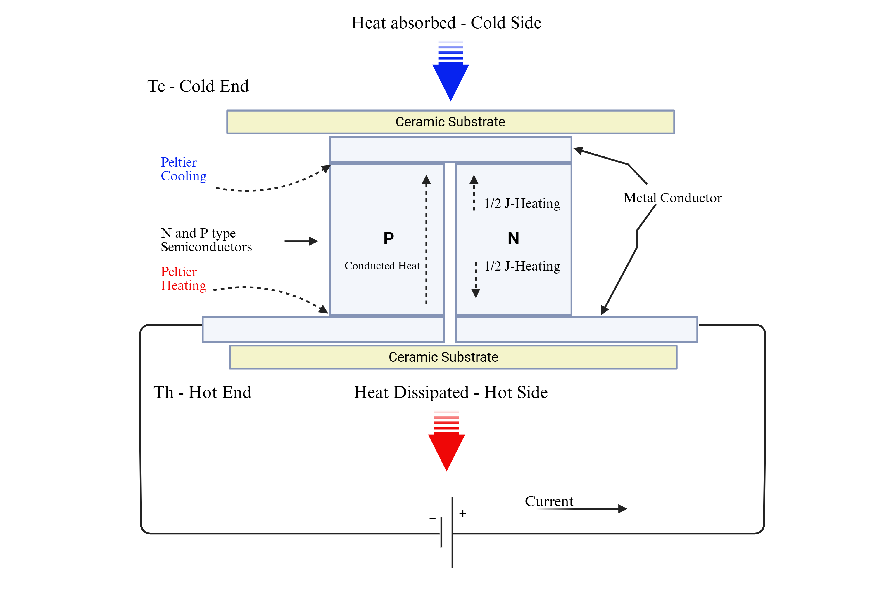
Project goal: ThermoElectric (TE) heat exchanger
Cooling process
Cooled Food
Improve energy efficiency by active heat recovery
            Electrical energy consumed is fully used for heating
        Eliminate the heating medium in HTST
Pasteurized Food
Heating process
Raw Food
Notes:
The proposed TEMP heat exchange technology is based on the TE cooling/heating application and uses both heating and cooling functions for better energy efficiency. The TE device works as a heat pump to move heat from one side of the device to the other, with the input of electric energy.
Peltier Effect
When an Electricity passes through a junction of two different conductive materials heat is absorbed on one side (cooling) and released on the other (heating). (Patil, et al. 2018)
Improve energy efficiency by active heat recovery
Electrical energy consumed is fully used for heating
Eliminate the Hot media for heating
Potentially minimize the chilled water for cooling
Additional savings on liquids pumping
not significant heat loss
Simplified design
On site farm pasteurization

Slide 4
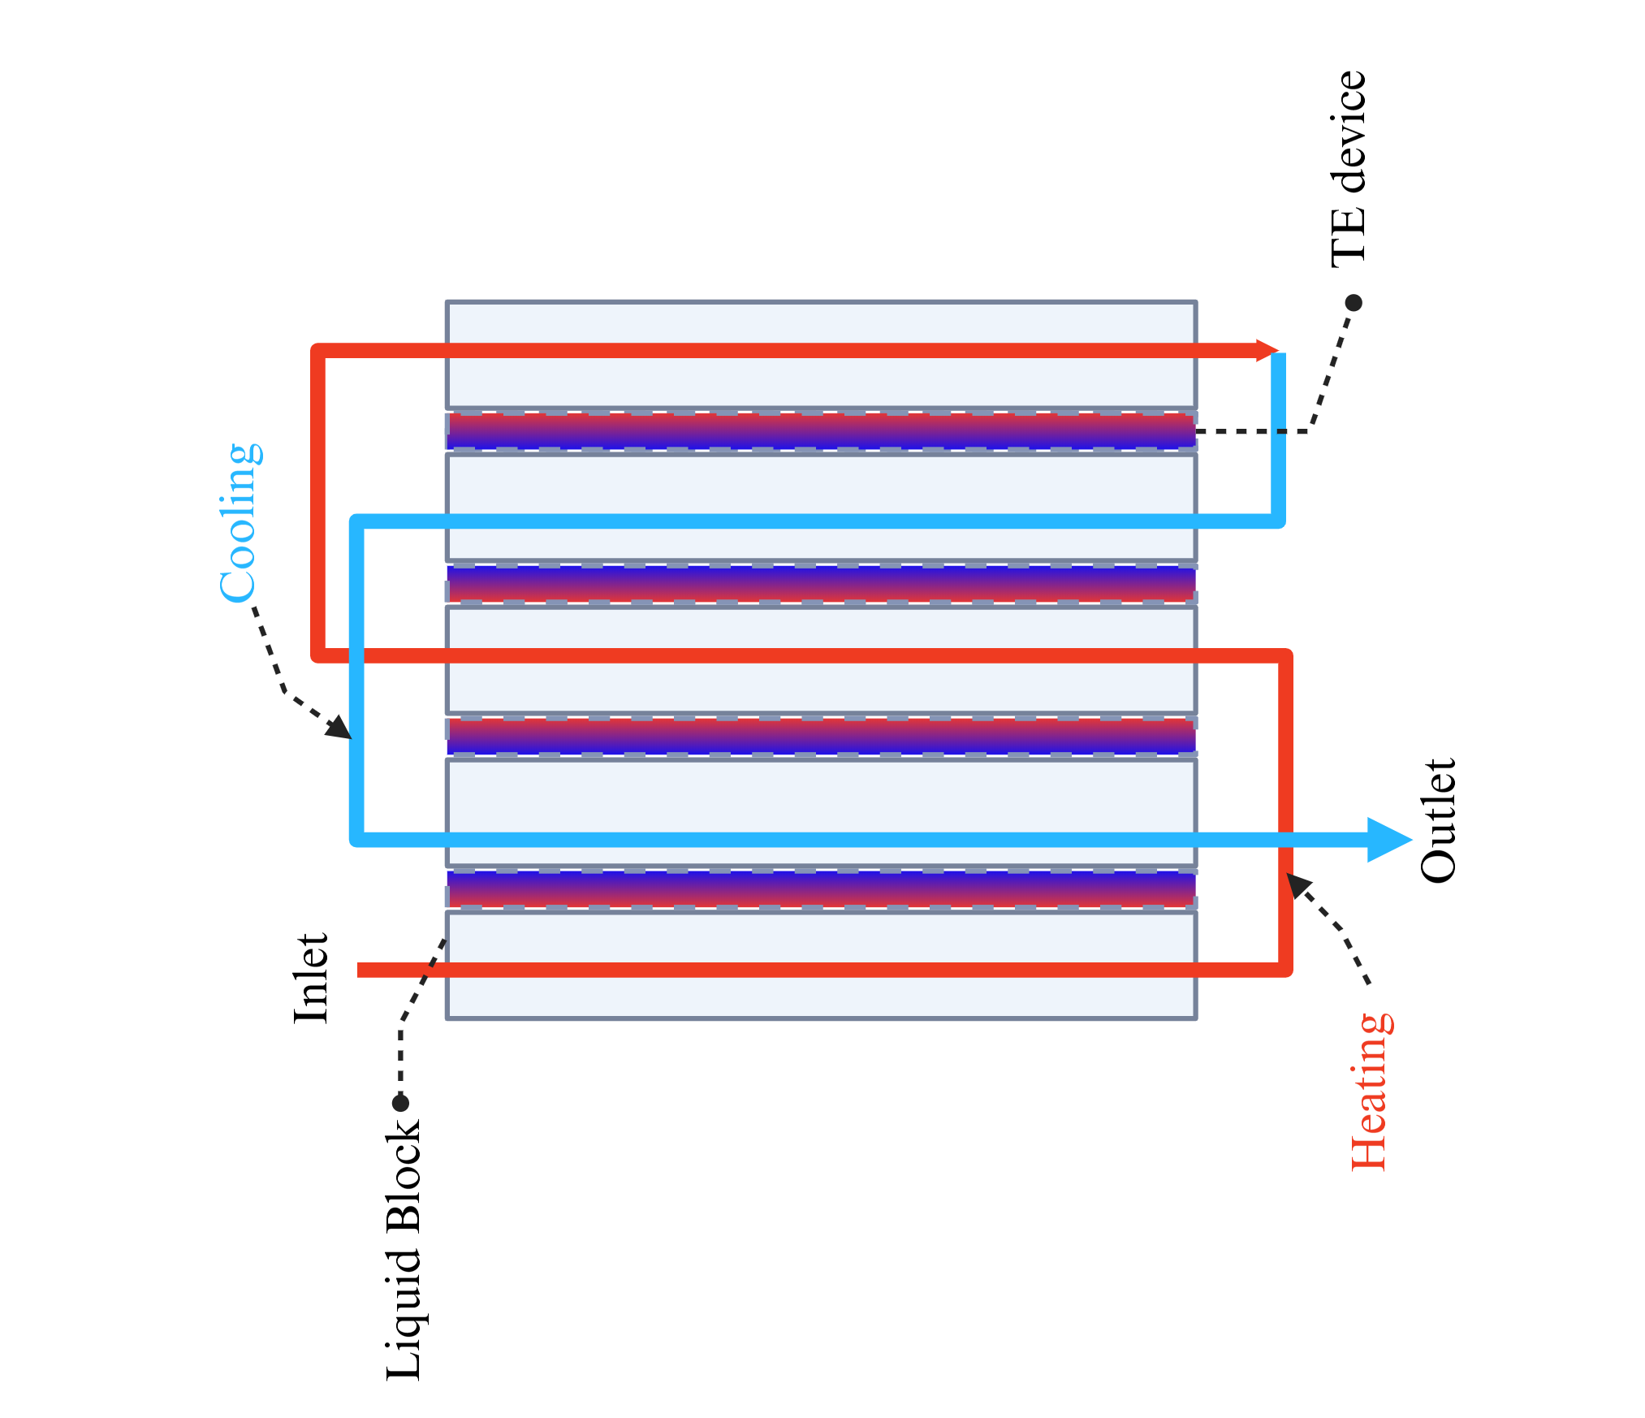
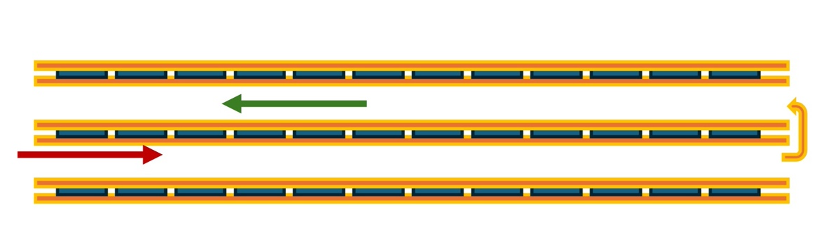
System design considerations
TE performance is temperature-dependent.
The temperatures on the two sides of TE devices need to be carefully controlled.
Thermal energy efficiency: TE device performance
Pumping energy efficiency: fluid flow performance
TE devices
Cooling channel
Heating channel
Parallel connection concept
(alternating channels)
Series connection concept
(single-pass flow)

Slide 5
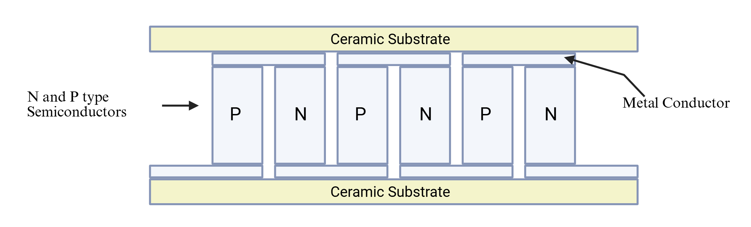
Modeling challenges and solutions
    ? The performance of TE devices depends on the temperature, which varies significantly throughout the whole TE heat exchanger. TE boundary conditions need to be assigned individually.
    Use COMSOL with MATLAB LiveLink to automate the geometry design, boundary values probing, and boundary conditions setup.
    ? Each thermoelectric device has a complicated design and material layout. Modeling its detailed geometry and associated physics is computationally demanding.
        Model TE devices as boundaries and use an analytical model to determine the heat flux of the two sides of TE devices.

Slide 6
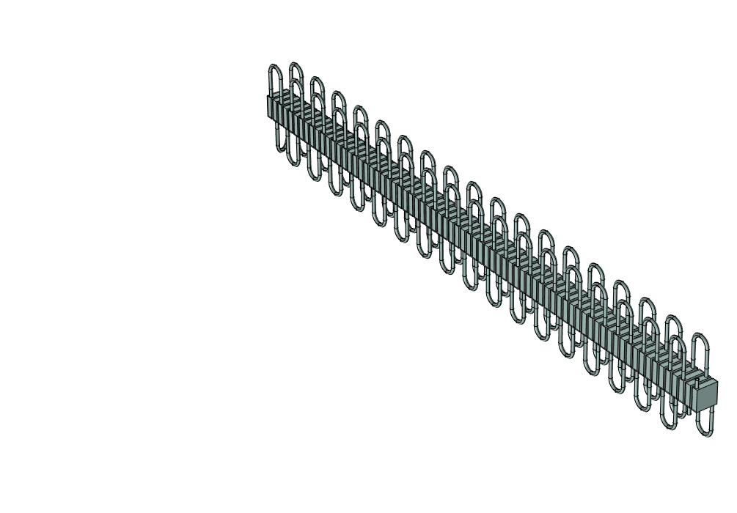
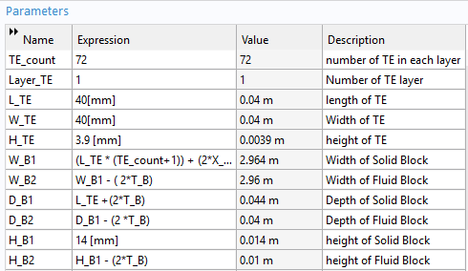
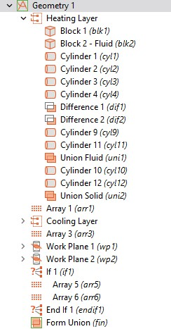
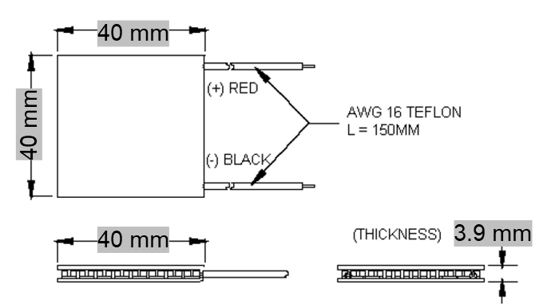
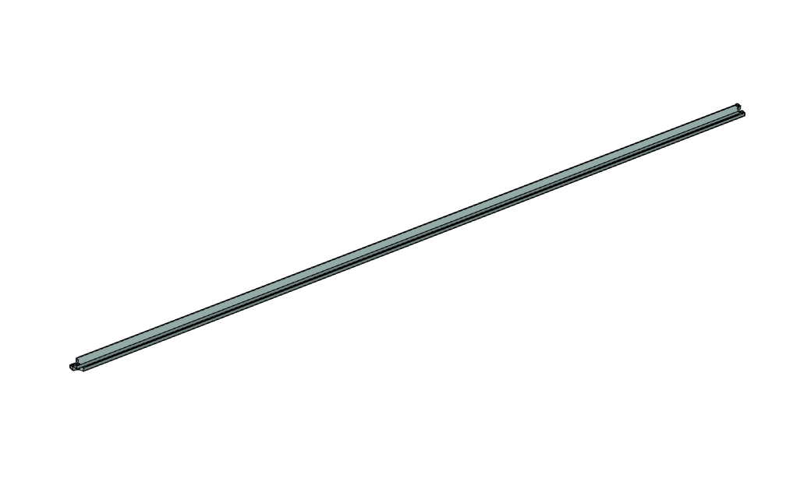
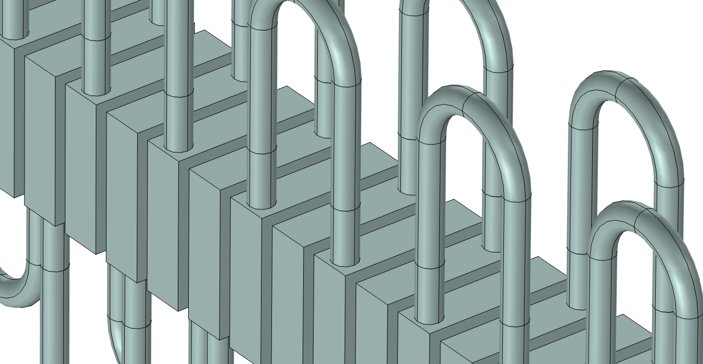
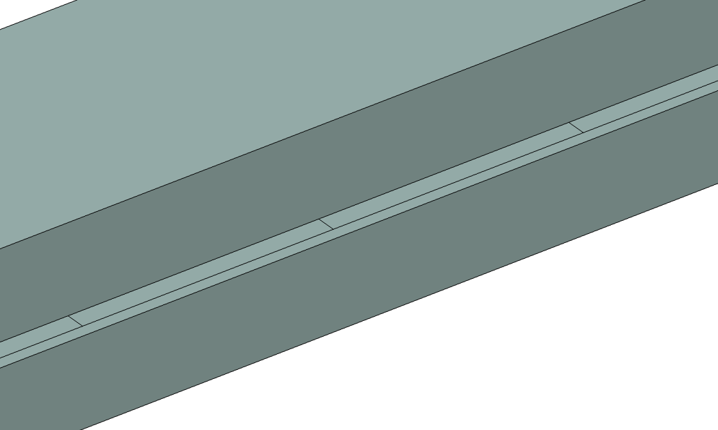
Automatic geometry designs
Parallel connection
Two domains defined:
Solid domain – Outer plates
Fluid domain – fluid flow channels
Thermoelectric device boundaries
Series connection

Slide 7
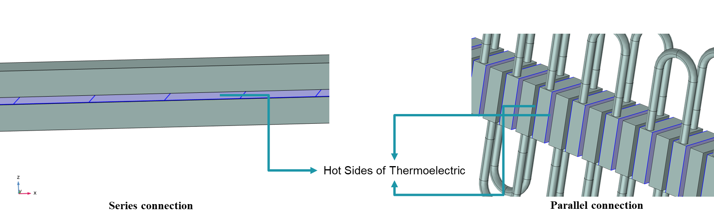
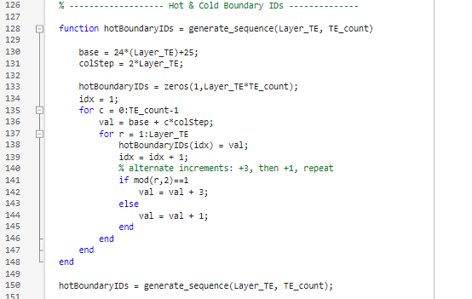
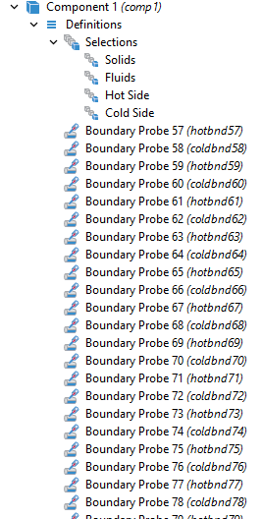
Automatic TE boundary values probing
Series connection
Parallel connection
To compute the heat flux ​at the hot and cold sides of each TE device
  require an accurate temperature value of both sides
Using MATLAB LiveLink to automatically assign boundary probes on two sides of each TE device.
Using MATLAB functions to automatically identify the Hot and Cold boundary IDs

Slide 8
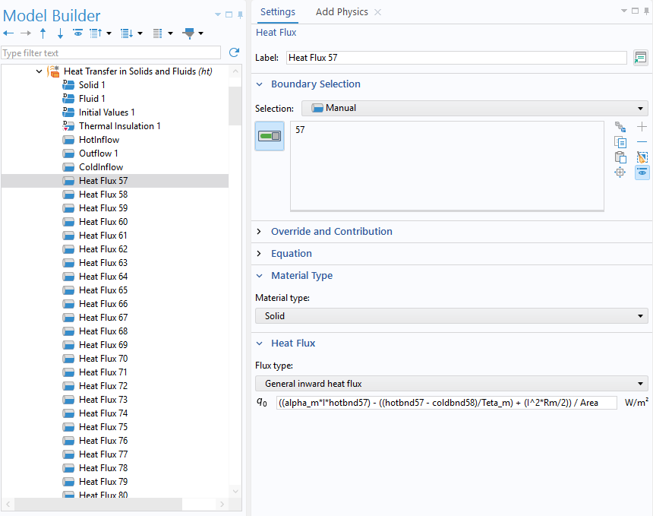
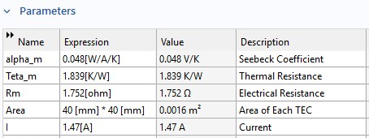
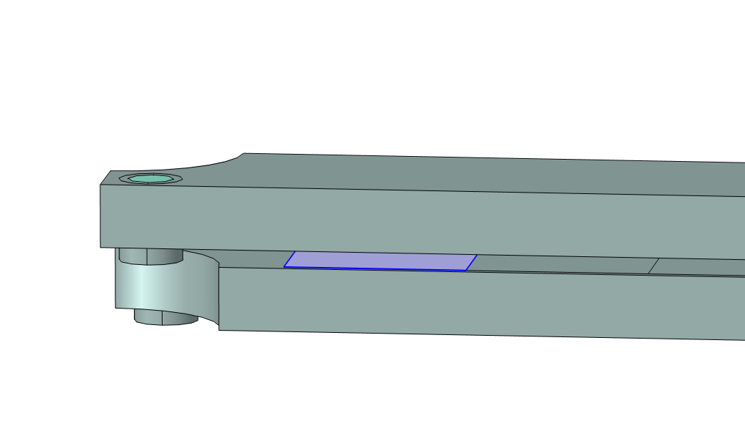
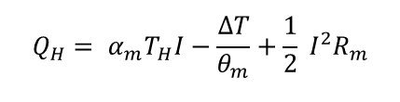
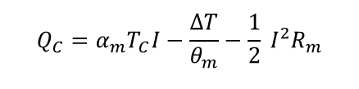
Individual boundary condition setup
Analytical Model
$$Q_{C}=α_{m}T_{C}I−\frac{∆T}{θ_{m}}−\frac{1}{2} I^{2}R_{m}$$
$$Q_{H}= α_{m}T_{H}I−\frac{∆T}{θ_{m}}+\frac{1}{2} I^{2}R_{m}$$
Related boundary probe for each side of all TE devices.
Related heat flux for each side of all TE devices.

Slide 9
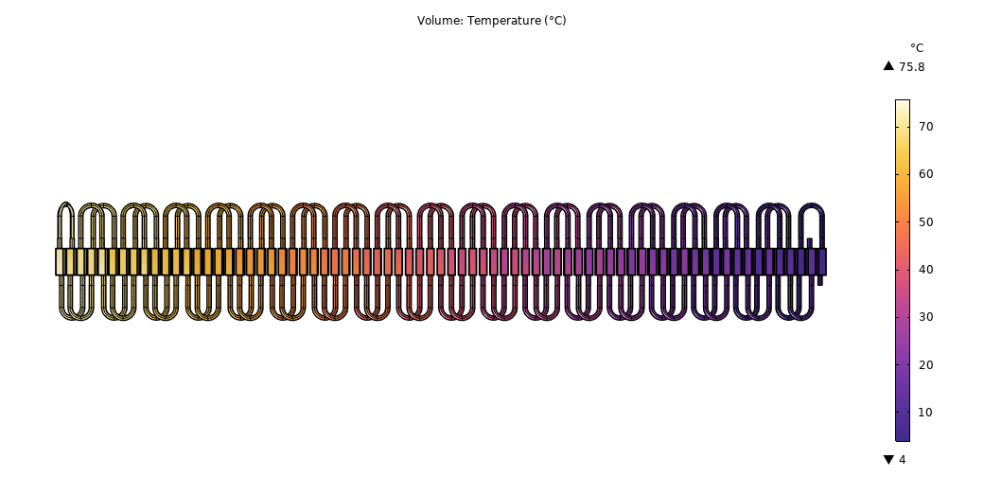
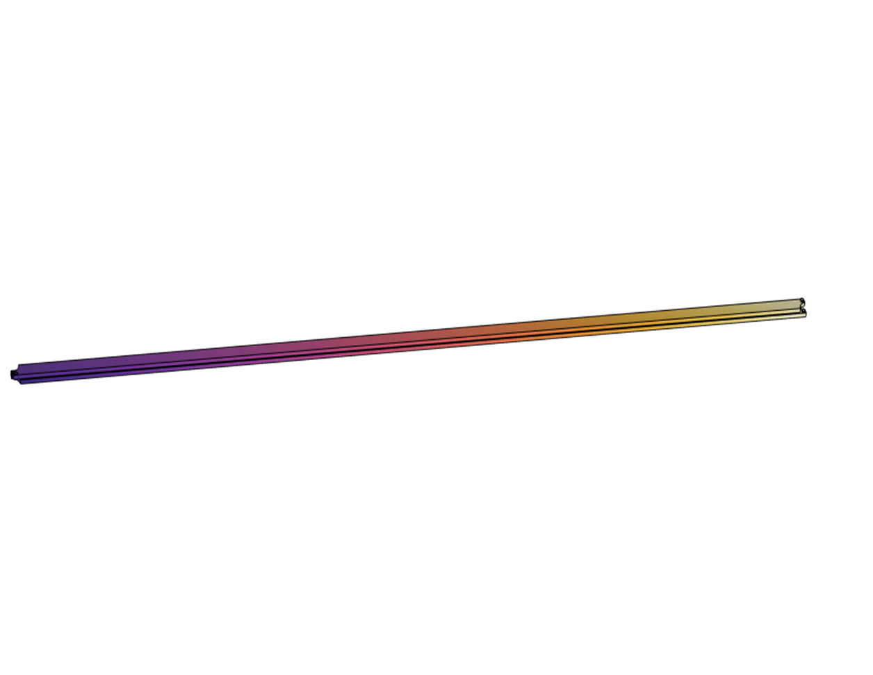
Temperature distribution
The simulation results showed that both parallel and series configurations can achieve similar and high thermal energy efficiency with a coefficient of performance (COP) of 15.9 and 15.0, respectively. This is higher than the reported lab-scale HTST system with a COP of 6.7 at an equivalent flow rate.
Parallel connection
Series connection

Slide 10
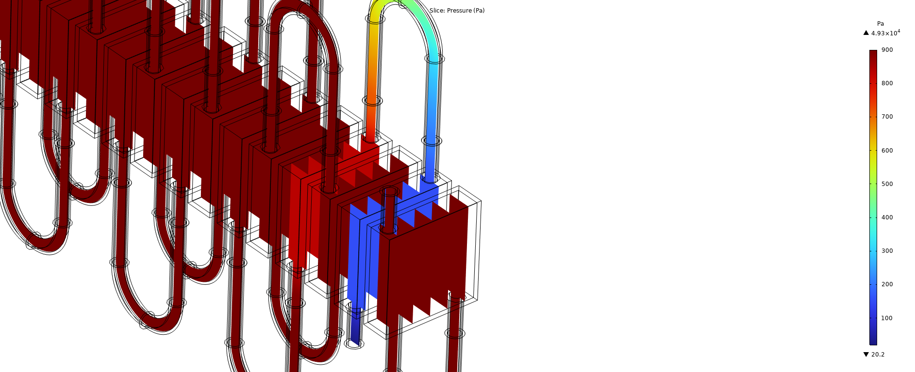
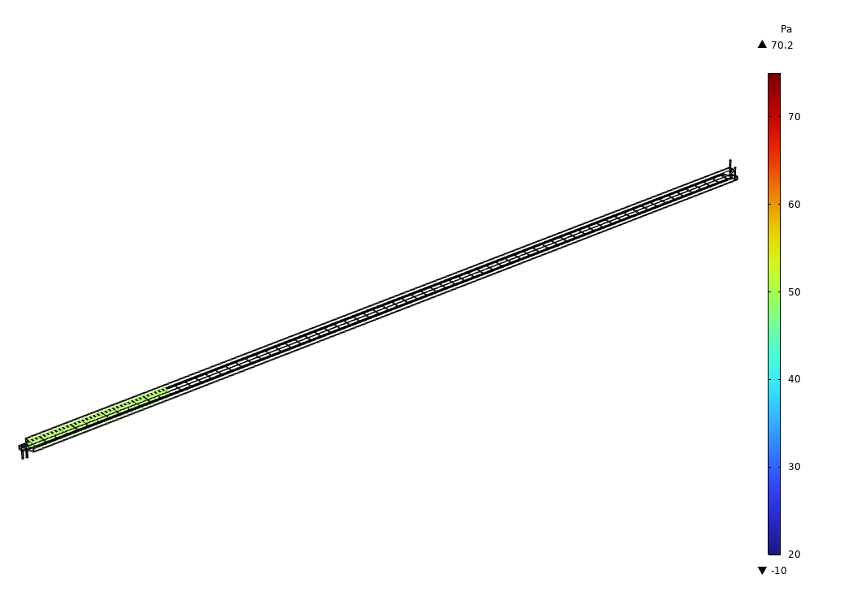
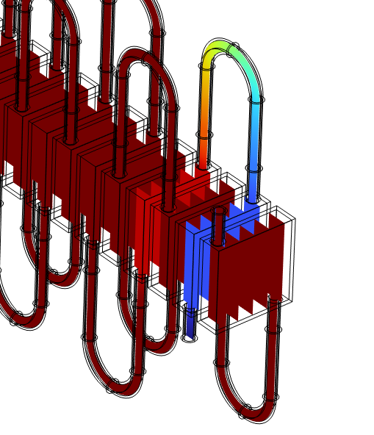
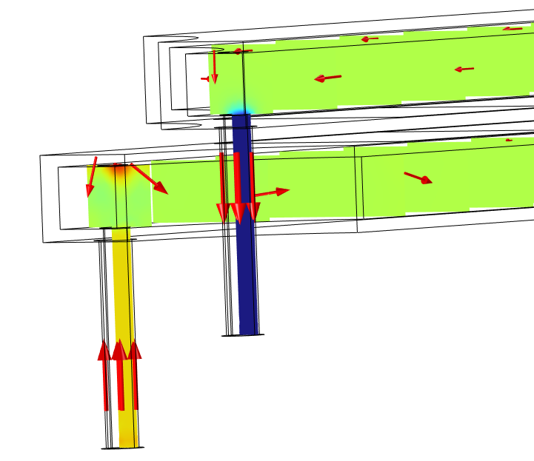
Pressure distribution
The pressure drop in the series configuration is much lower than that in the parallel configuration, indicating better pumping energy efficiency.
Parallel connection
Series connection

Slide 11
Conclusions
The TE heat exchanger is more energy efficient than HTST.
Both designs achieved high thermal energy efficiency, with the parallel connection slightly better.
Series design has much lower pressure drop than parallel, giving better pumping efficiency.
The developed model can be easily modified for different numbers of TE devices with two designs for system scale-up and evaluation.
COMSOL + MATLAB LiveLink enables straightforward geometry design, boundary values probing, and boundary condition setup.

Slide 12
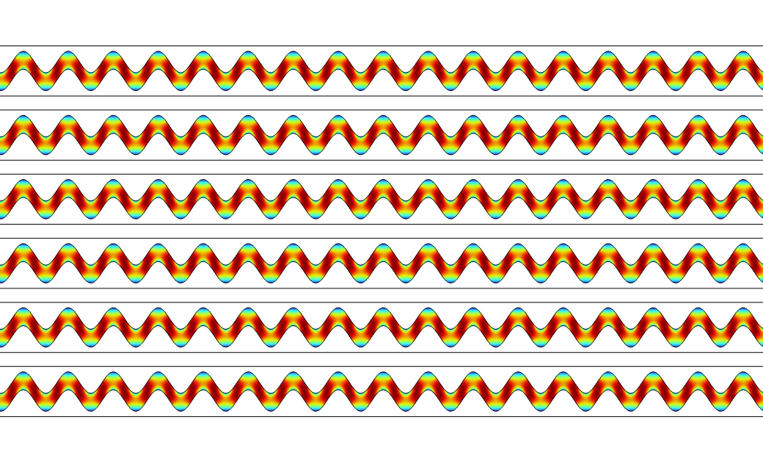

Future work
Series connection configuration
Refine channel design → add turbulence for better heat transfer
Test performance at industrial flow rates
Validate model with experimental trials

Slide 13

Acknowledgment

Slide 14


