Slide 1
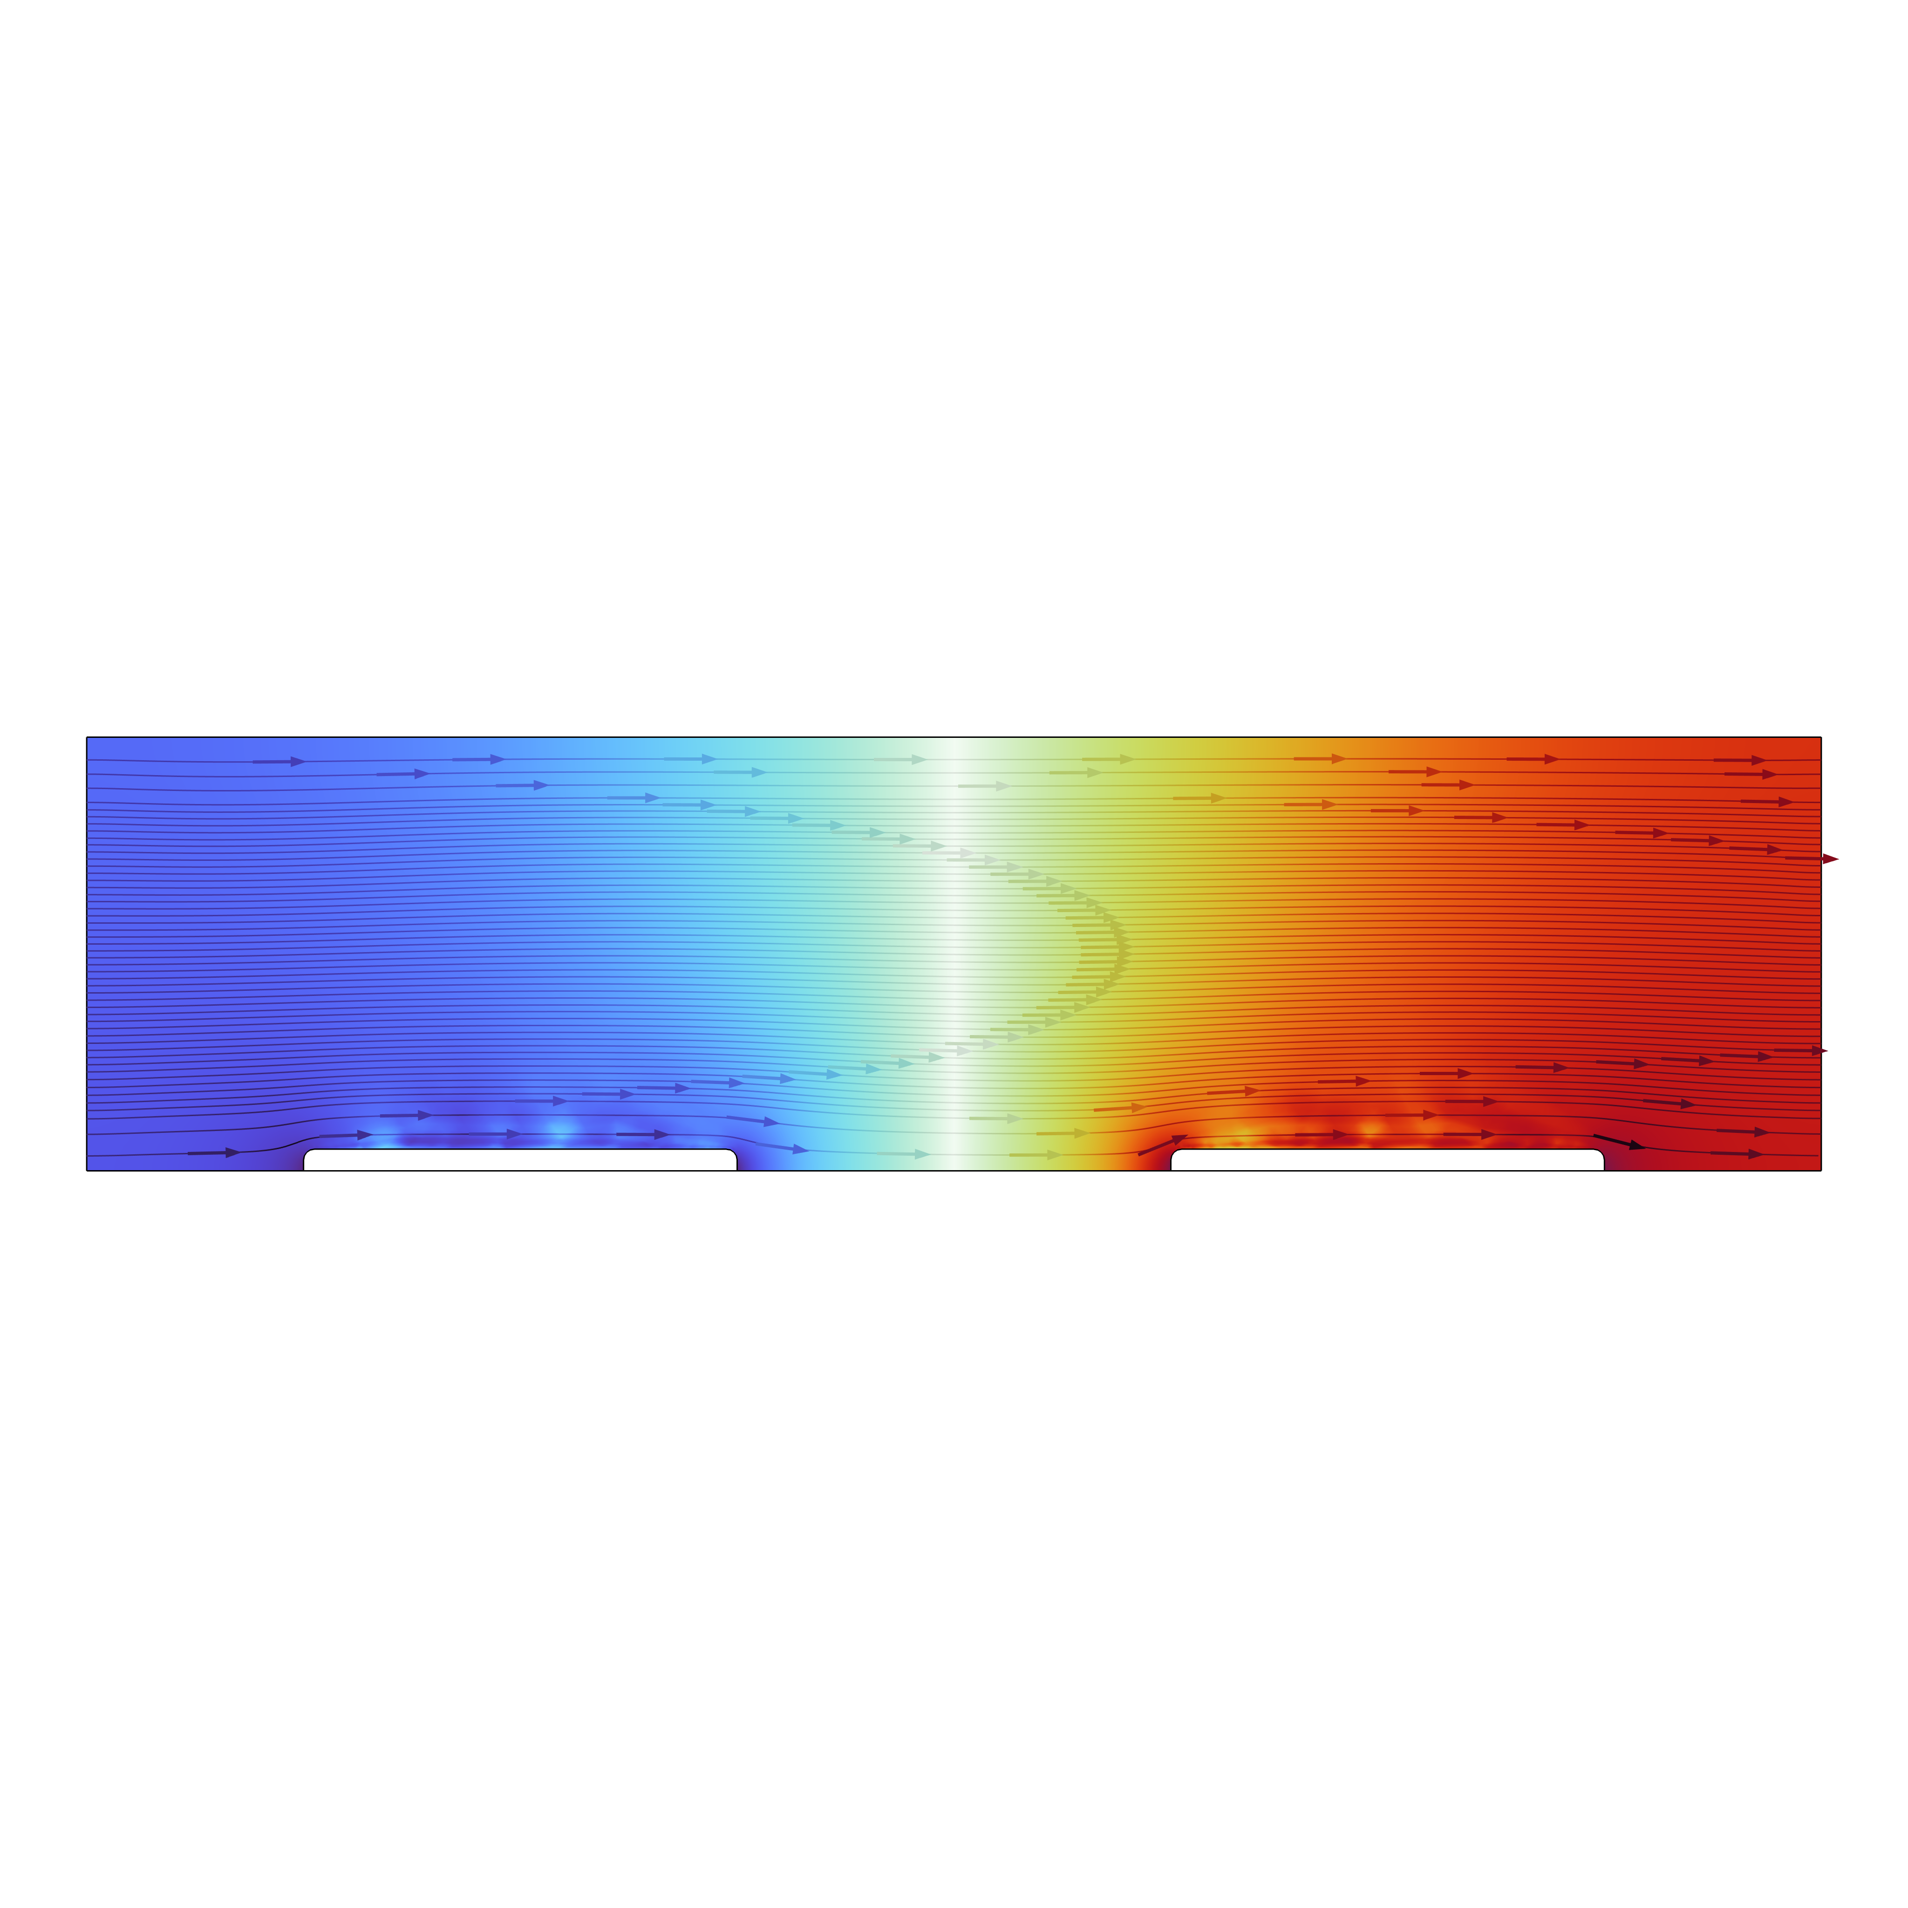
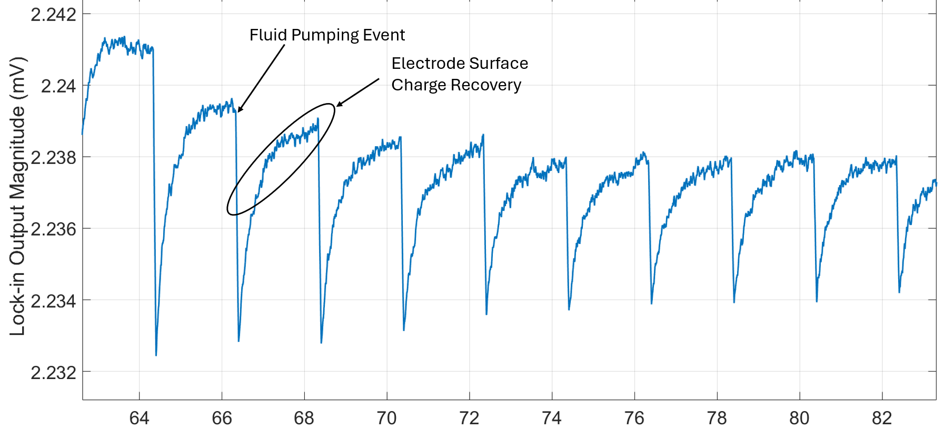
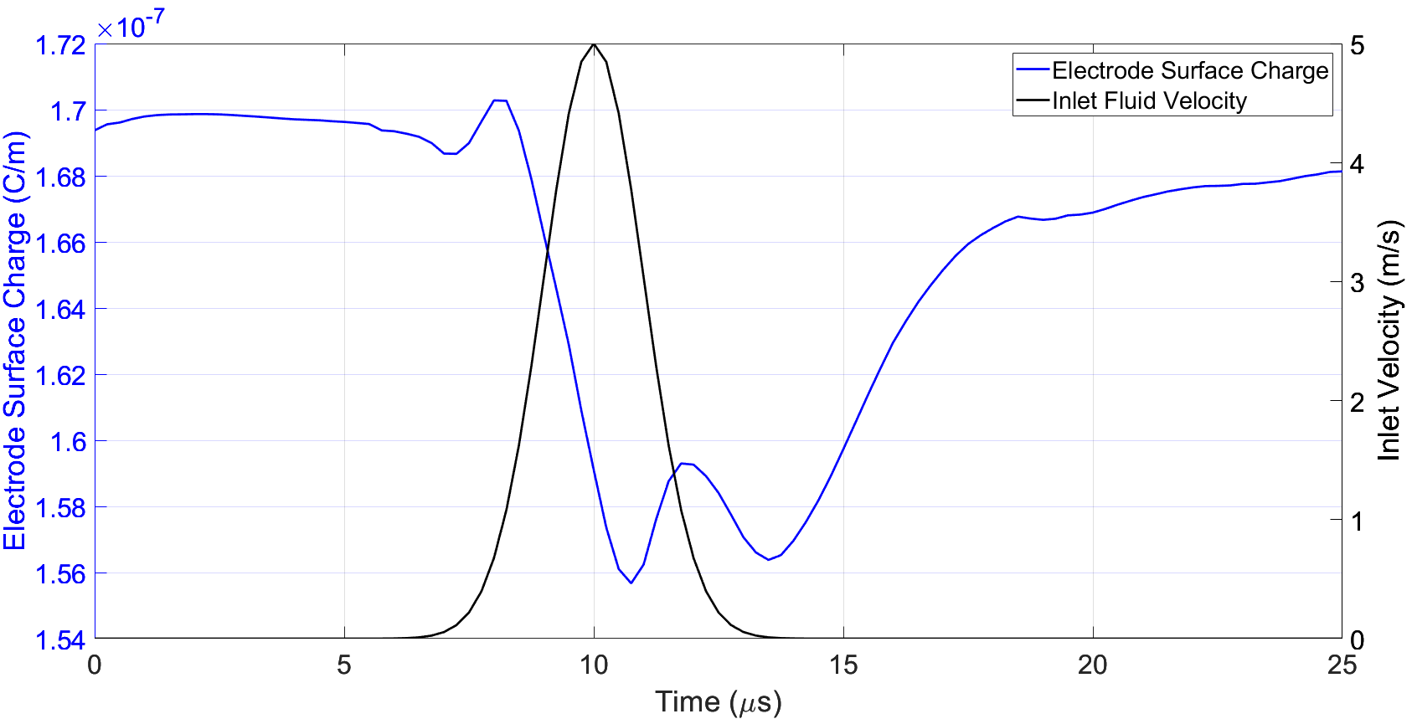

Modeling Pulsatile Flow Induced Surface Charge Disturbance in Flow Cytometry Sense Electrodes
Impedance-based flow cytometry systems typically use smooth, continuous flow when measuring cell characteristics. This model explores the impact of discontinuous or pulsatile flow on sense electrode performance.
George Corrigan^{1,2}, Pavel Kornilovich¹, Mattew L. Johnston²
1. Hewlett Packard Inc, Corvallis, OR USA
2. Oregon State University, Corvallis, OR USA
Abstract
When flow cytometry sense electrodes experience discontinuous or pulsatile surface flow, the capacitive double layer at the electrode surface is disturbed and its capacitance value is altered, creating significant measurement artifacts for impedance-based measurement systems. This paper shows how COMSOL multi-physics 2D modeling is used to demonstrate the effects of pulsatile flow on sense electrode performance by coupling the Electrostatics, Transport of Dilute Species, and Laminar Flow modules with the Time-domain solver. We show that a fluid velocity pulse applied at the inlet of a microfluidic channel disturbs the charge distribution in the double layer region, thereby altering the electrode surface charge density and effective double layer capacitance value. Parametric simulations reveal design techniques to minimize the impact of discontinuous flow on flow cytometry impedance measurements.
Methodology
A 2D micro-channel with two coplanar electrodes was filled with 1:1 electrolyte and subjected to an inlet velocity pulse using the Laminar Flow interface. All interior surfaces had no-slip boundary conditions The Transport of Dilute Species interface was used to calculate concentration and model charge migration through coupling to the Electrostatics interface. Species concentration near the electrode surface, and electrode surface charge were plotted as a function of time.
Time (s)
Figure 1. Micro-Channel Flow Cytometer Impedance Sensor Response to Pulsatile Flow
Results
We found strong correlation between fluid flow near the electrode surface and the charge disturbance that leads to impedance measurement artifacts. Results show that electrolyte concentration in the diffuse double layer region near the electrode surface is directly affected by fluid flow near the electrode surface. The relationship between surface charge and electrolyte concentration is modeled through the multi-physics coupling of the Transport of Dilute Species interface and the Electrostatics interface. Figure 2 shows the electrode surface charge response to a fluid velocity pulse applied to the inlet of the micro-channel.
Time (μs)
Figure 2. Electrode Surface Charge Response to Fluid Channel Inlet Velocity Pulse
1. Sun and H. Morgan, “Single-cell microfluidic impedance cytometry: a review,” Microfluidics and Nanofluidics, vol. 8, no. 4,pp. 423–443, 2010
2. T. Sun, N. Green, and H. Morgan, “Analytical and numerical modeling methods for impedance analysis of single cells on-chip, ”Nano, vol. 03, 11 2011
3. A. J. Bard and L. R. Faulkner, Electrochemical Methods: Fundamentals and Applications, New York: Wiley, 2nd ed., 2001

