Slide 1
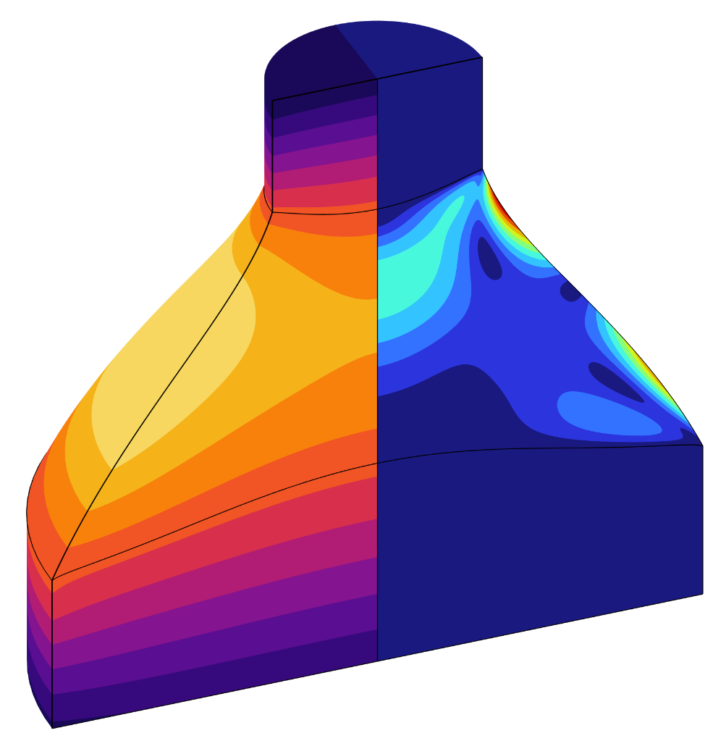
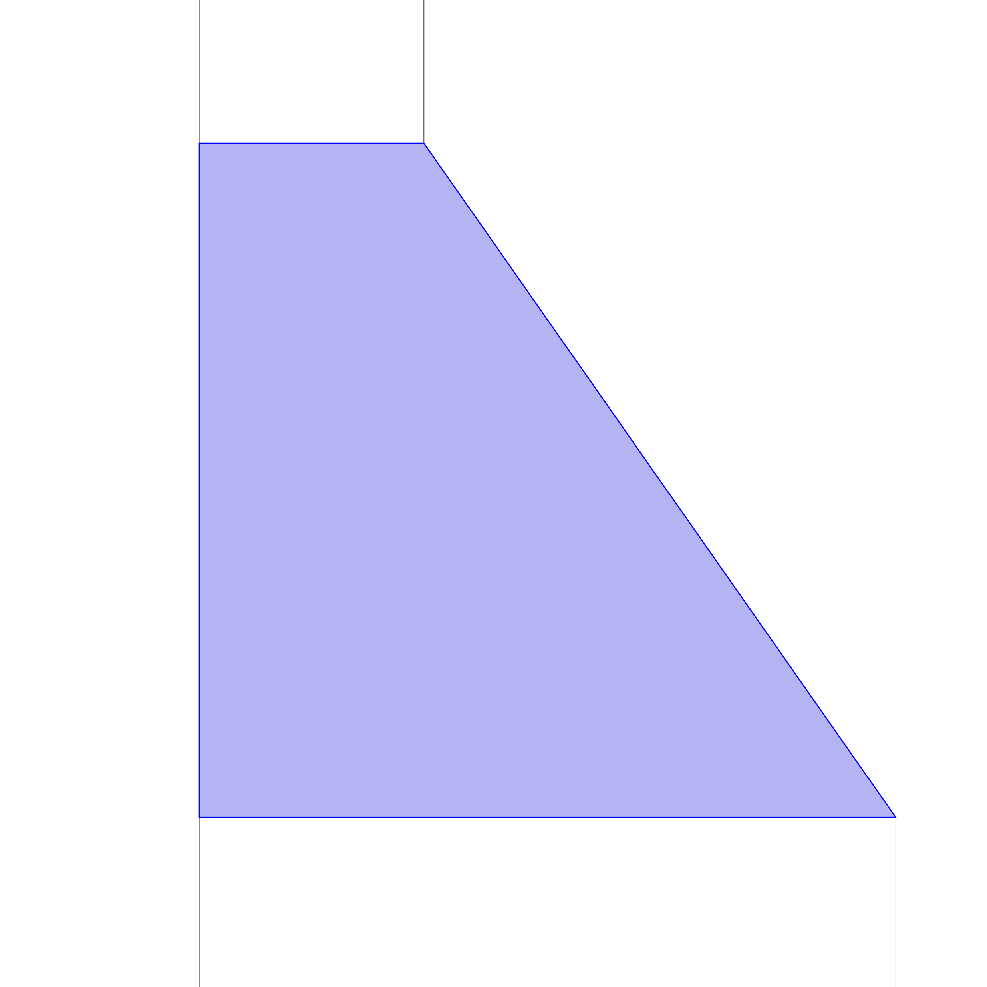
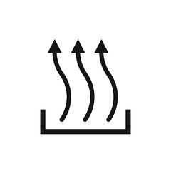
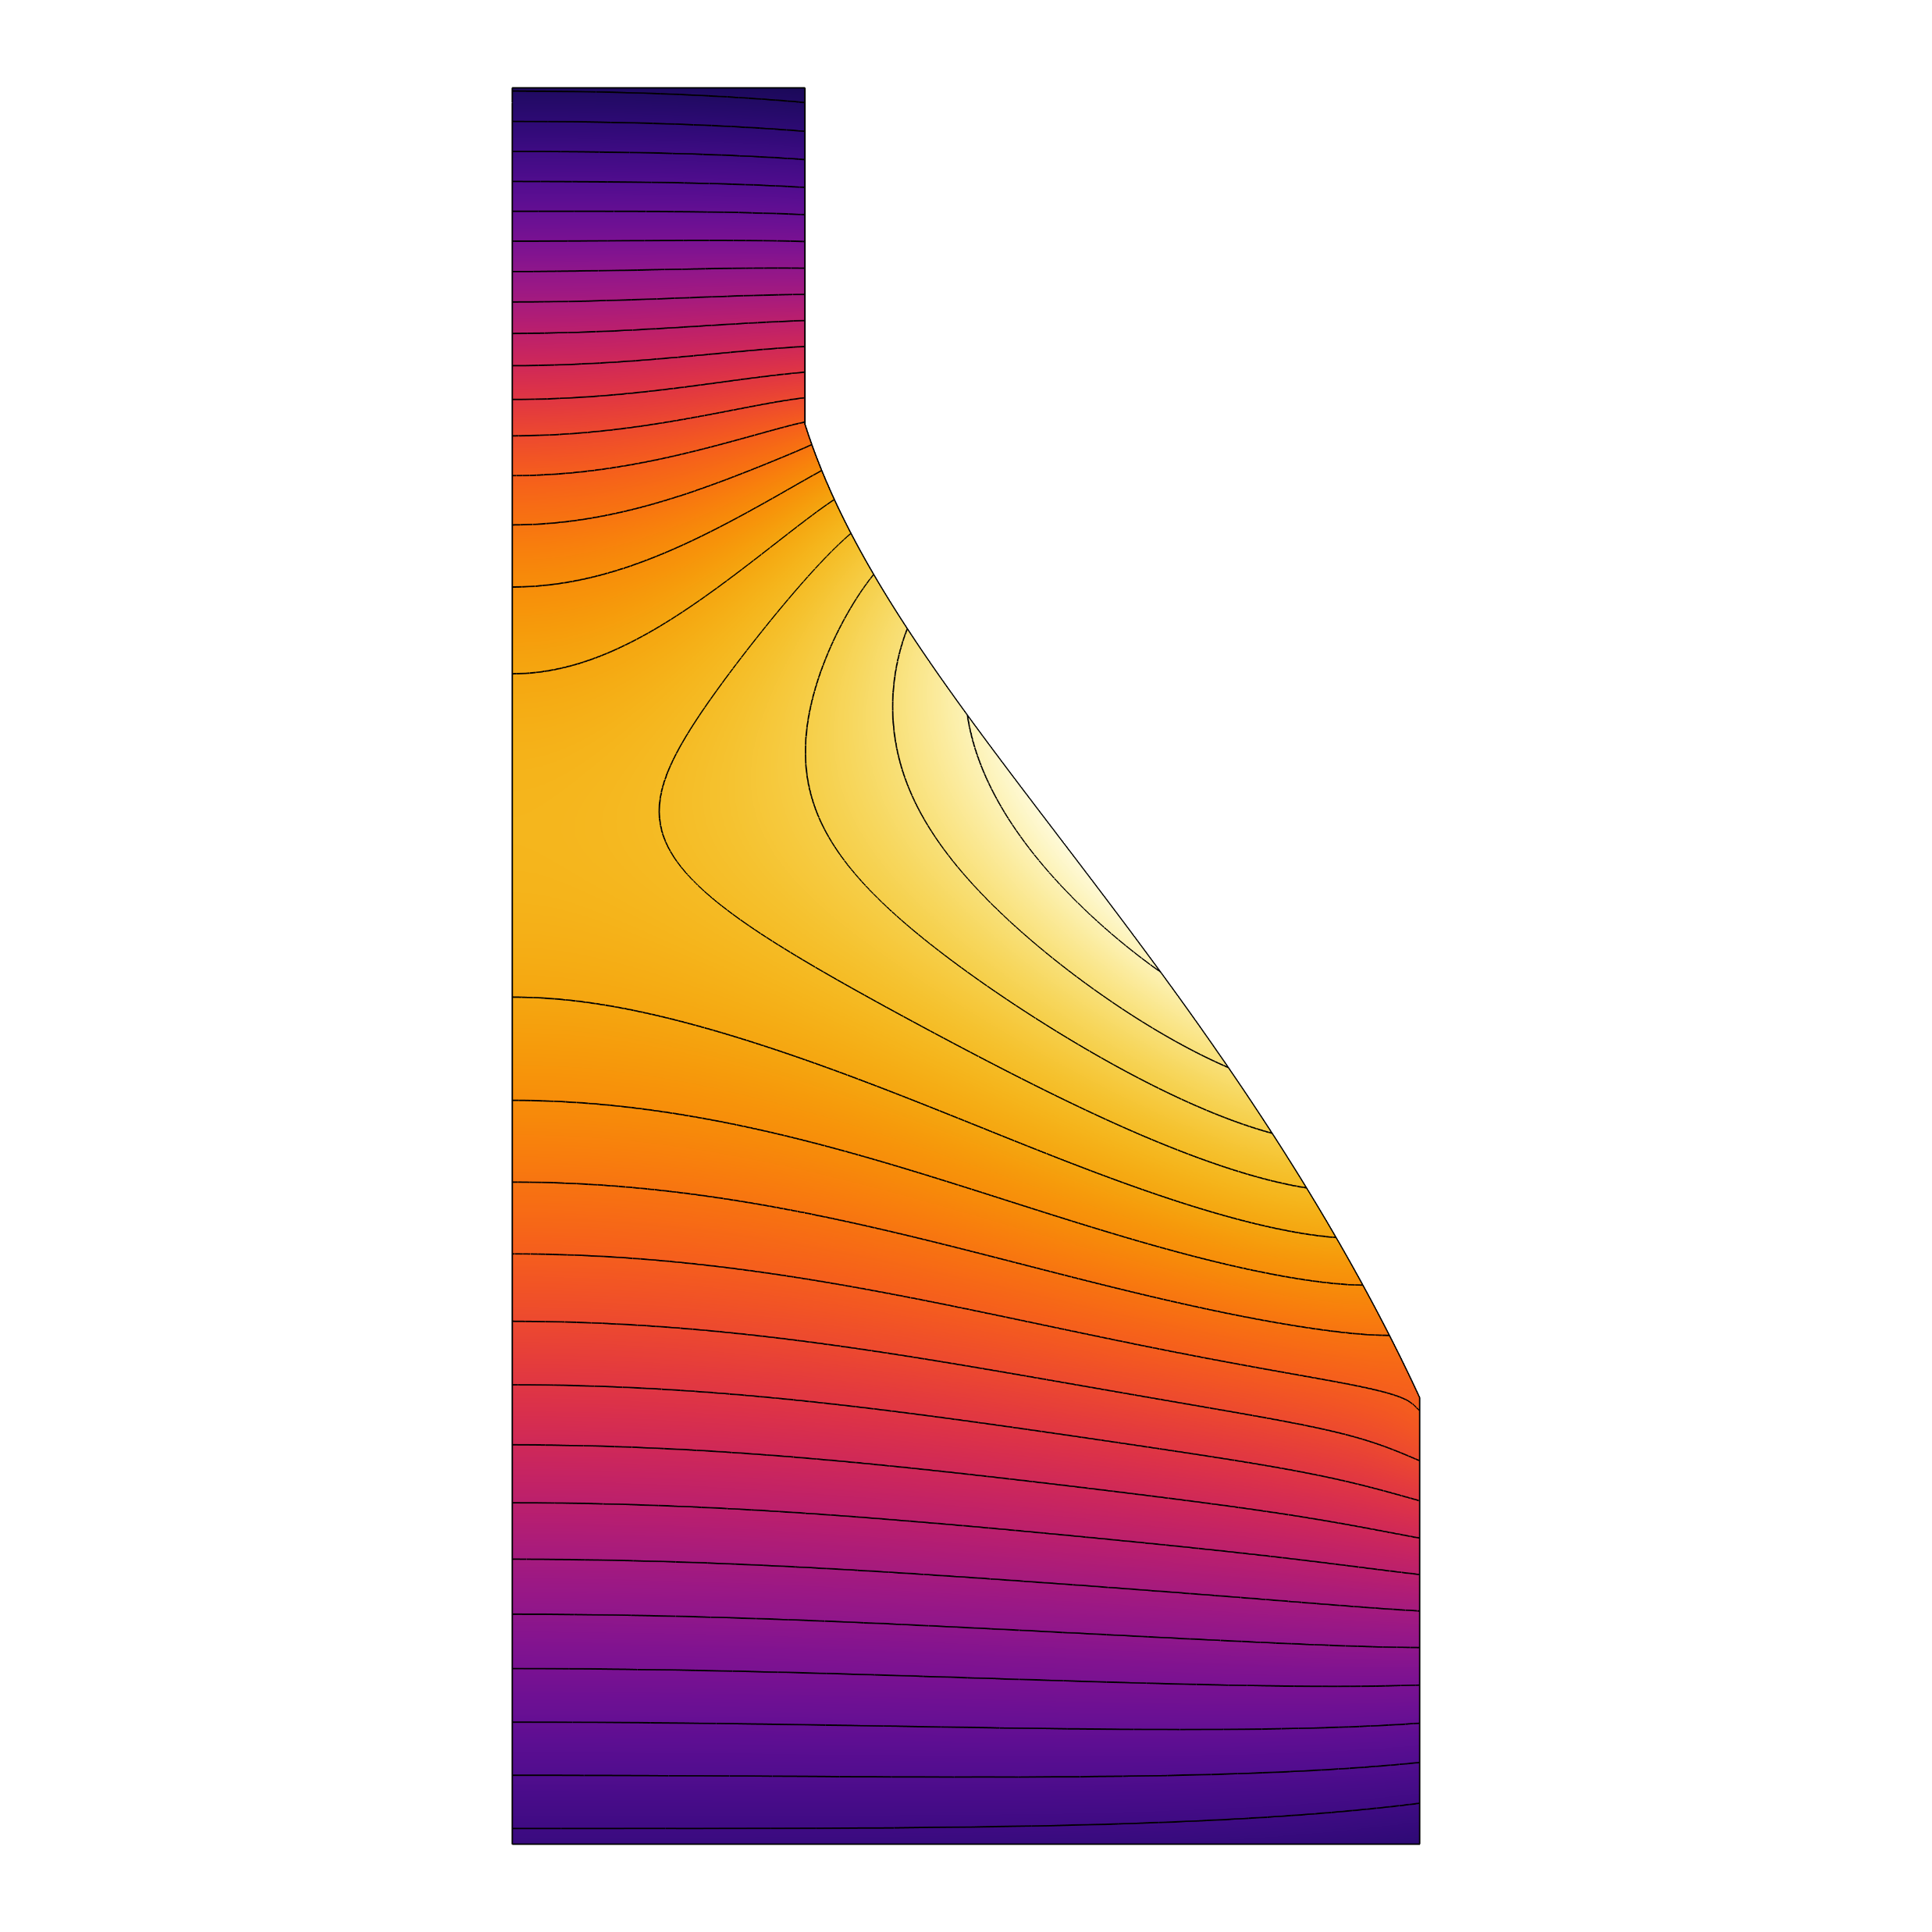
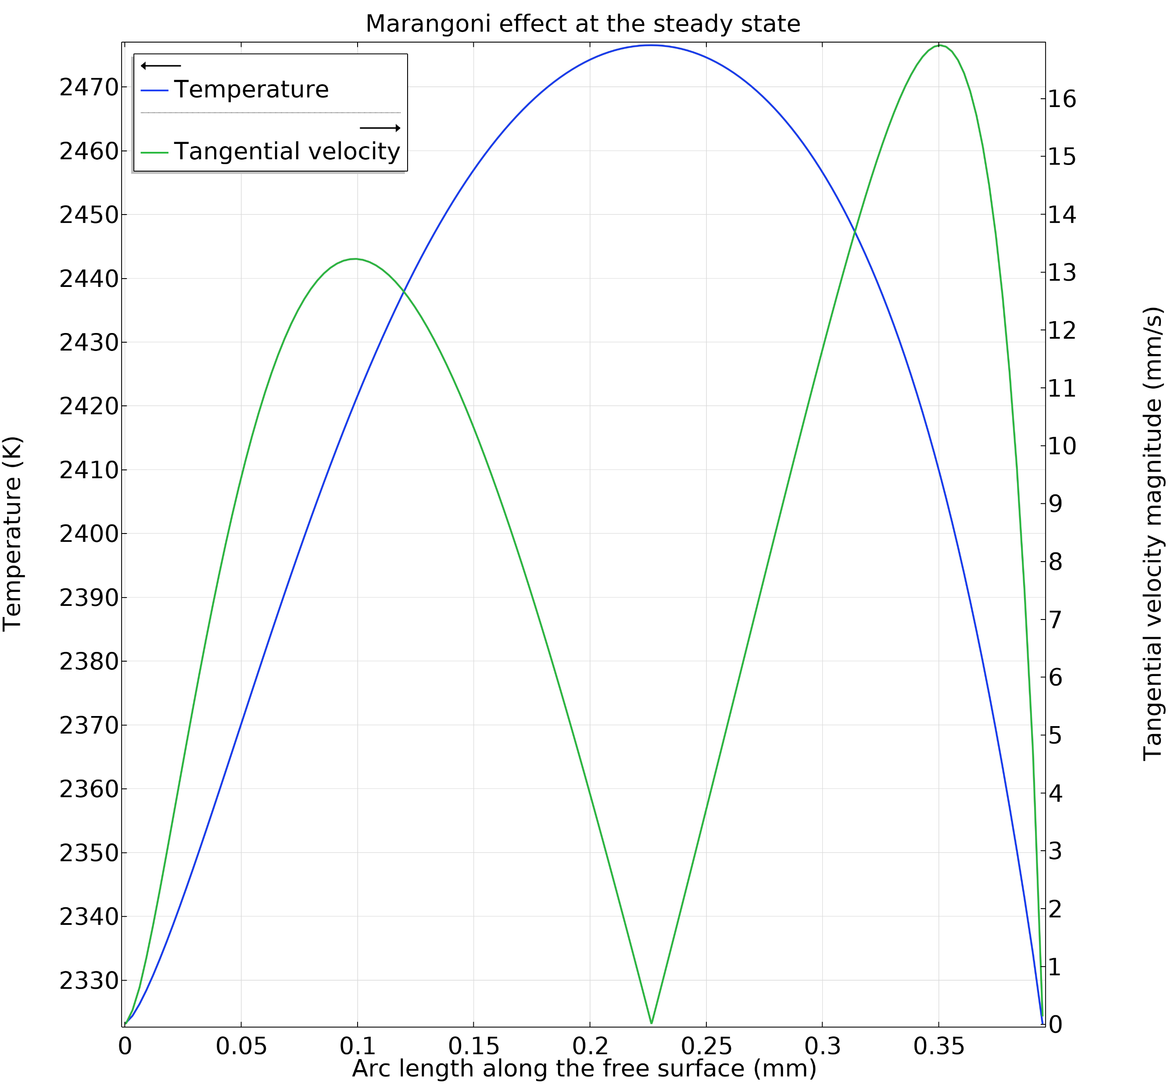
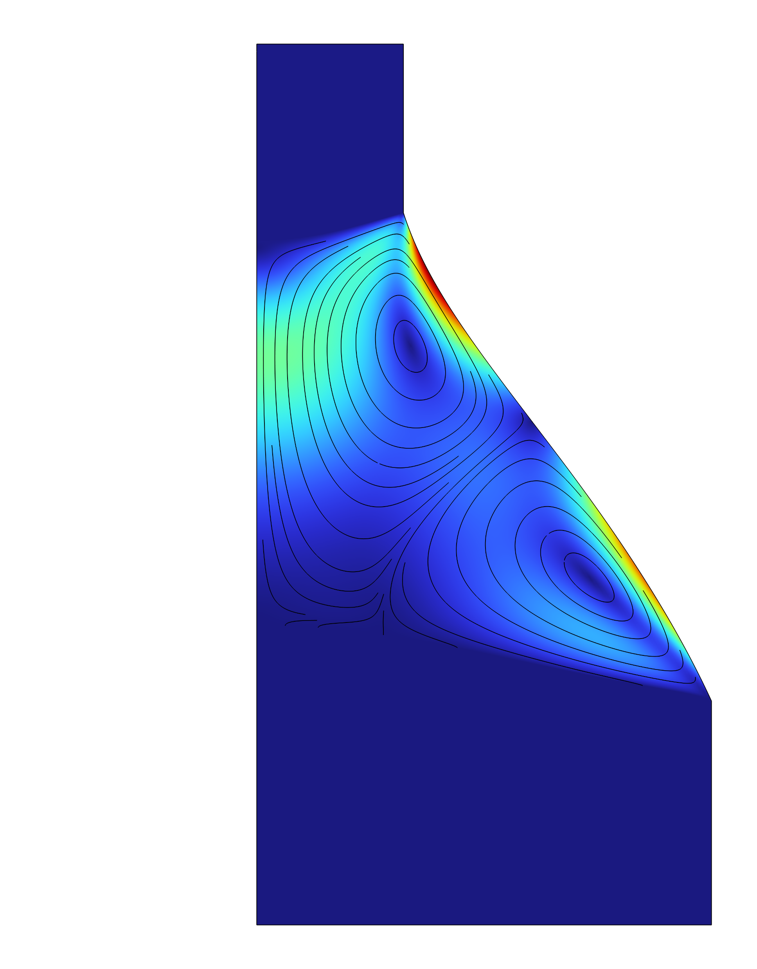

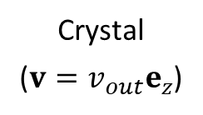
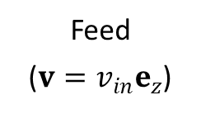
Modeling of Floating Zone in LHPG of Sapphire For Fiber Optics
Laser-Heated Pedestal Growth (LHPG) uses a focused laser beam to melt source material and grow single crystals, ideal for high melting point materials in clean environments. It enables tailored properties and produces uniform fibers and rods with excellent integrity.
A. I. Gad, G. Maxwell, and M. Ovchinnikov
R &D Division, Alcon Vision LLC, Lake Forest, CA, USA
Abstract
This work presents a Finite Element (FE) model for analyzing the steady-state sapphire molten zone formed via Laser-Heated Pedestal Growth (LHPG). The model couples incompressible fluid flow with heat transfer to simulate the molten zone, while heat transfer alone is applied to the seed and solidified regions.
The model accounts for phase change, mass transfer, buoyancy, and Marangoni effects. Solid sections are modeled as rigid bodies moving uniformly, and molten zone boundaries are tracked using an arbitrary Eulerian-Lagrangian method. Heat input is modeled with a far-field Gaussian temperature profile tailored to match the operating conditions. Simulations show strong agreement with experimental data in molten zone shape and size.
Crystal
($v=v_{out}e_{z}$)
Solid
Methodology
Solidification Line
Heat input
The model begins with an initially assumed geometry featuring straight boundaries. The free surface is then determined by minimizing total energy using the Young-Laplace equation subject to either a mass or growth angle constrains. Next, the full Navier-Stokes equations are solved under applied feed and crystal velocities. Finally, the heat equation—incorporating phase-change interfaces—is coupled to compute the melting and solidification profiles.
An Arbitrary Lagrangian-Eulerian (ALE) approach is employed to resolve the unknown boundaries. This includes a “Moving Mesh” for tracking the free surface and “Deformed Geometry” for the melting and solidification fronts. The system evolves dynamically until a steady-state solution is reached.
Symmetry Line
Liquid
Free Line
Feed
($v=v_{in}e_{z}$)
Melting Line
Solid
FIGURE 1. Shape of the molten zone (Experimental and as initially assumed in COMSOL’s 2D axi-symmetric model).
Results
Results indicate that the Marangoni effect is the dominant driver of fluid motion, with tangential velocity at the free surface reaching nearly 1500 times the crystal pulling speed.
The highest temperature occurs at the free surface of the liquid phase, while in the solidified region, it drops sharply from 2300 K to 600 K within approximately 5 mm of the solidification front.
The model is currently being extended to compute thermal stresses in the solidified section and to predict final dimensions under arbitrary dynamic loading conditions.
FIGURE 2. Final shape of the molten zone with temperature and velocity distributions displayed. Marangoni effect is shown to the right.
Dossa, Scott S., and Jeffrey J. Derby. "Modeling optical floating zone crystal growth in a high-pressure, single-lamp furnace." Journal of Crystal Growth 591 (2022): 126723.
Lan, Chung-Wen, and Sindo Kou. "Heat transfer, fluid flow and interface shapes in floating-zone crystal growth." Journal of crystal growth 108.1-2 (1991): 351-366.
Fejer, Martin Michael. "Single crystal fibers: Growth dynamics and nonlinear optical interactions." Stanford University, 1986.

