Slide 1
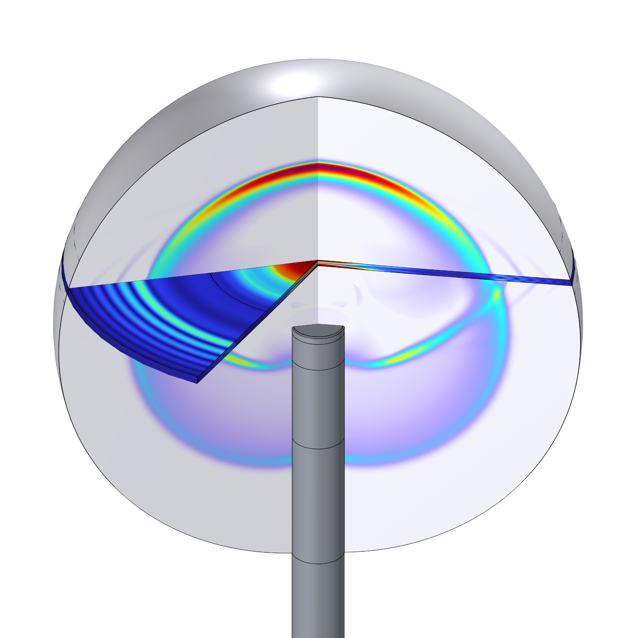
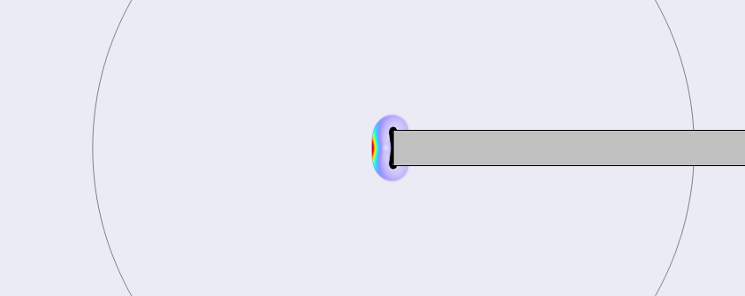
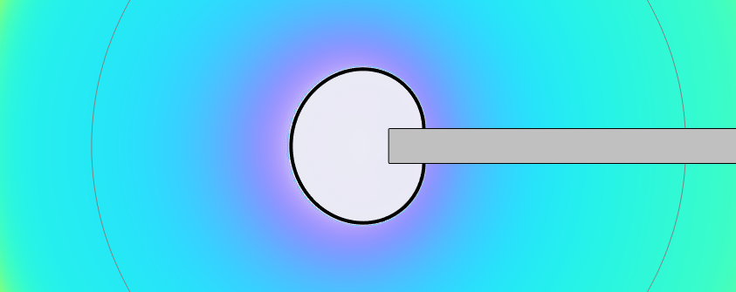
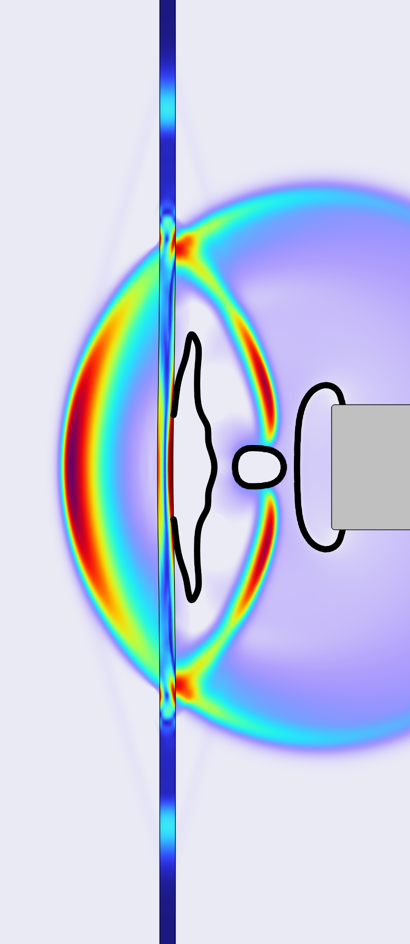
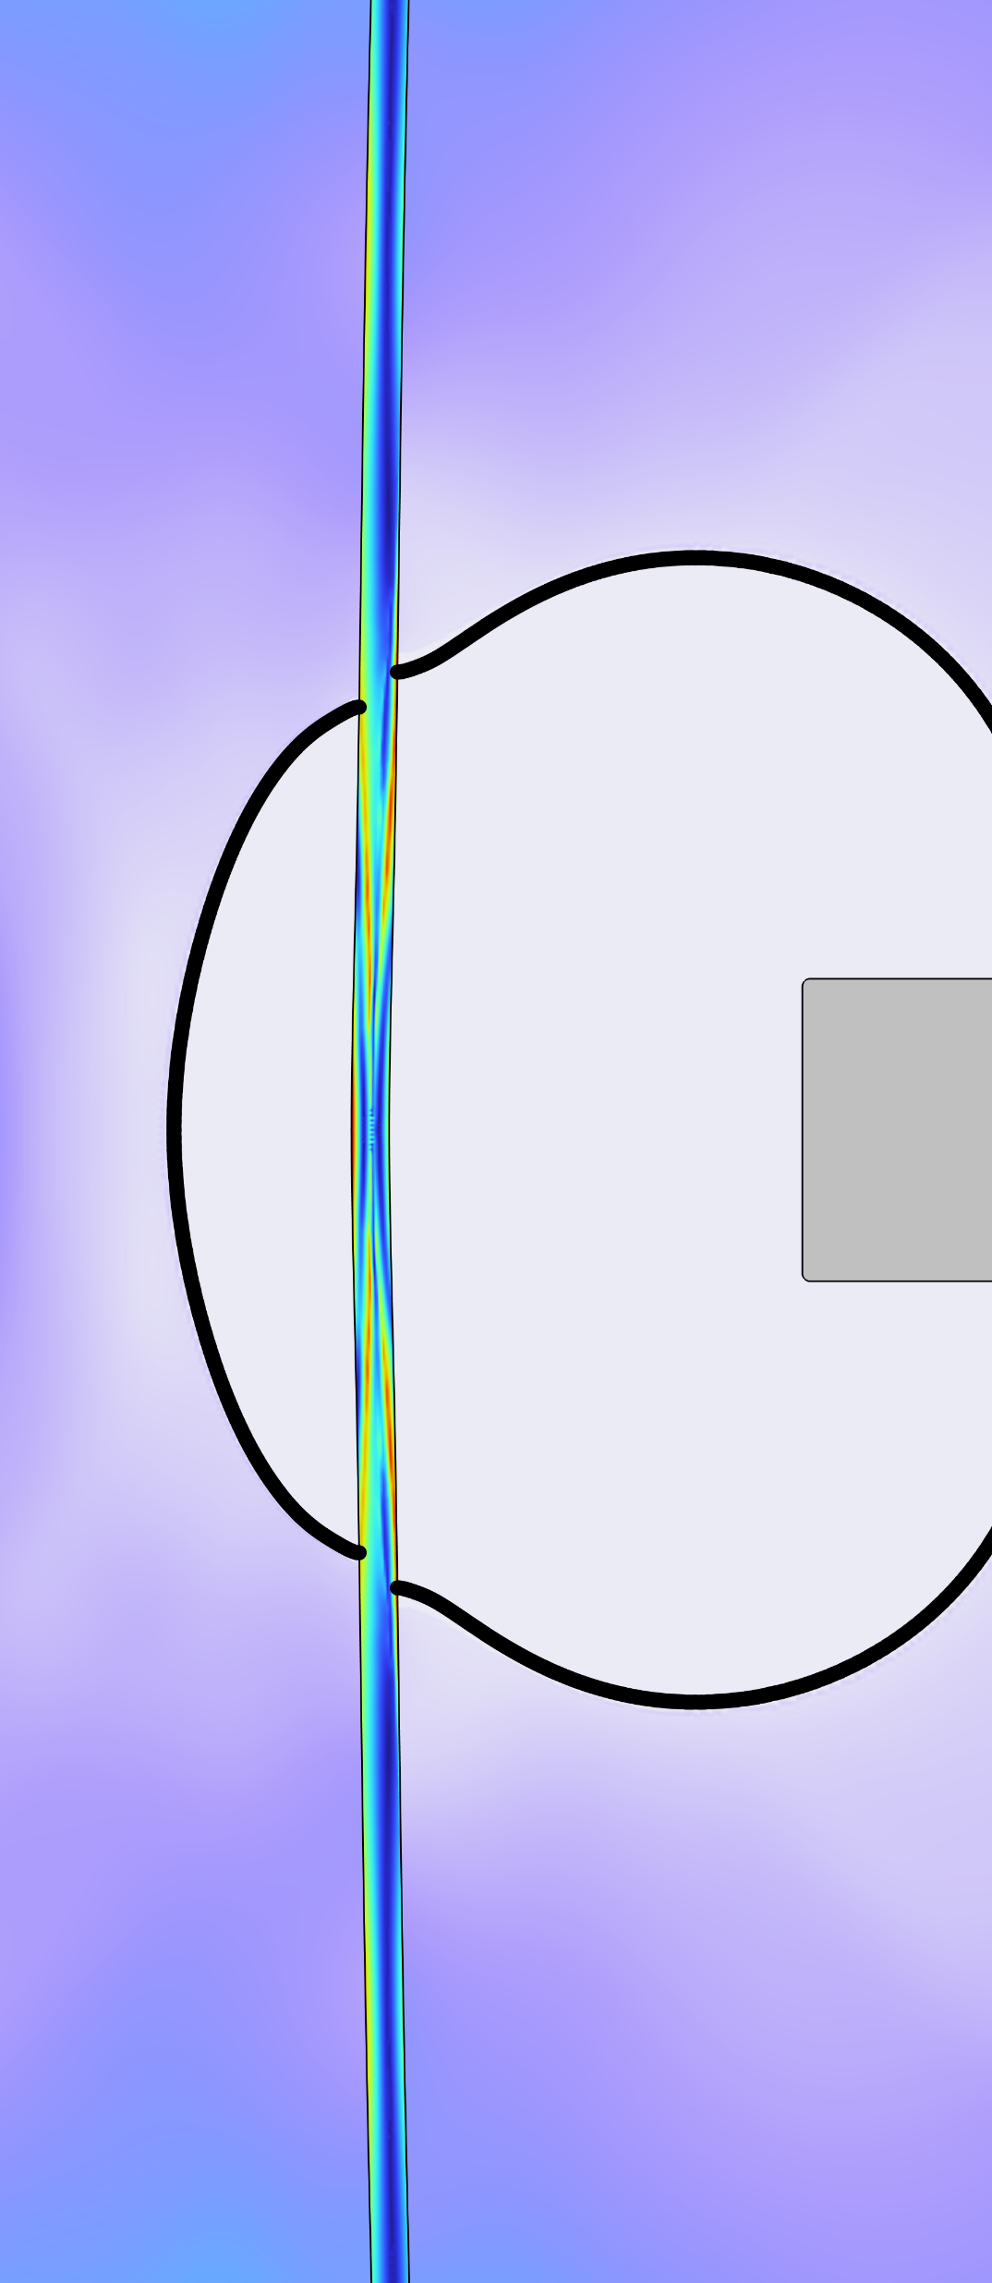
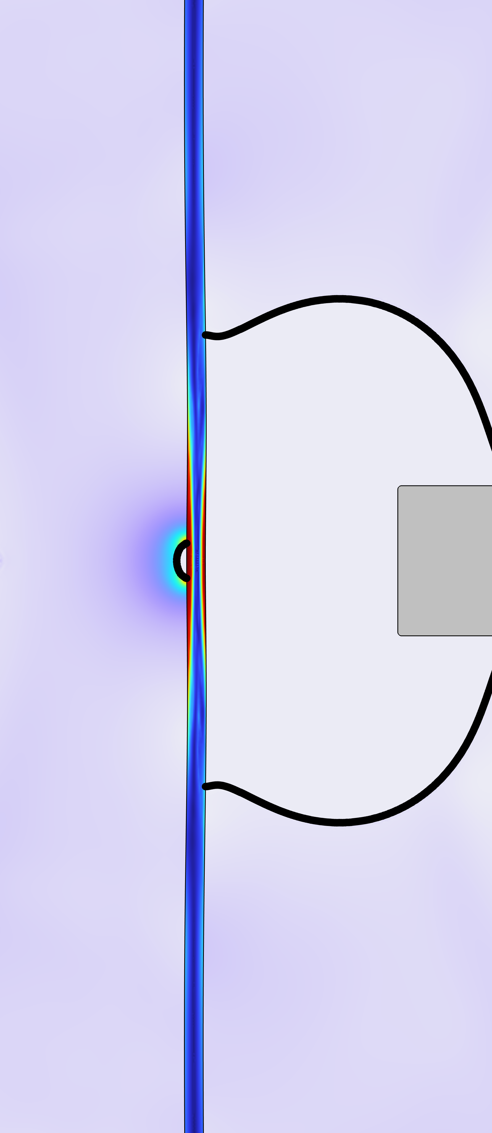
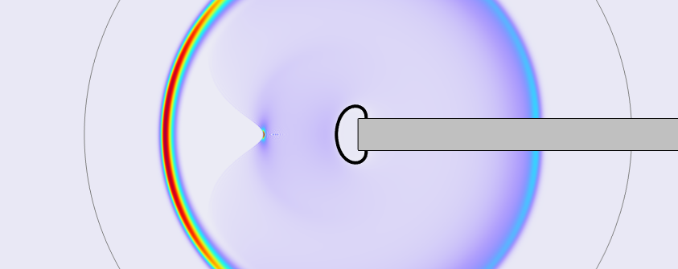
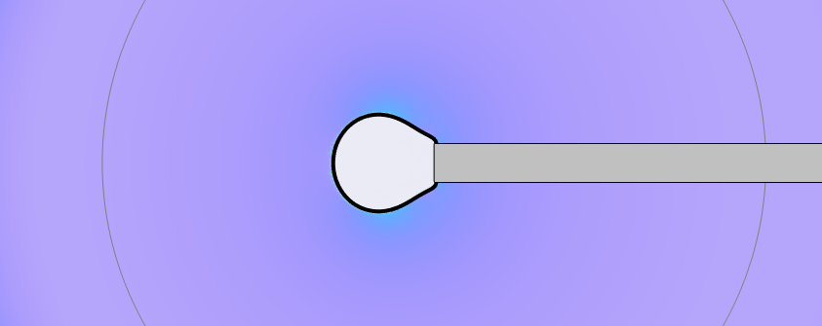
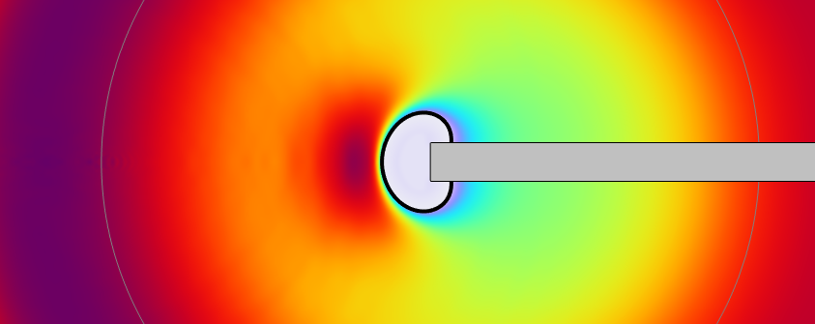
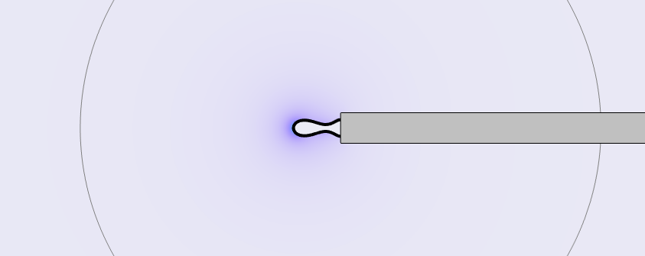
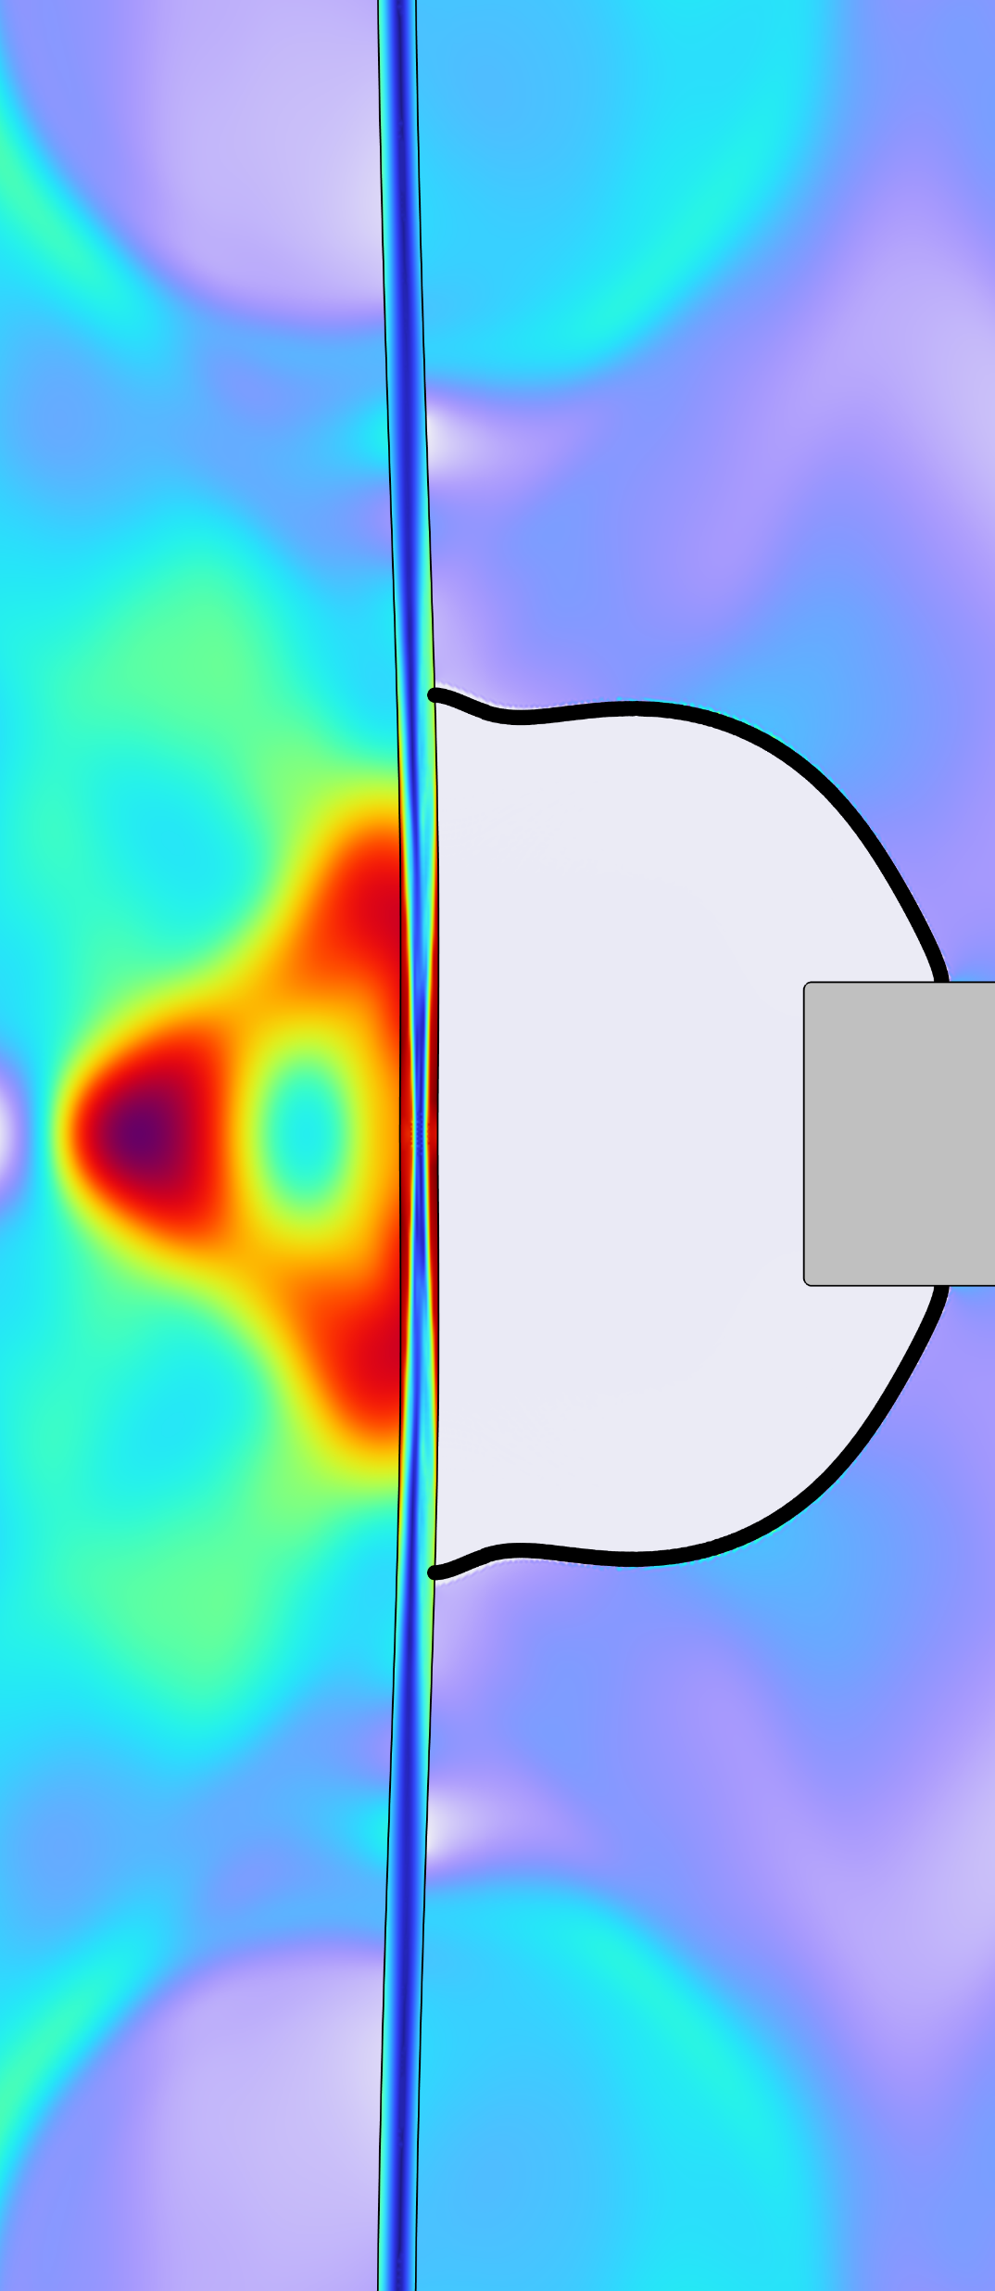
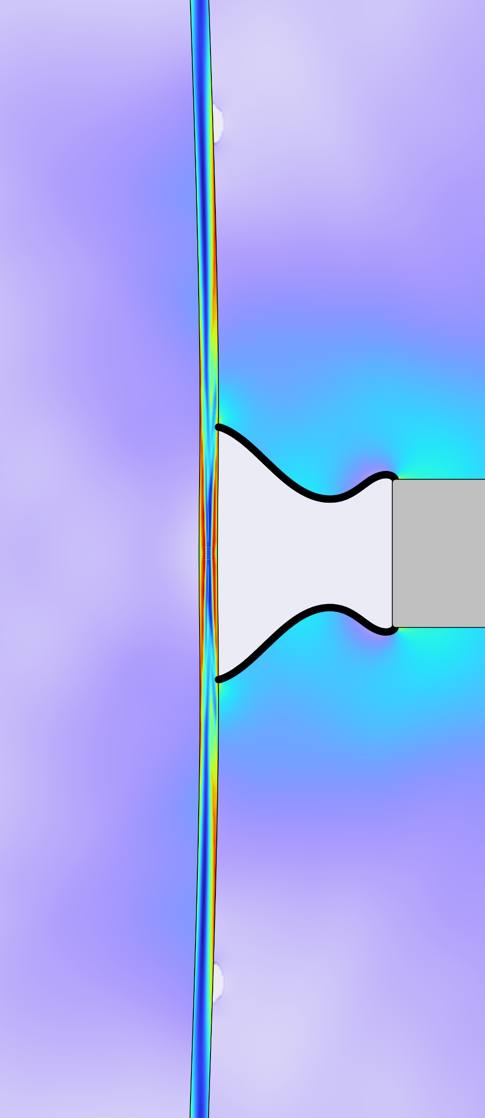
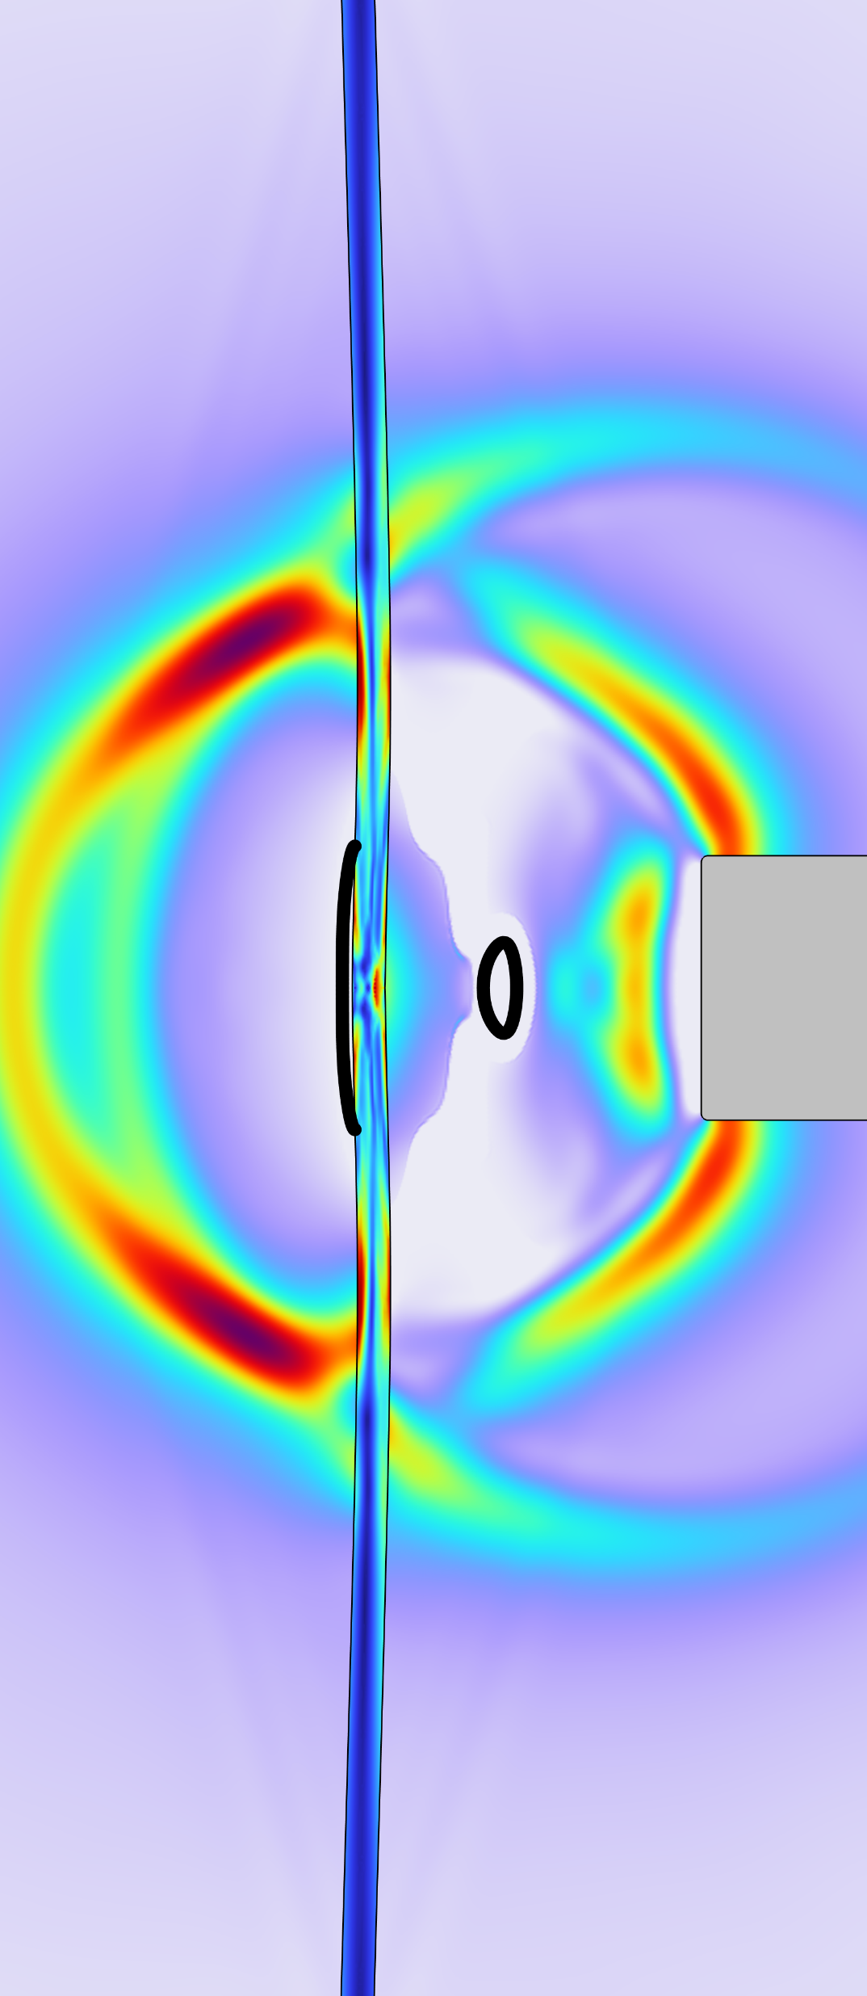
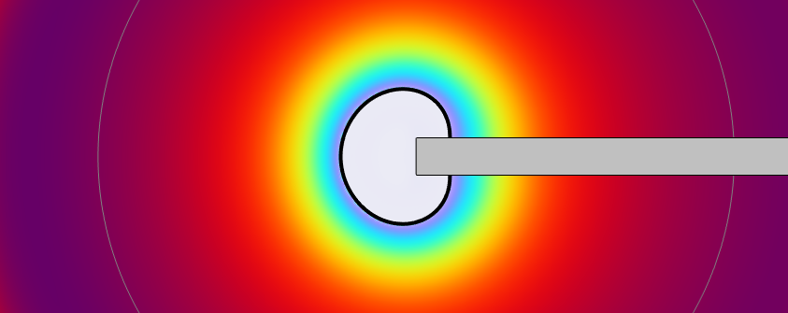
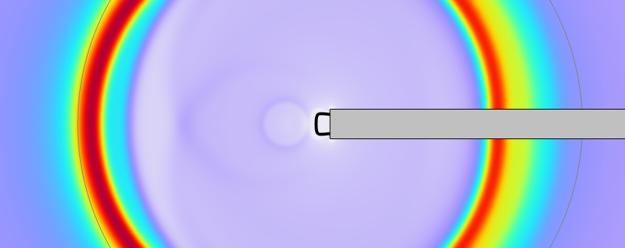

Interaction between Laser-Induced Cavitation Bubble and Rigid/Elastoplastic Membranes
This study investigates how nanosecond-pulsed infrared lasers interact with water to produce rapid, localized energy deposition, triggering shock waves and vapor bubble formation. The violent expansion and collapse of these bubbles are central to applications requiring precise energy delivery in confined liquid environments.
A. I. Gad, and M. Ovchinnikov
R &D Division, Alcon Vision LLC, Lake Forest, CA, USA
Abstract
We present a high-fidelity Finite Element model that simulates the full sequence of events following a nanosecond laser pulse in quiescent water, including shock wave generation, cavitation bubble expansion, and collapse.
The model examines bubble interactions with rigid boundaries and an elastoplastic aluminum membrane at varying distances from the laser source. Fluid dynamics are governed by the compressible Euler equations, with viscous and thermal diffusion neglected, and water’s thermodynamic behavior is described using the full IAPWS equation of state.
Phase change and bubble nucleation are modeled via the Homogeneous Equilibrium Model (HEM), assuming local thermodynamic equilibrium, which enables reasonably accurate, yet computationally efficient simulation compared to explicit interface tracking methods such as level set or phase field.
The Pulse → 0.82 μs
Methodology
6.59 μs
Using COMSOL’s equation-based modeling, we construct 1D spherical, 2D axisymmetric, and 3D models to solve the compressible Euler equations coupled with the full IAPWS equation of state (EOS). These models compute density, momentum, and internal energy, from which pressure and temperature are derived using the EOS. To reduce the computational domain and focus on shockwave and bubble dynamics, a perfectly matched layer is placed at an appropriate distance from the fiber tip.
For FSI, we test various solid models—rigid, elastic, and elastoplastic—across multiple geometries. An experimental setup featuring high-speed Schlieren imaging, particle image velocimetry, and hydrophone sensors is used to validate and correlate the simulation results.
8.24 μs
1st collapse → 0.15 ms
150 μs
2nd collapse → 0.31 ms
FIGURE 1. Shockwave propagation as well as bubble collapse over time (Schlieren imaging and hydrophone reading).
Results
Simulation results indicate that fluid near the optical fiber is swiftly driven into the supercritical regime, reaching pressures of few gigapascals and temperatures of thousands of kelvins. This intense, localized energy input generates a steep-fronted shock wave, imparting significant radial momentum to the surrounding liquid. The resulting inertial effect forms a transient low-pressure zone, initiating cavitation bubble formation. The bubble expands until inertial forces subside, then collapses rapidly due to the pressure differential.
Upon interacting with an elastoplastic membrane, the model predicts a concentrated region of plastic strain, suggesting potential for permanent material damage. Most of the material damage corresponds to shockwaves and bubble collapses on the membranes.
FIGURE 2. COMSOL simulation of pressure waves and bubble dynamics (Left), and shockwave–bubble interaction with 25 µm aluminum membrane placed at 250 µm from the fiber (Right).
1. Wagner, Wolfgang, and Andreas Pruß. "The IAPWS formulation 1995 for the thermodynamic properties of ordinary water substance for general and scientific use." Journal of physical and chemical reference data 31.2 (2002): 387-535.
2. Ishii, Mamoru, and Takashi Hibiki. “Thermo-fluid dynamics of two-phase flow.” Springer Science & Business Media, 2010.
3. Berenger, Jean-Pierre. "A perfectly matched layer for the absorption of electromagnetic waves." Journal of computational physics 114.2 (1994): 185-200.

