Slide 1
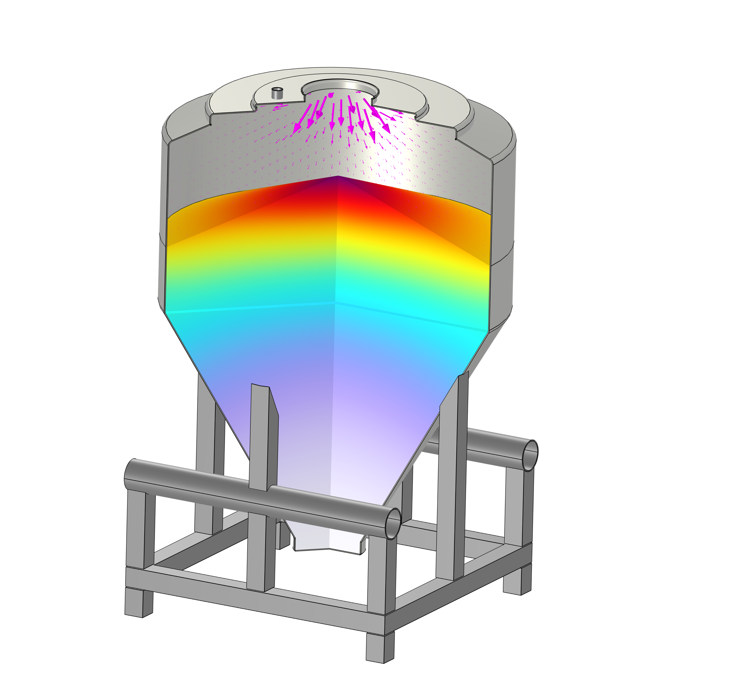
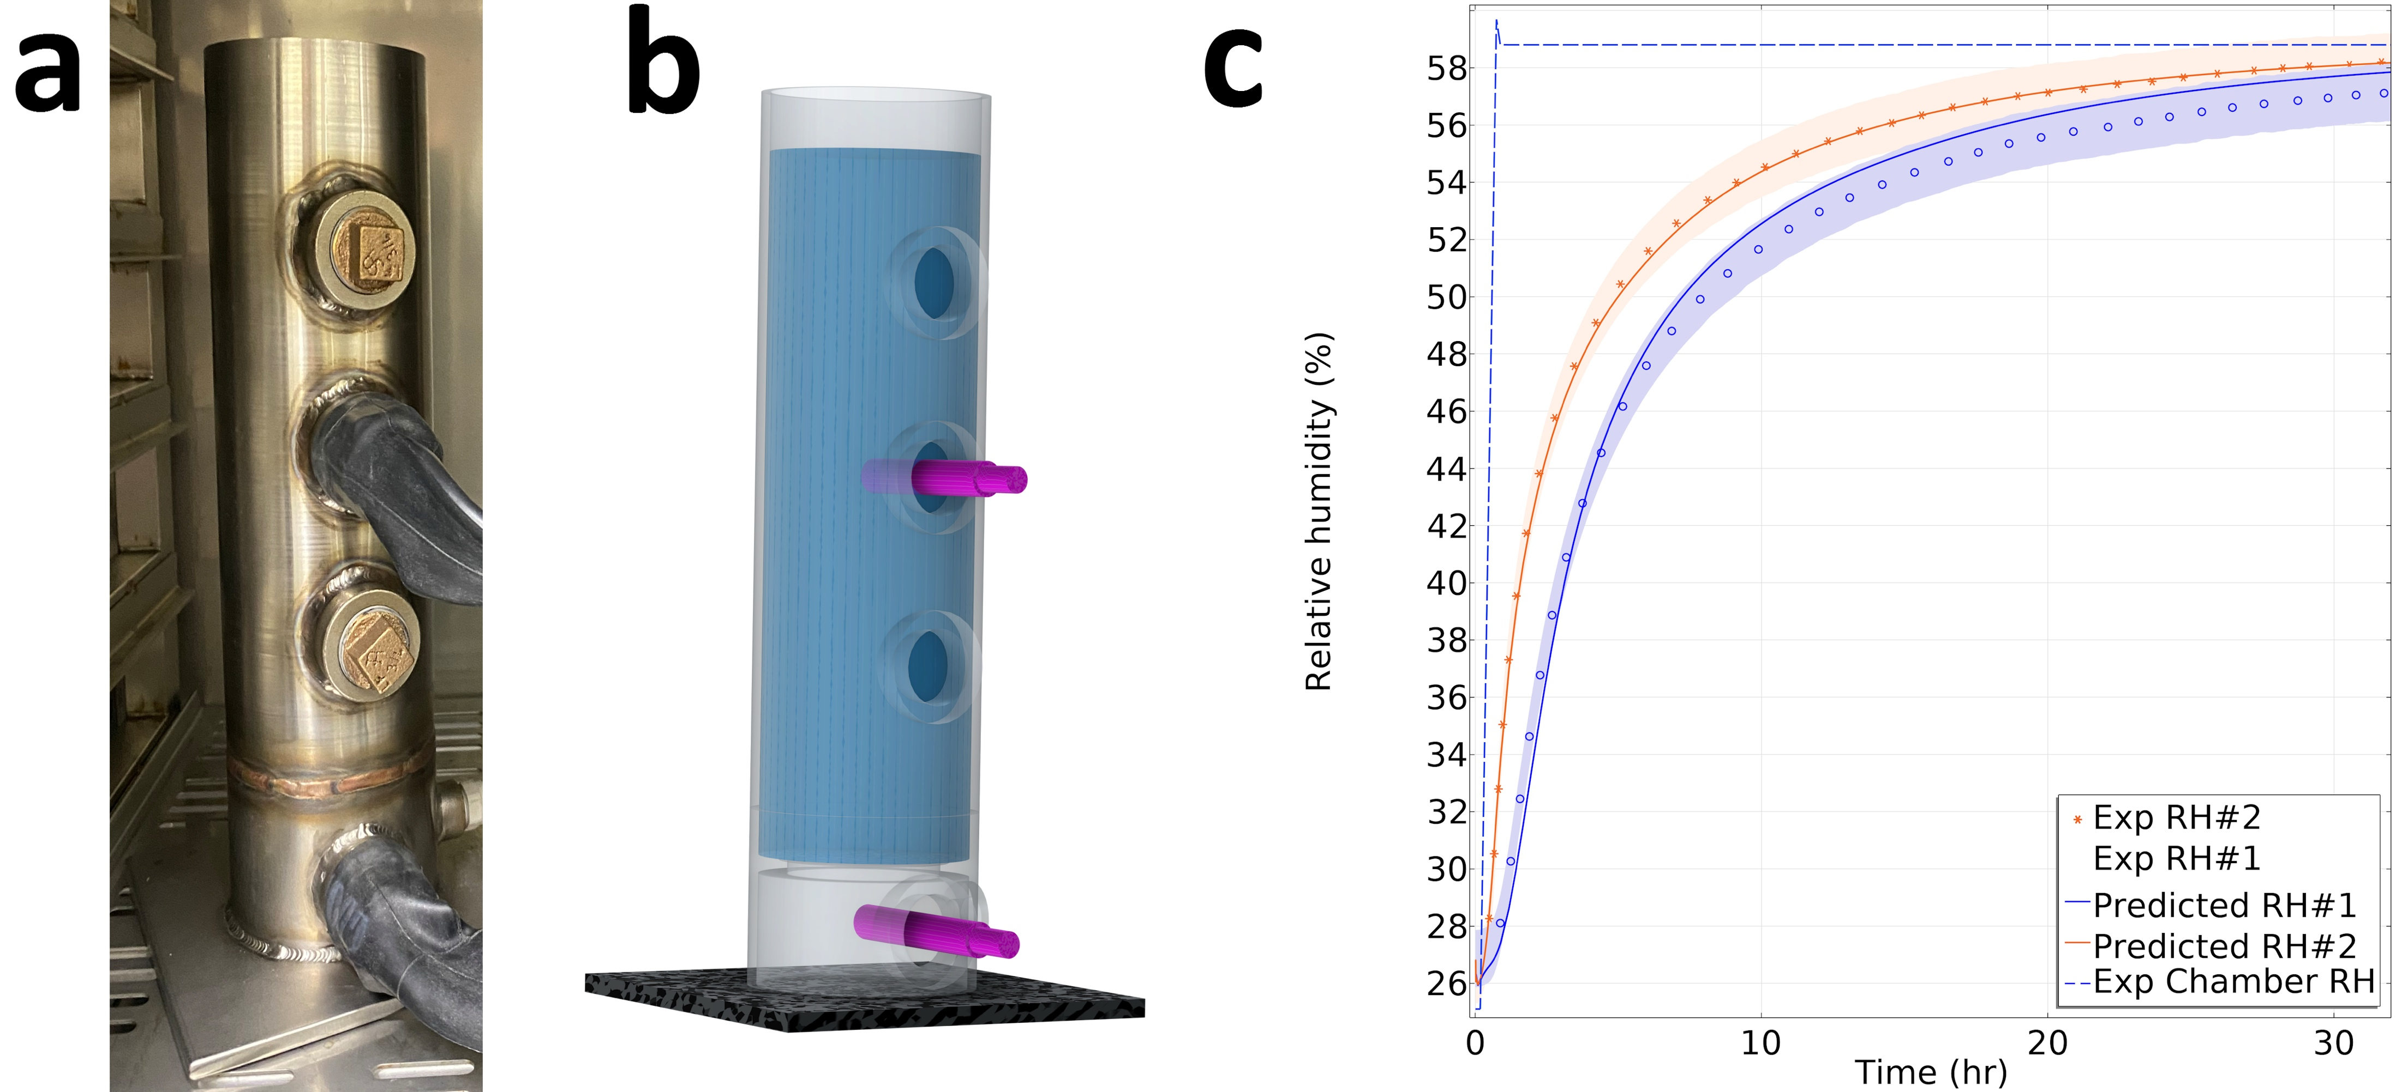
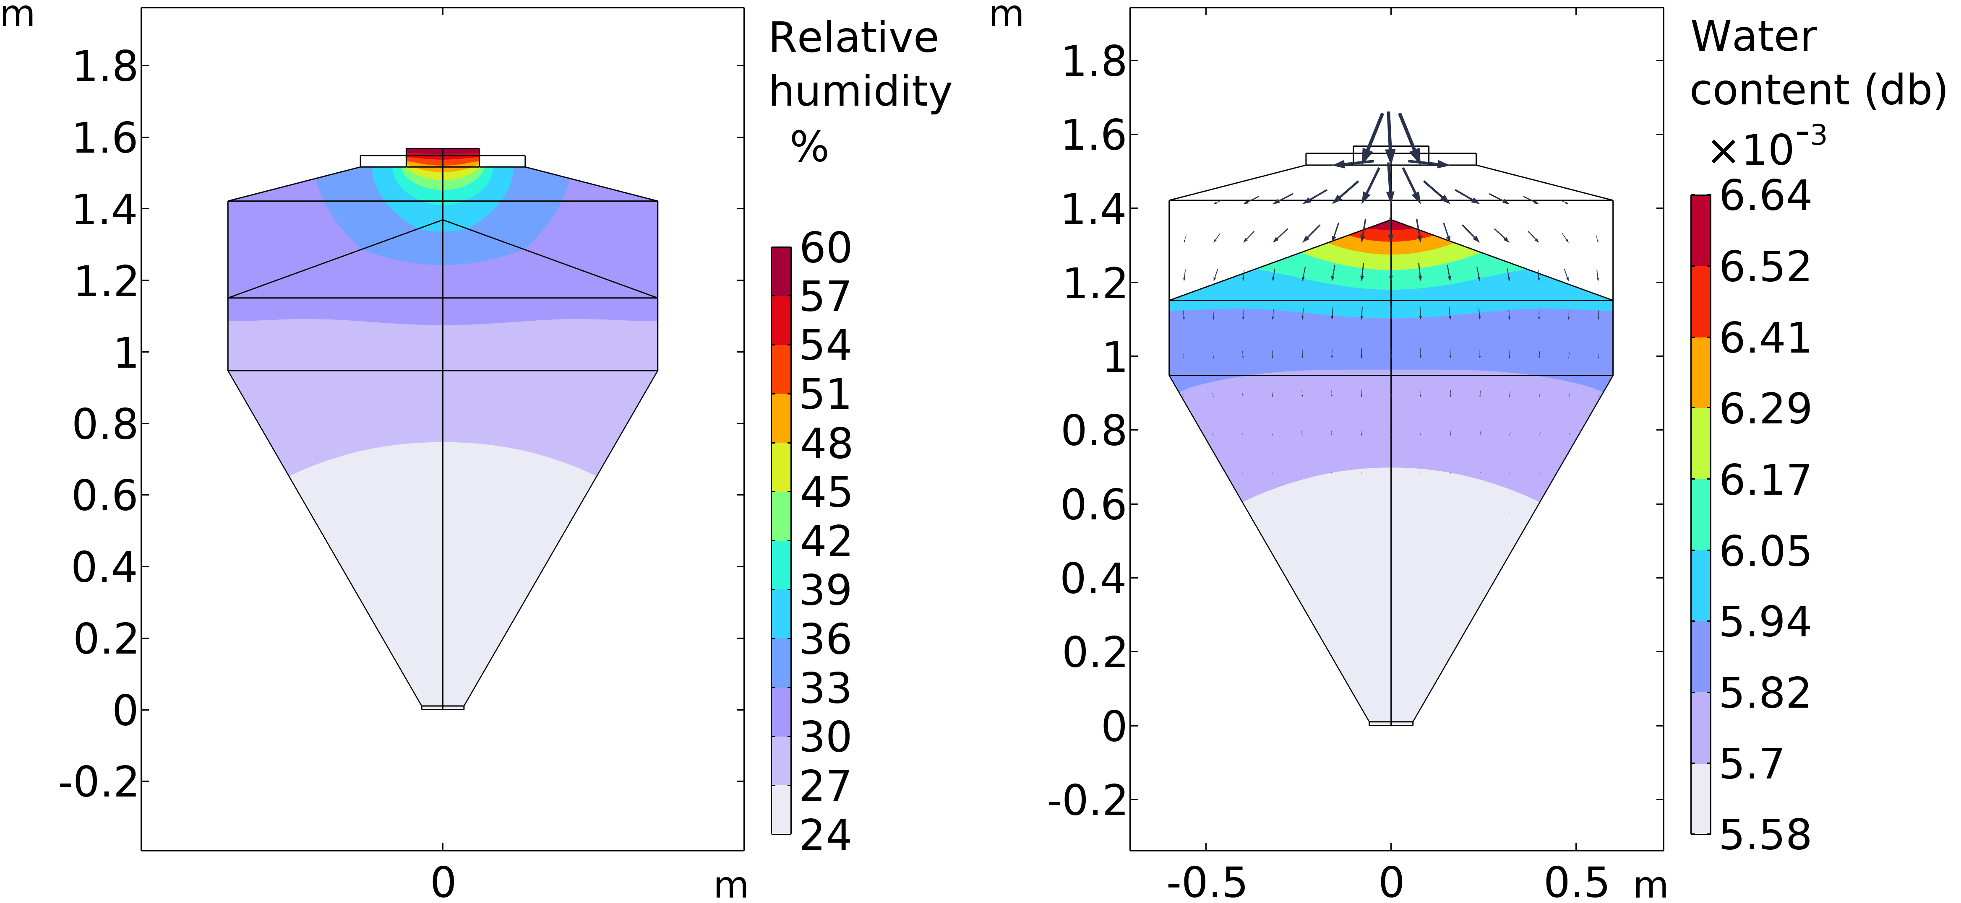

Mitigating Moisture Migration in Pharma: A Coupled COMSOL® and Experimental Approach
Predictive models for moisture transport in pharmaceutical powders: Moving beyond simple systems to accurately track and control moisture at multiple scales, protecting drug quality and stability
Fuat Sakirler, Ph.D.¹, Jairo Paternina ¹ 1. Jenike & Johanson Inc., Tyngsborough, MA fsakirler@jenike.com – jpaternina@jenike.com
Introduction & Goals
Mitigating moisture-induced degradation (for instance, caking) is critical for pharmaceutical product quality and longevity. Uncontrolled moisture migration can compromise a drug’s stability and efficacy.¹ By combining a multiphysics model of moisture diffusion with a robust understanding of bulk solids flow, we can create a more comprehensive solution. The COMSOL model helps identify where moisture is likely to accumulate, while the principles of Jenike² guide the design of bins, such as intermediate bulk containers (IBCs), to actively prevent or mitigate these accumulations. This is achieved through controlled, uniform solids flow coupled with practical and adequate process conditions. This synergistic approach not only predicts moisture migration but also provides a powerful design tool to optimize the physical handling (e.g., storage and transfer) of pharmaceutical powders, ensuring their quality and longevity.
Methodology
Our approach is two-fold: computational and experimental. We used COMSOL Multiphysics® to model the diffusion and sorption of water vapor in pharmaceutical powders. The model was built using material-specific parameters such as water sorption isotherms, diffusion coefficients, particle size, compressibility, and permeability.
This model was then validated by collecting real-time experimental data from powder beds in controlled environments, allowing us to accurately refine our computational approach (FIGURE 1)
FIGURE 1. a) Relative humidity test column. b) 3D view of column bed. c) Comparison of model predictions (solid lines) and experimental data (markers) for moisture uptake over time.
Results
The developed COMSOL model accurately captures the complex interplay of water vapor diffusion and sorption in pharmaceutical powders. Our results demonstrate quantitative agreement between the simulated temporal evolution of relative humidity within the powder bed and the real-time experimental data (FIGURE 1c)
This validated tool effectively is then used identifying moisture hotspots within a pharmaceutical IBC opened to humid air (FIGURE 2). This tool simulates how ambient water vapor ingress and diffuse, leading to a localized concentration of moisture, particularly at the interfaces and near the top surface of the powder bed. By applying Jenike’s methodology,^{2, 3} engineers can design bins with the correct hopper shapes and wall surfaces coupled with appropriate process conditions to ensure mass flow, thereby minimizing the risk of moisture hotspots.
FIGURE 2. The final spatial distribution of relative humidity (RH) and water content on dry basis (db) of a pharmaceutical excipient within IBC at 24 h after being exposed to a 60%RH environment
1) Veronica, N., Heng, P. W. S., & Liew, C. V. (2023). Relative Humidity Cycling: Implications on the Stability of Moisture-Sensitive Drugs in Solid Pharmaceutical Products. Molecular pharmaceutics, 20(2), 1072–1085. 2) Jenike, A.W. (1976). Storage and flow of solids. Bulletin No. 123 of the Utah Engineering Experiment Station; Vol. 53, No. 26, November 1964. 3) Prescott, J.K. & Barnum, R.A.. (2000). On powder flowability. Pharmaceutical Technology. 24. 60-84+236.

