Slide 1

Mitigating Moisture Migration in Pharma: A Coupled COMSOL® and Experimental Approach
COMSOL Conference 2025, Boston, MA
Fuat Sakirler, Ph.D. & Jairo Paternina fsakirler@jenike.com – jpaternina@jenike.com Jenike & Johanson Inc., Tyngsboro, MA

Slide 2
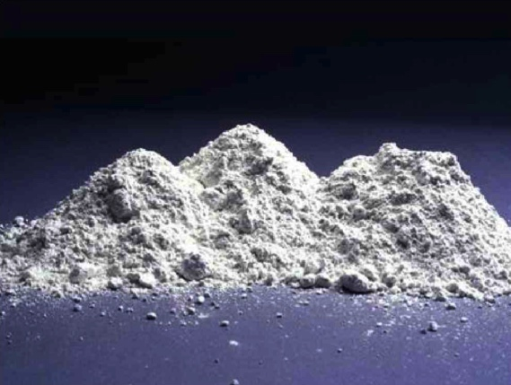
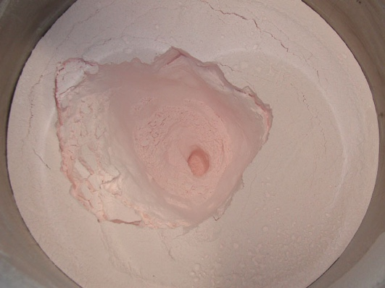
Pharmaceutical products are highly sensitive
Environmental conditions can cause damage to stability and flowability of active pharmaceutical ingredients (APIs) and excipients
Relative humidity (RH), temperature, light exposure and PH
Changes in humidity and temperature during storage can cause moisture to migrate (sometimes triggering phase transformations), leading to critical problems:
Degradation
Caking
Product instability
Loss in product efficacy
Ensuring the quality and longevity of drugs is paramount for patient safety and product reliability

Slide 3
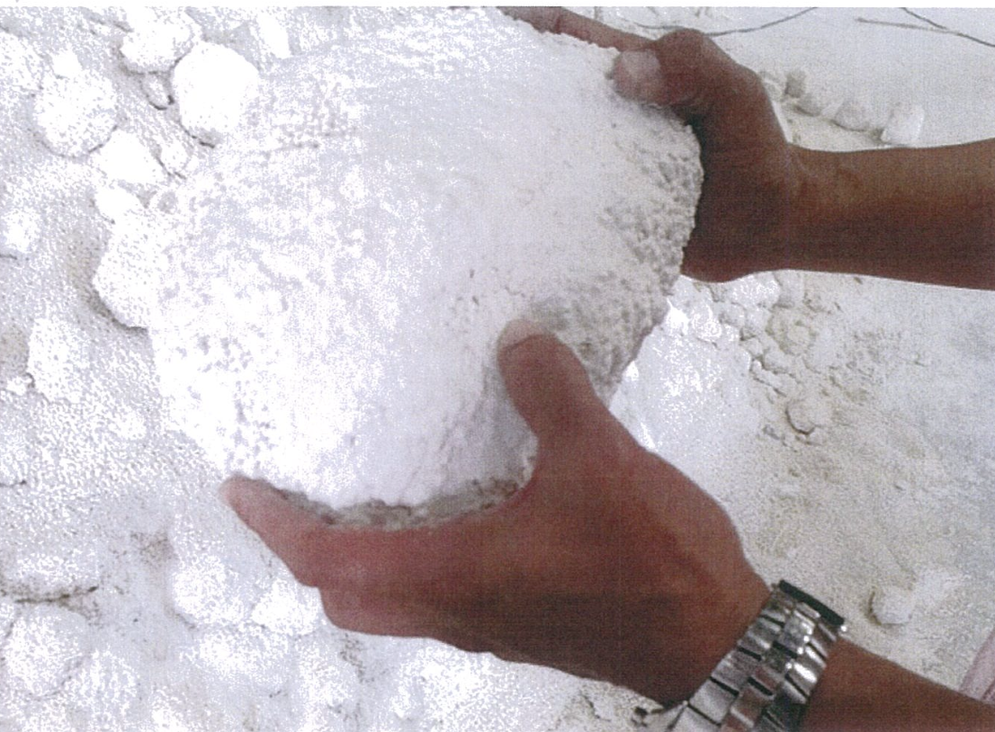
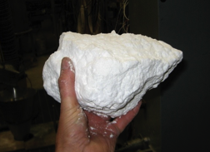
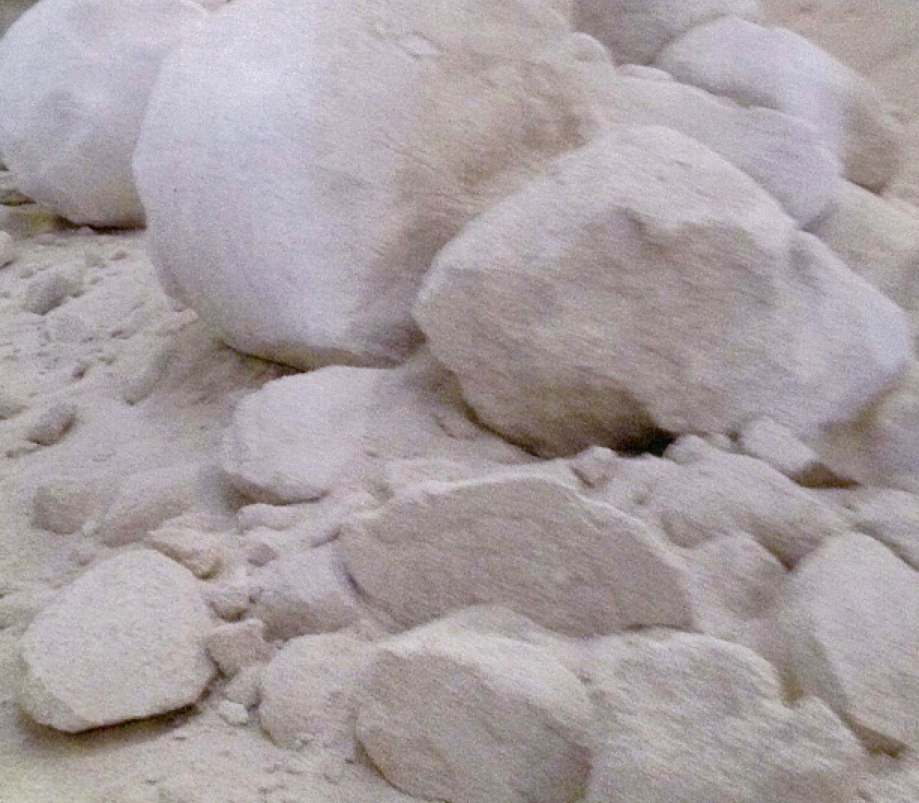
What is powder caking?
Powder caking is the undesired agglomeration and hardening of particles into consolidated lumps

Slide 4
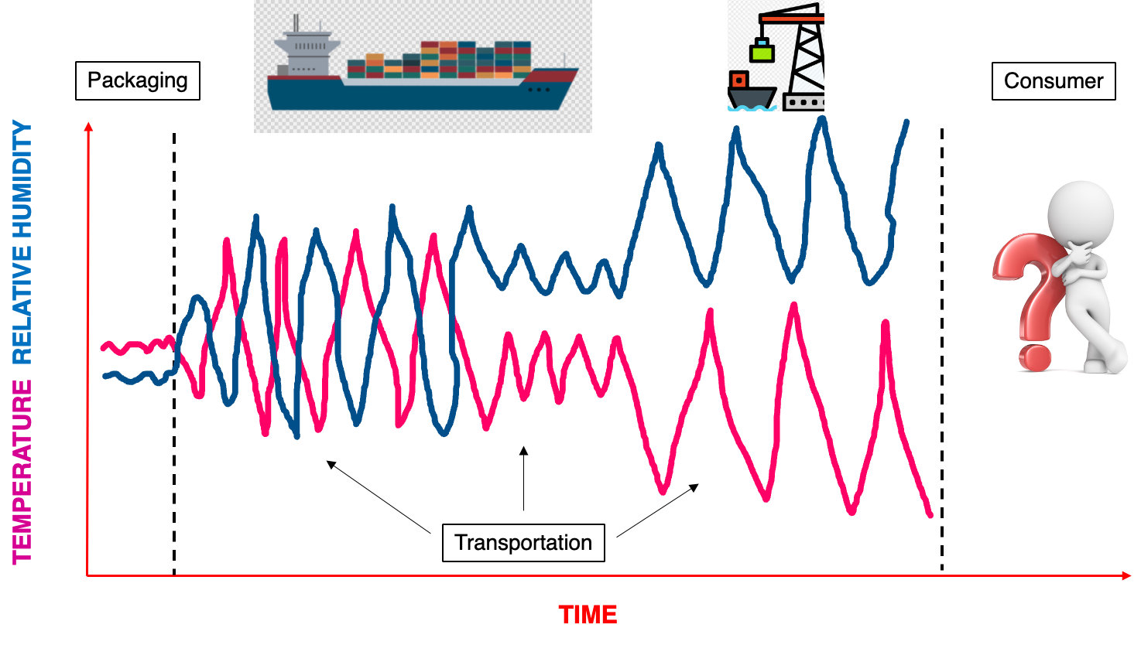
Critical factors for powder processing, storage, and transportation
Temperature & humidity
Pressure/consolidation

Slide 5
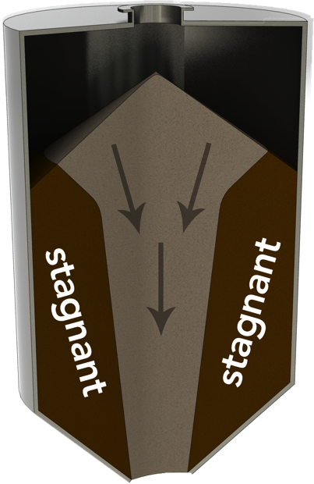
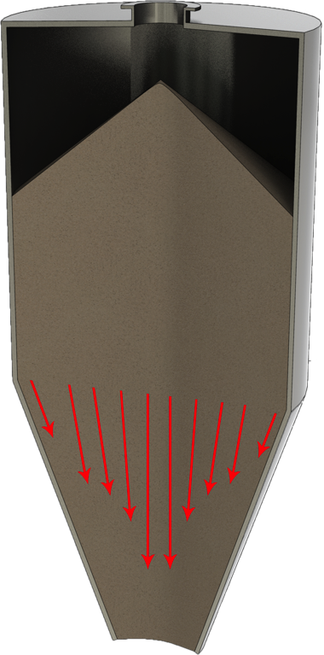
Moisture migration is a complex, multi-faceted problem
Traditional methods focus on environmental control, but don’t account for the physical handling of the powders themselves
The primary challenge faced by the presented study
Predicting moisture behavior inside a bin when ambient conditions are changing
Providing practical method to actively control it within the manufacturing process and/or during transport to manufacturing facilities
Mass flow
Funnel flow
All material is in motion

Slide 6
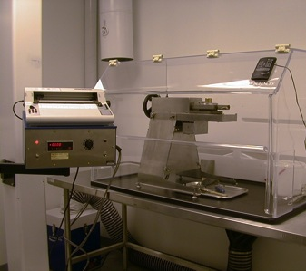
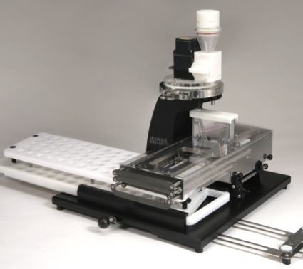
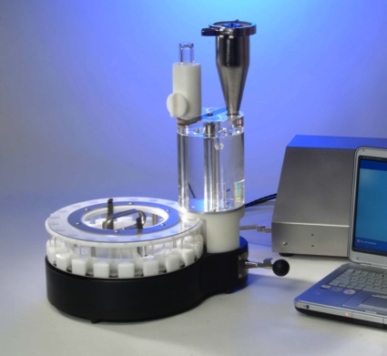
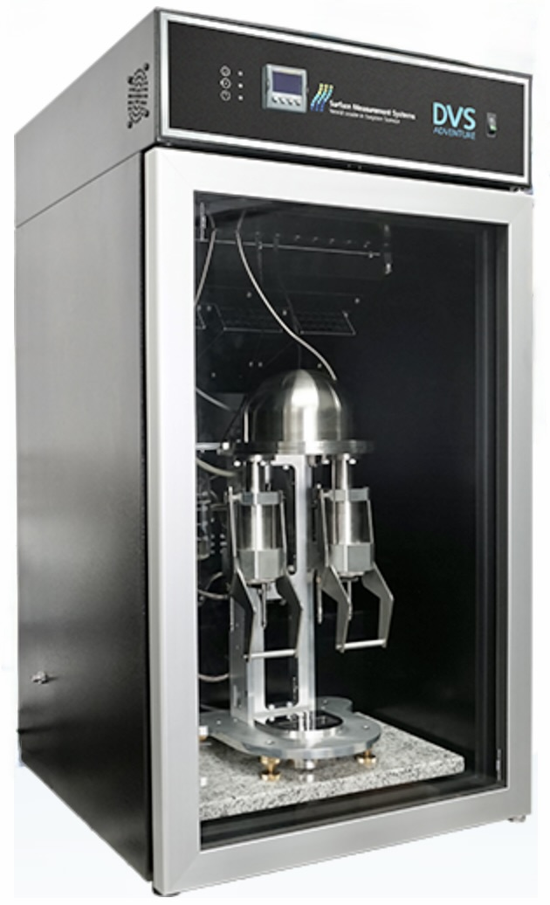
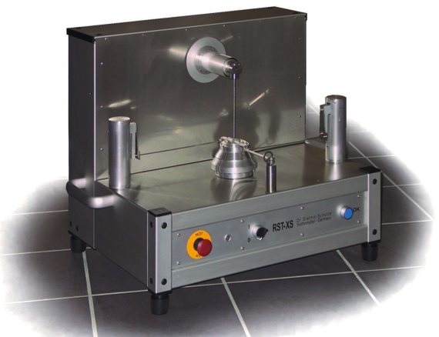
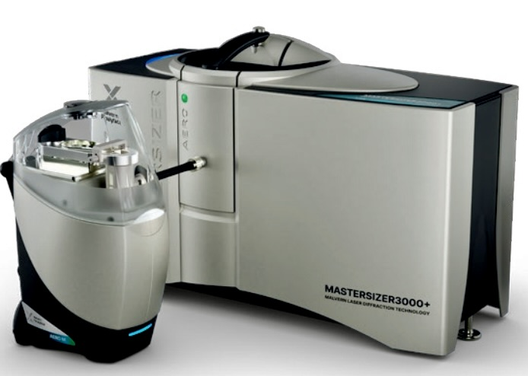
Typical powder flow characterization tests
Cohesive strength*
Wall friction*
Bulk density and Permeability*
Segregation tests*
Particle characterization (size, shape, density)*
Moisture absorption/desorption
Tests on API, final blend, excipients
Containment and environmental controls
* If required, materials tested as a function of moisture

Slide 7
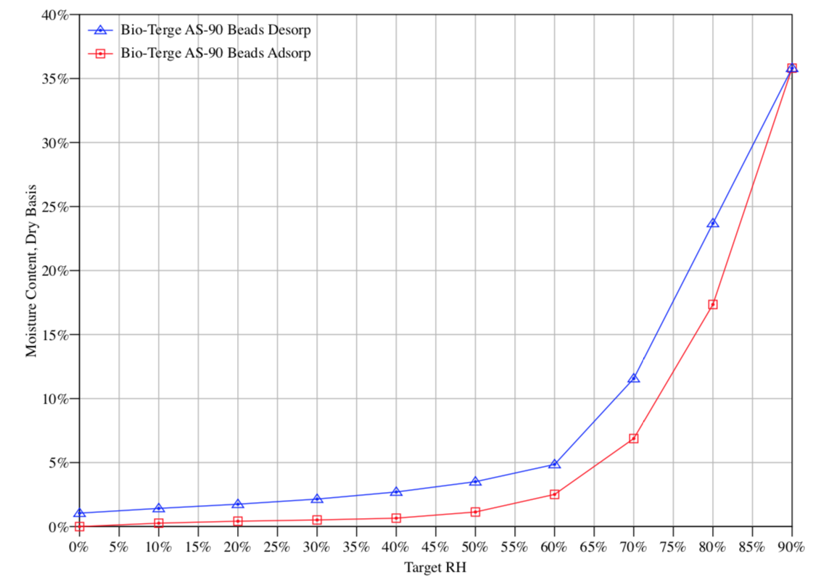
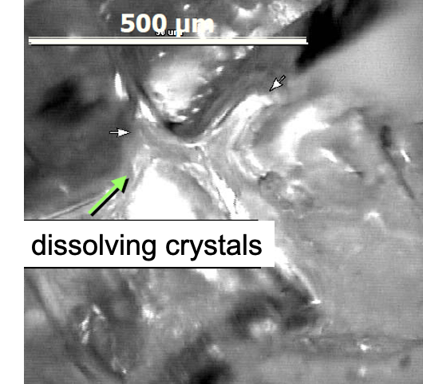
The role of moisture in powder caking
– Desorption
– Adsorption
Isotherm curve @ 20°C
Liquid bridge formation: Capillary condensation leads to initial caking by accumulating in the small gap
Solid bridge formation: As the liquid evaporates, the dissolved solute recrystallizes
Deliquescence
Capillary regime
Adsorbed regime
CRH
Capillary condensation
Dissolution
Drying

Slide 8
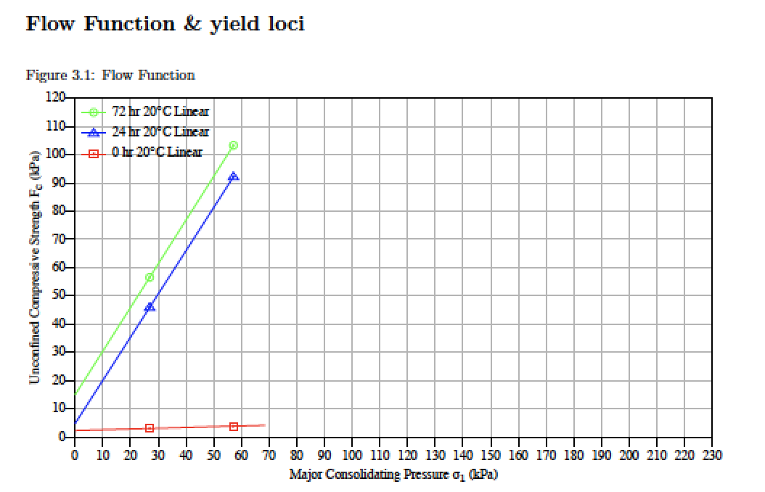
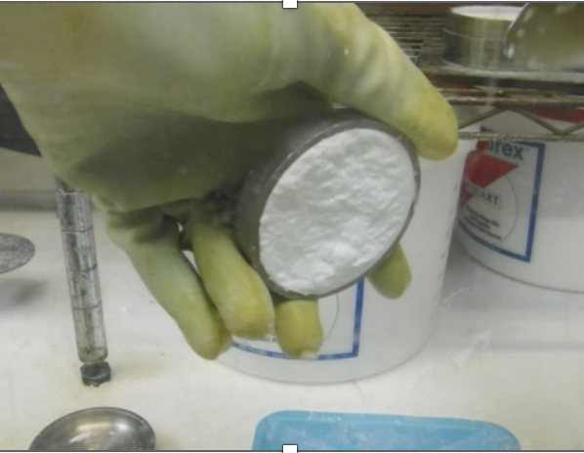
Caking test: Cohesive strength via Jenike shear test
Caking strength is a function of time, stress, particle size, and environmental conditions

Slide 9
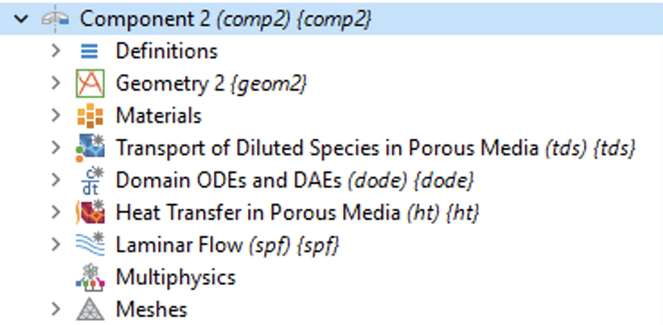
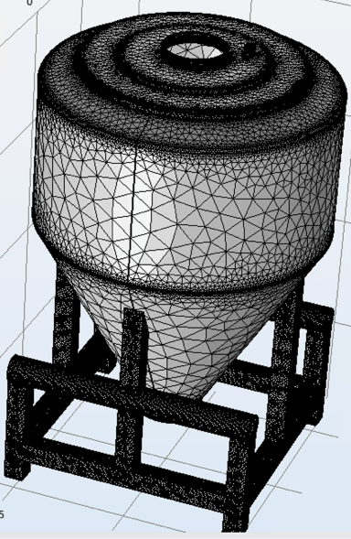
Considerations for modeling of moisture transport
Transport of Diluted Species
Moisture transport in air
Water vapor concentration (and humidity)
Laminar or turbulent flow
Natural convection
Forced convection (e.g., inlet of purge gas)
Moisture transfer in porous media (via equation-based modeling)
Sorption/desorption including kinetics
Vapor diffusion and convection
Thermal effects
Latent heat (sorption/desorption)
Changes in ambient conditions
Buoyancy
Multiphysics couplings
Nonisothermal flow
Mass transfer in porous media
Heat and moisture

Slide 10
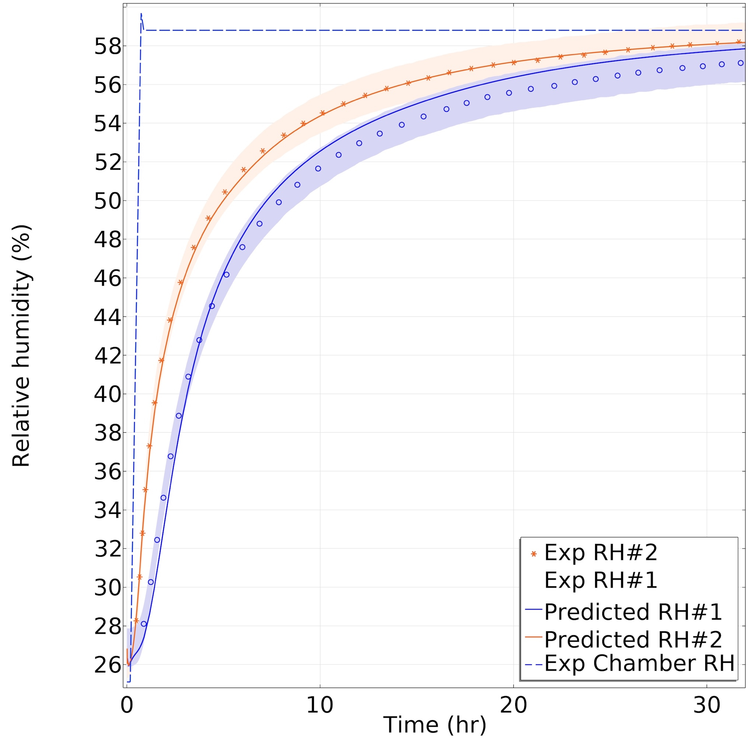
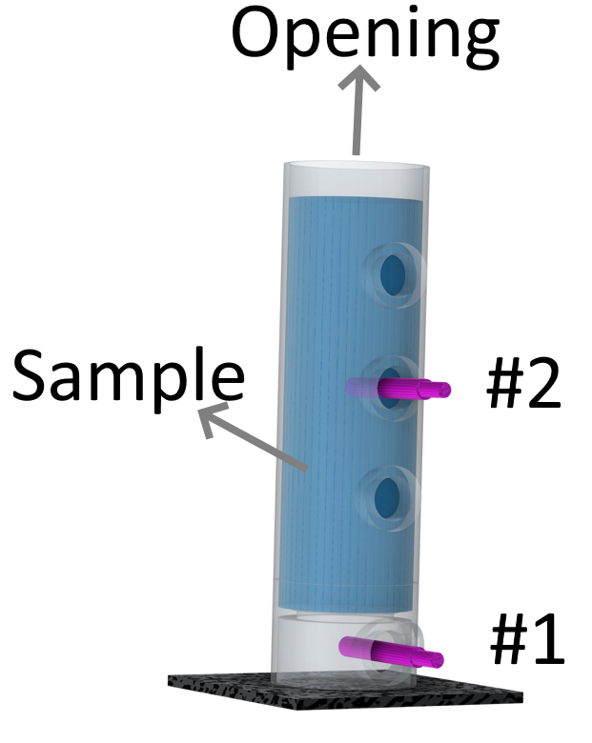
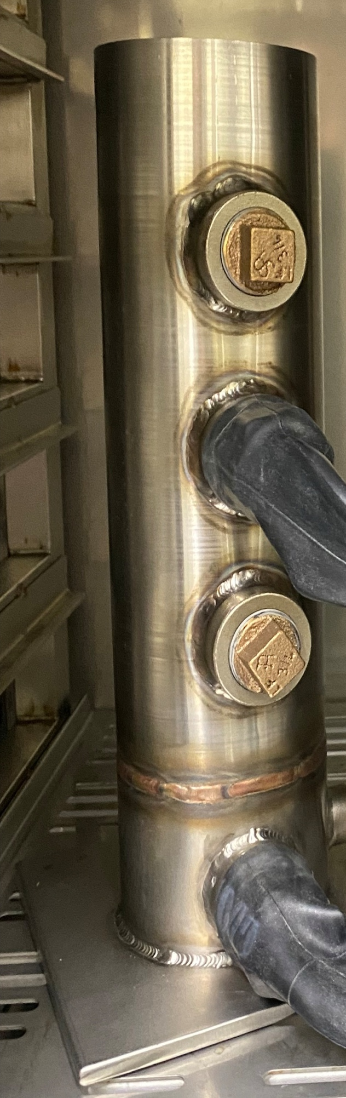
Model validation
Measured material and flow properties
Water sorption isotherms
Diffusion kinetics
Particle characterization (size, shape, density)
Permeability
Wall friction
Cohesive strength
Bulk density
Compressibility
Thermal properties (thermal conductivity and specific heat capacity)
Comparison with experimental data demonstrates quantitative agreement to model predictions, thus validating its accuracy

Slide 11
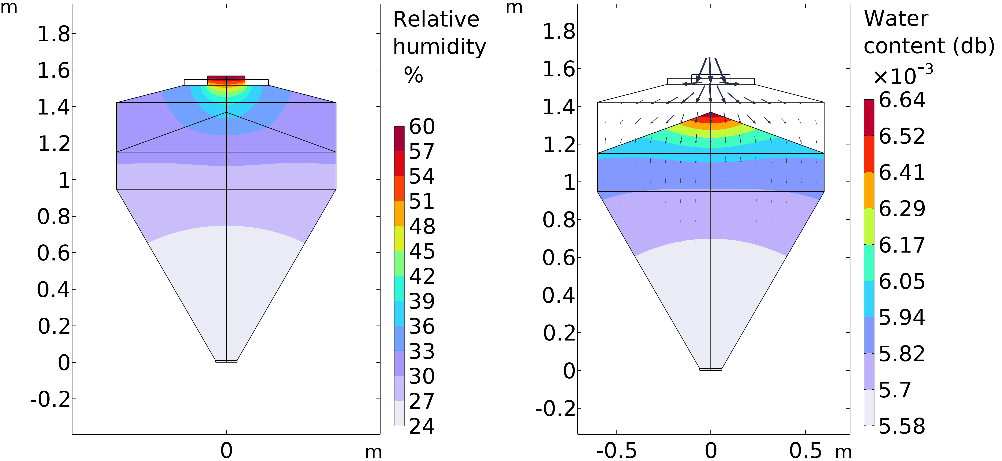
Results
Identified Moisture Hotspots: Our validated model accurately predicted and mapped where moisture accumulates inside a bin, specifically driven from the top surface where powder is exposed to humid air from outside
Modeled Real-World Conditions: We simulated the moisture transport under realistic storage conditions, tracking changes in water content, humidity, and temperature over time
Provided a Design Basis and Test Program: The simulation results offer a clear design basis for proactive measures, allowing us to optimize container and process designs to actively prevent moisture-induced degradation

Slide 12
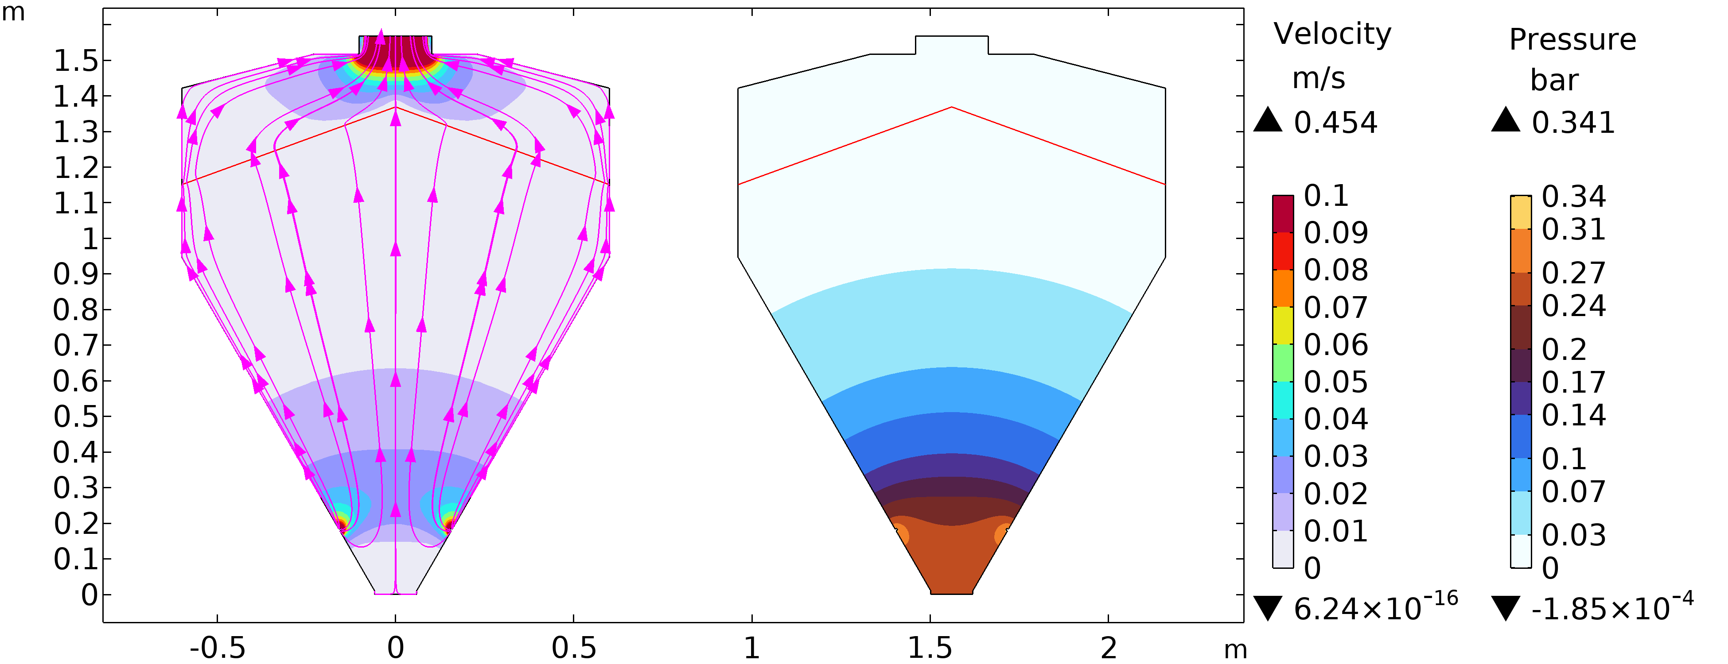
Results
Active Moisture Control: Successfully demonstrated that introducing dry air or nitrogen (N2​) from the silo bottom effectively sweeps moisture upward through the porous powder bed, actively reducing moisture content
Practical control method for industry: The upward flow of dry gas prevents moisture accumulation in the predicted hotspots, offering a validated, active control strategy for mitigating caking risk during storage

Slide 13
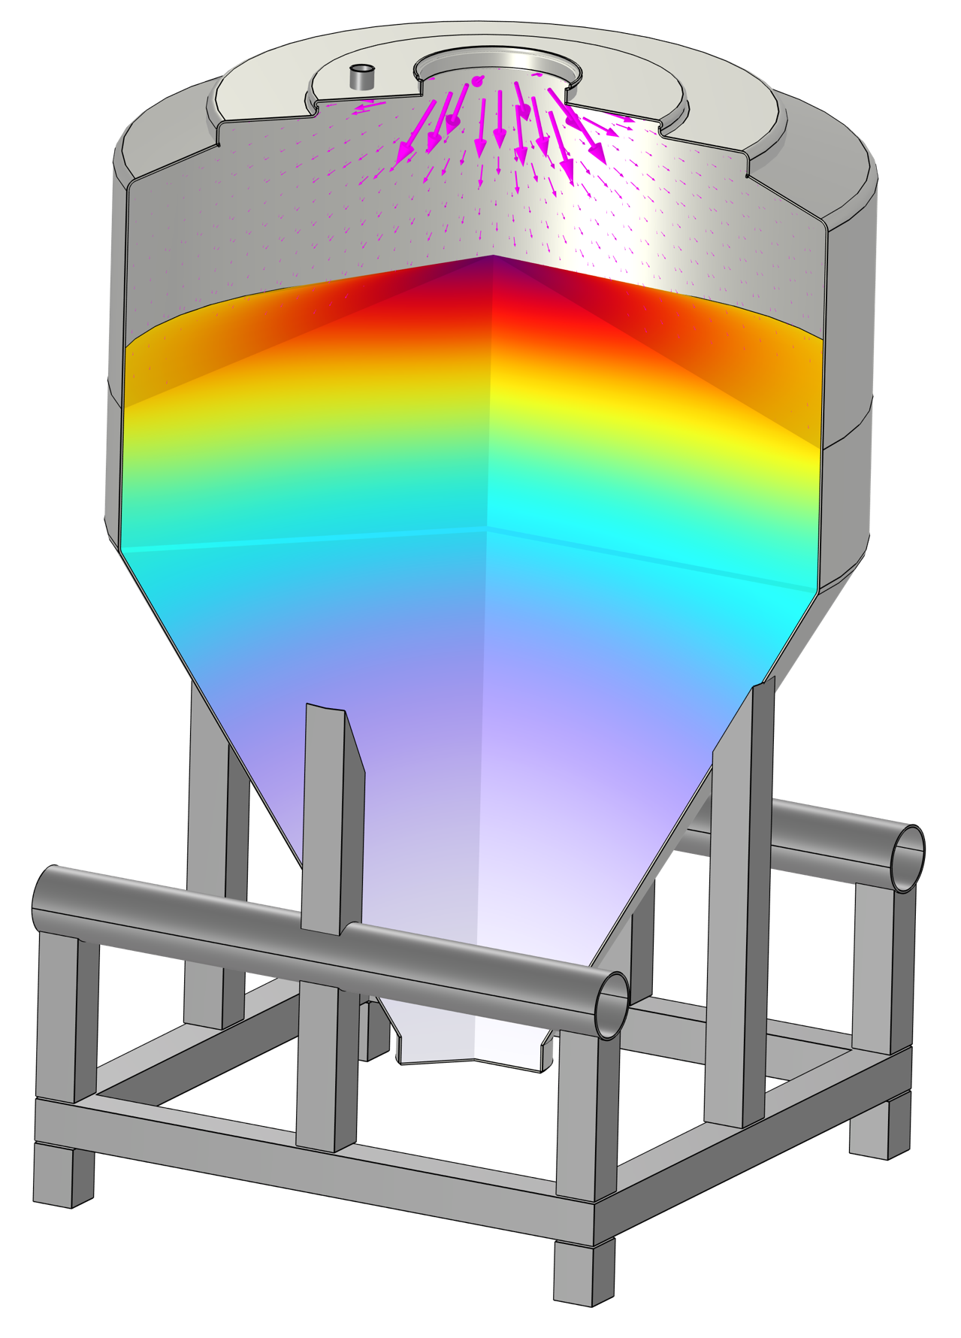
Key takeaways
Virtual Prototyping: We used COMSOL Multiphysics® to rapidly test various bin designs and scenarios in a virtual environment, saving significant time and cost compared to physical prototyping
Enhanced Visualization: Our model provided a clear visualization of moisture accumulation points—information that is difficult to obtain through experiments alone
Integrated Design Solutions: By combining our model with Jenike’s methodology, we can design practical process conditions for manufacturing and optimize the shape and wall surfaces of bins. This ensures uniform "mass flow" and actively prevents moisture hotspots

Slide 14


Fuat Sakirler, Ph.D. & Jairo Paternina fsakirler@jenike.com – jpaternina@jenike.com Jenike & Johanson Inc., Tyngsboro, MA
Copyright 2025 Jenike & Johanson, all rights reserved.

