Slide 1
Integrated Electro-Thermal-Mechanical Modeling for Next-Generation Transportation Infrastructure
Xiao Chen, Ph.D.
Civil and Environmental Engineering
Rutgers, The State University fo New Jersey

Slide 2
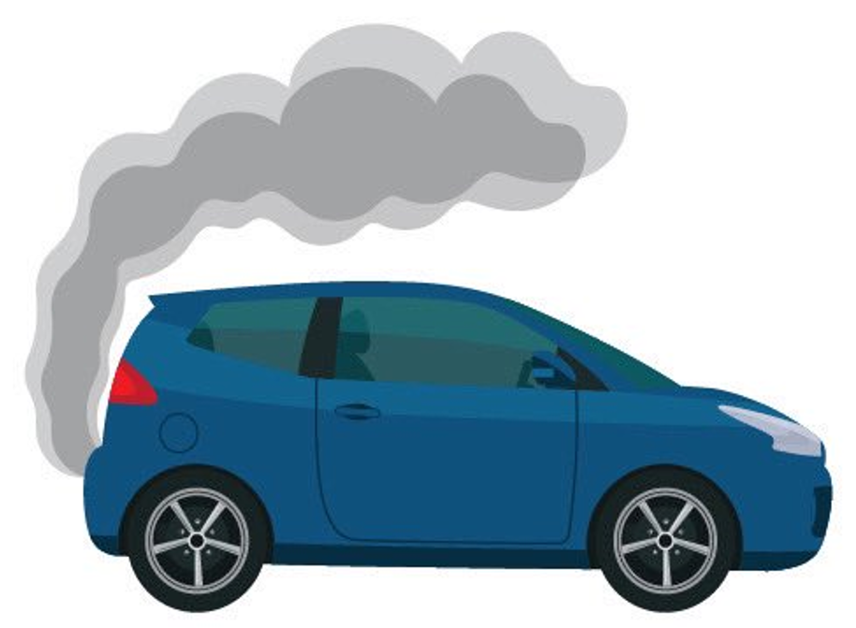



Introduction (1)
Traditional road transport has a great impact on the environment (air pollution and greenhouse gas emissions)
Electric vehicles (EVs) are a promising alternative to decrease reliance on non-renewable energy and lower greenhouse gas emissions
The current scarcity of charging infrastructure and the relatively longer charging time present barriers to widespread adoption of EV.
Innovative development of EV charging infrastructure is necessary to facilitate the transition towards a more sustainable transportation ecosystem.

Slide 3
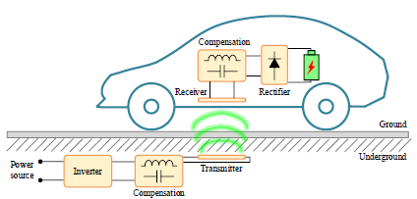
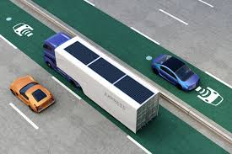
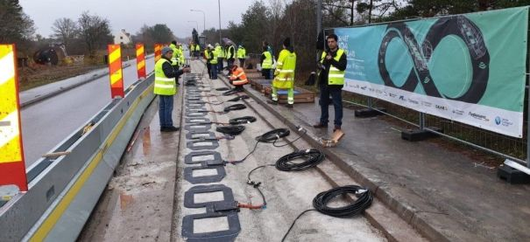
Introduction (2)
Electrified roadway with inductively coupled power transfer (ICPT) system enables EV to charge in motion via an electromagnetic field between a coil embedded in the pavement and a pick-up coil in the EV
However, the integration of ICPT system into roadway pavement requires multi-physics analysis (electromagnetic, thermal, mechanical, etc.) to ensure safety and long-term durability.
Zheng et al. (2025)
(Source: Electreon Wireless)

Slide 4
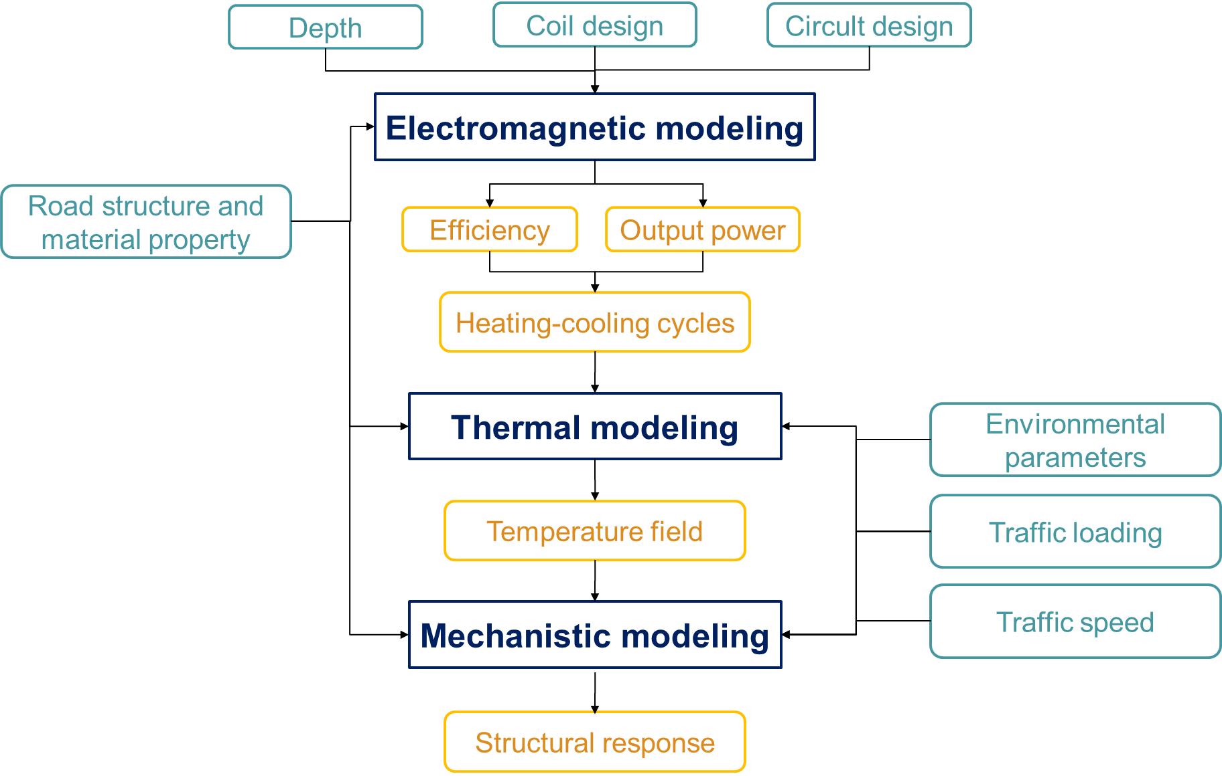
Methodology
Parameters
Laboratory experiments
Validation
Viscoelastic property

Slide 5
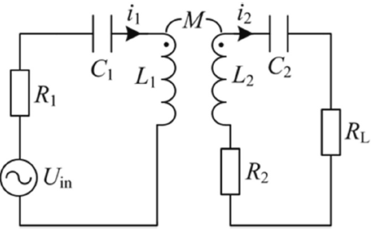

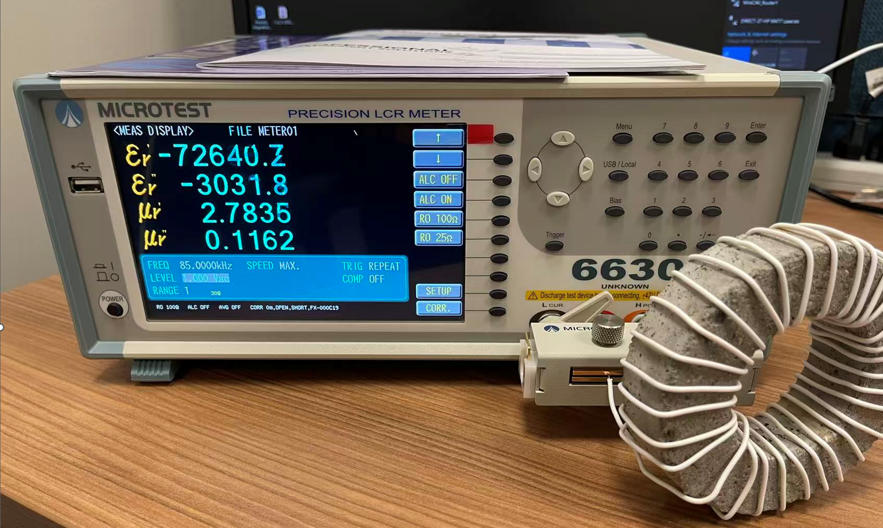
Electromagnetic Modeling Using COMSOL (1)
Empirical method cannot account for magnetic loss
Where, η is the efficiency; P_{in} is input power; P_{out} is output power; I₁ and I₂ are the current of transmitter and receiver coils; R₁ and R₂ are the equivalent resistances of coils; R_{L} is the equivalent load resistance.
Series-series topological resonant circuit
Laboratory experiments for material properties
Relative permeability (real part μ’)
Relative permeability (loss part μ’’)

Slide 6
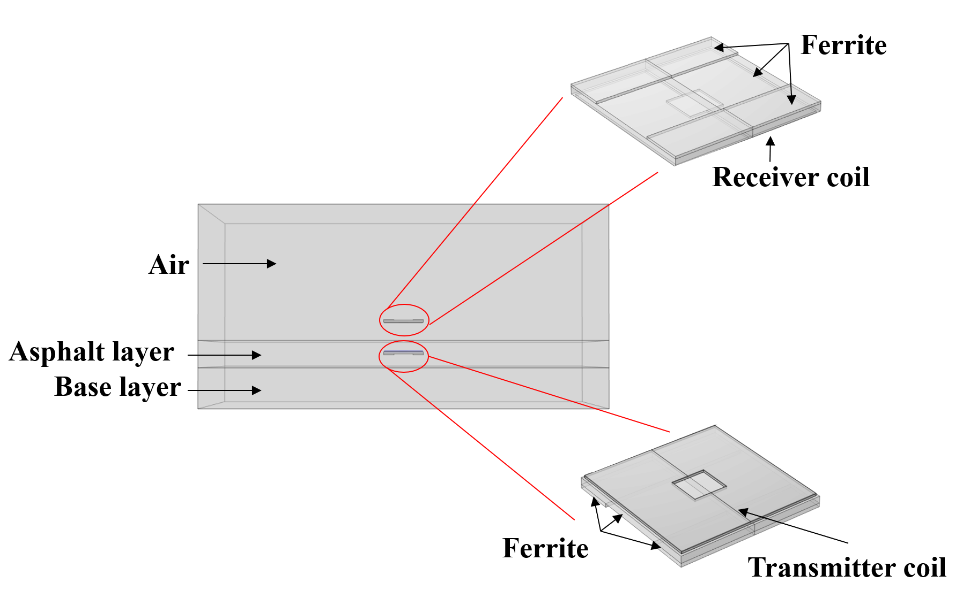
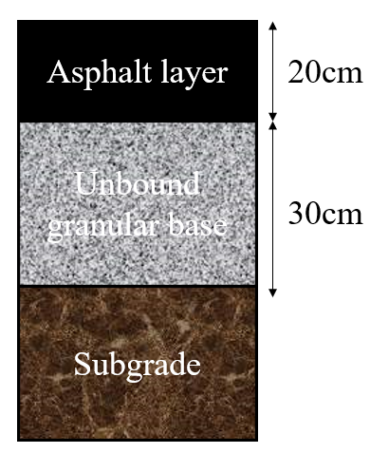
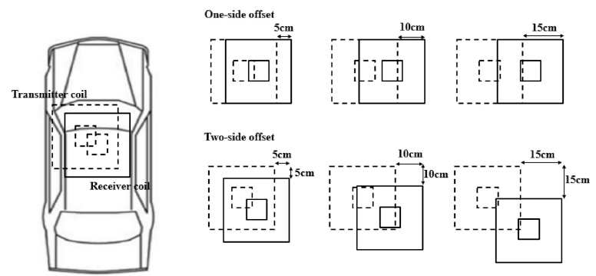
Electromagnetic Modeling Using COMSOL (2)
Electromagnetic model
Magnetic field + electric circult modules
Frequency domain study
Laboratory experiments for model validation
Scenarios
20cm AC layer +30 cm base layer + subgrade
Embedment depth of 4-16cm
Misalignment
Model geometry
Material property
Relative permeability
Relative permittivity
Electric conductivity
Misalignment
Laboratory validation

Slide 7
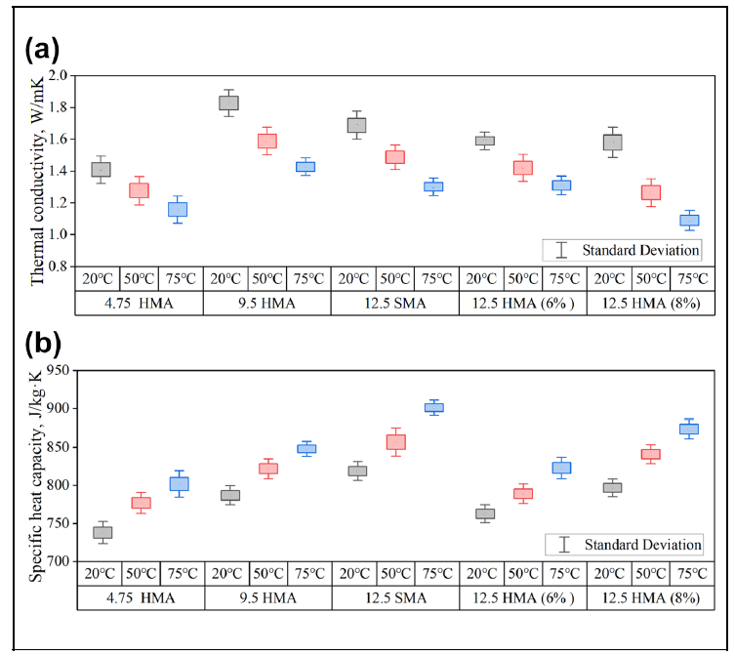
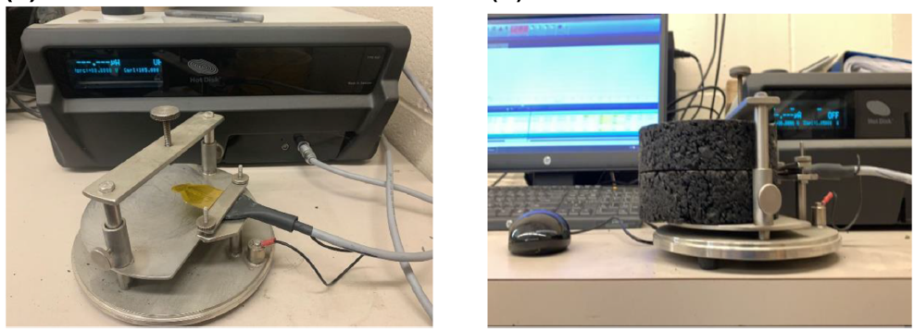
Thermal Modeling Using COMSOL (1)
Laboratory experiments using transient plane source (TPS) method
Temperature-dependent thermal conductivity
Temperature-dependent specific heat capacity
Test setup and process
Thermal parameters

Slide 8
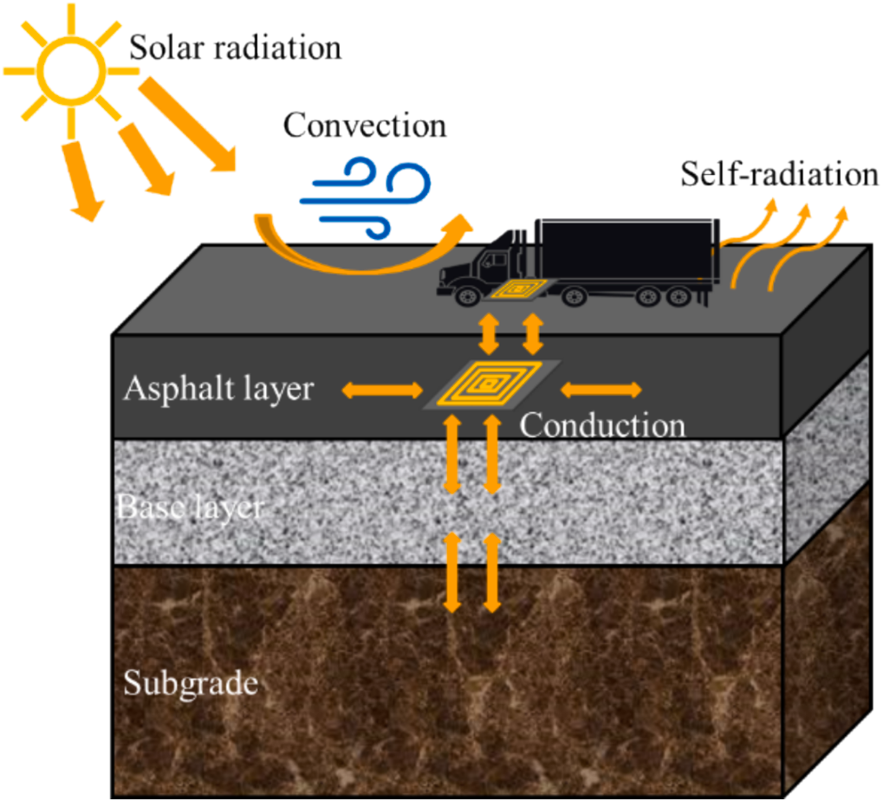
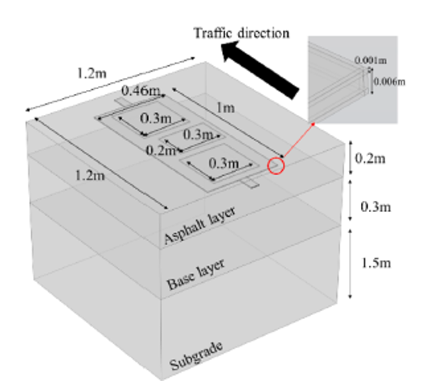
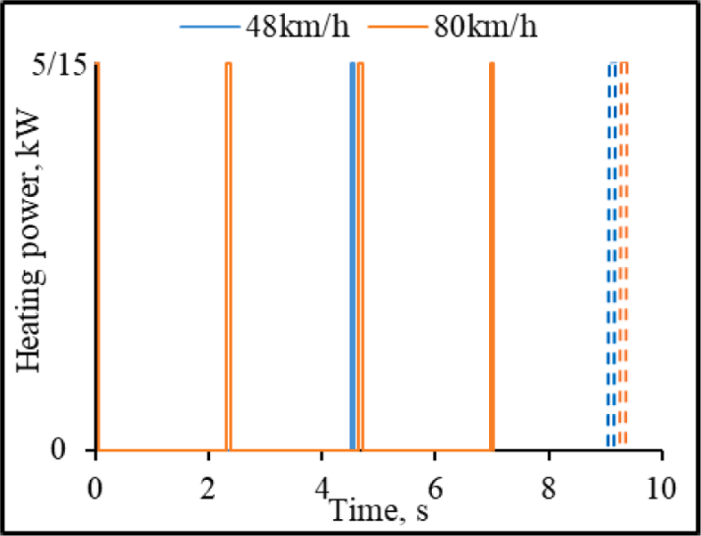
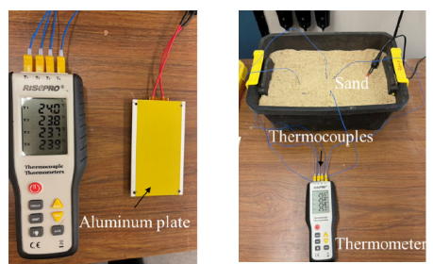
Thermal Modeling Using COMSOL (2)
Thermal model
Heat transfer in soilds + surface-to-surface radiation +PDE modules
Transient study
Laboratory experiments for model validation
Scenarios
Various heating-cooling cycles based on speed and headway
Summer/Winter conditions
5cm and 13cm embedment depths
Heat transfer mechanisms
Thermal model geometry
Illustration of dynamic charging
Laboratory validation

Slide 9
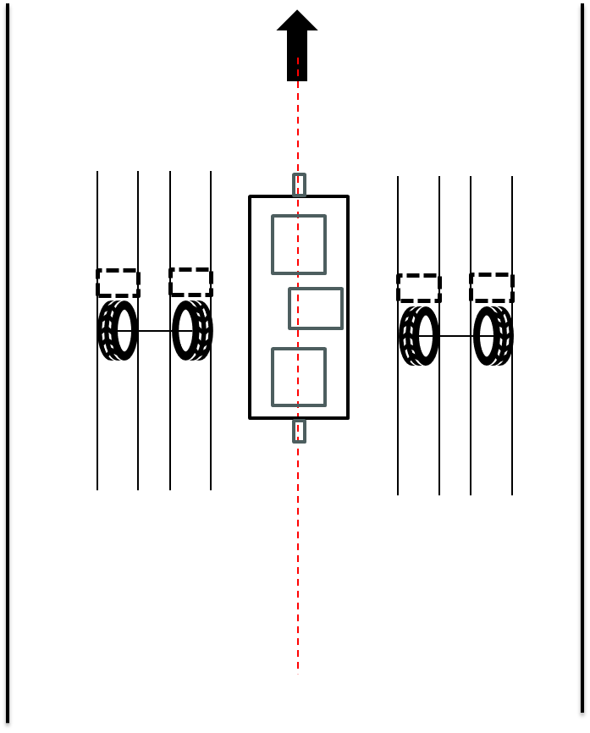
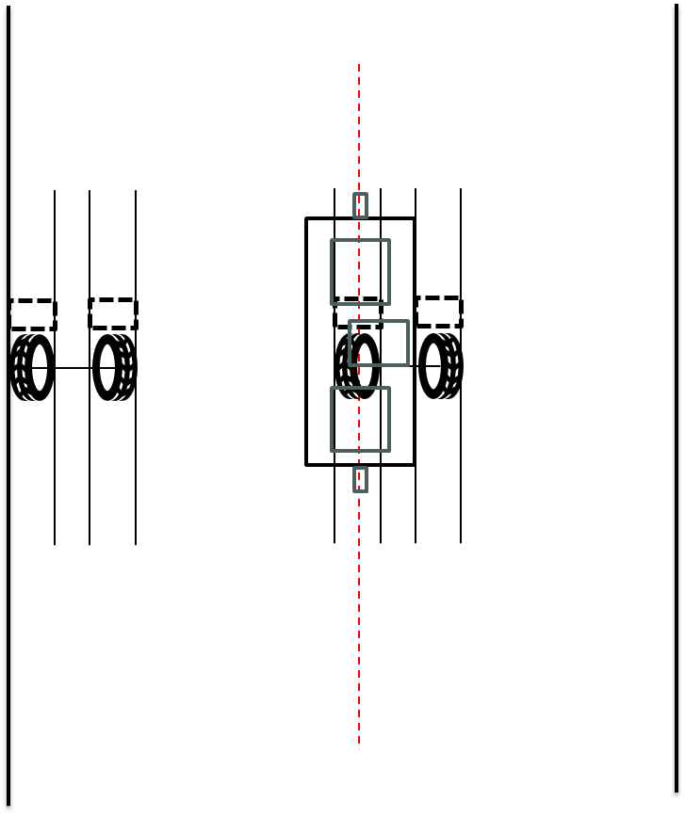
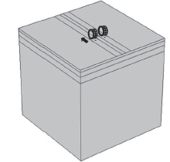
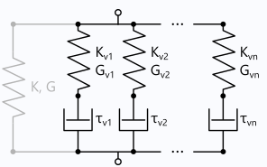

Mechanistic Modeling Using COMSOL
Mechanistic model
Solid structure + MEMS + PDE modulus
Boundary conditions
Single axle loading of 80kN
Moving speed of 90km/h
Wandering effect
Material property
Viscoelastic property of asphalt surface
Stress-dependent modulus for subsurface
Stress-dependent modulus model (the material modulus depends on stress state in the previous time step)
Model geometry
Sketch of viscoelastic model

Slide 10
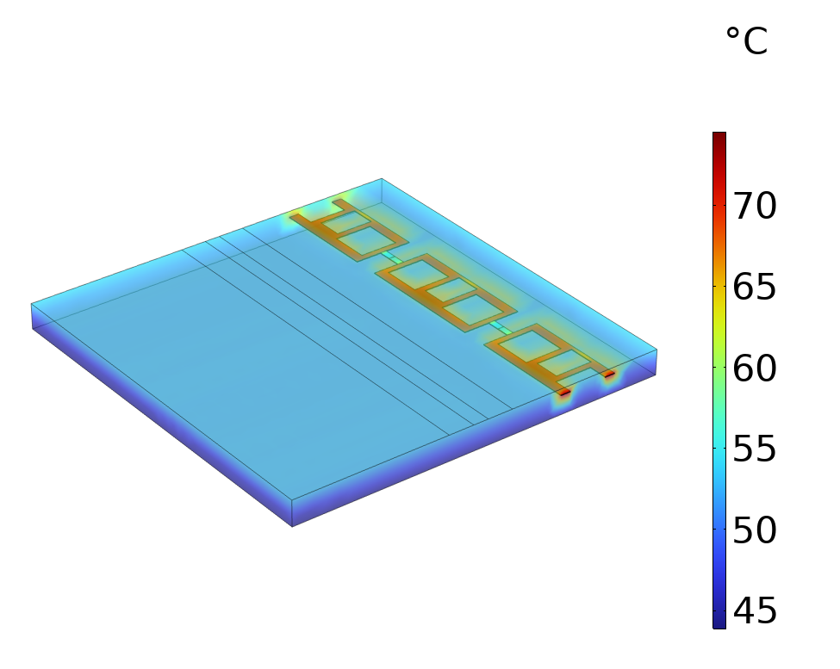
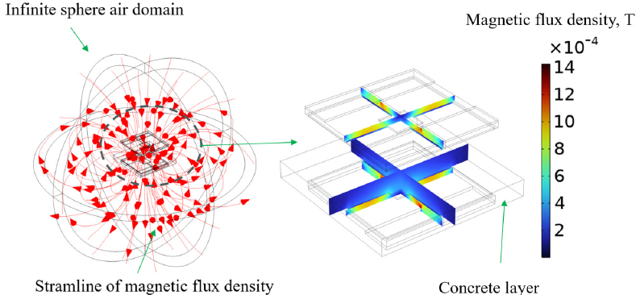
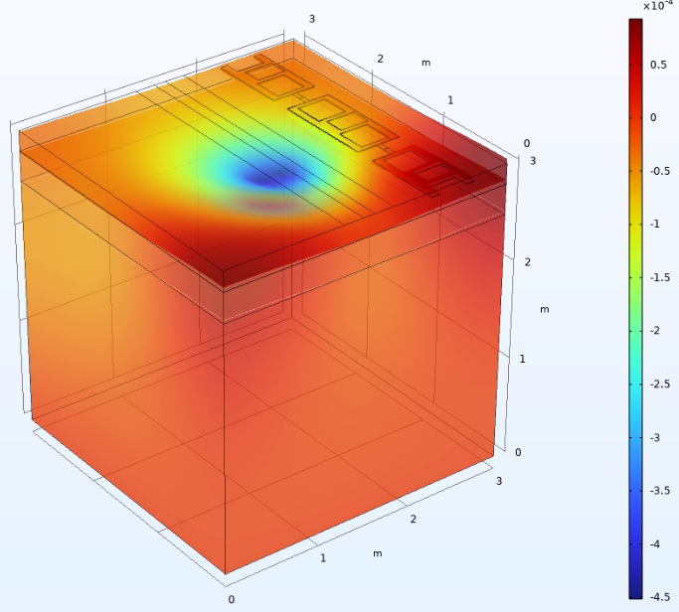


Integration of Electro-Thermal-Mechanical Model
Heat generation
Viscoelastic property change
Electromagnetic model
Thermal model
Mechanistic model
Magnetic field
Temeprature field
Structural responses

Slide 11
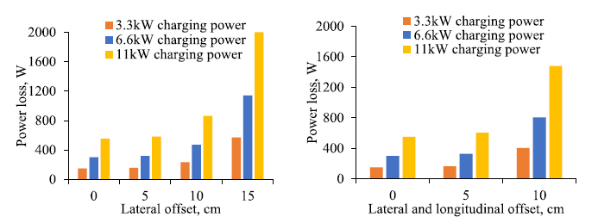
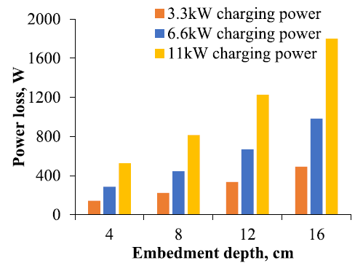
Results (1)
Power loss analysis from electromagnetic modeling
Various embedment depths
Various alignments

Slide 12
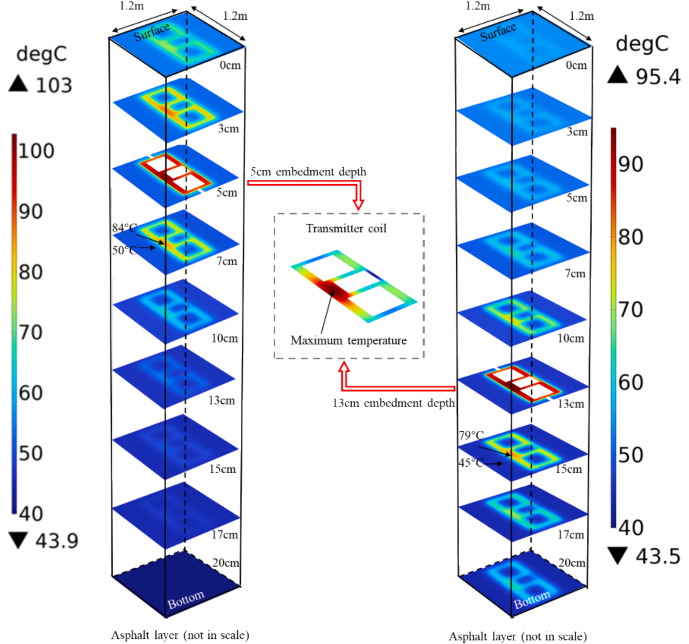
Results (2)
Temeprature distribution analysis from thermal modeling
Speed of 80km/h, headway distance of 30m and power loss of 15kW
Summer condition
13cm deep embedment
5cm deep embedment
5cm deep embedment
13cm deep embedment
Temperature profiles after peak-hour
Temperature profiles with time

Slide 13
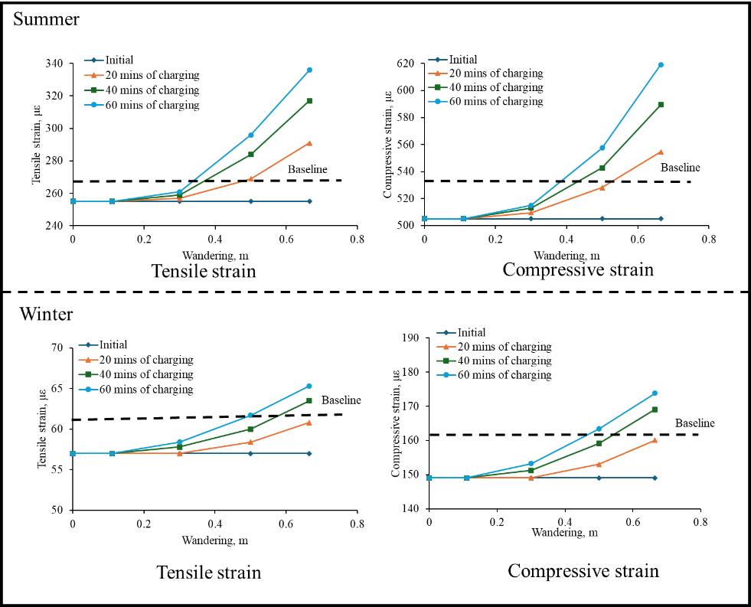
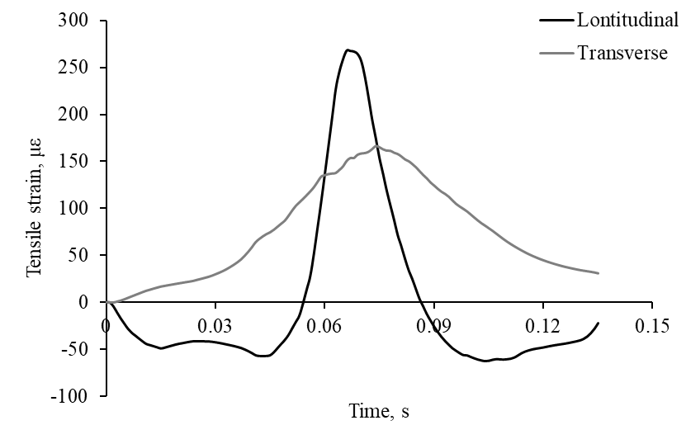
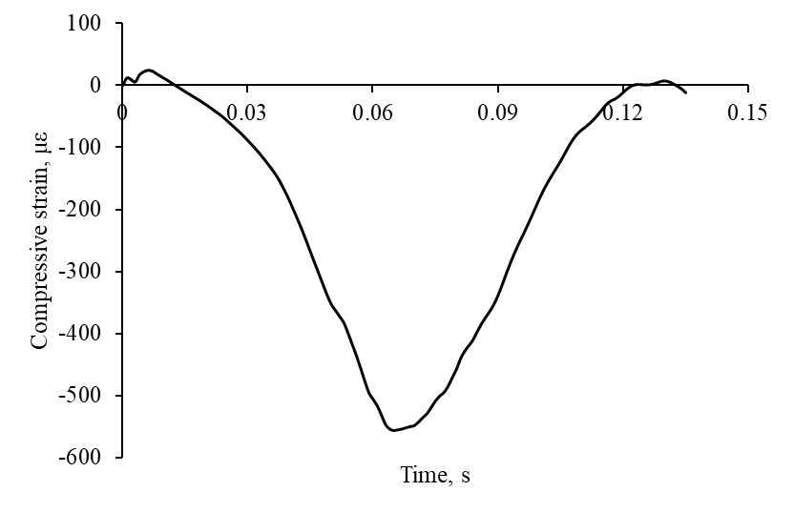
Results (3)
Structure response analysis from mechanistic modeling
Various lateral wandering
Various environmental conditions
5cm embedment depth
Example of time history curves of structural response
Critical structural responses with time and wandering

Slide 14
Conclusions
Electromagnetic analysis revealed the importance of magnetic coupling in power loss; thermal analysis highlighted the importance of power loss and traffic flow in temperature field; mechanstic analysis revealed the importance of temperature and wandering effect in structural responses.
To ensure the efficiency, safety, and long-term durability of electrified roadway pavements, a comprehensive multi-physics analysis is required.
COMSOL Multiphysics provides an integrated framework to simulate the complex coupled fields in electrified pavement systems.

Slide 15
Thank You
Questions?
Contact: xchen.cee@rutgers.edu
Related publications:
Chen, X., Wang, H., Zheng, Z., & Lu, F. (2025). Electro-thermal analysis of inductively coupled power transfer in pavement for electric vehicle charging. Applied Energy, 378, 124809.
Chen, X., & Wang, H. (2025). Thermal impact analysis of dynamic inductive charging in electrified roadway with asphalt pavement. Applied Thermal Engineering, 127885.
Zheng, Z., Chen, X., Wang, Y., Zhang, H., Wang, H., & Lu, F. (2025). High-Frequency Power Loss Investigation of Pavement Materials in Roadway Inductive Charging System. IEEE transactions on transportation electrification.
Chen, X., & Wang, H. Integrated Thermal-Mechanical Analysis of Wireless Power Transfer Through Roadway Pavement. Accepted presentation in Transportation Research Board Annual Meeting 2026.

