Slide 1
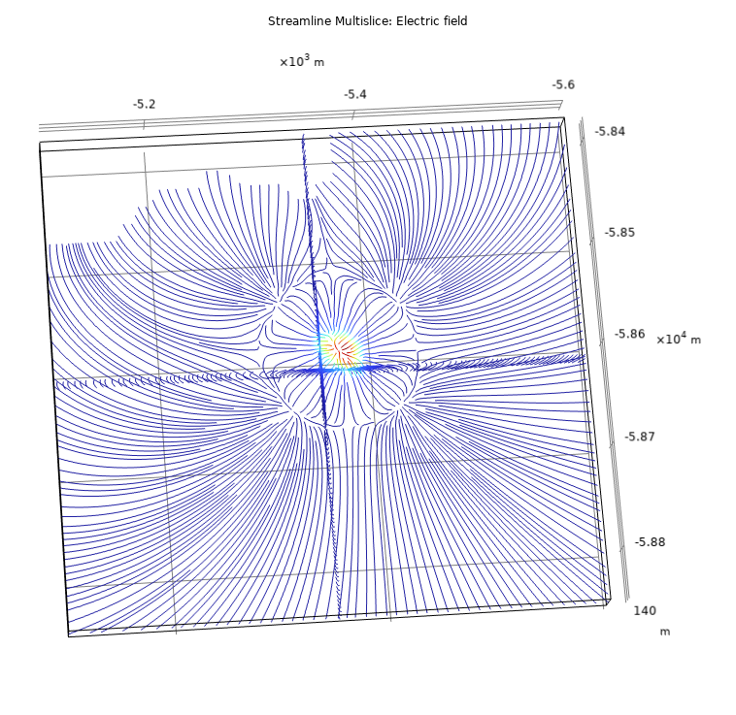
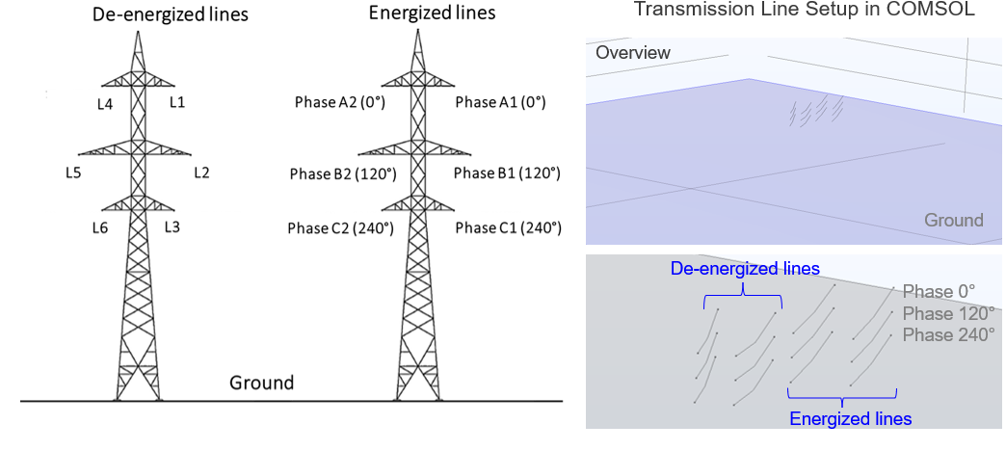
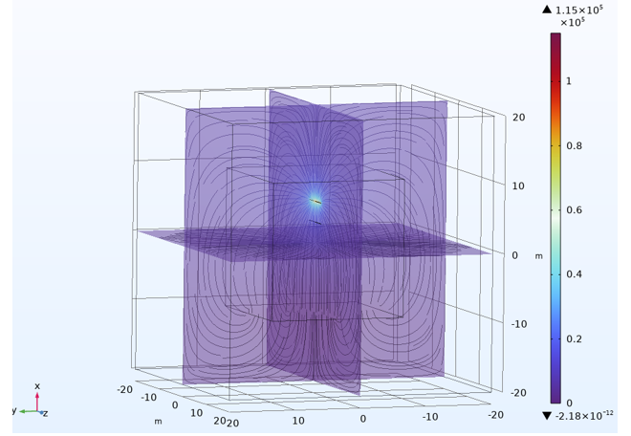
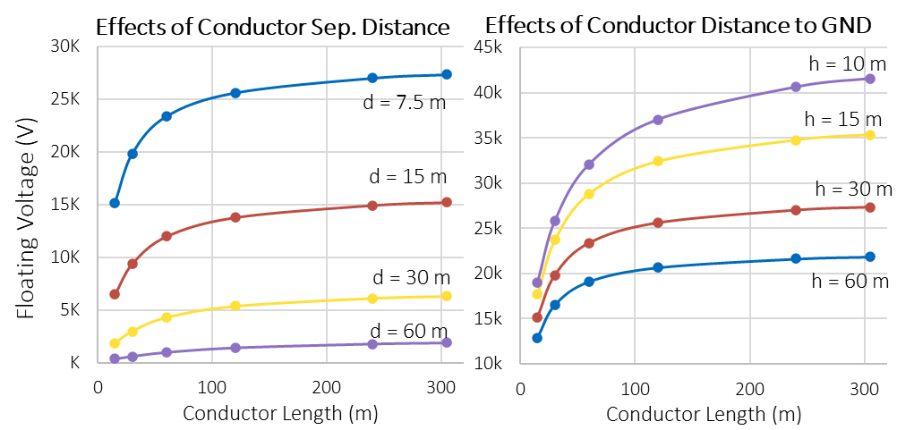
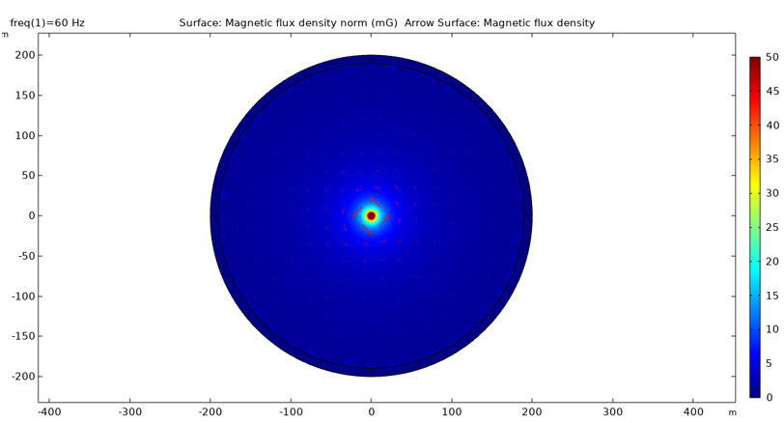

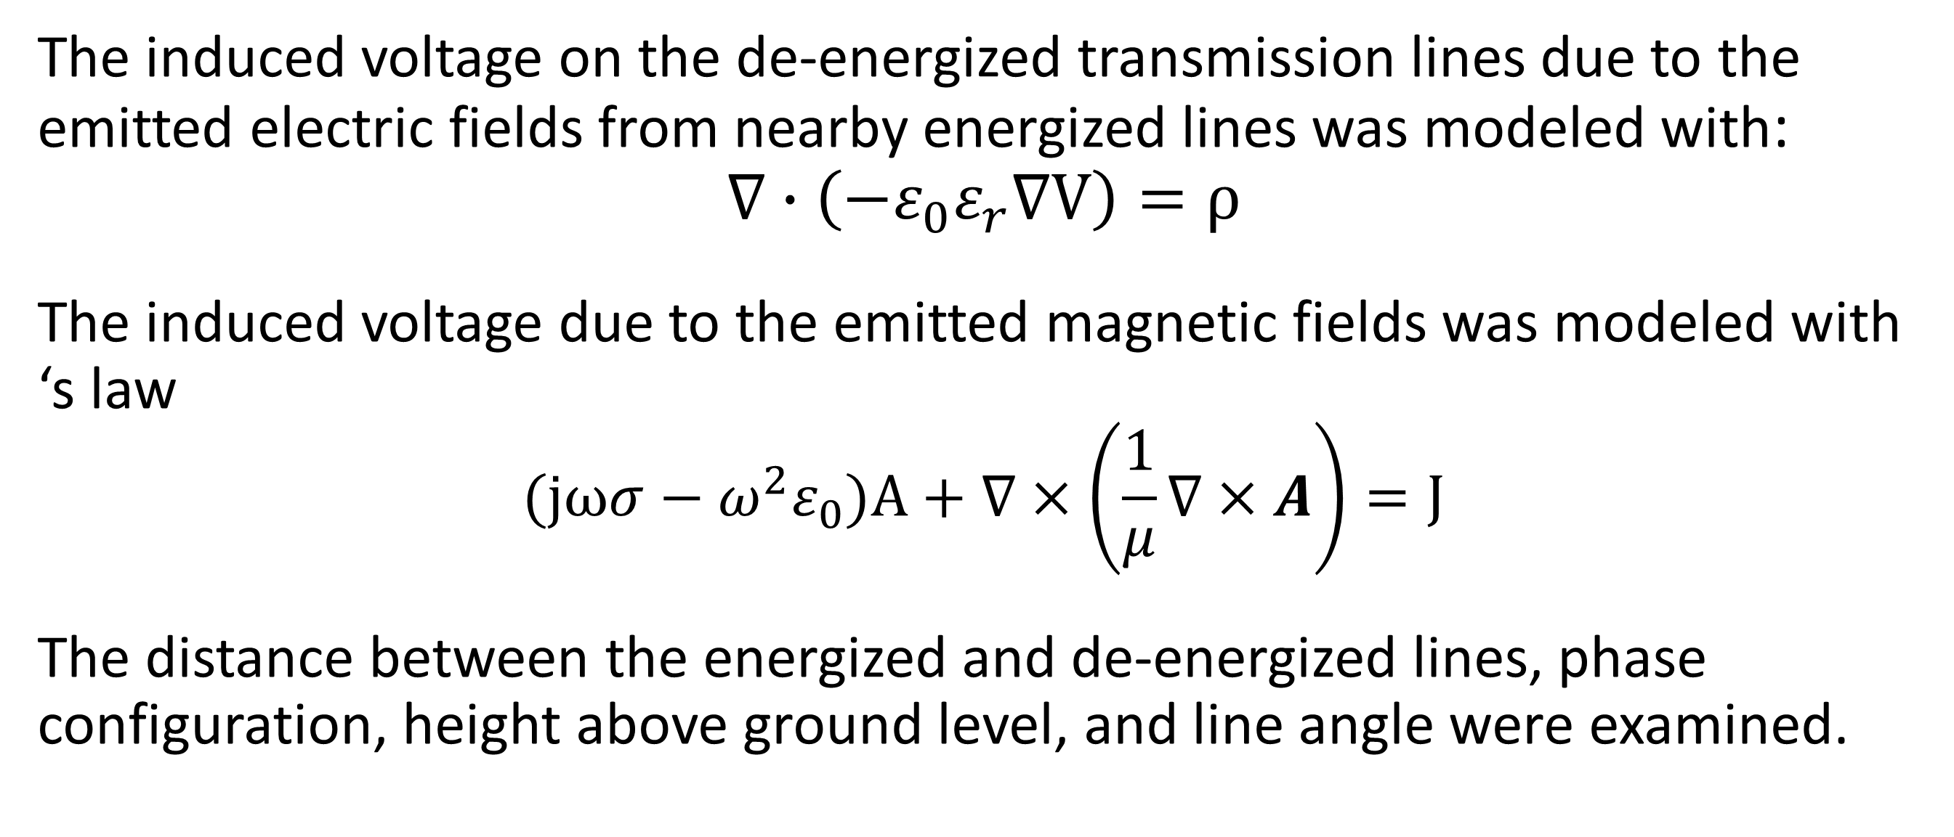
Induced Voltage of Overhead De-energized Transmission Lines
Investigate wildfire risks and public hazard by quantifying the voltages induced on de-energized lines from nearby energized lines under a public safety power shutoff situation
Susan Han, Ph.D., CFEI
Electrical Engineering and Computer Science Practice, Exponent, Inc.
Abstract
The utility company may shut off power in the overhead transmission or distribution lines as a preventative measure against wildfire risks and to ensure public safety. However, the de-energized transmission lines can still carry energy due to induced voltage from the electric- and magnetic-fields emitted from nearby energized lines, which pose an ignition risk should they fall and contact combustible ground fuels.
This presentation discusses the use of COMSOL (Electrostatics, Boundary Elements and Magnetic Fields interfaces in the AC/DC module) to calculate voltages induced on de-energized lines from nearby energized lines. We started with a simplified model. The induced voltage from the capacitive coupling effect is of orders of magnitude larger than that from the inductive effect. We then used realistic transmission line configurations with two sets of energized and de-energized transmission lines, respectively. The predicted induced voltage can serve as an input to the electrical and thermal arcing models to calculate of the probability of ignition.
Methodology
The induced voltage on the de-energized transmission lines due to the emitted electric fields from nearby energized lines was modeled with:
$$∇∙\left(−ε_{0}ε_{r}∇V\right)=ρ$$
The induced voltage due to the emitted magnetic fields was modeled with ‘s law
$$(jωσ−ω^{2}ε_{0})A+∇×\left(\frac{1}{μ}∇×A\right)=J$$
The distance between the energized and de-energized lines, phase configuration, height above ground level, and line angle were examined.
Figure 1. Phase configuration and spatial arrangement of the realistic transmission lines and their 3D setup in COMSOL.
Results
(a)
Two straight parallel transmission lines were evaluated at various lengths and at varying distances (d) from each other and height (h) above ground. One of the lines is energized to 115 kV while the other is de-energized and floating. The induced voltage on the de-energized floating line is shown in Figure 2 for selected configurations.
As the distance between the two transmission lines decreases, the floating voltage on the de-energized line increases quickly. A similar trend in the floating voltage was observed as the distance from the transmission lines to the ground decreases. In most cases, the floating voltage is in the kilo-volts range and increases as the conductor lines extends.
(c)
(b)
Figure 2. (a) Simplified transmission lines arrangement and visualization of the electric potential. (b) Visualization of the magnetic flux density around the energized line. (c) Floating voltage induced on a de-energized straight transmission line parallel with another transmission line energized to 115 kV. Various factors were investigated.
1. Golder Associates Inc. Induced Voltage and Current Report - A Review of Public Hazards Associated with High-Voltage Transmission Lines. Oregon Department of Energy. 073-99810-29 and 073-99810-31, 2013.
2. Allen Taflove, Prediction Method For Buried Pipeline Voltages Due To 60 Hz AC Inductive Coupling. IEEE Transaction on Power Apparatus and Systems, Vol. PAS-98, No. 3, 1979.
3. Xuan Wu, et al., Transient Analysis of Inductive Induced Voltage between Power Line and Nearby Pipeline. Electrical Power and Energy Systems. Vol. 84, No. 47-54, 2017.
4. Mazen Abdel-Salam, Abdallah Al-Shehri. Induced Voltages on Fence Wires and Pipelines by AC Power Transmission Lines. Vol. 30, No. 2, 1994.

