Slide 1
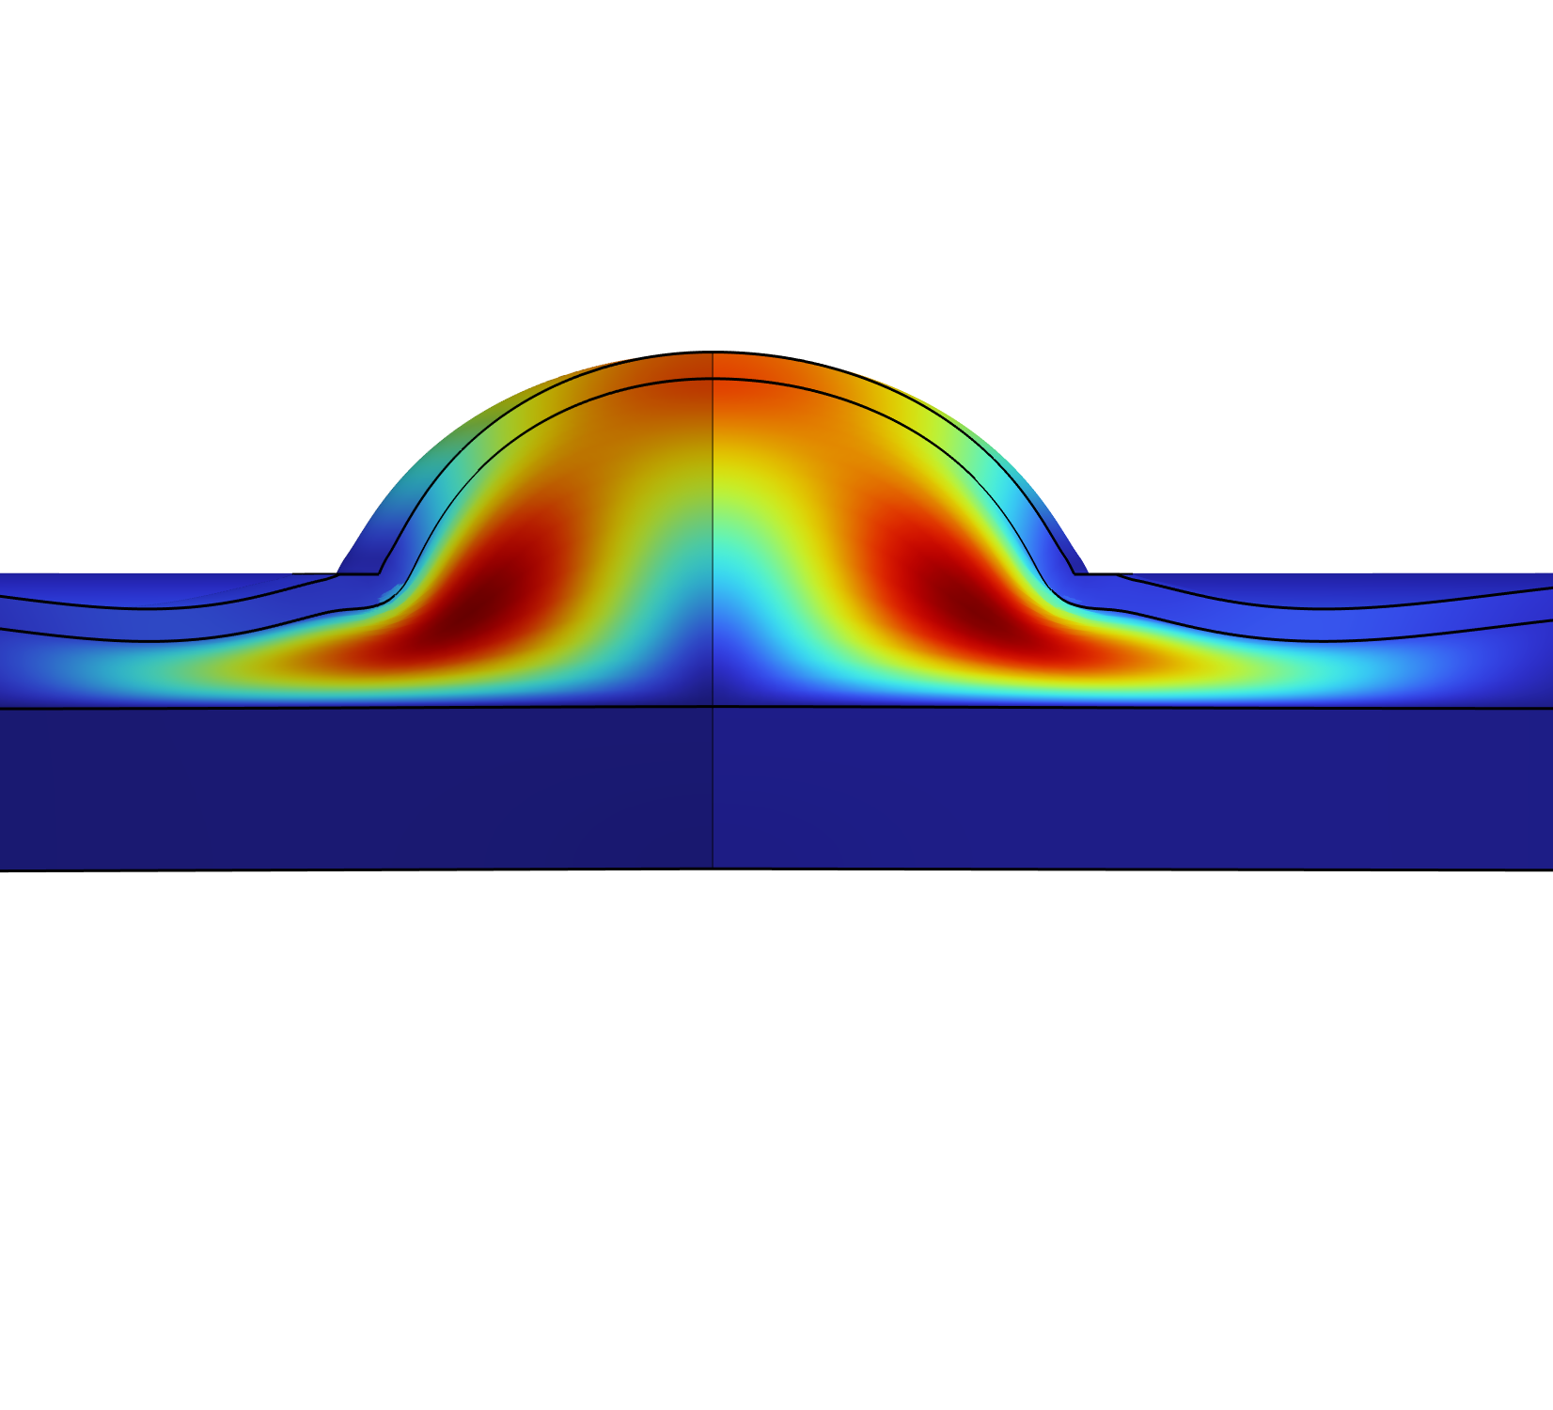
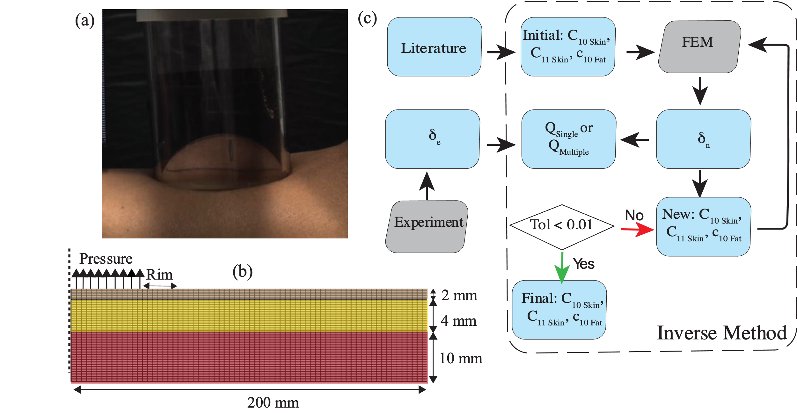
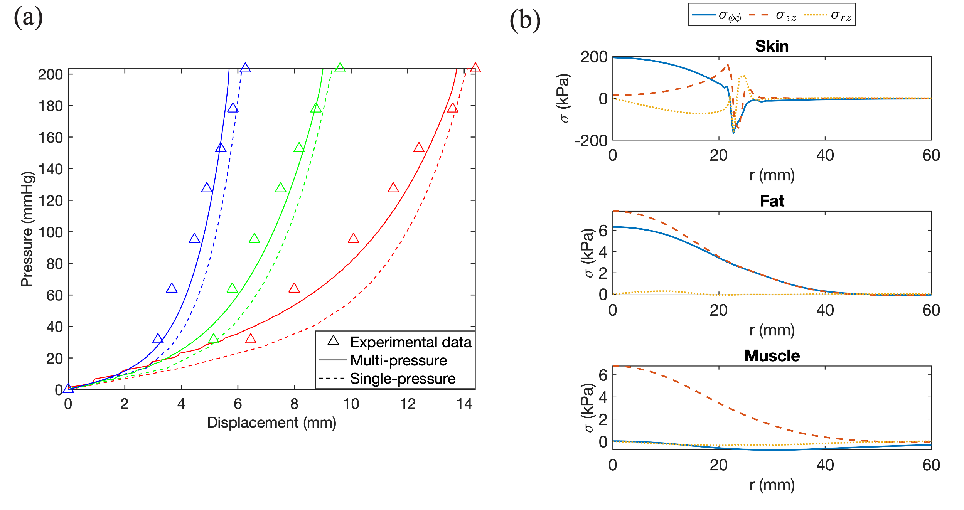

Impact of Pressure and Fat Thickness on Tissue Biomechanics During Large Deformation
We examine how the biomechanics of skin and fat vary with suction pressure, aperture size, and fat thickness to advance our understanding of tissue response in therapies that incorporate localized suction.
E. Etim¹, B. Martinez², J. A. Cagua³, E. Pinto-Rodriguez⁴, J. Jimenez-Lozano⁵, G. Frangineas⁵, W. Franco^{1,6}
1. Department of Biomedical Engineering, University of Massachusetts Lowell, Lowell, MA, USA.
2. Department of Chemistry, University of Puerto Rico at Mayaguez, Mayaguez, PR, USA.
3. Department of Industrial Engineering, University of Puerto Rico, San Juan, PR, USA.
4. Department of Mechanical Engineering, University of Massachusetts Lowell, Lowell, MA, USA.
5. Allergan Aesthetics, AbbVie Inc., Irvine, CA, USA
6. Department of Dermatology, University of Massachusetts Chan Medical School, Worcester, MA, USA.
Skin and Fat Biomechanics
Suction pressure elevates skin, fat, and muscle to varying degrees, depending on the pressure and contact area, producing layer-specific stress responses. Computational modeling helps reveal these stress patterns, enabling better prediction of device effects and assessment of extreme loading conditions.
Skin is a multilayered tissue comprising the epidermis, the collagen- and elastin-rich dermis, and the foam-like hypodermis (subcutaneous fat). The dermis deforms anisotropically due to fiber orientation, while the hypodermis behaves as an energy-absorbing layer because of its collagen matrix enclosing lipid-filled adipocytes.
Although most mechanical characterization has used suction devices with apertures under 10 mm, clinical applications such as cupping therapy, laser-assisted PWS removal, and some cryolipolysis applicators often utilize larger apertures of 30–65 mm, underscoring the need to evaluate a broader range of loading geometries.
Methodology
COMSOL’s Optimization Module was used to perform inverse calculations of tissue properties to match skin displacement at specific pressures and aperture sizes. The skin, fat, and muscle layers were modeled as incompressible, single-phase materials with strain energy density functions that describe their stress–strain relations. Two objective functions were applied: a squared relative error to fit properties at peak pressure (203.2 mmHg) and a least-squares objective to minimize error across seven pressure levels (31.75–203.2 mmHg). Skin was described using a polynomial formulation, fat with a single-parameter Mooney–Rivlin model, and muscle with an Ogden formulation. Suction was simulated for 16, 30, and 50 mm apertures under uniform pressure loading, with fixed outer boundaries and a roller constraint at the cup rim to restrict vertical displacement.
Figure 1. (a) Deformation of skin under suction pressure with a 50 mm applicator at 203.2 mmHg. (b) Discretization of skin (2 mm), fat (4 mm), and muscle (10 mm) domains using mapped quadrilateral mesh. A uniform pressure was applied to the skin surface along radius R (axisymmetric cross-section). A roller boundary condition was applied at the cup rim (3 mm), and a prescribed displacement of zero was enforced along the vertical boundary in the radial direction and at the bottom of the muscle layer in the axial direction. (c) Flowchart outlining the inverse method used to identify hyperelastic constants.
Results
Parameter Estimation: Properties from one aperture failed to generalize (50 mm fit: 15% error at 30 mm, >40% at 16 mm); multi-pressure optimization reduced errors to 5–8%.
Stress Distribution: Peak stresses occurred in skin near suction center; compliant fat showed low stress but large deformation. Muscle Response: Muscle stresses were lower but broadly distributed, amplified with decreased fat thickness.
Implications: Tissue response variability risks under-treatment or damage with fixed settings. Quantified hyperelastic properties across apertures and thicknesses fill a critical knowledge gap, providing design parameters for optimized suction devices and enabling personalized treatment based on individual characteristics.
Figure 2. (a) Experimentally measured and simulated pressure-displacement curves for a participant with 4 mm fat thickness using 50 mm (red), 30 mm (green), and 16 mm (blue) apertures. The continuous line is for the multi-pressure optimization and the dashed line is for the single pressure optimization. (b) Circumferential (blue), axial (orange), and shear (yellow) stress distributions at the mid-depth of the skin, fat, and muscle layers at a pressure of 203.2 mmHg.
1.Joodaki H, Panzer MB. Skin mechanical properties and modeling: A review. Proceedings of the Institution of Mechanical Engineers, Part H: Journal of Engineering in Medicine. 2018;232(4):323-343. ​
2. Tham LM, Lee HP, Lu C. Cupping: from a biomechanical perspective. J Biomech. 2006;39(12):2183-93.

