Slide 1
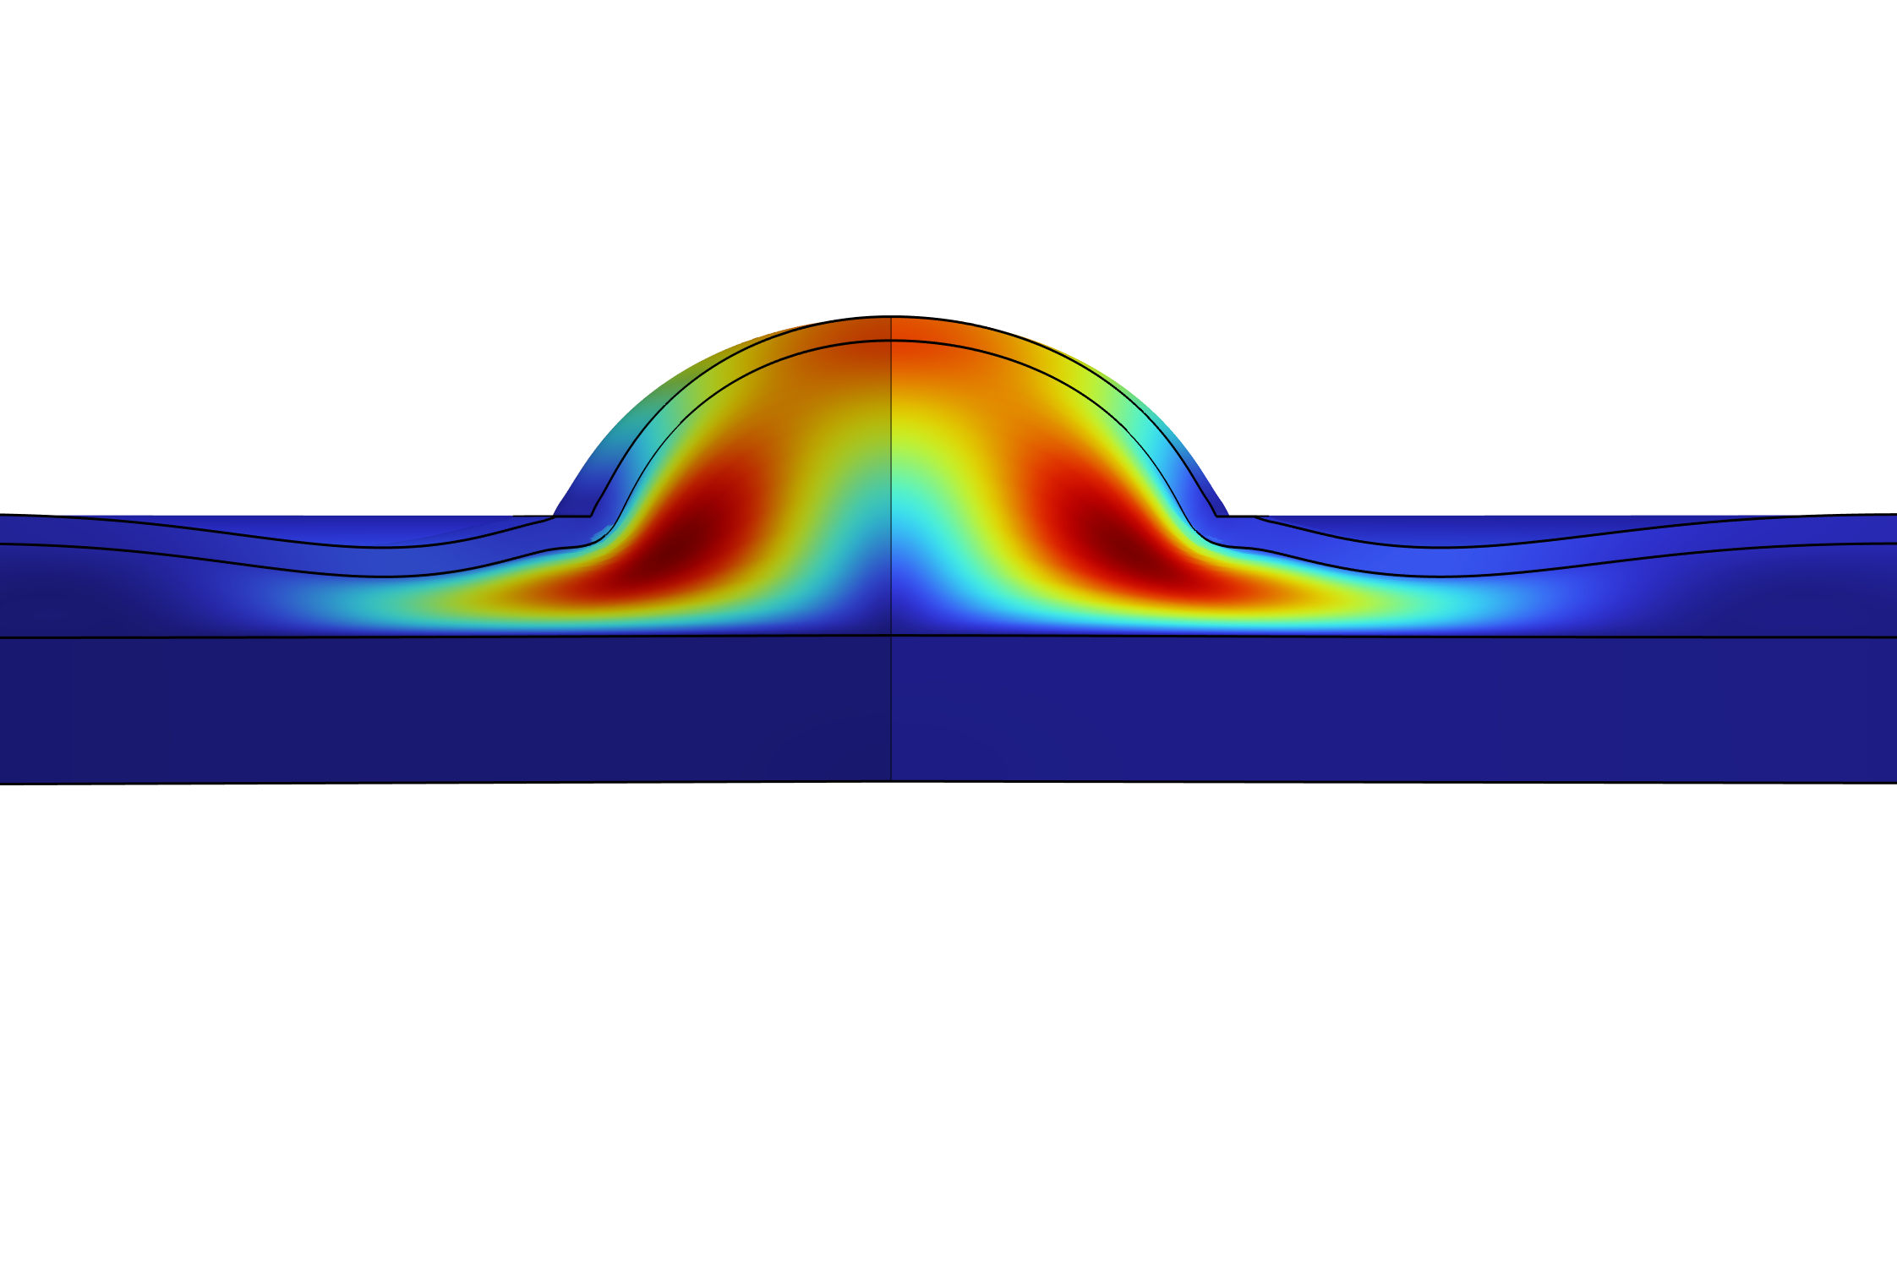
Impact of Pressure and Fat Thickness on Tissue Biomechanics During Large Suction Deformation
E. Etim, B. Martinez, J. A. Cagau, E. Pinto-Rodriguez, J. J. Lozano, G. Frangineas, W. Franco

Slide 2
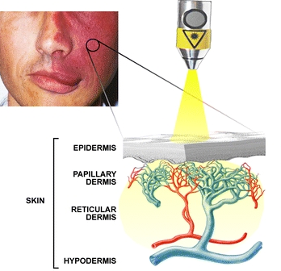
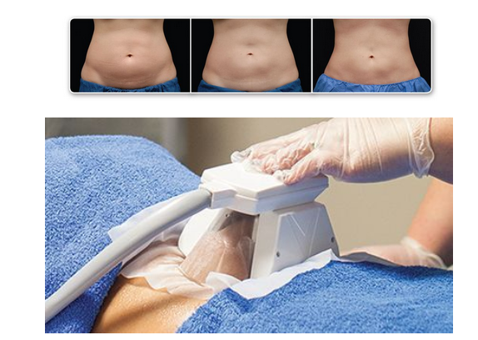
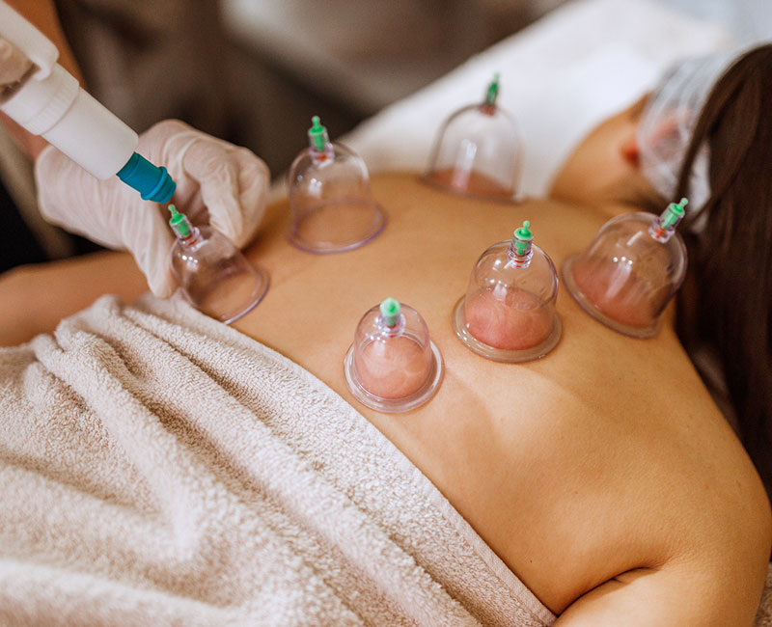
The use of Suction pressure in medical devices
Cryolipolysis for Fat Reduction
Cupping Therapy for Pain Relief and Recovery
Laser Treatment for Port Wine Stain Removal
Aguilar et al 2011; Sarah M Aesthetics; Cleaveland Clinic
Notes:
PWS (a birthmark caused by dilated, abnormal vessels/capillaries in the skin): Suction pressure helps increase blood flow and flatten skin for more effective blood flow.
Cryolipolysis (external non-invasive fat reduction): to pull in skin and fat before cooling, increases surface area and improves outcome
Cupping therapy (traditionally for pain relief and recovery): stimulate circulation and promote healing

Slide 3
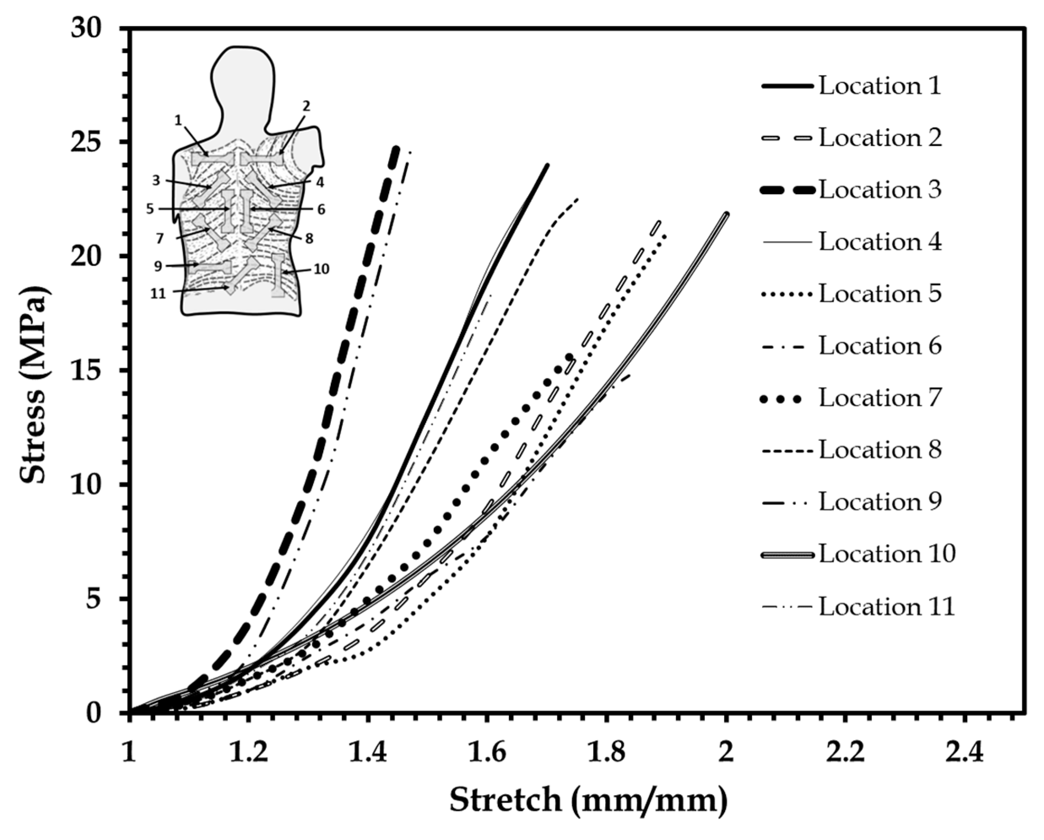
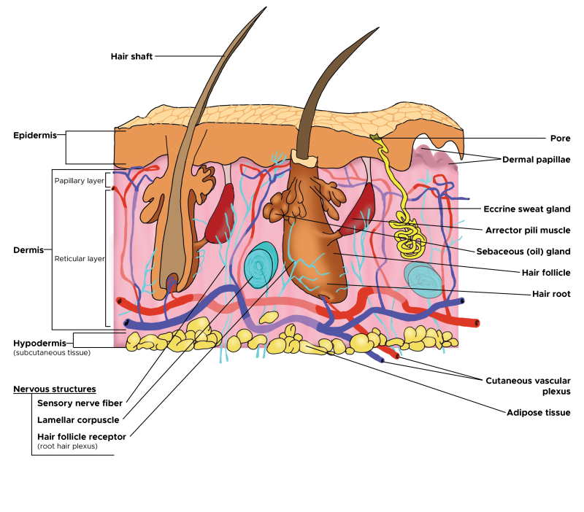
Biomechanical Properties of skin and fat
Skin and fat exhibit nonlinear, anisotropic, and viscoelastic properties.
Yousef et al. 2024; Chanda, 2018
Notes:
Skin
Largest organ in the body in terms of surface area
Purpose: defense, regulate body temperature
In medical devices whether invasive or non invasive, knowing the biomechanical properties of skin is important
Mechanically complex due to its multiple layers
Hypodermis
Often known as subcutaneous fat
It contains fat lobules, bigger blood vessels, nerves and connective tissues to connect skin to the fascia of muscles and bones
Below the hypodermis is the
Muscle
*

Slide 4
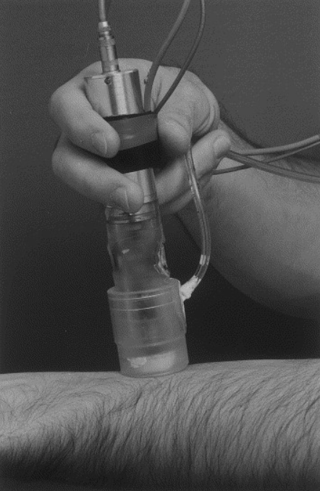
Computational modeling is a vital tool for predicting tissue response
Computational models are useful in
Device design and optimization
Exploring anatomical variability
Current models used to characterize the mechanical properties of skin with suction pressure are limited to
Small aperture sizes (<10 mm) which mostly result in significant skin deformation and minimal fat deformations.
Non-clinical/ therapeutic pressures (under 90 mmHg / 3.54 inHg)
Skin only deformation with absence of fat layer
Not using patient fat thickness
Etim et al., in preparation, 2025; Chanda, 2018

Slide 5
What are we investigating
The variability in the hyperelastic properties of skin and fat as a function of:
Clinically relevant aperture size
Clinically relevant loading pressure
Anatomically accurate fat thickness
To more accurately predict skin and fat mechanical response to different suction based devices.

Slide 6
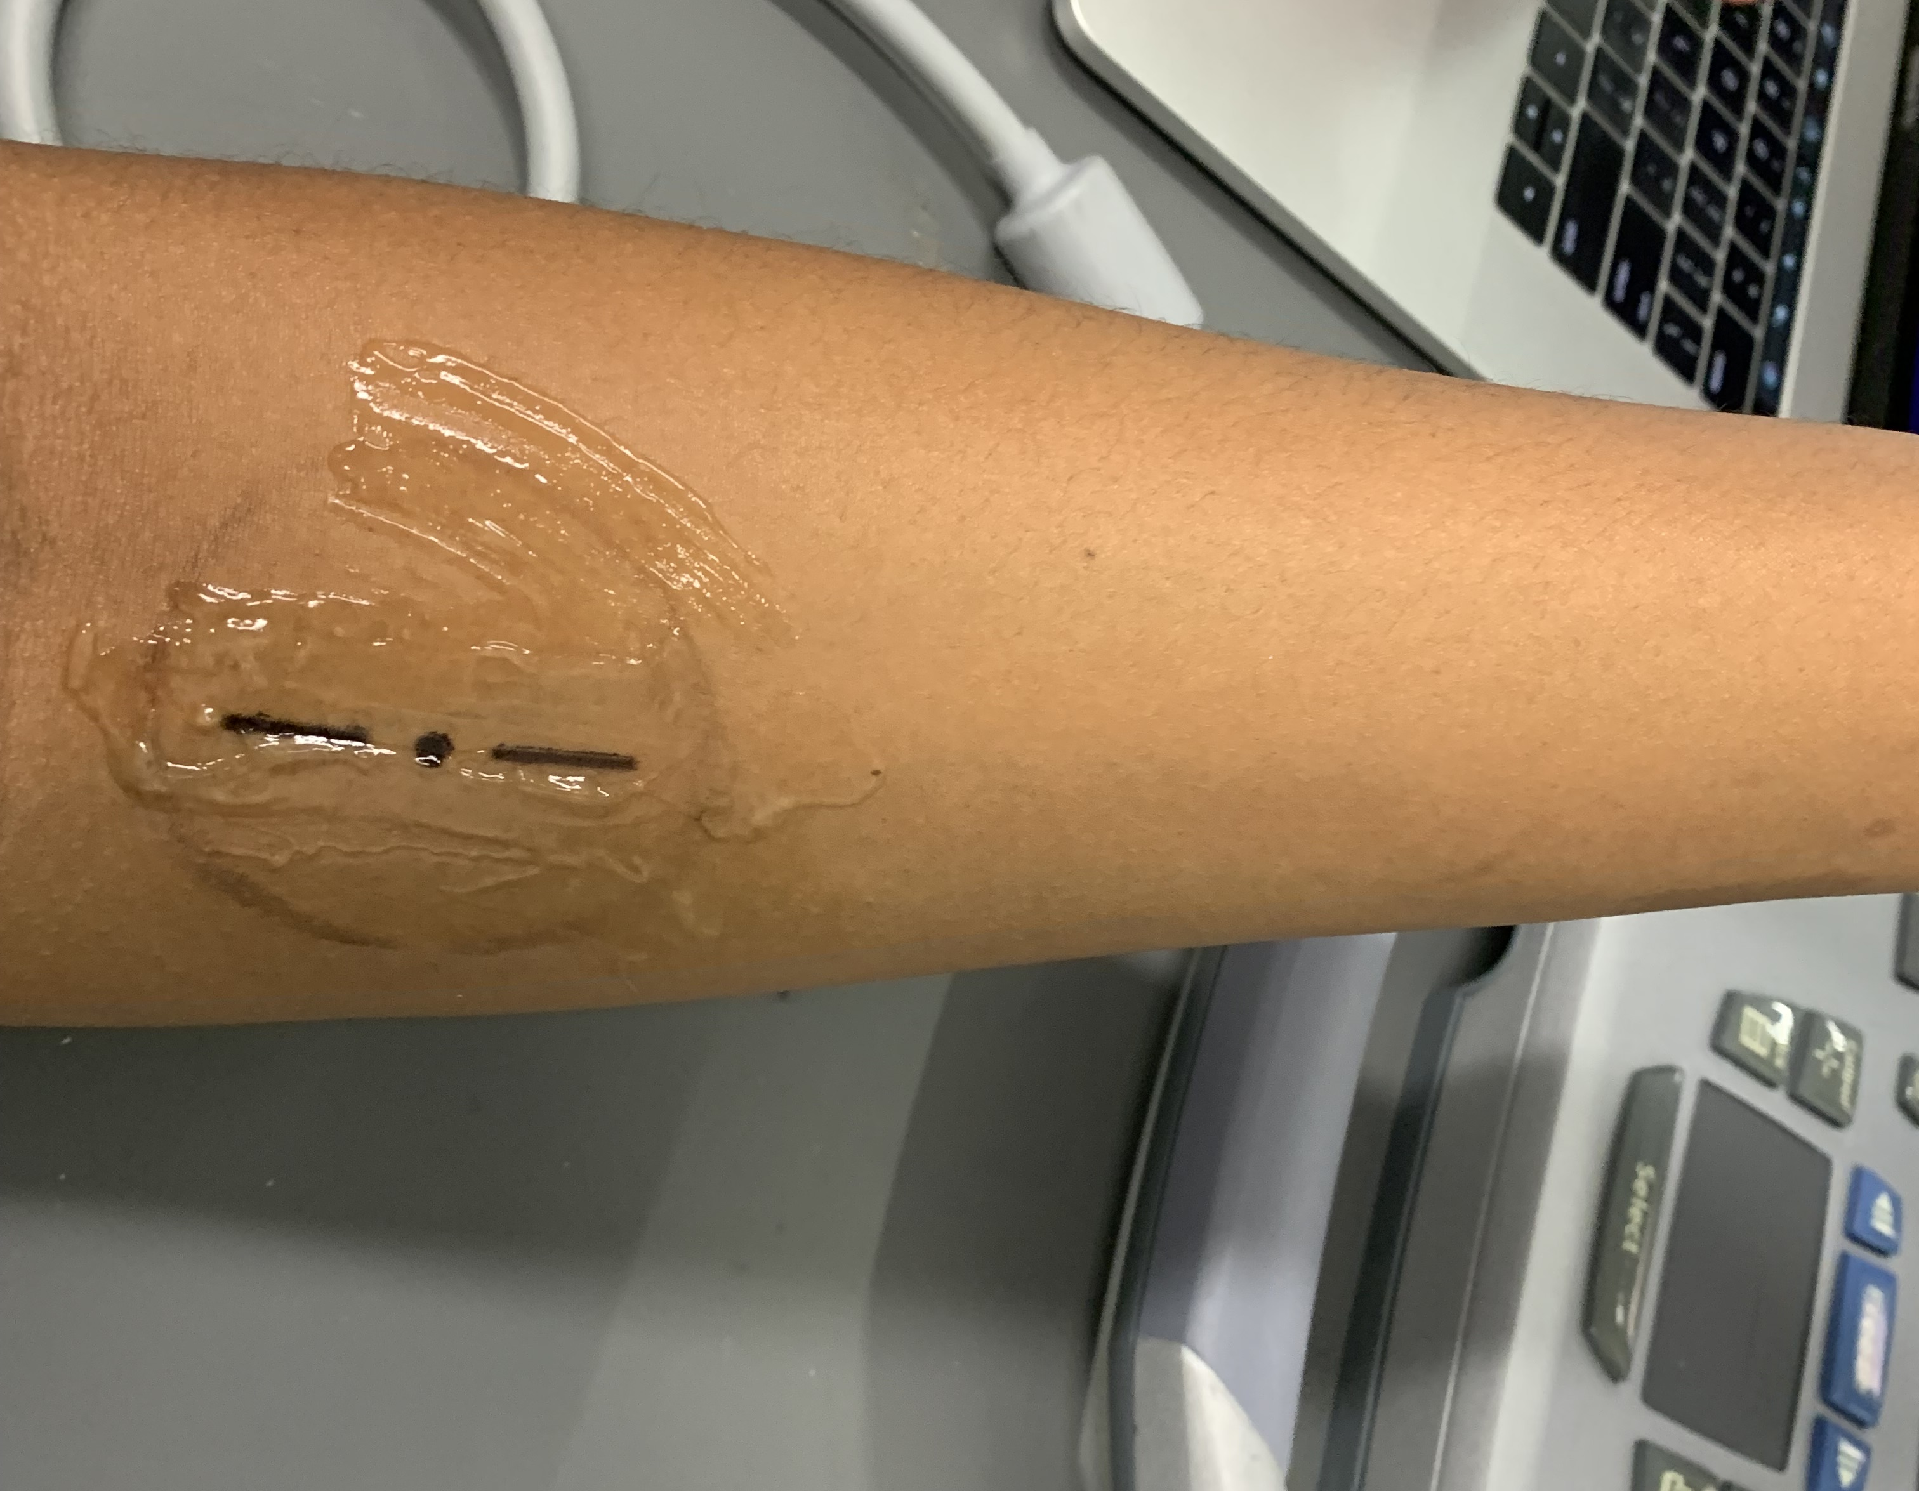
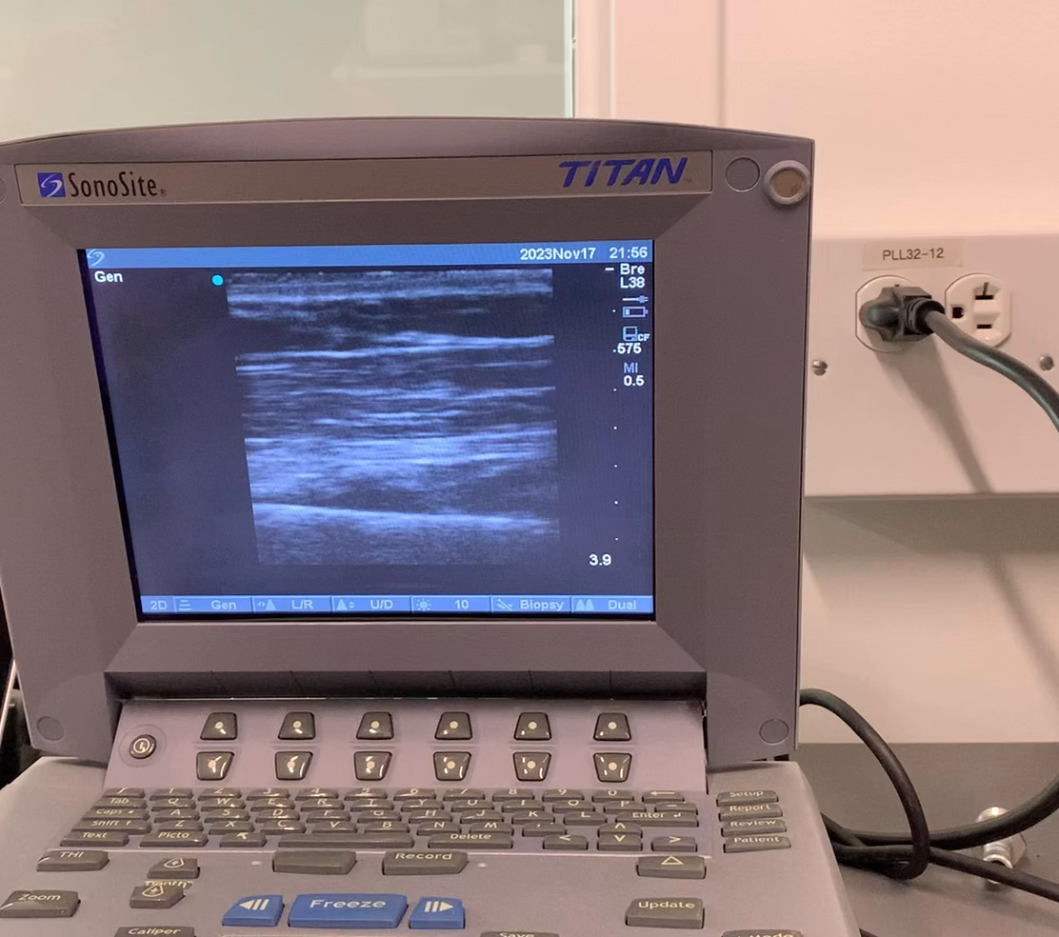
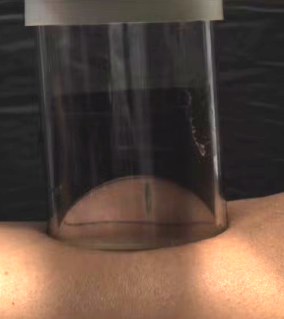
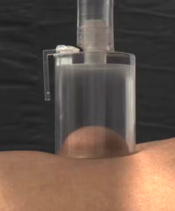
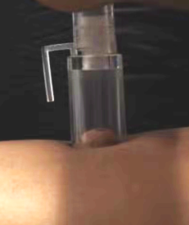
Experimental methods
Suction experiment on the forearm using vacuum pressure
IRB Protocol 24-131-FRA-XPD
Fat thickness was measured using ultrasound.
50 mm
30 mm
16 mm

Slide 7
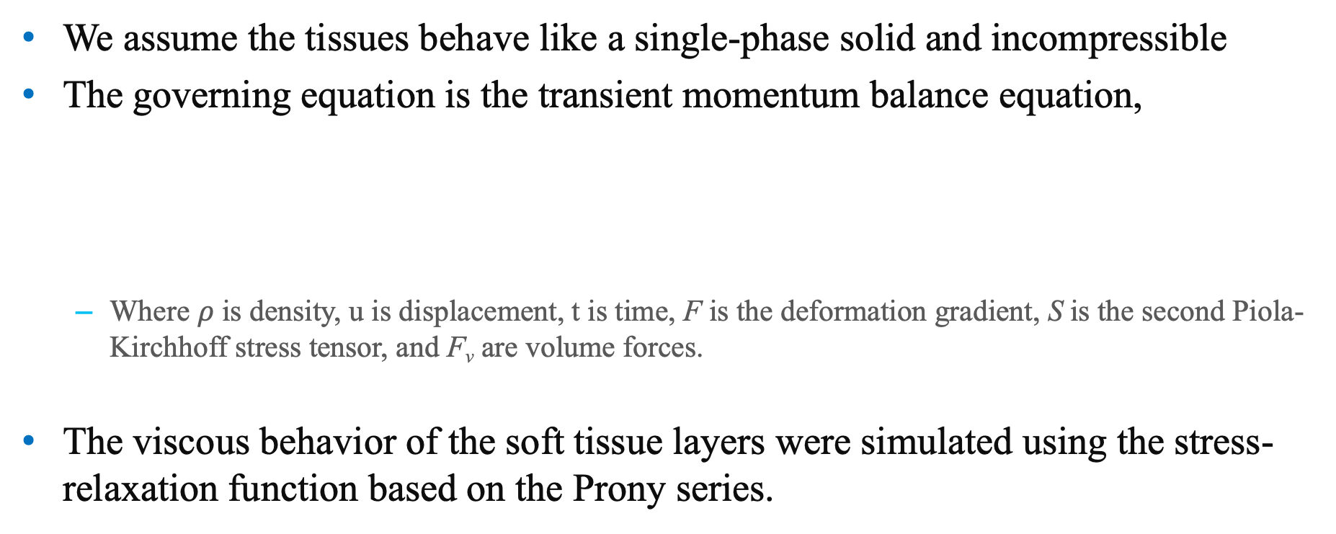
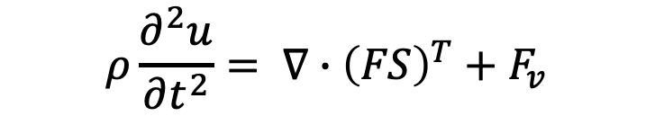
Governing equation
We assume the tissues behave like a single-phase solid and incompressible
The governing equation is the transient momentum balance equation,
Where $ρ$ is density, u is displacement, t is time, F is the deformation gradient, S is the second Piola-Kirchhoff stress tensor, and F_{v} are volume forces.
The viscous behavior of the soft tissue layers were simulated using the stress-relaxation function based on the Prony series.
$$ρ\frac{∂^{2}u}{∂t^{2}}= ∇∙{\left(FS\right)}^{T}+F_{v}$$
Etim et al., in preparation, 2025

Slide 8
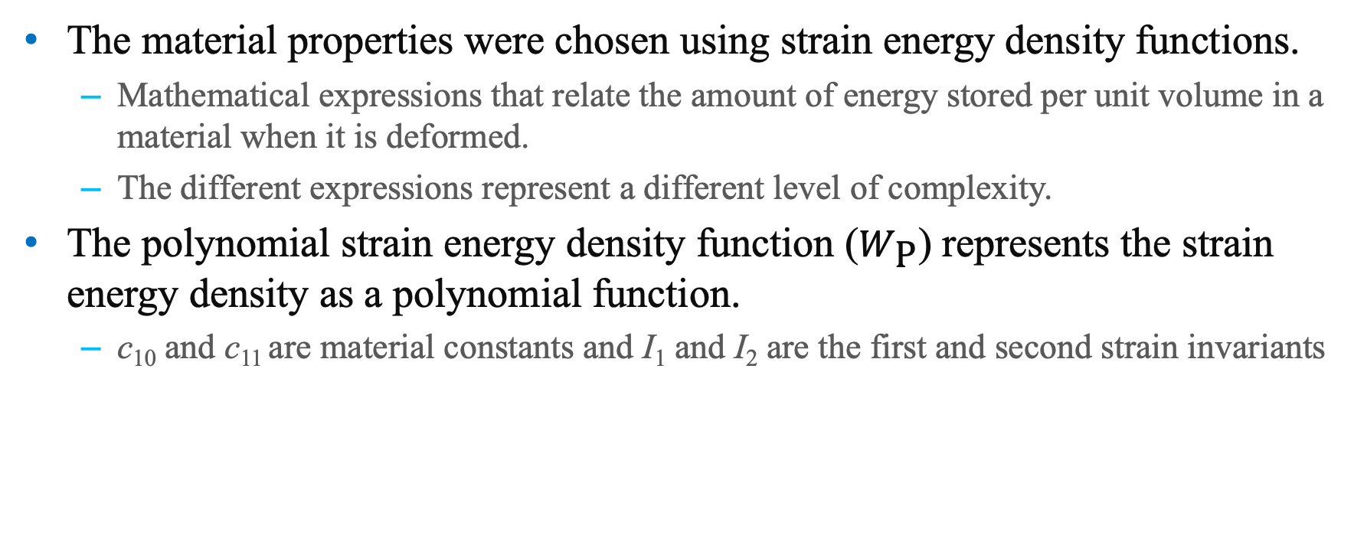
Constitutive relations
The material properties were chosen using strain energy density functions.
Mathematical expressions that relate the amount of energy stored per unit volume in a material when it is deformed.
The different expressions represent a different level of complexity.
The polynomial strain energy density function ($W_{\text{P}}$) represents the strain energy density as a polynomial function.
c₁₀ and c₁₁ are material constants and I₁ and I₂ are the first and second strain invariants
$$W_{\text{P}}=c_{10}\left(I_{1}−3\right)+c_{11}(I_{1}−3)(I_{2}−3)$$
Etim et al., in preparation, 2025

Slide 9
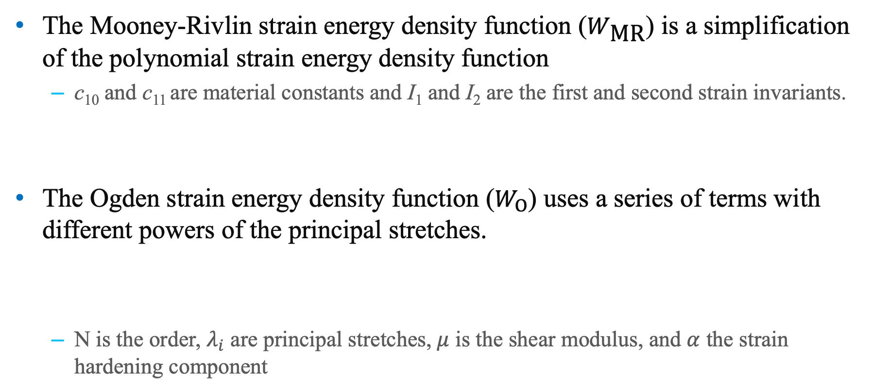
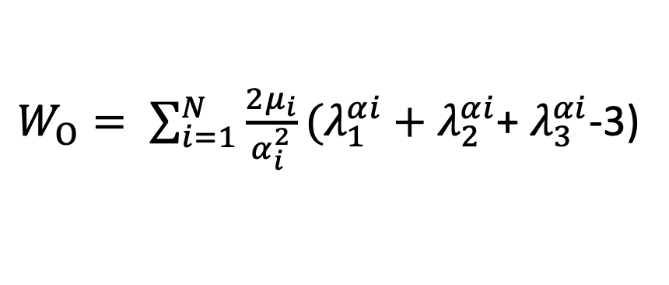

Constitutive relations
The Mooney-Rivlin strain energy density function ($W_{\text{MR}}$) is a simplification of the polynomial strain energy density function
c₁₀ and c₁₁ are material constants and I₁ and I₂ are the first and second strain invariants.
The Ogden strain energy density function ($W_{O}$) uses a series of terms with different powers of the principal stretches.
N is the order, $λ_{i}$ are principal stretches, $μ$ is the shear modulus, and $α$ the strain hardening component
$$W_{\text{MR}}=c_{10}\left(I_{1}−3\right)$$
$W_{O}= \sum_{i=1}^{N}{\frac{2μ_{i}}{α_{i}^{2}}}(λ_{1}^{αi}+λ_{2}^{αi}$+ $λ_{3}^{αi}$-3)
Etim et al., in preparation, 2025

Slide 10
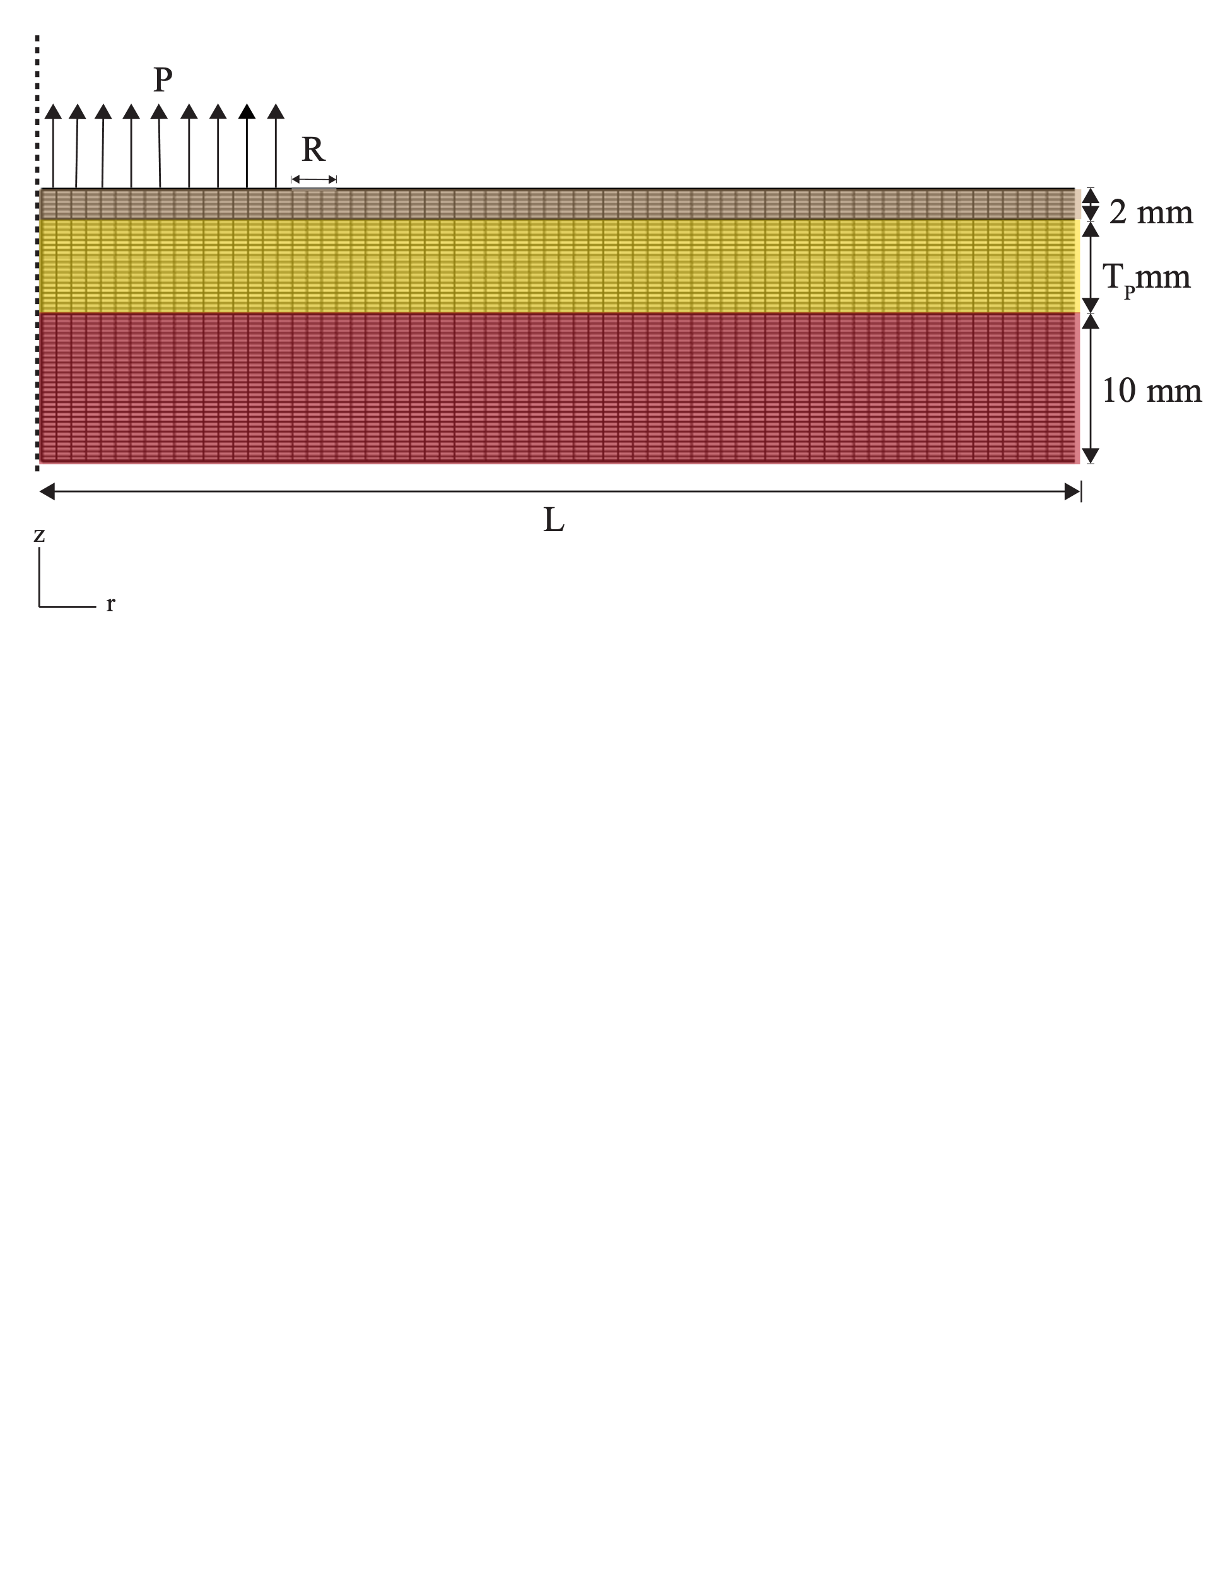
Modeling geometry and boundary conditions
Modeling Geometry
200 mm long domain with fixed skin and muscle thicknesses.
Boundary conditions
Uniform pressure along cross-section corresponding to radius
No friction between layers or surface with rim.
Skin
Fat
Muscle
Discretization
Uniformly mapped quadrilateral mesh in each domain.
Etim et al., in preparation, 2025

Slide 11
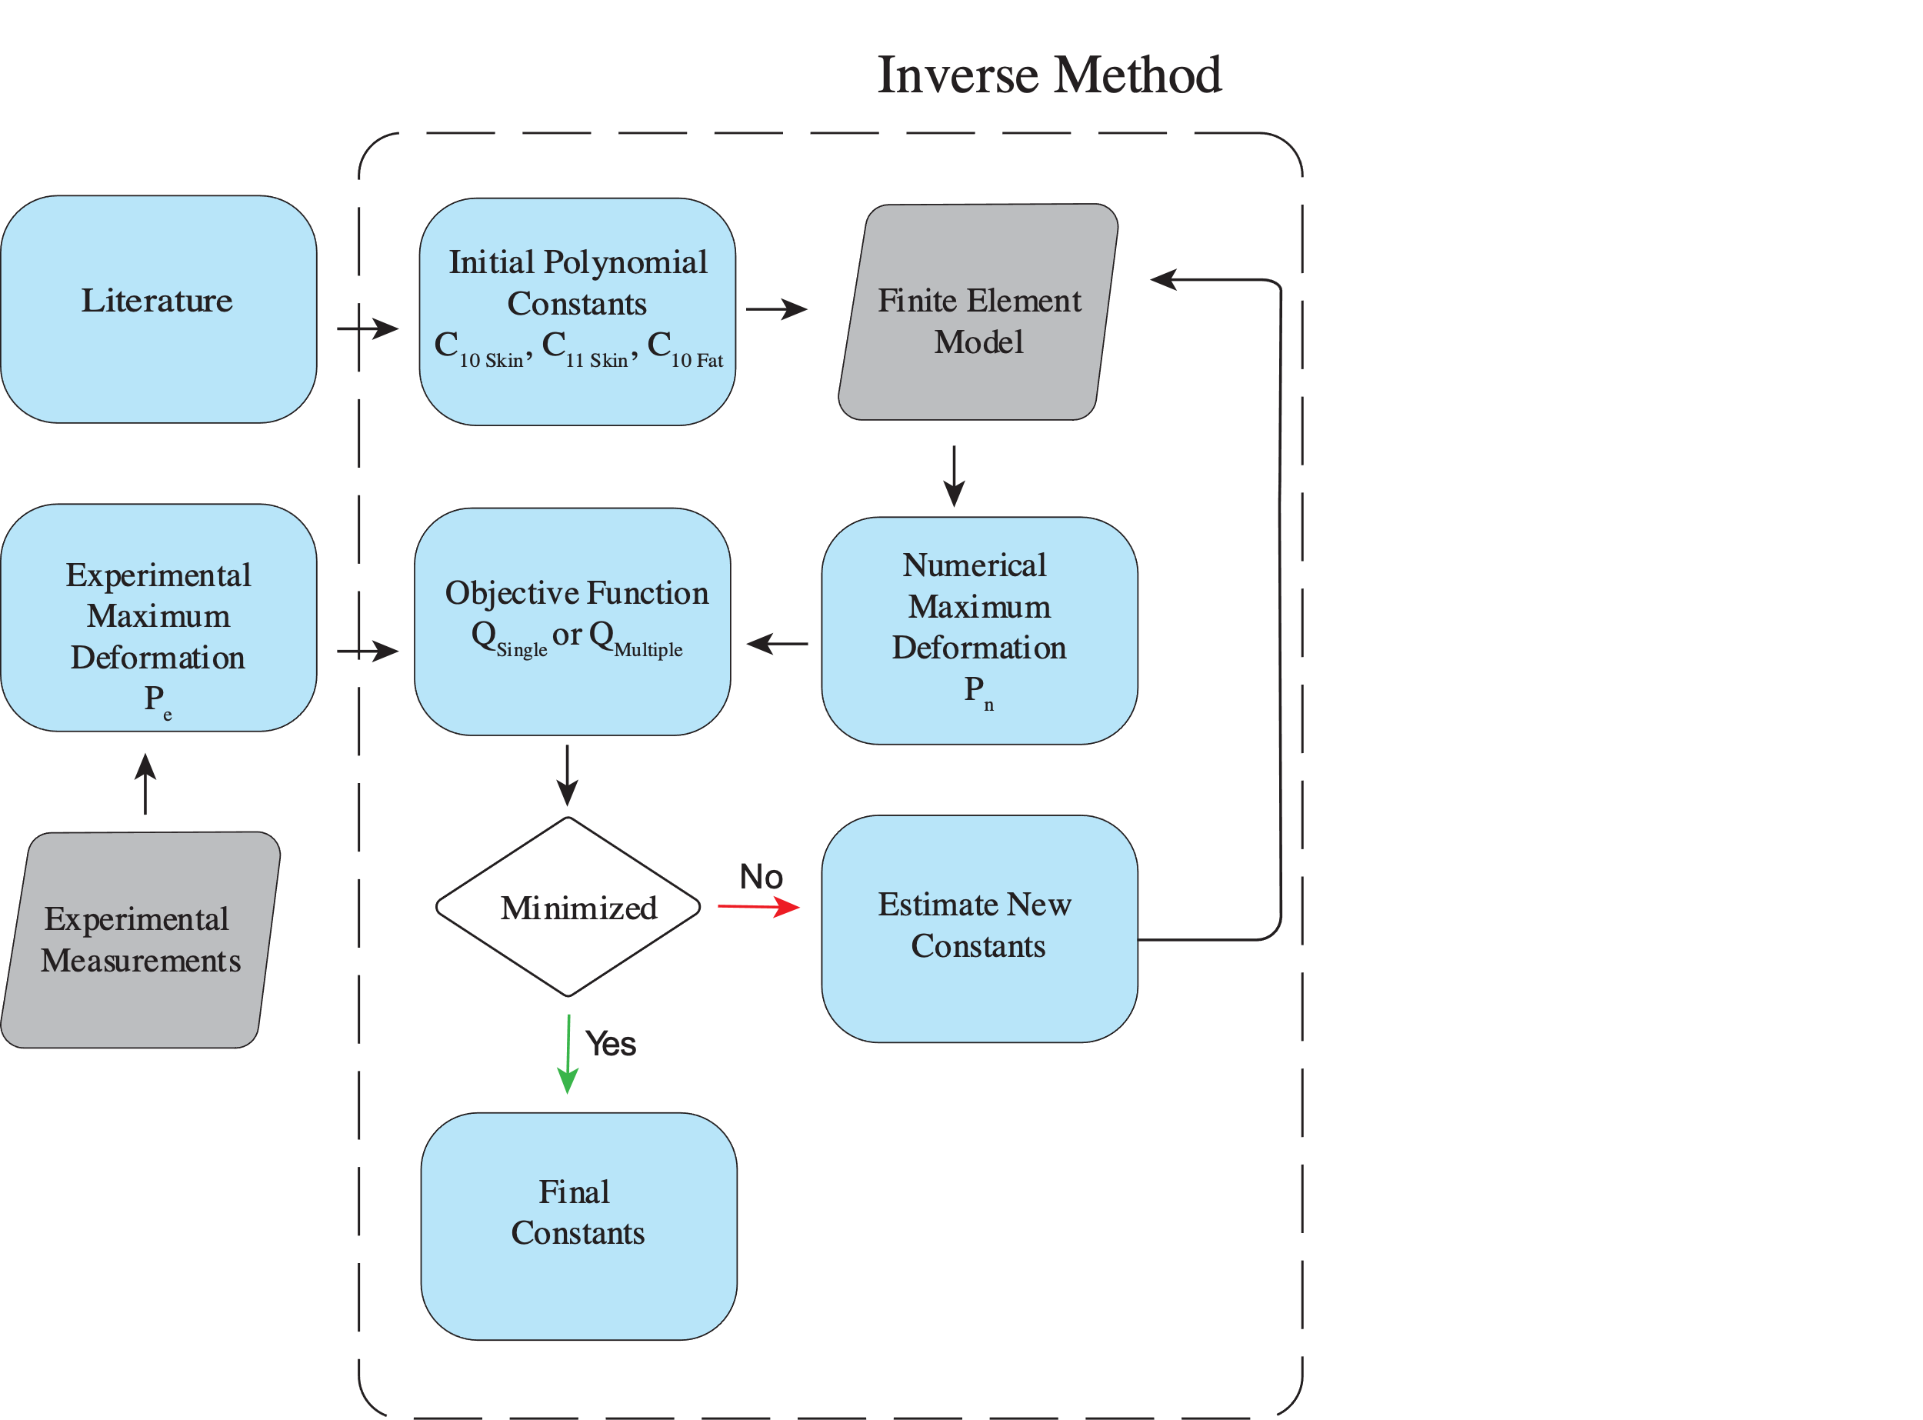
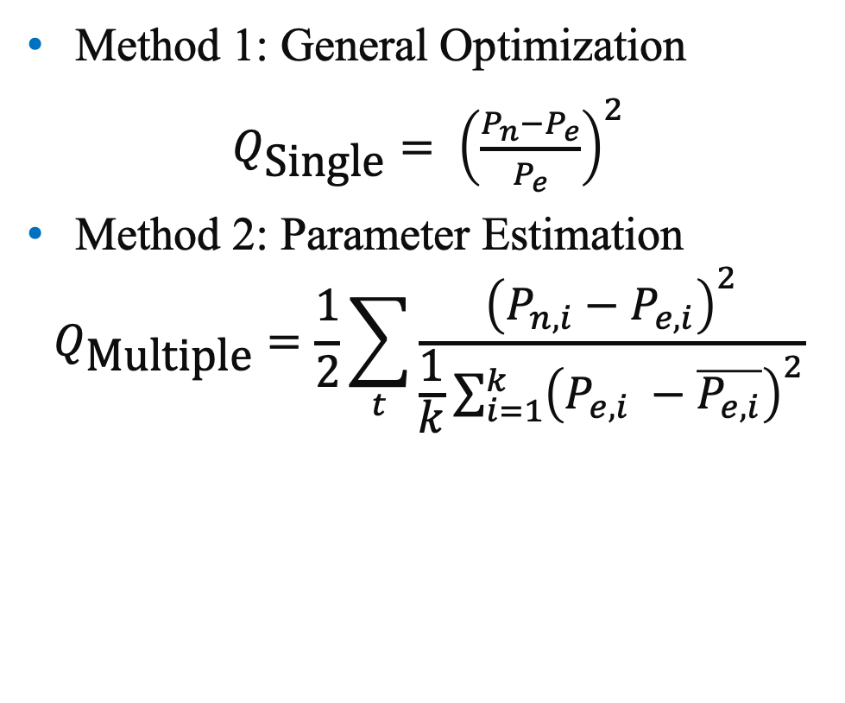
Hyperelastic property estimation
Method 1: General Optimization
$Q_{\text{Single}}= {\left(\frac{P_{n}−P_{e}}{P_{e}}\right)}^{2}$
Method 2: Parameter Estimation
$$Q_{\text{Multiple}}=\frac{1}{2}\sum_{t}{\frac{{\left(P_{n,i}−P_{e,i}\right)}^{2}}{\frac{1}{k}\sum_{i=1}^{k}{{\left(P_{e,i} −\overline{P_{e,i}}\right)}^{2}}}}$$
Etim et al., in preparation, 2025

Slide 12
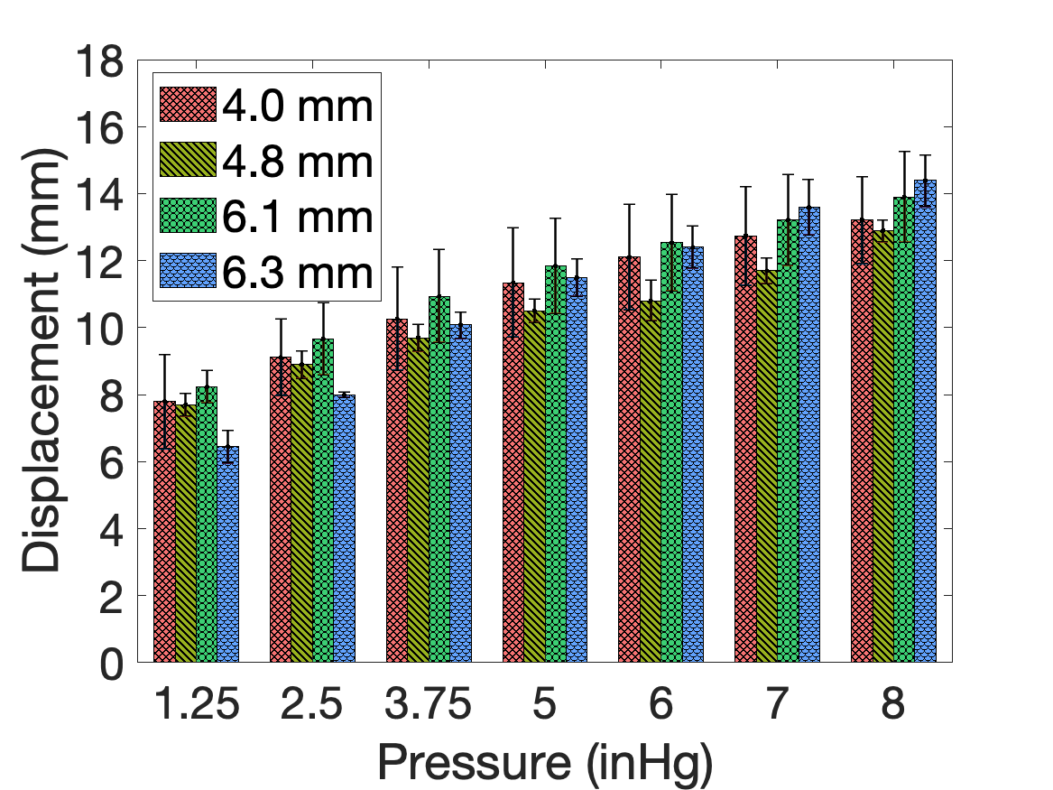
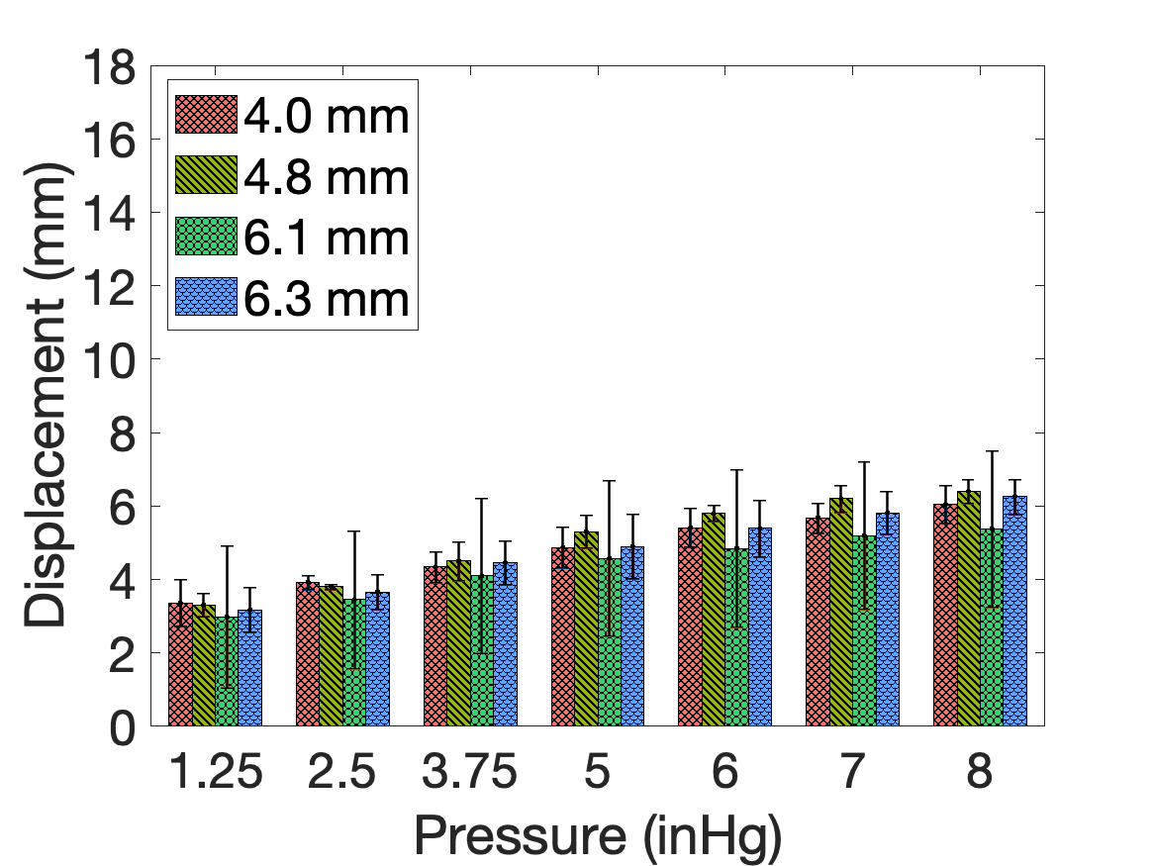
Experimental displacement variation
50 mm aperture
16 mm aperture
Etim et al., in preparation, 2025

Slide 13
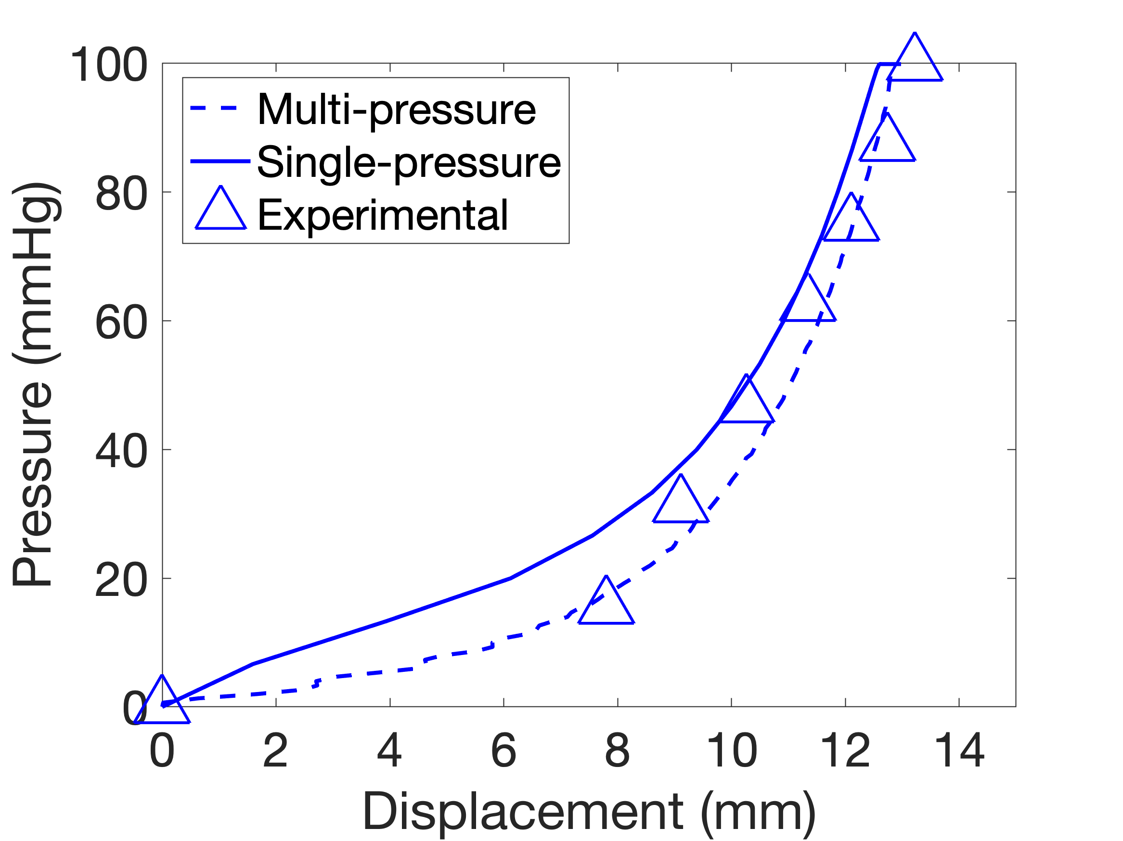
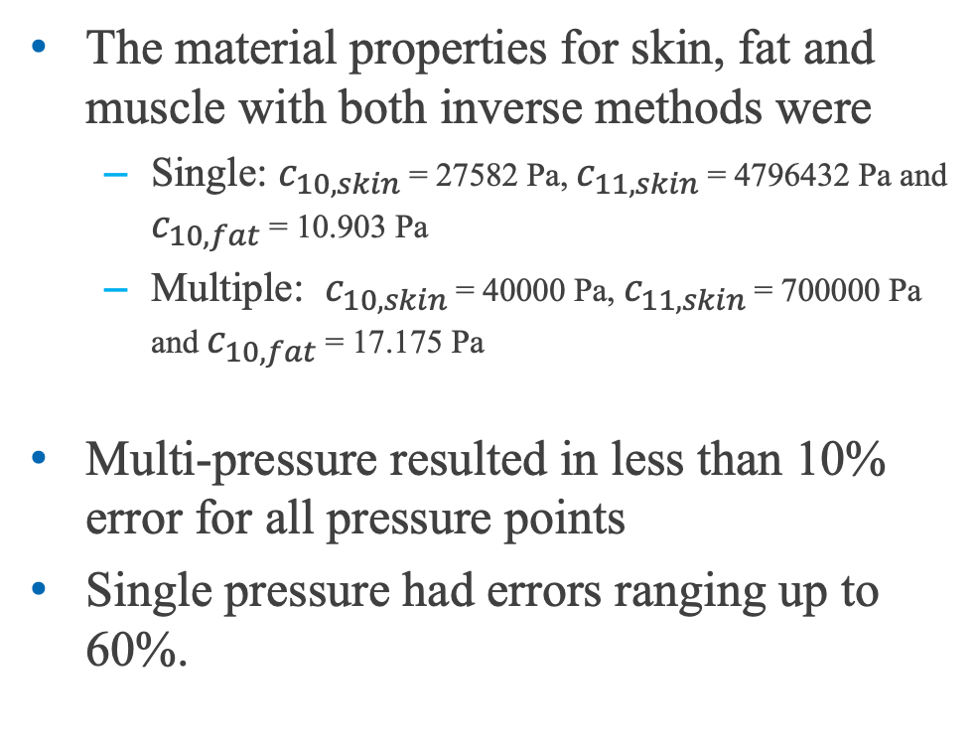
Multi value Vs Single value property identification
The material properties for skin, fat and muscle with both inverse methods were
Single: $c_{10, skin }$= 27582 Pa, $c_{11, skin }$= 4796432 Pa and $c_{10, fat }$= 10.903 Pa
Multiple: $c_{10, skin }$= 40000 Pa, $c_{11, skin }$= 700000 Pa and $c_{10, fat }$= 17.175 Pa
Multi-pressure resulted in less than 10% error for all pressure points
Single pressure had errors ranging up to 60%.
Multi-value
Single-value
Experimental

Slide 14
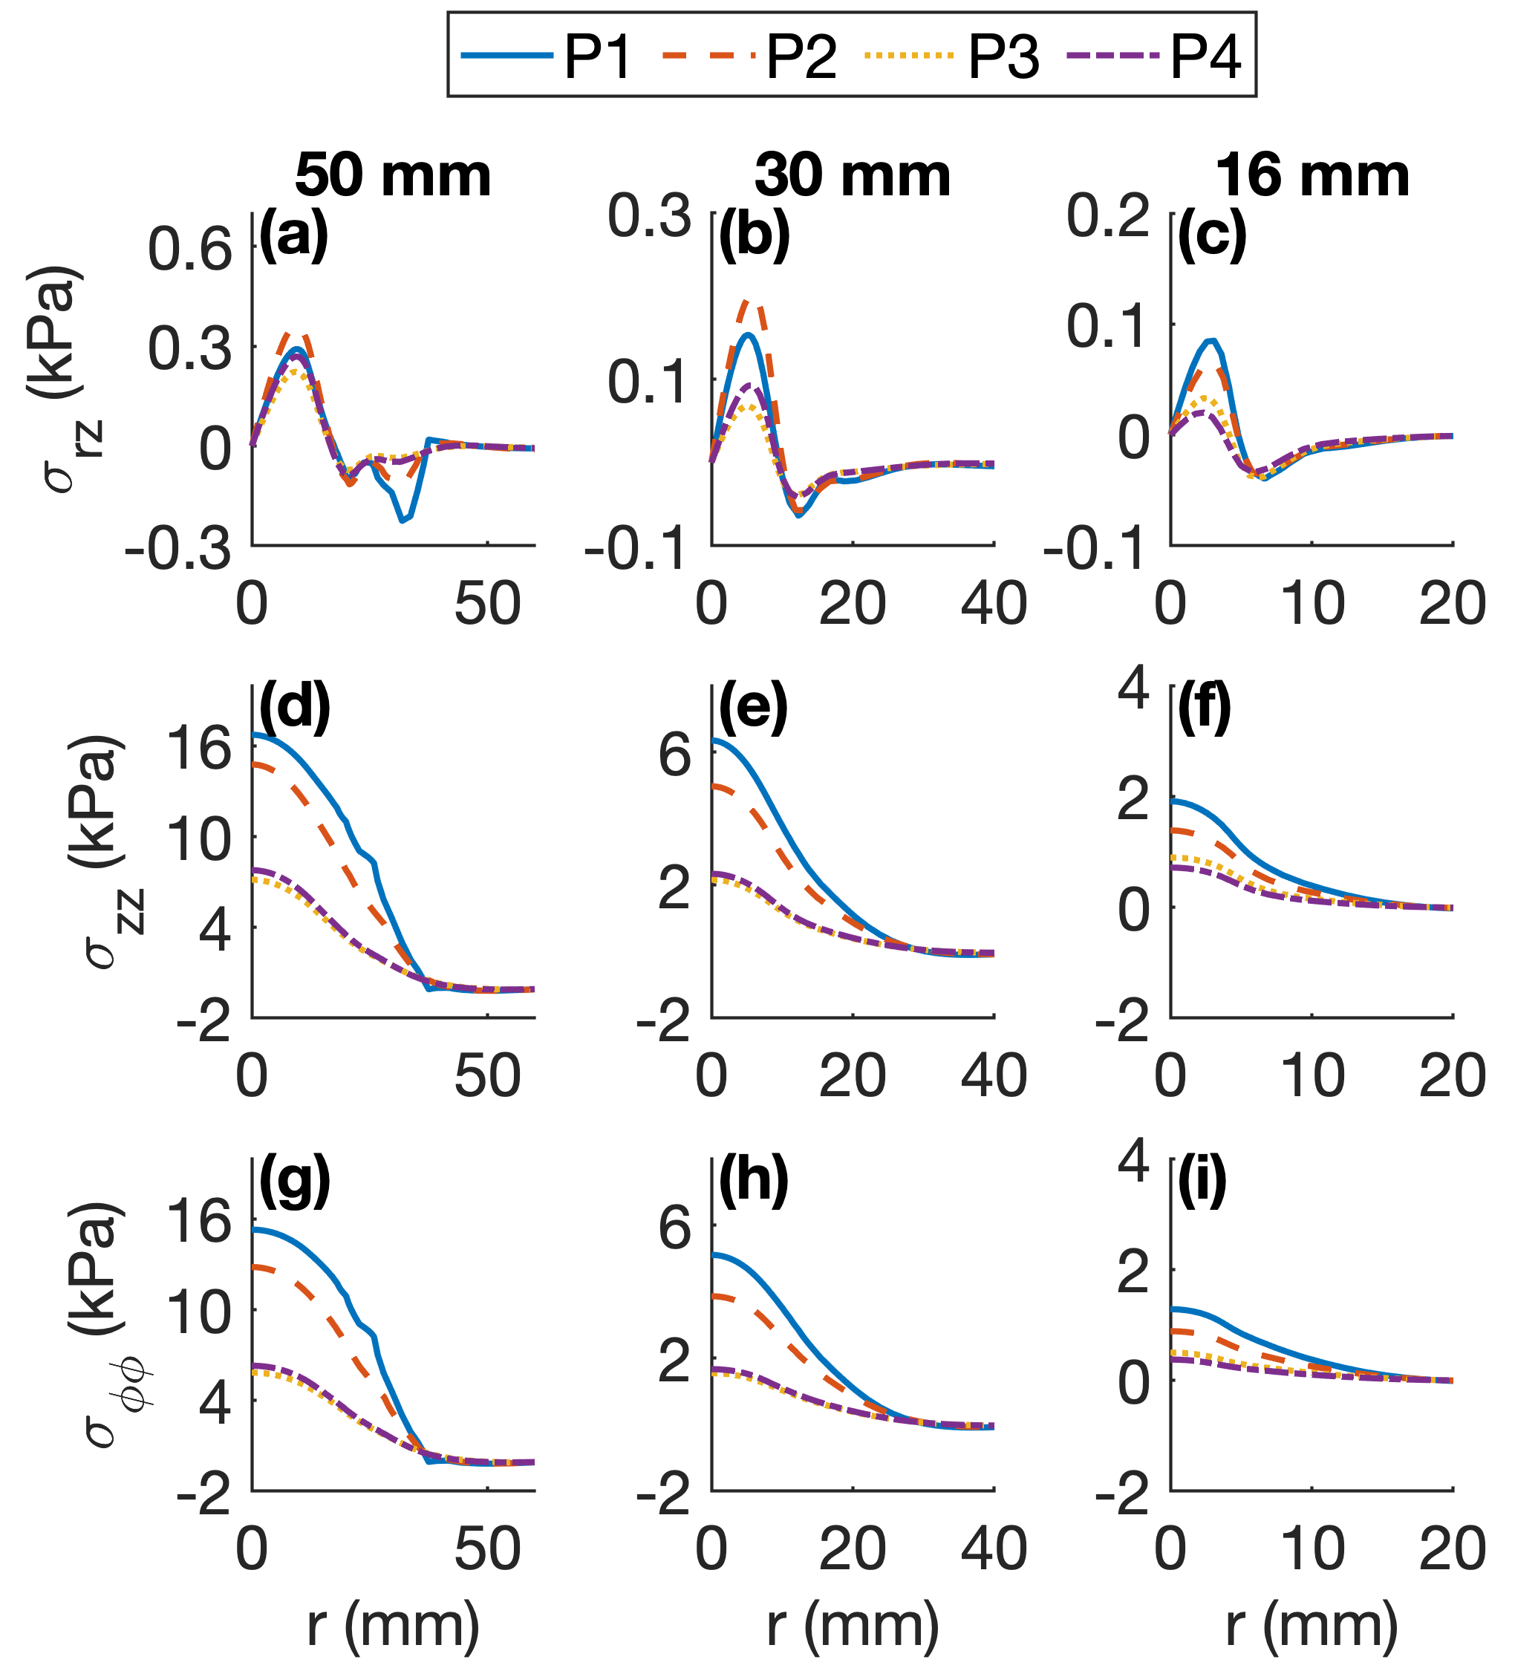
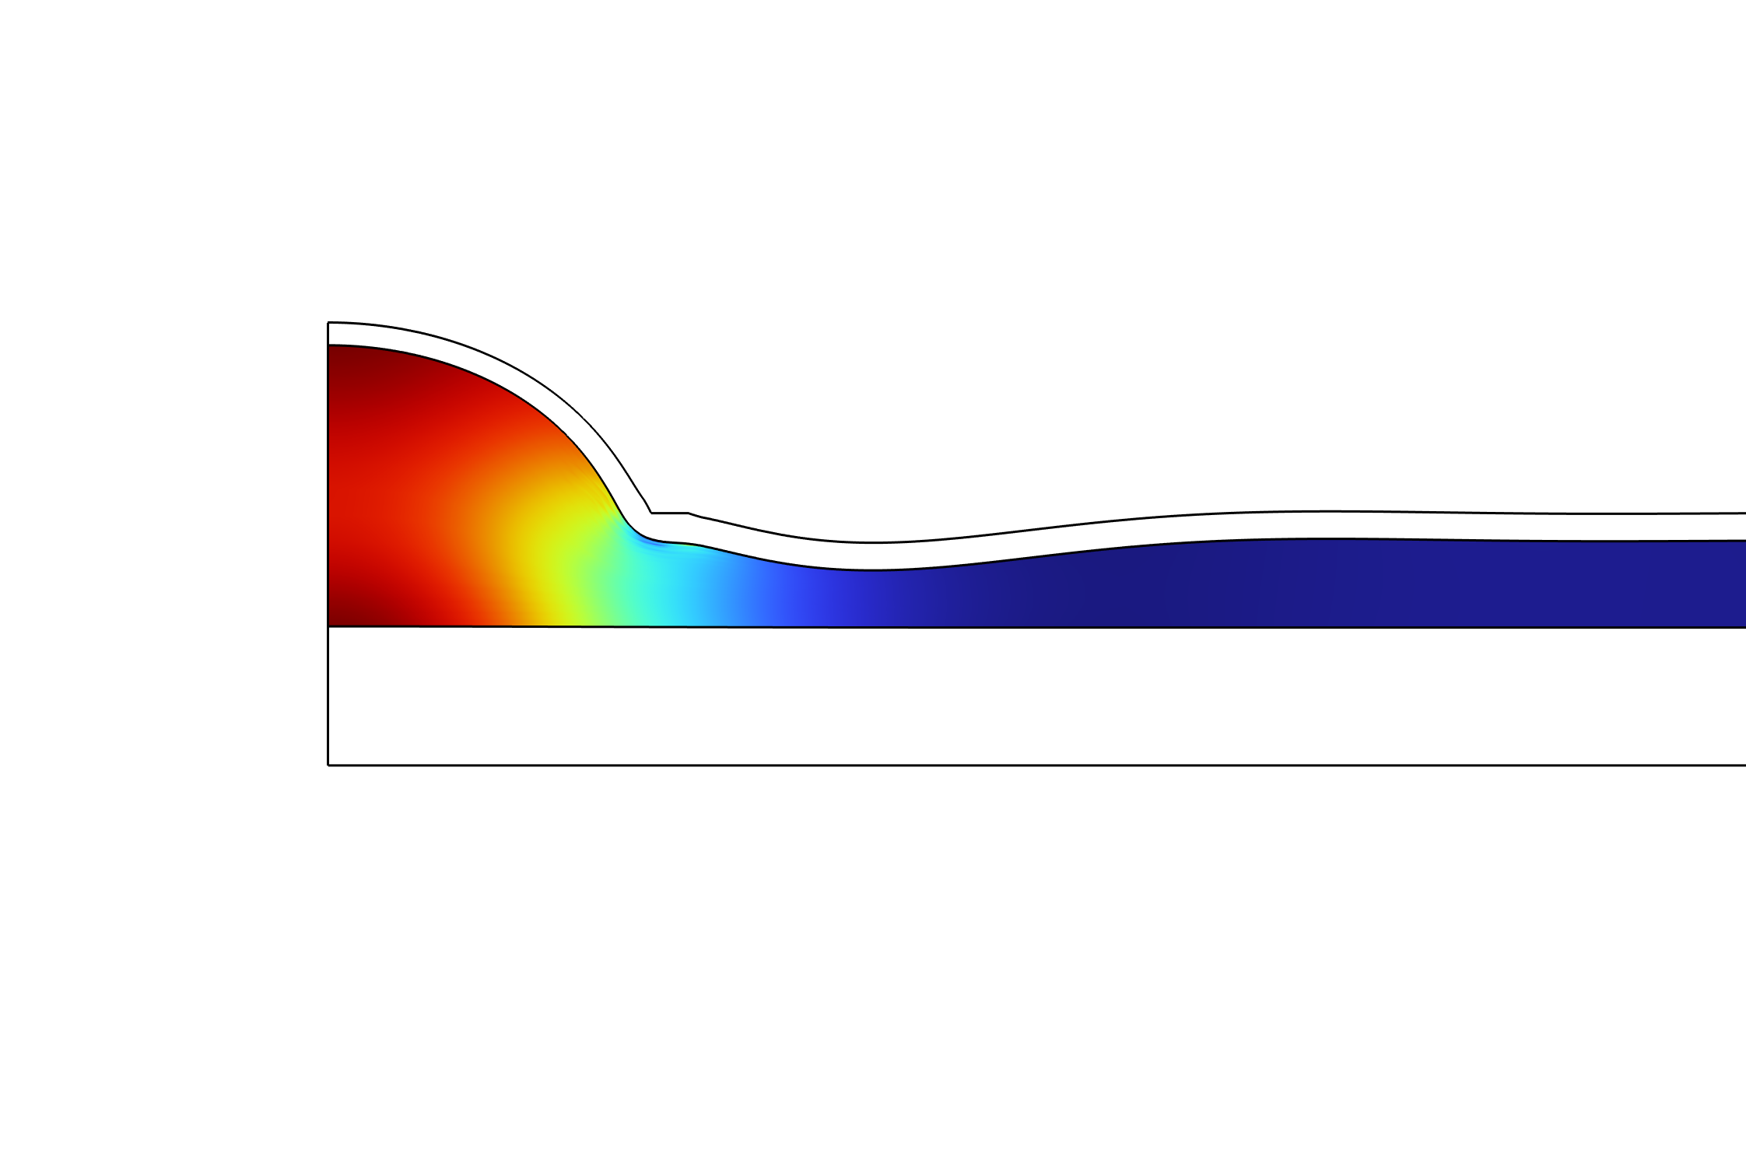
Stress analysis in fat
Increase in normal stress with fat thickness while shear stress varies

Slide 15
Why is this important?
Device safety varies by person: Tissue response variability can cause under-treatment or tissue damage with fixed pressure settings
Explains inconsistent complications: Mechanical response depends on tissue composition and contact geometry, explaining unpredictable pressure injuries and bruising
Fills critical knowledge gap: Quantified hyperelastic properties across aperture sizes and thicknesses provide design parameters for suction-based devices
Enables personalized treatment: Relationships between fat thickness, aperture size, and hyperelastic properties allow adaptive suction parameters

Slide 16

Thank you for listening
Questions?

