Slide 1
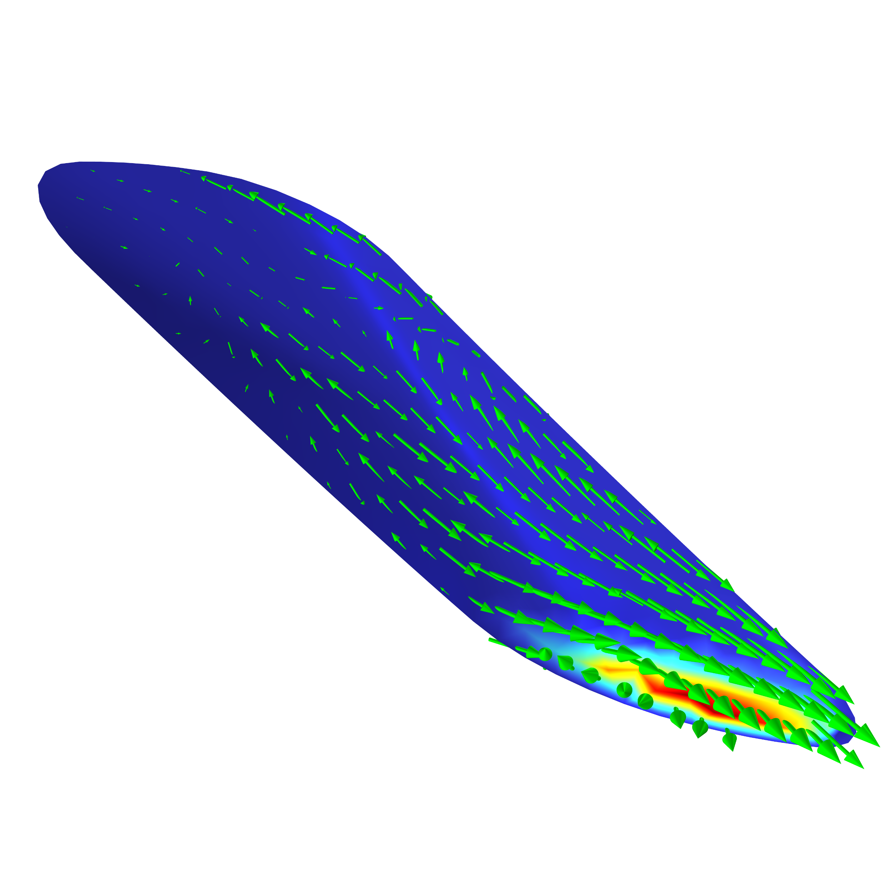
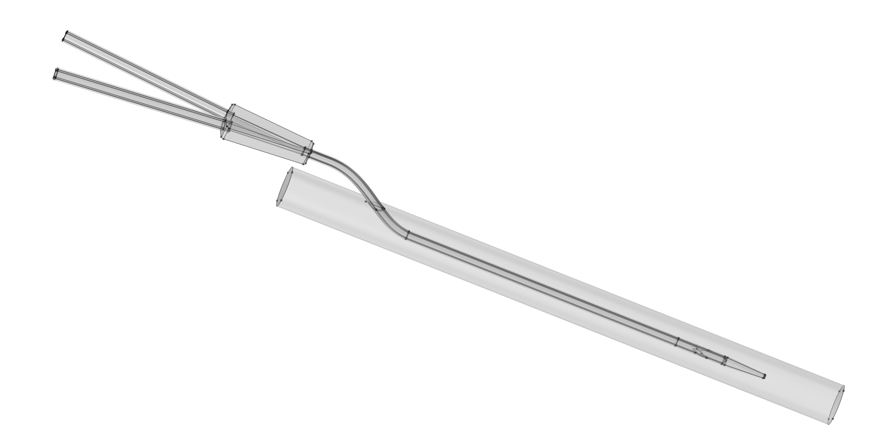
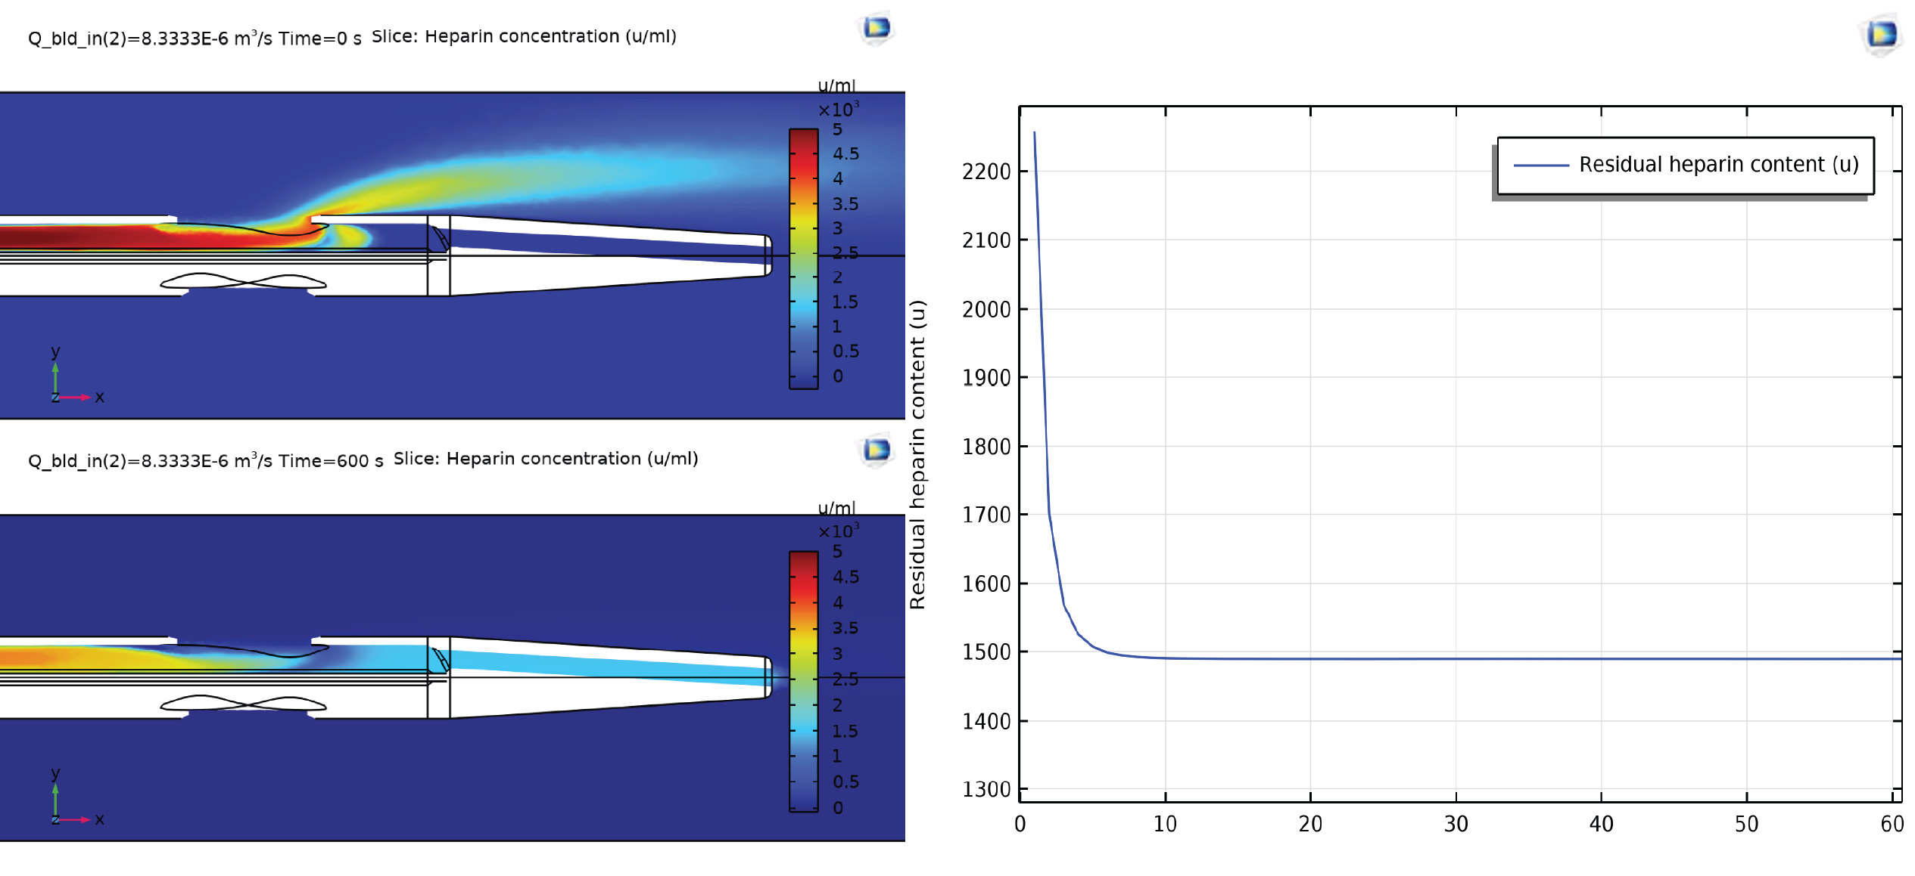

Heparin Retention in Hemodialysis Catheters Following Heparin Solution Locking
Heparin lock solutions are used to maintain patency in hemodialysis catheters. This work uses simulation to predict the retention and dispersion of heparin after locking fluid instillation.
G. Daigle¹, S. A. Conrad²
1. School of Medicine, Louisiana State University Health, Shreveport, LA
2, Department of Medicine, Louisiana State University Health, Shreveport, LA
Introduction
Hemodialysis catheters are placed in large veins for long-term hemodialysis. Heparin-containing lock solutions (typically 5,000 u/ml) are instilled into the catheter lumens between dialysis sessions to maintain patency. The volume of heparin injected is traditionally chosen to be equal to the lumen volume. The prevailing assumption is that this volume remains in the lumen, and no heparin reaches the patient. However, this would require plug flow to prevail, which is not a feature of laminar flow in a long channel with boundary layers. Clinical studies document coagulopathy following heparin locking but has not [1] been systematically studied. The purpose of this project is to evaluate flow patterns in the hemodialysis catheter lumen, determine the amount of heparin which is delivered to the patient, evaluate the retention of heparin in the catheter and rate of loss over time, and determine areas with low heparin concentrations (< 0.3 u/ml) that risk thrombosis in the lumen.
Methodology
A 3D geometry based on the Mahurkar™ 12 Fr 20 cm acute hemodialysis catheter inserted into the femoral/iliac vein was constructed as a COMSOL geometry sequence (Figure 1)based on micro-CT imaging . The mesh included swept and free elements. Injection lumen and bl[2]ood vessel flow were modeled as single-phase flow using water and blood material properties. Heparin convection and diffusion were coupled to fluid flow in both domains. Studies were solved with the segregated direct solver and included the immediate bolus of heparin to the patient during injection (1.4 ml of 5,000 u/ml lock solution), loss of heparin over time from the distal ports, and an optimization study to calculate the injection volume that minimizes heparin exposure to the patient during locking.
Figure 1: Geometry of the Mahurkar™ catheter inserted into the blood vessel using the configuration seen during clinical use. Only the injection lumen was used for the current studies since it included the tip.
Results
Laminar parabolic flow, and not plug flow, prevailed, as expected. Locking fluid injection resulted in 18 – 20% (1200 – 1350 units) of the heparin reaching the patient as a bolus per lumen (Figure 2A), potentially reaching transient blood levels of 0.5 to 0.6 u/ml (full intensity anticoagulation) if both lumens were locked. Rapid rates resulted in greater retention. Following injection, there was additional loss of about 30% over the course of 15 minutes independent of blood flow, following which heparin loss from the catheter was trivial (about 32 u/hour), primarily through convection at the side hole (see header image), also independent of blood flow (Figure 2B). The optimization study revealed that an injection volume of 1.32 ml limits the amount of heparin reaching the patient, avoiding significant systemic effect.
Figure 2A: Loss of heparin into the blood vessel at the end of injection and 10 minutes later (left). B: Retention of heparin within the lumen for 15 minutes following end of injection (right).
1.Bong YC, Walsham J. Systemic anticoagulation related to heparin locking of non-tunnelled venous dialysis catheters in intensive care patients. Anaesth Intensive Care. 2016;44(4):474–6.
2. Solitro, Lucia: Louisiana State University Health Sciences Center Shreveport - Small Animal Imaging Facility, RRID:SCR_024777

