Slide 1
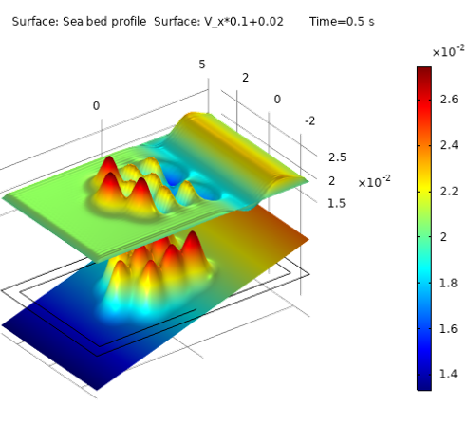
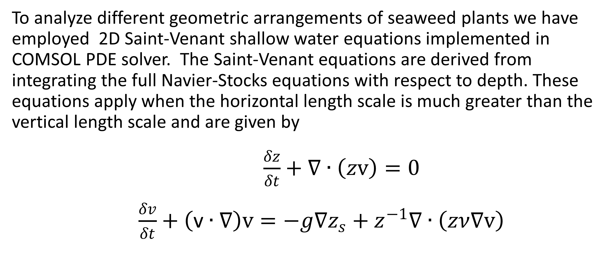
Fluidic analysis of shore-based seaweed farm design for sustainable seaweed aquaculture
Seaweed farming offers a pathway towards sustainable food source for growing human population. In the work we present modeling analysis of optimized shore-based seaweed farm topology.
Roxanna Fridman¹, Roman Shugayev² 1. Rosenstiel School of Marine, Atmospheric and Earth Science , University of Miami, Miami, USA. 2. Electrical Engineering Department, University of Nevada Las Vegas, Las Vegas, USA
Abstract
Recognized for its potential as a sustainable food source, seaweed farming has become pivotal in tackling future food security concerns, necessitating innovative solutions to achieve optimal, high-yield, and commercially viable production [1]. In this work address gaps in aquaculture seaweed farm design by investigating the correlation between farm geometry and the coastal water environment using COMSOL Multiphysics. Using 2D shallow water equations we perform comparison of important seaweed farm parameters such as wave height, wave velocity and turbidity between different geometrical arrangements of seaweed plants. Our results show that the randomized rectangular patterns and checkerboard patterns offer highest turbidity [2] with maximum values exceeding by ~37% simplistic rectangular arrangements. These findings would pave the way for smart, high efficiency seaweed farm design and can lead to new sustainable solutions for scalable aquaculture
Methodology
To analyze different geometric arrangements of seaweed plants we have employed 2D Saint-Venant shallow water equations implemented in COMSOL PDE solver. The Saint-Venant equations are derived from integrating the full Navier-Stocks equations with respect to depth. These equations apply when the horizontal length scale is much greater than the vertical length scale and are given by
$\frac{δz}{δt}+∇∙\left(zv\right)=0$
$\frac{δv}{δt}+\left(\text{v}∙∇\right)v=−g∇z_{s}+z^{−1}∇∙\left(zν∇v\right)$
Figure 1. Comparison of wave velocity for different structures. Rectangular (a) Checkerboard (b) Randomized (c) Spiral (d) Geometry is shown on the background for clarity
Results
One of the key flow parameters affecting nutrient absorption is water circulation and turbidity [2,3]. Turbidity greatly benefits the nutrient absorption by replenishing the diminished supply of the nutrients, increasing their dwell time, and consequently their adsorption to the plant surface [2]. Turbidity is proportional to the curl of the velocity field, ∇×v, which we have computed from our transient solutions (Figure 2). Our results indicate the circulation of water flow around the plants can be greatly improved with smart design. In particular, going from simple rectangular geometry to randomized geometry allows us to gain 37% in maximum turbidity value while keeping the average values of turbidity relatively similar. These results can offer a pathway to designing aquaculture farms with improved yield for sustainable food production.
Figure 2. Comparison of turbidity ( curl of velocity) for different structures. Rectangular (a) Checkerboard (b) Randomized (c) Spiral (d)
[1] C.M. Duarte et al. "A seaweed aquaculture imperative to meet global sustainability targets", Nature Sustainability, 185-193, 2022.
[2] C. Hurd, "Water motion, marine macroalgal physiology, and production." Journal of phycology 36, no. 3 (2000): 453-472.
[3] P. Harrison and C. Hurd. "Nutrient physiology of seaweeds: application of concepts to aquaculture." Cah Biol Mar 42, no. 1-2 (2001): 71-82.

