Slide 1
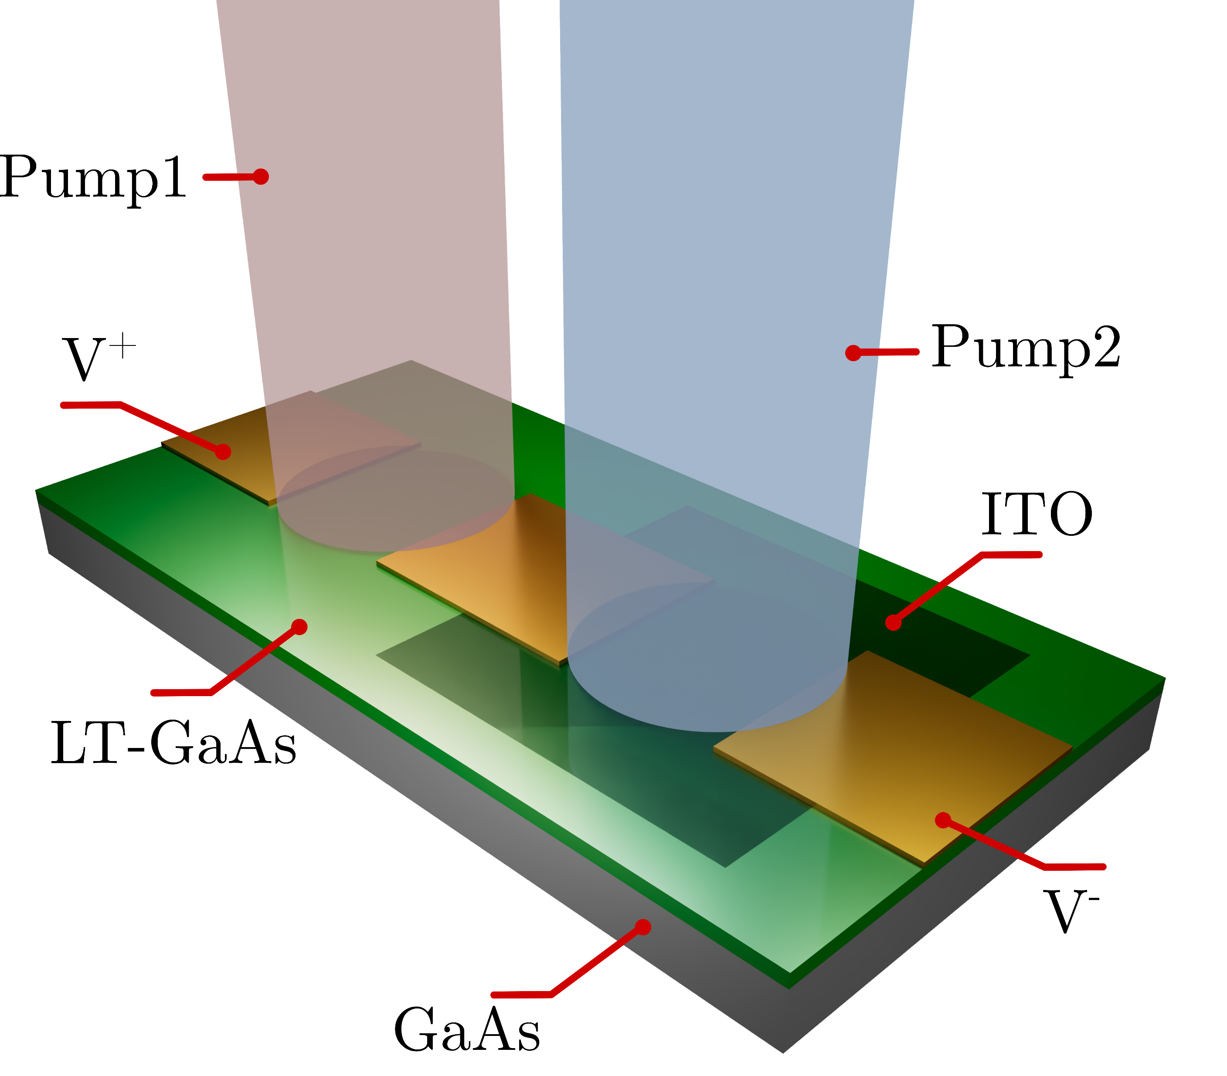
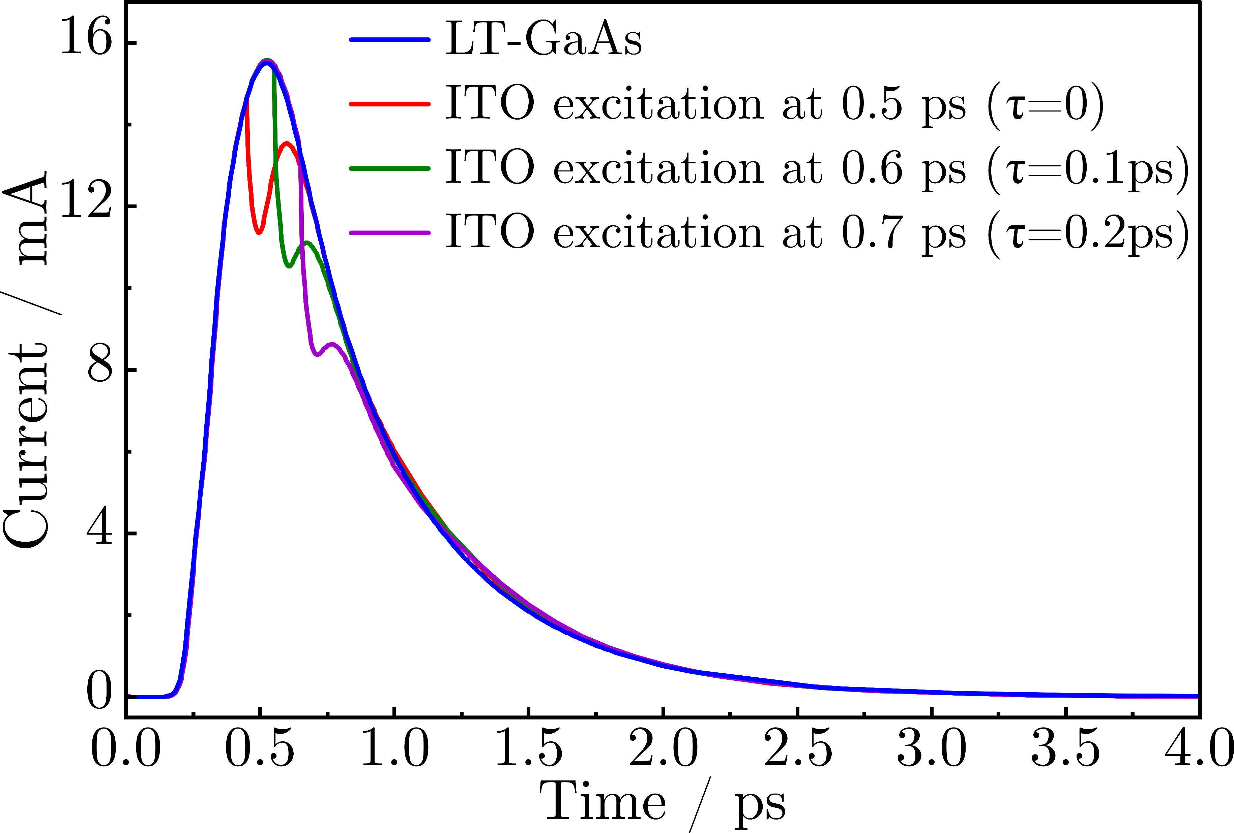
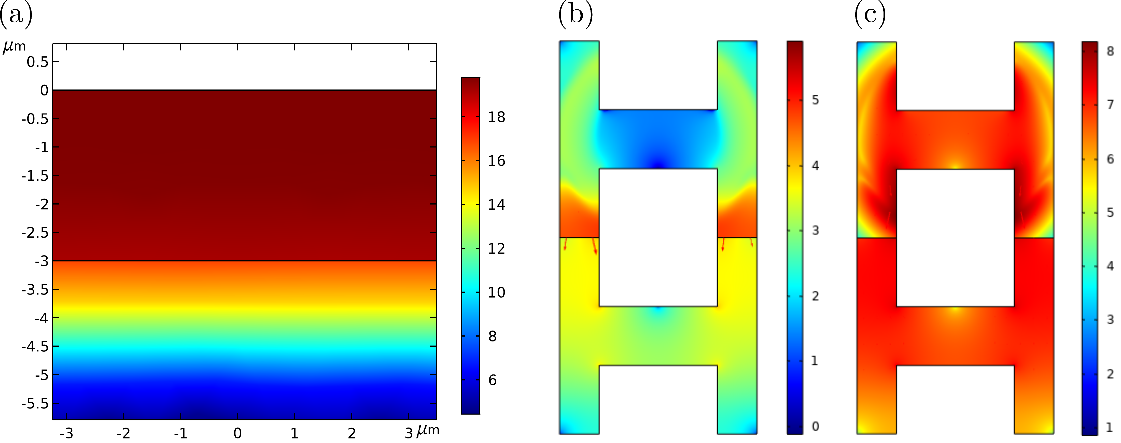

Epsilon-Near-Zero ITO Bolometer Gated By LT-GaAs: A COMSOL Study
We explore a bolometer design that combines LT-GaAs and ENZ-tuned ITO to achieve ultrafast, compact, and CMOS-compatible detectors for next-generation photonic systems.
S. Abdolhosseini¹, J. Weber², A. Ball², S. Saha², N. Kinsey¹
¹Saint Louis University
²Virginia Commonwealth University
Introduction
Transparent conductive oxides (TCOs) operating near their epsilon-near-zero (ENZ) point have recently been shown to exhibit strong and ultrafast intraband optical absorption processes, whose excitation results in a variation of the effective mass and electrical conductance of the film [1,2]. Combined with their CMOS-compatibility, tunablity, and broadband operation, TCOs near ENZ represent a potential avenue for integrated bolometeric detectors. In this work, we study a hybrid bolometer that combines a photoconductive LT-GaAs section with an ENZ film comprising indium thin oxide (ITO), to generate picosecond, delay-controlled current waveforms for photonic integrated circuits. When the ITO is excited by a laser near its ENZ condition, the absorbed light energy is transferred to the electrons, increasing their electron temperature. Hotter electrons occupy higher energy states in the conduction band, which correspond to a larger effective mass. This reduces mobility and raises resistance, providing a fast, optically controlled gate for the bolometer response.
Methodology
A 2D transient model is employed for COMSOL Multiphysics® simulation. The LT-GaAs region is analyzed using the Semiconductor Module, which includes optical generation at 775 nm as well as Shockley Read Hall (SRH) recombination with user-defined carrier lifetimes. The intraband optical absorption of ITO is modeled through optically-driven changes in effective mass, affecting mobility, and through the influence of plasma frequency on permittivity, as described by the Drude model. In this model, the plasma frequency is determined by the carrier density and the effective mass. Because of the nonparabolic nature of the ITO conduction band, hot electrons lead to an increase in effective mass and a reduction in mobility [2].
FIGURE 1. Output current for LT-GaAs excitation alone and combined LT-GaAs + ITO excitation at different pump delays.
Results
Exciting the LT-GaAs with a 775 nm pump produces a clean picosecond current impulse, establishing the baseline device response (Figure 1). When a delayed 1540 nm pump excites the ITO near its ENZ point, the effective mass increases, raising resistance and modulating the output current. The modulation depth is modeled by varying m from 0.35m₀ to 0.55m₀ with ultrafast rise/fall times (50 fs/200 fs), consistent with experimental reports [2]. Figure 1(b) shows current dips shifting with optical delay, while Figures 2(a–c) illustrate electron generation, enhanced electric field in ITO, and transient diversion of current density that underlies the hybrid bolometer mechanism. These results demonstrate a delay-programmable optical gating effect with sub-picosecond resolution. This confirms the potential of ENZ-tuned ITO to provide ultrafast modulation in photonic integrated circuits.
FIGURE 2. (a) Electron concentration in LT-GaAs after laser excitation. (b) Electric field distribution at 0.5 ps with simultaneous LT-GaAs and ITO excitation. (c) Current density distribution at 0.5 ps showing transient diversion during ITO modulation.
1. O. Reshef, I. De Leon, M. Z. Alam, & R. W. Boyd, “Nonlinear optical effects in epsilon-near-zero media”, Nature ReviewsMaterials, 4(8), 535-551 (2019).
2. D. Fomra, A. Ball, S. Saha, J. Wu, M. Sojib, A. Agrawal, H. J. Lezec, & N. Kinsey, “Nonlinear optics at epsilon near zero: From origins to new materials”, Applied Physics Reviews, 11(1), 011317 (2024).

