Slide 1
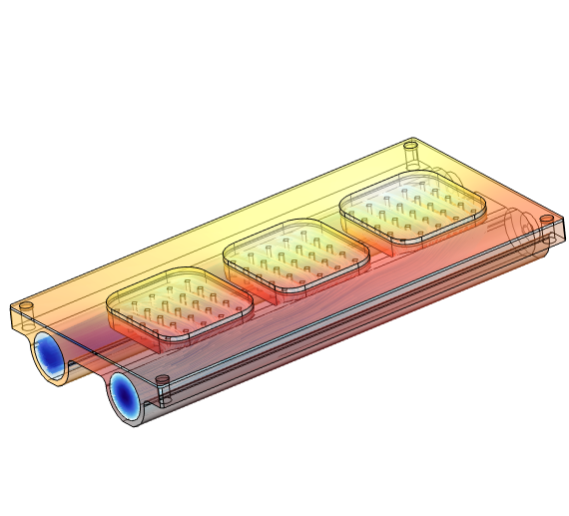
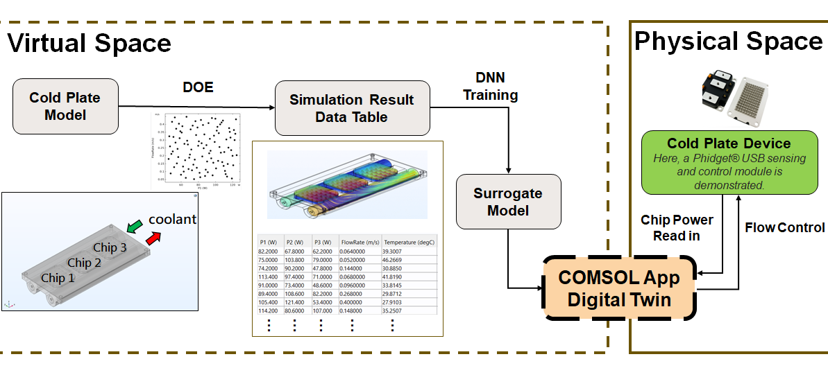
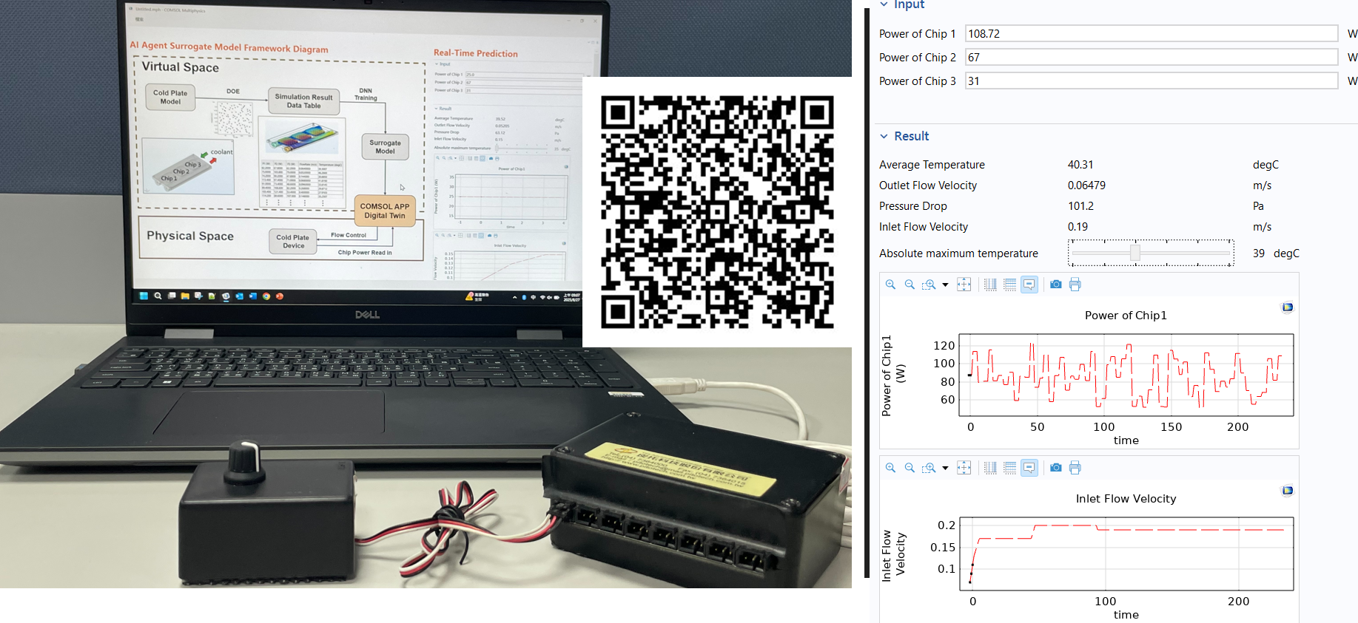

Digital Twin-Based Predictive Thermal Management Of Cold Plate For Electronics Devices
A digital twin model for cold plate cooling using conjugate heat transfer model trained with deep neural network. The surrogate model is deployed in COMSOL App for real-time predictive flow control.
C.S. Tsui (Pavel), K.W. Huang (Wade), C.C. Chiu (Arthur), H.C. Chang (Shane) PITOTECH CO., LTD. Taichung City, Taiwan
Abstract
This study proposes a digital twin–based thermal management approach for cold plate. A conjugate heat transfer model is developed in Heat Transfer Module, with 100 sample conditions of chip power and coolant flow rate generated using Latin Hypercube Design (LHD) in COMSOL Multiphysics. For each sample condition, simulations are performed to extract temperature distribution with the maximum chip temperature as the output. A high-precision surrogate model is then trained by deep neural network (DNN) in COMSOL Multiphysics.
Finally, the surrogate model is deployed as a COMSOL App and integrated with external hardware signal interfaces. When real-time chip power variations are read in, the surrogate model predicts the required coolant flow rate to maintain safe temperature level while minimizing energy consumption.
Methodology
The cold plate model is developed using conjugate heat transfer in COMSOL Multiphysics. The surrogate model is deployed in a COMSOL App with Timer Events to enable automated monitoring and control (Ref. 1).
For hardware integration, a Phidget® USB sensing and control module (Phidgets Inc., Canada) is used to provide real-time chip power signals (Ref. 2). A Phidget® voltage knob is used to generate analog signals that represent chip power variation, serving as a substitute for real cold plate sensor data. This analog signal is converted into a digital input and transmitted via USB to the COMSOL App. The surrogate model within the App processes this input to predict the required coolant flow rate, enabling dynamic control.
Figure 1. Workflow of the digital twin–based cold plate thermal management from simulation to real-time control
Results
The proposed approach reduces the number of required physical sensors, achieves more precise temperature regulation, and lowers average coolant flow. By leveraging the COMSOL App with Timer Events, it enables automated, real-time monitoring and control. demonstrating fast response and high energy efficiency.
This demonstrates fast response and high energy efficiency, confirming that digital twin-based thermal management is both practical and advantageous for advanced electronics cooling.
Please scan the QR code (as shown in the middle of Figure 2) to watch a demo video of the hardware and COMSOL App integration in real-time operation.
Figure 2. Photo showing the hardware integration with the COMSOL App, QR code and snapshot of the App
Introduction to Application Builder (Version 6.3), COMSOL AB. https://doc.comsol.com/6.3/doc/com.comsol.help.comsol/IntroductionToApplicationBuilder.pdf
https://www.phidgets.com/

