Slide 1
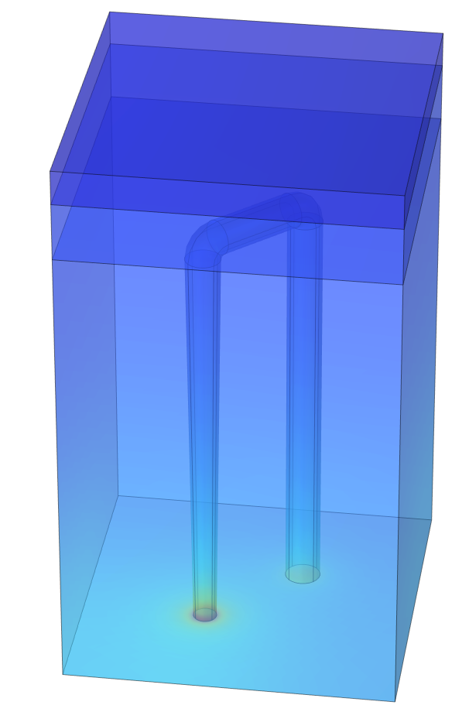
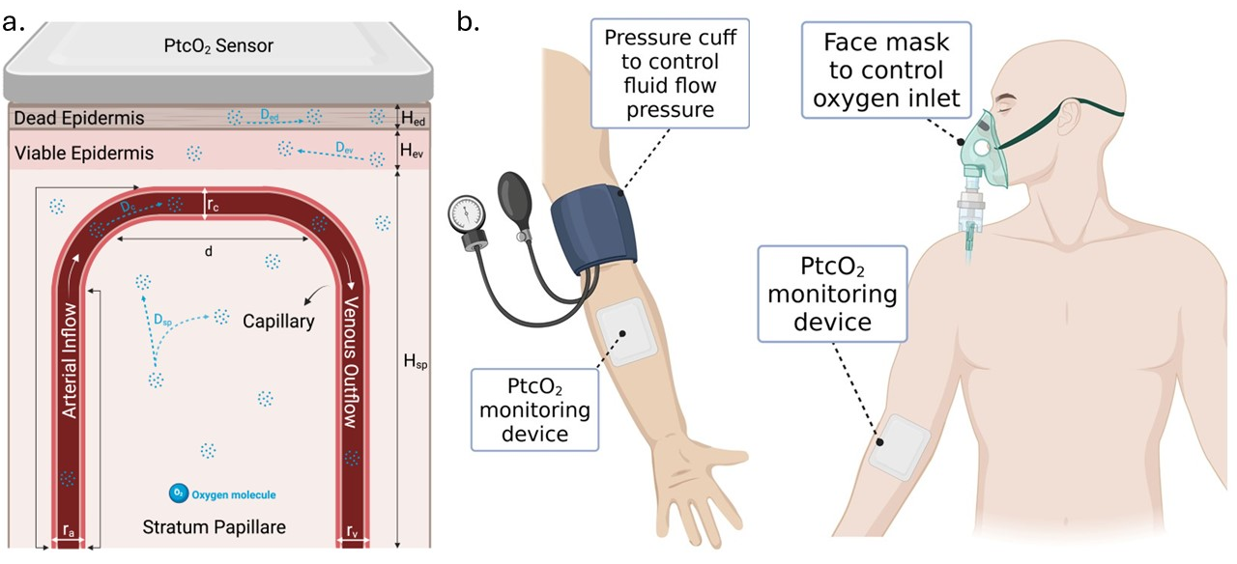
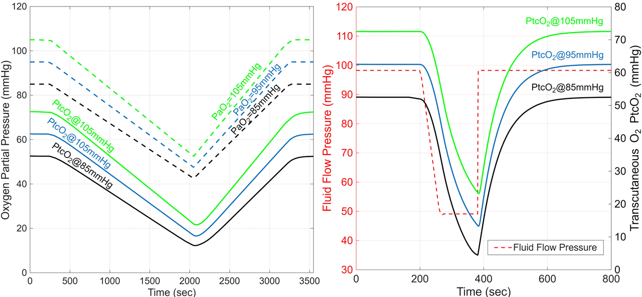

Modeling and Simulation of Transcutaneous Oxygen Transport
A finite element modeling to define the relationship between PaO₂ and PtcO₂ aimed to enhance measurement accuracy, improve clinical relevance, and enable more personalized patient monitoring.
M. A. Almatrood¹, B. D. Unluturk¹ 1. Institute for Quantitative Health Science and Engineering, Department of Biomedical Engineering, Michigan State University, East Lansing, MI, USA
Abstract
Continuous, real-time respiratory monitoring is vital for managing chronic respiratory diseases, preoperative care, and critical care, where rapid hypoxia detection impacts outcomes. Transcutaneous O₂ monitoring (PtcO₂) offers a noninvasive surrogate for arterial O₂ partial pressure (PaO₂), the gold standard, but its use is limited by physiological variability and inconsistent correlation with PaO₂. To address this, we present a finite element modeling (FEM) framework to examine the relationship between PaO₂ and PtcO₂. By simulating physiological O₂ transport through multilayered skin, the model reveals dynamic responses under blood flow occlusion and oxygen inflow changes. Results align with clinical observations, validating the model’s accuracy and supporting its potential for personalized monitoring. These findings demonstrate the value of computational modeling in improving PtcO₂ reliability, enabling continuous, real-time respiratory assessment in high-risk clinical settings.
Methods
We developed a partial differential equation (PDE)-based O₂ transport model within a 3D multilayer skin structure inspired by Grossmann’s model [1] (Fig. 1a). FEM was then performed in COMSOL to simulate O₂ transport based on this model. We focused on time-dependent behavior to replicate the experimental conditions in [2], where PtcO2 is measured under modulated PacO₂ using either through local occlusion with blood pressure cuff or systemic hypoxia via hypoxia mask. A set of PDEs was used to describe the blood flow and O₂ transport inside the capillaries and across each skin layer (Fig. 1b )
FIGURE 1. a) Cross-sectional unit volume of skin in Grossmann’s model. b) Human tests scenarios used in FEM studies
Results
The simulated occlusions (left) showed an immediate response in PtcO₂ levels, reflecting rapid physiological response to decreased perfusion. Post-occlusion recovery times (around 6 minutes) were consistent across scenarios, emphasizing delayed vascular and metabolic compensatory mechanisms.
Simulated oxygen reductions (right) displayed a slow and more prolonged decrease in PtcO₂, indicating a gradual skin adaptation to less drastic oxygen deprivation. PtcO₂ measurements responded well to the gradual recovery levels of PaO₂ post-hypoxia, suggesting intrinsic physiological limits in restoring tissue oxygenation levels, emphasizing the critical need for timely clinical interventions irrespective of the initial severity of hypoxia.
FIGURE 2. FEM results for PtcO₂ with respect to time for systemic hypoxia (left) and local occlusion (right) for different PaO₂ values
U. Grossmann, “Simulation of combined transfer of oxygen and heat through the skin using a capillary-loop model,” Math. Biosci., pp. 205–236, 1982.
V. Vakhter et al., “A Prototype Wearable Device for Noninvasive Monitoring of Transcutaneous Oxygen,” IEEE Trans. Biomed. Circuits Syst., pp. 323–335, 2023.
Notes:
A finite element modeling (FEM) framework is presented to explore the intricate relationship between arterial O₂ partial pressure (PaO₂) and transcutaneous O₂ partial pressure (PtcO₂). By simulating physiological O₂ transport through multiple skin layers, the model provides detailed insights into the dynamic responses of O₂ levels under conditions of blood flow occlusion and O₂ inflow variations. The results obtained closely correlate with clinical observations, validating the model’s effectiveness and offering a robust foundation for personalized transcutaneous O₂ monitoring devices. These findings through the computational model significantly enhances the accuracy of transcutaneous O₂ monitoring, facilitating continuous, real-time respiratory assessment. Such precise monitoring is vital in clinical scenarios involving chronic respiratory disorders, preoperative care, and critical care settings, where rapid and accurate detection of hypoxia significantly influences patient outcomes.

