Slide 1
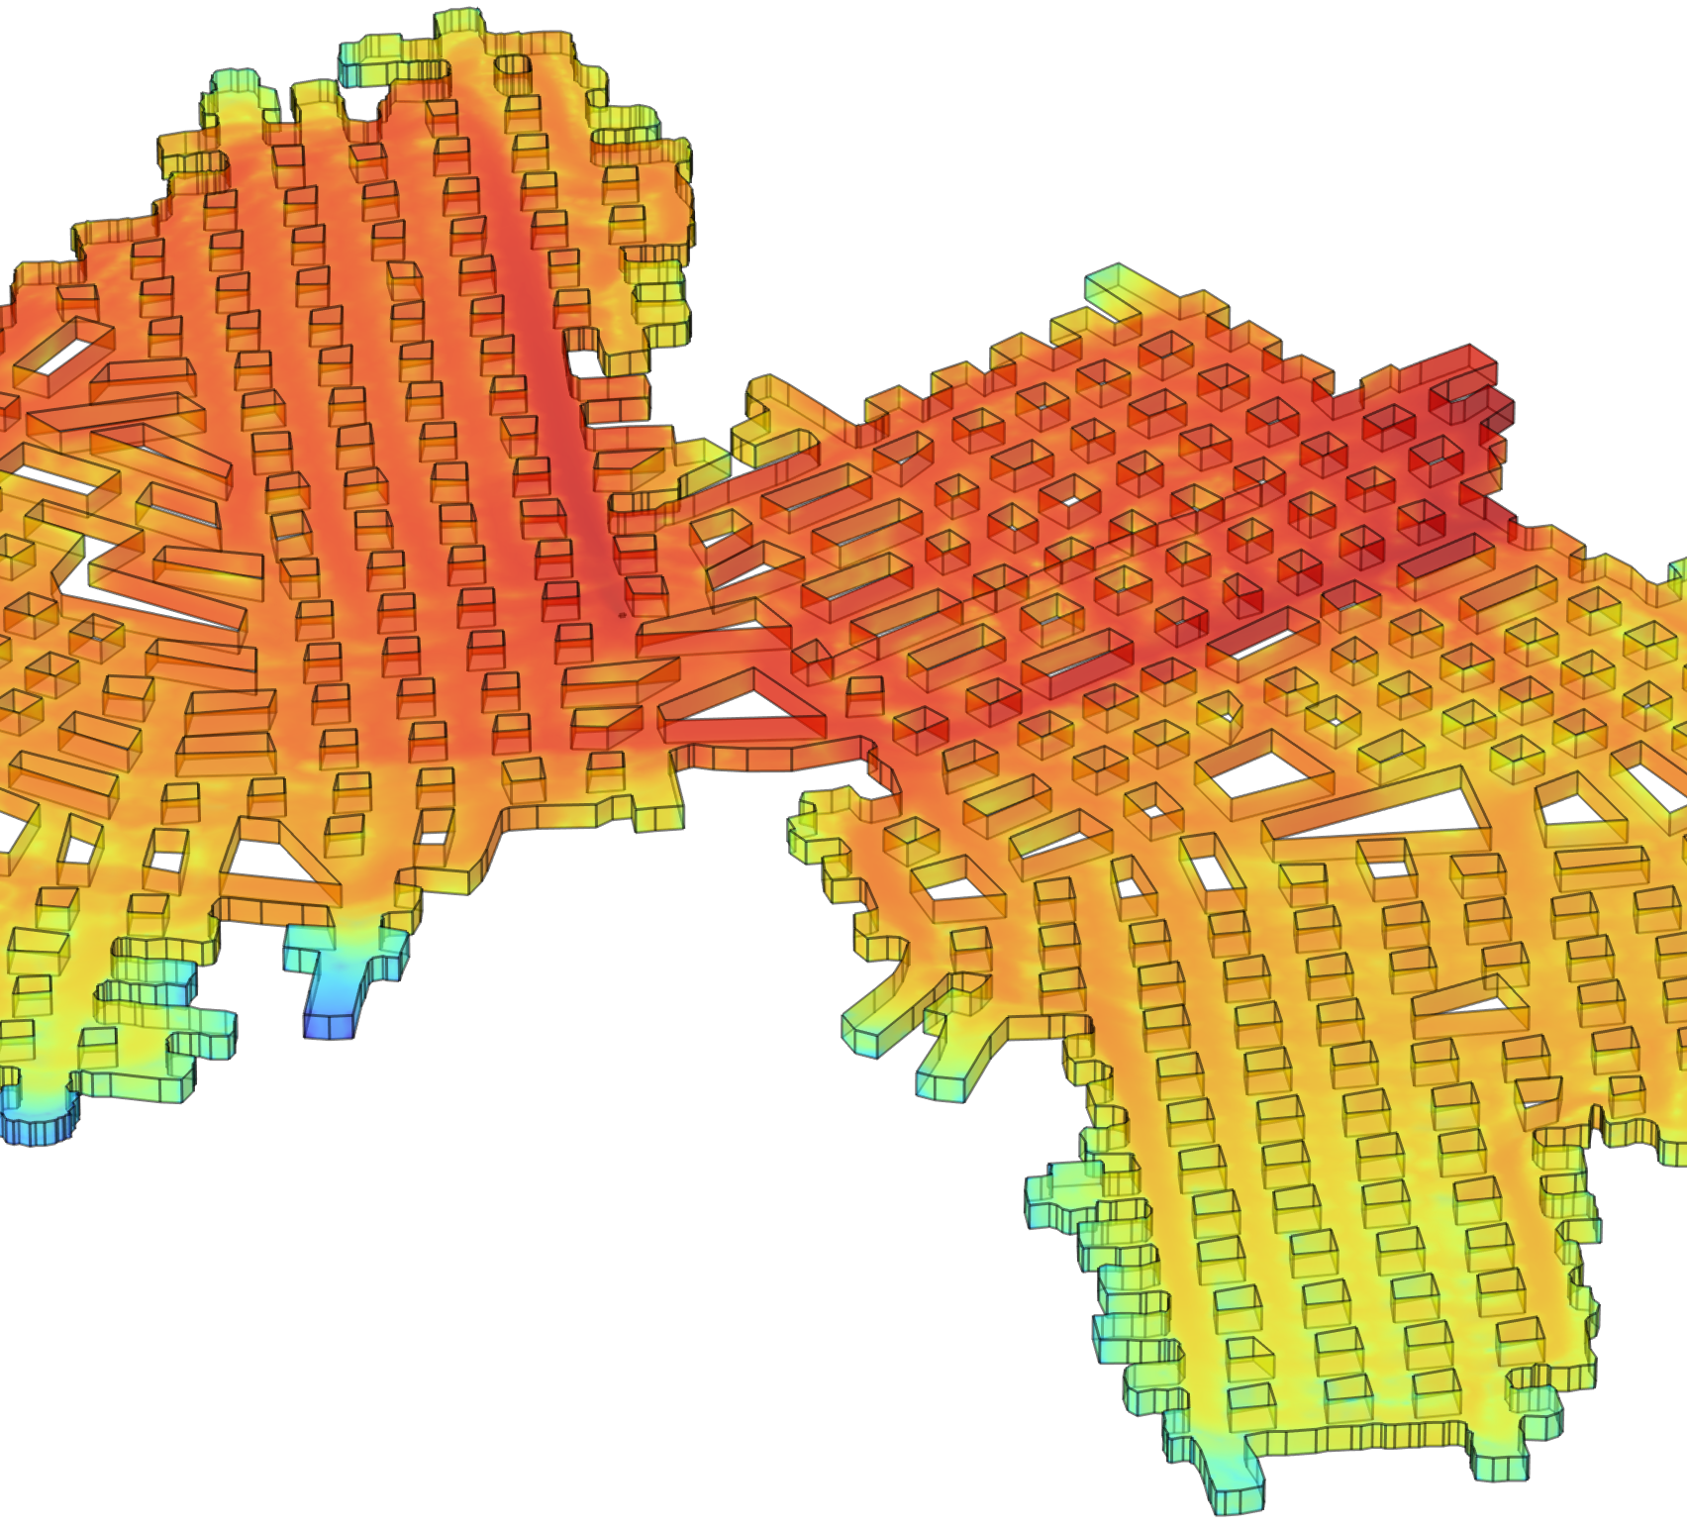
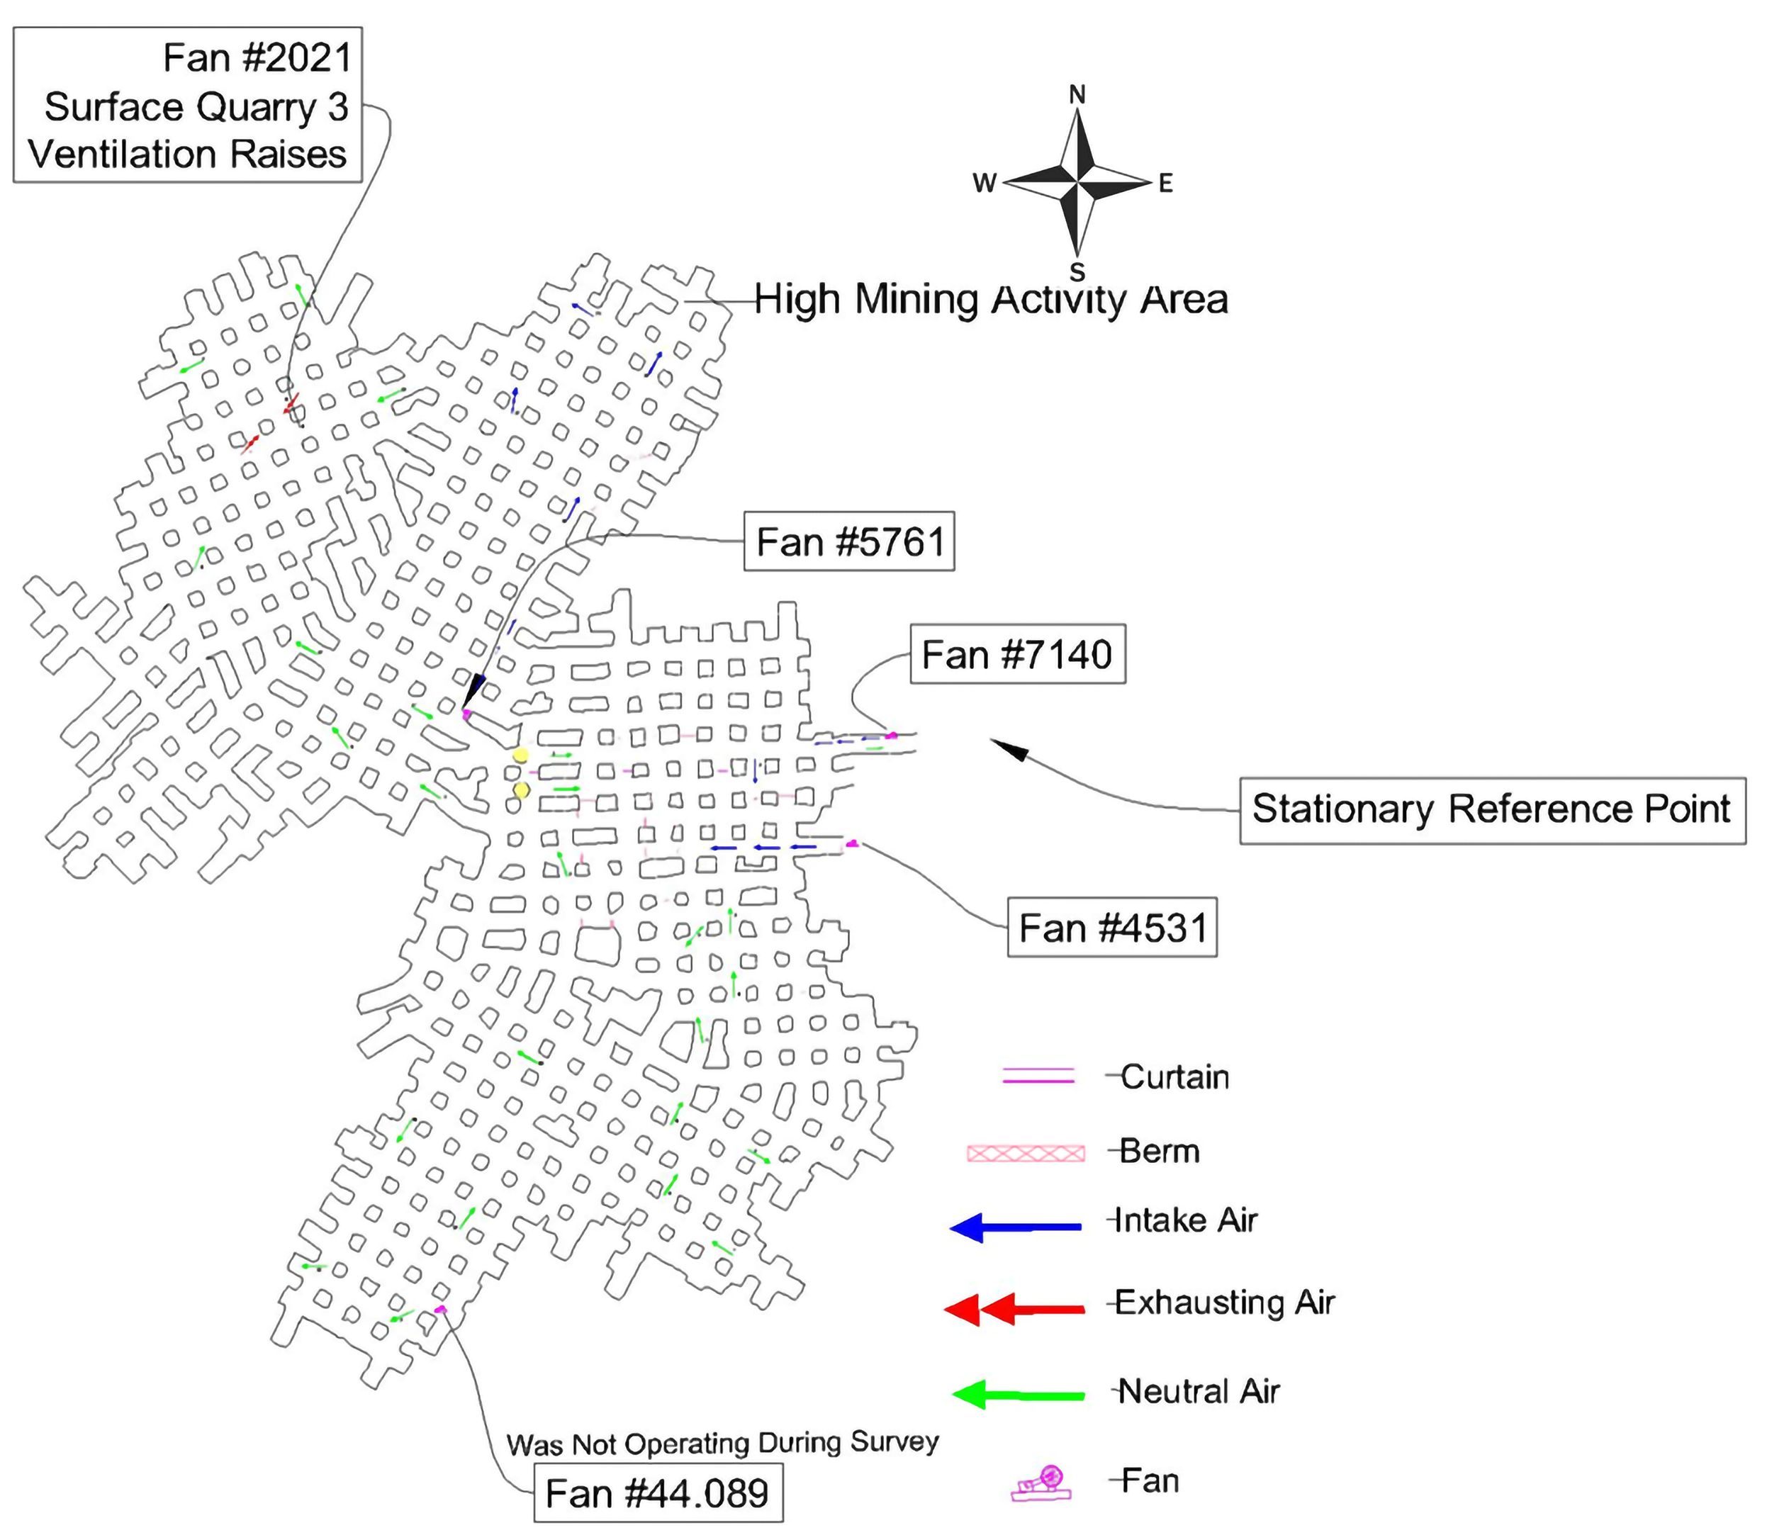
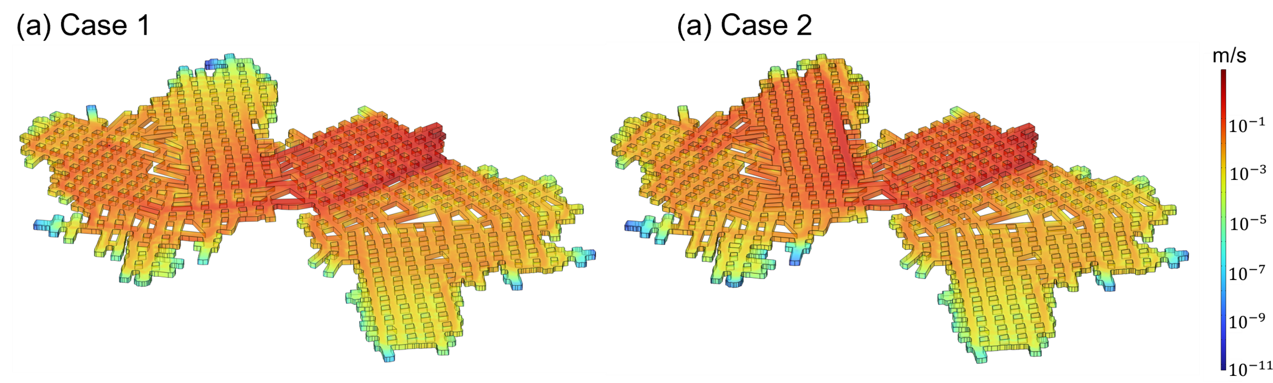

CFD Modeling of Ventilation in Large Underground Mines – Impact of Booster Fan on Ventilation
This work develops a full-scale CFD model to evaluate ventilation performance in a large underground mine. It evaluated the influence of booster fan on airflow distribution, air exchange, and mine safety.
S. Azam¹, S. Liu¹, X. Song¹, C.L. Spellman²
1. Department of EME, Pennsylvania State University, University Park, USA
2. Pennsy Supply Inc., Thomasville, USA
Introduction and Goals
Large underground mines (LUMs) present ventilation challenges due to their vast size, low airflow resistance, and complex geometries. Ventilation is essential for providing fresh air and removing contaminants but can contribute up to 40% of operating costs. To address this, a full-scale CFD model of a limestone mine (880 m × 730 m) was developed using COMSOL.
The model applied a realizable k-ε turbulence formulation to analyze airflow under realistic boundary conditions. Two scenarios - without and with booster fans - were simulated. Results show that booster fans substantially enhanced airflow penetration and air exchange in targeted regions, reducing residence times, while the effects remained highly localized.
Methodology
A field survey of the limestone mine recorded airflow, pressure, temperature, and humidity at multiple locations to define boundary conditions and validate the model. A full-scale CFD geometry (880 m × 730 m) with irregular pillars was developed, incorporating turbulent flow, heat transfer, and moisture transport.
The realizable k-ε turbulence model was applied with weakly compressible air and gravity in the -z direction to capture buoyancy effects. Ventilation boundaries included intake and exhaust fans, an open boundary, curtains, and a centrally located booster fan. Two scenarios, with and without booster operation, were simulated to evaluate airflow distribution and ventilation effectiveness across different mine zones.
Figure 1. Ventilation Map of the section of the LUM where the present study was conducted
Results
Simulation results highlight the influence of booster fans and boundary conditions on airflow in large underground mines.
Booster fans significantly increased airflow penetration and air exchange in targeted zones, reducing residence times by over an order of magnitude.
The improvements were highly zone-specific with minor effects on the overall ventilation because of the large size of the mine.
CFD proved to be an effective tool for predicting airflow behavior and guiding ventilation planning beyond empirical methods.
Figure 2. Airflow Velocity contours in the whole LUM when: (a) no BF is present to force air into the (case 1) and (b) when booster fan is located to boost air into the working region (case 2).
[1] Gendrue, N., Liu, S., Bhattacharyya, S., & Clister, R. (2023). An investigation of airflow distributions with booster fan for a large opening mine through field study and CFD modeling. Tunnelling and Underground Space Technology, 132, 104856.

