Slide 1
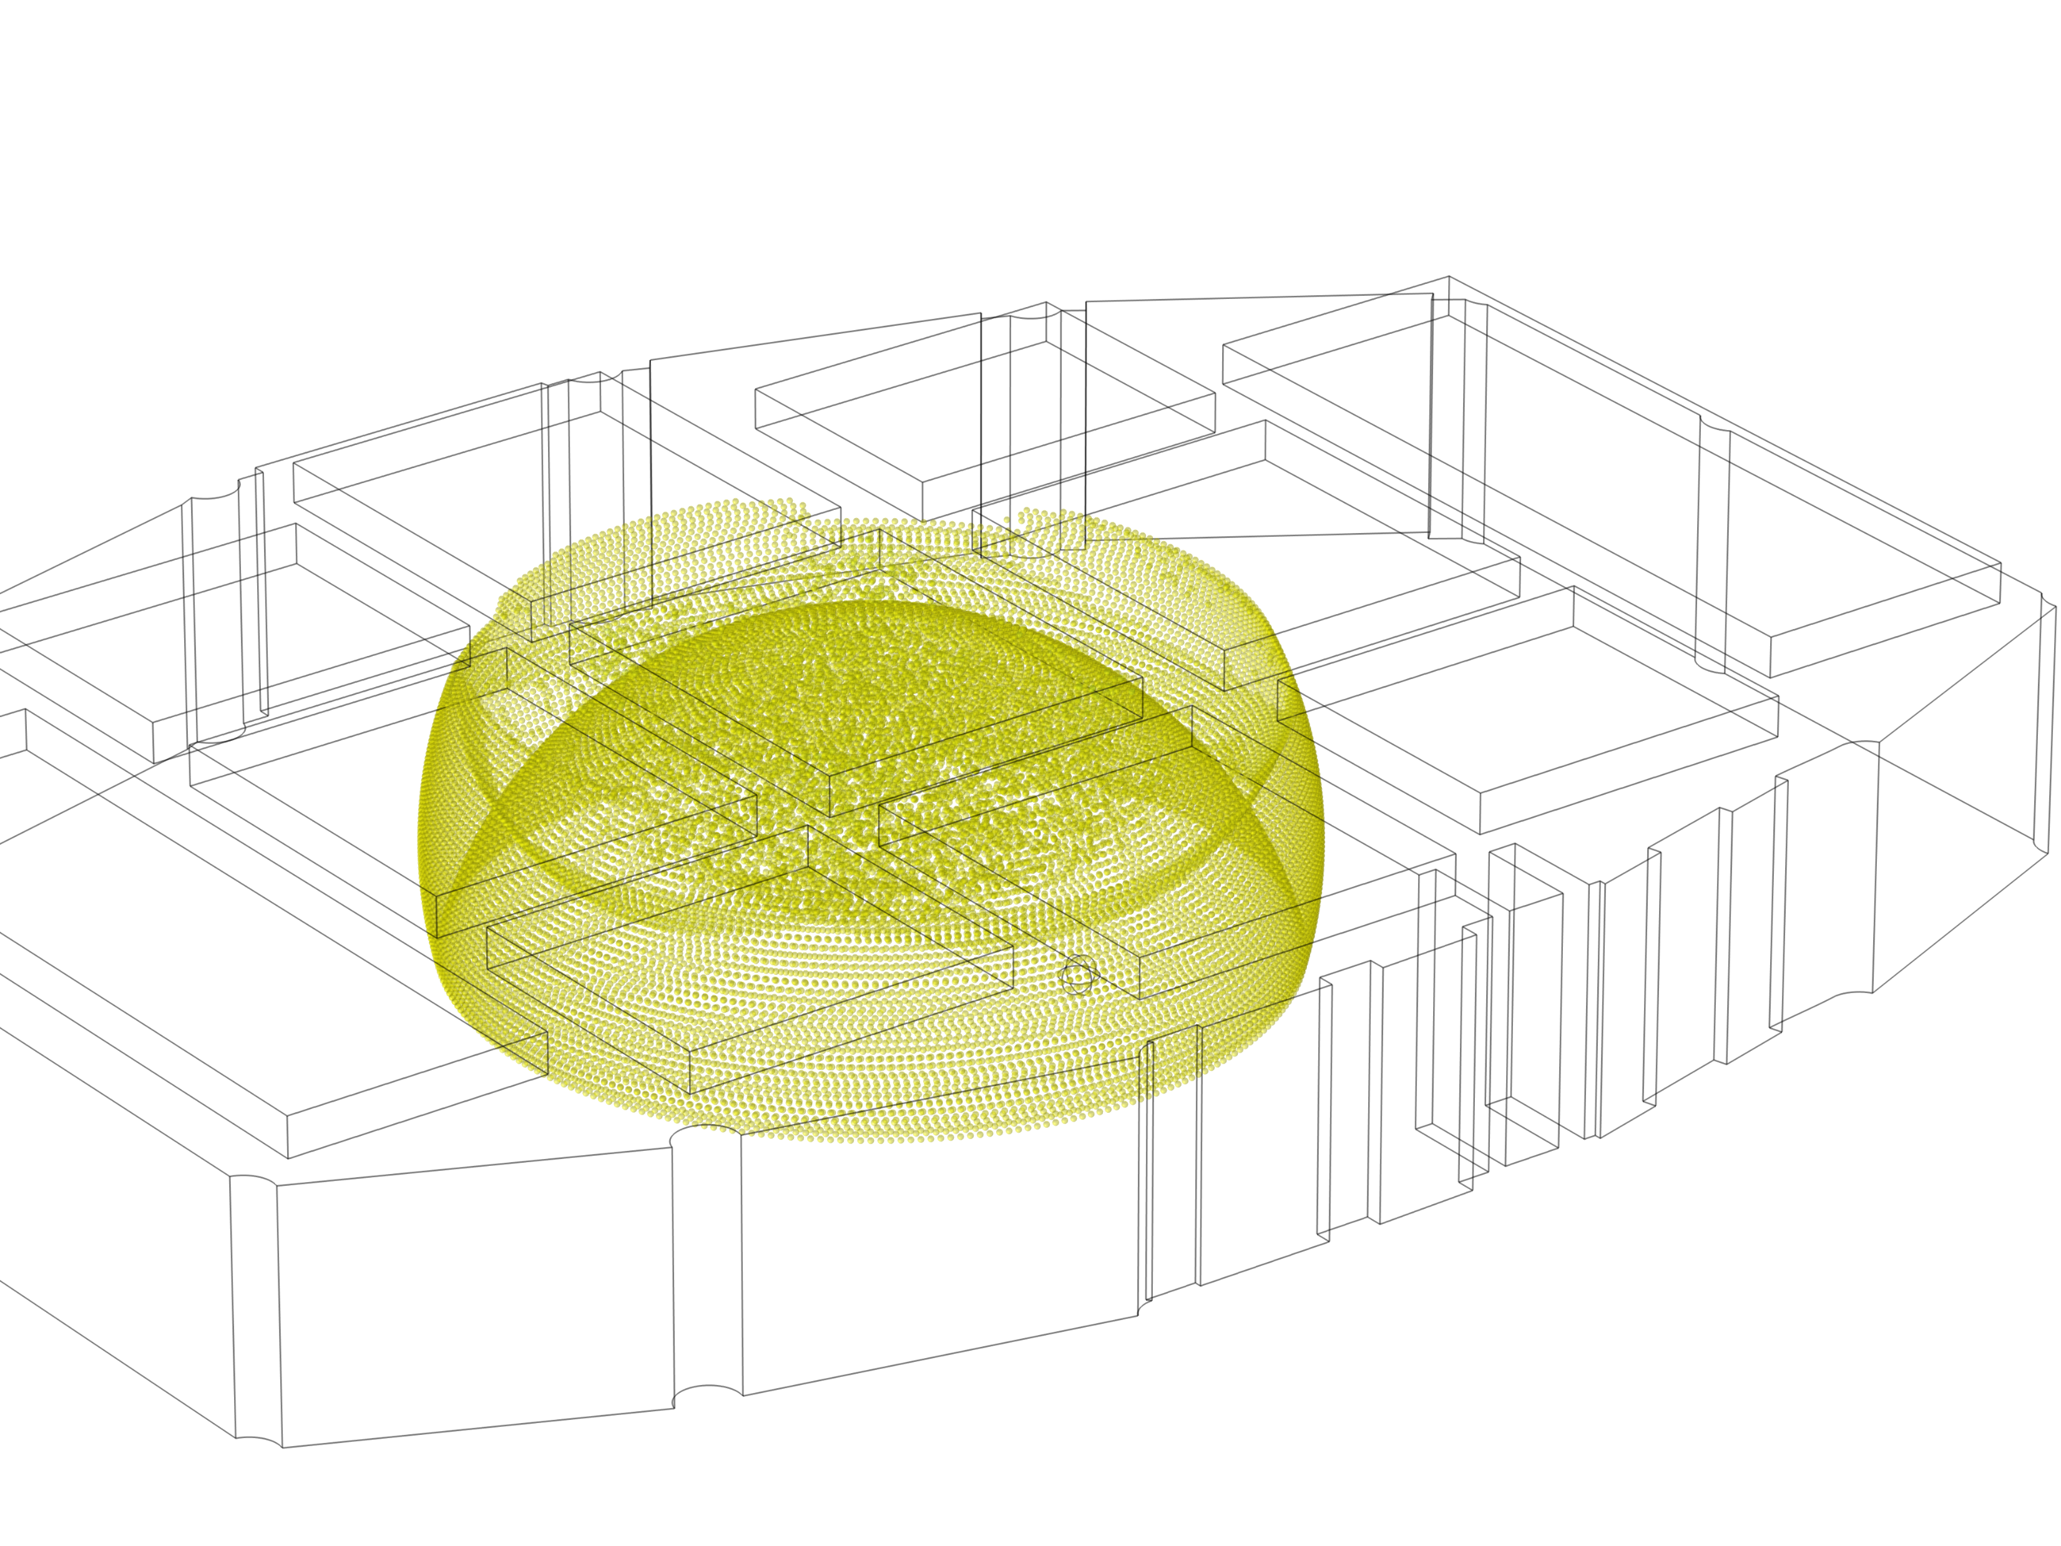


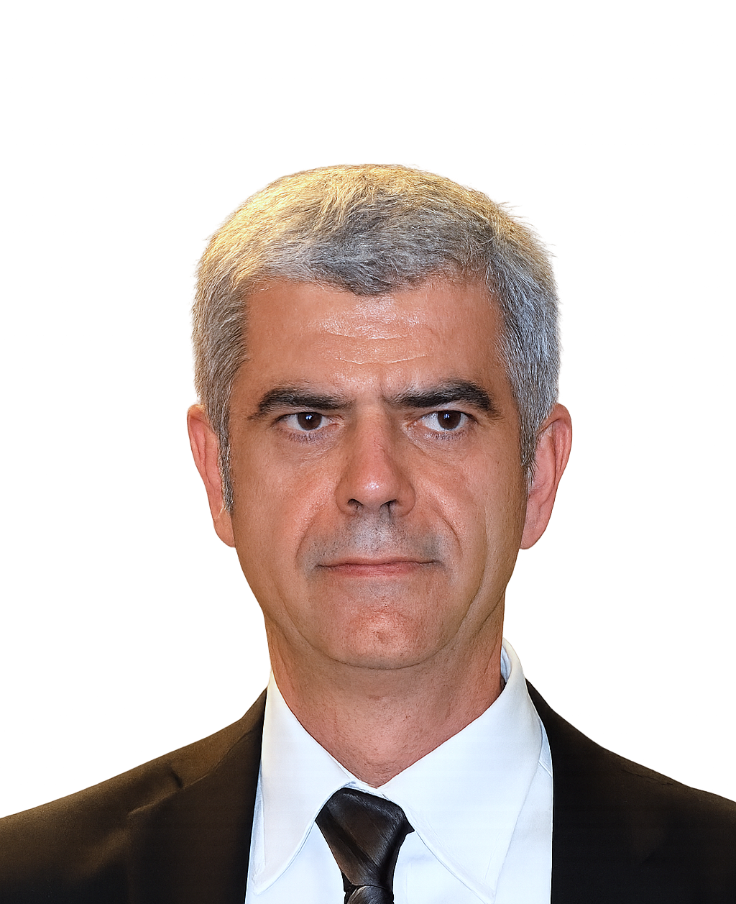
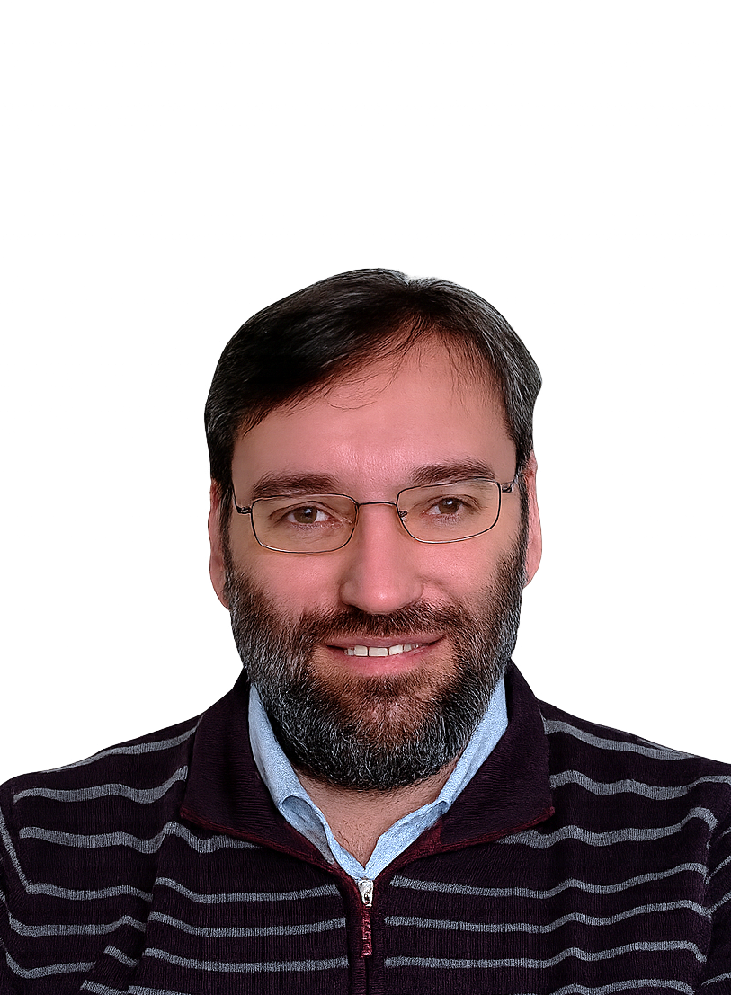
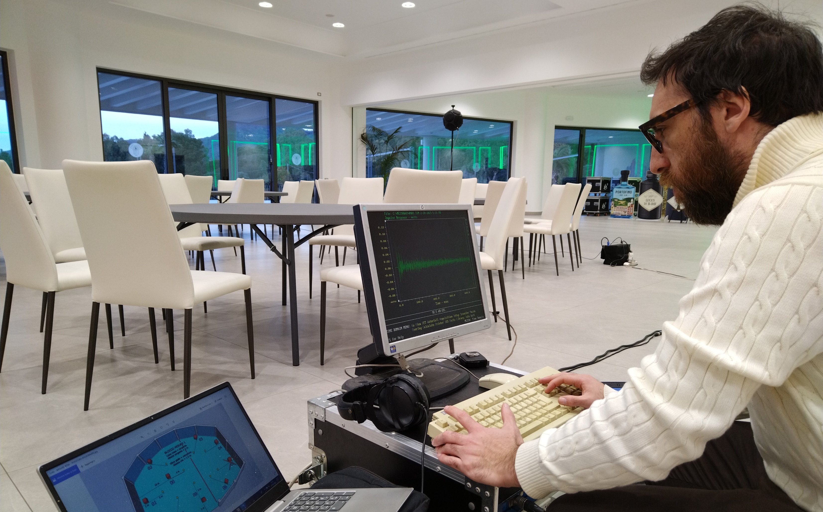
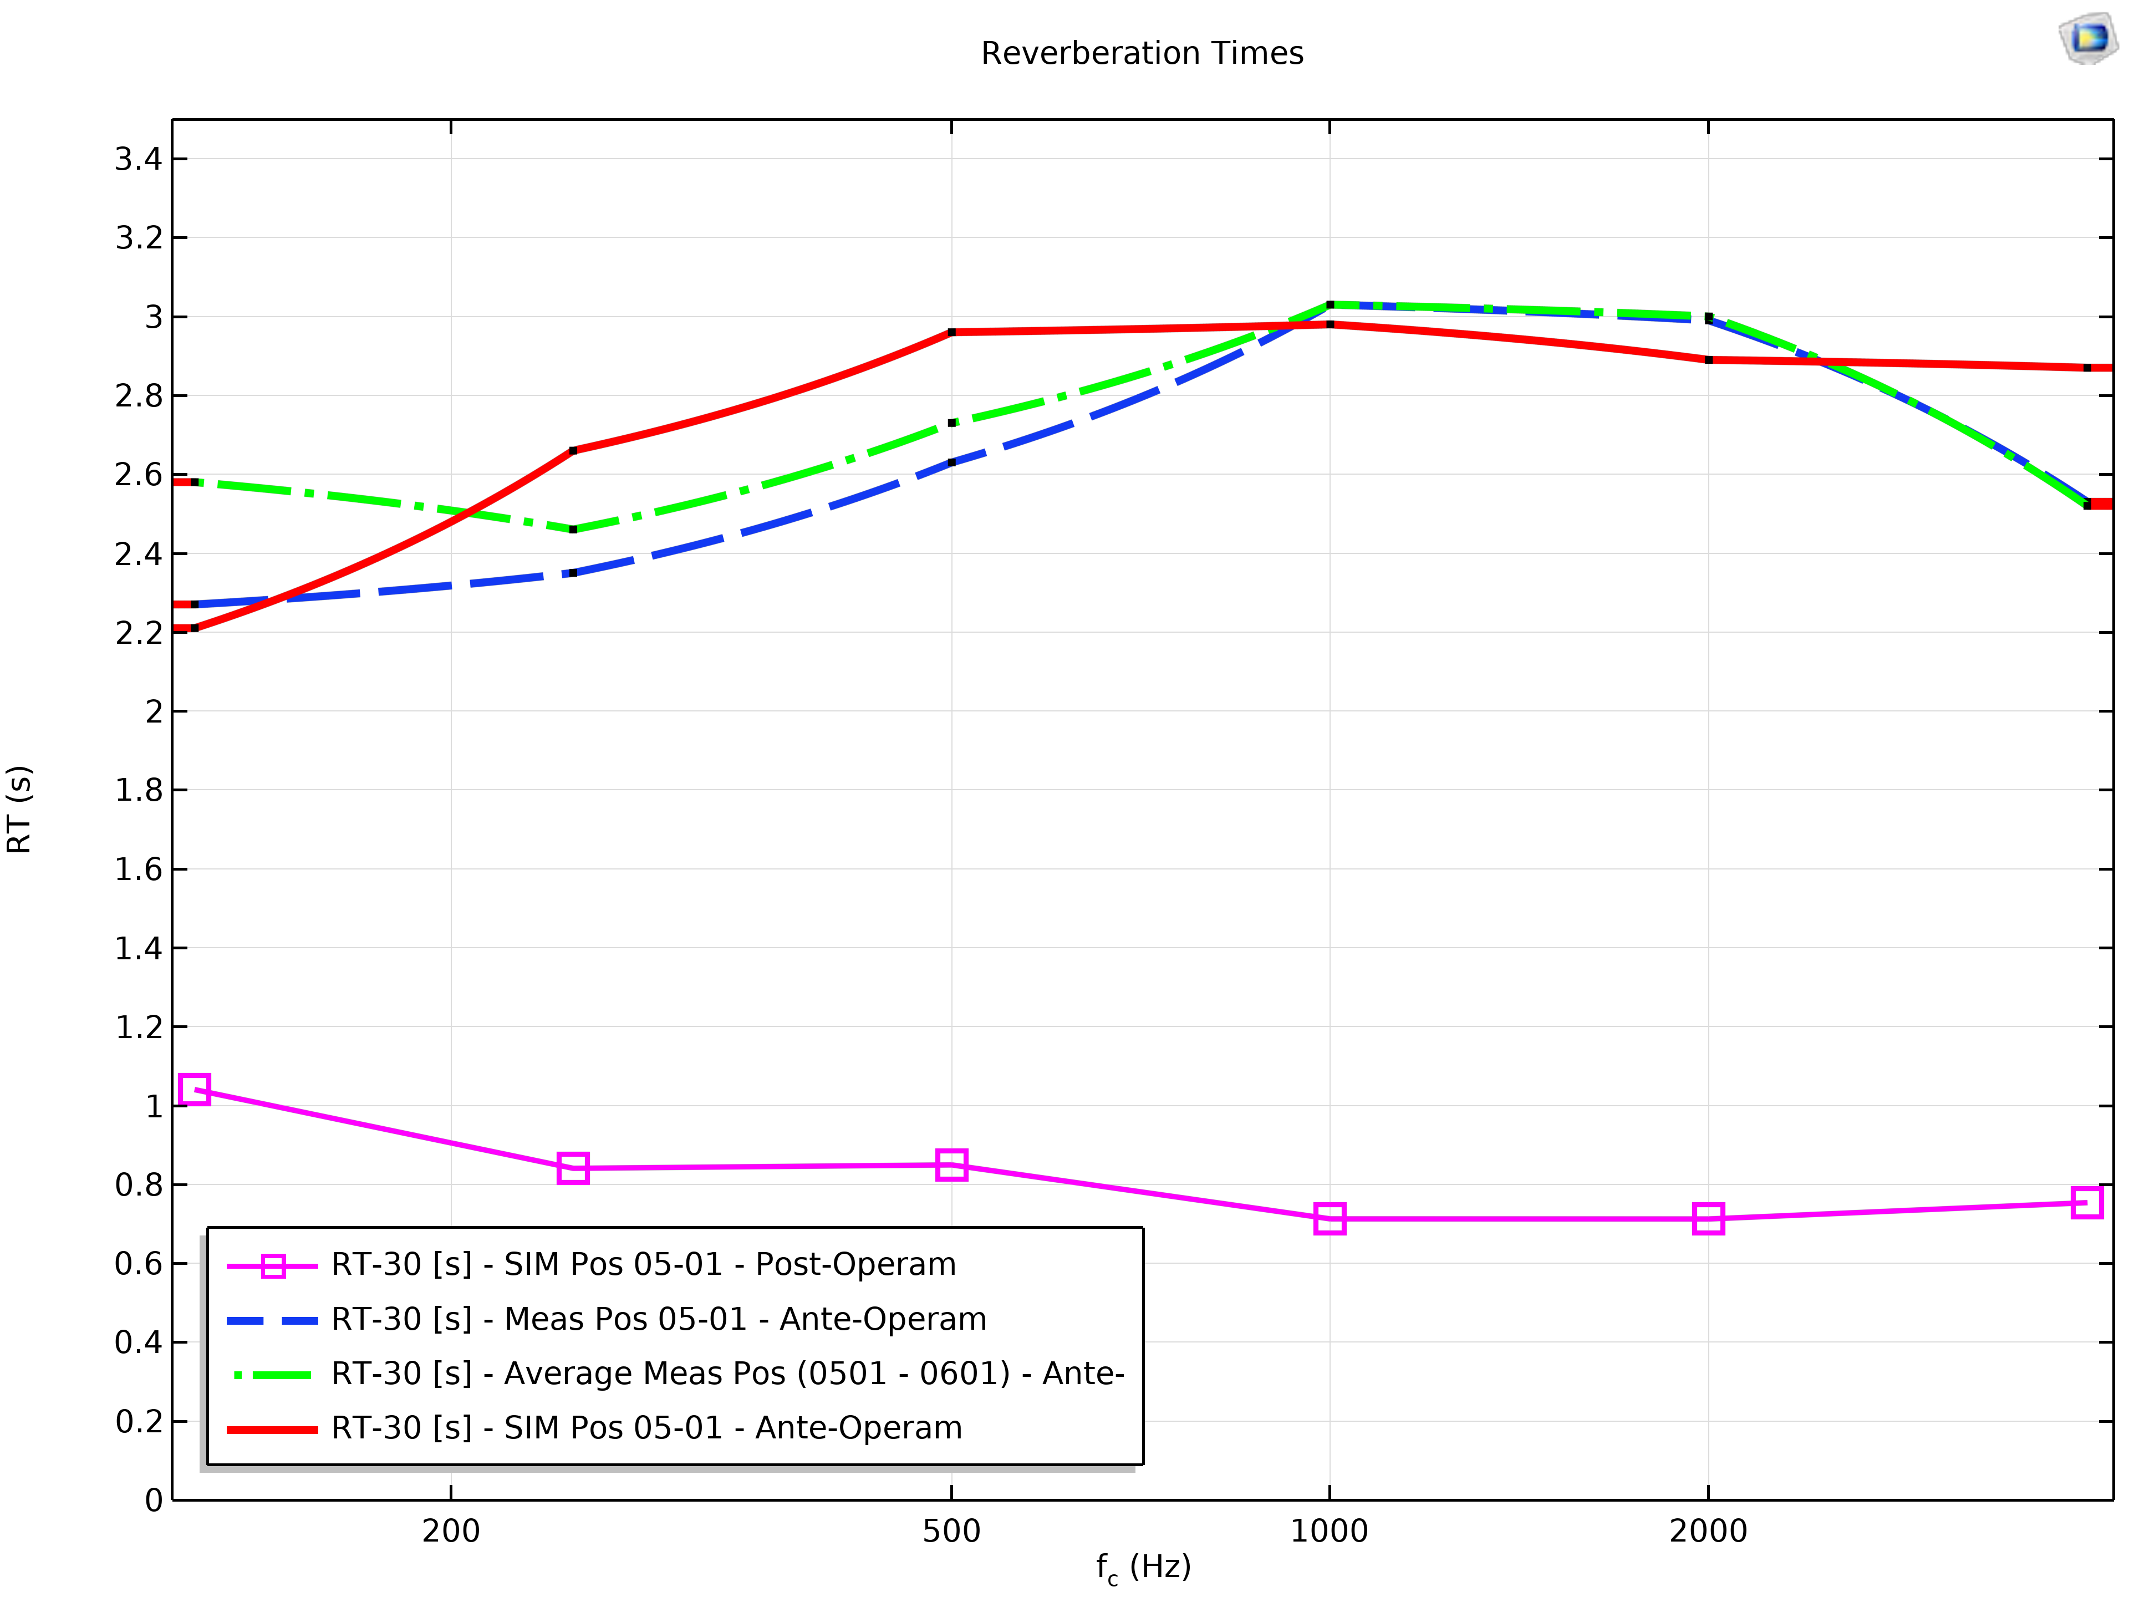
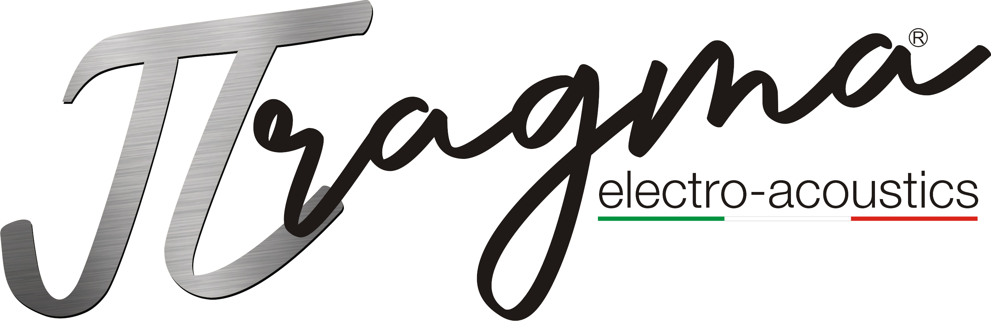



Assessment and Acoustic Enhancement of a Multi-Purpose Venue with COMSOL Multiphysics.
This study establishes a measurement → model → auralization pipeline combining Schröder-based T₃₀ with acoustical ray tracing.
Autors: Riccardo Balistreri¹; Martin Castrovinci¹; Gianpiero Majandi¹, Emilio Ruiz‑Reina²
Affiliation: ¹ Pragma Electro‑Acoustics Ltd, Birkirkara, Malta ² Department of Applied Physics II, University of Málaga, Spain
Introduction and Goals
This work addresses the acoustic design of a multipurpose hall (~3,000 m³) subject to stringent architectural constraints allowing only ceiling interventions. The design goal is to achieve RT₆₀ ≤ 1.4 s with spatial and spectral uniformity suitable for speech, amplified, and acoustic music. The methodology integrates: (i) ISO 3382-compliant in-situ measurements, (ii) predictive modeling with COMSOL Multiphysics® 6.3 Ray Acoustics using the real STL geometry, and (iii) auralization for perceptual evaluation. Model–measurement consistency was verified by octave-band decay curves and Schröder-based T₃₀ regression. Simulations show systematic RT reduction and improvements in C₈₀/D₅₀/STI across 500–4000 Hz. Predictive limitations of C₅₀/D₅₀/STI in geometrical models are discussed. The absence of a fixed stage reinforces RT as primary design parameter, while ISO 3382-1/2 and ISO 23591:2021 provide the normative framework for target and spectral tolerances.
Methodology
Acoustic simulations were conducted in COMSOL Multiphysics® 6.3 using the STL-derived geometry of the hall. Following Christensen’s approach, no scattering coefficients were applied in Ray Acoustics to avoid non-physical approximations, modeling surface behavior through edge diffraction and roughness with boundary conditions defined per surface. Absorption was set as frequency-dependent interpolation functions. The setup replicated DRA-MLSSA measurements with an Audio Research Group ODX-1 (OmniDrive Experimental Series 1) source at 115 dB SPL/1 m and a Audio Research Group MCR-12C1 (½" Class 1 Random Incidence Condenser Microphone). COMSOL reproduced the same SPL, 0.30 m receiver radius, Δt = 20 ms, and 1.82 s output. RT₆₀ estimated by linear regression on the –5 dB to –35 dB interval (T30 extrapolation) using backward Schröder integration, in accordance with ISO 3382.
Results and Final Considerations
Key acoustic metrics (ISO 3382) were analyzed, with T30 adopted as the main reverberation descriptor. COMSOL simulations showed consistent T30 reduction and improvements in C80, D50, and STI within 500–4000 Hz, critical for intelligibility. Pre-intervention data in an empty hall represented worst-case conditions, while low correlation invalidated EDT and T20. Predictive limits persist, as C50/D50/STI are sensitive to source directivity, ray models neglect wave effects, and STI fails to separate early vs. late reflections. These results motivate simulating a real dodecahedron omnidirectional source with integrated directivity. As a subsequent objective, we will design and benchmark a spherical radiator that has a more uniform angular energy distribution above 1 kHz and to reduce prediction uncertainty in complex architectural spaces where sound propagation is strongly governed by geometry and material properties.
- ISO 3382, “Acoustics—Measurement of room acoustic parameters”.
- ISO 23591:2021, “Acoustics—Acoustic quality criteria for rehearsal rooms and spaces”.
- R.Schroeder, “New method of measuring reverberation time,” JASA 37(3):409–412 (1965).
- C. L. Christensen, “Practical methods to define scattering coefficients in a room acoustics computer model”.
- D. D. Rife, “Room acoustics measurements using MLSSA,” J. Acoust. Soc. Am., vol. 89, p. 1877, 1991.
- M. Kleiner, B.-I. Dalenbäck, and P. Svensson, “Auralization - An overview,” JAES 41(11):861–875 ’93.

