Slide 1
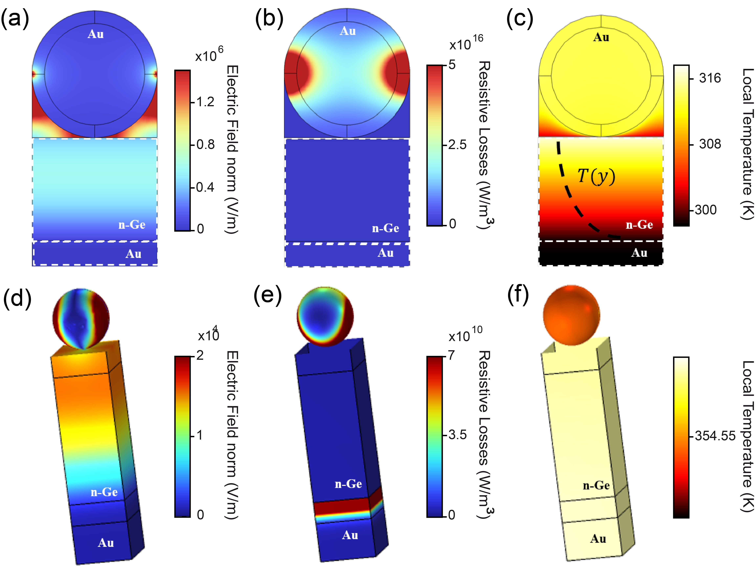
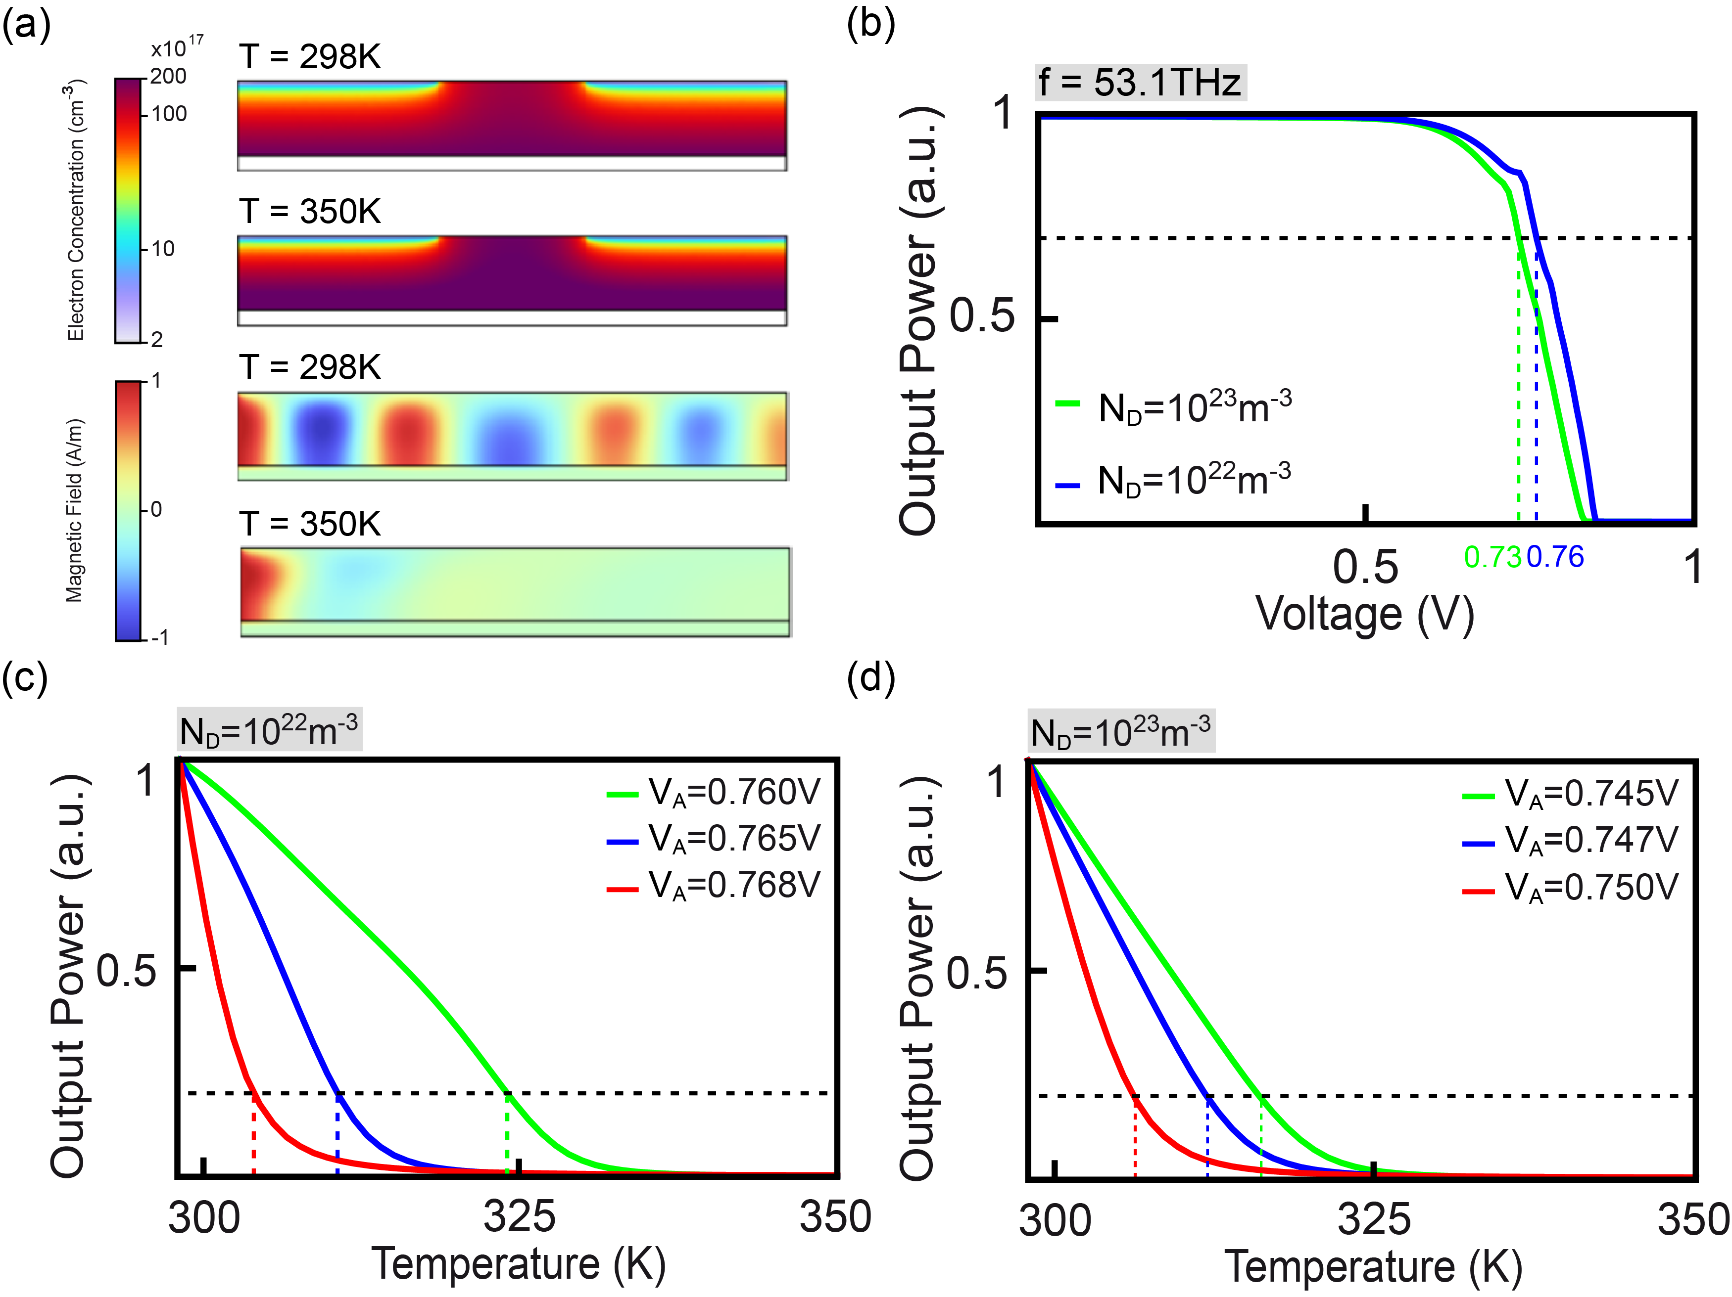
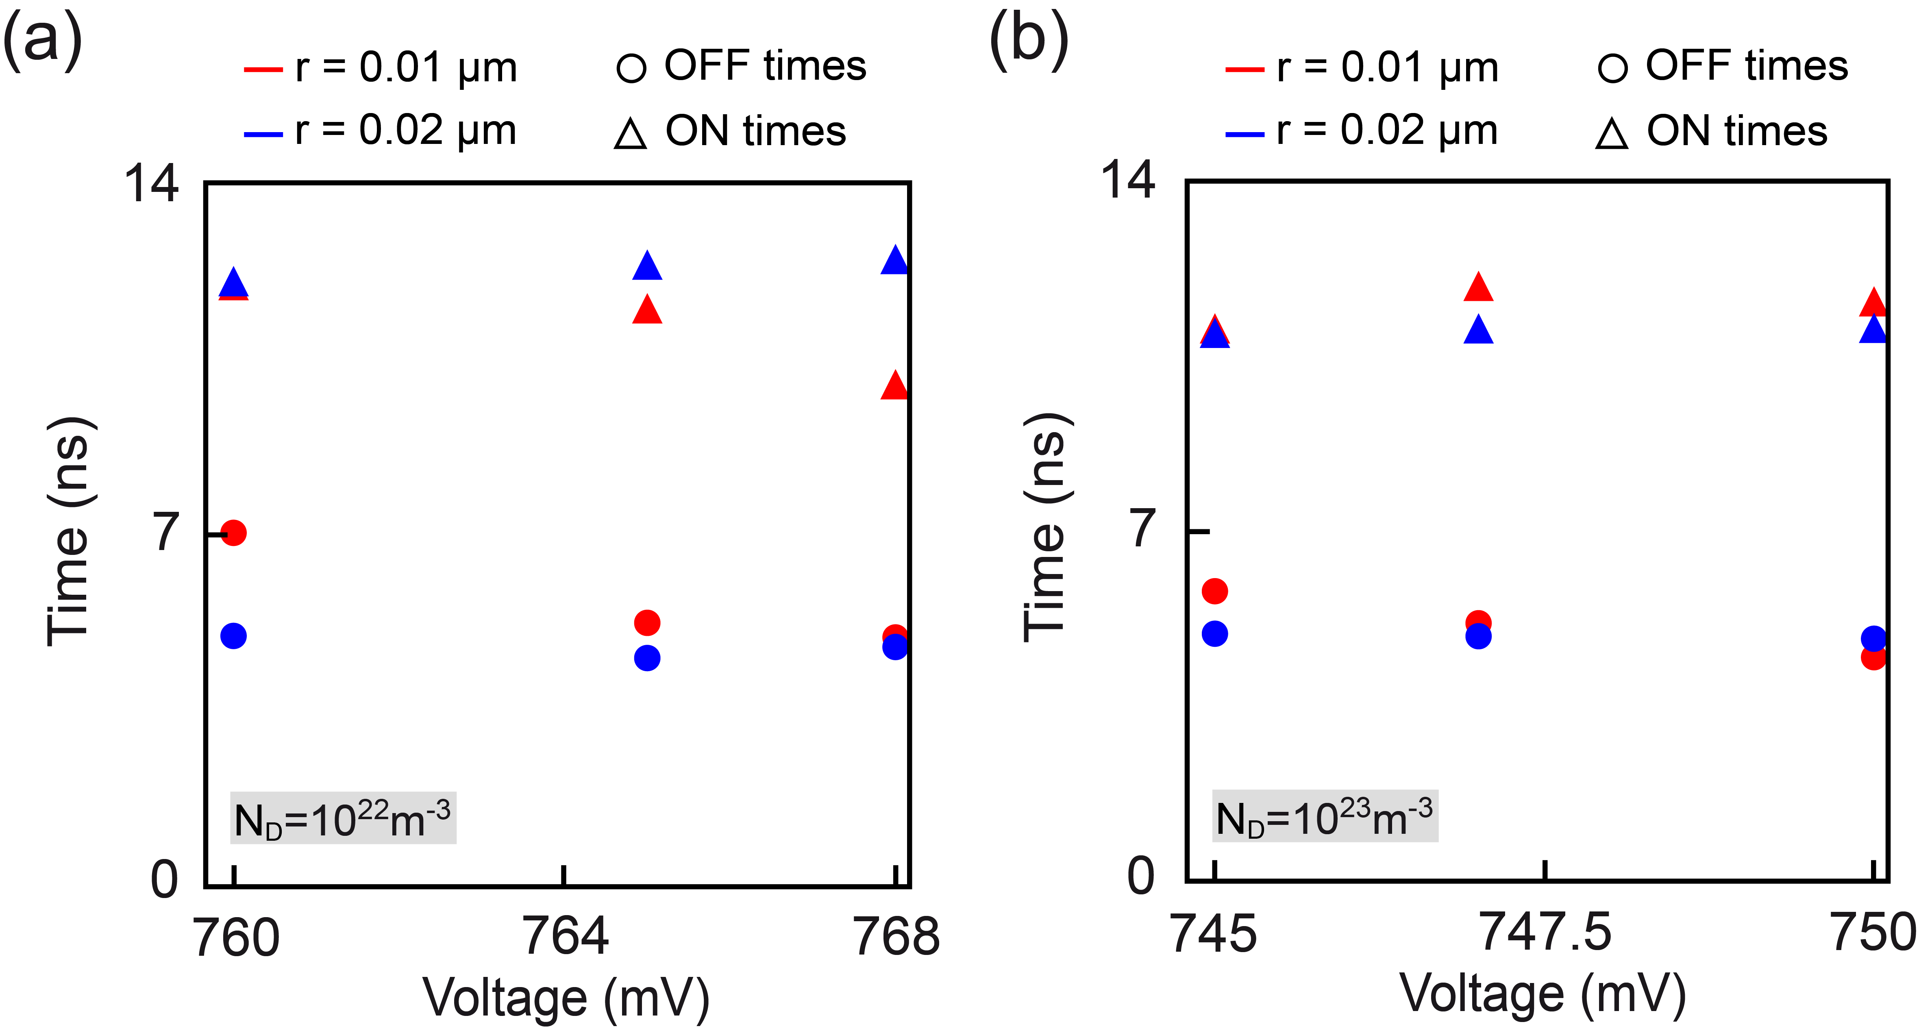


All-Plasmonic Thermo-Optic Modulator for GHz Signal Switching at Metal–Semiconductor Interfaces
We present an all-plasmonic modulator based on a Metal-Semiconductor junction, engineered to enable functional plasmonic circuits through thermal control of surface plasmon polaritons at the junction interfaces.
Mayra M. Schliemann¹, Raj K. Vinnakota¹
1. Center for Materials and Manufacturing Sciences, Troy University, Troy, AL, USA.
FIGURE 1. (a) Cylindrical particle structure’s electric field distribution, (b) LSPR-induced resistive heating, (c) and steady-state temperature profiles. (d) Spherical particle structure’s electric field distribution, (e) LSPR-induced resistive heating, (f) and steady-state temperature profiles.
Abstract
The integration of plasmonic elements into optoelectronic systems opens new avenues for achieving high-speed, ultra-compact signal modulation at the nanoscale. In this work, we introduce a novel all-plasmonic modulator, termed the Thermal-Assisted Plasmonic Switch (TAPS).
The TAPS leverages localized surface plasmon resonance (LSPR)-induced heating to dynamically control surface plasmon polariton (SPP) propagation along the metal–semiconductor (M–S) interface. This offers a promising mechanism for plasmonic signal routing and logic at GHz frequencies.
Methodology
COMSOL Multiphysics was used extensively to design, simulate, and optimize the TAPS device. The developed model integrates the Electromagnetic Waves Module (ewfd), the Heat Transfer Module (ht), and the Semiconductor Module (semi) in the steady state and temporal domain. Also, parametric sweeps were performed over structural geometries, input powers, wavelengths, and doping levels to analyze the TAPS operation’s dependency on these parameters and optimize the device. This multiphysics model was implemented in 2D and 3D geometries with fine meshing near metal-dielectric boundaries. To comprehensively capture the switching phenomena that arise from the combined electro-optic and thermo-optic effects, the investigation was conducted in two stages: (1) electro-optic response without the presence of plasmonic particles and (2) thermo-electro-optical control of SPPs in the proposed device.
FIGURE 2. (a) Local electron concentration and electromagnetic field profiles corresponding to SPP ON/OF states. (b) Transmittance as a function of applied voltage. (c-d) Critical temperature analysis
Results
The TAPS steady state response demonstrates that the critical voltage values are V_{C}=0.73V for N_{D}=10²³m⁻³ and V_{C} =0.76V for N_{D}=10²²m⁻³ . Once we knew the critical voltage values for various doping concentrations, we analyzed the transmission as a function of the temperature of the n-Ge layer to find the critical temperature values. For N_{D}=10²²m⁻³, T_{C}=323K for V=0.760V, T_{C}=310K for V=0.765V, and T_{C} =303.5 for V=0.768V.
The results extracted from the COMSOL Multiphysics model demonstrate a modulation depth exceeding -30 dB, with a thermal responsivity greater than -3 dB·K⁻¹, and switching speeds in the order of 1 GHz. Therefore, it is clear that the presented numerical prototype offers a promising solution for integrating electronic and photonic technologies.
FIGURE 3. Extracted response times as a function of the applied bias, varying n-doping concentration, and particle radius.
[1] Vinnakota RK, Schliemann MM, & Shahriar S (2025). Optoelectronic control of surface plasmon polaritons at metal-doped semiconductor interfaces. Journal of Physics: Photonics, 7(3), 035001.
[2] Vinnakota RK, Dong Z, Briggs AF, Bank SR, Wasserman D, Genov DA (2023). Response times of a degenerately doped semiconductor based plasmonic modulator. Journal of the Optical Society of America B, 40(5), 978.
[3] Vinnakota RK, Dong Z, Briggs AF, Bank SR, Wasserman D, Genov DA (2020). Plasmonic Electro-optic modulator based on degenerate semiconductor interfaces. Nanophotonics, 9(5), 1105–1113.
Funding for this research was provided by the National Science Foundation ERI (Award No. ECCS-2138198)

