Slide 1
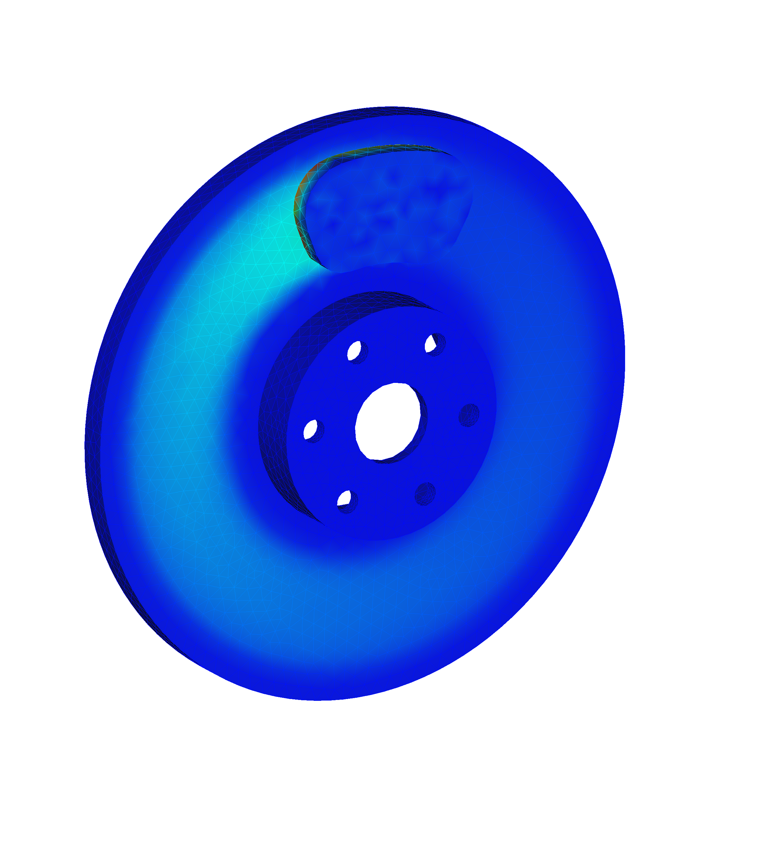
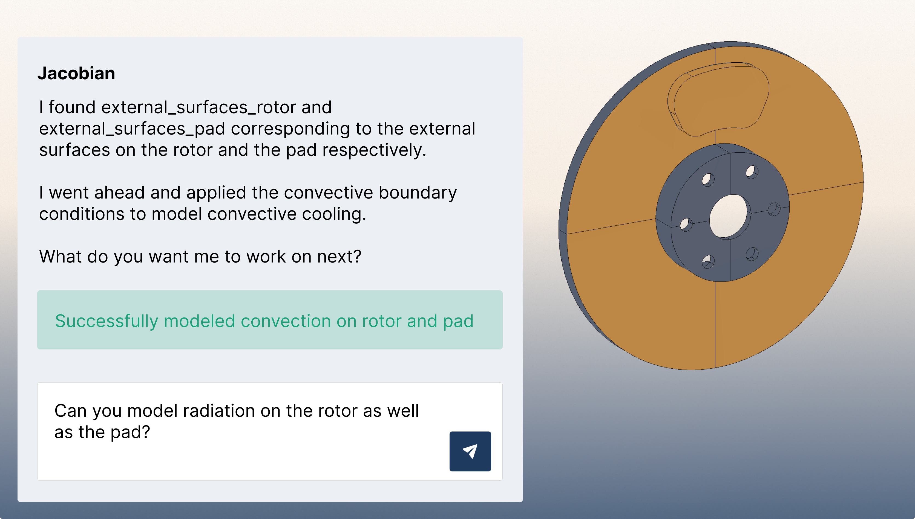
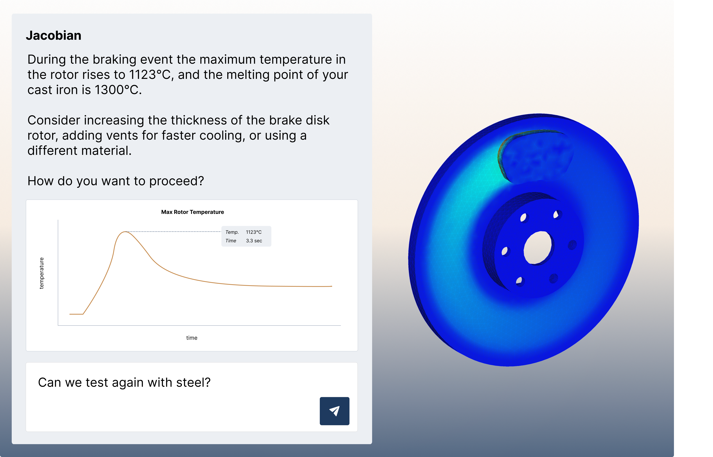

Jacobian: AI Copilot for Automating Simulation Setup in COMSOL
In collaboration with Constellium (NYSE: CSTM), we developed a system that can automate the process of running thermal analyses on brake discs. This system is extensible to other geometries and physics.
C. Shrivastava¹, D. Wallace¹, N. Evers¹
1. CompLabs, San Francisco, USA
Introduction
Simulation engineers need simulation results, but today, they spend most of their time on non-value add work (geometry cleanup, meshing, connecting parts, applying boundary conditions, debugging). Jacobian is an AI-native simulation platform that integrates with COMSOL to automate the tedious work required to get simulation results. Currently, Jacobian can help set up, execute, and post-process transient thermal simulations for brake discs, but this same system will soon be generalized to handle other geometries and physics. The purpose of Jacobian is to make it easier and faster to run simulations.
Methodology
A CAD brake disc model (STEP format) is uploaded and procedurally preprocessed into components, faces, edges, and vertices with stable indices. Jacobian (the AI copilot) plans how to run a transient thermal analysis on a brake disc, prompting the user to identify key parts (rotor, pads, exposed faces) and parameters (braking conditions, velocity, cooling). Physics (rotation, friction, convection, and radiation) are applied automatically. The solver-agnostic model is translated into COMSOL script, executed on a server, and post-processed.
Figure 1. Jacobian starting the simulation setup.
Results
Jacobian successfully automates the setup and execution of transient thermal simulations for brake discs. The system identifies geometry, assigns boundary conditions, parameterizes physics, and runs the solver with significantly less manual work than is typically required. Results are extracted and displayed directly in the GUI.
Jacobian interfaces with COMSOL on behalf of the engineer, so that they can take actions through natural language and focus on the critical design decisions.
Figure 2. Jacobian has run the simulation and post-processed the results.

