Slide 1
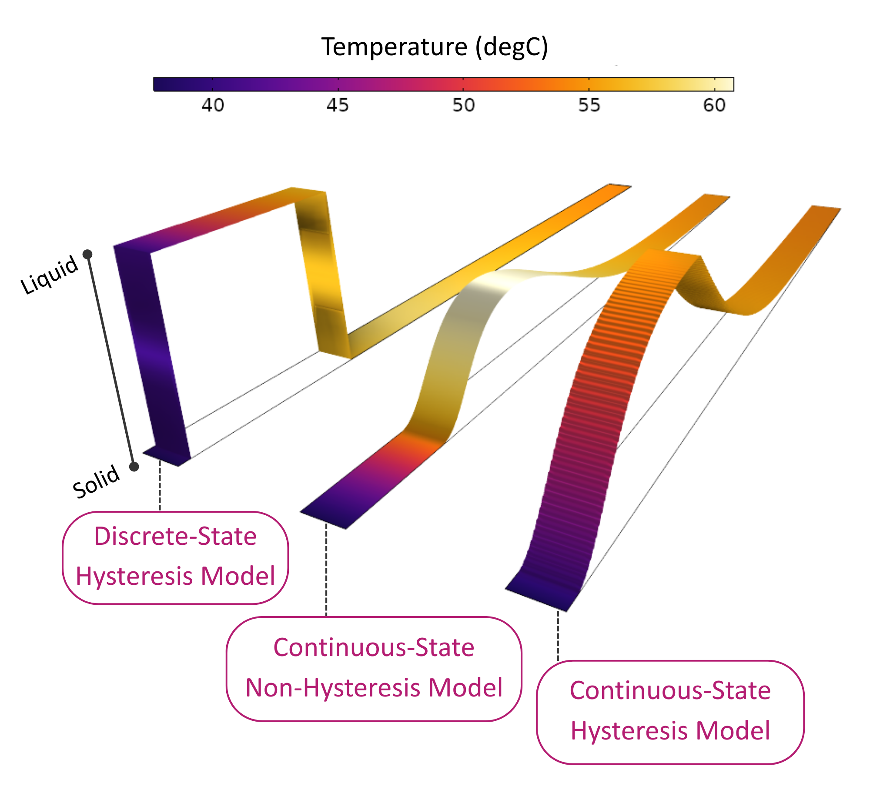
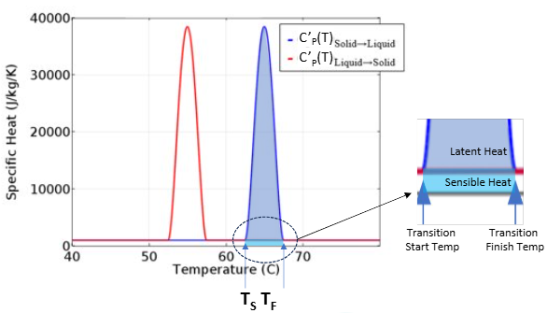
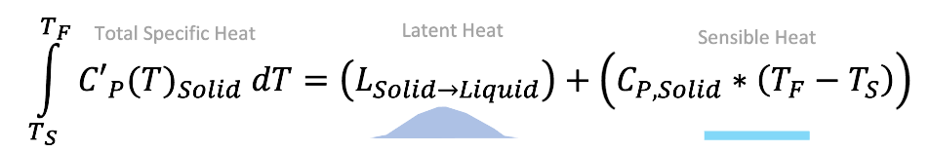
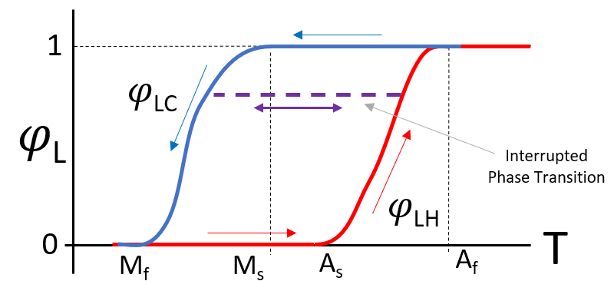

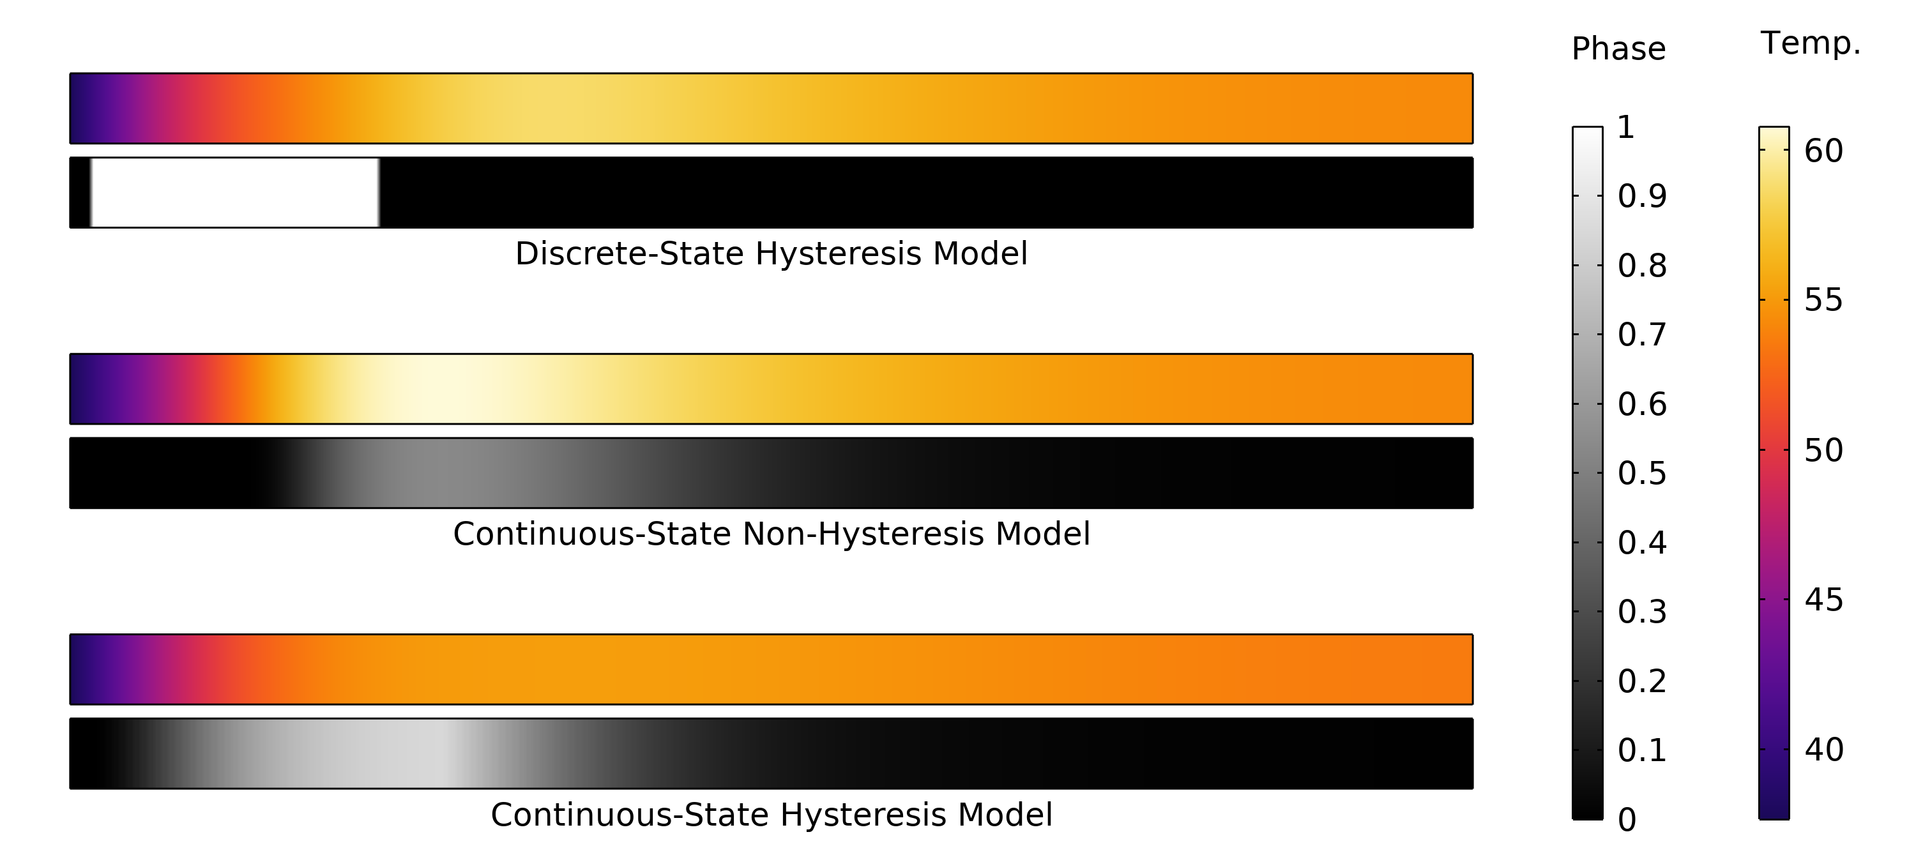

A Continuous-State Modeling Framework for Phase Change Materials in COMSOL Multiphysics
This work adapts the Bony and Citherlet interrupted phase transition model for COMSOL Multiphysics, enabling accurate simulation of thermal hysteresis and partial phase transitions.
J. Frankel¹, A. Taylor¹, B. Krass¹, C. Hannon¹
¹Triton Systems, Inc.
Abstract
Phase change materials (PCMs) such as shape memory alloys exhibit transformations that occur over temperature ranges and display thermal hysteresis during heating and cooling. Binary models often fall short when intermediate states, spatial gradients, or history-dependent behavior need to be captured. We developed a framework in COMSOL Multiphysics that uses a continuous transformation fraction state variable. DSC data define transition curves and latent heat distributions, reproducing characteristic looped responses with high fidelity while conserving energy throughout partial reversals.
This framework improves predictive accuracy in systems where gradual transitions and thermal memory are critical. It is extensible beyond two phases, accommodates arbitrary latent heat distributions, and can replicate complex DSC behavior such as multiple inflections in the heat flow. By enabling more realistic simulation of nonlinear and hysteretic PCM responses, the method supports the design of advanced systems for energy storage, smart materials, and thermal regulation applications.
Methodology
A continuous-state PCM model was implemented in COMSOL using the Heat Transfer Module and State Variable node. A phase fraction variable (ϕ) evolves between 0-1 based on DSC-derived heating and cooling curves. Latent heat is applied through the derivative of these curves, and total specific heat is computed as the sum of phase-specific sensible heats and latent contributions. Hysteresis is enforced by updating ϕ only when transition boundaries are crossed, conserving energy during partial reversals.
FIGURE 1. Integration of the total specific heat curve from transformation start (T_{S}) to finish temperature (T_{F}) is the sum of the latent heat of transformation and the sensible heating value. Normalization of the integral between these transition temperatures yields a phase transformation curve.
Results
Implementation of this method allows simulations to accurately reflect complex phase change behavior with hysteresis. Partial transition is accounted for using the Bony and Citherlet [2] or “outer loop” model, which maintains constant phase during interrupted transition until the local temperature and phase reach the appropriate transformation curve which bound the hysteresis range.
The continuous-state framework successfully reproduced DSC-measured hysteresis loops and latent heat distributions. Simulations showed accurate energy conservation during partial/interrupted heating and cooling transition cycles, with phase fraction remaining stable until the opposing transition curve was reached. The approach replicated complex transformation behavior, including multiple inflections in the DSC heat flow, and proved extensible beyond two-phase systems. Compared to binary or non-hysteretic models, this framework captures smooth phase evolution, as shown in the comparative figure, where discrete transitions are replaced by continuous gradients consistent with experimental behavior.
FIGURE 2. Interrupted transition of a strip of material subjected on left boundary to rapid heating followed by rapid cooling, comparing three methods of phase change modeling. Note the difference in distribution of temperature and phase along the length, despite identical boundary conditions and material properties.
[1] Darin Sharar et al. (2020). High-Capacity High-Power Thermal Energy Storage Using Solid-Solid Martensitic Transformations. 10.48550/arXiv.2011.12339.
[2] Jacques Bony, Stéphane Citherlet (2007). Numerical model and experimental validation of heat storage with phase change materials, Energy and Buildings, Volume 39, Issue 10, 2007. https://doi.org/10.1016/j.enbuild.2006.10.017

