Slide 1




Impact of The Key Aging Mechanisms in NMC-622 Batteries and their Consequences in Degradation
Rifat Rashid Ahmed, Joris de Hoog, Maitane Berecibar & Md. Sazzad Hosen
Electromobility Research Centre-MOBI, Vrije Universiteit Brussel (VUB)- Belgium

Slide 2
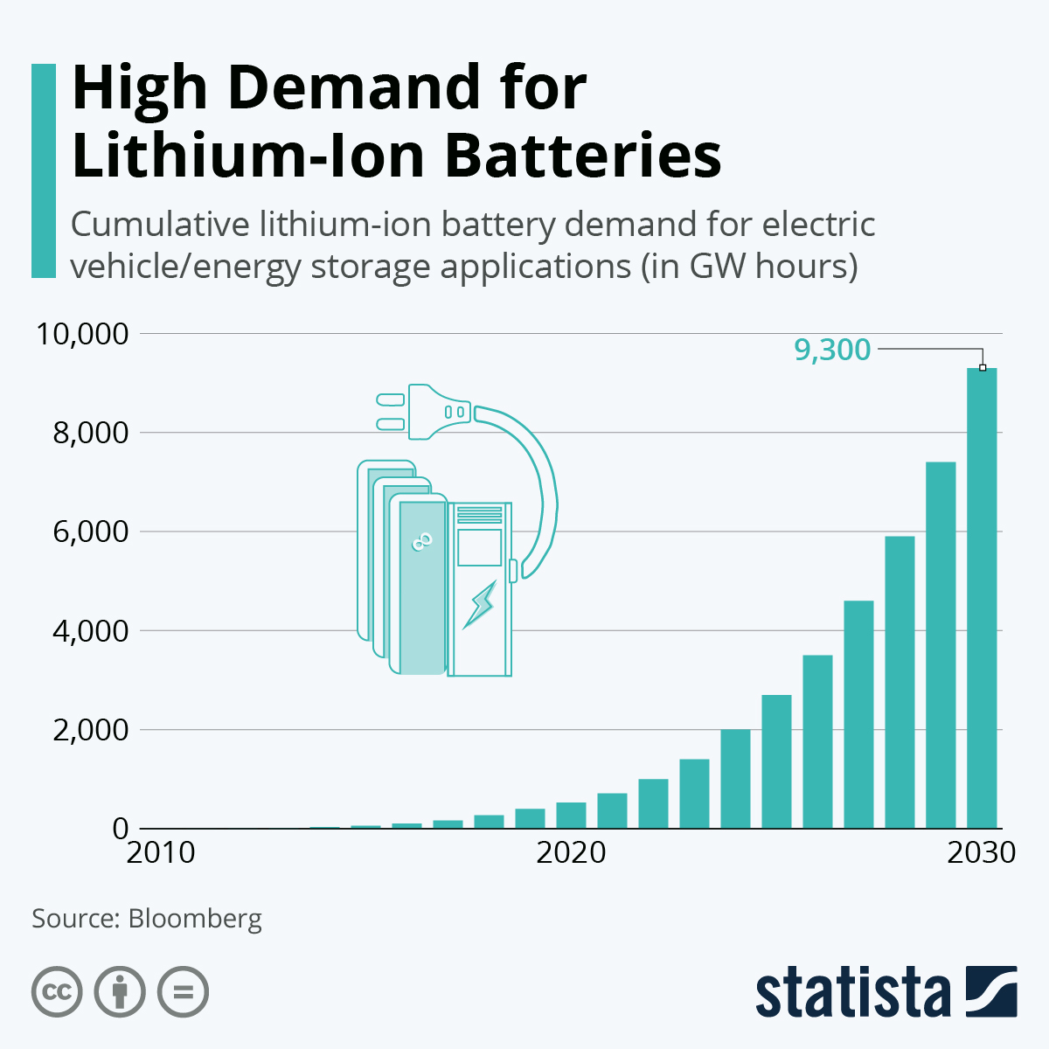

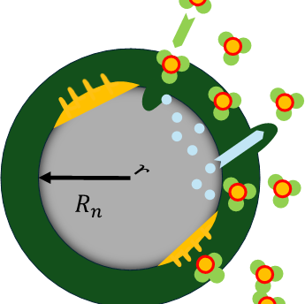
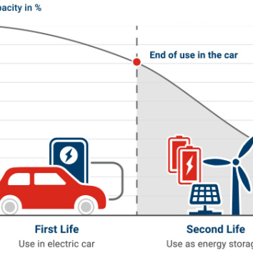

Motivation
Growing demand for reliable battery systems for numerous applications
Challenges in understanding and predicting battery aging and safety
Need for fundamental understanding of aging mechanisms to improve battery performance and lifespan
Need for upscaling and model optimization for enhancing performance in real life applications with physics-based understanding

Slide 3
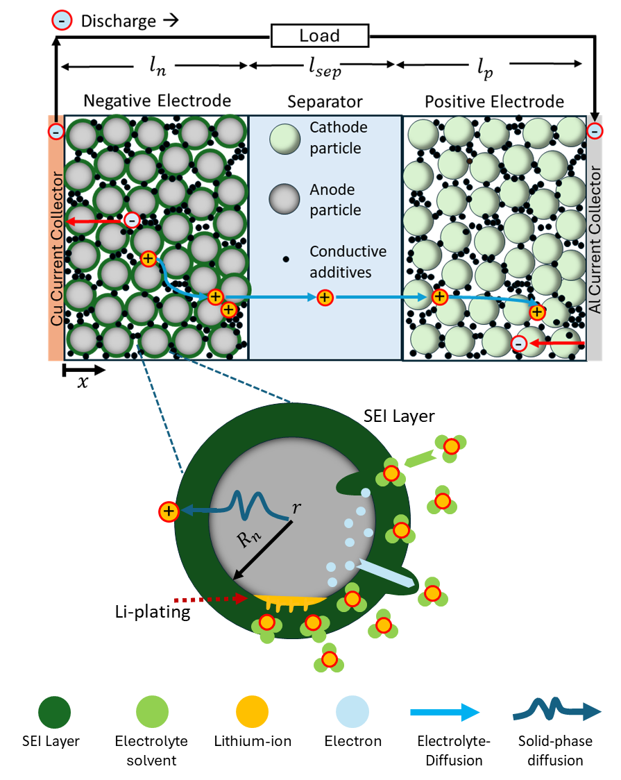
What makes battery age?
Growth of parasitic SEI layer
Need for upscaling and model optimization for enhancing performance in real life applications
Identifying the influences of key aging mechanisms
Lithium-plating
Particle cracking
Electrolyte decomposition

Slide 4
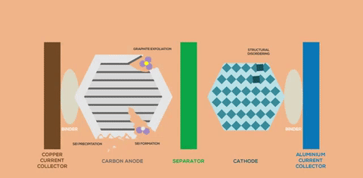

Objectives
Coupled degradation mechanisms (SEI and lithium-plating/stripping) applied into electrochemical model
1
*Oxford University
Considering other factors- graphite expansion, particle cracking, electrolyte decomposition
2
Investigate the impact of these aging mechanisms on battery performance and lifetime
3

Slide 5
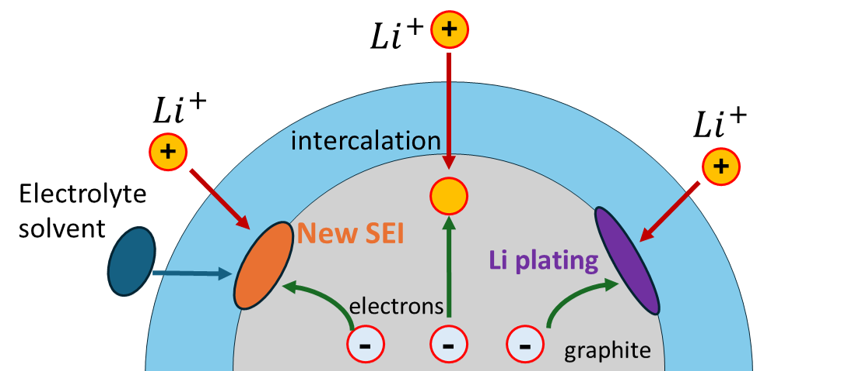
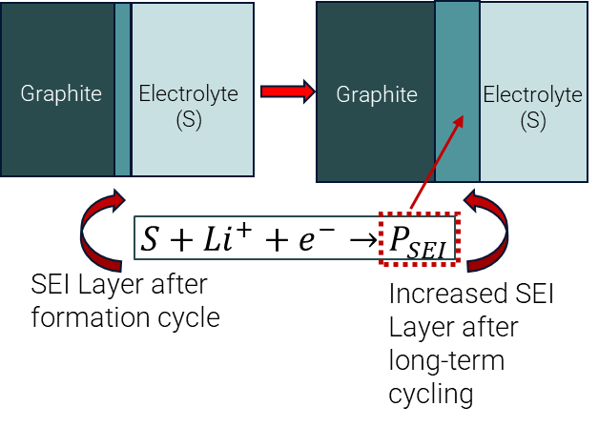
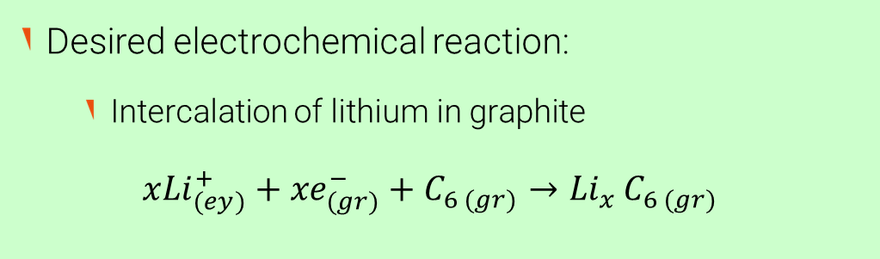
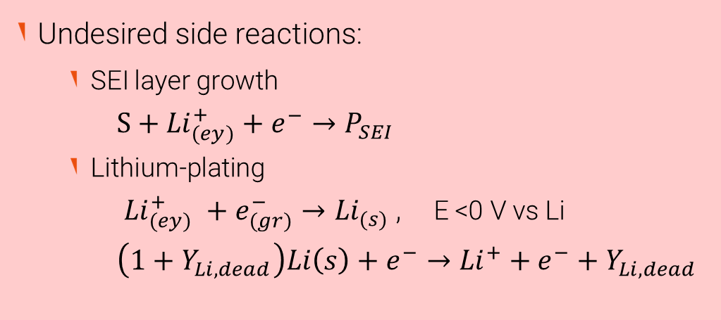
Electrochemical model with aging mechanisms
Desired electrochemical reaction:
Intercalation of lithium in graphite
$x{Li}_{(ey)}^{+}+{xe}_{(gr)}^{−}+C_{6 (gr)}→{Li}_{x }C_{6 (gr)}$
Undesired side reactions:
SEI layer growth
$S+{Li}_{(ey)}^{+}+e^{−}→P_{SEI }$
Lithium-plating
${Li}_{(ey)}^{+} +e_{(gr)}^{−}→{Li}_{(s)}$ , E <0 V vs Li
$\left(1+Y_{Li,dead}\right)Li\left(s\right)+e^{−}→{Li}^{+}+e^{−}+Y_{Li,dead}$
* Yang et al., Journal of Power Sources, 2017

Slide 6
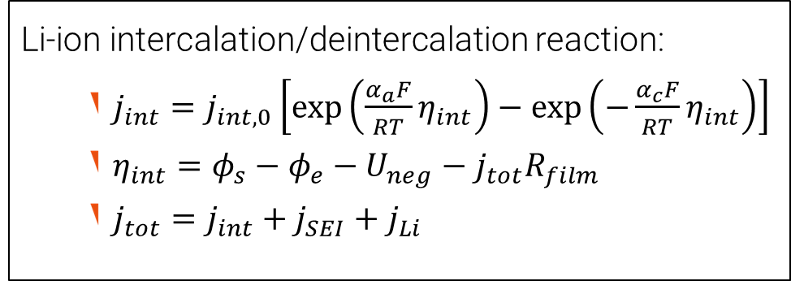
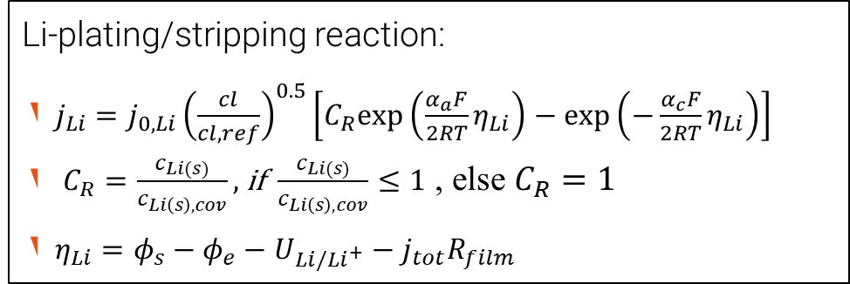
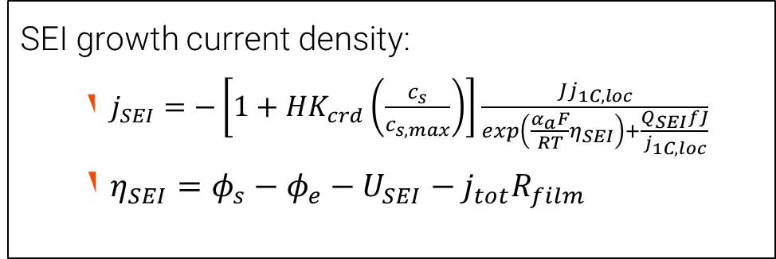
Electrochemical model with aging: equations
P2D electrochemical model
Li-ion intercalation/deintercalation reaction:
$j_{int}=j_{int,0}\left[\exp\left(\frac{α_{a}F}{RT}η_{int}\right)−\exp\left(−\frac{α_{c}F}{RT}η_{int}\right)\right]$
$η_{int}=φ_{s}−φ_{e}−U_{neg}−j_{tot}R_{film}$
$j_{tot}=j_{int}+j_{SEI}+j_{Li}$
SEI growth current density:
$j_{SEI}=−\left[1+HK_{crd}\left(\frac{c_{s}}{c_{s,max}}\right)\right]\frac{Jj_{1C,loc}}{exp\left(\frac{α_{a}F}{RT}η_{SEI}\right)+\frac{Q_{SEI}fJ}{j_{1C,loc}}}$
$η_{SEI}=φ_{s}−φ_{e}−U_{SEI}−j_{tot}R_{film}$
Li-plating/stripping reaction:
$j_{Li}=j_{0,Li}{\left(\frac{cl}{cl,ref}\right)}^{0.5}\left[C_{R}exp\left(\frac{α_{a}F}{2RT}η_{Li}\right)−\exp\left(−\frac{α_{c}F}{2RT}η_{Li}\right)\right]$
$C_{R}=\frac{c_{Li(s)}}{c_{Li\left(s\right),cov}},$if $\frac{c_{Li(s)}}{c_{Li\left(s\right),cov}}≤1$ , else $C_{R}=1$
$η_{Li}=φ_{s}−φ_{e}−U_{Li/{Li}^{+}}−j_{tot}R_{film}$
* Ekström et al. 2015
*COMSOL Application Library

Slide 7

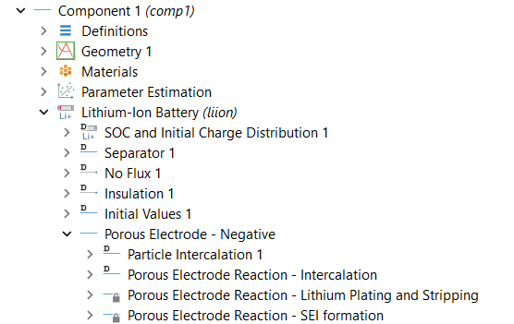
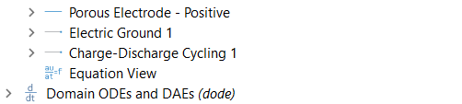
COMSOL Implementation
Degradation Model Tree
Battery design module- LIB
NMC-622/Gr Cylindrical & pouch cells
Degradation- focused on negative electrode
Coupled degradation implemented
SEI: Mixed kinetics and diffusion, graphite expansion, SEI cracking
Li-P/stripping: Reversible reaction, irreversible LLI- dead lithium.
Intercalation
Degradation: SEI and Li-P/Str
Coupling SEI and Li-P

Slide 8
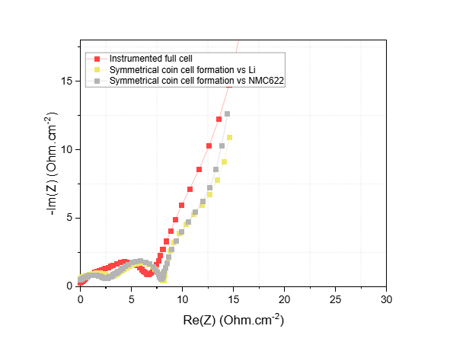
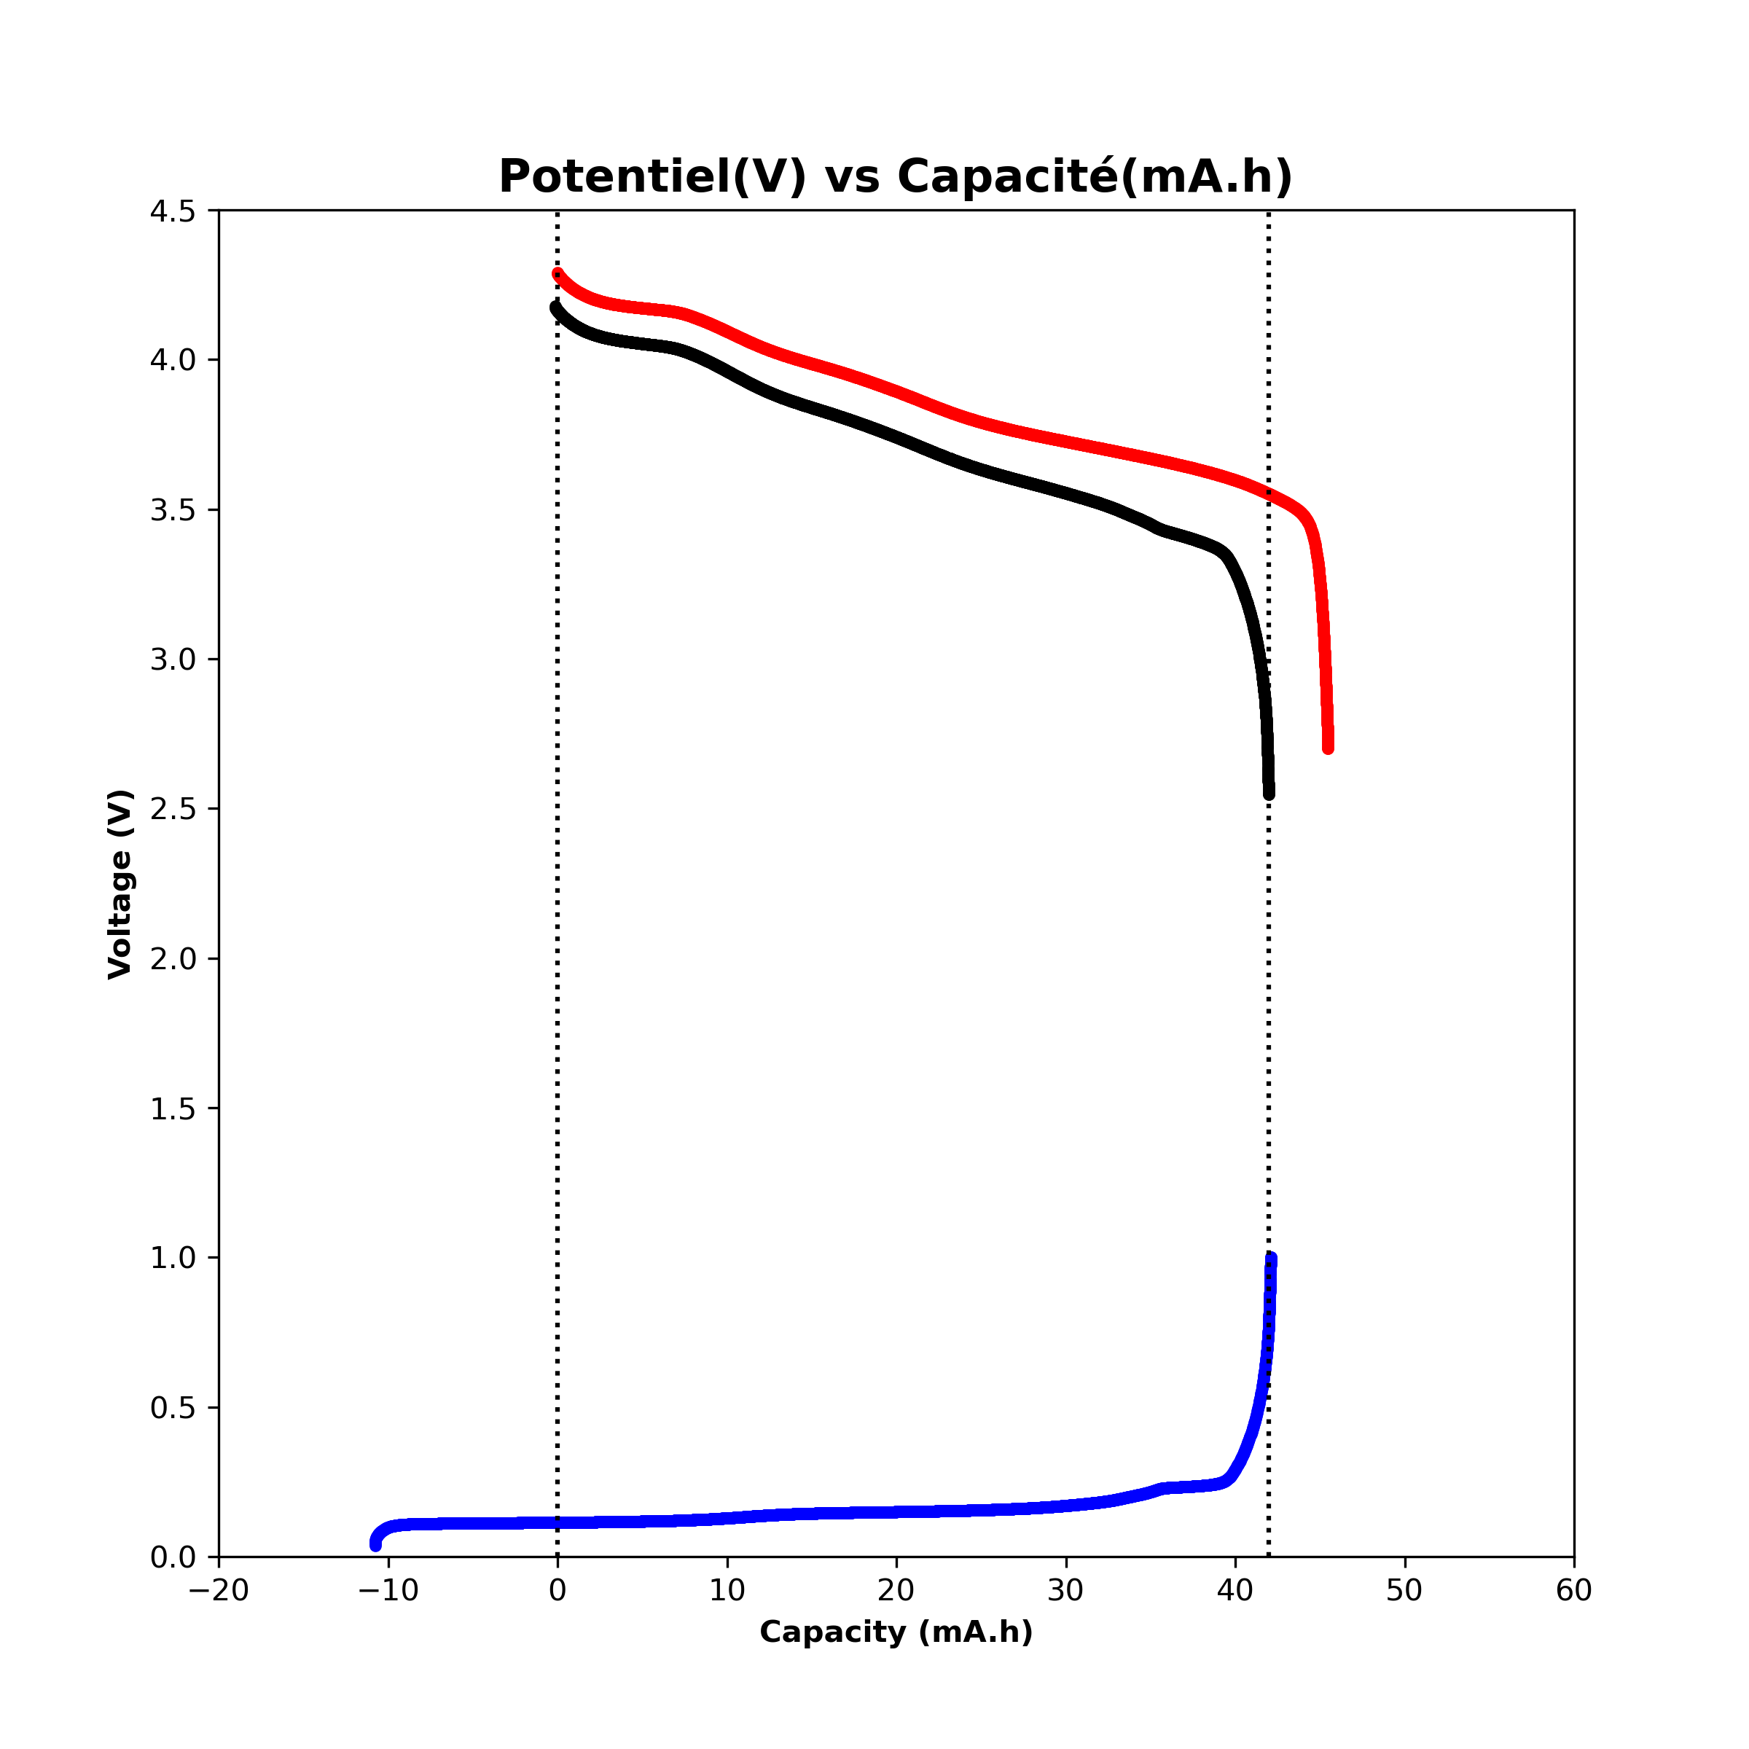
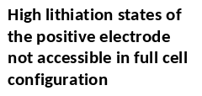
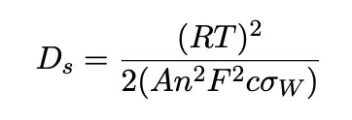
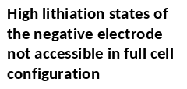
Parameter Extraction
Physical characterization- SEM, cross-section analysis, radius, porosity, thickness
Test- EIS, HPPC, reference performance test
Few parameters assumed/taken from literature
1. | 2. | 3. | 4.
10um
50um
EIS Test
SEM: Surface Morphology
SEM: Cross-section
Half cell OCV

Slide 9
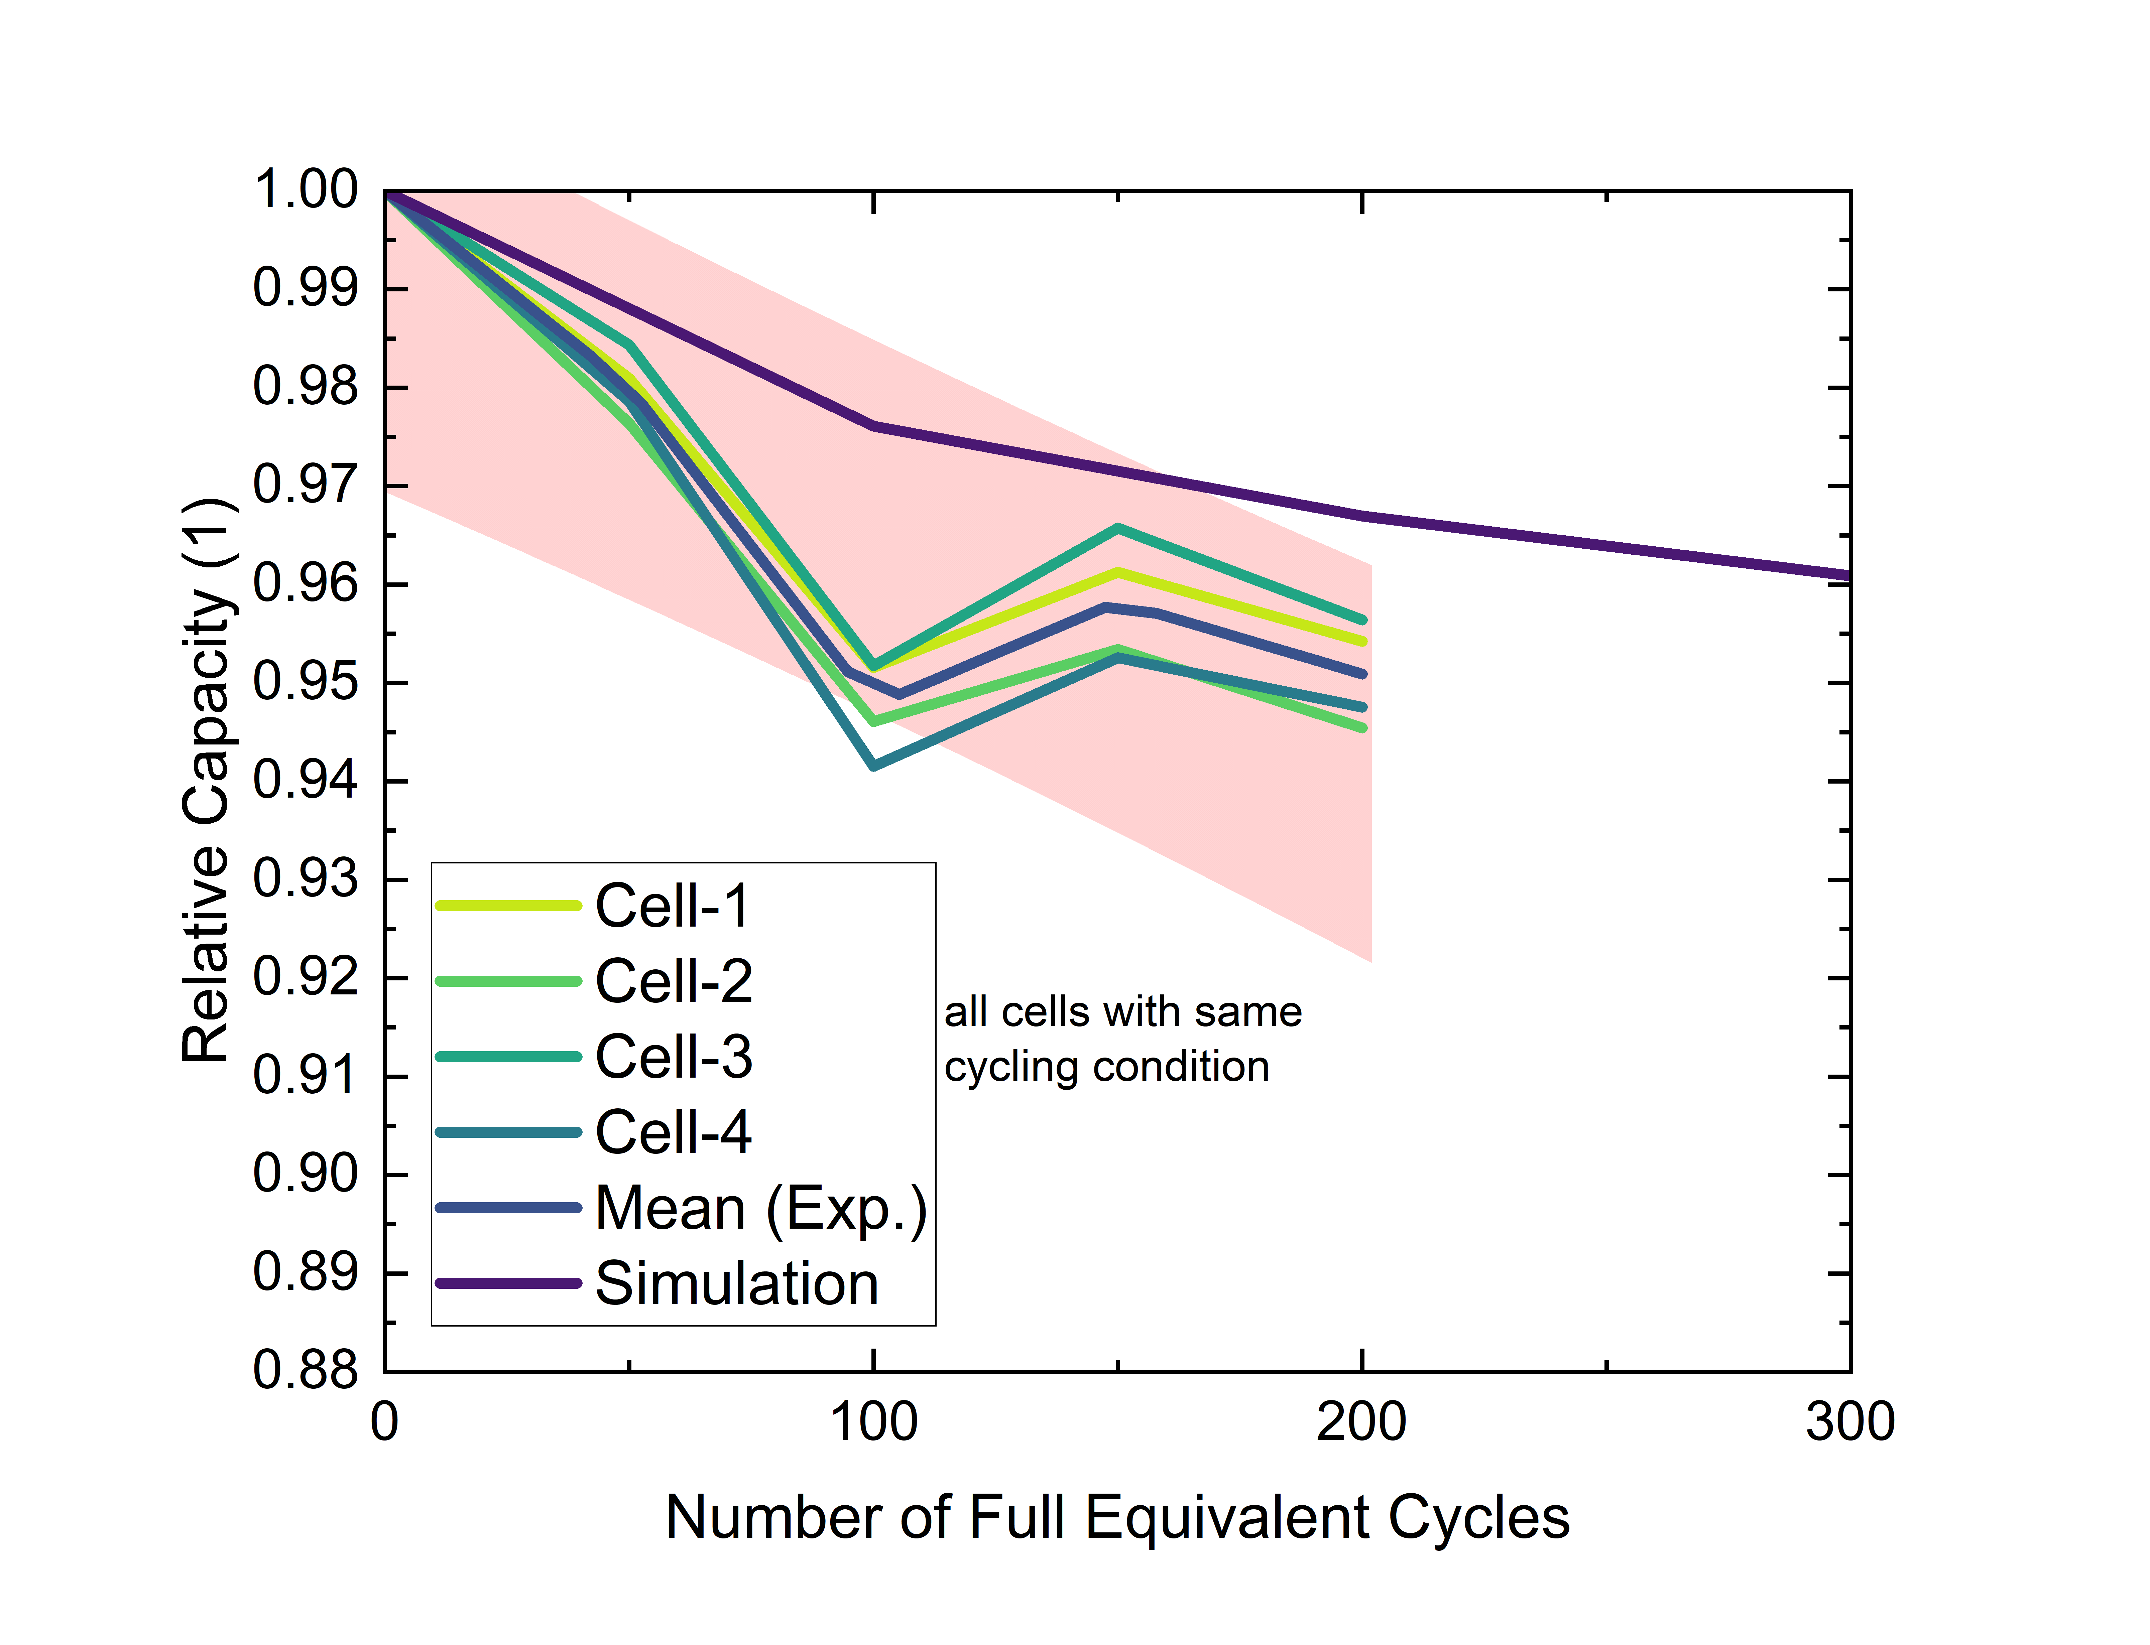
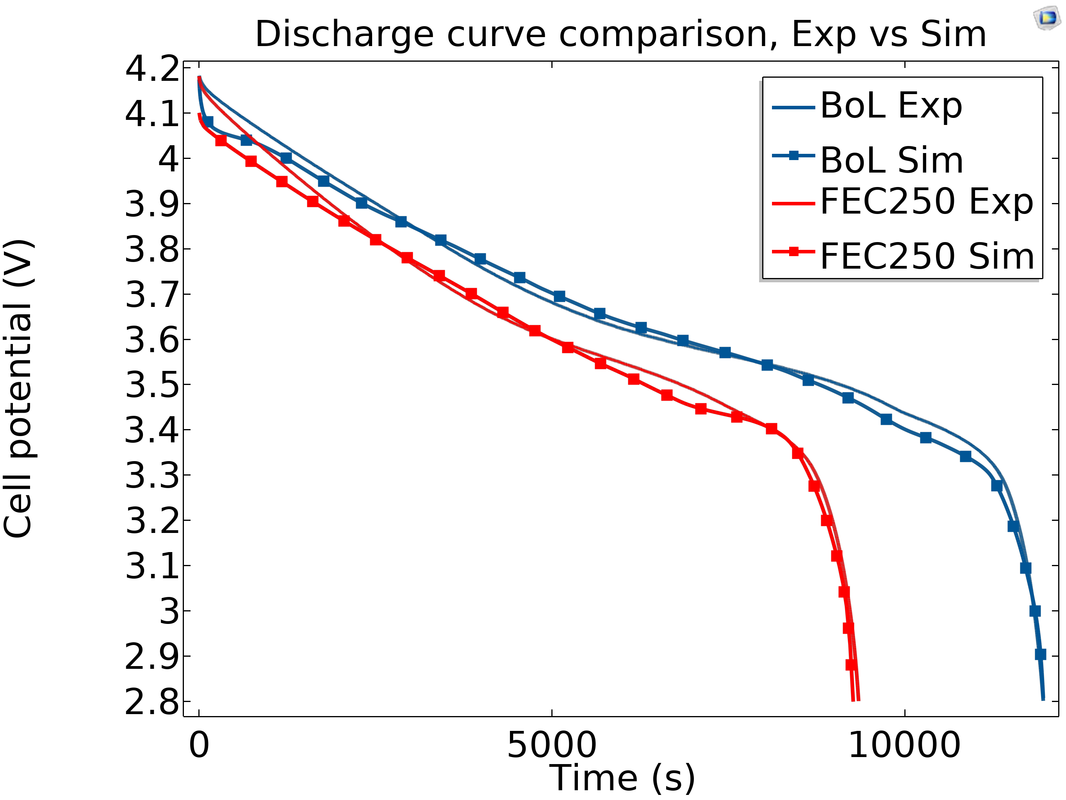
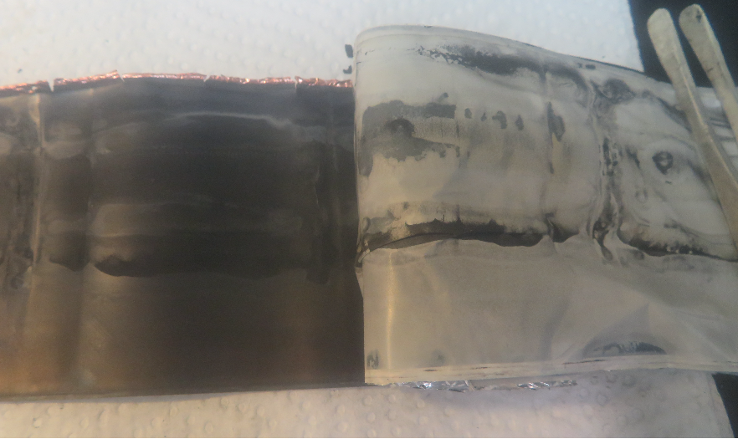
Comparison of simulation and experiment
Condition: 1C/0.3C
Cells → EoL
Lithium plating observed for 1C/1C cycling after ~250 FEC
Difference between simulation and experimental discharge curves, RMSE~0.025
Relative capacity from experiments
Increased capacity due to anode overhang effect
Notes:
Simulation follows experimental mean trajectory
Further aging parameters needed

Slide 10
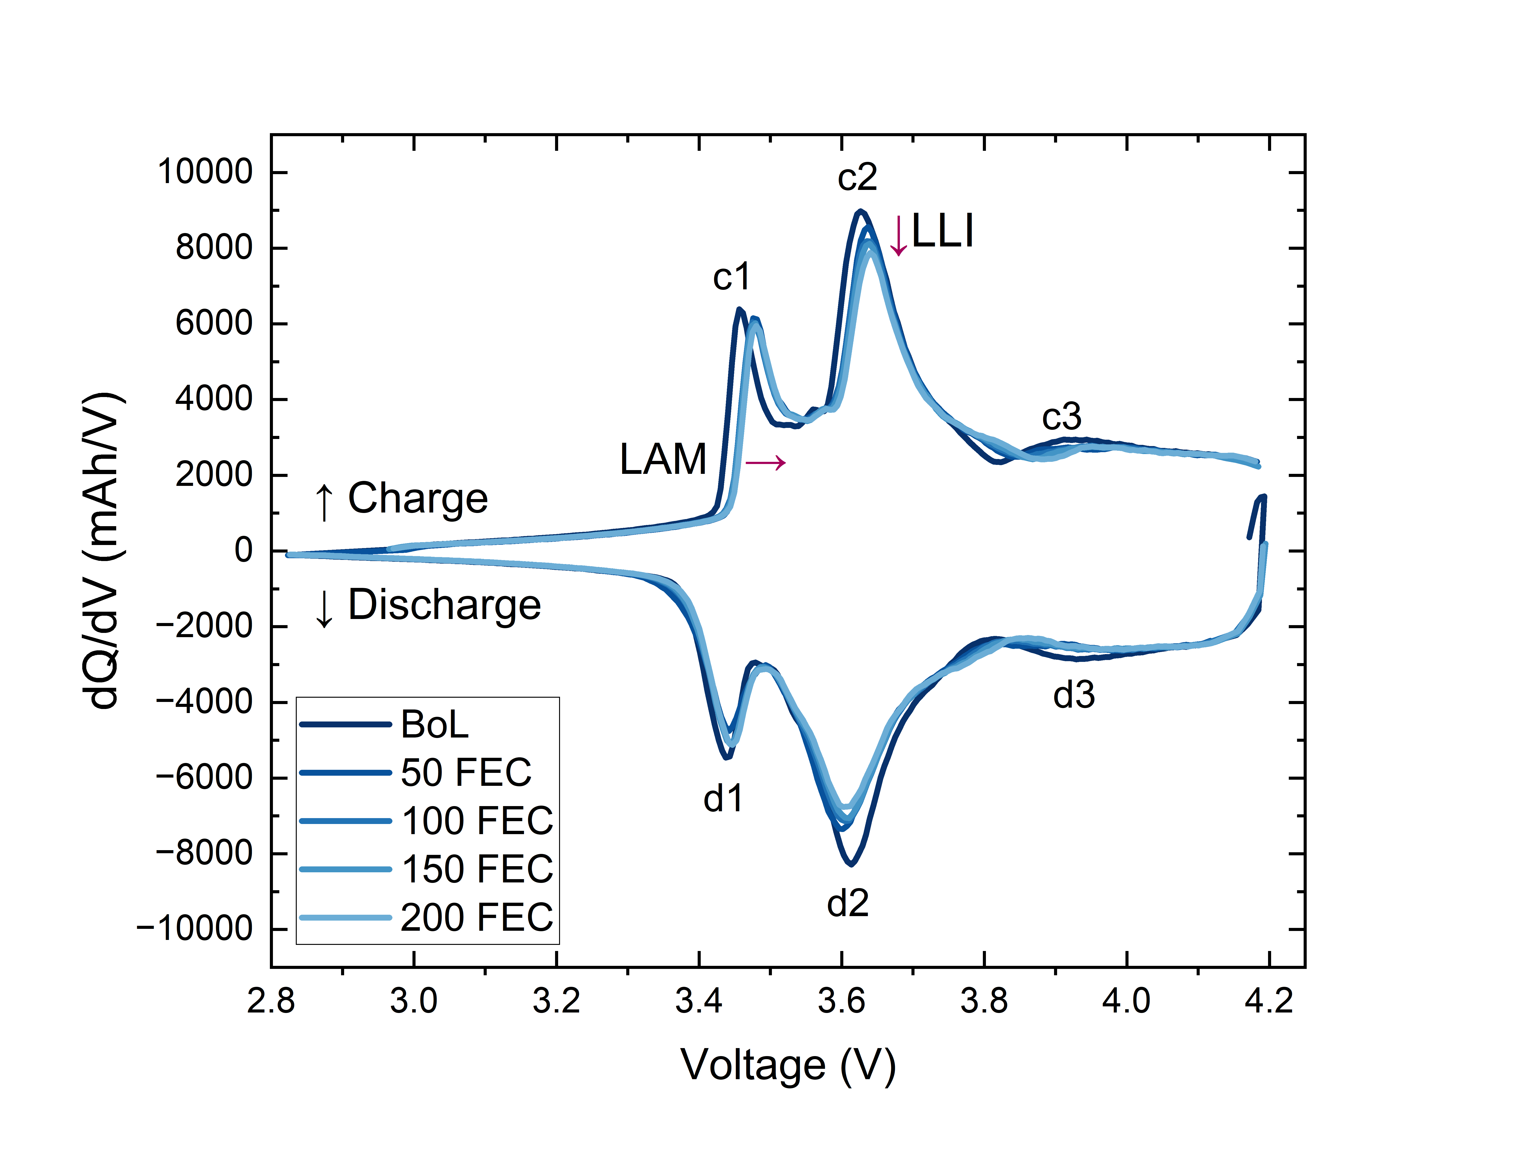
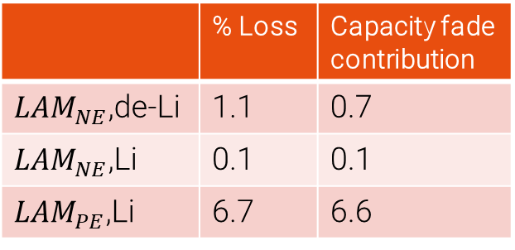
Differential Voltage & Incremental Capacity Analysis
1. | 2.
 | 3.
dQ/dV
 | % Loss | Capacity fade contribution
${LAM}_{NE}$,de-Li | 1.1 | 0.7
${LAM}_{NE}$,Li | 0.1 | 0.1
${LAM}_{PE}$,Li | 6.7 | 6.6
Optimization outputs
Calc. capacity fade | 7.48%
Actual capacity fade | 6.35%
Error | 1.13%
*Using peak tracking method from J.Chen et al. Journal of Energy Storage 2022

Slide 11
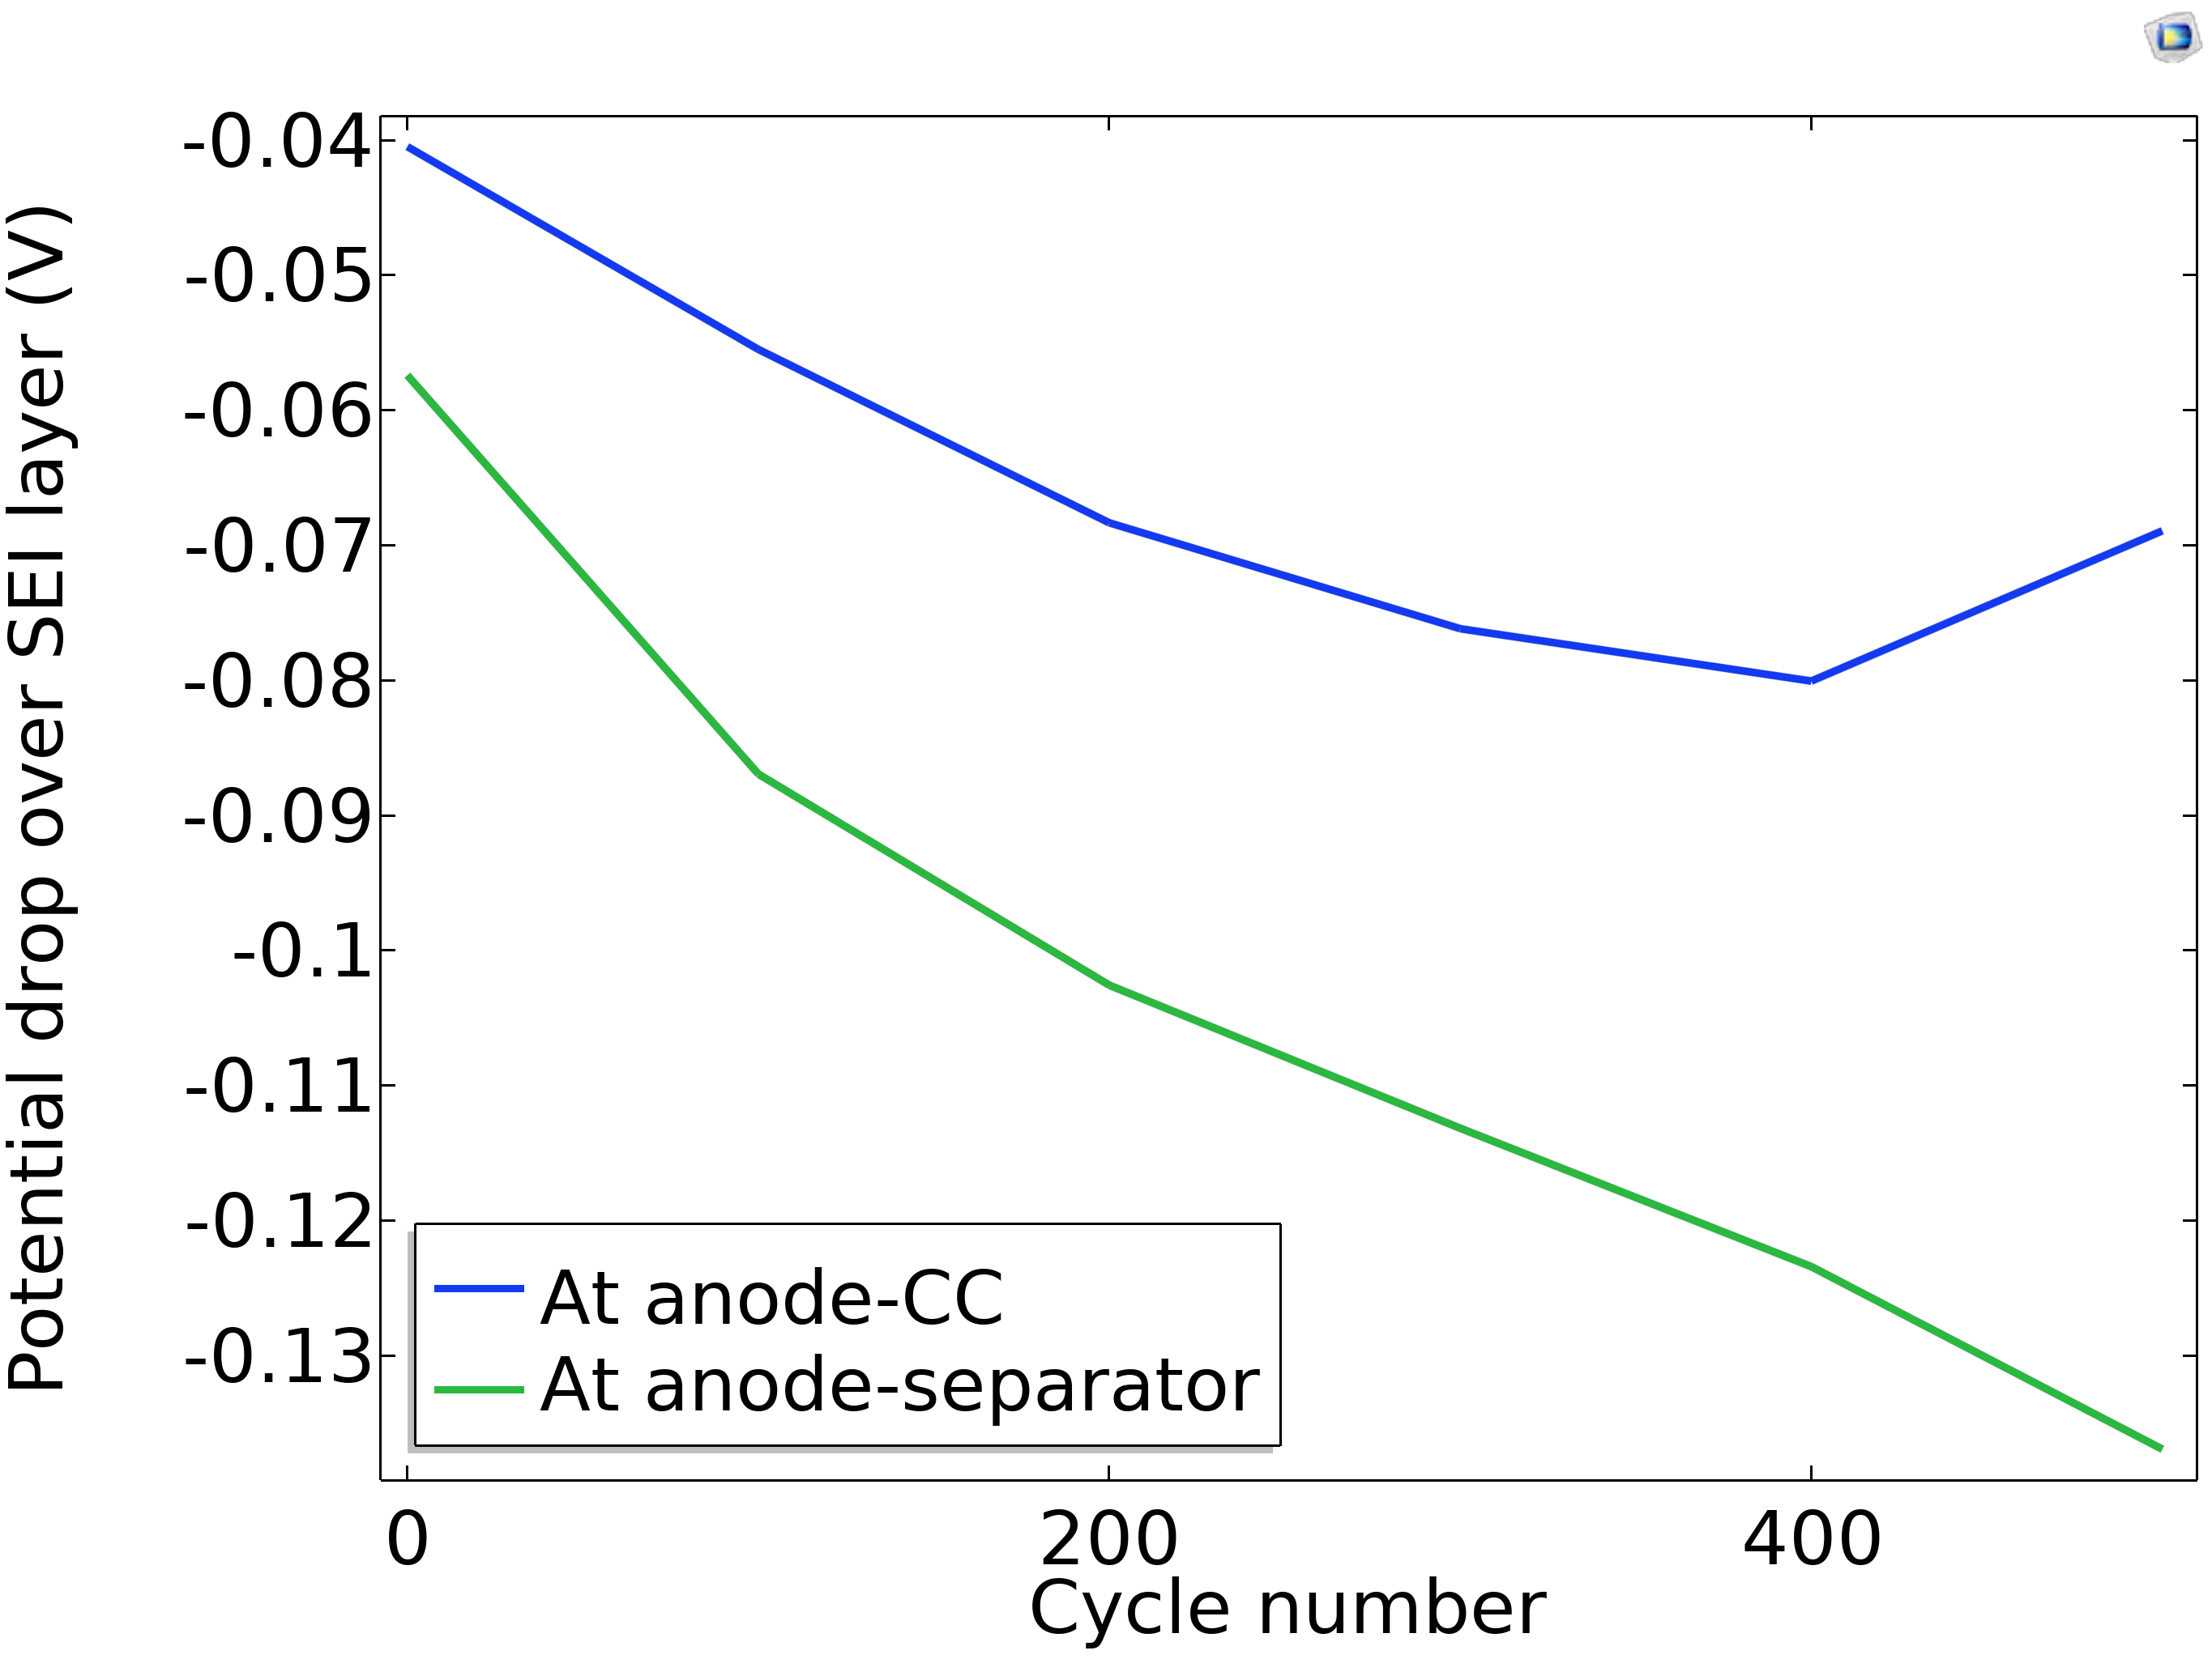
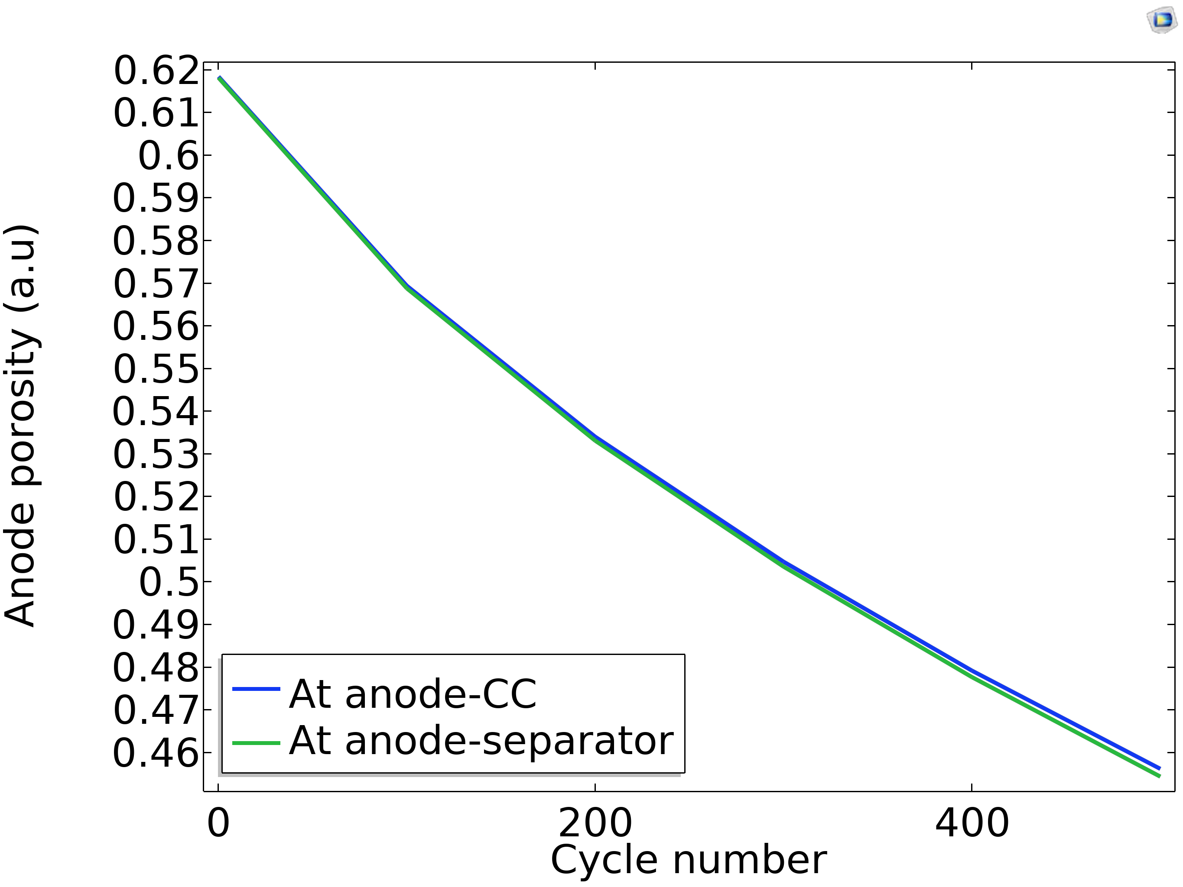
Coupling effect of SEI and Lithium-Plating
SEI layer thickness increases resistance
Film thickness causes potential drop over SEI layer
Drop is more prominent near separator region
SEI growth causes reduction in anode porosity
Leads to lower lithium deposition potential
Triggers the onset of lithium plating
Thus, causing more cell degradation

Slide 12
Conclusions & Future Scope
SEI and lithium plating degradation mechanisms investigated through electrochemical model
Coupled interaction affects overall cell performance of LIB
SEI layer growth can trigger onset of lithium plating causing non-linear degradation
Future studies will include
Validation with SEI, lithium plating related parameters
Upscaling model to module and pack-level

Slide 13




Acknowledgements
The author would like to acknowledge the effort of the following:
Prof. Dr. MD Sazzad Hosen
Professor,
Vriije Universiteit Brussel (Planning, review & supervision)
Dr. Joris de Hoog
Senior Researcher,
Vriije Universiteit Brussel
(Review & editing)
Prof. Dr. Maitane Berecibar
Professor ,
Vrije Universiteit Brussel
(Planning & supervision)
EU funding from HORIZON EUROPE project THOR- Grant agreement number 101103708
Project partners

Slide 14


Thank you for your attention
Rashid Ahmed Rifat
PhD Researcher, Battery Innovation Centre, MOBI, Vrije Universiteit Brussel- Belgium
Contact: Email : rashid.ahmed.rifat@vub.be Cell No. : +32472322527
Let’s get connected!

