Slide 1
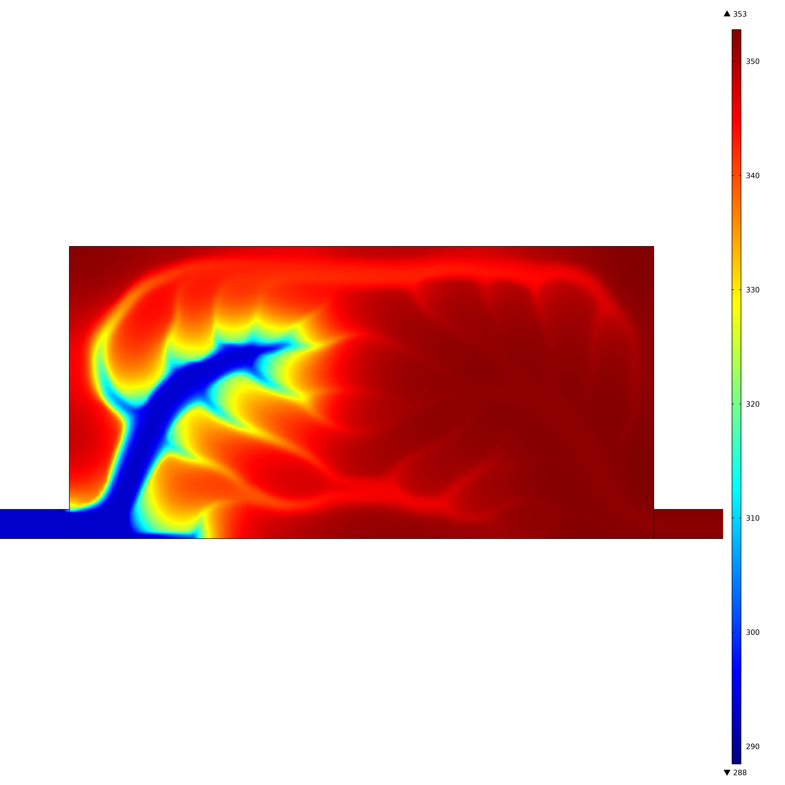
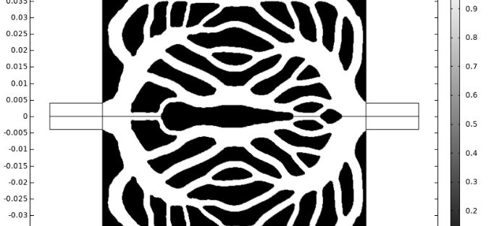
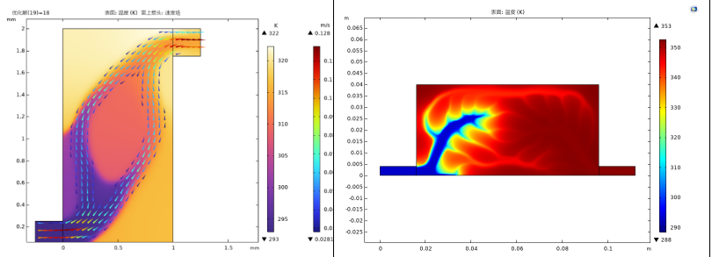
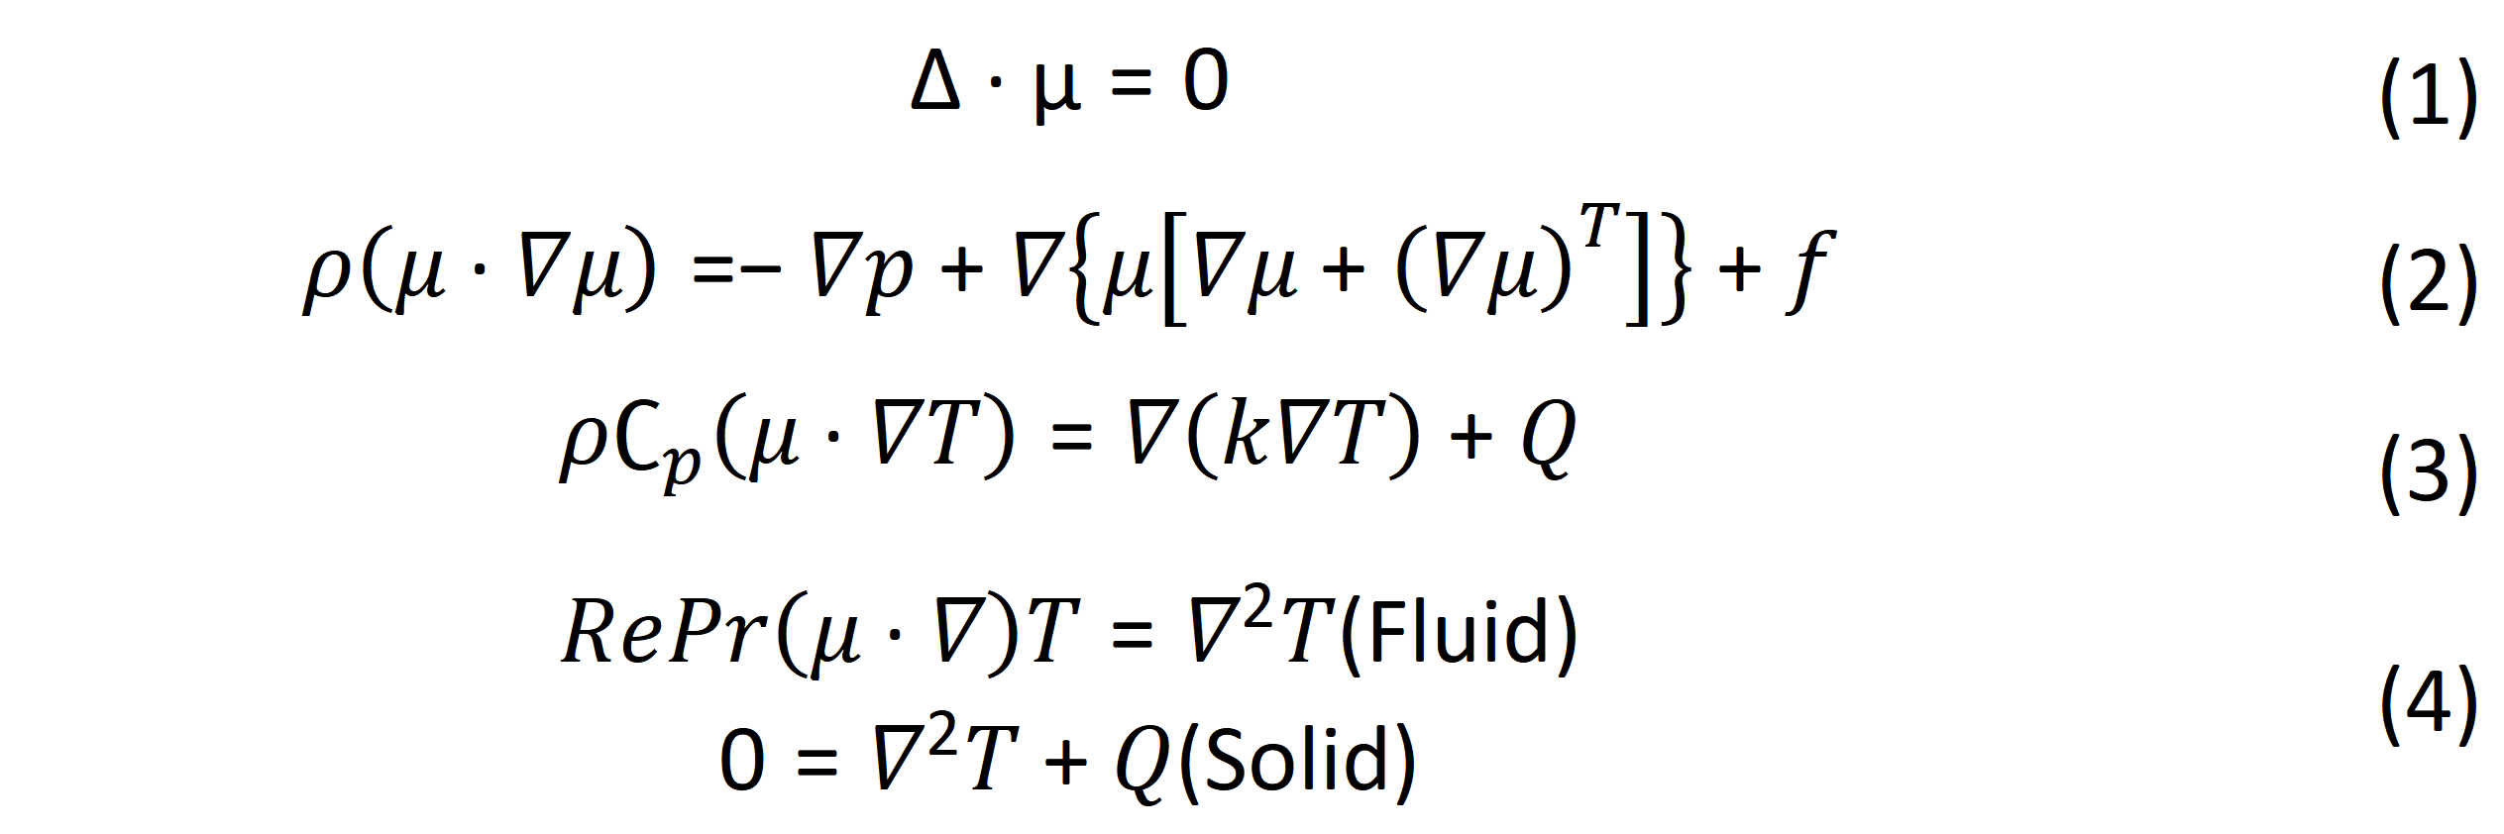
Research on Topology Optimization of Liquid-Cooled Plates
Enhancing the design freedom and potential performance of liquid-cooled plates, providing a novel approach for the design of high-efficiency thermoelectric generation systems.
J. Xiaolong. Liu¹, Fei. Xiao²
1. Nanjing University of Aeronautics and Astronautics, Nanjing, China.
2. Nanjing University of Aeronautics and Astronautics, Nanjing, China.
Abstract
At present, solar-energy utilization relies predominantly on photovoltaic technology, whose output is strongly weather-dependent and inherently intermittent. Thermoelectric generation (TEG) offers a complementary route: it contains no moving parts, promises long service life and minimal maintenance, and can operate with only a small temperature difference. (Ref. 1)
Yet, owing to environmental losses and internal irreversibilities, practical TEG efficiencies remain far below the theoretical limit. (Ref. 2) This study therefore targets the cold side of the TEG system; by topology-optimizing the heat-transfer channels of a liquid-cooled plate, we seek to enhance heat rejection and, consequently, to raise the overall electrical output of the module.
Methodology
The coupled thermal–fluid physics consists of the mass-conservation equation, the momentum-conservation equation, the heat-transfer (energy) equation, and the overall energy-balance equation.
$$∆∙μ=0$$ | (1)
$$ρ\left(μ∙∇μ\right)=−∇p+∇\left\{μ\left[∇μ+{\left(∇μ\right)}^{T}\right]\right\}+f$$ | (2)
$$ρ∁_{p}\left(μ∙∇T\right)=∇\left(k∇T\right)+Q$$ | (3)
$RePr\left(μ∙∇\right)T=∇^{2}T$(Fluid) $$0=∇^{2}T+Q(Solid)$$ | (4)
FIGURE 1. Bifluidic-channel topology-optimized flow pattern under a dual-objective function
Results
Varying the weights of the objective functions leads to markedly different channel patterns. When heat-removal performance alone is targeted, the resulting topology is relatively simple; by contrast, a bi-objective optimization that balances heat transfer and hydraulic power yields a markedly more branched configuration. Under identical heat-input conditions, the bi-objective design achieves a lower chip operating temperature, confirming the effectiveness of this strategy in enhancing overall cooling performance.
FIGURE 2. Temperature results of single-objective and bi-objective topology optimization
REFERENCES
1. W Mao, “Experimental Investigation of a Compound Parabolic Concentrator-Based Solar Thermoelectric Generation System”, South China University of Technology,2013.
2. Y Li, S.H Zheng and W.G Li, “Research status of solar thermoelectric generation technology”, Mechanical & Electrical Engineering Technology, 44 (02), 74-79, 2015.

