Slide 1

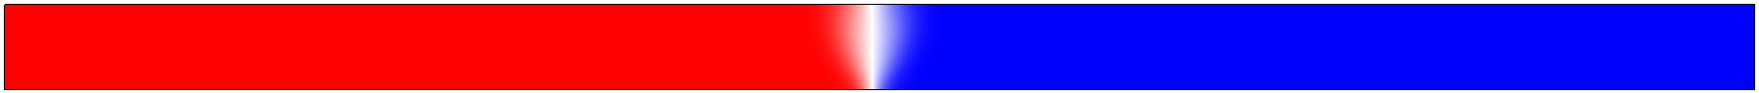
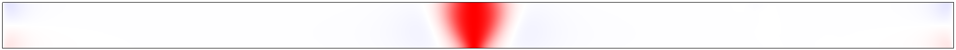
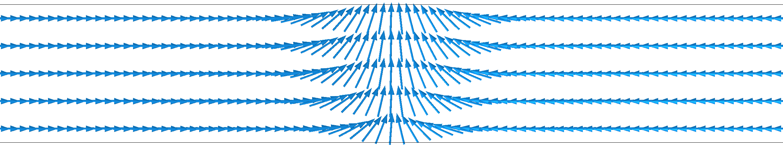
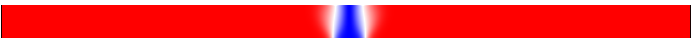
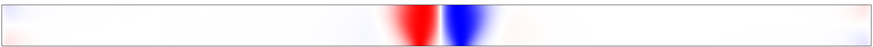
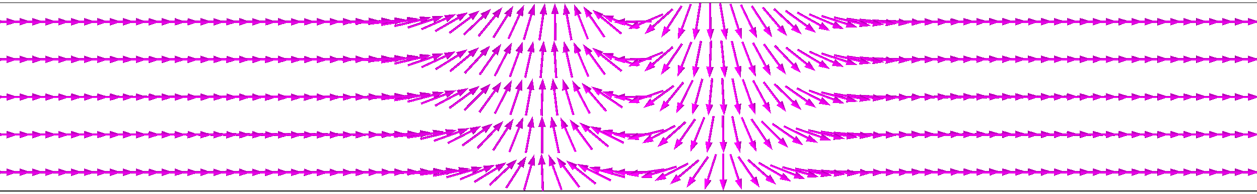
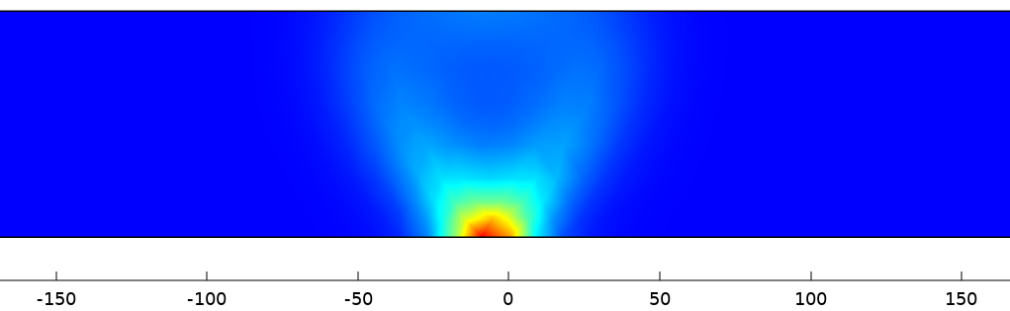
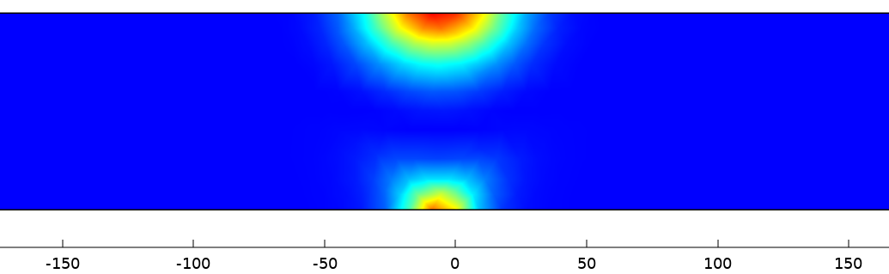
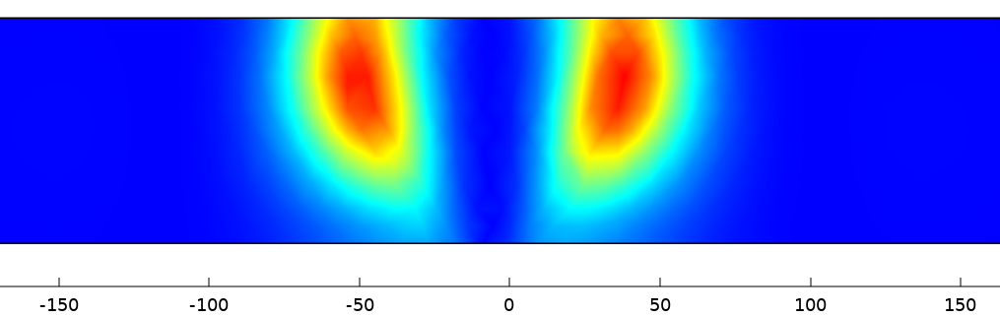


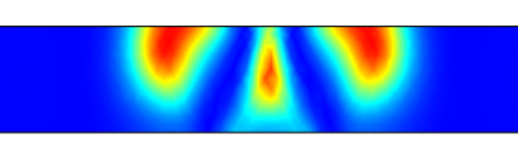
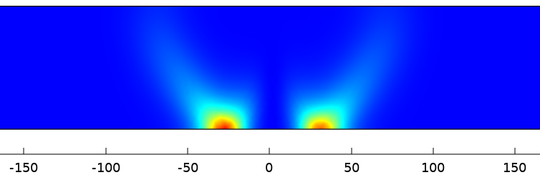
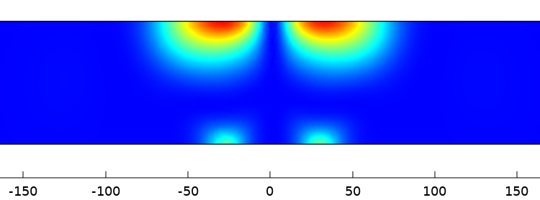
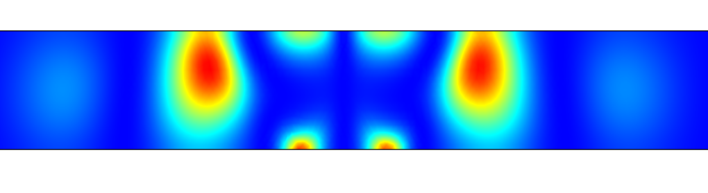




Soft Modes of Domain Wall by Micromagnetic Simulation
Ruoban Ma (马若般) and Jiang Xiao (肖江)
Department of Physics, Fudan University, Shanghai 200433, China
Introduction Domain walls (DWs) in ferromagnetic nanowires are particle-like objects. A Coulomb-like attraction originating from dipolar fields, countered by a short-range topological repulsion, binds two 180° DWs into a stable 360° DW. In this bound state, soft modes of the individual 180° DWs hybridize, forming new soft modes characteristic of the 360° DW.
180° Domain Wall：Transition region between two opposite domains
A 180° domain wall results from the competition between dipolar field and Heisenberg exchange.
1536 nm × 75 nm × 9 nm
$$m_{x}$$
$$m_{y}$$
*Magnetic dipolar field: the field lines prefer a closed path
*Heisenberg exchange: neighboring needles tend to be parallel
360° Domain Wall: Transition region between two identical domains
Dynamically, a 360° domain wall is formed because, akin to two coupled oscillators, two neighboring 180° domain walls would attract each other when they are far apart but repulse each other when they are too close.
1536 nm × 75 nm × 9 nm
$$m_{x}$$
$$m_{y}$$
Domain Wall soft modes: Coupling and Hybridization
Soft modes of the individual 180° domain walls hybridize to form new soft modes characteristic of the 360° domain wall, akin to two coupled oscillators.
180° DW
1 Translation
2 Tilting
3 Breathing
0.22GHz
4.76GHz
7.12GHz
360° DW
0.25GHz
4.82GHz
7.17GHz
1a Translation
2a In-phase Tilting
3a In-Phase Breathings
3.06GHz
5.81GHz
8.10GHz
1b Overall Breathing
2b Out-of-phase Tilting
3b Out-of-Phase Breathings
References
[1] J. Zhang, W. Yu, X. Chen and J. Xiao, A frequency-domain micromagnetic simulation module based on COMSOL Multiphysics®, AIP Advances 13, 055108 (2023).
[2] P. E. Roy, T. Trypiniotis and C. H. W. Barnes, Micromagnetic simulations of spin-wave normal modes and the resonant field-driven magnetization dynamics of a 360° domain wall in a soft magnetic stripe, Phys. Rev. B 82, 134411 (2010).
[3] H. Yu, J. Xiao, and H. Schultheiss, Magnetic texture based magnonics. Physics Reports 905 (2021), 1-59.
Excerpt from the Proceedings of the COMSOL Conference 2025 Shanghai

