Slide 1
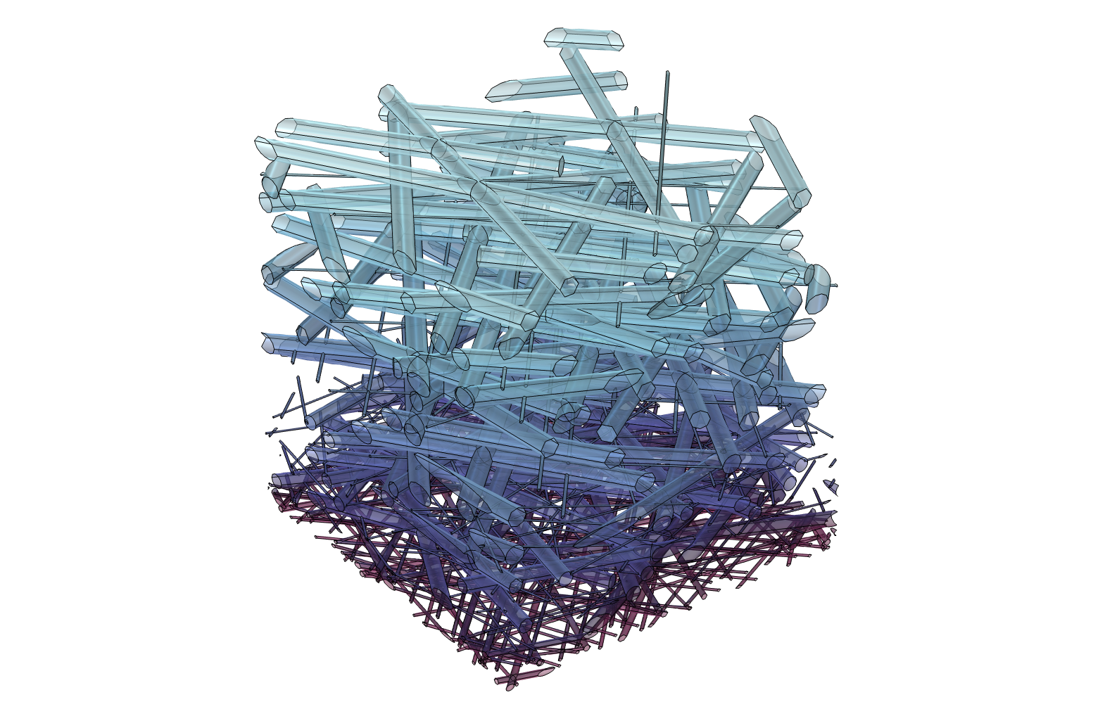
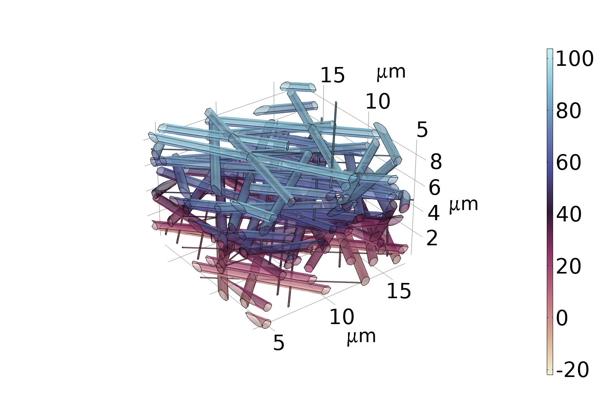
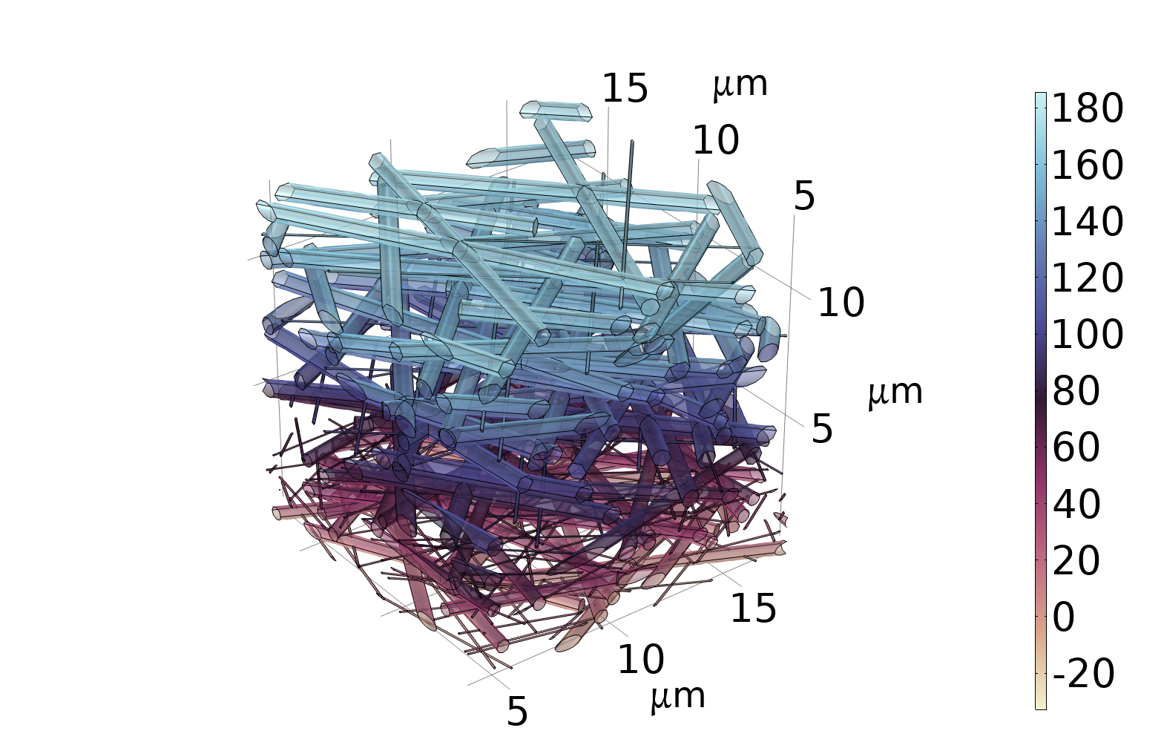
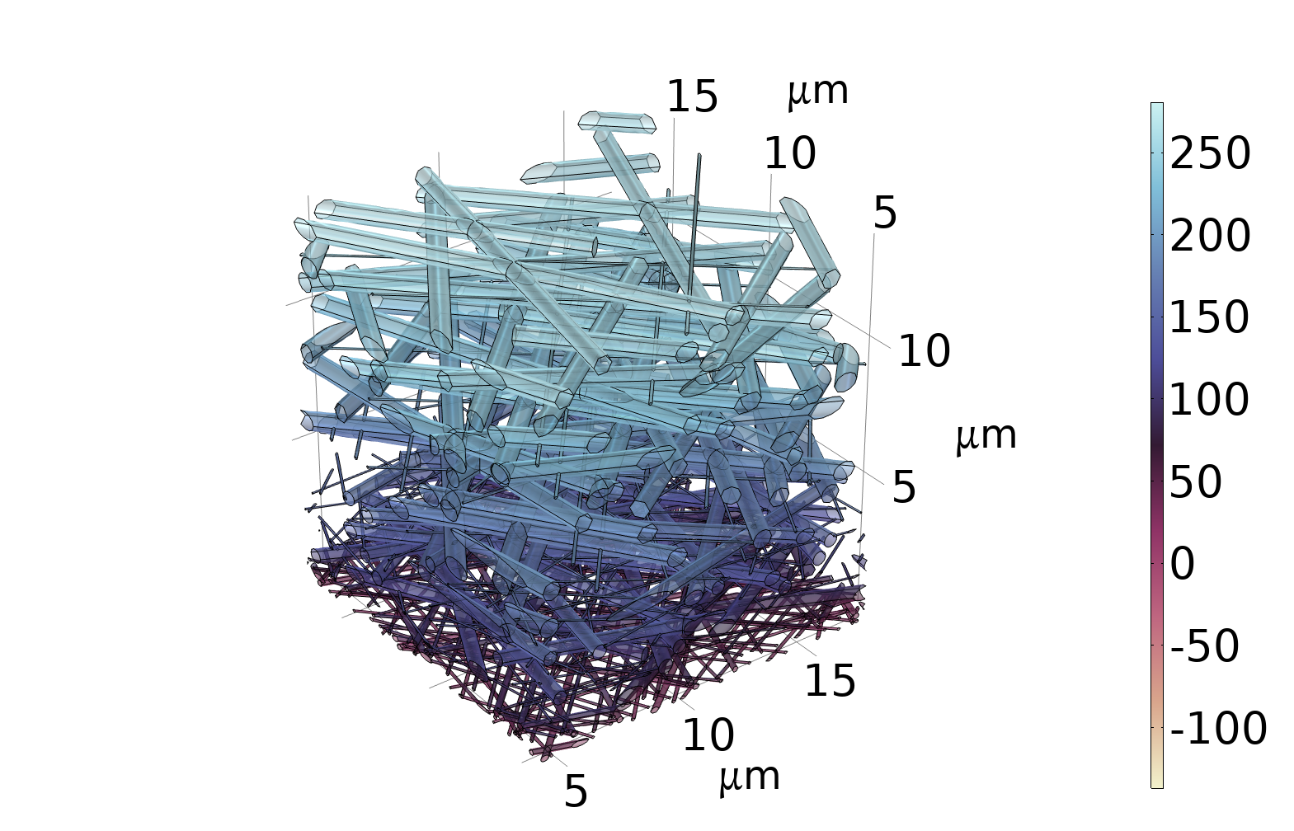
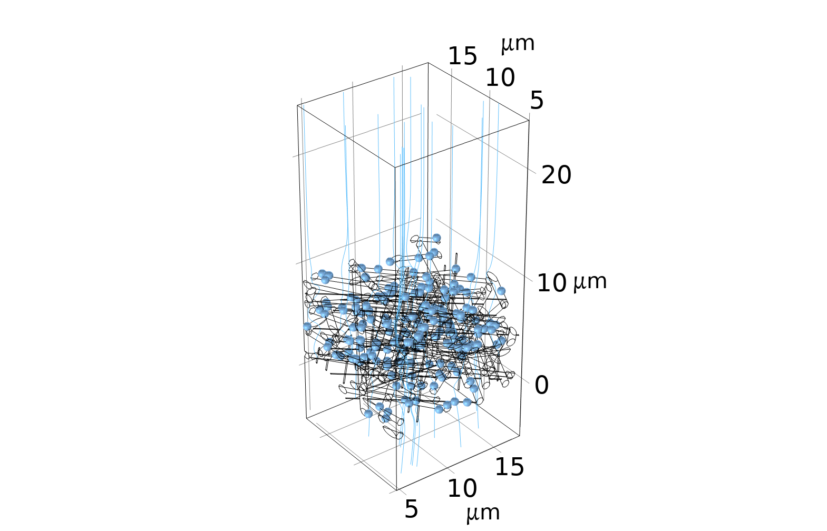
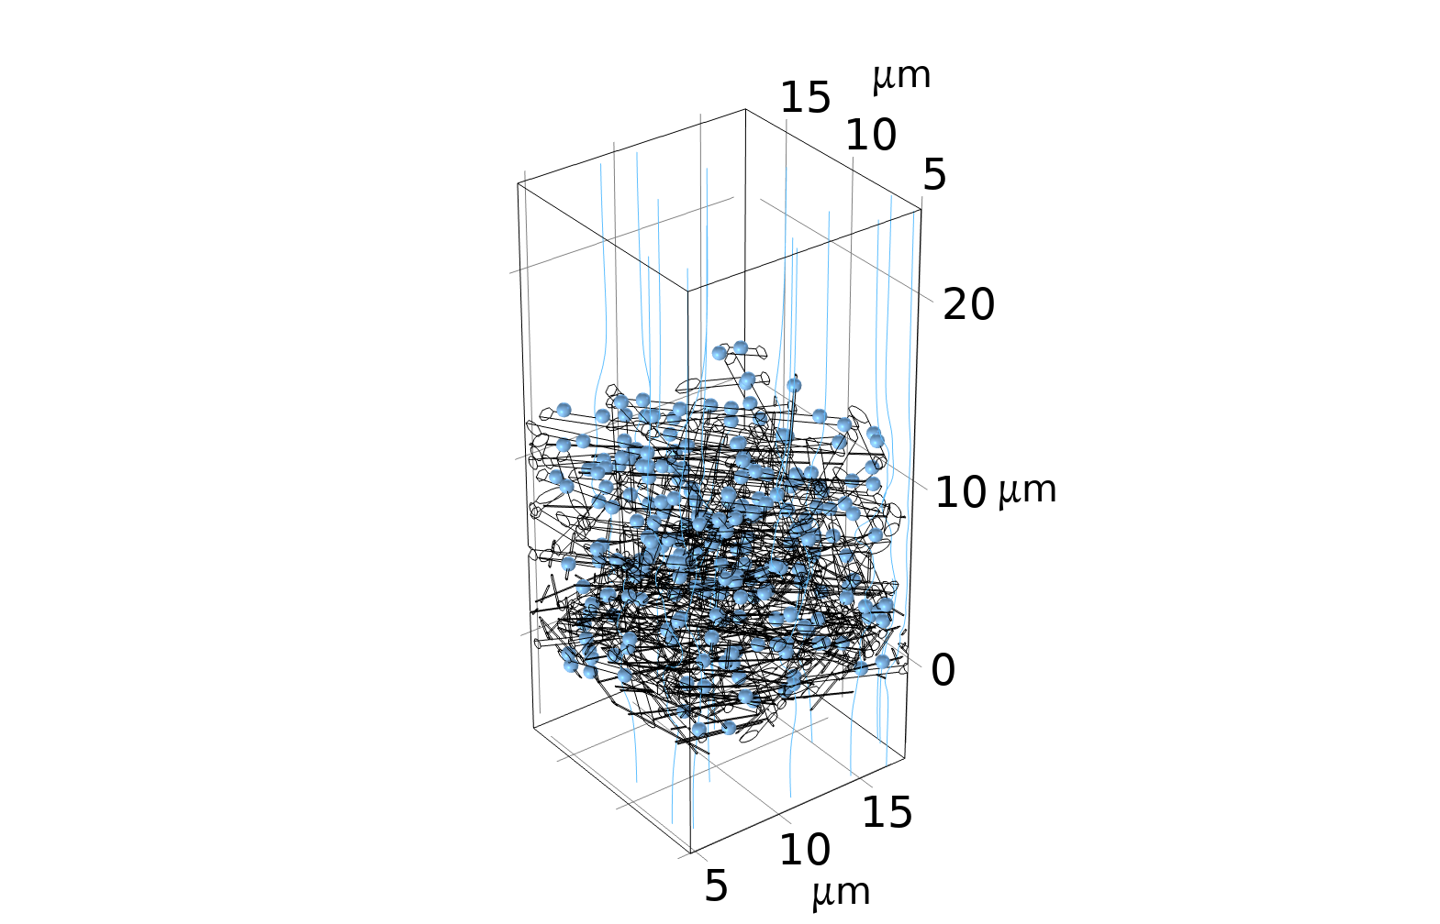
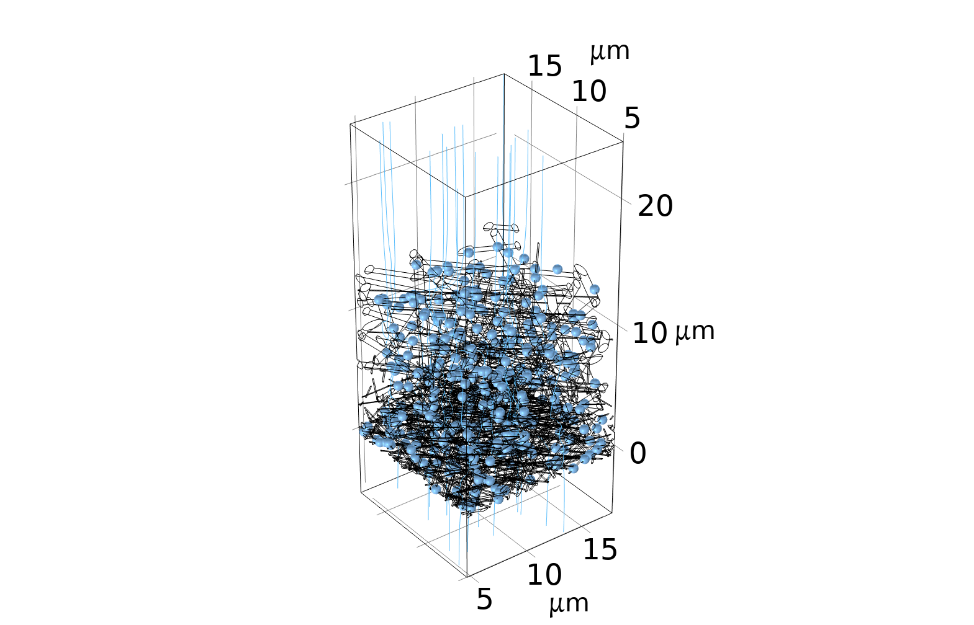
Thermally Stable Multilevel Nanofiber Membranes with Gradient Architecture for High-Temperature Air Filtration
A multilevel gradient fibrous membrane designed via electrospinning demonstrates high efficiency (99.98%), low pressure drop (65 Pa), and exceptional thermal stability (250°C for 12h).
Chenyang Houª, Jinke Guoª, Fengying Wangª, Beijie Zhuª, Zaodong Sunª, Yuanqiang Xuª*, Yuansheng Zhengª*,
Hugh Gong^{b}, Binjie Xinª
a School of Textiles and Fashion, Shanghai University of Engineering Science, Shanghai 201620, China
b Department of Materials, The University of Manchester, Manchester M13 9PL, UK
*E-mail: yuanqiang@sues.edu.cn (Yuanqiang Xu); yuansheng@sues.edu.cn (Yuansheng Zheng)
Abstract
To overcome the challenges of poor thermal stability and the trade-off between filtration efficiency and pressure drop in conventional high-temperature filtration materials, a heat-resistant fibrous membrane with a multilevel gradient structure was developed. Using electrospinning technology, the fibrous membrane
with gradient bimodal fiber diameter distribution was constructed by integrating polysulfonamide (PSA), polyacrylonitrile (PAN), and SiO₂ nanoparticles, combined with in situ crosslinking and interfacial reinforcement strategies within the fiber assembly.
(a)
Pressure (Pa)
(b)
Pressure (Pa)
(c)
Pressure (Pa)
Methodology
During the simulation, the inlet flow rate was set to 5.3 cm s⁻¹[1], and the outlet pressure was set to 0 Pa. Simulation results encompassing pressure fields are illustrated in Figures 1(a-c), respectively. The pressure gradients exhibit high-pressure zones (light blue) concentrated at upper surfaces, transitioning to low-pressure regions (dark brown) toward the bottom.
FIGURE 1. 3D diagrams of pressure field when the airflow passes through the inside of the (a) O-PPS single-layer fibrous model, (b) O-PPS/M-PPS bilayer fibrous model, and (c) OMI multilevel gradient fibrous model.
Results
(a)
(b)
(c)
Figures 2(a-c) presents the particle velocity fields for the three sample models. With the increase in the number of fibrous layers, a greater proportion of particles are intercepted by the fibers, and the capture efficiency of OMI fibrous membrane improves progressively. The simulation results exhibit a similar trend to the experimental observations. Overall, the simulation outcomes can be utilized to reasonably predict the pressure drop and filtration efficiency, providing valuable guidance for the design of fibrous filtration membranes.
FIGURE 2. 3D diagrams of particle velocity field when the particle-laden airflow passes through inside of the (a) O-PPS single-layer fibrous model, (b) O-PPS/M-PPS bilayer fibrous model, and (c) OMI multilevel gradient fibrous model.
REFERENCES
1. T. Stylianopoulos, A. Yeckel, J.J. Derby, X.J. Luo, M.S. Shephard, E.A. Sander, V.H. Barocas, Permeability calculations in three-dimensional isotropic and oriented fiber networks, Physics of Fluids 20 (2008). https://doi.org/10.1063/1.3021477.

