Slide 1
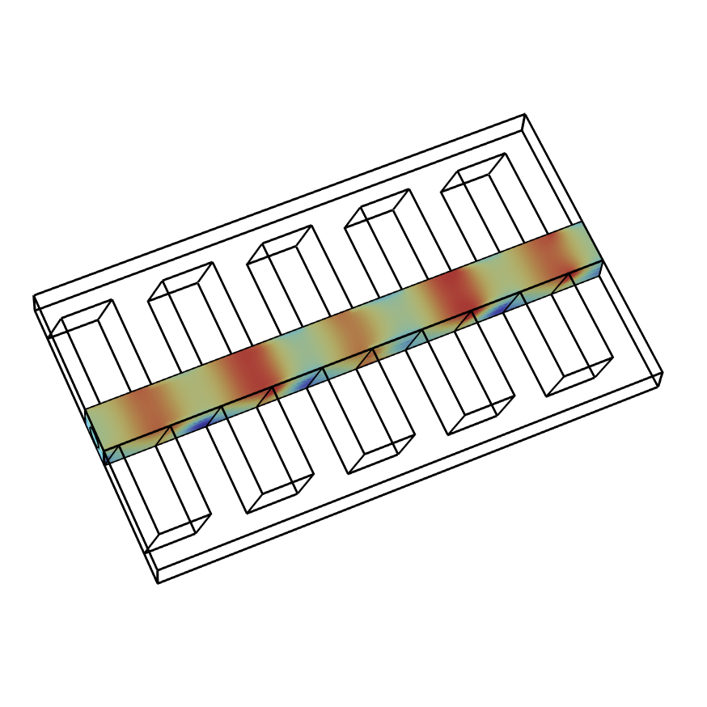
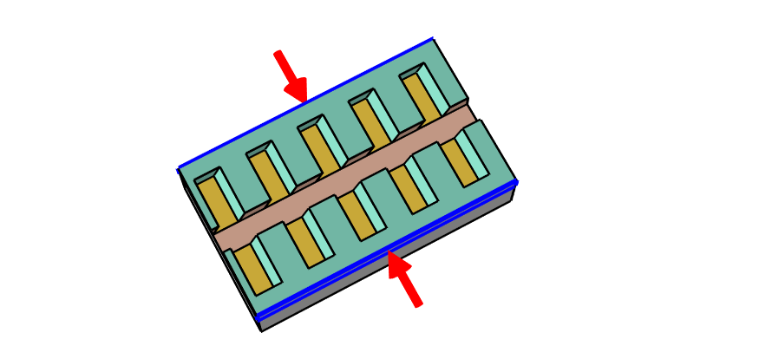

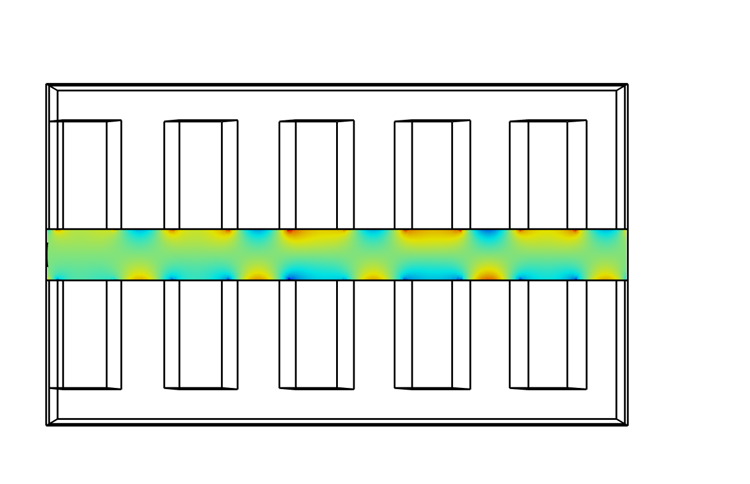
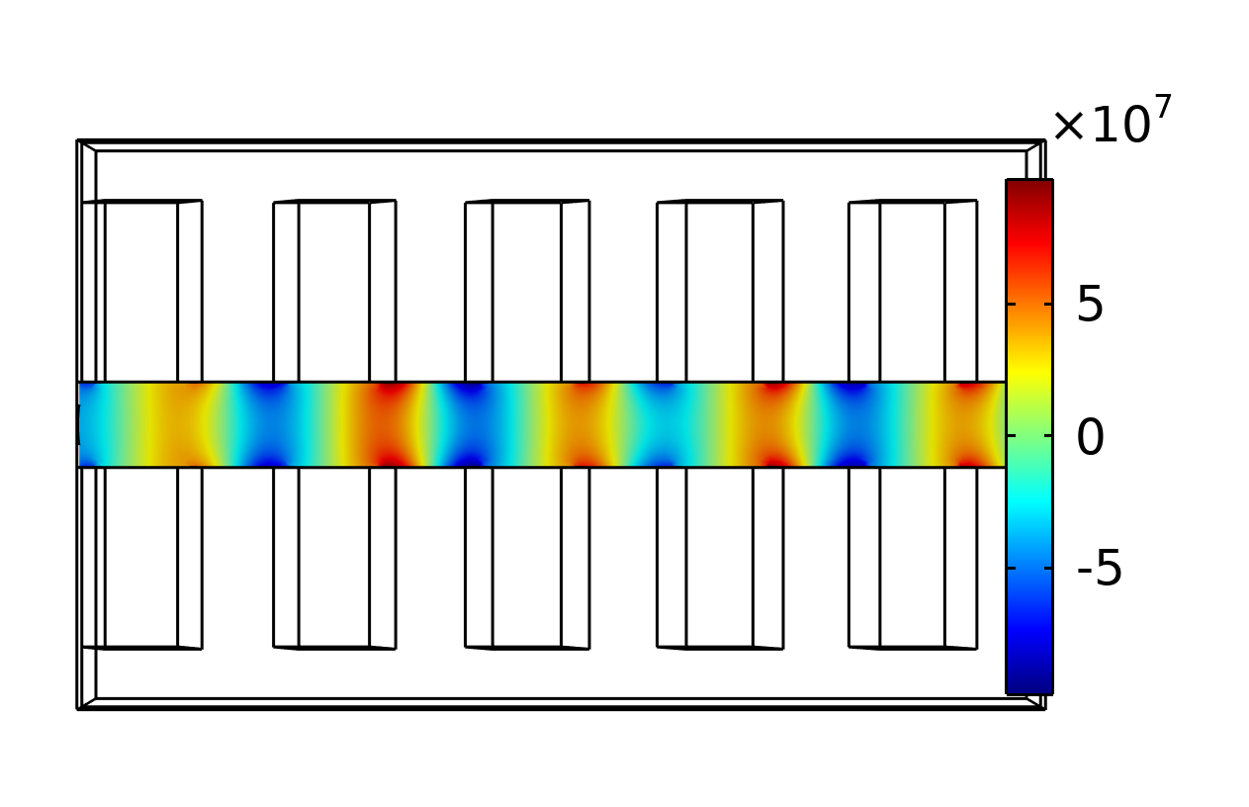
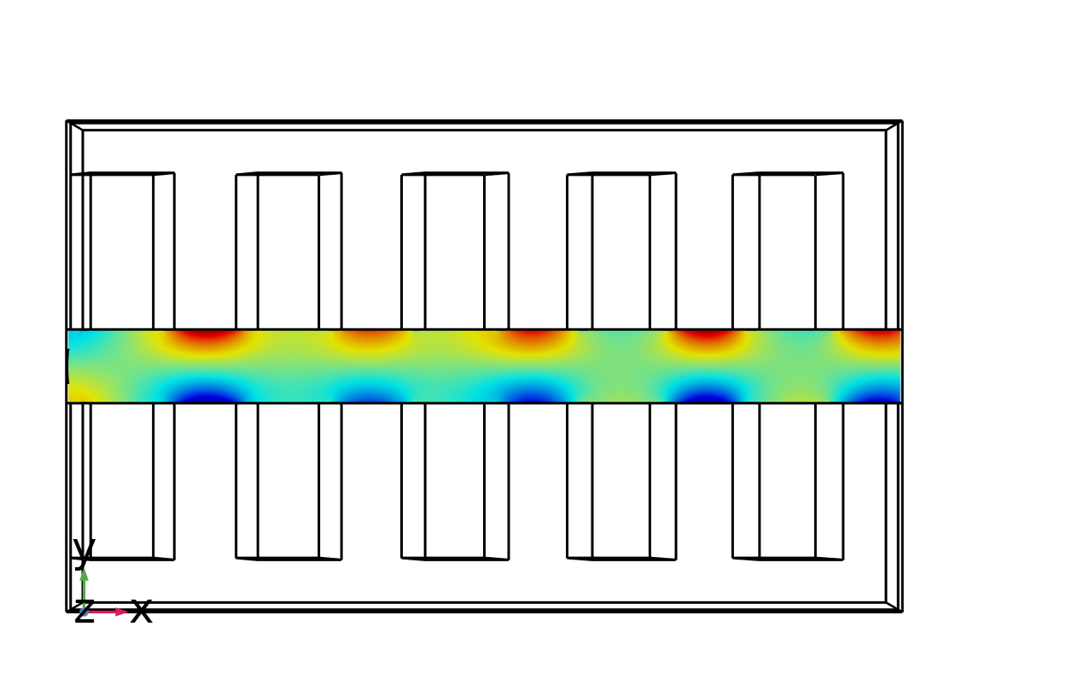
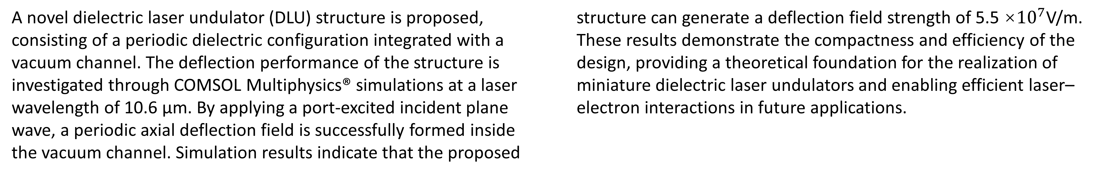
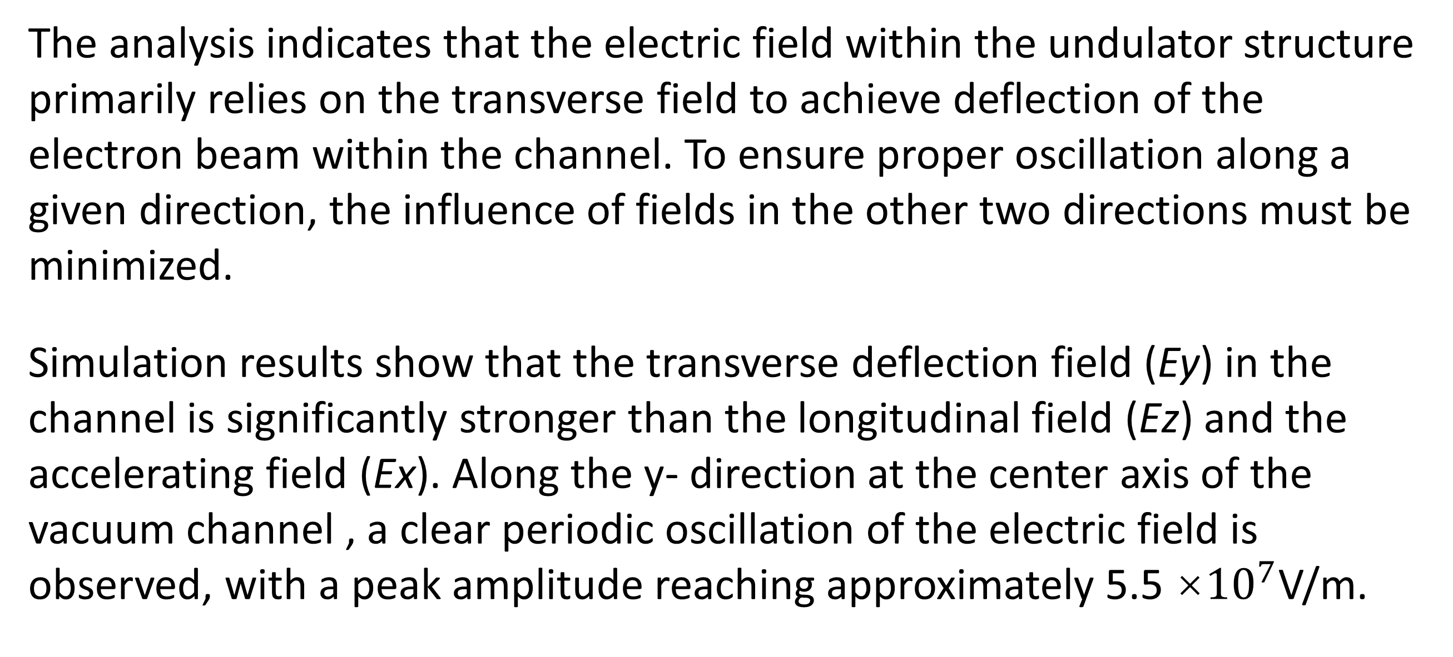
Electric Field Modeling of a Dielectric Laser Undulator
A novel dielectric laser undulator consists of a periodic structure. The electromagnetic field generated by the periodic structure provides a phase-synchronized transverse deflection force within the vacuum channel.
DONGJING DENG¹,YINLIN LU¹,WENLONG HE¹
1.College of Electronics and Information Engineering , Shenzhen University , CHINA
Abstract
A novel dielectric laser undulator (DLU) structure is proposed, consisting of a periodic dielectric configuration integrated with a vacuum channel. The deflection performance of the structure is investigated through COMSOL Multiphysics® simulations at a laser wavelength of 10.6 µm. By applying a port-excited incident plane wave, a periodic axial deflection field is successfully formed inside the vacuum channel. Simulation results indicate that the proposed structure can generate a deflection field strength of 5.5 ×${10}^{7}$V/m. These results demonstrate the compactness and efficiency of the design, providing a theoretical foundation for the realization of miniature dielectric laser undulators and enabling efficient laser–electron interactions in future applications.
Methodology
Model: The structure consists of a vacuum channel flanked by two dielectric elements, each featuring grooves with a certain tilt angle.
Boundary Conditions: Perfect electric conductor (PEC) conditions were applied to metallic surfaces, while perfectly matched layers (PMLs) were used at the external boundaries to simulate an open environment and prevent reflections.
Source Configuration: Two counter-propagating plane waves with a wavelength of 10.6 μm were introduced via port excitations.
Figure 1. Dielectric Laser Undulator Model component diagram
Results
The analysis indicates that the electric field within the undulator structure primarily relies on the transverse field to achieve deflection of the electron beam within the channel. To ensure proper oscillation along a given direction, the influence of fields in the other two directions must be minimized.
Simulation results show that the transverse deflection field (Ey) in the channel is significantly stronger than the longitudinal field (Ez​) and the accelerating field (Ex). Along the y- direction at the center axis of the vacuum channel , a clear periodic oscillation of the electric field is observed, with a peak amplitude reaching approximately 5.5 ×${10}^{7}$V/m.
Figure 2. Electric field distribution in the undulator. Top Left: Electric field about x direction. Top Right: Electric field about y direction. Lower Left: Electric field about z direction .
REFERENCES
1. Plettner, T. & Byer, R. L. Proposed dielectric-based microstructure laser-driven undulator. Physical Review Special Topics - Accelerators and Beams 11, (2008).
2. Prat, E., Al Haddad, A., Arrell, C. et al. An X-ray free-electron laser with a highly configurable undulator and integrated chicanes for tailored pulse properties. Nat Commun 14, 5069 (2023).
.

