Slide 1
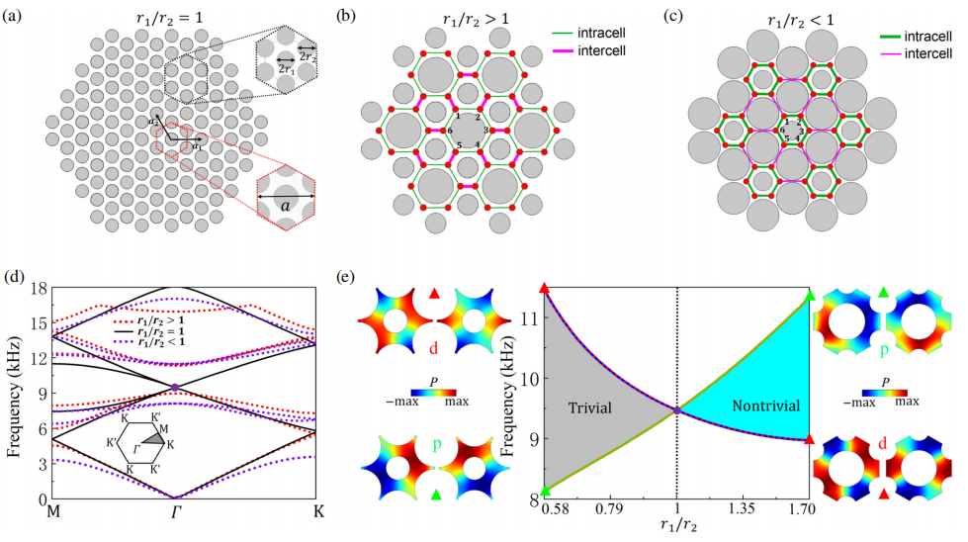
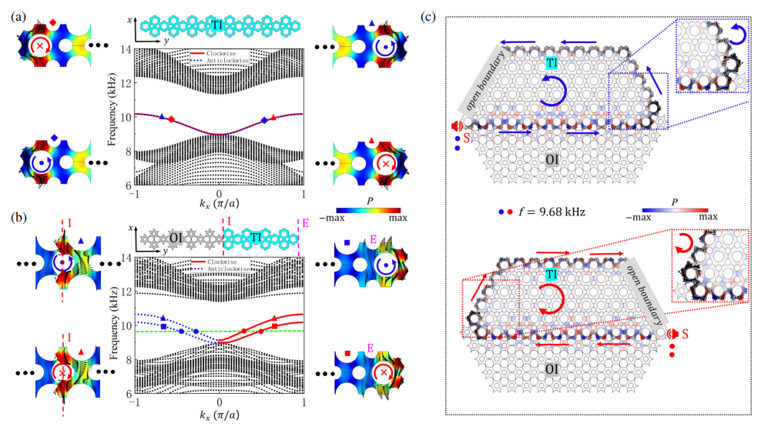
Helical corner states in continuous topological interface states in a topological crystalline insulator
This work designs a Kekulé-like lattice-modulated acoustic crystal, realizes the long-distance mutual excitation of acoustic topological interface and helical corner states, enriches their applications, and provides ideas for acoustic multifunctional devices.
JinLi(黎锦),† ChengXin Deng (邓程欣),† ZiXin Huang (黄梓馨),.BaiHong Liu(刘柏宏), Jian Huang (黄鉴),Xiaoyan Wang (王晓燕), and Hai Yang (杨海)*
Recent higher-order topological insulators in topological crystalline insulators that go beyond the con-
ventional bulk-edge correspondence principle have drawn extensive attention. However, the acoustic
source that excites corner states must be near the corner’s position due to the acoustic source in the domain
of the band gap, which is an unfavorable manipulation of acoustic waves. If we place the acoustic source
far from the position of the corner state, we cannot detect the higher-order topological insulators. Here, we
design an acoustic crystal based on Kekulé-like Lattice modulations to crack this tough nut and achieve
the long-distance mutual excitation of acoustic topological interface and helical corner states. In addition,
the corner states can appear in the interface states due to the charge accumulation at the boundary that
ensures the presence of the corner states. Our ﬁndings enrich applications of topological corner states and
interface states and share the potential to broaden the possibilities for acoustic higher-order topological
states and interface states, which can extend to other classical wave systems.
Conversion from the interface state to edge state. (a) Projected dispersion relations of the armchair ribbon configuration of topological insulator (cyan) consisting of 17 layers. (b) Projected dispersion relations of the armchair ribbon configuration of a supercell consisting of8 layers of the topological insulator (cyan) and 9 layers of the ordinary insulator (gray). The helical topological states are clockwise (red solid arrow) and counterclockwise (blue solid arrow). The green dashed line indicates the frequency of 9.68 kHz, and the two red and blue dots on the green dashed line describe the counterclockwise and clockwise helical topological states, respectively. (c) Propagation of the counterclockwise (upper panel) and clockwise (lower panel) helical topological states along the boundaries and edges of the supercell.
[1] W. A. Benalcazar, B. A. Bernevig, and T. L. Hughes, Quantized electric multipole insulators, Sciences 357,61 (2017).
[2] J. Langbehn, Y. Peng, L. Trifunovic, F. von Oppen, and P. W. Brouwer, Reflection-symmetric second-order topologi-cal insulators and superconductors, Phys. Rev. Lett. 119, 246401 (2017).
[3] Z. Song, Z. Fang, and C. Fang, (d − 2)-dimensional edge states of rotation symmetry protected topological states, Phys. Rev. Lett. 119, 246402 (2017).

