Slide 1
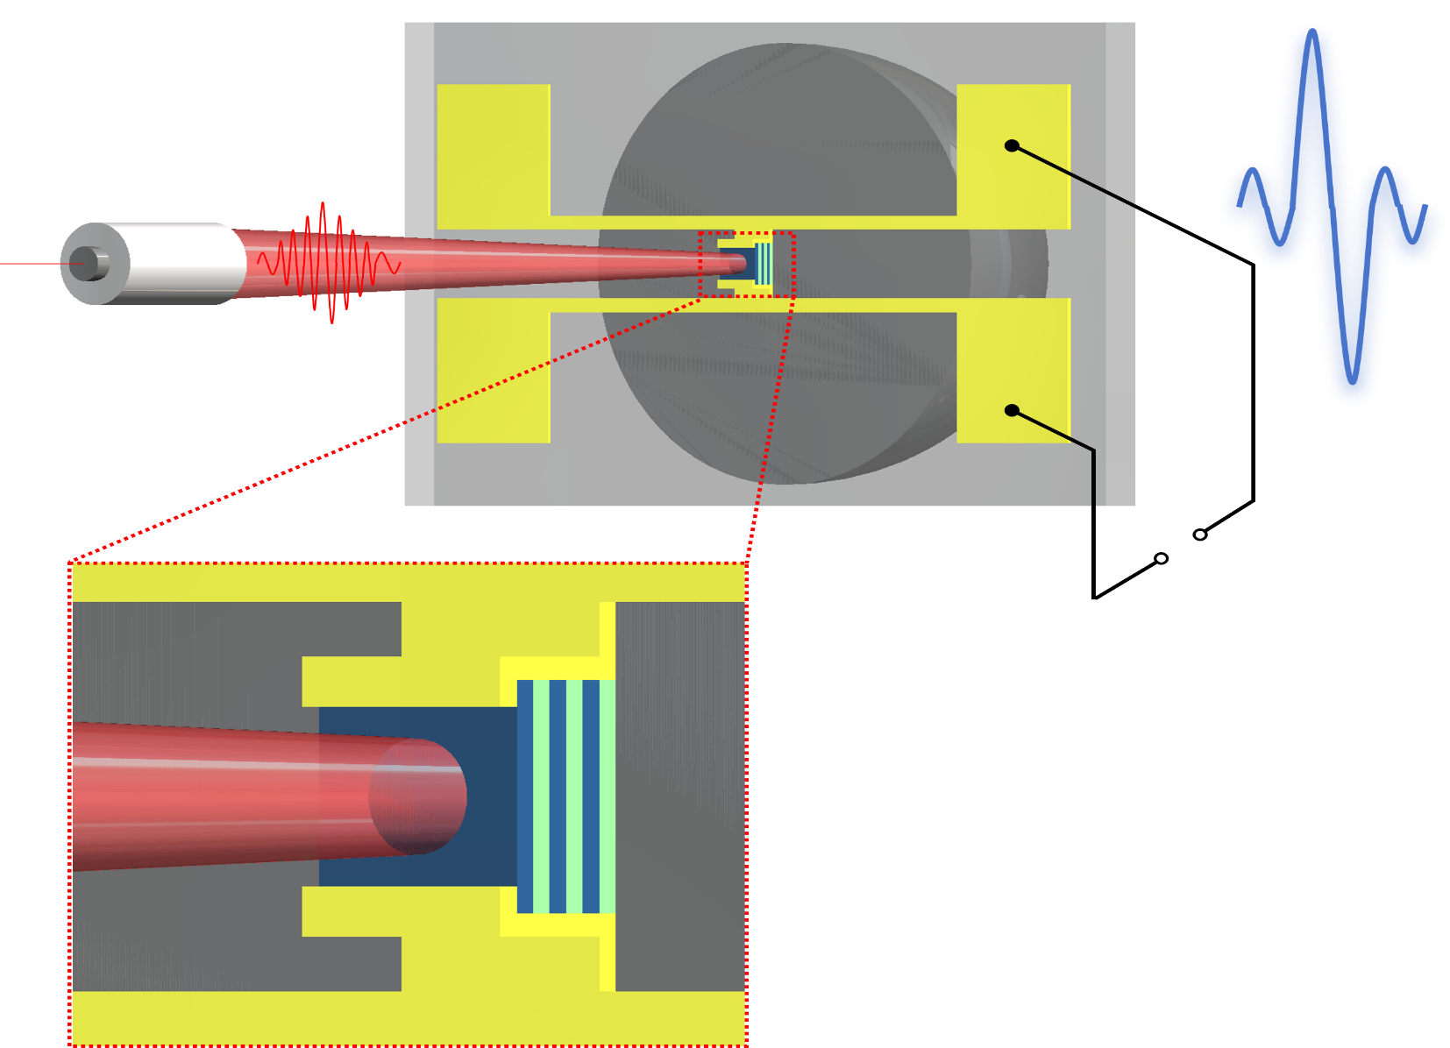

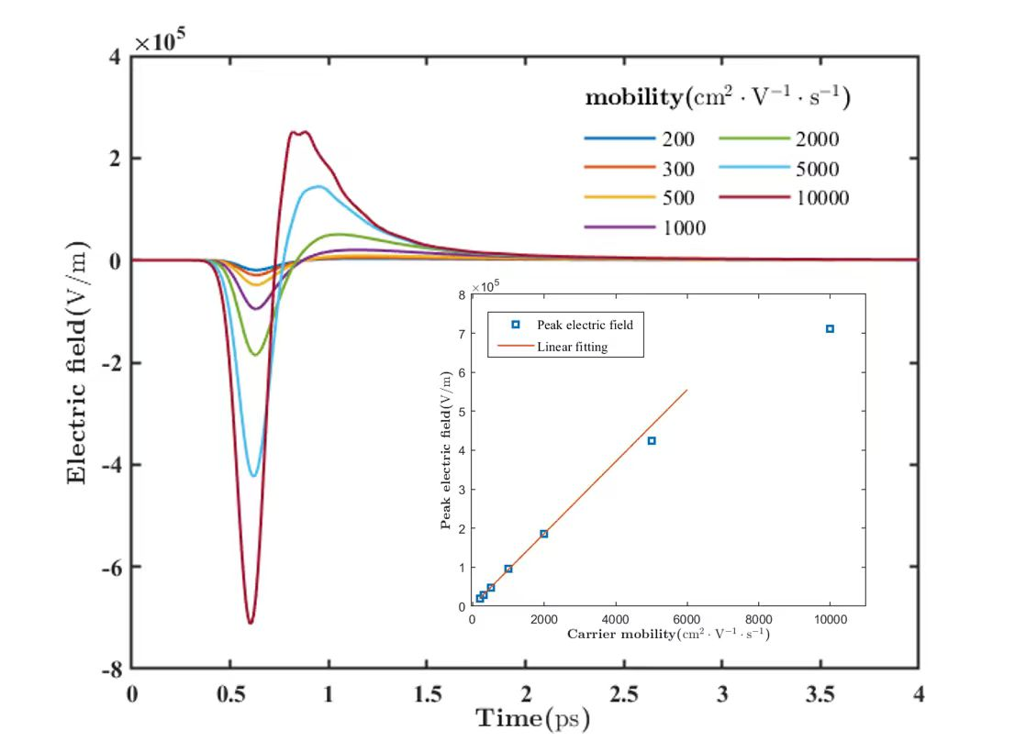
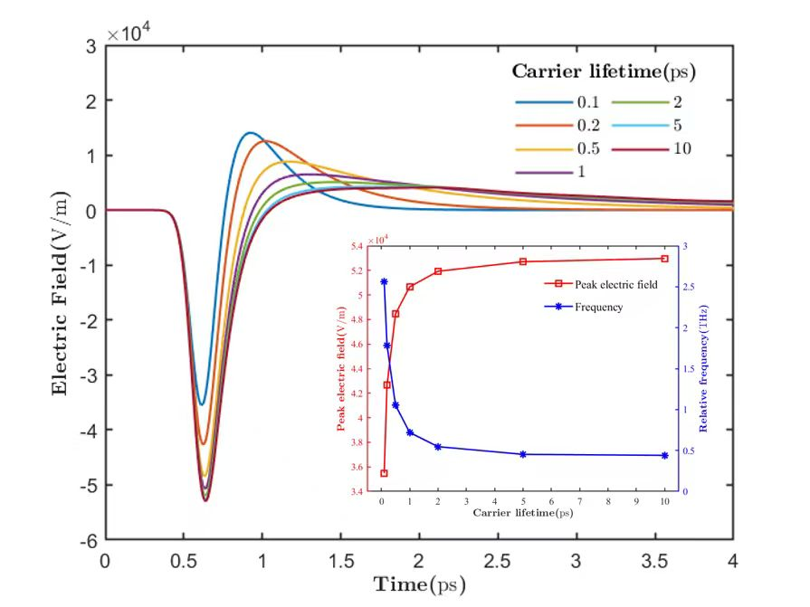
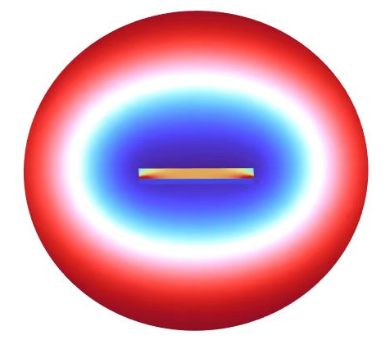
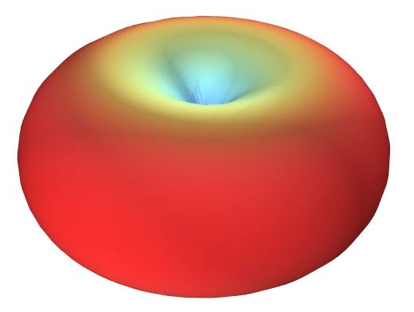
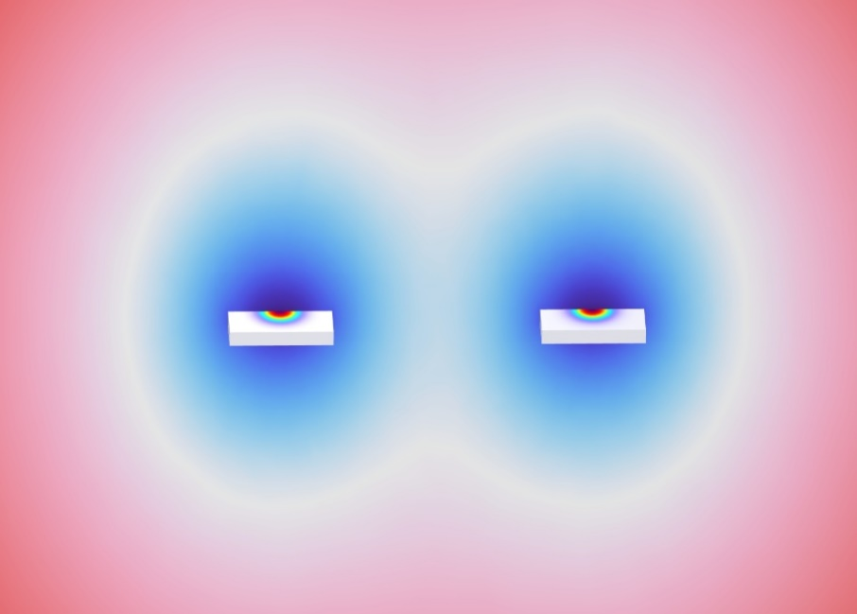



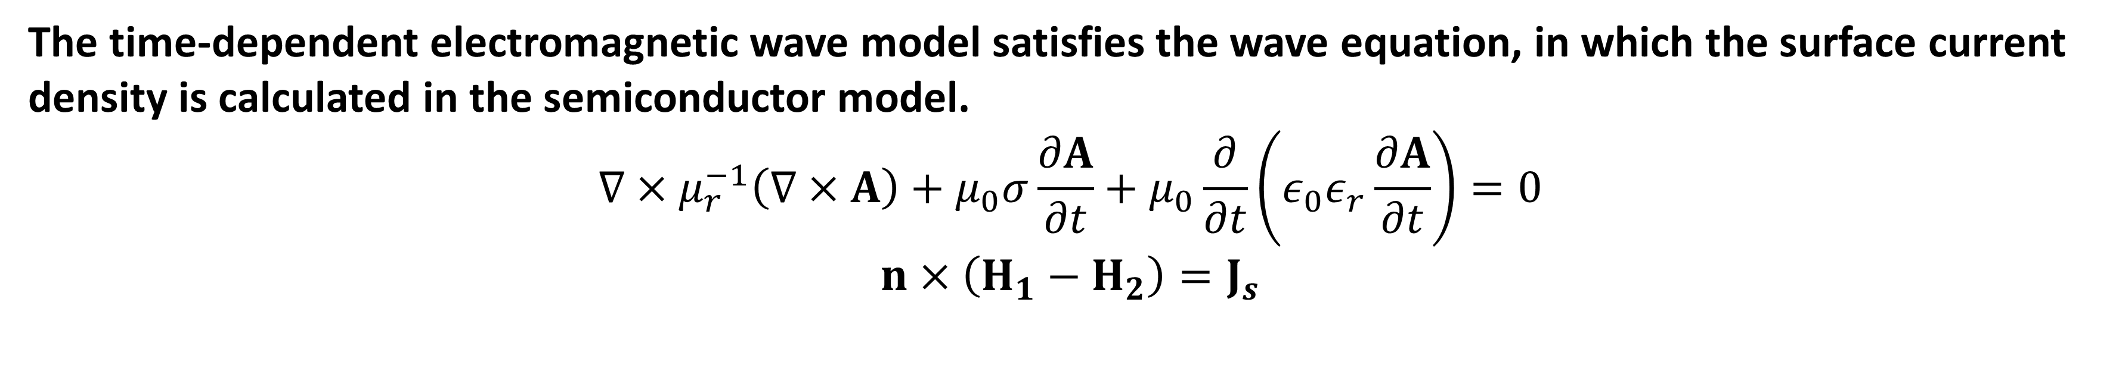
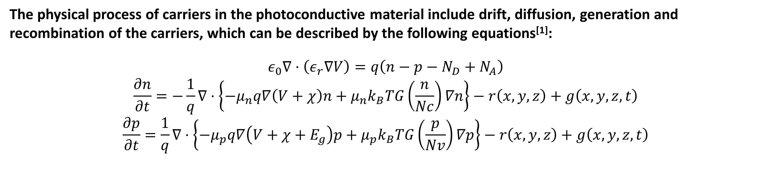
Modeling and Simulation of Terahertz Photoconductive Antenna in 3D
Shangzhe Xu, Yuanbo Cheng, Minghui Lu, and Hong Lu*
*E-mail: hlu@nju.edu.cn
Abstract
The simulation research of THz Photoconductive Antenna (PCA) based on COMSOL is mainly divided into 2D model and 3D model. The 2D model has limitations such as insufficient accuracy and inability to study the spatial orientation of radiation; the 3D model consumes a lot of computing resources, and the feasibility of parameter optimization research is low. In order to solve this problem, this work uses semiconductor module to construct the physical model of optical response and photocurrent excitation of photoconductive devices under two-dimensional conditions, and further constructs the physical model of terahertz wave excitation and propagation in three-dimensional space. Based on this model, we studied the effects of carrier mobility and carrier lifetime of photoconductive materials on terahertz wave power and bandwidth. The simulation results show that the peak electric field of terahertz wave has a linear relationship with the carrier mobility in a small range, but with the further increase of the mobility, the peak electric field shows a saturation trend. With the carrier lifetime becomes longer, the terahertz peak electric field increases, but the FWHM of the terahertz electric field also increases, and the device bandwidth decreases seriously. This result is consistent with the theoretical prediction and some experimental results, which verifies the rationality and effectiveness of this simulation model.
Simulation methods
(a)
Equation of semiconductor model
The physical process of carriers in the photoconductive material include drift, diffusion, generation and recombination of the carriers, which can be described by the following equations^{[1]}:
$$ε_{0}∇⋅\left(ε_{r}∇V\right)=q\left(n−p−N_{D}+N_{A}\right)$$
$$\frac{∂n}{∂t}=−\frac{1}{q}∇⋅\left\{−μ_{n}q∇\left(V+χ\right)n+μ_{n}k_{B}TG\left(\frac{n}{Nc}\right)∇n\right\}−r\left(x,y,z\right)+g\left(x,y,z,t\right)$$
$$\frac{∂p}{∂t}=\frac{1}{q}∇⋅\left\{−μ_{p}q∇\left(V+χ+E_{g}\right)p+μ_{p}k_{B}TG\left(\frac{p}{Nv}\right)∇p\right\}−r\left(x,y,z\right)+g\left(x,y,z,t\right)$$
(b)
Equation of temw model
The time-dependent electromagnetic wave model satisfies the wave equation, in which the surface current density is calculated in the semiconductor model.
$$∇×μ_{r}^{−1}\left(∇×A\right)+μ_{0}σ\frac{∂A}{∂t}+μ_{0}\frac{∂}{∂t}\left(ε_{0}ε_{r}\frac{∂A}{∂t}\right)=0$$
$$n×\left(H_{1}−H_{2}\right)=J_{s}$$
Figure. 1. (a) Mesh of the semi model. (b) Mesh of the temw model.
[1] Burford N et.al. Computational modeling of plasmonic thin-film terahertz photoconductive antennas[J]. Journal of the Optical Society of America B, 33(4): 748-759(2016).
Results
Figure. 2. THz wave & surface current.
Figure. 3. 3D far filed radiation.
Figure. 4. THz-mobility relationship.
Figure. 5. THz-lifetime relationship.
THz peak electric field has a linear relationship with the carrier mobility below 2000 $cm^{2}/(V⋅s)$, but shows a saturation trend with the further increase of the mobility.
With the carrier lifetime becomes longer, THz peak electric field increases, but the bandwidth of PCA decreases seriously.
Potential applications
Summary
Design and research of photoconductive antenna array.
Radiation spatial orientation research.
Design of novel PCA structure.
The results of this simulation model are consistent with the theoretical prediction and some experimental results, which verifies the rationality and effectiveness of this simulation model.
Figure. 6. Potential application of this simulation model.
Excerpt from the Proceedings of the COMSOL Conference 2025 Shanghai

