Slide 1
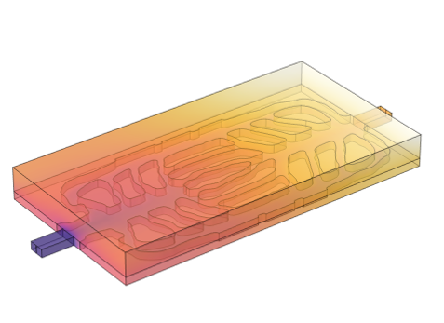
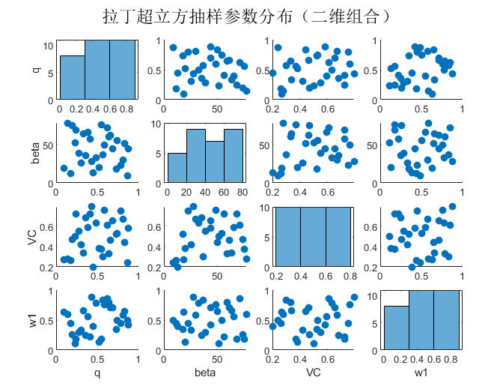
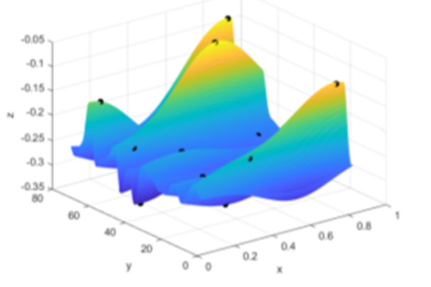
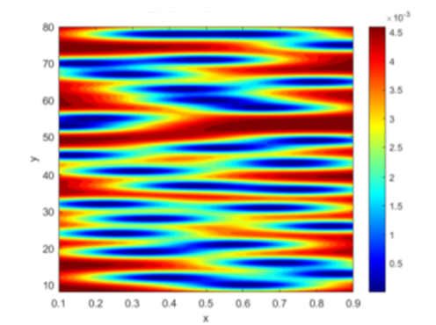




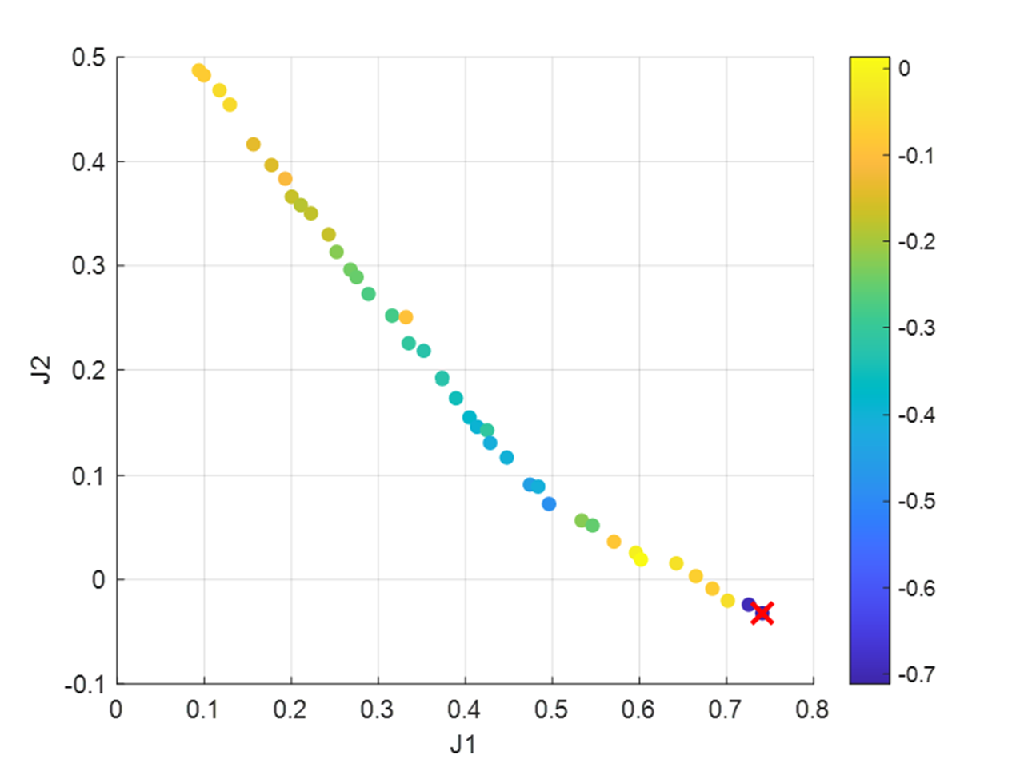
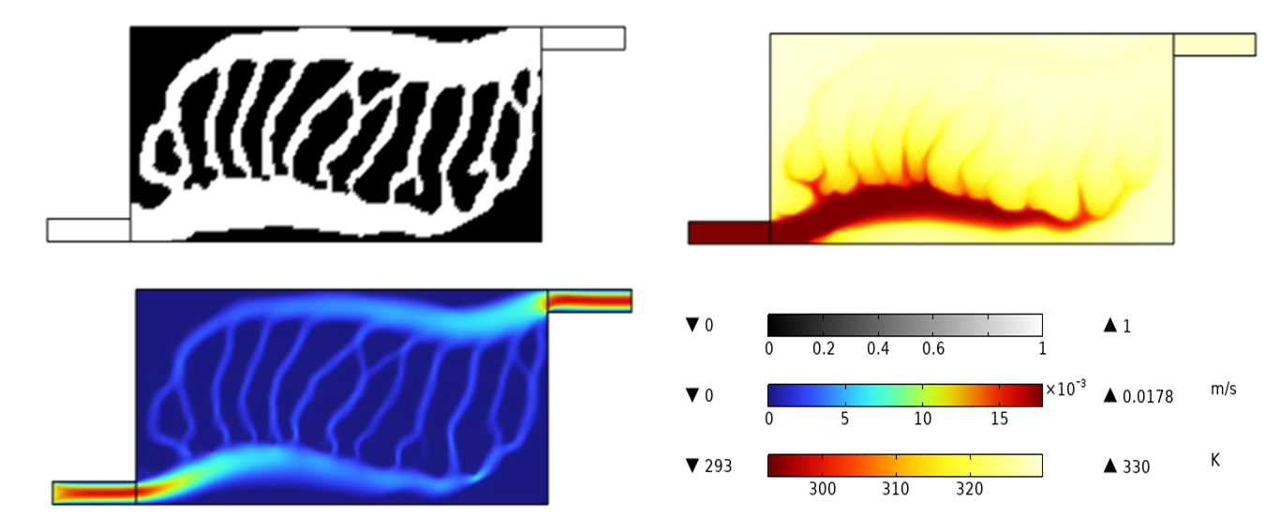

An Intelligent-Algorithm-Driven Topology Optimization Framework for Designing Liquid Cooling Plates in Energy Storage Devices
Confronting the thermal challenges of next-generation energy storage devices, this work explores a new design paradigm for liquid cooling plates. Our approach leverages intelligent topology optimization to autonomously generate high-performance flow structures, achieving a synergistic balance of superior heat dissipation, temperature uniformity, and low flow resistance.
Panchun Tang
East China University of Science and Technology
Abstract
The rising power density of batteries and supercapacitors in modern electric vehicles and energy storage systems demands innovative thermal management solutions. Traditional cooling approaches face challenges in achieving the required balance of heat dissipation efficiency, temperature uniformity, and energy consumption within constrained spaces.
This research presents an intelligent topology optimization framework specifically developed for designing high-performance liquid cooling plates. By establishing a comprehensive multi-objective model that integrates both thermal performance and flow dynamics, we employ a surrogate model-assisted optimization approach to generate sophisticated biomimetic channel architectures.
The optimized cooling plate design demonstrates substantial improvements in thermal performance while maintaining favorable flow characteristics. Supported by a systematic decision-making methodology, this research offers a viable pathway for advanced thermal management systems, with promising potential for extension to hybrid cooling applications.
Methodology
Developed topology optimization model with thermal-flow constraints
Established multi-objective framework using key thermal and flow metrics
Implemented surrogate-assisted NSGA-II for biomimetic channel generation
Fig. 1. Latin Hypercube Sampling Design
Fig. 2. Surrogate Model and Error Distribution
Results
Topology-optimized cooling plate significantly reduces maximum cell temperature while maintaining controlled pressure drop
Improved temperature uniformity enhances overall thermal management efficiency
Multi-objective optimization with decision-making method improves engineering applicability
Fig. 3. Pareto Front and Selected Optimal Solution
Fig. 4. Optimized Channel Structure with Flow and Temperature Fields
REFERENCES
[1]Zhong Q, et al., Transfer learning based topology optimization of battery cooling channels design for improved thermal
performance, Applied Thermal Engineering, 263: 125400 (2025).
[2]Zhan S, et al., Optimization design method for serpentine cold plates combining structural parameter tuning and topology
optimization, Applied Thermal Engineering, 126868 (2025).
[3]Pan C, et al., Topology optimization-based design and performance analysis of liquid cooling plates for lithium-ion batteries,
Journal of Energy Storage, 124: 116842 (2025).

