Slide 1
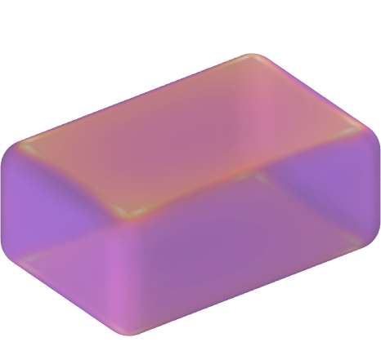
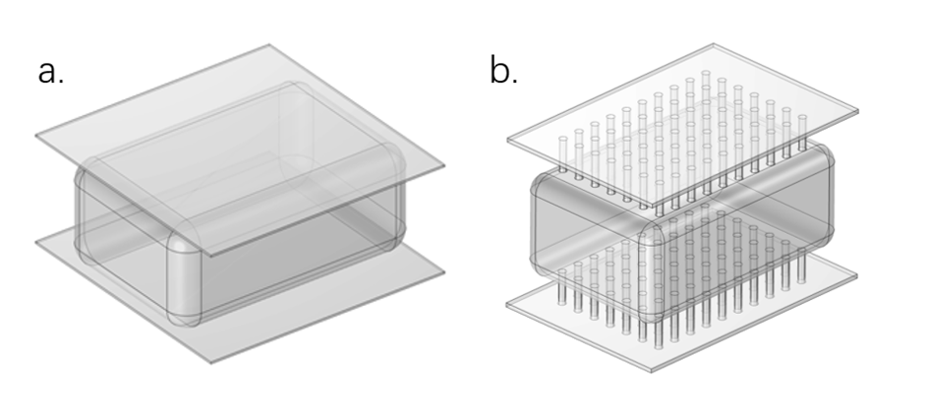
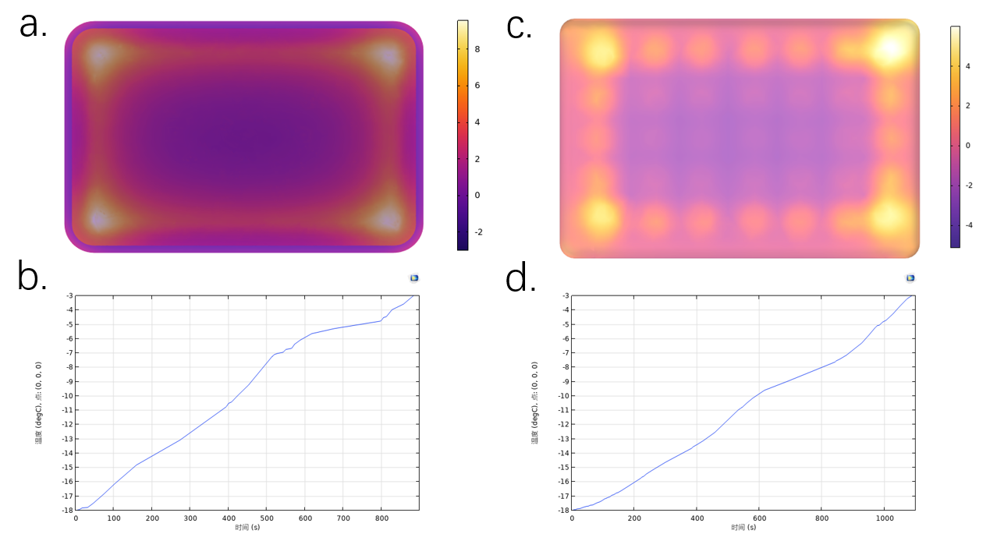

Research on the Electrode Characteristics in the Ohmic Thawing Process of Lean Pork
Explores the impact of different parameters of electrodes on the thawing effect of lean pork in ohmic heating.
YuQi Ge¹，Yang Jiao^{1,2}
1. College of Food Science and Technology, Shanghai Ocean University, Shanghai 201306, China
2. Engineering Research Center of Food Thermal-processing Technology, Shanghai Ocean University, Shanghai 201306, China
Abstract
This study utilizes COMSOL simulation to analyze the application of ohmic heating in the thawing of lean pork, focusing on the effects of electrode material, shape, thickness, and applied electric field strength on thawing efficiency. The results indicate that the use of needle-shaped electrodes improves the issue of uneven contact between conventional plate electrodes and the food, significantly enhancing thawing uniformity. Additionally, different materials and thicknesses have a notable impact on thawing rates. Specifically, a 1.5mm thick stainless steel plate electrode can achieve a thawing rate of 1.5°C/min with an overall temperature difference of less than 8°C at an electric field strength of 28V/cm. This research provides theoretical support for optimizing the electrode design in the ohmic thawing process of lean pork.
Methodology
By employing a coupled model of electromagnetic fields and heat transfer, this study evaluates the thawing effectiveness based on thawing rate and temperature distribution uniformity under various parameters, including electrode materials (nickel, titanium, platinum, and stainless steel), shapes (plate, sheet, perforated plate, and needle), thicknesses (1-2.5 mm), and applied electric field strengths (10-40 V/cm).
FIGURE 1 : a. Plate-shaped electrode model b. Needle-shaped electrode
Results
Stainless steel electrodes exhibit a higher thawing rate in ohmic thawing of lean pork, approximately 1.5°C/min.
The 1.5 mm thick plate electrode, under a field strength of 28 V/cm, can reduce the temperature at the edges of the frozen product, achieving a maximum temperature of approximately 6.2°C. The needle electrode improves the uneven contact issue of conventional plate electrodes with the food, greatly enhancing thawing.
Within the explored range of 10-40 V/cm, a suitable field strength range of 20-36 V/cm can achieve a thawing rate of 0.75-1.5°C/min with an overall temperature difference of ≤8°C.
FIGURE2: a. Temperature distribution of the plate electrode at 28 V/cm b. Temperature rise curve of the plate electrode at 28 V/cm c. Temperature distribution of the needle electrode at 28 V/cm (r = 1.94 mm, 70 units on a single surface) d. Temperature rise curve of the needle electrode (r = 1.94 mm, 70 units on a single surface).
Balthazar, Celso F., et al. "Recent findings on the ohmic heating application in meat products." Current Opinion in Food Science 58 (2024): 101180.
Zhang, Xiao, et al. "Influence of low voltage programmed thawing on the quality of frozen pork and its myofibrillar protein." Innovative Food Science & Emerging Technologies 98 (2024): 103858.

