Slide 1
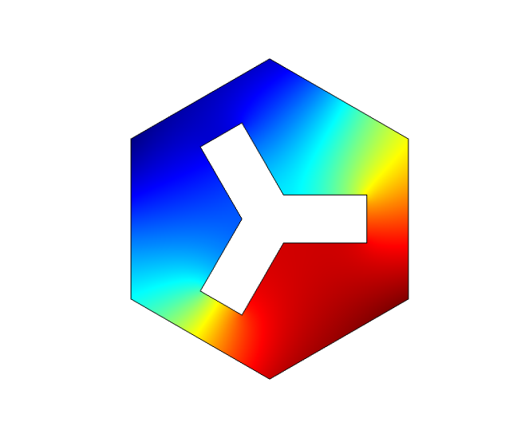
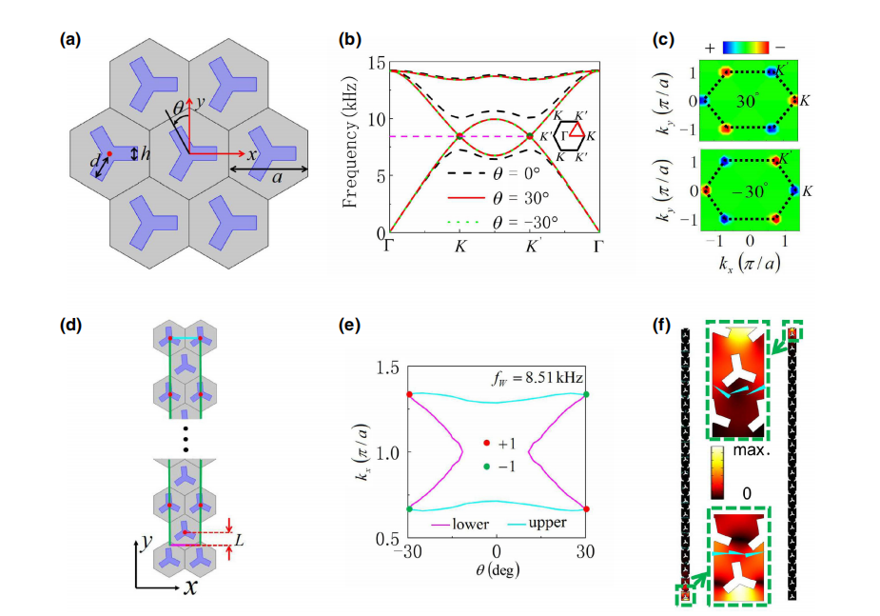
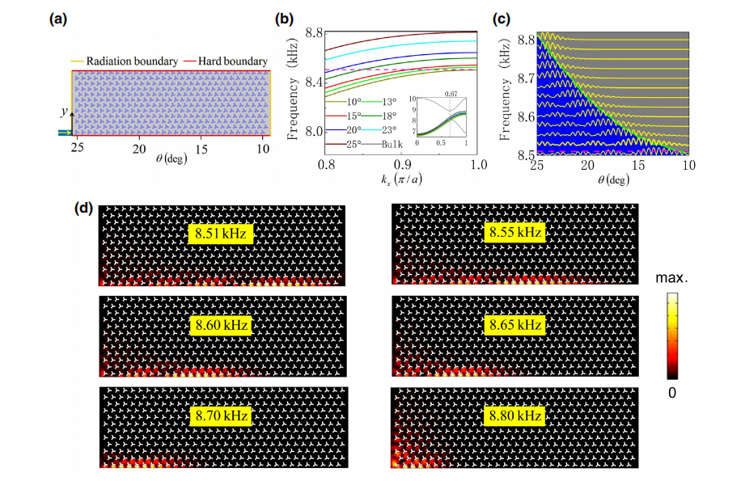
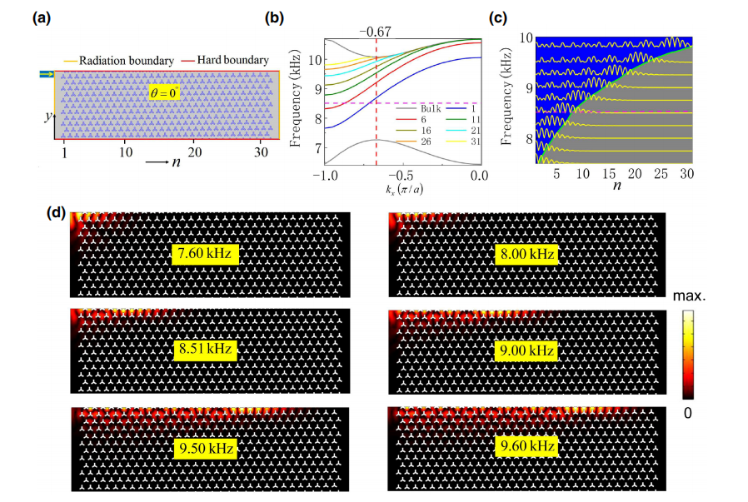

Probing Two Distinct Types of Topological Rainbow Concentrators Related to the Acoustic Valley Hall Insulator in Synthesized Three-Dimensional Space
Our work may open up a path for the realization of topological rainbow devices in acoustic systems and provide potential applications in concentrating weak signals and distributing different frequency components of topological states to different positions along the interface of the sonic crystals. Throughout our work, the simulations are performed using the commercial finite-element software COMSOL Multiphysics®.
Zhennan Wang,¹ Zhenyu Wang,² Houyin Li,¹ Zhenzhen Liu,¹ Yaxian Yu,¹ Jinlong Luo,¹ Feijie Huang,¹ Jian Huang,¹ Xiaoyan Wang,¹ Hui Li,¹ and Hai Yang^{1,*}
¹Key Laboratory of Artificial Microstructures in Yunnan Higher Education Institutions, School of Physics Science and Technology, Kunming University, Kunming 650214, China
²Key Laboratory of Artificial Micro- and Nanostructures of Ministry of Education and School of Physics and Technology, Wuhan University, Wuhan 430072, China
ABSTRACT
Synthesized three-dimensional space provides us with a platform to explore the intriguing acoustic valley Hall insulator. In this paper, a rotational degree of freedom is introduced to construct a synthetic three-dimensional space. Based on simulations, our results show that Weyl points and Fermi arcs and topologically nontrivial edge modes appear in a synthetic space. Not only rotational operation but also boundary truncation can modulate the frequencies of nontrivial edge states, which result in two completely different edge states at the upper and lower boundaries. Using frequencies of edge states protected by Weyl points, we devise two different acoustic topological rainbow devices. The two devices are able to trap states with different frequency components at different spatial positions: one device is capable of capturing low-frequency components at close range, while the other has the ability to confine low frequency components at long distances. This work may boost further the development of topological rainbow devices in a synthetic space related to the acoustic valley Hall insulator.
FIG. 1. Weyl points synthesized by 2D triangular-lattice sonic crystals
FIG. 2. A topological rainbow concentrator based on rotation
CONCLUSIONS
In summary, synthesized Weyl points are realized in synthetic 3D space, which leads to the existence of topological edge states at the upper and lower boundaries. By modulating the rotation and the boundary truncation, the frequencies of the edge states can be shifted monotonically. On the basis of the rotation and boundary truncation, we can design two completely different types of topological rainbow devices related to the Weyl points. These results are demonstrated in simulations and experiments. This work may provide a platform for exploring acoustic topological rainbow devices connected to Weyl points in synthetic parameter space.
FIG. 3. A topological rainbow concentrator based on boundary truncation
[1] K.L.Tsakmakidis, et.al. Trapped rainbow storage of light in metamaterials, Nature (London) 450, 397 (2007).
[2] H. Kurt, et.al. Rainbow trapping using chirped all-dielectric periodic structures, Appl. Phys. B 110, 411(2013).
[3] G. J. Chaplain, et.al. Delineating rainbow reflection and trapping with applications for energy harvesting, New J. Phys. 22, 063024(2020).

