Slide 1
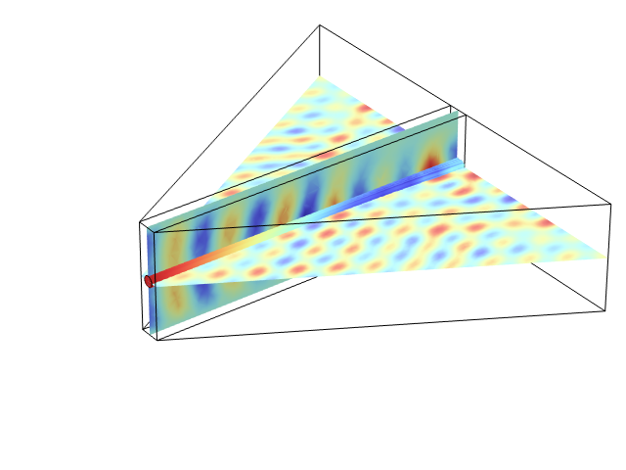
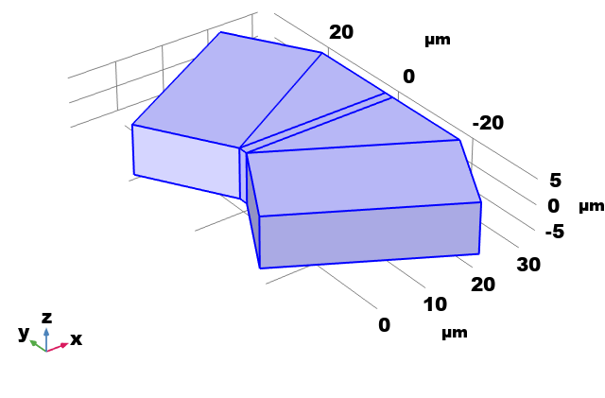
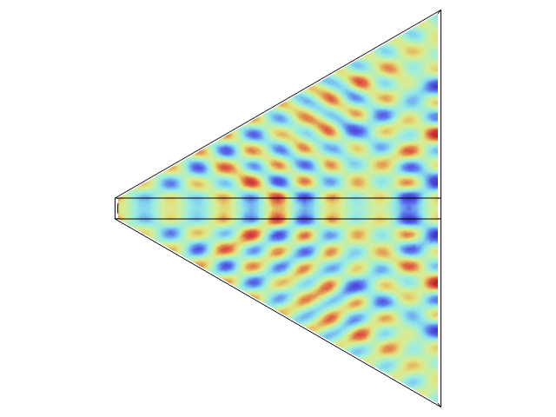
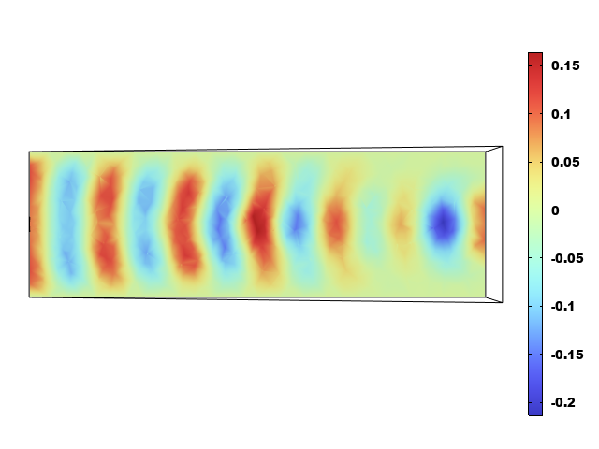
Analysis of Electric Fields in a Dielectric Laser Accelerator
A novel dielectric laser accelerator structure using a triangular-gradient dielectric medium is proposed to achieve high-gradient acceleration via the Inverse Cherenkov Effect.
YINLIN LU¹, DONGJING DENG¹, WENLONG HE¹
1. College of Electronics and Information Engineering, Shenzhen University, CHINA
Abstract
This paper proposes a novel dielectric laser accelerator (DLA) structure that leverages the Inverse Cherenkov Effect through the use of a triangular-gradient dielectric medium. We used COMSOL Multiphysics® simulations to investigate the acceleration performance of this structure in a high-intensity laser field. Our simulations, which applied incident plane waves with scattering boundary
conditions, confirmed the formation of a periodic axial accelerating electric field within the channel. The results show that the proposed structure can generate an accelerating gradient of up to 150 MV/m. This design has significant potential for realizing high-efficiency, compact accelerators and provides a new pathway for future on-
chip accelerator systems.
Methodology
Model: The structure consists of a central vacuum channel located inside a triangular-gradient dielectric medium.
Boundary Conditions: Scattering Boundary Conditions (SBC) are used to simulate an open environment and prevent reflections.
Excitation Source: The structure is excited using counter-propagating plane waves with a wavelength of 10.6 μm, which create the required standing-wave longitudinal electric field
in the channel.
FIGURE 1. Dielectric Laser Accelerator Model component diagram
Results
Simulation results confirm that the proposed structure generates a clear, periodic, longitudinal accelerating electric field. The maximum peak value of this field reaches approximately 150MV/m along the central axis of the channel. This ultra-high accelerating gradient demonstrates the structure's immense potential for
realizing compact, high-energy accelerators.
FIGURE 2. Electric field distribution in the accelerator
REFERENCES
1.England, R. J., Noble, R. J., Bane, K., Dowell, D. H., Ng, C.-K., Spencer, J. E., Tantawi, S., Wu, Z., Byer, R. L., Peralta, E., Soong, K., Chang, C.-M., Montazeri, B., Wolf, S. J., Cowan, B., Dawson, J., Gai, W., Hommelhoff, P., Huang, Y.-C., et al., “Dielectric laser accelerators,” Rev. Mod. Phys. 86(4), 1337–1389 (2014).
2. Sun, B., He, Y.-F., Luo, R.-Y., Zhang, T.-Y., Zhou, Q., Wang, S.-Y., Zheng, J. and Zhao, Z.-Q., “On-chip stackable dielectric laser accelerator,” NUCL SCI TECH 34(2), 23 (2023).

