Slide 1
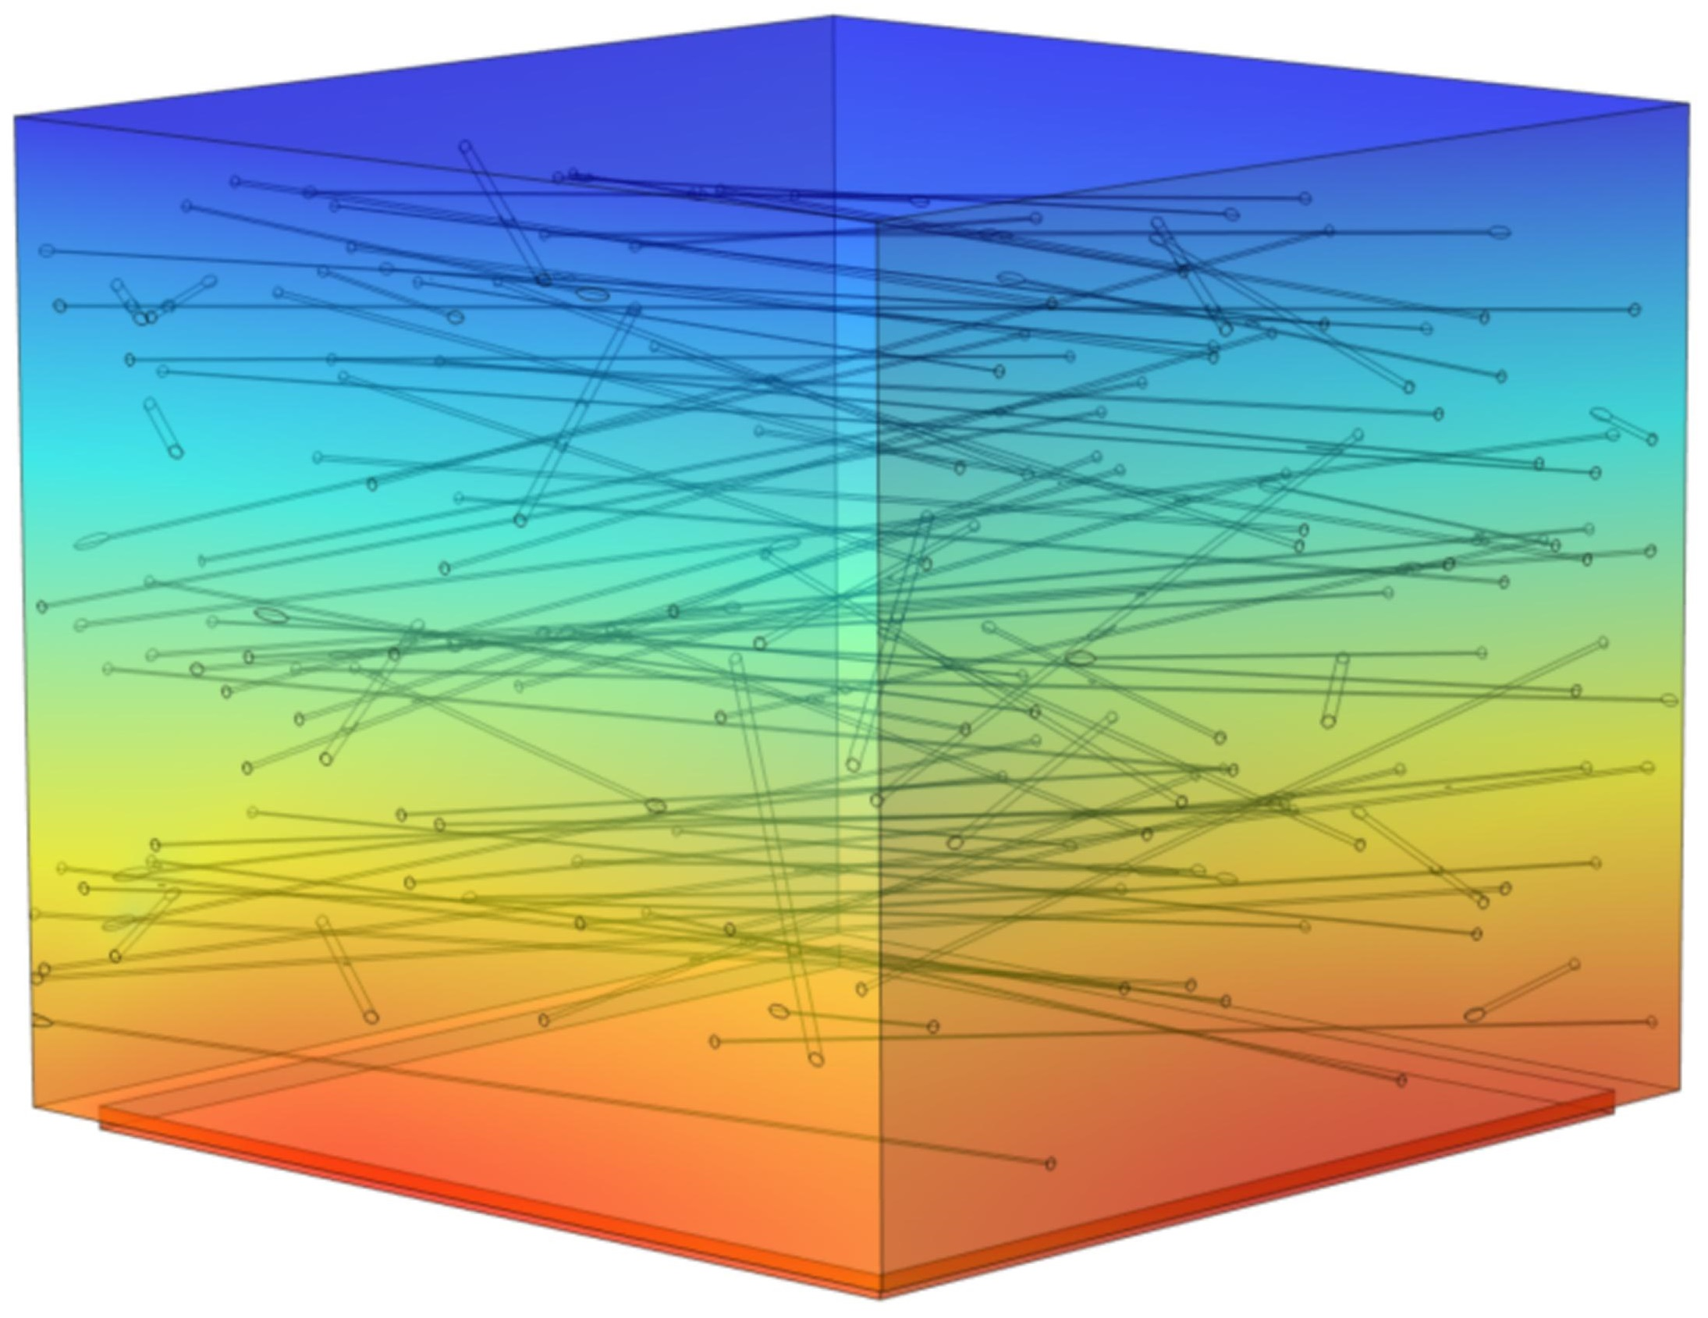
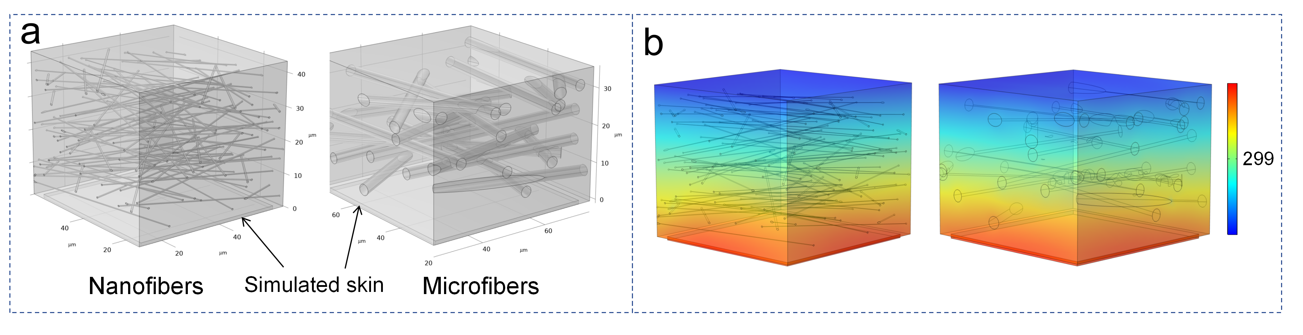
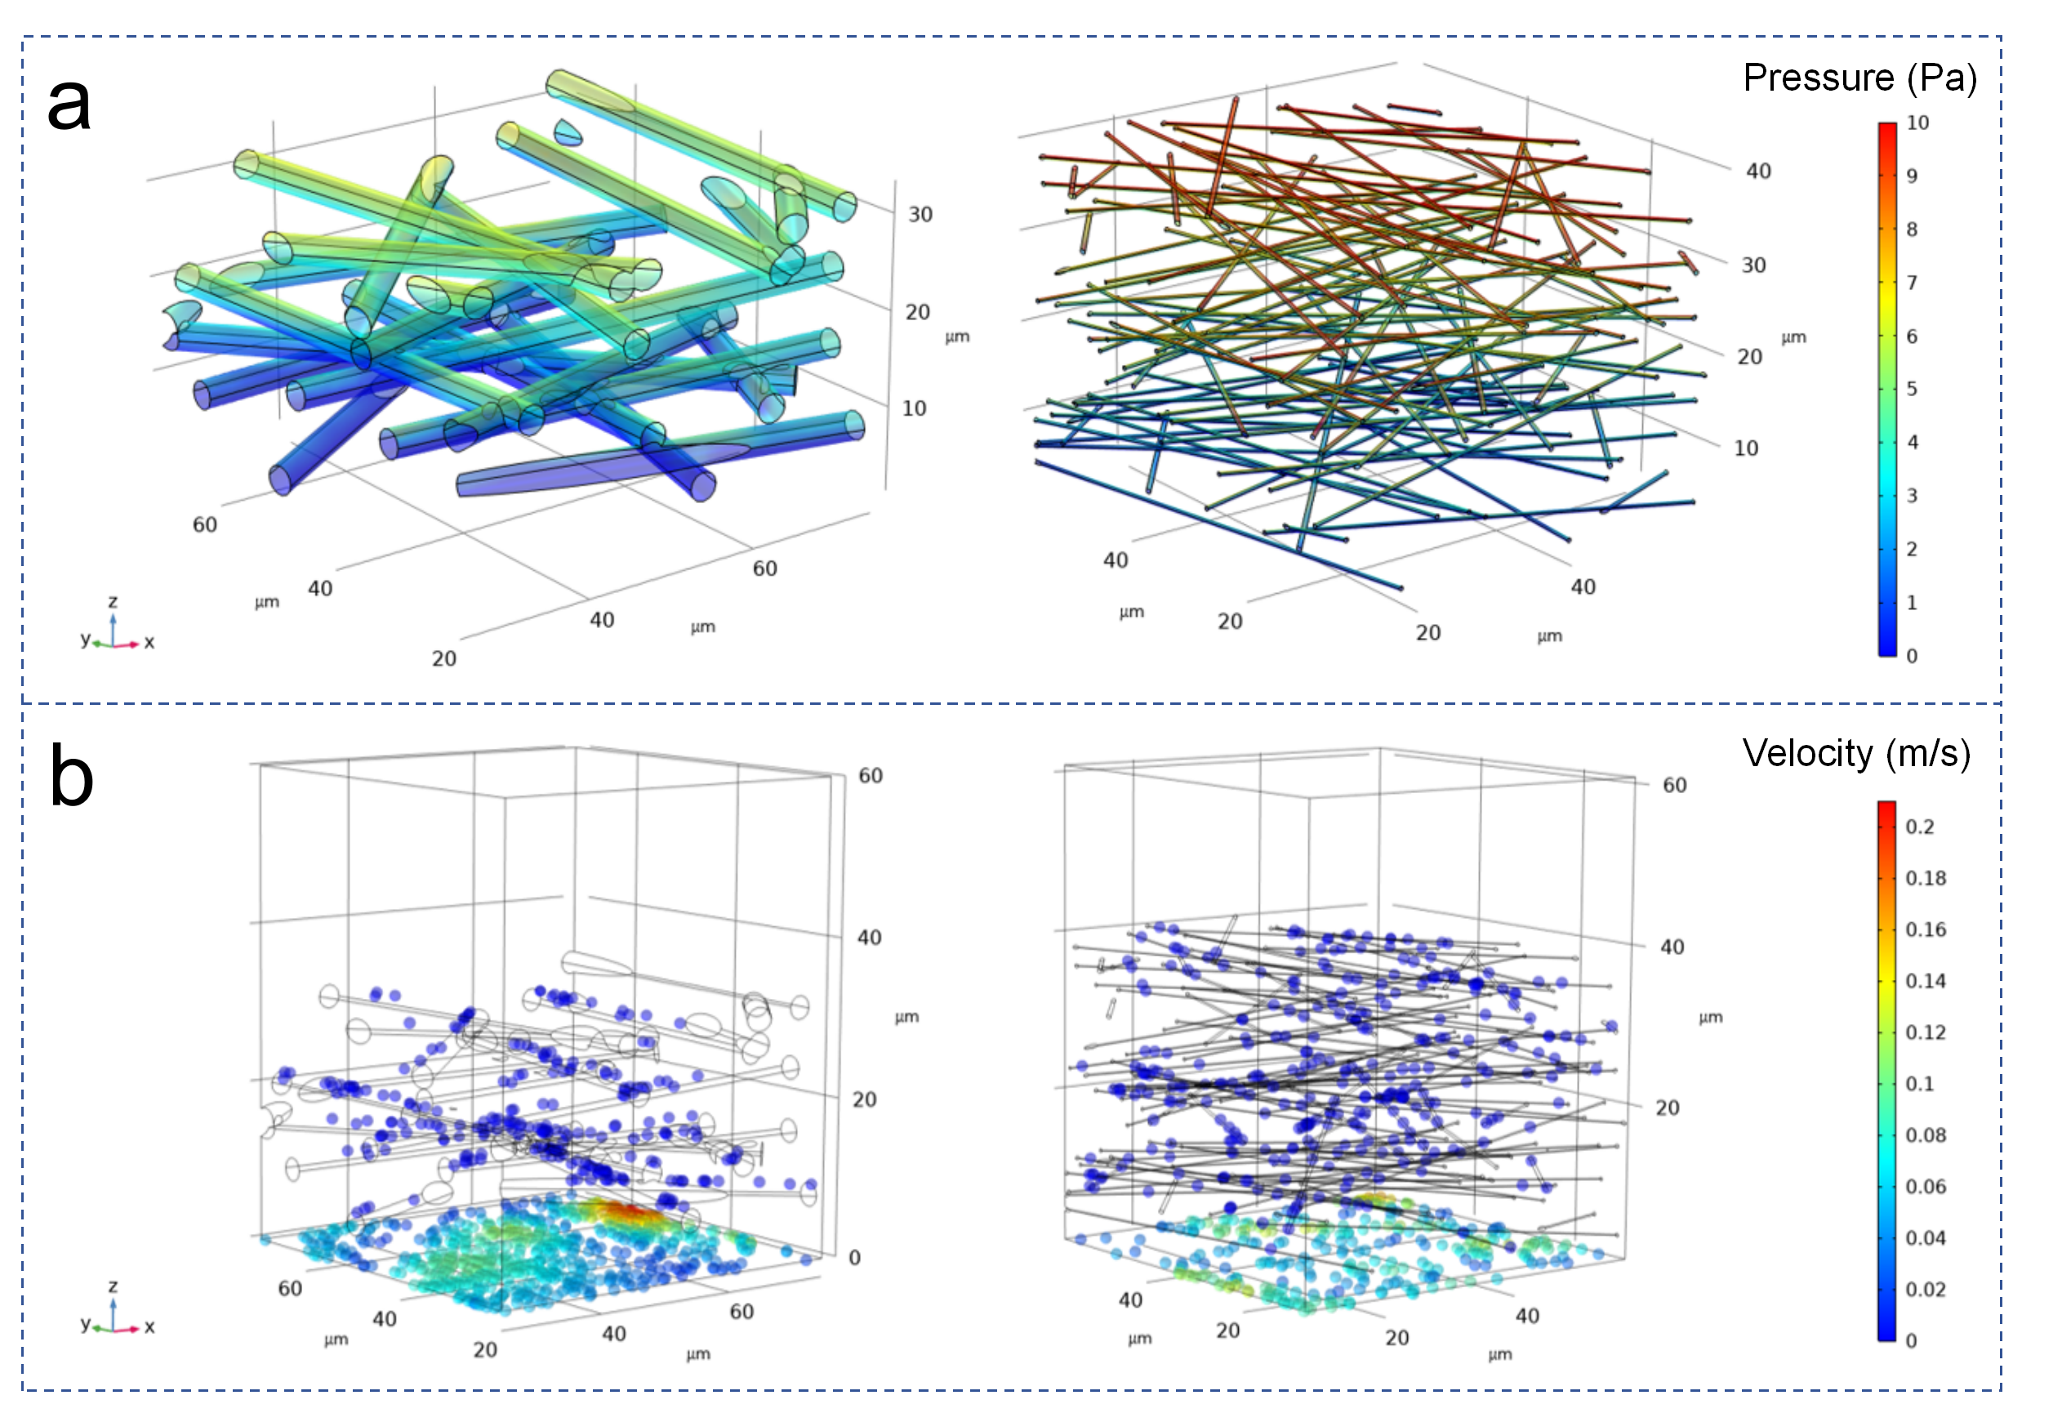

Thermal Insights into Curly 3D Nanofibrous Sponges for Air Filtration
A 3D nanofiber sponge with curly, hierarchical fibers was fabricated via electrospinning, exhibiting ultralow density, >98% PM_{0.3} filtration, low air resistance (~56 Pa), and excellent durability.
Beijie Zhu¹, Liwei Xing¹, Lei Zang¹, Saisai Chen¹, Jiaxin Xu¹, Zhiang Zhang¹, Xiao Yang¹, Shengqi Xia¹,
Yuanqiang Xu¹*, Yuansheng Zheng¹*, Lijun Yang¹
1 School of Textiles and Fashion, Shanghai University of Engineering Science, Shanghai, China.
* Corresponding authors.
Abstract
To address the challenge of combining high filtration efficiency with thermal insulation, a 3D nanofibrous sponge with curly fibers, hierarchical porosity, and ultralow density was fabricated via electrospinning. The material exhibits excellent filtration performance, low air resistance, and mechanical stability under repeated airflow, while maintaining higher skin temperatures than conventional counterparts. COMSOL Multiphysics® simulations and thermal analyses demonstrate that its porous, interlocked fiber network effectively suppresses conduction, convection, and radiation, offering a promising route toward breathable, thermally protective materials for extreme environments.
Methodology
The simulations examined the effects of structural parameters on thermal insulation. The model used ~3.3 μm microfibers and ~0.5 μm three-dimensional nanofibers, with a simulated skin layer beneath the fibers maintained at 34 °C [1]. The computational domain approximated the fiber network, and boundary conditions followed experimental thermal tests. Representative structures are shown in Figure 1.
FIGURE 1. (a) Schematic representation of the 3D simulation models composed of microfibers and nanofibers, respectively. (b) Simulated 3D temperature distributions in a traditional microfiber assembly and a 3D nanofibrous sponge.
Results
Figure 1(b) shows the simulated temperature distributions of a microfiber assembly and a 3D nanofibrous sponge, with the sponge exhibiting a lower thermal gradient and better insulation. Figure 2(a) presents the pressure field from high (top) to low (bottom), while Figure 2(b) shows particle trajectories and velocity fields, where nanofibers achieve higher capture efficiency. Simulations agree with experiments and guide the design of fibrous membranes.
FIGURE 2. 3D distributions of (a) pressure fields and (b) particle velocity fields in microfiber and nanofiber models.
REFERENCES
1. W. Song, F. Zhong, J. K. Calautit, J. Li, “Exploring the role of skin temperature in thermal sensation and thermal comfort: A comprehensive review”, Energy and Built Environment, 6, 762-781, 2025; https://doi.org/10.1016/j.enbenv.2024.03.002.

