Slide 1
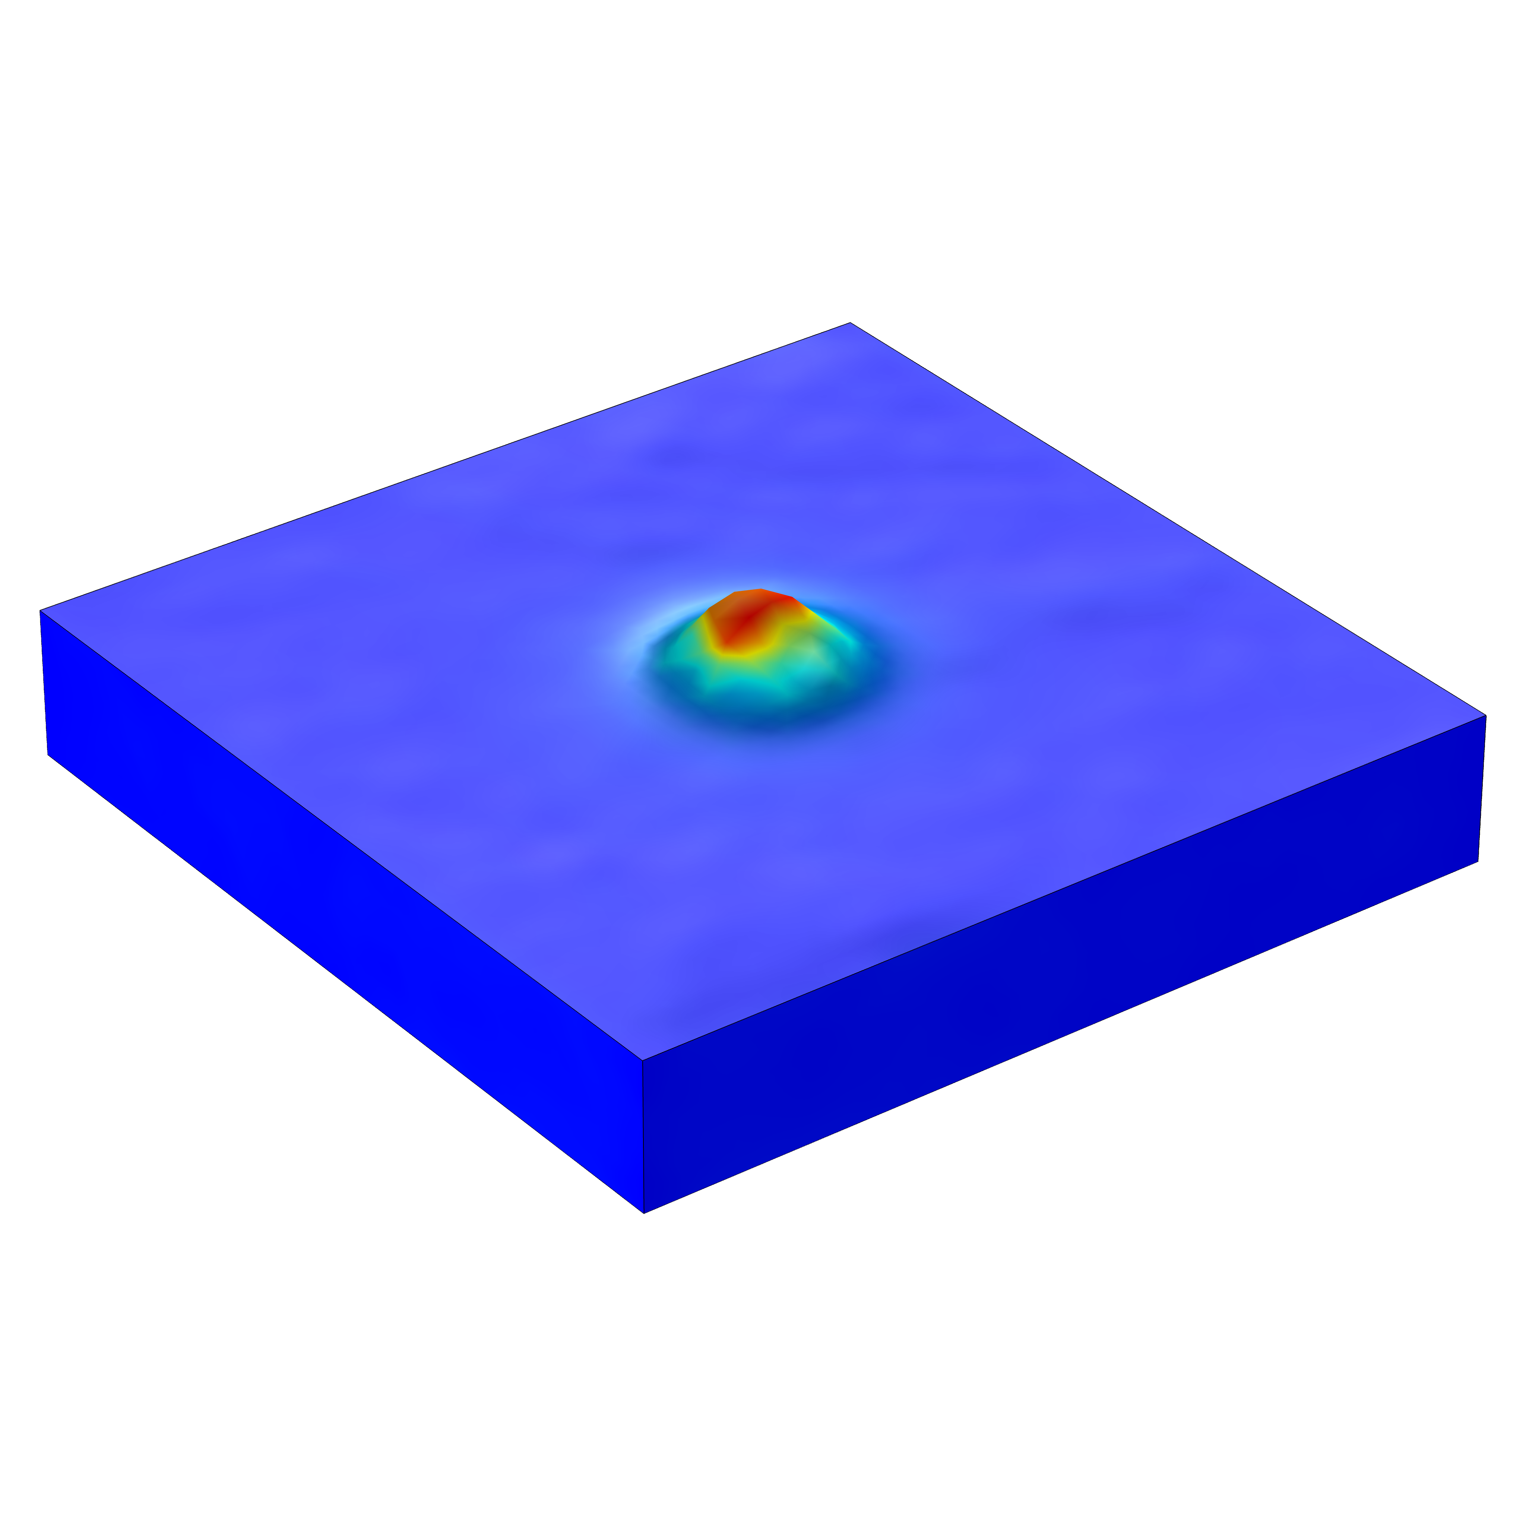
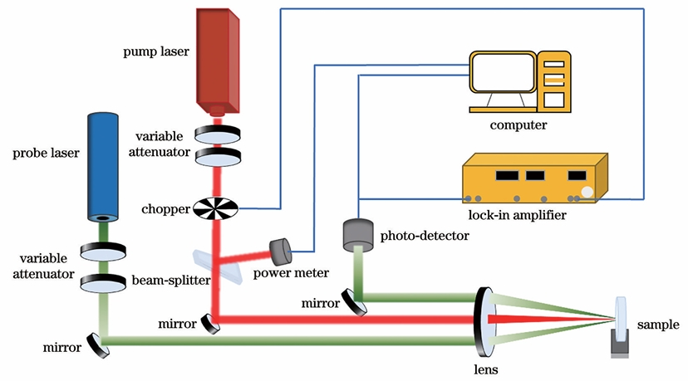
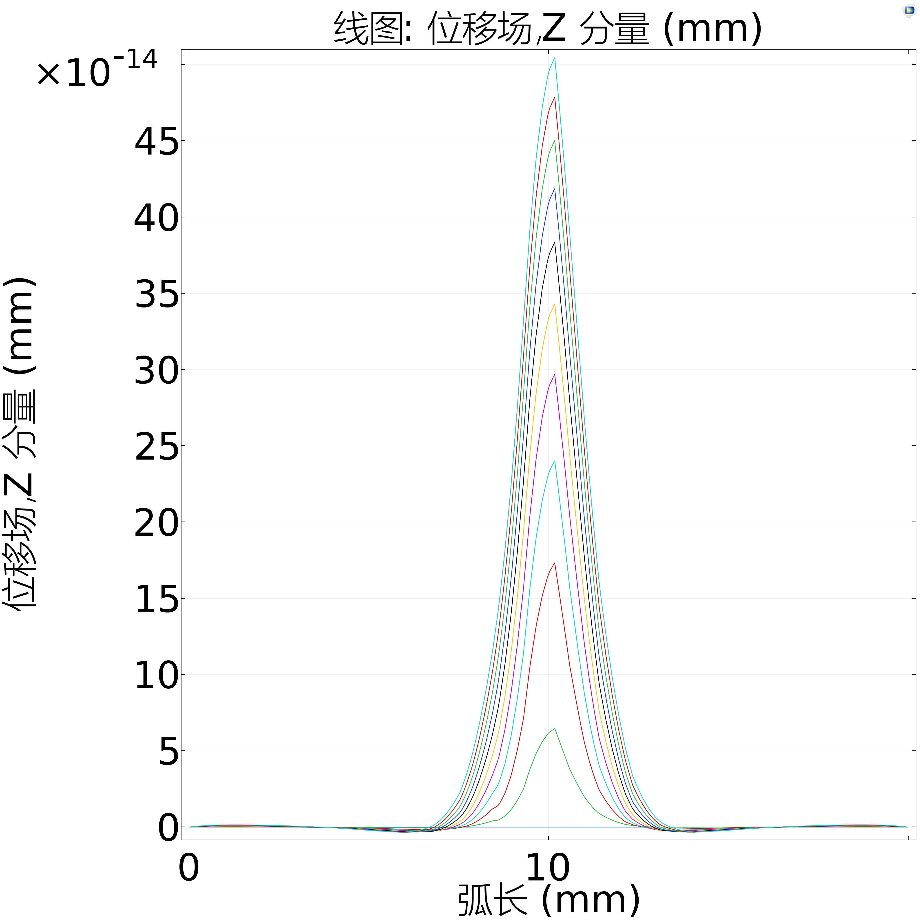
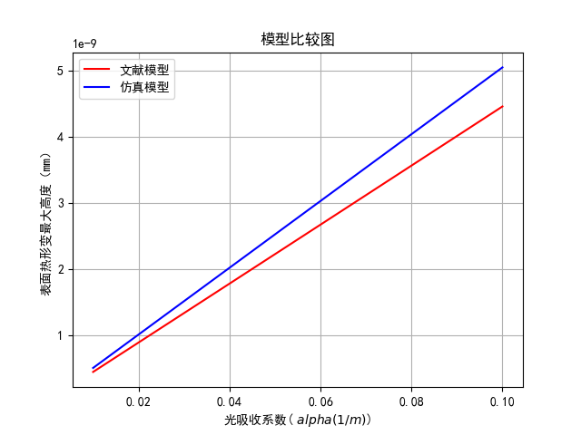

Thermal Deformation in Surface Thermal Lensing
Numerical simulation is used to optimize the measurement accuracy of the endothermic and deformation processes in surface thermal lensing (STL).
Cheng Chen¹, Yuejin Chen² 1. Shanghai Institute of Optics and Fine Mechanics, Chinese Academy of Sciences, Shanghai 201800, China 2. Shanghai Institute of Optics and Fine Mechanics, Chinese Academy of Sciences, Shanghai 201800, China
Abstract
Surface thermal lensing (STL) is a powerful tool for non-destructive characterization of high-performance optics by detecting the thermal effects of the absorption of the pumped beam by the sample. Therefore, it is important to understand the pumping mechanism in the STL.
Through the simulation of the heat absorption, temperature field and thermal deformation field of the material surface during the pumping process, we verify the linear relationship between the thermal deformation height and the light absorption coefficient, and preliminarily simulate the thermal deformation enhancement effect under the condition of defects. These results can help us improve our assay protocols.
Methodology
The sample is set as 10mm*10mm*3.3mm fused quartz, with the upper and lower surfaces set as adiabatic free boundaries, and the sides fixed. The pump beam is a Gaussian beam, which, after modulation, is vertically incident on the center of the sample along the z-axis and is slightly absorbed by the sample, forming a periodic temperature field centered at the origin, thus producing periodic thermal deformation on the sample surface.
When there are no defects within the sample, stress is mainly concentrated on the surface, and its degree of deformation has a Gaussian distribution similar to that of a beam; when small cavities exist within the sample, stress will concentrate near the cavities, and the thermal deformation will significantly increase.
FIGURE 1. Schematic diagram of surface thermal lens technology on single lens
Results
The maximum height of surface thermal deformation within a range below 200nm has a good linear relationship with the sample's absorption coefficient, indicating that STL is very suitable for use in absorption detection; without cavities, the spatial distribution of energy deposition and thermal deformation in the sample is very close to a Gaussian distribution, while with cavities, the thermal deformation is significantly increased, which provides a theoretical basis for using the STL method for defect detection.
FIGURE 2. Deformation graphs under different absorption coefficients; the left figure is a line graph of the cross-section at the deformation location, and the right figure is a graph showing the relationship between absorption coefficient and maximum deformation height
Olmstead M A, Amer N M, Kohn S, et al. Photothermal displacement spectroscopy: an optical probe for solids and surfaces[J]. Applied Physics A, 1983, 32(3): 141-154.
花艳, 李大伟, 韩玉晶, 刘晓凤, 赵元安. 基于表面热透镜的单透镜测量光学薄膜吸收技术研究[J]. 中国激光, 2025, 52(1): 0103101. Yan Hua, Dawei Li, Yujing Han, Xiaofeng Liu, Yuan an Zhao. Single-Lens Measurement Optical Thin Film Absorption Technology Based on Surface Thermal Lens[J]. Chinese Journal of Lasers, 2025, 52(1): 0103101.

