Slide 1
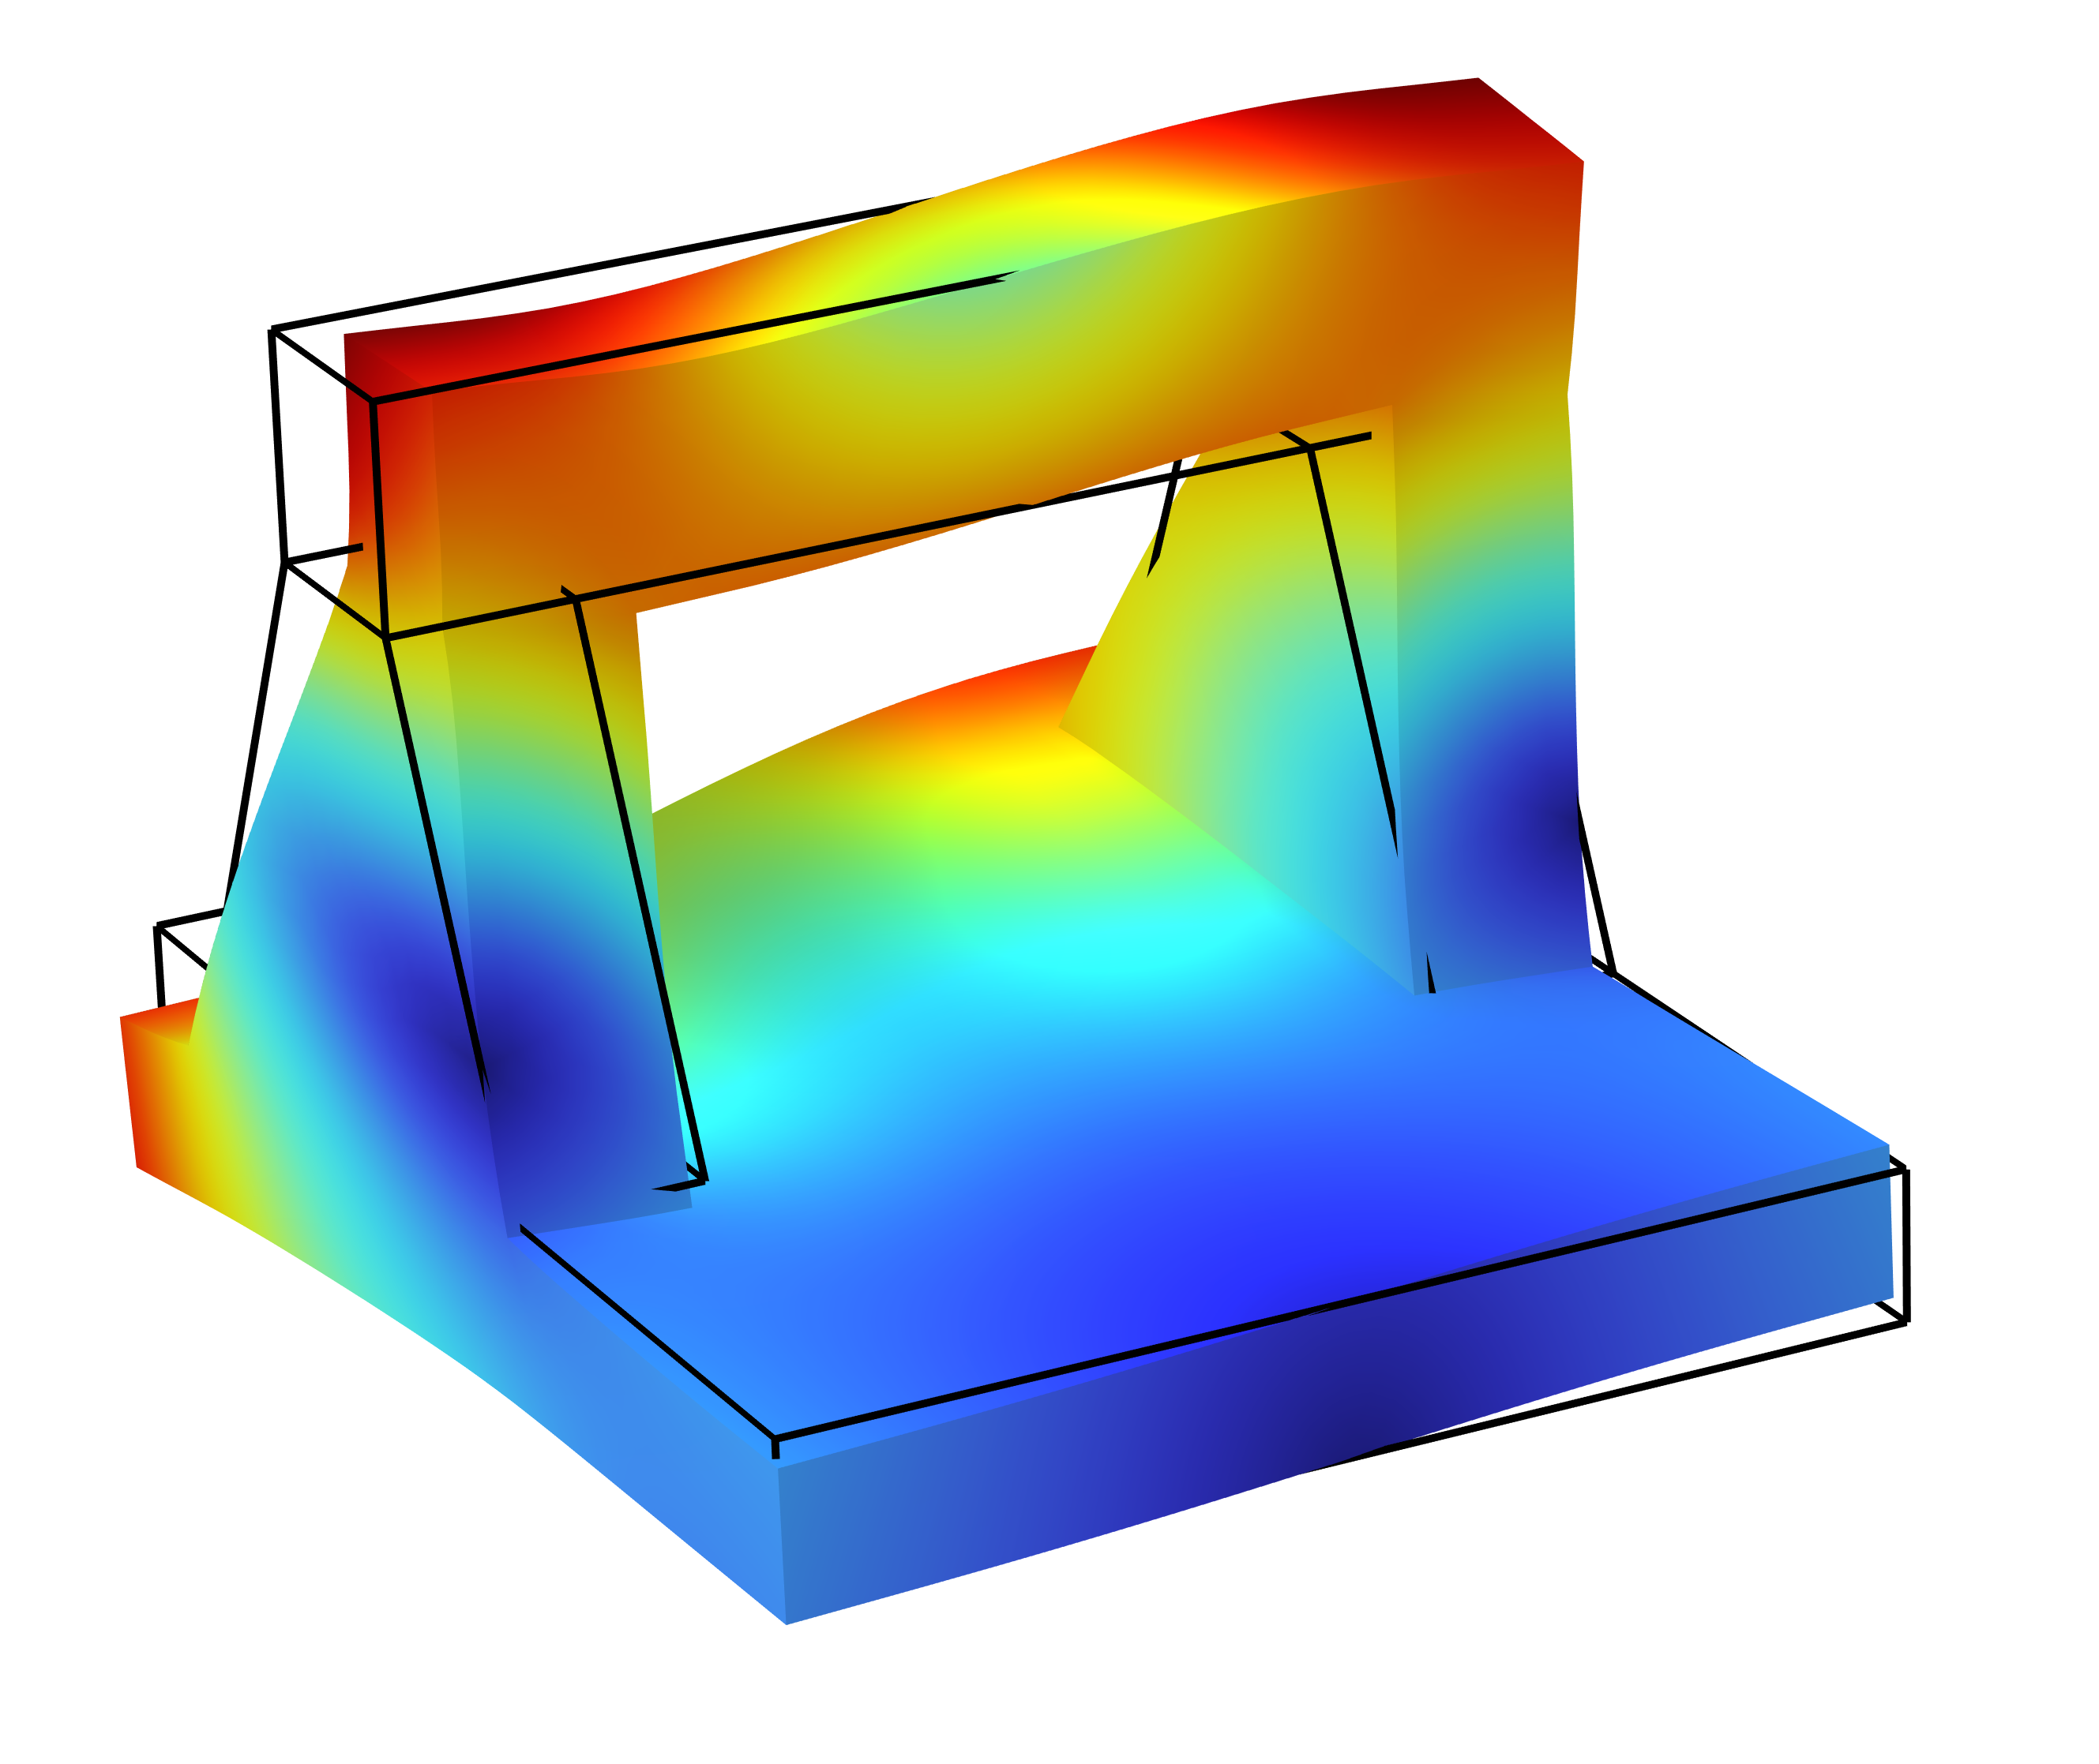
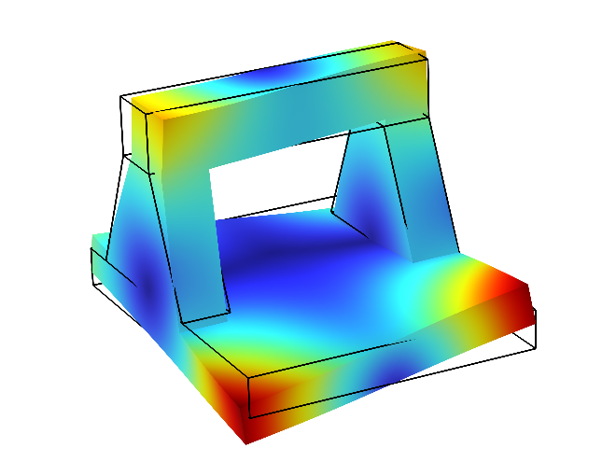
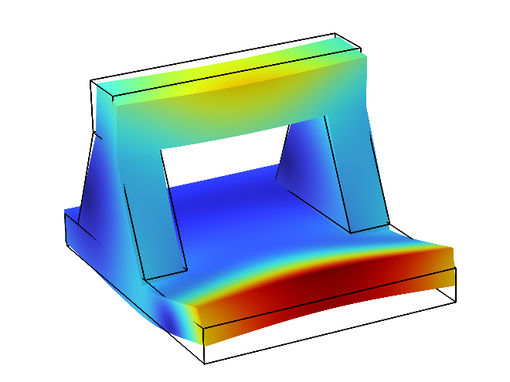
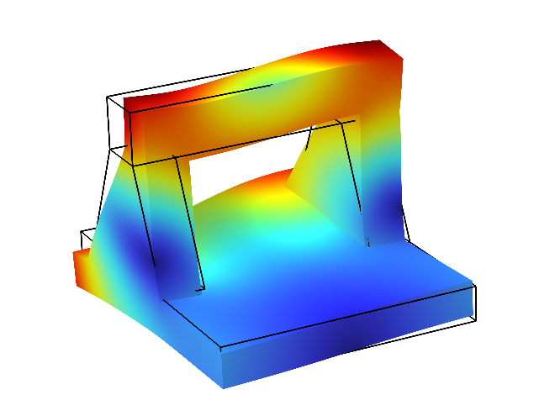
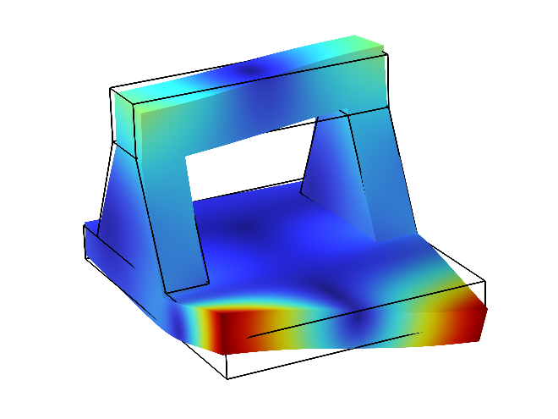
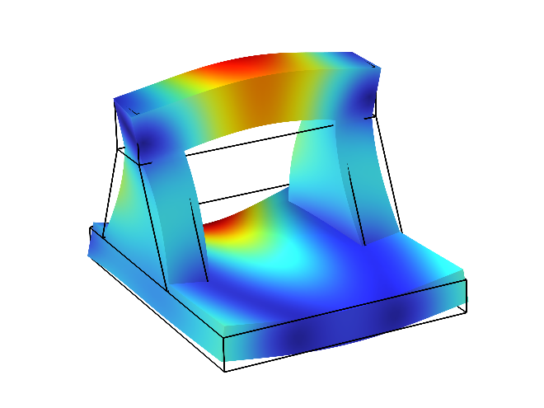
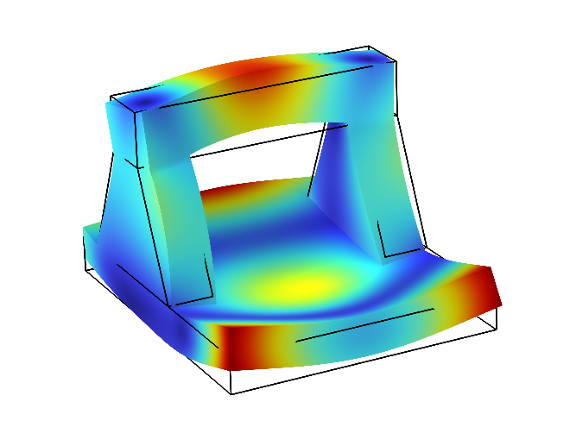
Stiffness Analysis and Modal Testing of a Large-Aperture Precision Optical Component Surface Inspection Platform
The natural vibration modes of the marble platform carrying a large-aperture vertical interferometer under free-state conditions were analyzed to evaluate its dynamic stiffness characteristics.
Quanliang Dong¹, Cheng Chen¹
1. Shanghai lnstitute of Optics and Fine Mechanics, Chinese Academy of Sciences, Shanghai, China.
Abstract
Large-aperture precision optical components are widely used in aerospace, micro-nano manufacturing, lithography, and many other fields. Their surface roughness and figure accuracy critically affect the performance of the overall optical system. When using a vertical interferometer for surface inspection, equipment stability is essential to ensure measurement accuracy and repeatability. This necessitates that the marble platform supporting the optical components possesses sufficient stiffness. This study employs finite element analysis based on COMSOL to establish a mechanical model of a meter-scale marble platform and computes its natural
frequencies under free-state conditions to evaluate dynamic stiffness characteristics. Furthermore, hammer-impact modal testing was conducted to validate the simulation results. The results show that the simulated first-order natural frequency is 237.5 Hz, while the experimentally measured value is 242.7 Hz, yielding a relative error of 2.18%. Moreover, the first six mode shapes show good agreement between simulation and experiment, confirming the reliability of the finite element model. This model can serve as a reference for subsequent structural optimization and dynamic performance studies.
Results
TABLE 1. Comparison of Simulated and Experimental First Six Natural Frequencies.
The simulation results are shown in Figure 1. Through modal analysis of the marble platform, the first six mode shapes and natural frequencies were obtained. It can be observed that the front section and the top beam of the marble platform are the areas most susceptible to deformation during resonance. Additionally, as shown in Table 1, the accuracy of the simulation was verified by experimentally testing the natural frequencies of the structure.
Order | 1 | 2 | 3 | 4 | 5 | 6
Simulation | 237.5 | 266.4 | 310.5 | 425.6 | 455.7 | 515.8
Experiment | 242.7 | 246.9 | 332.7 | 450.1 | 496.5 | 521.4
Error | 2.18% | 7.32% | 7.15% | 5.76% | 8.95% | 1.07%
(a) First-order mode
(b) Second-order mode
(c) Third-order mode
(d) Fourth-order mode
(e) Fifth-order mode
(f) Sixth-order mode
FIGURE 1. Simulation results of the first 6 free modes of the marble platform.
REFERENCES
1. SUZANA E et.al. Review of finite element model updating methods for structural applications [J]. Structures, 41, 684-723, 2022.
2. X.X.C, Z.Y.S. Modal experiment and model updating for Yingzhou Bridge [J]. Structures, 32, 746-759, 2021.
3. Y. Zhao, et.al. Effects of different boundary conditions on free mode test, 2023 3rd International Conference on Electrical Engineering and Mechatronics Technology (ICEEMT), 810-813, 2023.

