Slide 1
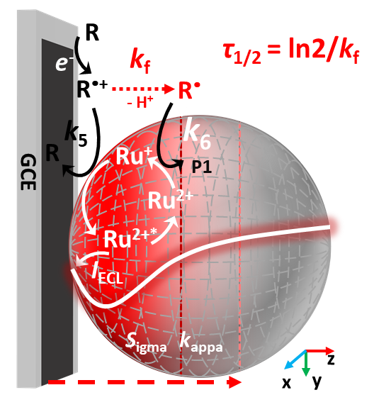
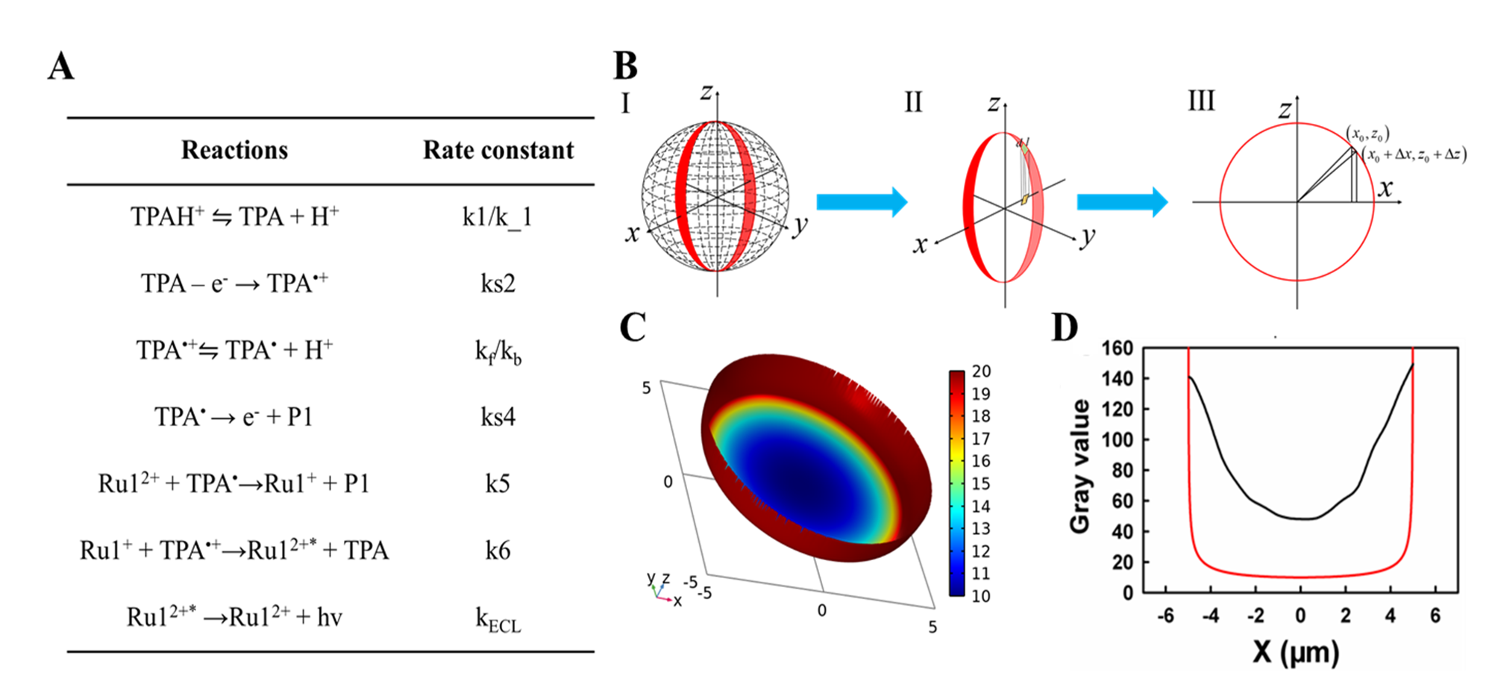
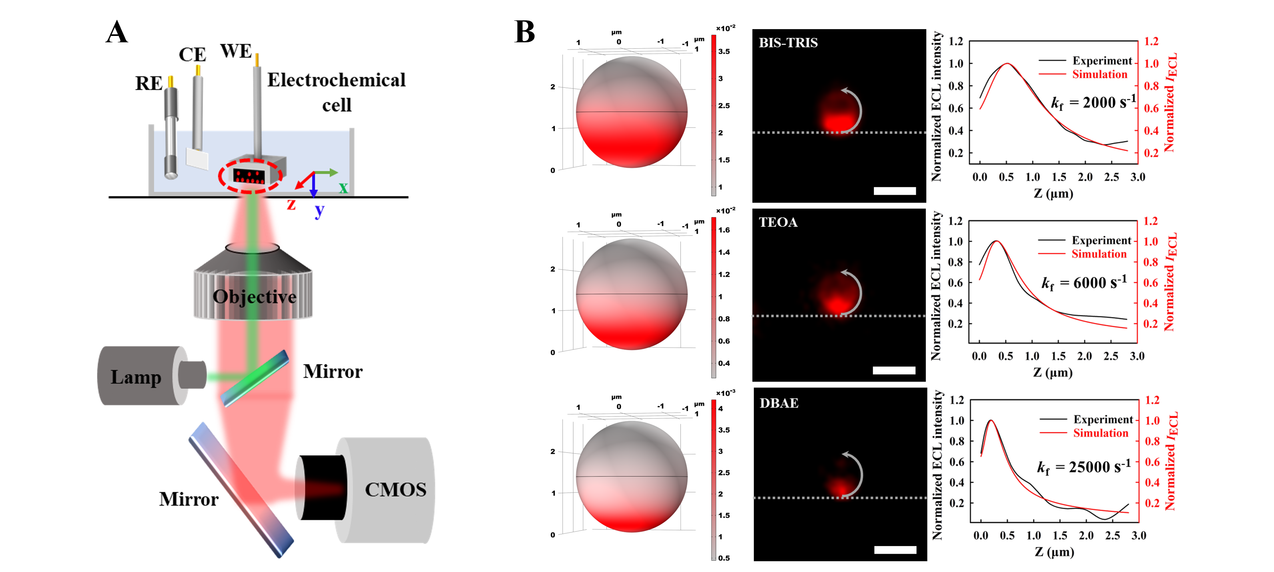

Simulation Mechanism within Co-reactant Electrogenerated Chemiluminescence System
A sidelong ECL microscopy and finite element simulation are developed for tomography imaging from single magnetic microbeads.
Chengkai Wang, Honglan Qi*
Key Laboratory of Analytical Chemistry for Life Science of Shaanxi Province, School of Chemistry and Chemical Engineering, Shaanxi Normal University
Abstract
Electrogenerated chemiluminescence (ECL) bioassay has witnessed remarkable growth in biosensing and diagnostics. An understanding of the reaction mechanism within ECL is important for improving and designing sensitive ECL methods. Herein, a sidelong ECL microscopy and finite element simulation are developed for tomography imaging from single magnetic microbeads and deciphering reaction mechanism within bead-based co-reactant ECL system. ECL emissions from Ru1-Mag@MB in different conditions are imaged via the sidelong ECL microscopy, which can allow the spatially resolved measurement of the ECL emitting layer from single microbeads in the vertical direction of the electrode surface. The sidelong ECL microscopy with the tomography of the ECL emitting layer can provide a promising way for insightful mechanistic information within a bead-based ECL system.
Methodology
The ECL mechanism of Ru1-TPA is shown in FIGURE 1. A Ru1-PS@MB is modeled in 3D. Axial mirror symmetry are utilized to reduce the computational effort.
The content distribution of Ru1 on the three-dimensional spherical surface can be expressed as:
FIGURE 1. (A) Reactions involving ECL process of Ru1-TPA in this work. (B) A simplified model for quantifying the variation of Ru1 content in the radial direction of projection Ru1-PS@MB. (C) Projected distribution plot of Ru1 content on 10 µm Ru1-PS@MB by fitting a three-dimensional surface. (D) Profiles for experimental gray value (black) and theoretical Ru1 content (red) vs the distance in diameter of 10 µm Ru1-PS@MB.
Results
In sidelong ECL imaging, ECL emissions are mainly observed at or near the interface between the GCE surface and the Ru1-Mag@MB. Different co-reactants, including BIS-TRIS, TEOA and DBAE, were chosen in this work while 2.8 µm Ru1-Mag@MB was used as luminescence microbead. For all co-reactants, the “first increase and then decrease” profile was clearly observed. According to the experimental plots of the ECL intensity across single 2.8 µm Ru1-Mag@MB, the lifetime of BIS-TRIS^{•+}, TEOA^{•+} and DBAE^{•+} was estimated to be 347, 116 and28 µs, respectively.
A complete tomography ECL imaging method, which can allow the spatially resolved measurement of the ECL emitting layer from single microbeads, was obtained.
REFERENCES
FIGURE 2. (A) Schematic diagram of sidelong ECL imaging. (B) Representative pseudo-color experimental ECL images of single 2.8 µm Ru1-Mag@MB modified on S-GCE in 0.1 M PBS (pH 6.9) containing 180 mM BIS-TRIS, 180 mM TEOA and 180 mM DBAE under the sidelong imaging. Normalized representative plots of the experimental (black line) and simulated (red line) ECL intensity (IECL) across single 2.8 μm Ru1-Mag@MB. Scale bar: 3 μm.
1. Yanlong Feng, Wenshuai Zhou, Xiaofei Wang, Jian Zhang, Min Zou, Chengxiao Zhang and Honglan Qi. Imaging and simulation of ruthenium derivative coating microbeads at the opaque electrode with electrogenerated chemiluminescence, Chemical & Biomedical Imaging, 2023, 1, 648-658.
2. Yanlong Feng, Chengkai Wang, Wenshuai Zhou, Xiaolin Yang, Francesco Paolucci, Giovanni Valenti and Honglan Qi. Tomography electrogenerated chemiluminescence imaging from magnetic microbeads, small, 2025, 2500804.

