Slide 1
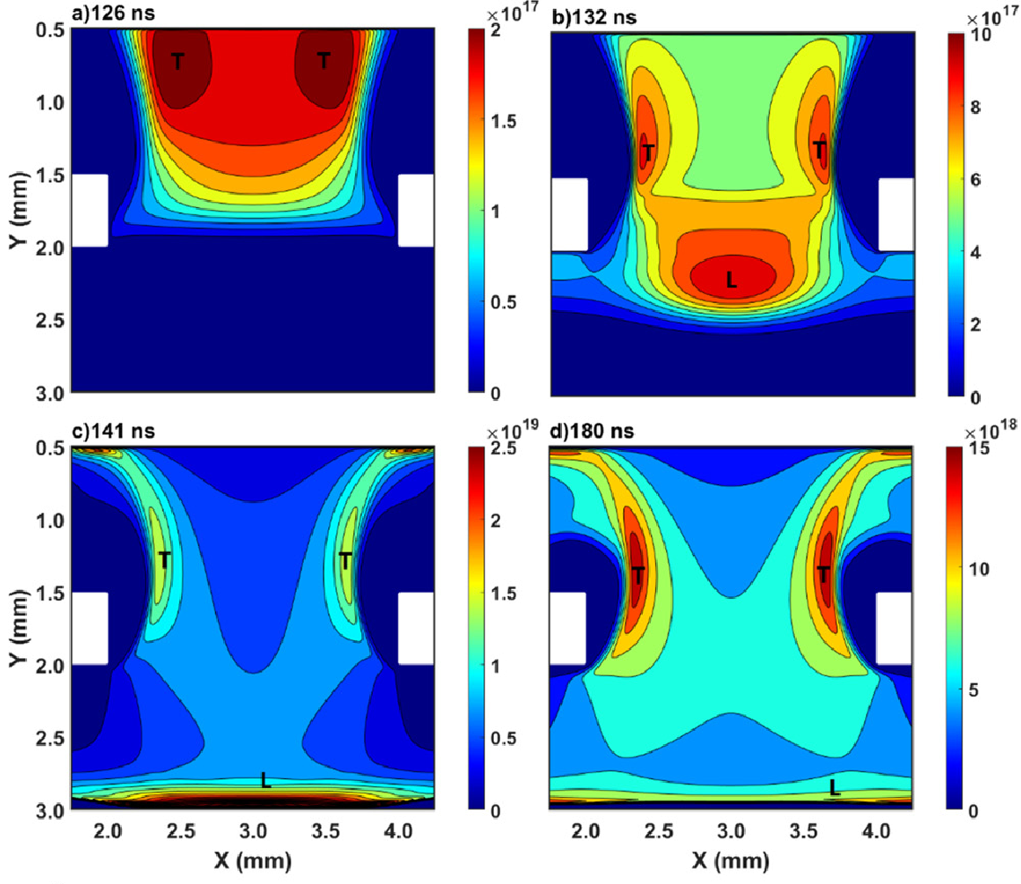
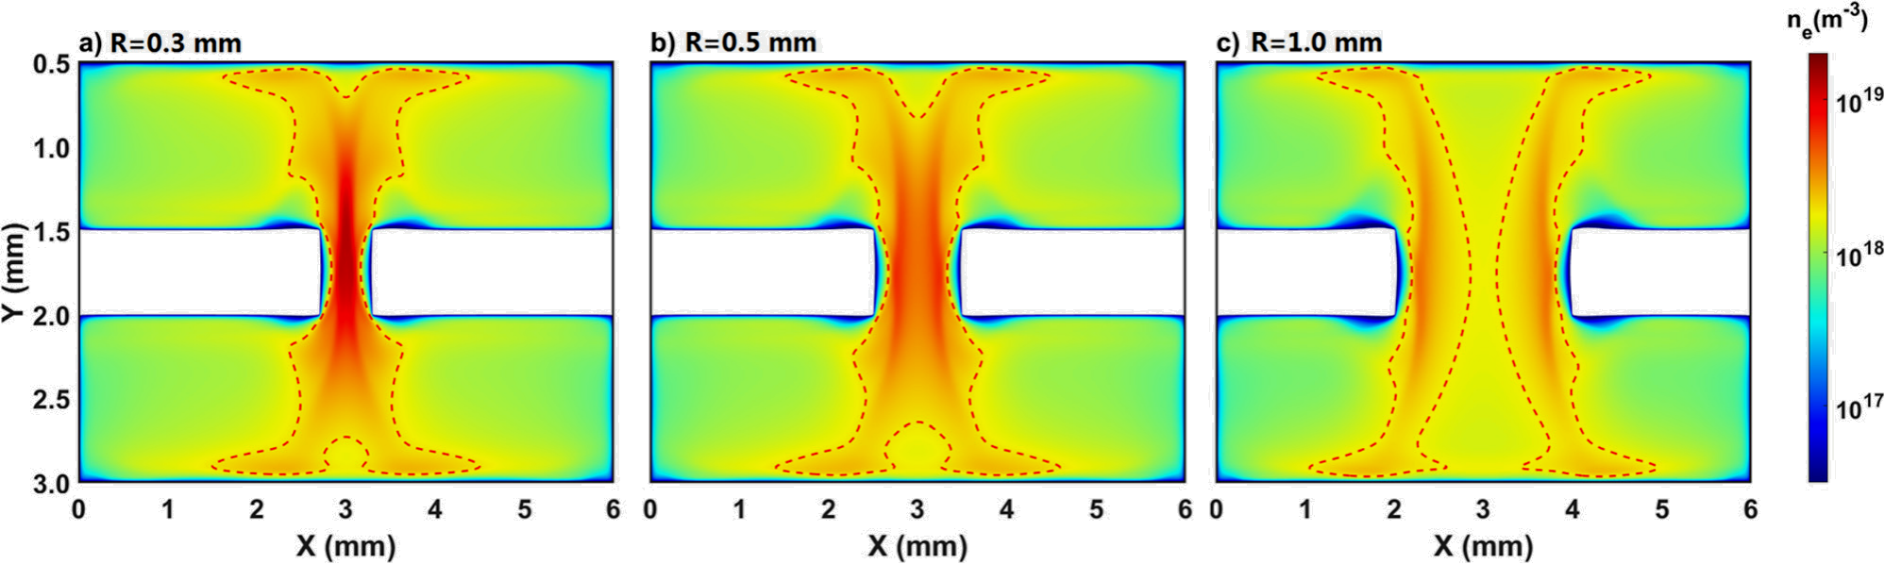
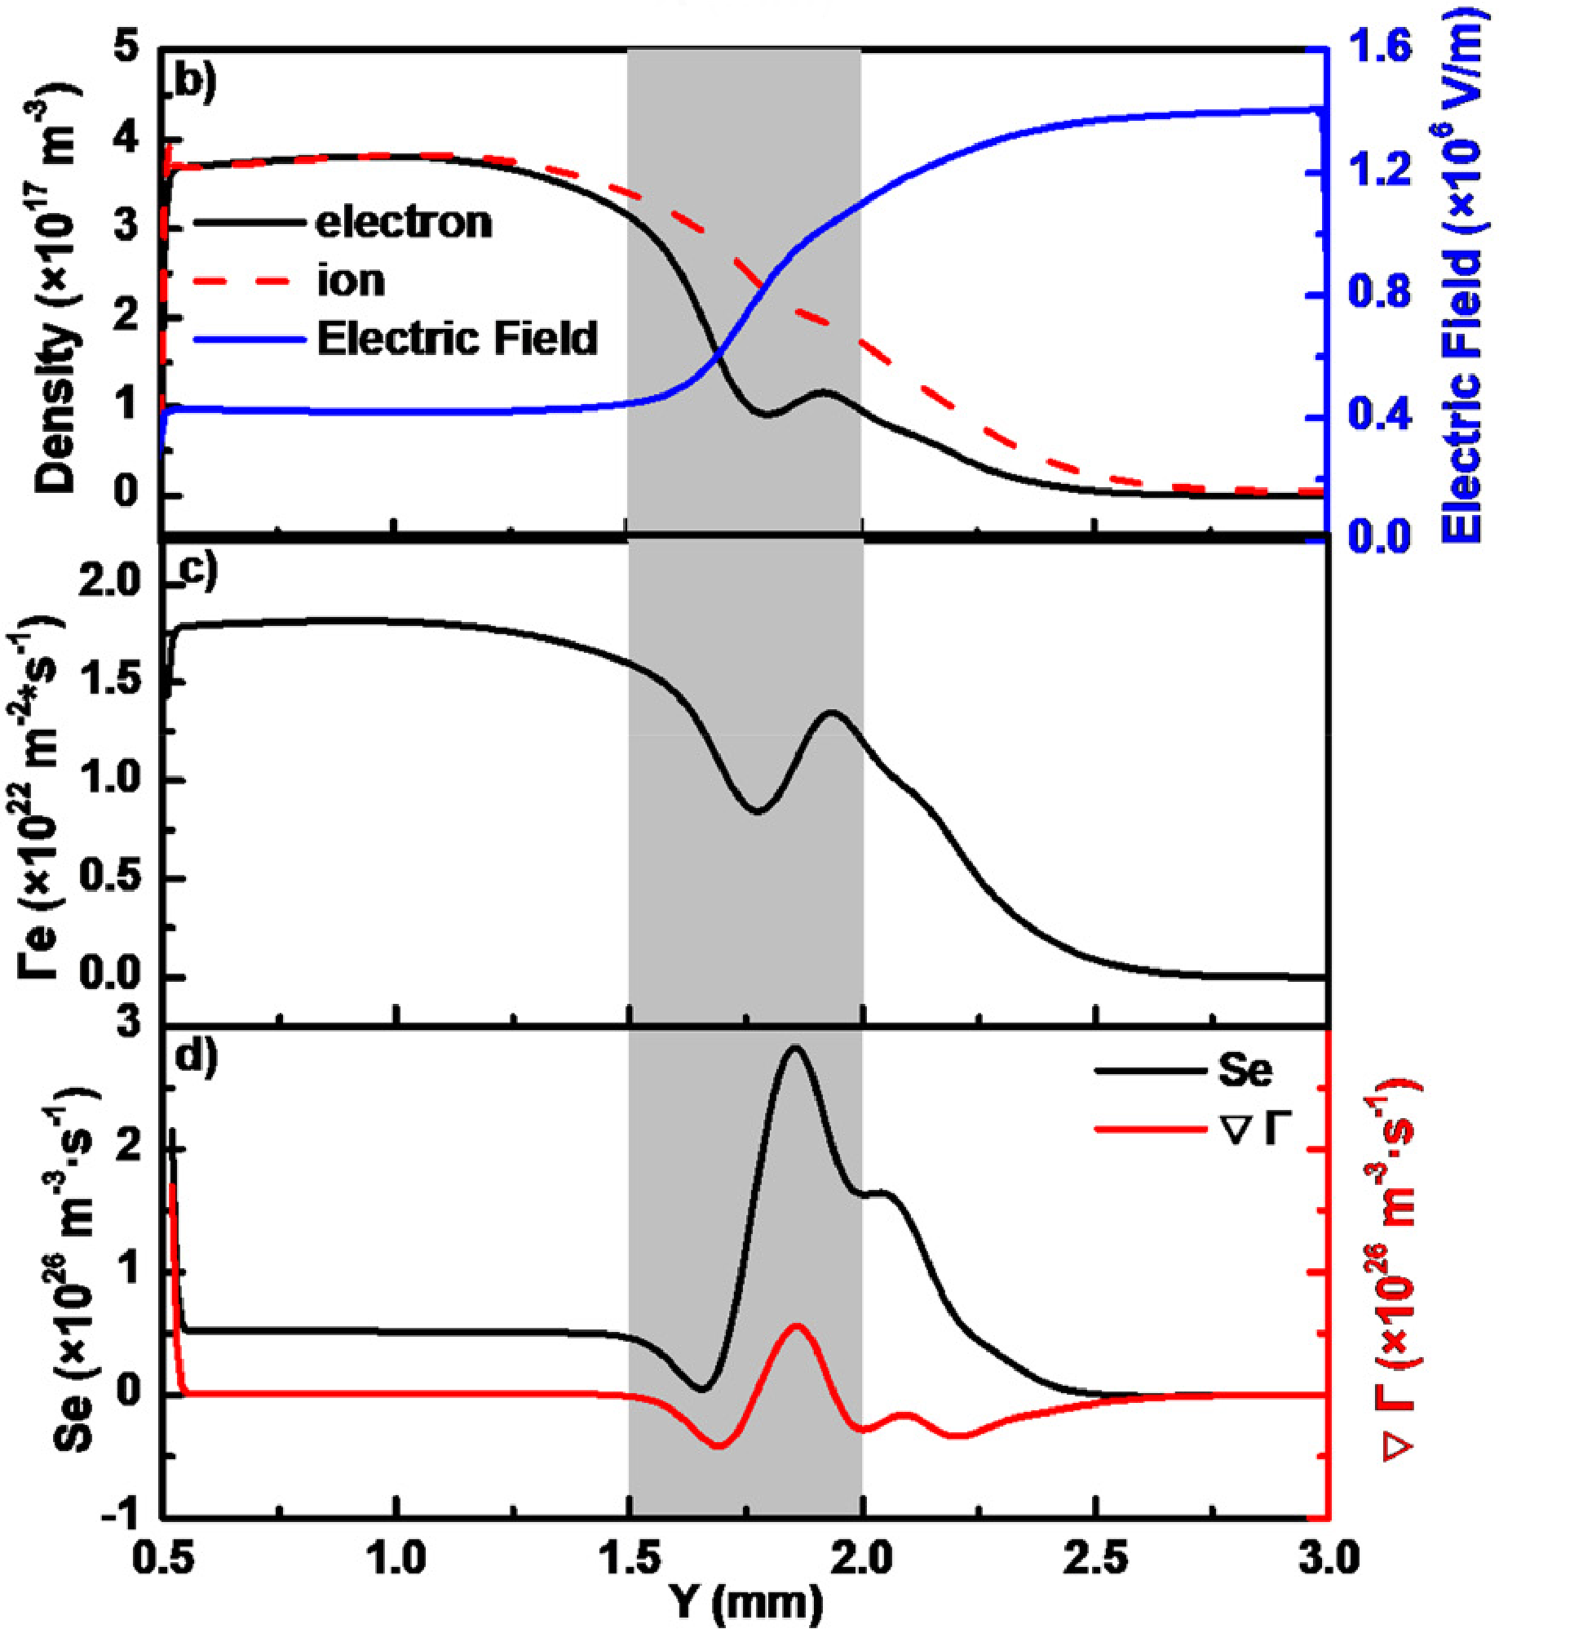
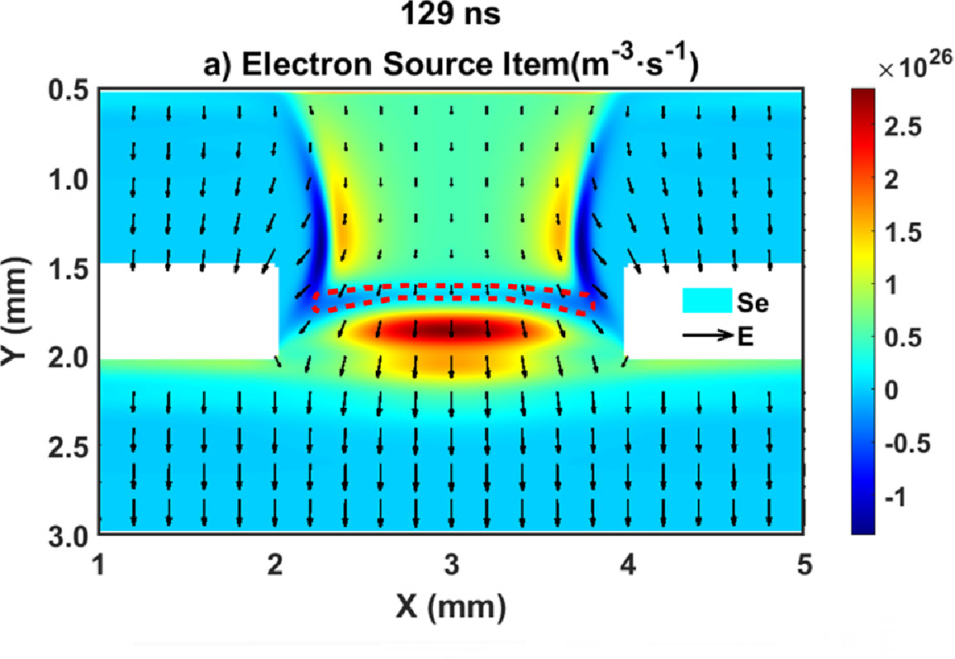

Penetration of ionization wave through dielectric microhole in atmospheric pulsed discharges
A two-dimensional fluid model is used to study the penetration of ionization waves through dielectric microholes in atmospheric pulsed discharges.
Zhiduan Liu¹, Lili Gu², Junlin Fang³, Shaofeng Xu⁴, Ying Guo*, Jianjun Shi*
1. College of Physics, Donghua University, Shanghai, People’s Republic of China.
2. Yiwu Research Institute of Fudan University, Yiwu, People’s Republic of China.
3. Institute of Optoelectronics, Fudan University, Shanghai, People’s Republic of China.
Abstract
Microstructure-enhanced discharges are critical for achieving higher plasma electron density and energy, offering significant potential in advanced plasma applications. A two-dimensional fluid model of pulsed dielectric barrier discharge was developed in atmospheric helium with a dielectric microhole. Two distinct high-electron-density regions, the T-region and L-region, were identified, driven, respectively, by transverse and longitudinal electric fields as the ionization wave traversed the microhole. The axisymmetric T-region is approached and squeezed as the radius decreases, in which the discharge intensity and electron density are enhanced. Based on the electron reaction source item, a virtual electrode is proposed in the dielectric microhole, which segregates the T- and L-regions. The width of the virtual electrode decreases with the microhole radius, and the virtual electrode extinguishes with the discharge ignition in the lower chamber and the formation of ionization wave in the dielectric microhole. These findings offer insights into plasma behavior in microstructures for advanced applications.
Methodology
A two-dimensional fluid model of pulsed dielectric barrier discharge was developed in atmospheric helium with a dielectric microhole.
This study, under a pulse voltage of 8 kV, determined the dependence of discharge characteristics and mechanisms in the gas gap on the size of the dielectric micro-pores.
The model outputs are analyzed across two spatial regions:Transverse (T) region and Longitudinal (L) region.
FIG.1.Time-averaged electron density(on a log₁₀ scale,unit:m⁻³)with dielectric microhole radius of (a)0.3mm,(b)0.5mm,and(c)1.0mm.
Results
The microhole radius modulates discharge characteristics via transverse/longitudinal electric fields, affecting current density and electron dynamics.
The T-region generated by the transverse electric field,the L-region generated by the longitudinal electric field.the high electron density range of region T is also compressed with reducing radius,eventually the two T-regions are compressed into one.
The increase in electron density amplitude is due to the enhanced discharge in the T-region, which is influenced by the microhole radius.
The electron dissipation in dielectric microhole proposes a virtual electrode in the discharge, as shown in Fig. 2(a), where the red dashed line indicates the location of the virtual electrode.
FIG. 2. Density amplitude curves with the radius of (a) 0.5 mm and (b) 0.3 mm; spatial distribution of electron density at (c) 135 ns and (d) 138 ns;
T. N. Kurtukova, D. S. Kopylova, et al. Plasma treated carbon nanotubes for fast infrared bolometers. Appl. Phys. Lett.122(9), 093501 (2023)
T. Goto, M. Iida,et al. Thermally conductive tough flexible elastomers as composite of slide-ring materials and surface modified boron nitride particles viaplasma in solution. Appl. Phys. Lett. 112(10), 101901 (2018).

