Slide 1
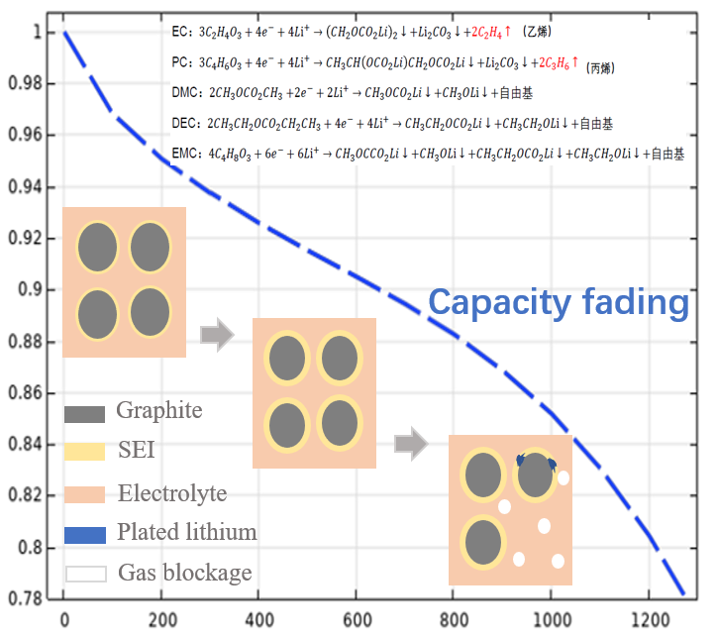
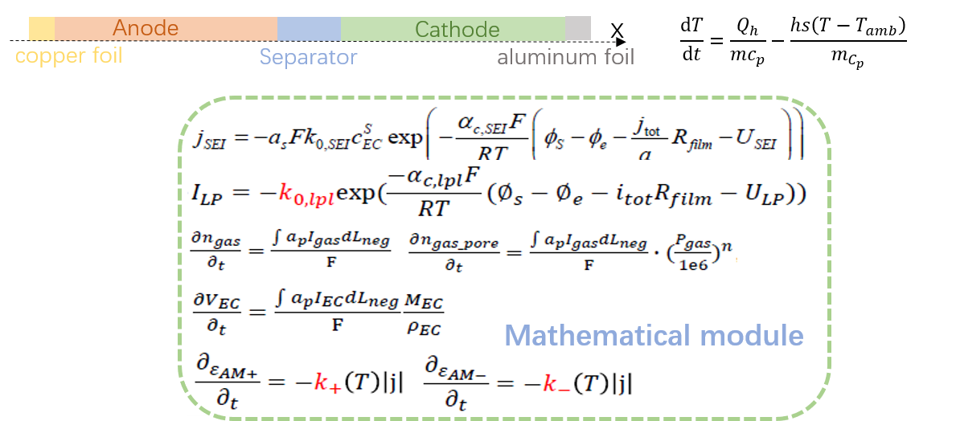
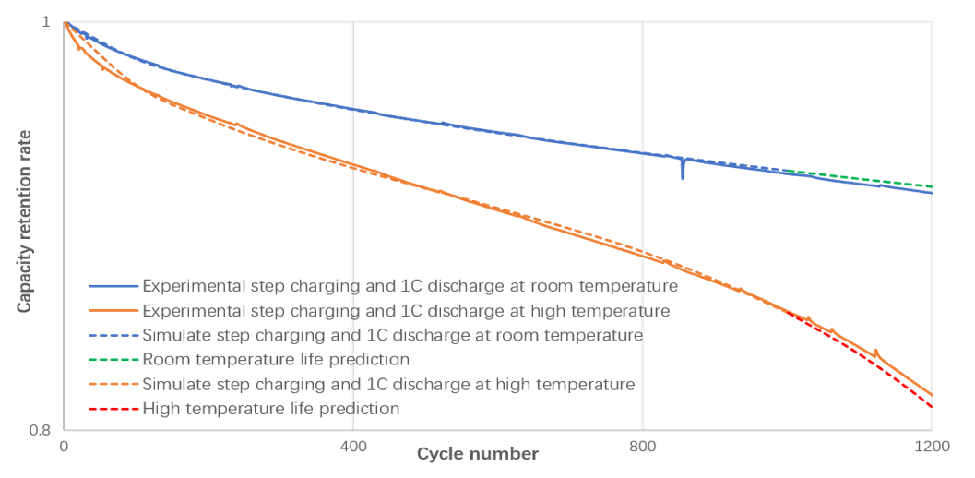

Modeling of Aging Mechanism of Lithium ion Batteries
Through the coupling P2D model and 0D thermal model, the capacity degradation mechanism of lithium-ion batteries during aging was explored to make reasonable predictions of battery life and lay the foundation for mechanism quality assurance simulation.
L. Lin¹ ,L.F.Cai¹
1 Zhejiang Jiyao Tongxing Energy Technology Co., Ltd., Zhejiang, China
Abstract
The capacity degradation mechanism of lithium-ion batteries considering five aging factors is investigated by coupling the 0D thermal model with the P2D model. It is found that after multiple cycles of step charging and 1C rate discharge, the capacity of the battery is first linearly degraded by SEI film formation and growth, and then rapidly decreased at some point due to electrolyte consumption and gas production. This model extends the consideration of aging influencing factors, which is closer to the actual aging process of battery cells and can scientifically predict battery life.
Methodology
Construct P2D model and 0D thermal model based on the cell design table, considering five influencing mechanisms in the aging process of the cell, namely SEI film formation and growth, lithium evolution, gas production, electrolyte consumption, and active material peeling. Add aging side reactions on the negative electrode side of the battery cell and add differential equations related to the aging impact mechanism in the mathematical module. The heat generated during the charging and discharging process of the battery cell serves as a heat source, and the temperature calculated by the thermal model is transmitted to the P2D model to achieve simulation of battery cell aging at different temperatures.
FIGURE 1. Aging model and mechanism equation
Results
FIGURE 2 shows the measured and simulated capacity fading curves at room temperature and high temperature. Perform step charging and 1C discharging of the battery, identify aging parameters based on the experimentally measured cycle data, and use the identified parameters to predict the battery cell life at room temperature and high temperature. Compared with existing measured data, it was found that the aging model can identify the “Knee point" of the curve at high temperatures, and the prediction error within low cycle numbers is relatively small.
FIGURE 2. Fitting of simulation and measured data and prediction of normal and high temperature life
Jin X , Vora A , Hoshing V ,et al. Physically-based reduced-order capacity loss model for graphite anodes in Li-ion battery cells[J].Journal of Power Sources, 2017, 342(FEB.28):750-761.DOI:10.1016/j.jpowsour.2016.12.099.
ASA , AMS , BAM ,et al. Theory of battery ageing in a lithium-ion battery: Capacity fade, nonlinear ageing and lifetime prediction - ScienceDirect[J].Journal of Power Sources, 478[2025-08-28].DOI:10.1016/j.jpowsour.2020.229026.

