Slide 1
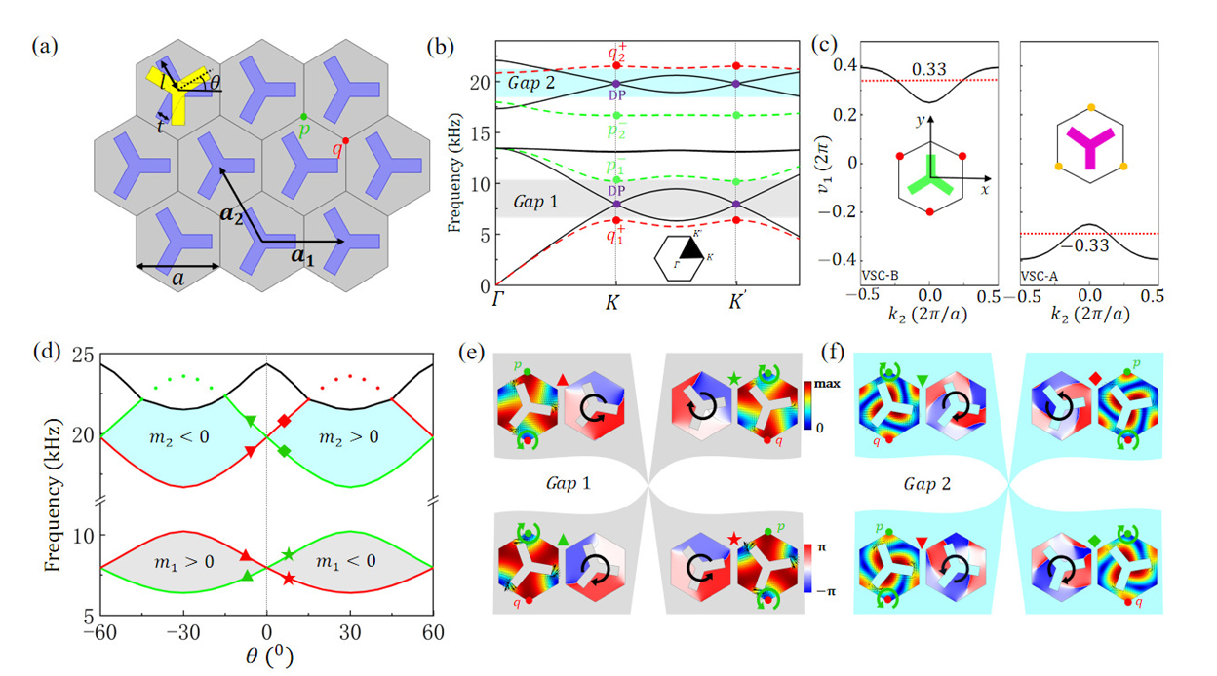
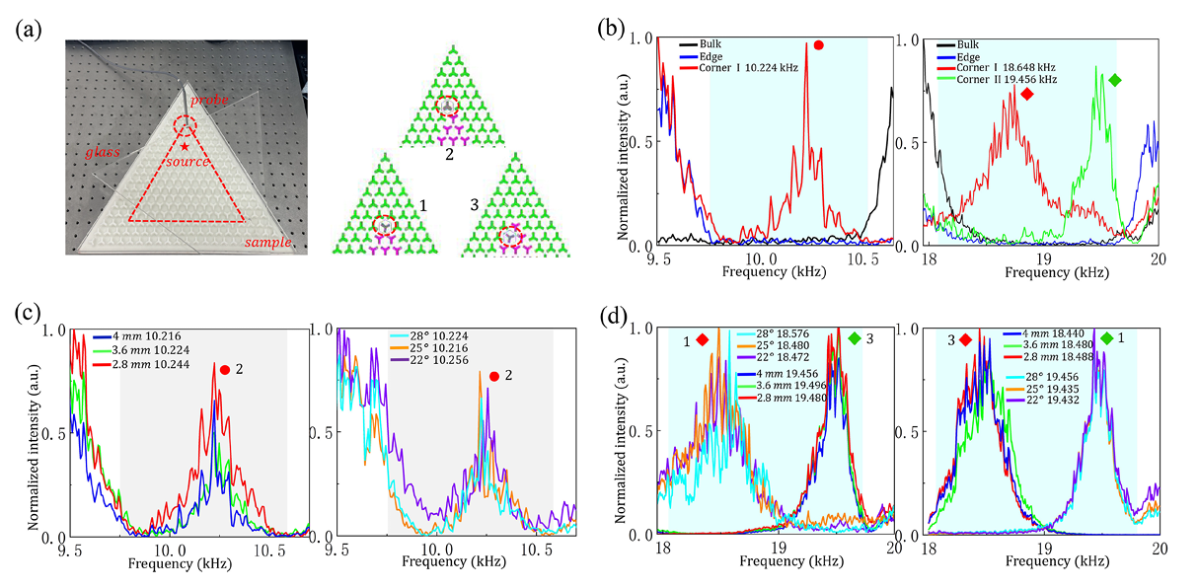
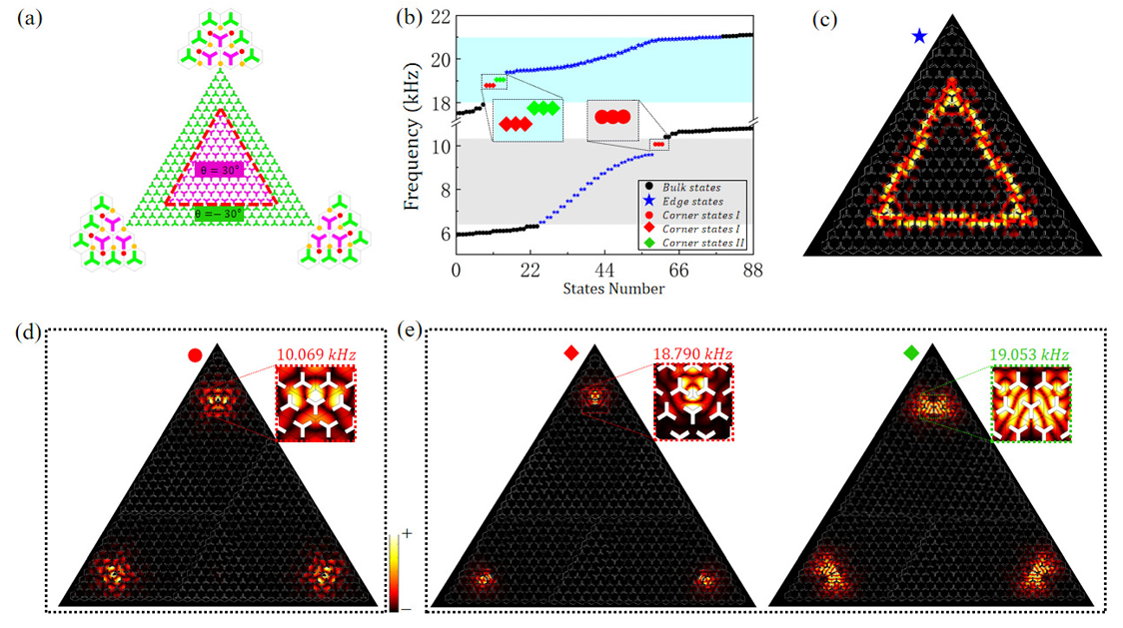
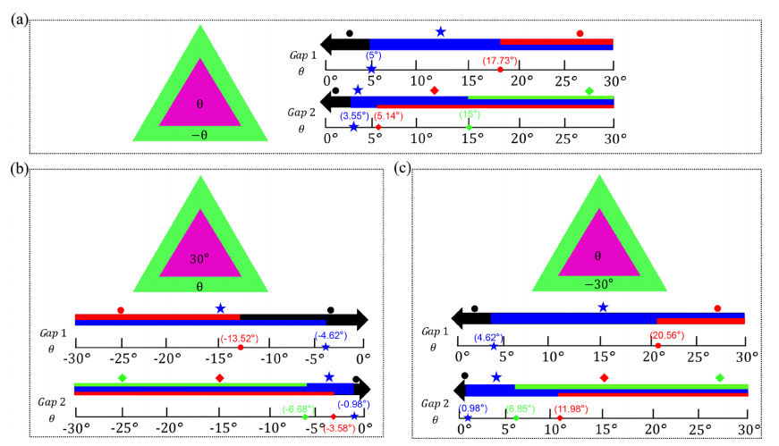
Higher-order topological states in dual-band valley sonic crystals
Jin Li,¹ ChengXin Deng,¹ Kun Zhang,¹ Qiao Lu,² Yan Peng, and Hai Yang^{1,a)}
¹Key Laboratory of Artificial Microstructures in Yunnan Higher Education Institutions, School of Physics Science and Technology, Kunming University, 650214 Kunming, China
²Physics Department, Zhaotong University, 657000 Zhaotong, Yunnan, China
^{a)}Author to whom correspondence should be addressed: kmyangh@263.net
Abstract:
As a quantum state of frequency extrema in the momentum space of acoustic systems, sonic valley pseudospin provides a new degree of freedom for controlling acoustic waves. Higher-order topological insulators (HOTIs) have extended the traditional bulk-edge correspondence principle and are a crucial concept for classic wave regulation. However, HOTIs in valley sonic crystals (VSCs) only appear in a single bandgap, which limits the multi-frequency selectivity of the corner state and is not conducive to the design of multi-frequency acoustic communication devices. Here, we demonstrate “Y-shaped” acoustic crystals with C3 symmetry that form a double-band VSC, and the topological phase transitions in both low- and high-frequency band gaps coincide. We realize theoretically and experimentally higher-order states in dual-band valley sonic crystals. Our work enriches the application of HOTIs in acoustic multi-frequency regulatory systems and provides different avenues for designing of multi-band acoustic devices.
Results :
1. Structure of "Y-shaped" C3 symmetric valley sonic crystal and dual-band gap topological characteristics analysis
Structure of "Y-shaped" C3 Symmetric Valley Sonic Crystal and Dual-Band Gap Topological Characteristics Analysis
3. Dual-band valley sonic crystal sample, measured distributions of sonic pressure and the Effect of two types of defects on corner states
FIG. 1. (a) Schematic diagram of a valley sonic crystal, which is made of photosensitive resin (gray area) immersed in an air matrix (blue area). (b) Dispersion relations of θ = 0°(black solid curves) and θ = 30°(colored dotted curves). (c) On the left (right) side: the Berry phase of ν₁ of VSC-B (VSC-A) as a function of k₂. (d) Phase transition diagrams with θ at the point K. (e) and (f) Eigenstates and phase distributions in band gaps 1 and 2, respectively, which correspond to eight symbols in (d), the green and black arrows indicate the direction of energy flow and phase direction, respectively.
FIG. 3. (a) Sample photograph of a valley phonon crystal that is made of photosensitive resin and air. The sample consists of the VSC-B and the VSC-A, in which the VSC-B surrounds the VSC-A. The red pentagram star is the position of the sonic source, and the red dashed circle is the position of the angle. (b) Measured distributions of sonic pressure of bulk, edge states, and corner states in the band gaps 1 (left side) and 2 (right side). (c) and (d) Effect of two types of defects on corner states in band gaps 1 and 2,respectively.
2.Spectrum of triangular supercell and sound pressure distribution of higher-order topological States
4. Evolution of corner states (I/II) in dual-band gaps under different rotational angles
FIG. 2. (a) Schematic diagram of the supercell, consisting of VSC-B (green) surrounding VSC-A (magenta), and the interfaces formed by the VSC-A and VSC-B (red dotted line). The left, top, and right illustrations show the Wannier centers (red and orange circles) corresponding to VSC-B and VSC-A, respectively. (b) Calculated spectrum of the large triangular supercell in (a). Bulk and edge states are marked by the black dots and blue stars, respectively. In the spectrum, the triple degenerate corner states in bandgap 1 are indicated by red dots, and those in bandgap 2 are marked by red diamonds and green diamonds. (c) Edge state. (d) Corner states I in bandgap 1. (e) Corner states I and
II in bandgap 2, respectively.
FIG. 4.(a) Evolution of corner states I and II in band gaps 1 and 2 in the case of the inner rotational angle equal to the outer rotational angle. Bulk state (black), edge state (blue), corner state I (red) in bandgap 1, and corner states I (red) and II (green) in bandgap 2 are marked with the black dot, blue star, red dot, red diamond, and green diamond, respectively. (b) Evolution of corner states I and II in band gaps 1 and 2 in the case of the inner rotational angle equal to 30°. (c) Evolution of corner states I and II in band gaps 1 and 2 in the case of the outer rotational angle equal to -30°.
Conclusion :
We theoretically and experimentally realize higher order states in dual-band valley sonic crystals, verify the robustness of the corner states in the band gaps I and II, and give the evolution of the corner states I and II in band gaps 1 and 2 as the rotational angle changing. We believe that our work provides a versatile platform for the efficient collection of different energies of sonic waves, supplies different avenues for the design of multi-band acoustic devices, and extends the potential applications of topological materials.
References :
1. M. Li et. al.Higher-order topological states in photonic kagome crystals with long-range interactions. Photonics 14, 89 (2019).
2. X. D. Chen et. al. Direct observation of corner states in second-order topological photonic crystal slabs, Phys. Rev. Lett. 122, 233092 (2019).
3. D. Jia et.al.Topological refraction in dual-band valley sonic crystals,Phys. Rev. B 103, 144309 (2021).
Excerpt from the Proceedings of the COMSOL Conference 2025 Shanghai

