Slide 1
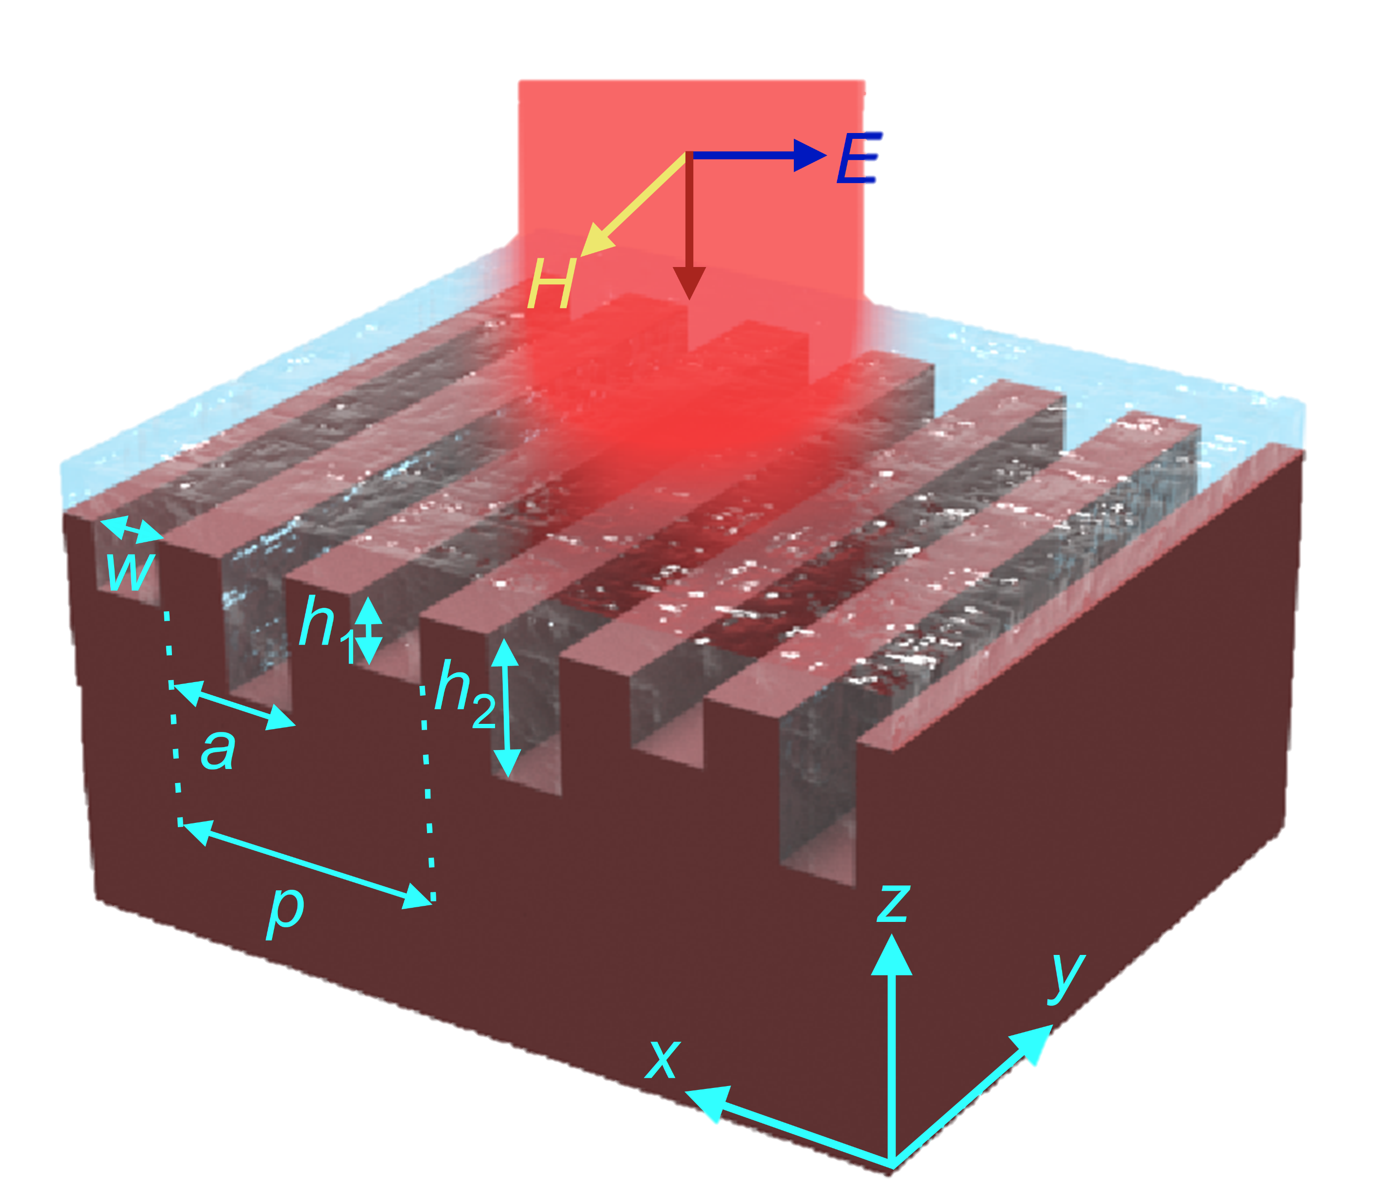
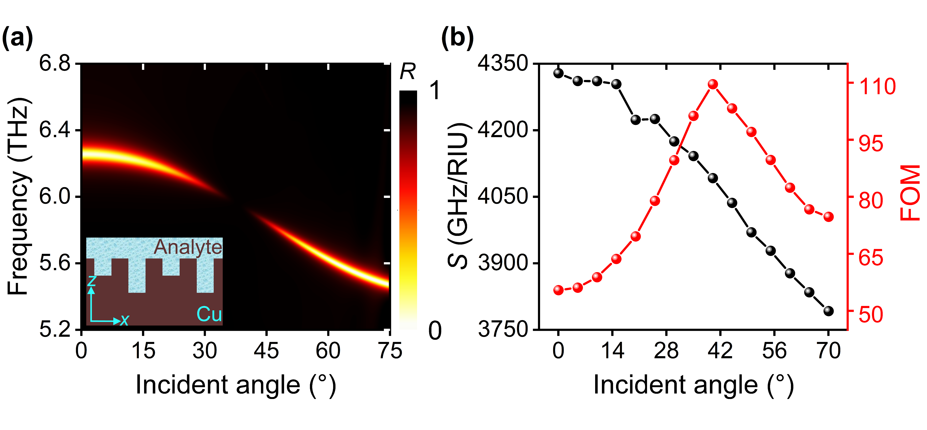
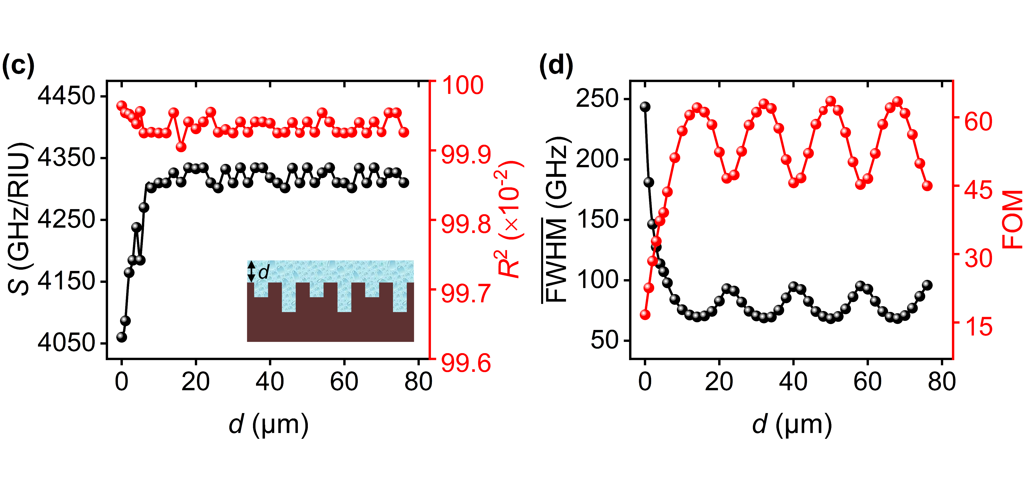

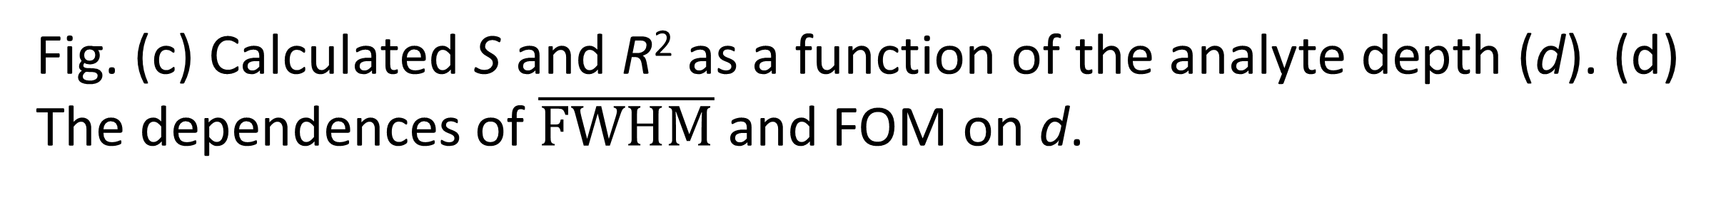
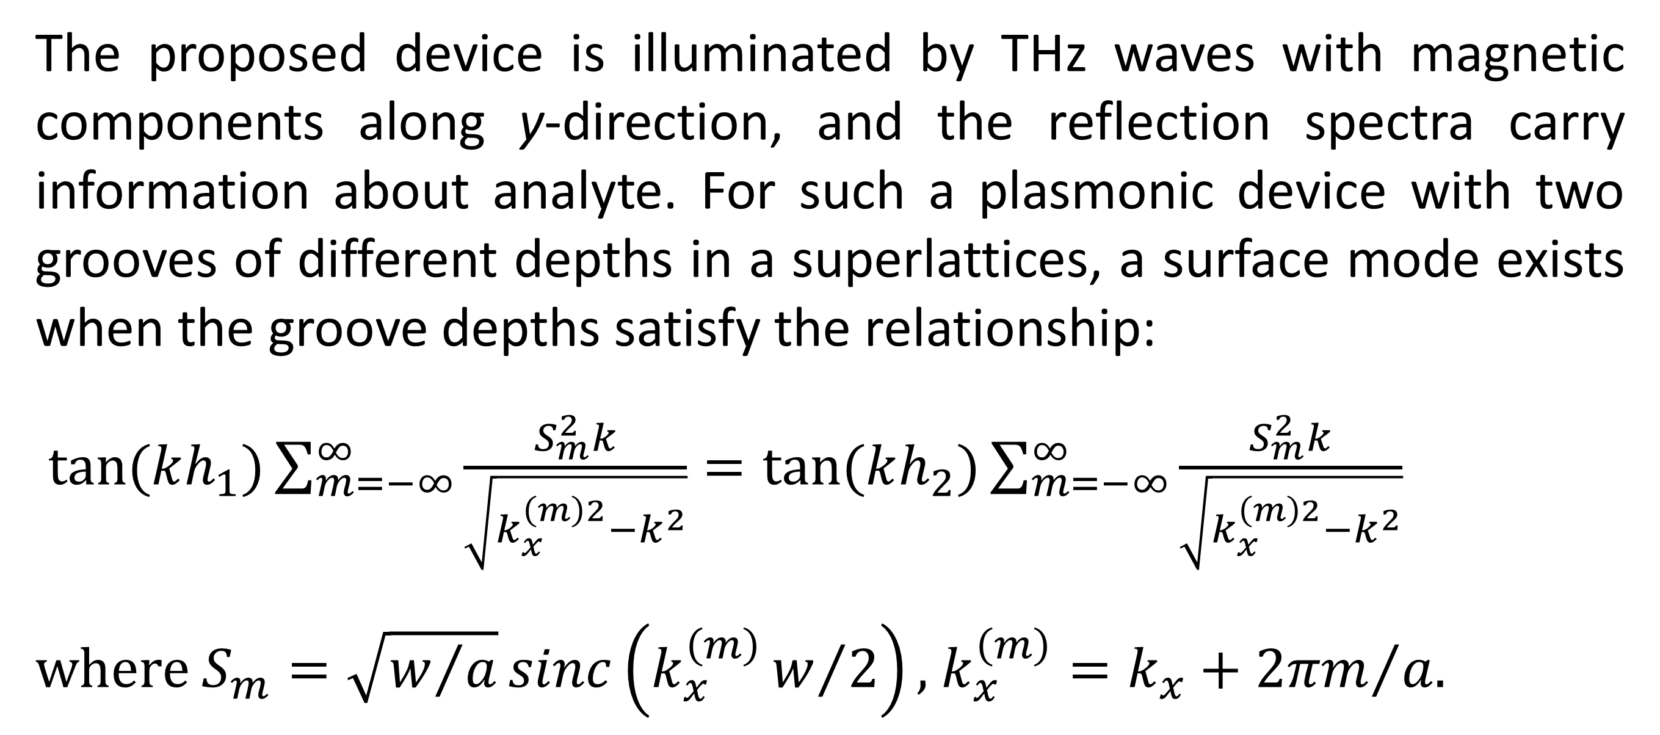
High-Performance and Incident Angle-Tunable Terahertz Sensing Assisted by BIC
We present a design of BIC-based THz sensors featuring ultrahigh and tunable S and FOM. The device consists of 1-D metagrating with compound lattices that support accidental BICs.
Y. Wang¹, J. Hao¹, W. Shao¹, Q. Zhou¹* and Y. Xu²* 1. School of Physical Science and Technology, Guangxi Normal University, Guilin, China. 2. School of Physical Science and Technology, Soochow University, Suzhou, China.
Abstract
Terahertz (THz) sensing has been attracting interest due to its capabilities for biological fingerprint and medical identification. However, achieving angle-tunable ultrahigh figure-of-merit (FOM) of THz sensing remains challenging due to the difficulty in realizing tunable resonances with ultrahigh quality factors. Here, we design a series of THz sensors based on subwavelength metallic metagratings with compound lattices, enabling tunable ultrahigh FOM utilizing the physics of accidental bound states in the continuum (BICs). Under transverse-magnetic polarized electromagnetic wave illumination, the excited field of quasi-BIC is strongly localized within the grooves, leading to ultrahigh sensitivity (S) and FOM.
Methodology
The proposed device is illuminated by THz waves with magnetic components along y-direction, and the reflection spectra carry information about analyte. For such a plasmonic device with two grooves of different depths in a superlattices, a surface mode exists when the groove depths satisfy the relationship:
$tan⁡(kh_{1})\sum_{m=−∞}^{∞}{\frac{S_{m}^{2}k}{\sqrt{k_{x}^{\left(m\right)2}−k^{2}}}=tan⁡(kh_{2})}\sum_{m=−∞}^{∞}{\frac{S_{m}^{2}k}{\sqrt{k_{x}^{\left(m\right)2}−k^{2}}}}$
where $S_{m}=\sqrt{w/a}sinc\left(k_{x}^{\left(m\right)}w/2\right),$ $k_{x}^{\left(m\right)}=k_{x}+{2πm}/a$.
Fig. (a) When n = 1.33, the reflection (R) spectra as a function of the incident angle. (b) The calculated S and FOM versus incident angles.
Results
Strong field localization of quasi-BICs within the subwavelength grooves renders resonance frequencies highly sensitive to the refractive index of analyte, enabling high-performance S and FOM. The FOM can be enhanced by tuning the incident angle towards the BIC angle while maintaining ultrahigh S.
The location of the accidental BIC can be tuned by adjusting the groove depths, and BIC angle dependent S and FOM are revealed. Our work provides a new idea for achieving ultrahigh S and tunable FOM sensors, opening avenues for sensing in complex scenarios.
Fig. (c) Calculated S and R² as a function of the analyte depth (d). (d) The dependences of $\overline{FWHM}$ and FOM on d.
REFERENCES
[1]. Y. Xu et al., “Optical refractive index sensors with plasmonic and photonic structures: Promising and inconvenient truth,” Adv. Opt. Mater., vol. 7, no. 9, May 2019, Art. no. 1801433. [2]. Q. Zhou et al., “Optical bound states in the continuum in metallic gratings with compound lattices,” Opt. Exp., vol. 32, no. 25, pp. 44238–44249, Dec. 2024.

