Slide 1


广西师范大学
High-performance And Dual-modal GHz Sensing For Toxic Gases With Spoof Localized Surface Plasmons
GUANGXI NORMAL UNIVERSITY
Presented by: Jia Hao
Supervised by: Weijia Shao and Qingjia Zhou
Date: 2025.11.07

Slide 2



CONTENTS
目录
01
背景介绍
02
研究方法
03
仿真结果
04
总结

Slide 3
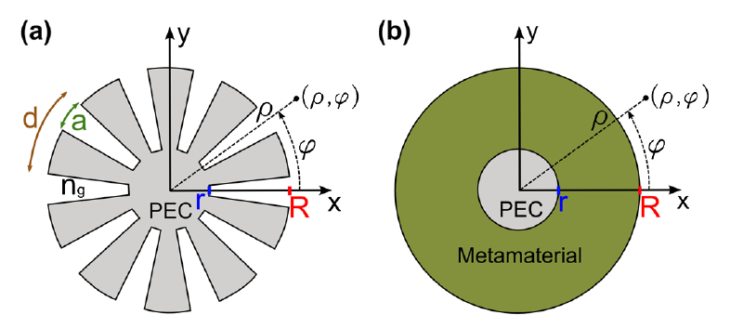
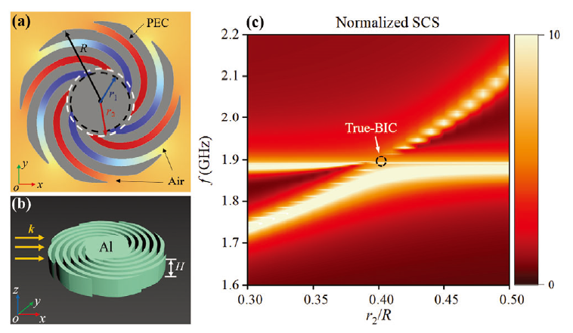
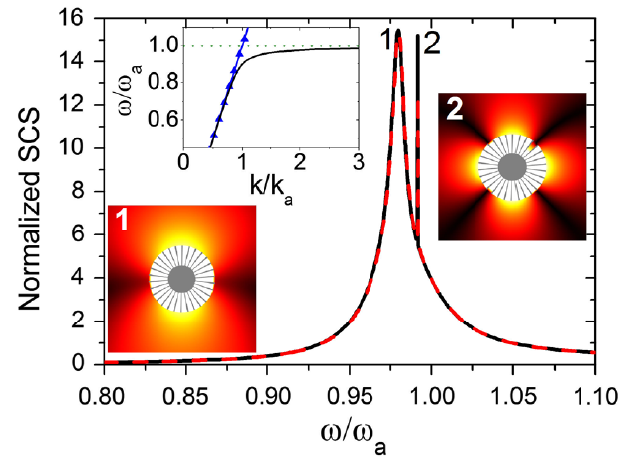
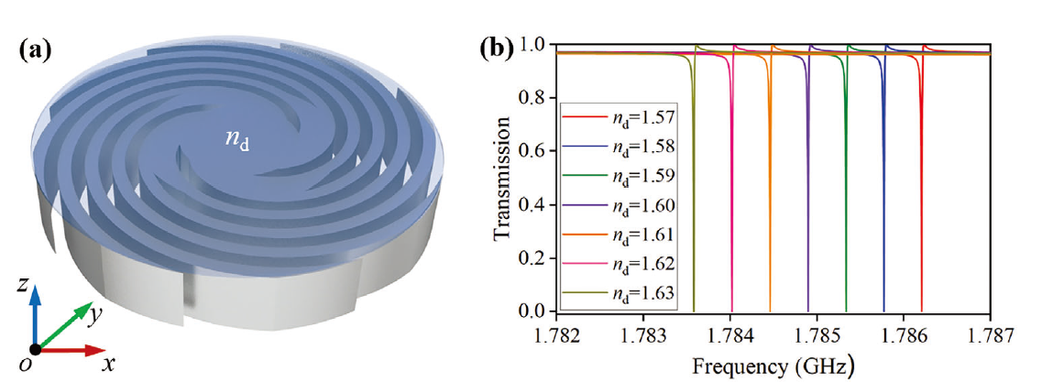
01
背景介绍
[1] A. Pors, et al. Physical Review Letters 108(22), 223905 (2012)
[2] R. Zhao, et al. Advanced Optical Materials 12(36), 2401906 (2024)

Slide 4
CONTENTS
目录
01
背景介绍
02
研究方法
03
仿真结果
04
总结

Slide 5
02
研究方法
器件设计
仿真建模
测试性能
仿真软件与解析算法的结果进行对比验证数据准确性
计算数据
完成绘图与论文撰写

Slide 6
CONTENTS
目录
01
背景介绍
02
研究方法
03
仿真结果
04
总结

Slide 7
03
仿真结果
Figure 1. (a) Two-dimensional schematic diagram of a single textured cylinder supporting spoof localized surface plasmon (SLSP) resonances. (b) In the absence of toxic gases within hollow space, the frequency-dependent normalized scattering cross section (SCS) as a function of r₁. (c) Enlarged view of the dashed rectangle in (b). When r₁ = 9.5 mm and toxic gases are absent (n = 1), magnetic field (|H|) distributions at (d) 3.532 GHz, (e) 7.953 GHz, (f) 9.327 GHz, (g) 10.069 GHz, (h) 10.552 GHz, and (i) 10.860 GHz, corresponding to the 0th-, 1st-, 2nd-, 3rd-, 4th-, and 5th-order SLSP resonances, respectively.

Slide 8
03
仿真结果
Figure 2. (a) Three-dimensional schematic of the designed GHz sensor formed by periodic arrangement of the textured cylinders. The period is p. The yellow and blue arrows indicate the directions of magnetic and electric field components of incident plane wave. (b) Reflection spectrum of the device when p = 21 mm and n = 1. (c)-(h) Magnetic field distributions at the resonance dips in (b). Resonance orders (m) and their resonance frequencies are indicated.

Slide 9
03
仿真结果
Figure 3. (a) Reflection spectra of the designed device associated with the 5th-order SLSP resonance for different n when r₁ is fixed at 9.5 mm. (b) Dependences of resonance frequency on n for the 1st-, 2nd-, 3rd-, 4th-, and 5th-order SLSPs. The lengths of vertical line segments represent the magnitudes of FWHMs with different scales in five panels. (c) S and FOM as a function of |m|.

Slide 10
03
仿真结果
Figure 4. The |m|-dependent (a) S and (b) FOM as a function of r₁. For the 1st-, 2nd-, 3rd-, 4th-, and 5th-order SLSP resonances, (c) S and (d) FOM versus period p.

Slide 11
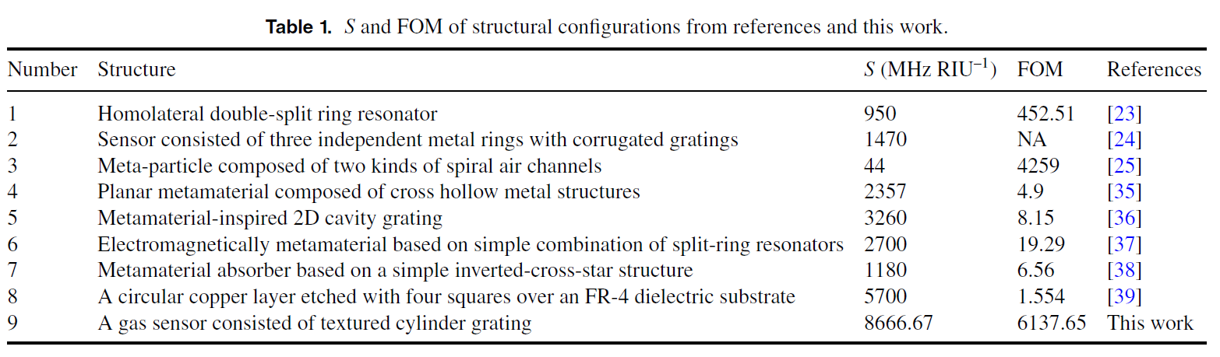
03
仿真结果

Slide 12
CONTENTS
目录
01
背景介绍
02
研究方法
03
仿真结果
04
总结

Slide 13
04
总结
在GHz波段通过设计器件，实现了超高的性能（S和FOM）并对有毒气体（极小的折射率变化⁓0.0015）进行检测。
人工表面等离激元共振（SLSP）在GHz波段表现出了多模的性质，其中越高阶，越有更高的性能。
本工作已在Journal of Physics D: Applied Physics期刊上发表。

Slide 14

感谢聆听！

