Slide 1
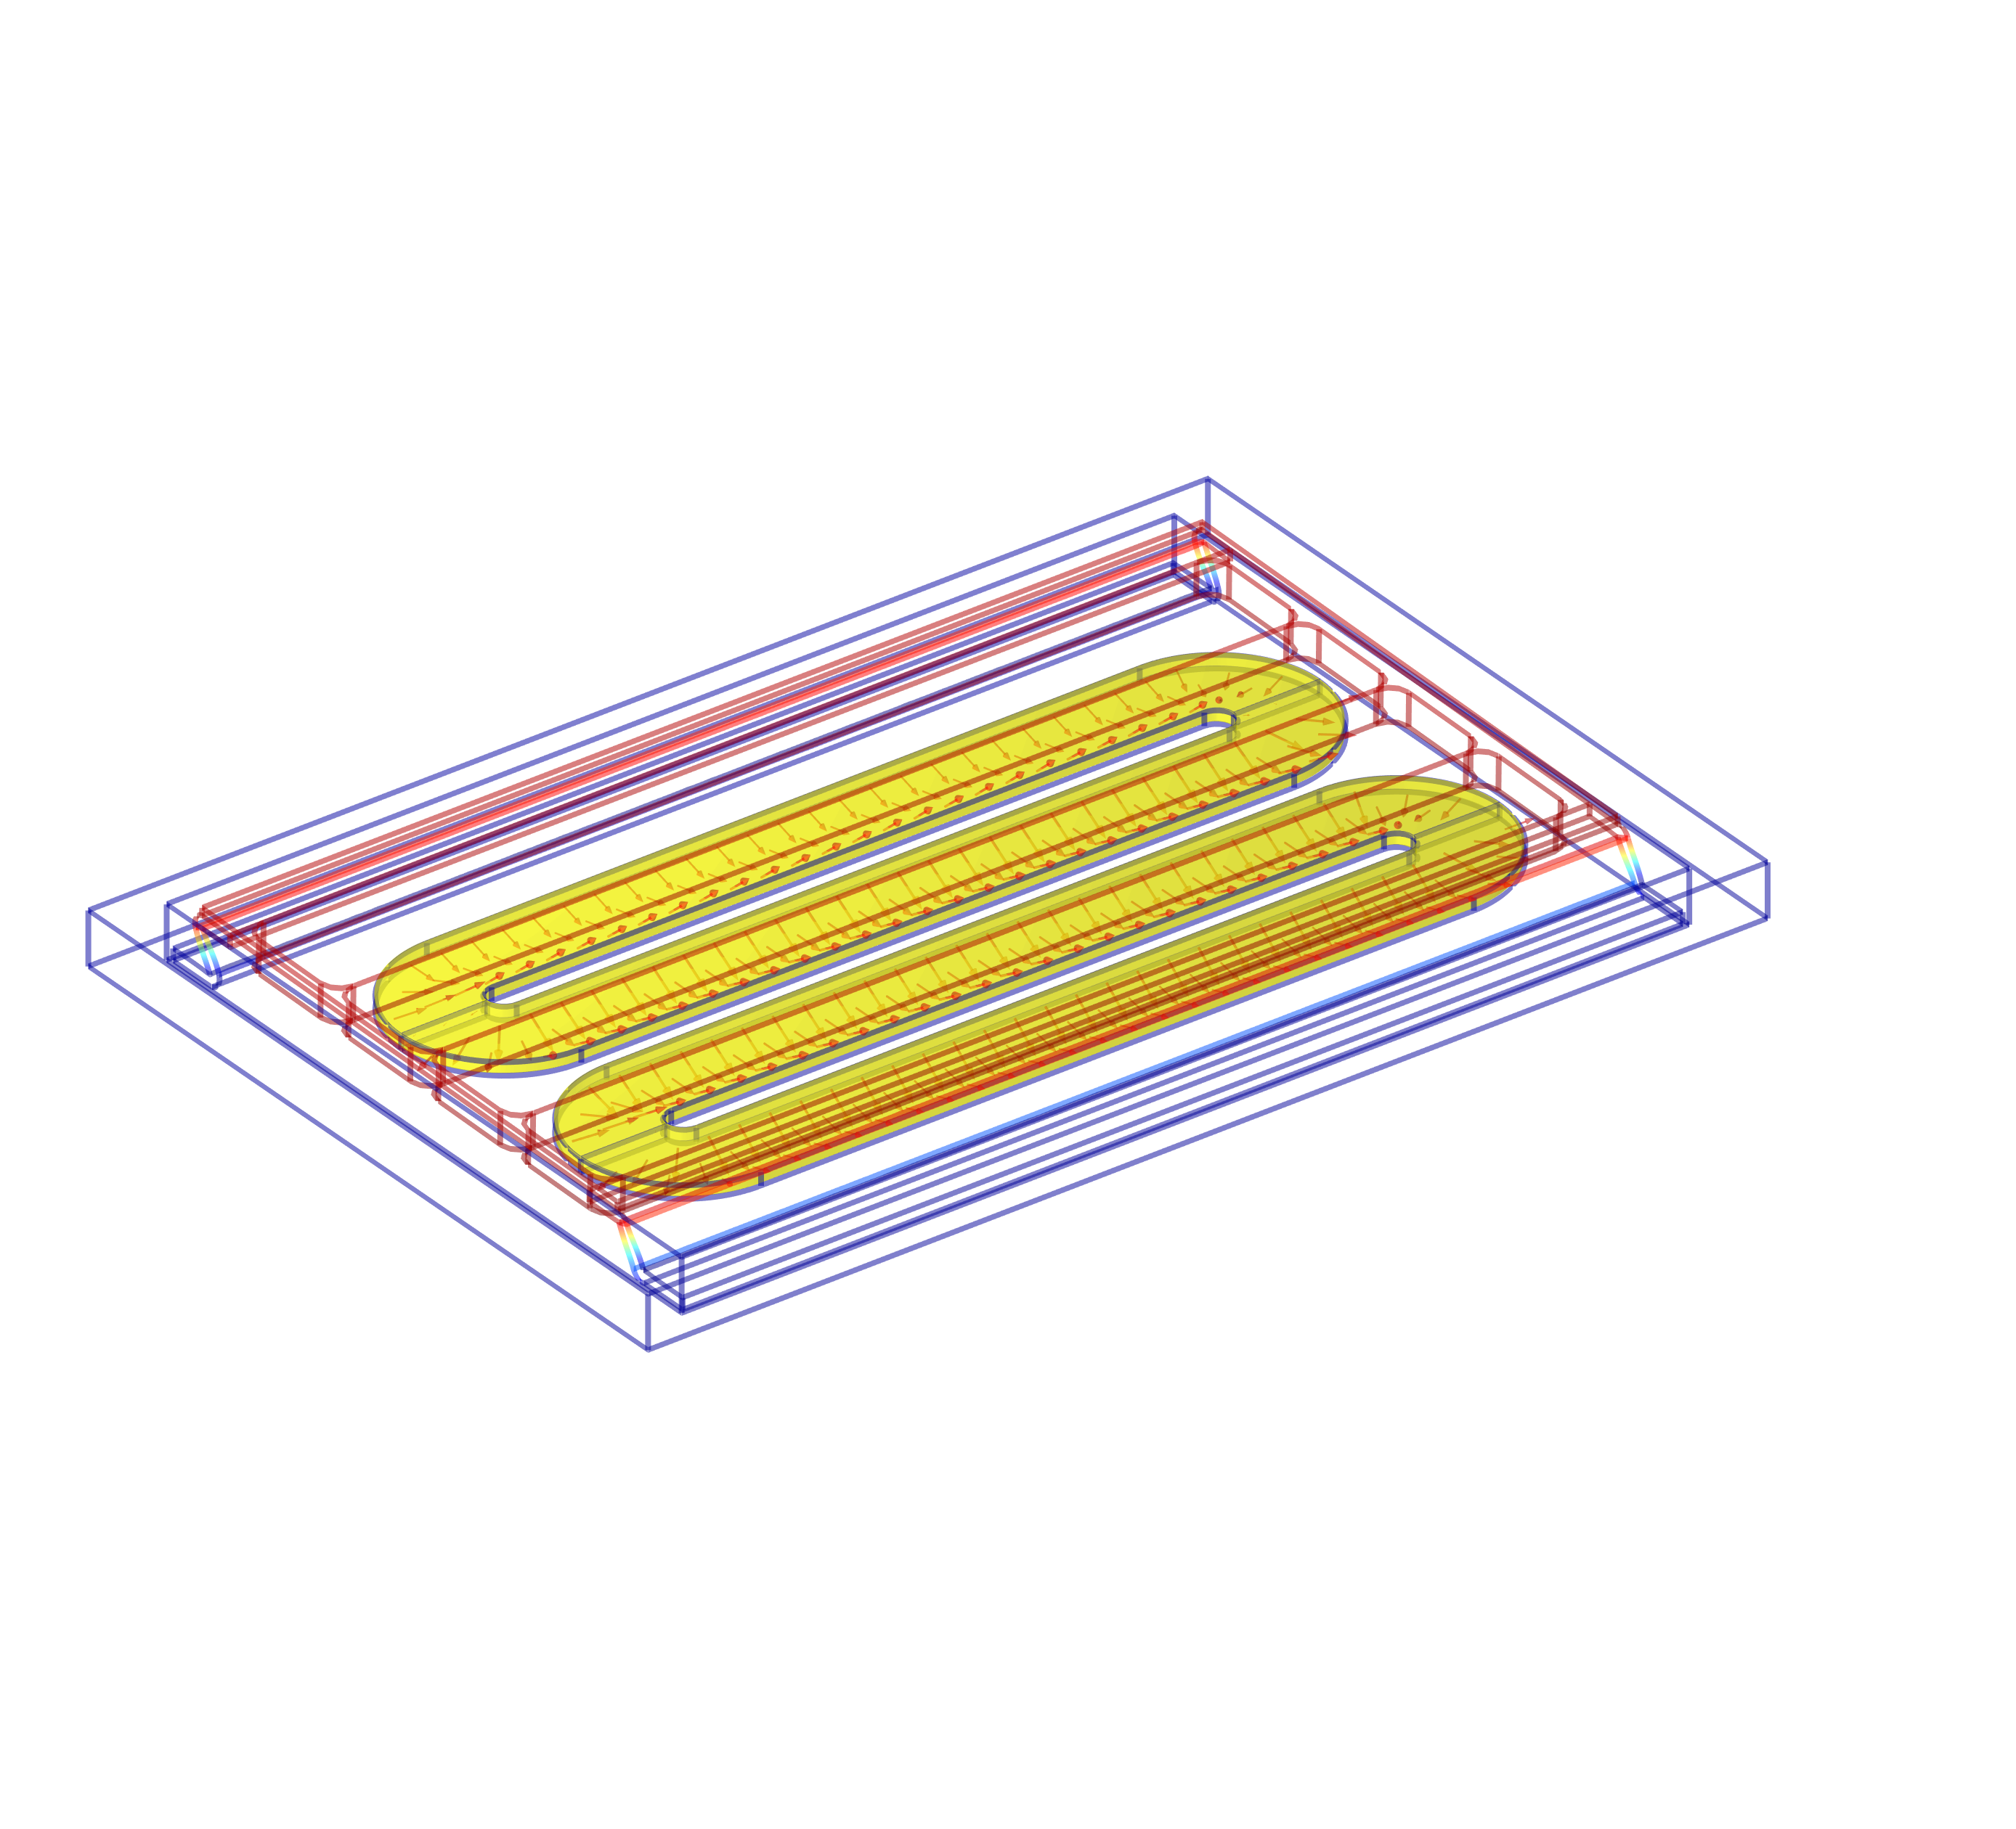
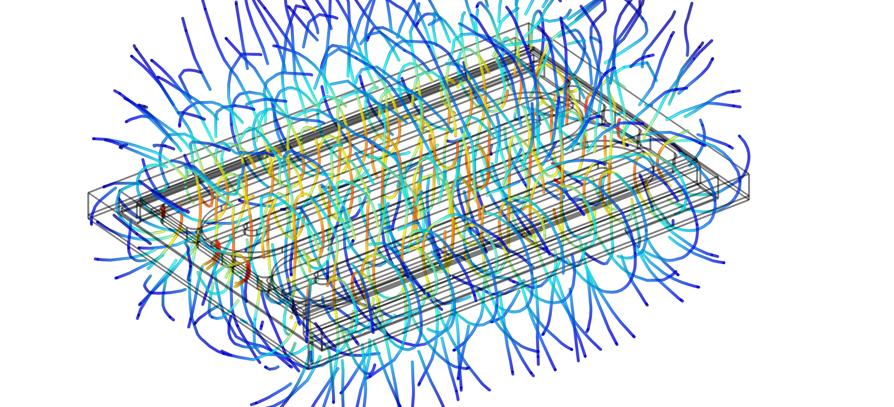
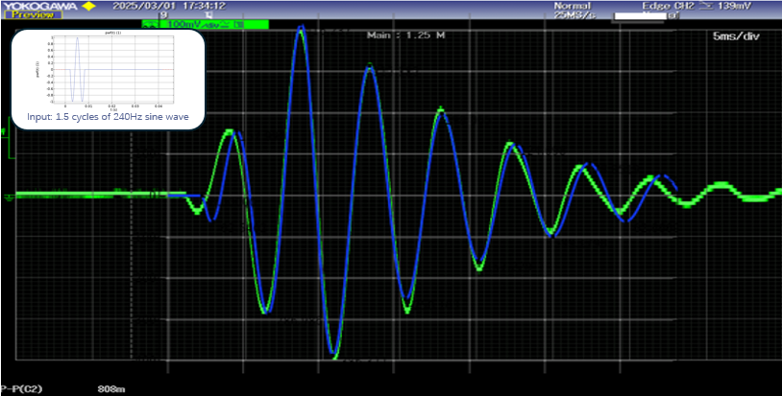


Performance Enhancement of a Haptic Motor via 3D Multi-Physics Simulation
A High-Fidelity Predictive Model from Electrical Signal to Vibration
Lucy Hsia
Jiangsu Yucheng ELE CO.,LTD
Introduction
Haptic motors are critical for immersive user experiences in consumer electronics (e.g., Touchpad , VR controllers). Traditional design methods, however, often rely on simplified models that fail to capture critical electromagnetic-structural couplings.
This study establishes a high-fidelity 3D Multiphysics transient simulation framework, accurately modeling the complete process from electrical input to vibrational output to enable precise performance analysis and enhancement.
Methodology
Our approach utilizes a coupled 3D electromagnetic-structural transient analysis.
Key parameters—including coil turns, excitation current, and the magnet's remnant flux density (Br)—are defined to calculate the 3D Lorentz force. This force is applied as a time-dependent load in a structural transient simulation, directly solving for the vibrational response (displacement, velocity, acceleration) and fully capturing the electromechanical process.
Fig. 1. Spatial Distribution of the Magnetic Field
Results
The high-fidelity model provided profound insights into motor performance: • Accurate Frequency Tuning: Parametric studies of the vibration mass and spring stiffness enabled rapid and precise configuration of the target resonant frequency (F0). • Full-Dimensional Force Coupling: The magnetic-solid mechanics coupling inherently accounted for force transmission in both vibrational and non-vibrational directions, revealing the complete 3D force state for superior simulation accuracy. • Optimized Transient Response: Simulation of various drive waveforms identified an optimal profile that achieved faster start-stop response times.
Fig. 2. Simulated vs. Measured Acceleration Curve
(Measured: Green, Simulated: Blue)
1. Y. Chen, W. Zhang, J. Z. Bird, et al. A 3-D Analytic-Based Model of a Null-Flux Halbach Array Electrodynamic Suspension Device. IEEE Transactions on Magnetics, 2015, 51(11): 8300405. 2. S. Zhang, M. Wang, H. Zhou, et al. Structural Analysis and Optimal Design of a Mobile Phone Vibration Motor [J]. Machinery Design & Manufacture, 2020, (3).

