Slide 1

Electromagnetic Sensing System for Ore Waste Classification and Grade Detection in LHD Buckets
Robert J. Exposito M.¹
1. Mining and rock engineering division, department of civil, environmental and natural resources engineering, Luleå University of Technology, Luleå, Sweden
☎ 0920-493212
✉ robert.exposito@ltu.se
📍 Luleå, T3366

Slide 2
Agenda
Introduction
Case study
Motivation
Concept overview
Objectives
Methods
Simulation setup
Ore domain preparation
Results
Homogeneous domain
Heterogeneous domain
Concluding remarks

Slide 3
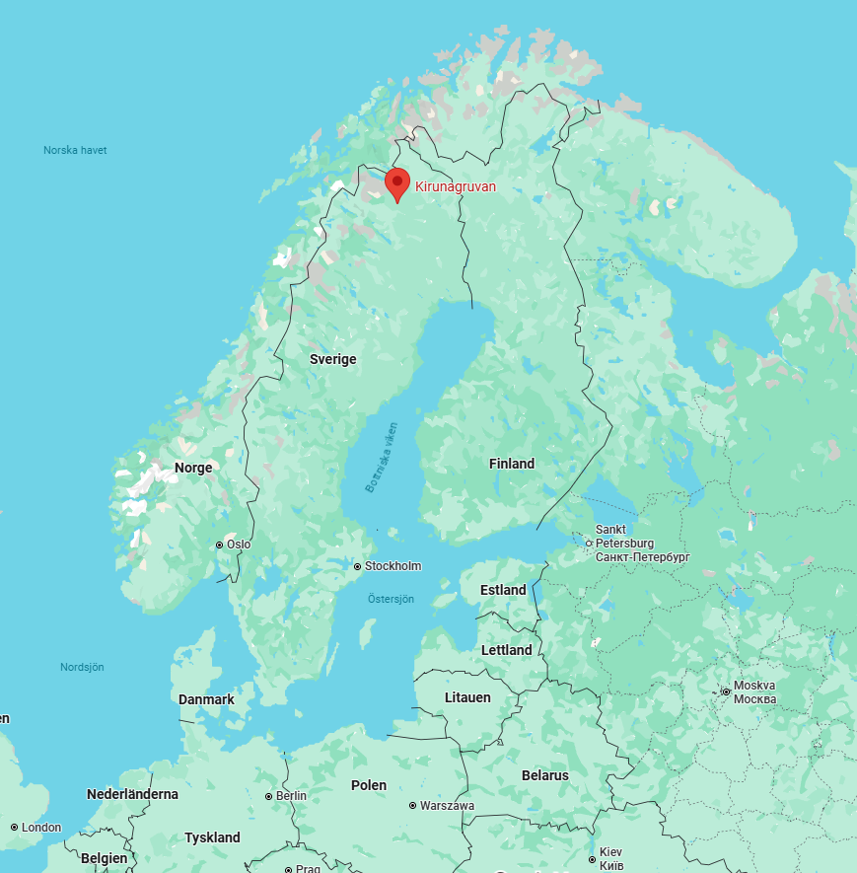
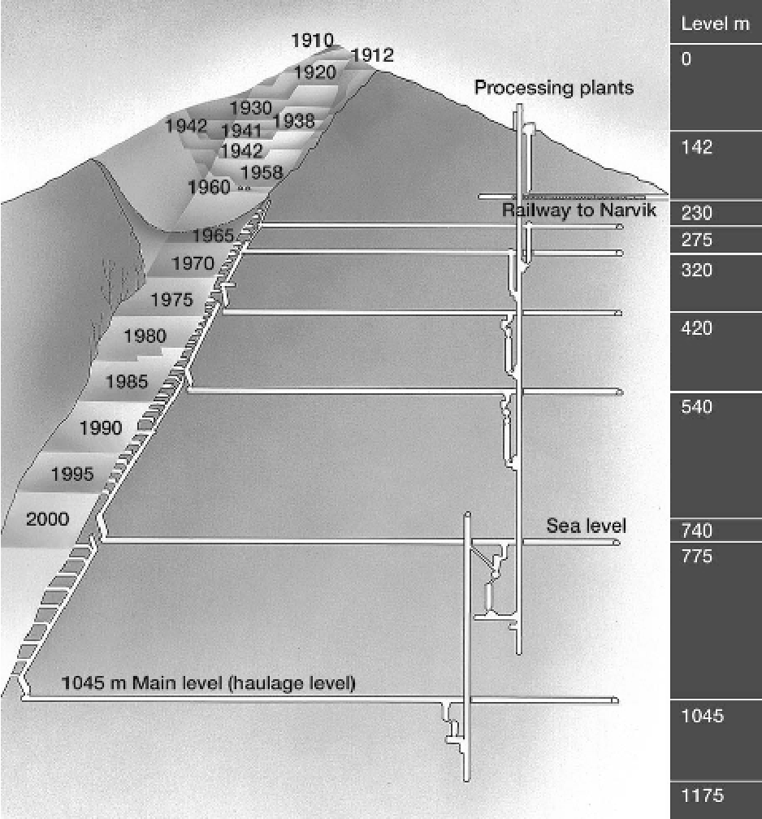
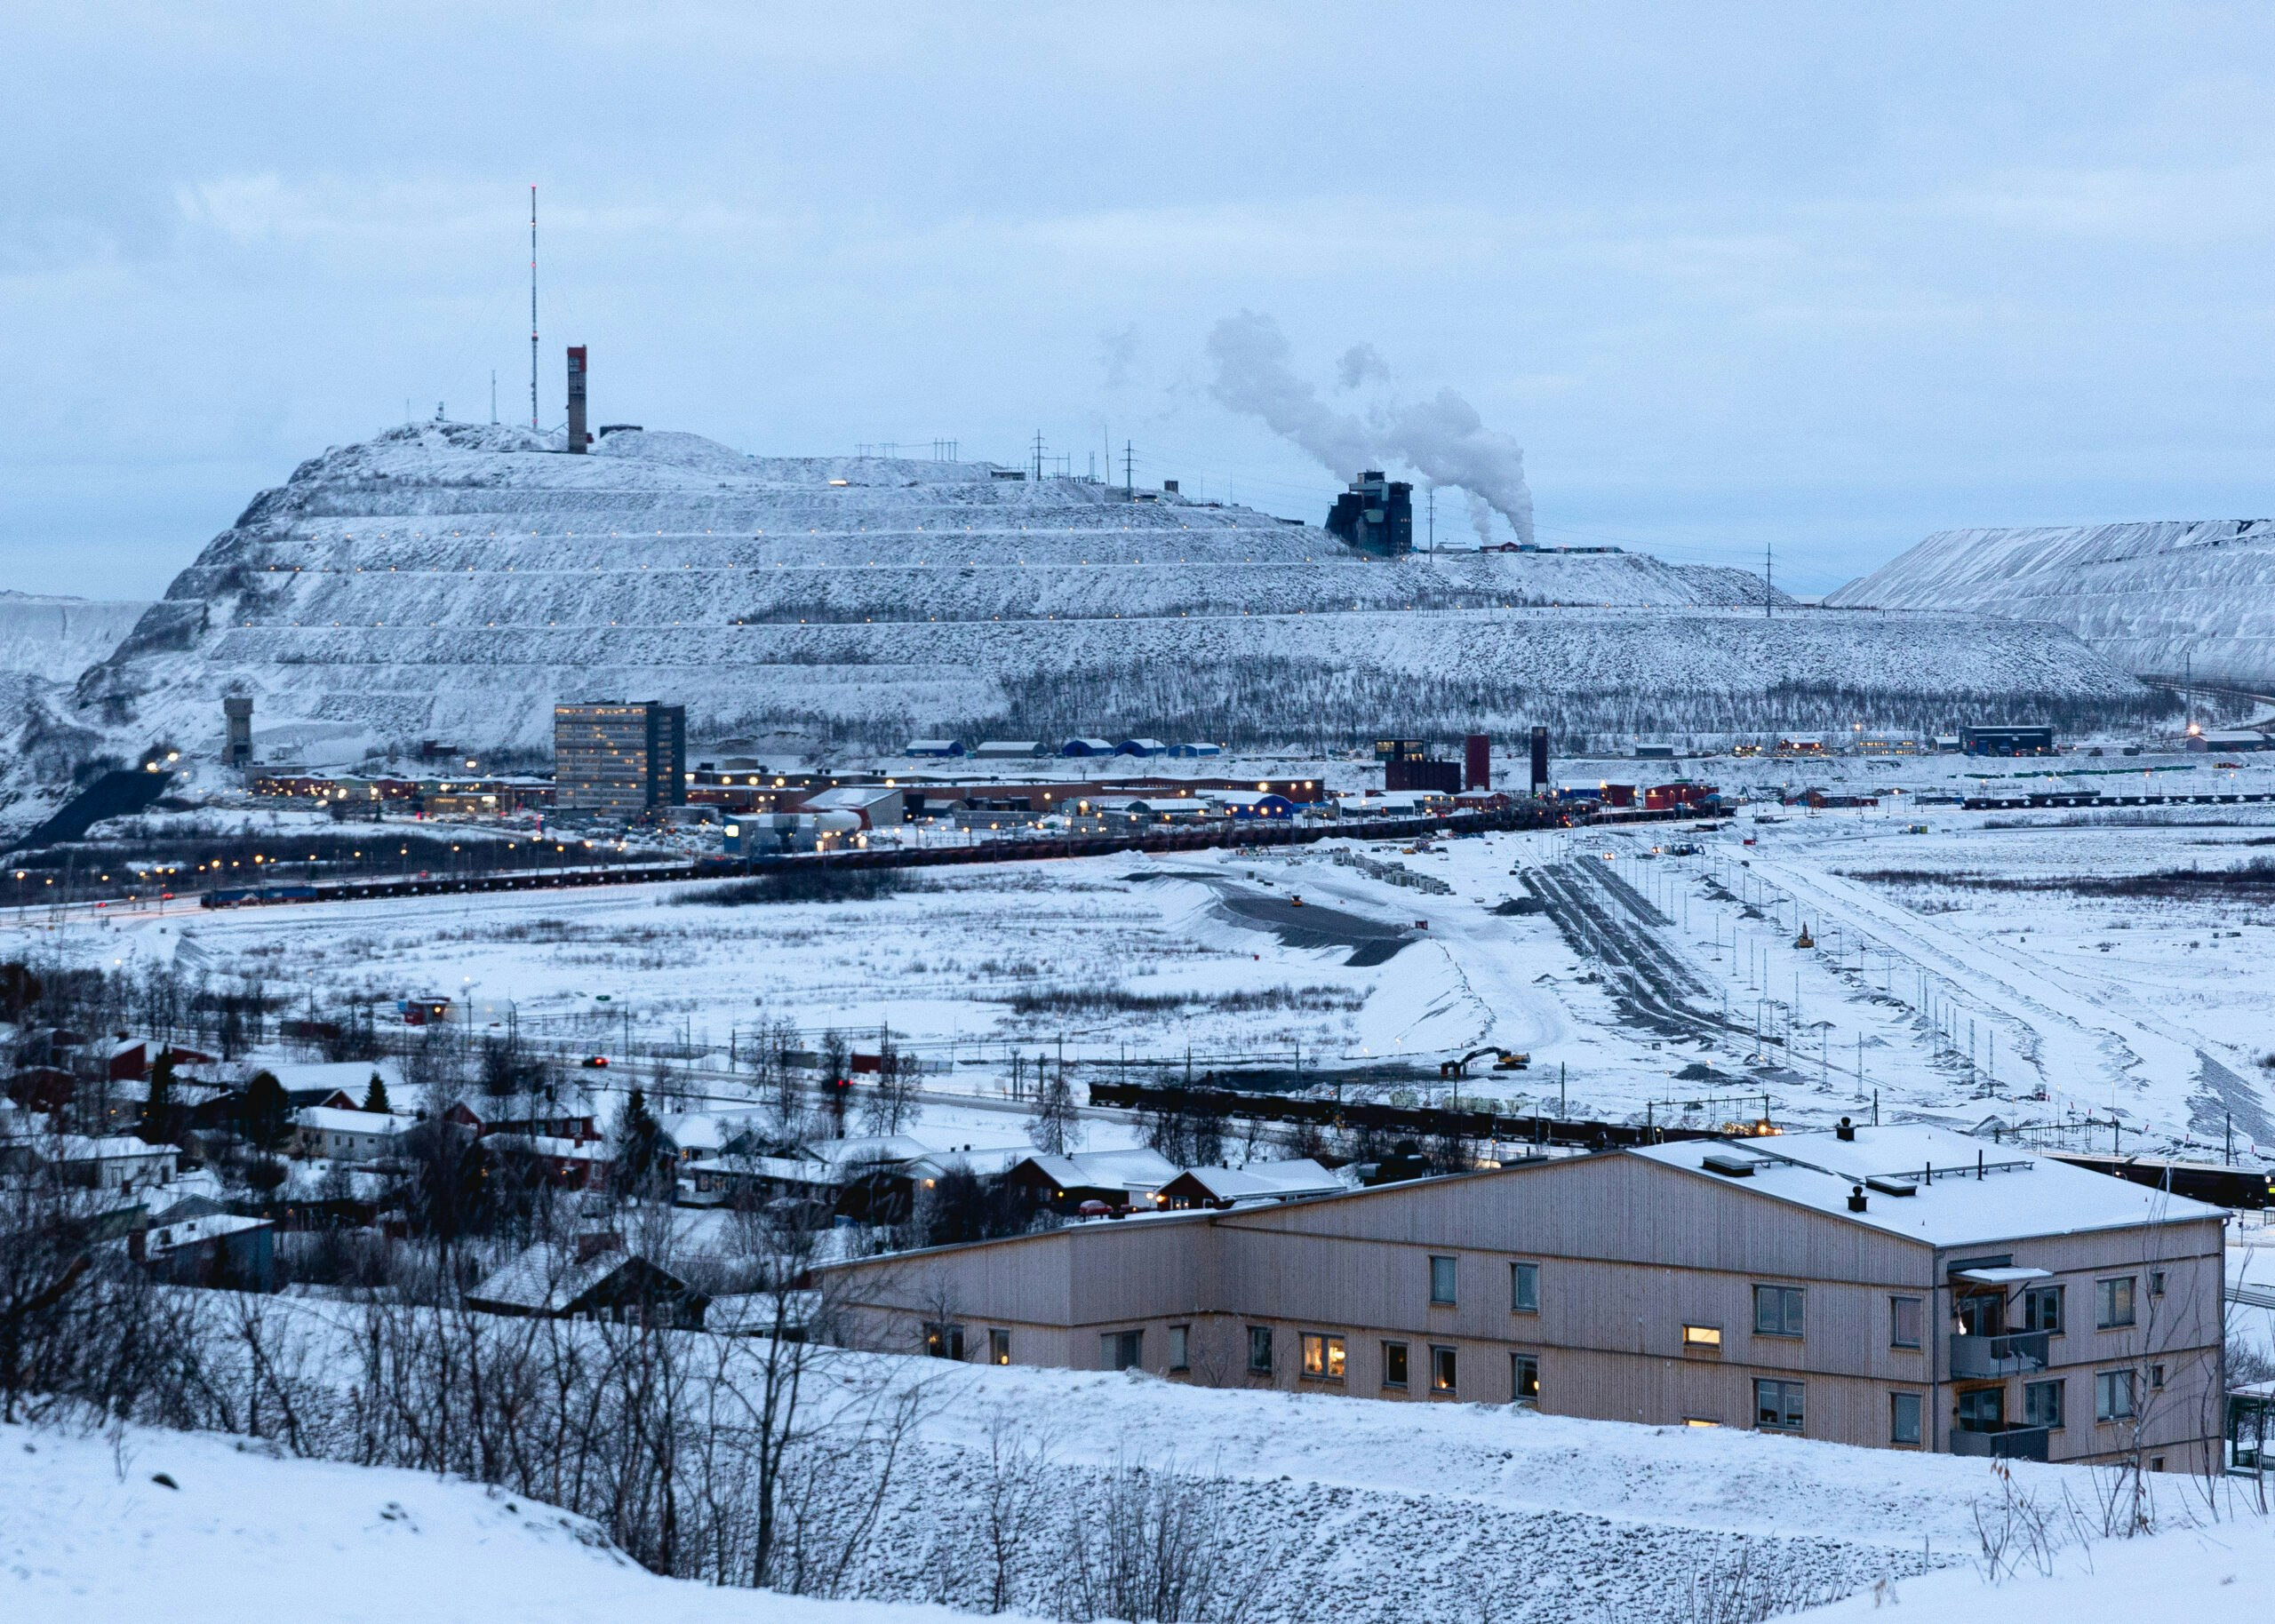
Kiirunavaara mine (Kiruna, Sweden)

Slide 4
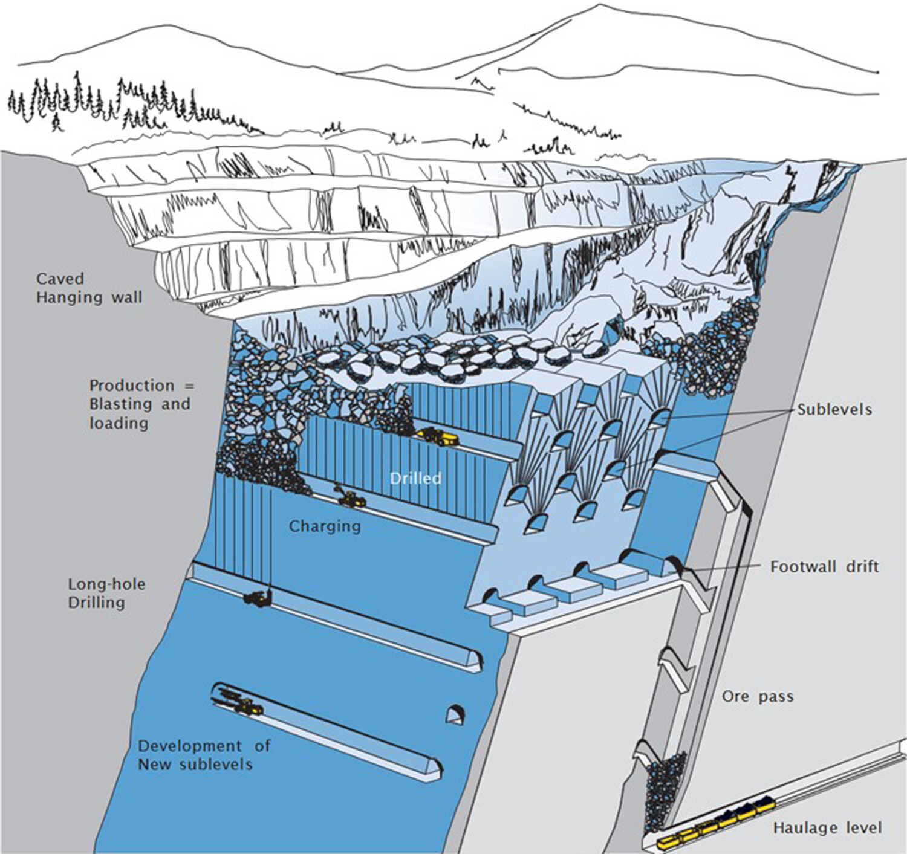
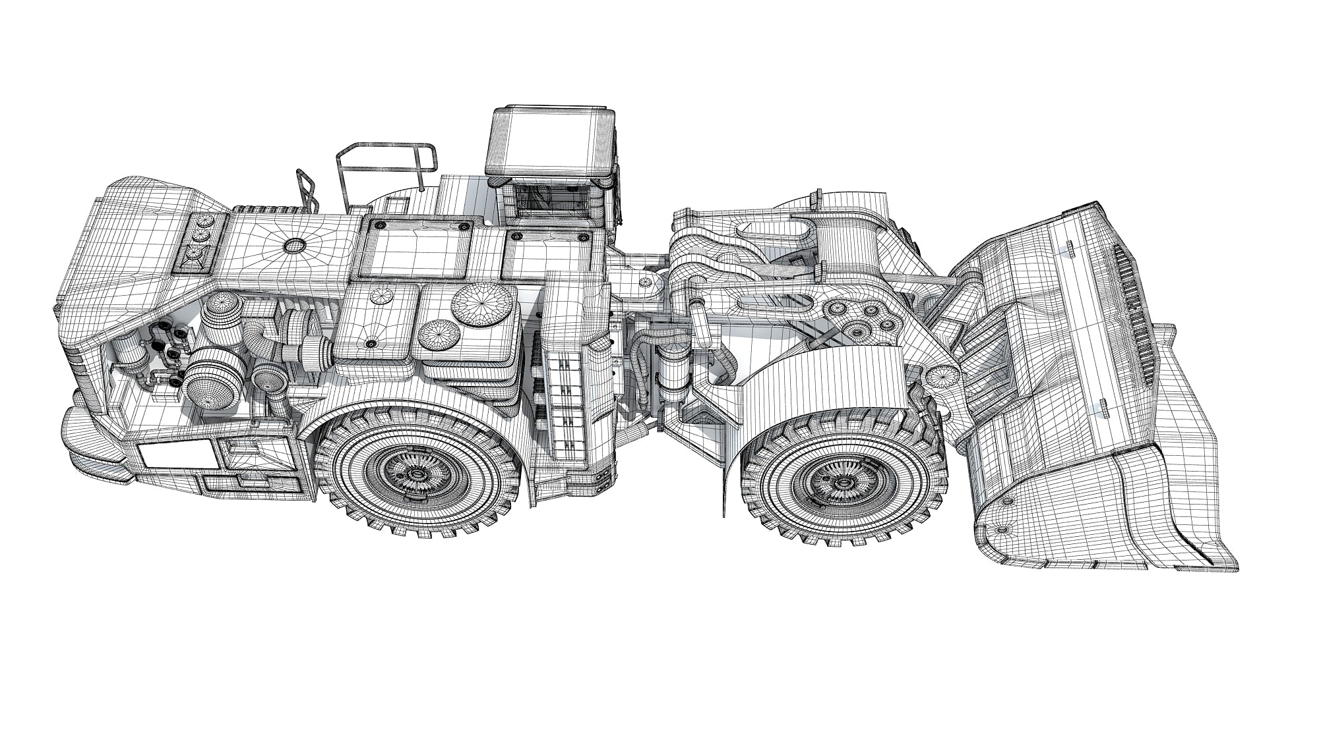
Motivation
Why Improve Ore-Grade Monitoring in Loading Operations?
Current LHD system uses density-based monitoring.
Performance affected by fragmentation, loading volume variation, and moisture.
Need for a continuous reliable approach to corroborate current monitoring data and avoid false positives.

Slide 5
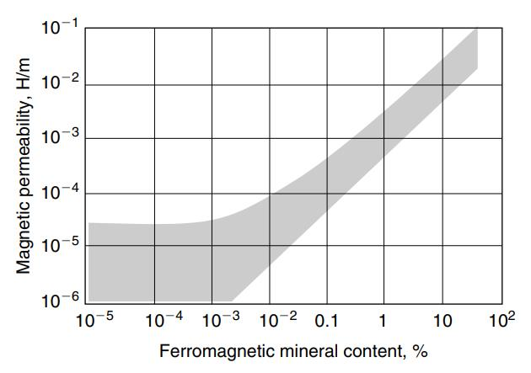
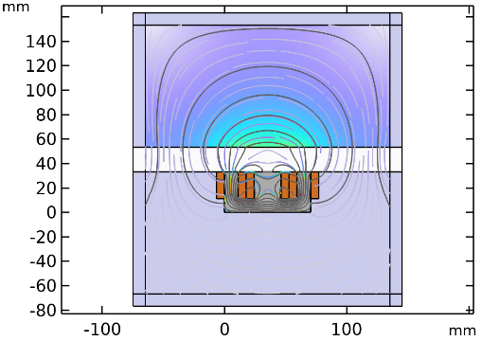
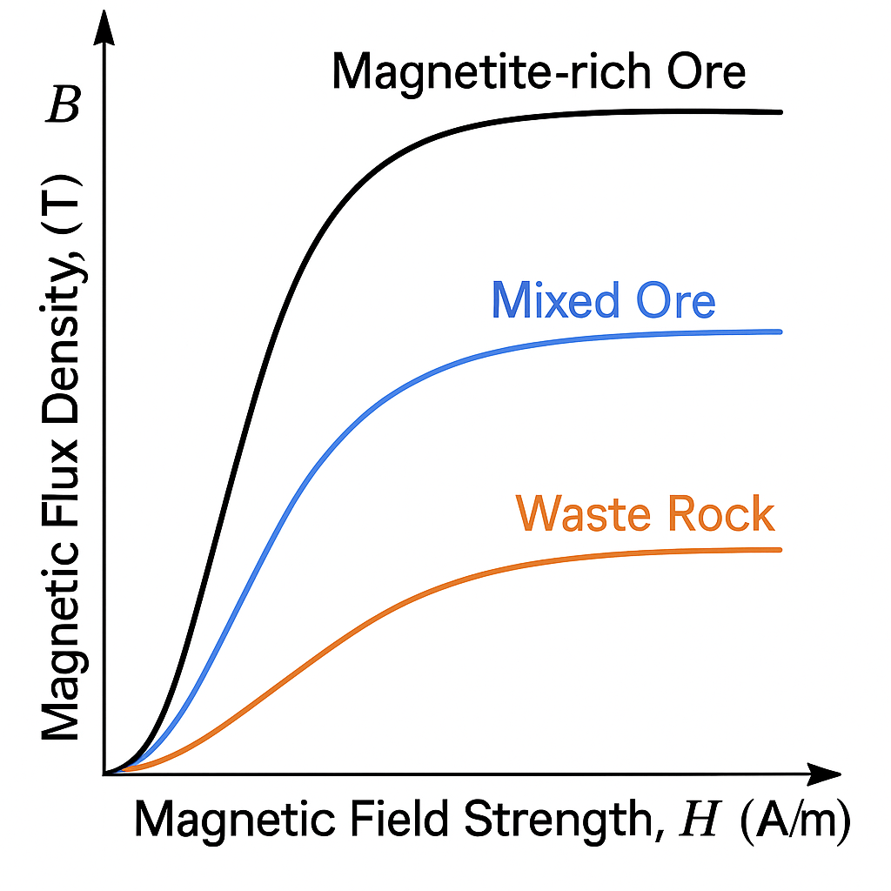
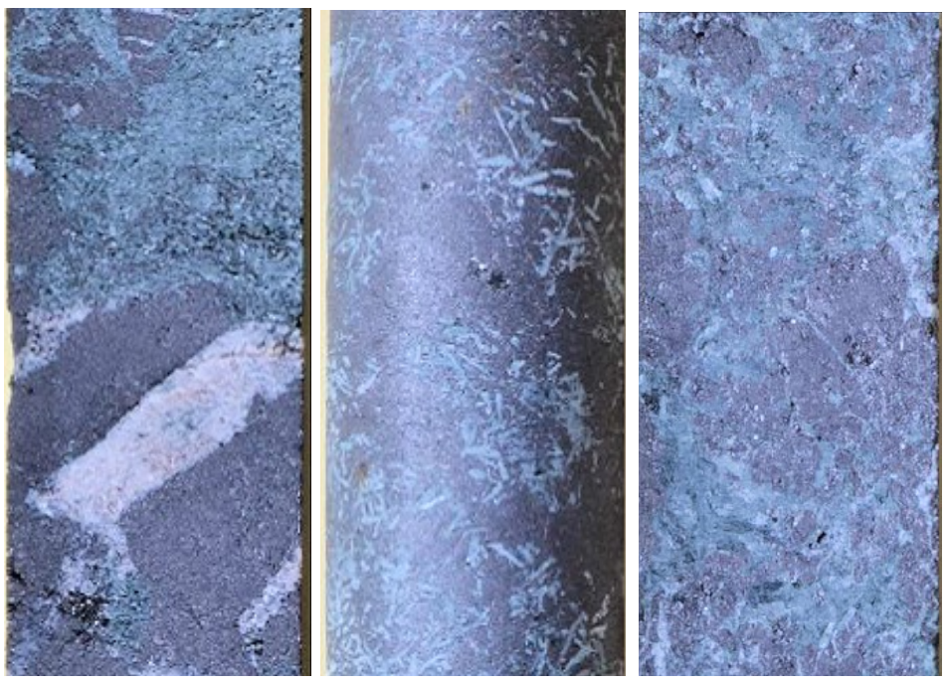
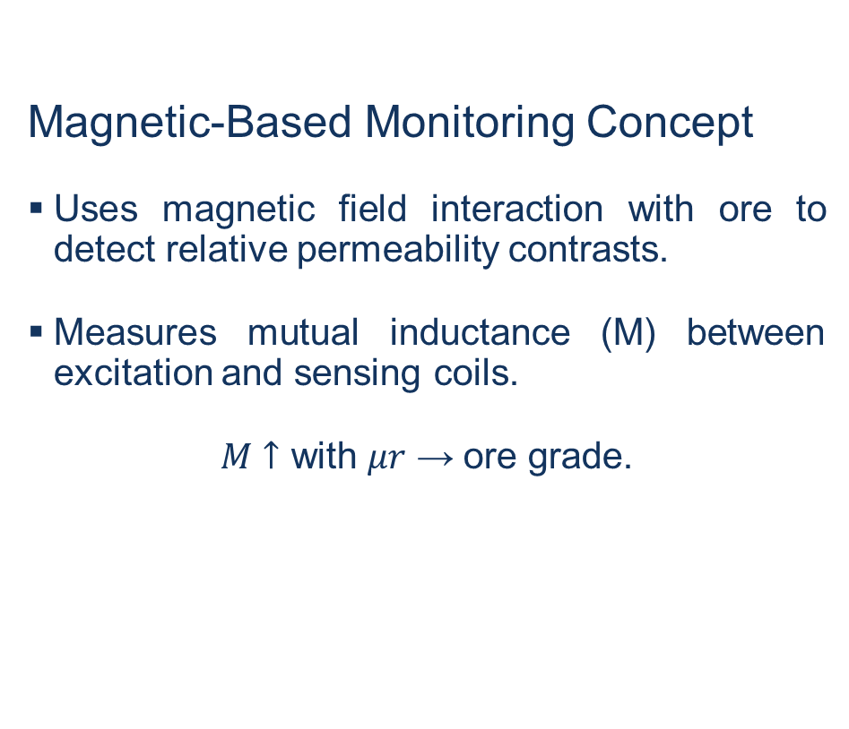
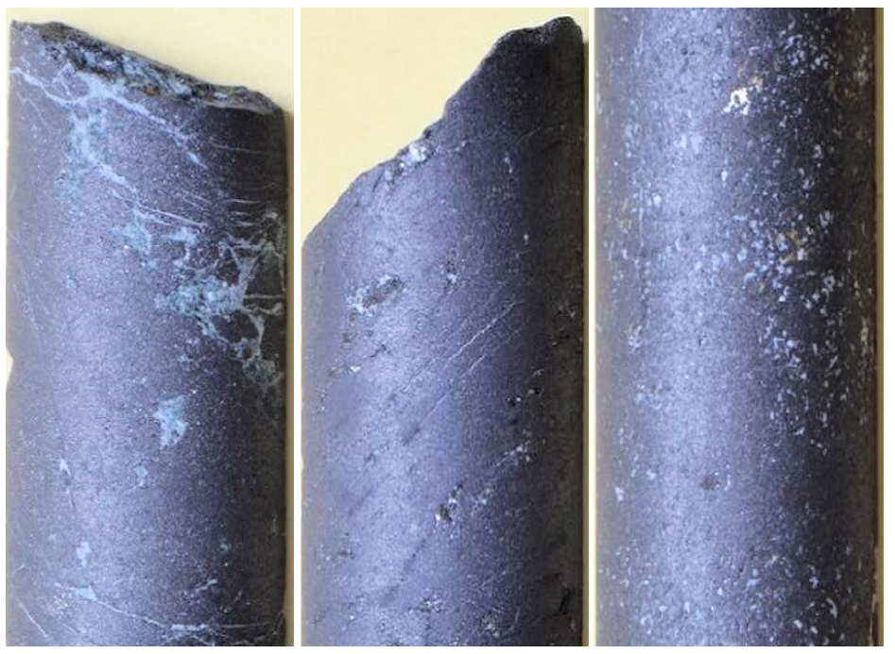
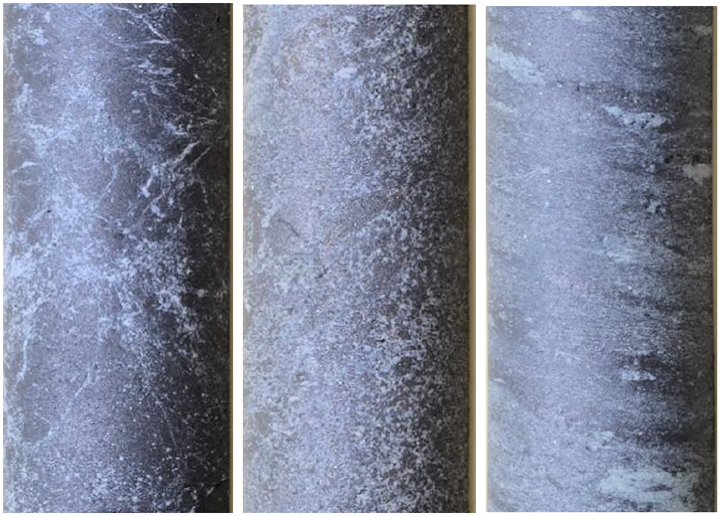
Concept Overview
Magnetic-Based Monitoring Concept
Uses magnetic field interaction with ore to detect relative permeability contrasts.
Measures mutual inductance (M) between excitation and sensing coils.
𝑀 $↑$ with 𝜇𝑟​ → ore grade.

Slide 6
Objectives
Evaluate feasibility of magnetic-based sensing for ore–waste differentiation and grade estimation.
Simulate electromagnetic response under homogeneous and heterogeneous domains.
Assess effect of rock heterogeneity in grade estimation.

Slide 7


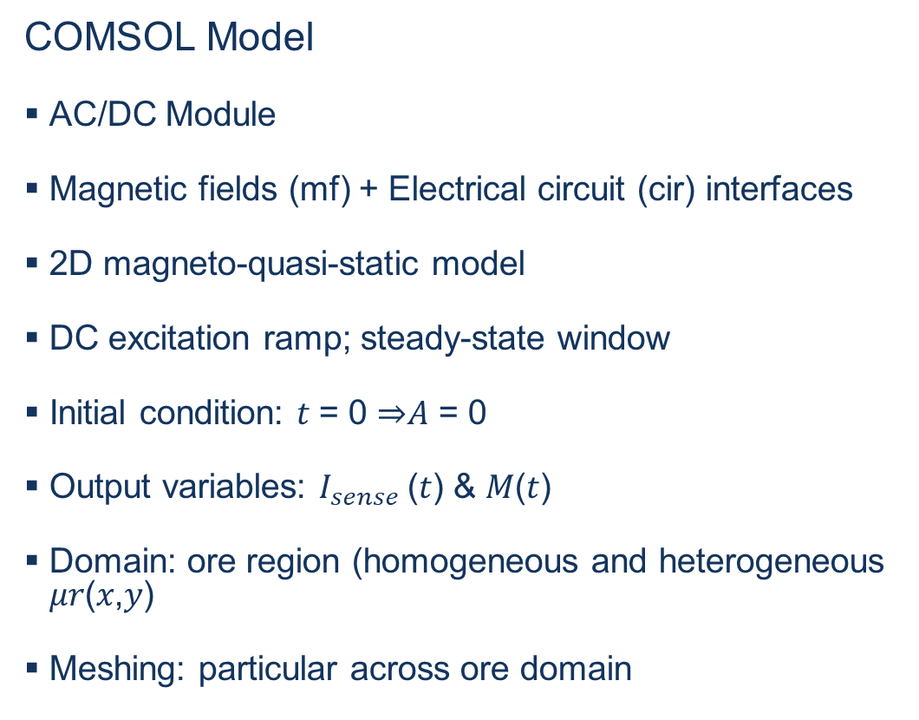
Simulation Setup
COMSOL Model
AC/DC Module
Magnetic fields (mf) + Electrical circuit (cir) interfaces
2D magneto-quasi-static model
DC excitation ramp; steady-state window
Initial condition: 𝑡 = 0 ⇒𝐴 = 0
Output variables: $I_{sense}$(𝑡) & 𝑀(𝑡)
Domain: ore region (homogeneous and heterogeneous 𝜇𝑟(𝑥,𝑦)
Meshing: particular across ore domain
$$I_{sense}=\frac{M}{R_{sense}}k$$
$$I_{drive}\left(t\right)=kt$$

Slide 8
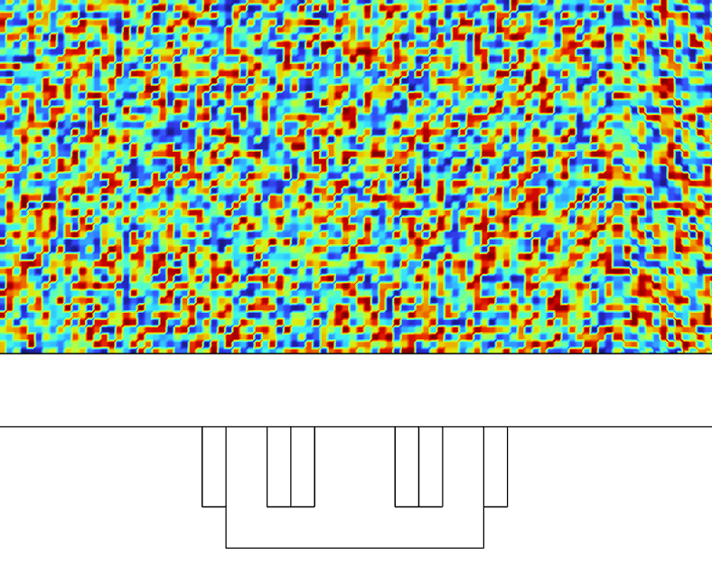
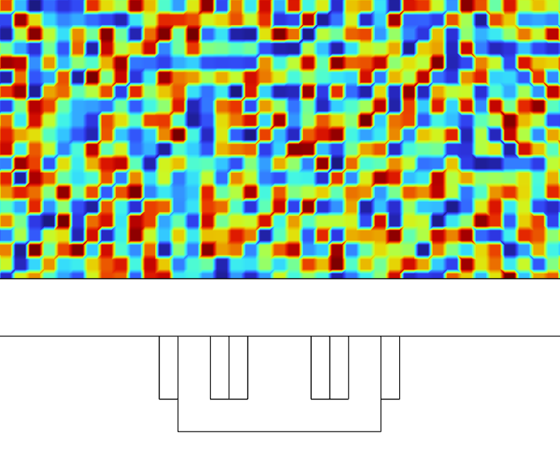


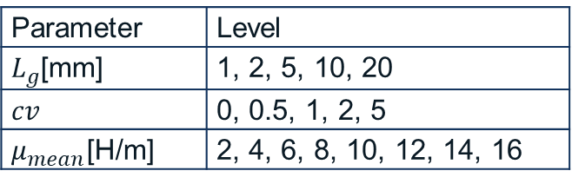

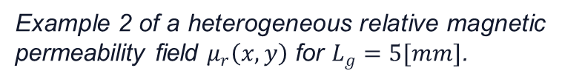

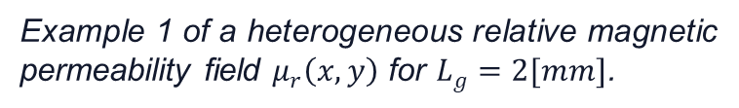

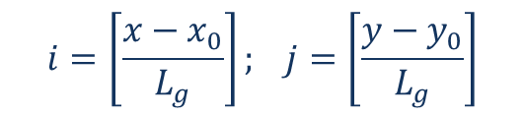
Ore Domain
Permeability Distribution in Ore Domain
$$i=\left[\frac{x−x_{0}}{L_{g}}\right]; j=\left[\frac{y−y_{0}}{L_{g}}\right]$$
$$u_{0}=u−u_{Avg}$$
$$u=mod\left(\sin\left(ai+bj+seed\right) , c 1\right)$$
Example 1 of a heterogeneous relative magnetic permeability field $μ_{r}\left(x, y\right)$ for $L_{g}=2[mm]$.
$$f\left(x, y\right)=1+cv u_{0}$$
$$μ_{r}\left(x, y\right)$$
$$μ_{r}^{raw}\left(x, y\right)=μ_{mean} f\left(x , y\right)$$
$$μ_{r}\left(x, y\right)=max⁡(μ_{min},\min\left(μ_{max}, μ_{r}^{raw}\right))$$
Parameter | Level
$L_{g}$[mm] | 1, 2, 5, 10, 20
$$cv$$ | 0, 0.5, 1, 2, 5
$μ_{mean}$[H/m] | 2, 4, 6, 8, 10, 12, 14, 16
Example 2 of a heterogeneous relative magnetic permeability field $μ_{r}\left(x, y\right)$ for $L_{g}=5[mm]$.

Slide 9
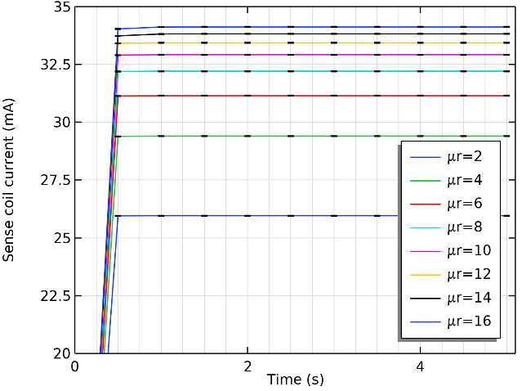
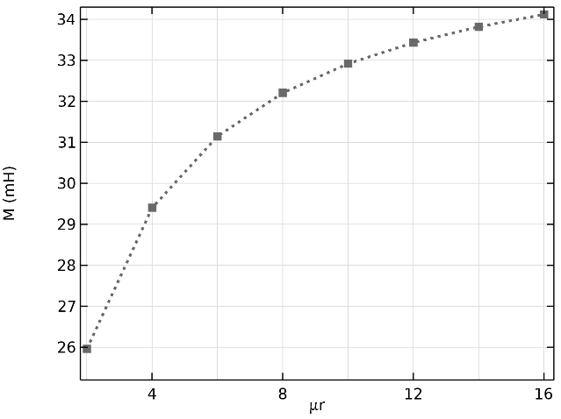
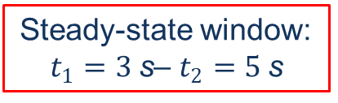
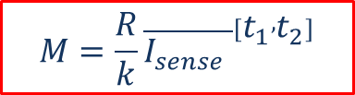
Results
Homogeneous Ore Domain
Steady-state window:
$t_{1}=3 \text{s}$– $t_{2}=5 \text{s}$
$$M=\frac{R}{k}{\overline{I_{sense} }}^{\left[t_{1} , t_{2}\right]}$$
Sense coil current versus time for constant relative magnetic permeability along homogeneous ore domain.
Mutual inductance versus relative magnetic permeability for homogeneous ore domain.

Slide 10
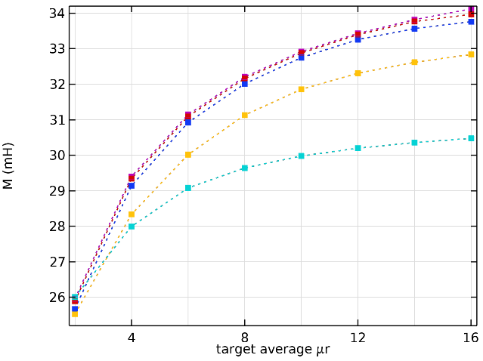
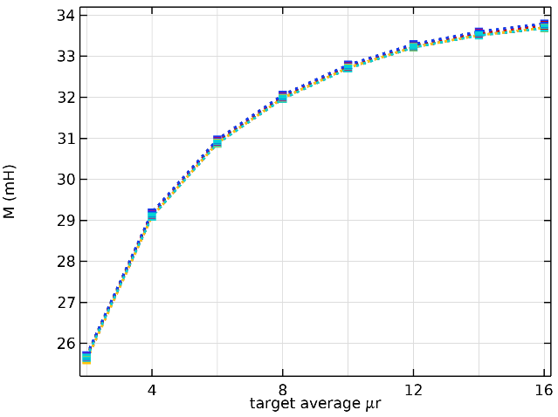
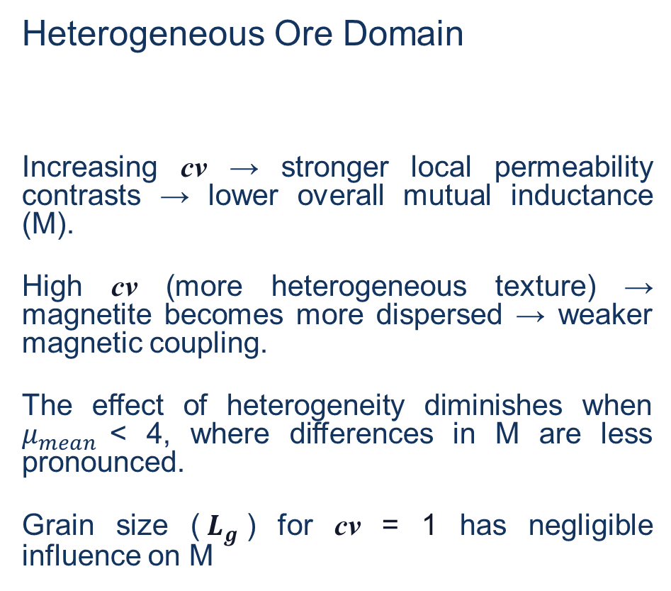
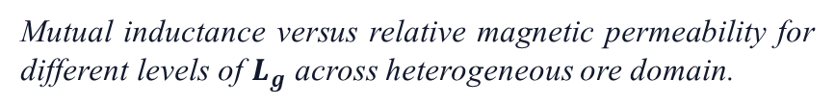
Results
Heterogeneous Ore Domain
Increasing cv → stronger local permeability contrasts → lower overall mutual inductance (M).
High cv (more heterogeneous texture) → magnetite becomes more dispersed → weaker magnetic coupling.
The effect of heterogeneity diminishes when $μ_{mean}$< 4, where differences in M are less pronounced.
Grain size ($L_{g}$) for cv = 1 has negligible influence on M
Mutual inductance versus relative magnetic permeability for different levels of cv across heterogeneous ore domain.
Mutual inductance versus relative magnetic permeability for different levels of $L_{g}$ across heterogeneous ore domain.

Slide 11
Concluding remarks
Magnetic-based monitoring was explored as an alternative to density-based systems for ore-grade estimation in magnetite-rich iron ore.
The current LHD density-based system is limited by fragmentation, loading-volume variation, and moisture content.
The proposed magnetic concept shows promising results for both ore–waste differentiation and ore-grade estimation, sensitive to variations in magnetic permeability.
Mutual inductance (M) serves as a robust metric to track effective low-field permeability and thus ore grade.
Future work should assess:
Influence of water content, natural joints, and mineral veins on the response.
Conductivity effects (moisture) are expected to be less significant in magneto-quasi-static DC regime.
Non-linear B–H characterization of specific Kiirunavaara ore types.
Validation against drill-core grades and field calibration across different fragment positions and levels.
Notes:
These steps will enable calibration coefficients and support integration into real-time LHD monitoring systems.

